Slide 1
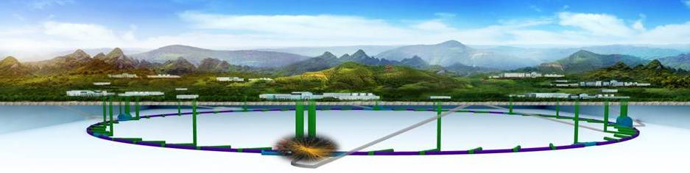
CEPC Accelerator
Jie Gao
Accelerator Division, IHEP
June 14, 2018

Slide 2
Outline
Accelerator CDR
Accelerator key technology R&D
R&D funding
Accelerator team
Summary

Slide 3
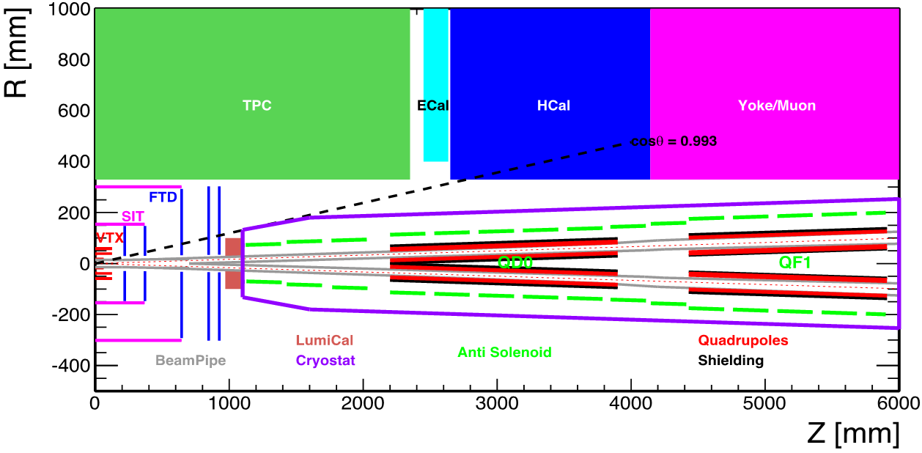
CEPC CDR Accelerator Chain and Systems
Energy Ramp
10 ->45/120GeV
10 GeV
Electron
1) Injector
2) Booster
L=1.2km
Positron
C=100km
Three rings in the sane channel：
  CEPC & booster
  SppC
Booster Cycle (0.1 Hz)
The key systems of
CEPC:
1) Linac Injector
2) Booster
3) Collider ring
4) MDI
5) Civil Eng.
5) Civil Eng.
3) Main Ring
C=100km
2IP
45/120 GeV
4) Detector Machine
Interface (MDI)
CEPC Booster
CEPC Collider
SppC

Slide 4
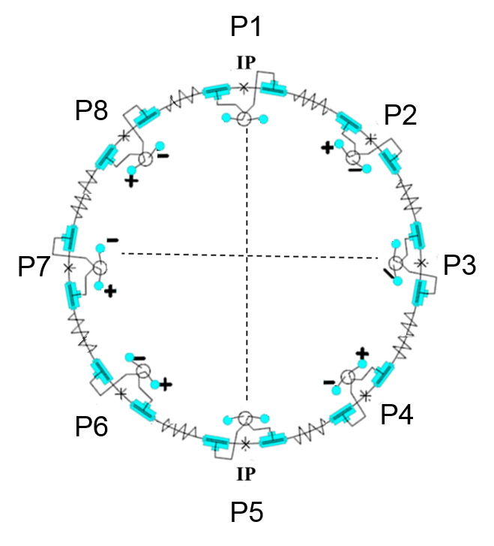
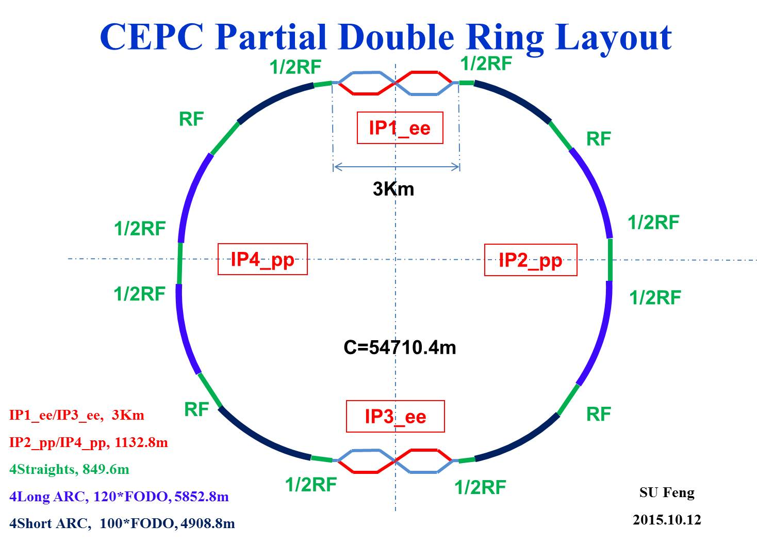
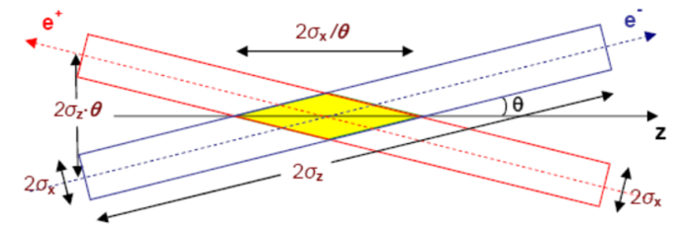
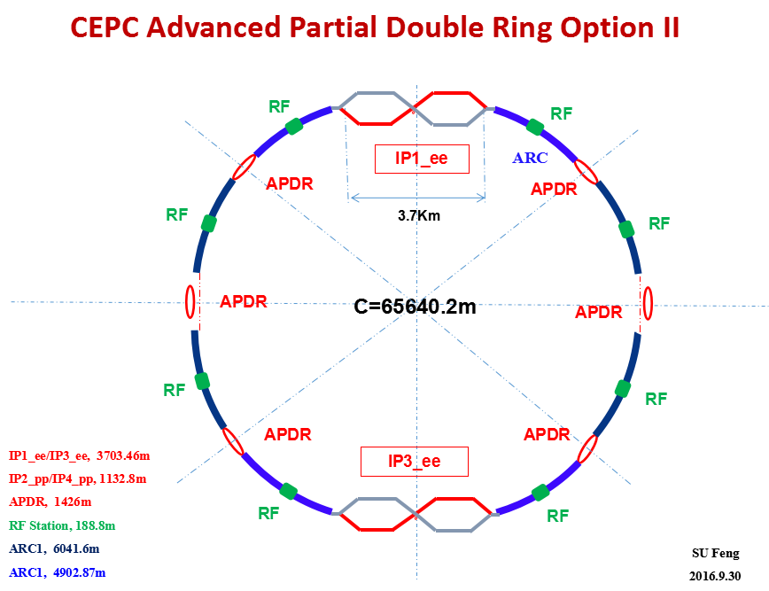
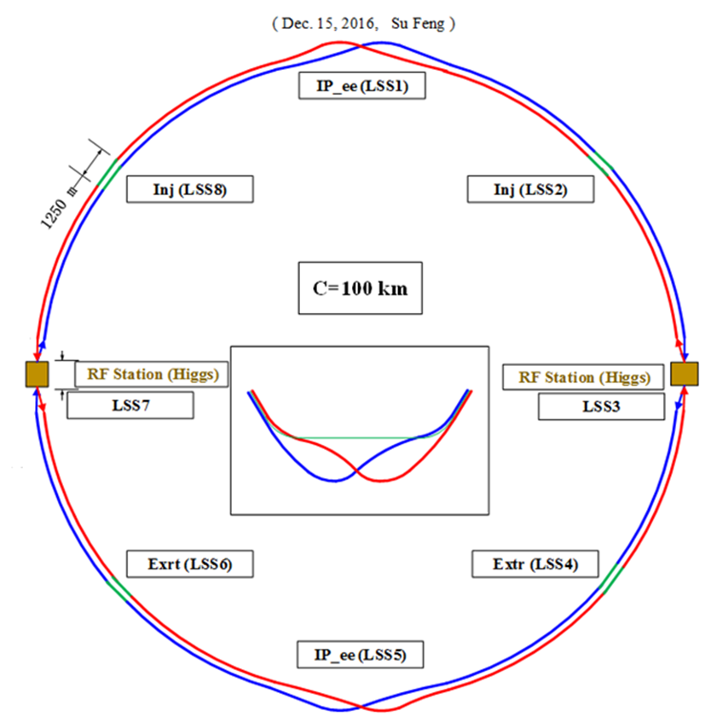
CEPC Four Options Evoluting towards CDR
CEPC Pre-CDR Scheme (head -on collision)
Crab-waist collision
Since Oct 2012
Since May 2015
CEPC Alternative Design
Lower cost and reaching the
fundamental requirement for
Higgs and Z luminosities, under the condition that sawtooth and beam loading effects be solved
CEPC Baseline Design
Better performance for Higgs and Z compared with alternative scheme, without bottle neck problems, but with higher cost
Since May 2016
Since Nov 2016
CEPC baseline and alternative options have been decided on Jan. 14, 2017

Slide 5
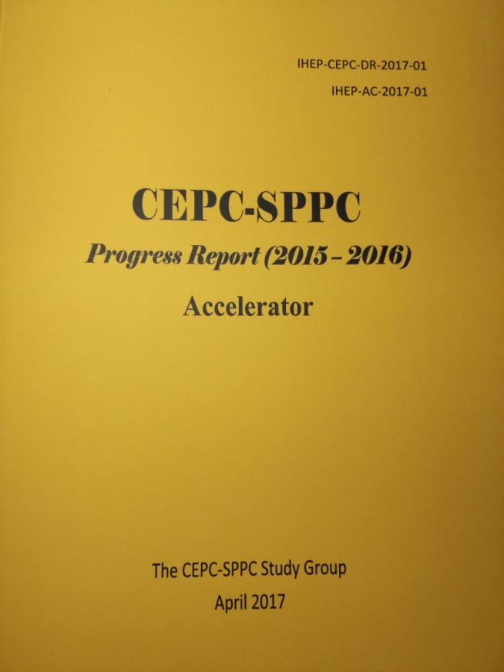
CEPC Accelerator CDR Completed
CEPC accelerator CDR completed in June 2018 (to be printed in July 2018)
  Executive Summary
  Introduction
  Machine Layout and Performance
  Operation Scenarios
  CEPC Collider
  CEPC Booster
  CEPC Linac
  Systems Common to the CEPC Linac, Booster and Collider
  Super Proton Proton Collider
  Conventional Facilities
  Environment, Health and Safety
  R&D Program
  Project Plan, Cost and Schedule
  Appendix 1: CEPC Parameter List
  Appendix 2: CEPC Technical Component List
  Appendix 3: CEPC Electric Power Requirement
  Appendix 4: Operation for High Intensity γ-ray Source
  Appendix 5: Advanced Partial Double Ring
  Appendix 6: CEPC Injector Based on Plasma Wakefield Accelerator
  Appendix 7: International Review Report
Mmmaaarch
March 2015
April 2017
Draft Nov 2017,
final version
June 2018
hhah

Slide 6
Main Parameters of Collider Ring
 | Higgs | W | Z（3T） | Z（2T）
Number of IPs | 2
Beam energy (GeV) | 120 | 80 | 45.5
Circumference (km) | 100
Synchrotron radiation loss/turn (GeV) | 1.73 | 0.34 | 0.036
Crossing angle at IP (mrad) | 16.5×2
Piwinski angle | 2.58 | 7.0 | 23.8
Number of particles/bunch N_{e} (10¹⁰) | 15.0 | 12.0 | 8.0
Bunch number (bunch spacing) | 242 (0.68μs) | 1524 (0.21μs) | 12000 (25ns+10%gap)
Beam current (mA) | 17.4 | 87.9 | 461.0
Synchrotron radiation power /beam (MW) | 30 | 30 | 16.5
Bending radius (km) | 10.7
Momentum compact (10⁻⁵) | 1.11
β function at IP β_{x}* / β_{y}* (m) | 0.36/0.0015 | 0.36/0.0015 | 0.2/0.0015 | 0.2/0.001
Emittance ε_{x}/ε_{y} (nm) | 1.21/0.0031 | 0.54/0.0016 | 0.18/0.004 | 0.18/0.0016
Beam size at IP σ_{x} /σ_{y} (μm) | 20.9/0.068 | 13.9/0.049 | 6.0/0.078 | 6.0/0.04
Beam-beam parameters ξ_{x}/ξ_{y} | 0.031/0.109 | 0.013/0.106 | 0.0041/0.056 | 0.0041/0.072
RF voltage V_{RF} (GV) | 2.17 | 0.47 | 0.10
RF frequency f _{RF} (MHz) (harmonic) | 650 (216816)
Natural bunch length σ_{z} (mm) | 2.72 | 2.98 | 2.42
Bunch length σ_{z} (mm) | 3.26 | 5.9 | 8.5
HOM power/cavity (2 cell) (kw) | 0.54 | 0.75 | 1.94
Natural energy spread (%) | 0.1 | 0.066 | 0.038
Energy acceptance requirement (%) | 1.35 | 0.4 | 0.23
Energy acceptance by RF (%) | 2.06 | 1.47 | 1.7
Photon number due to beamstrahlung | 0.29 | 0.35 | 0.55
Lifetime _simulation (min) | 100
Lifetime (hour) | 0.67 | 1.4 | 4.0 | 2.1
F (hour glass) | 0.89 | 0.94 | 0.99
Luminosity/IP L (10³⁴cm⁻²s⁻¹) | 2.93 | 10.1 | 16.6 | 32.1

Slide 7
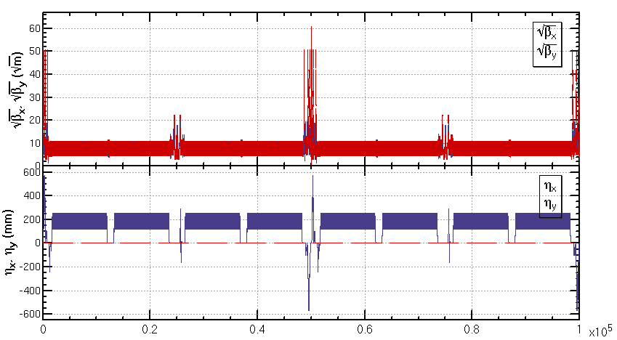
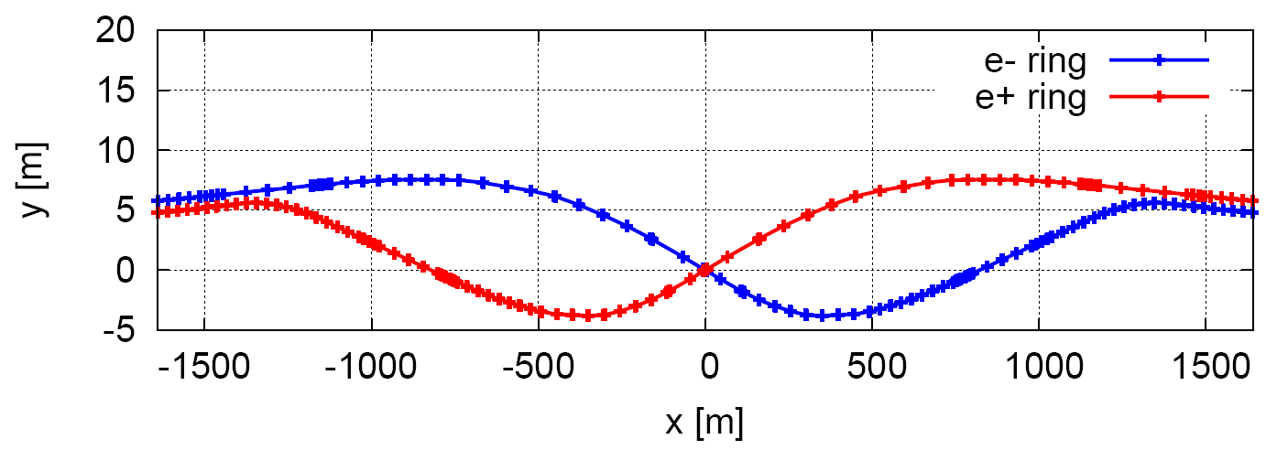
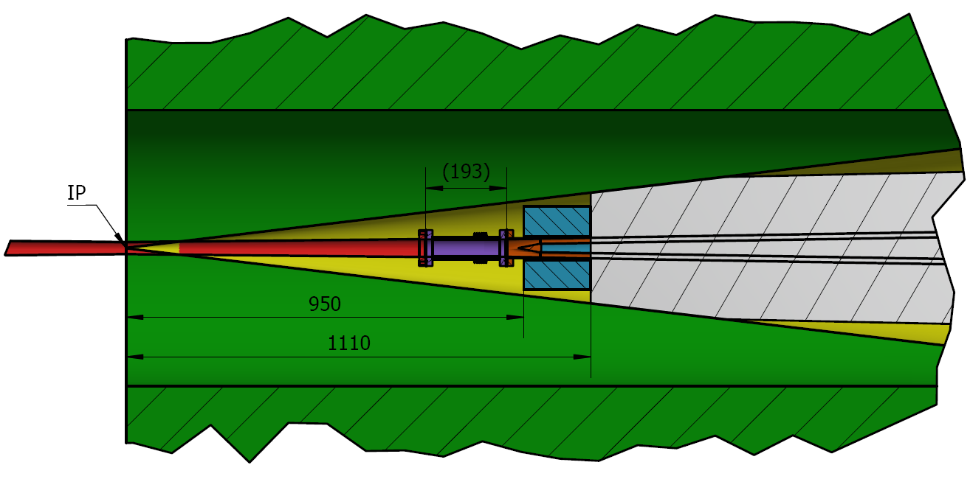
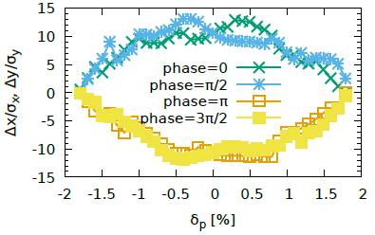
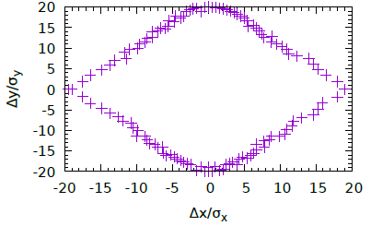
The studies on key beam dynamic issues
The collider ring lattice design
The collider SCRF system
The MDI and control of detector background
The beam-beam effect
The optimization of dynamic aperture
The on-axis injection scheme
The impedance and instabilities
Booster design
Injection linac design
Booster Injectcion and extraction
Key design have been finished
（H,W and Z)

Slide 8
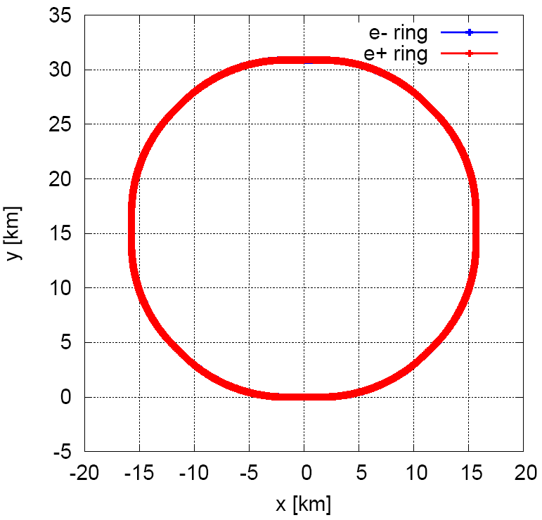
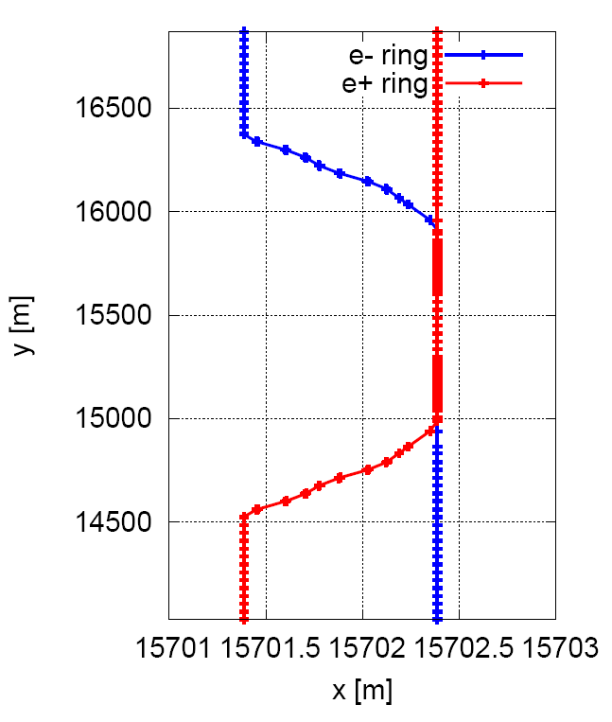
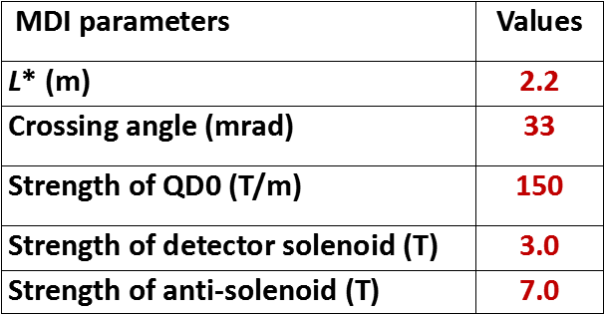
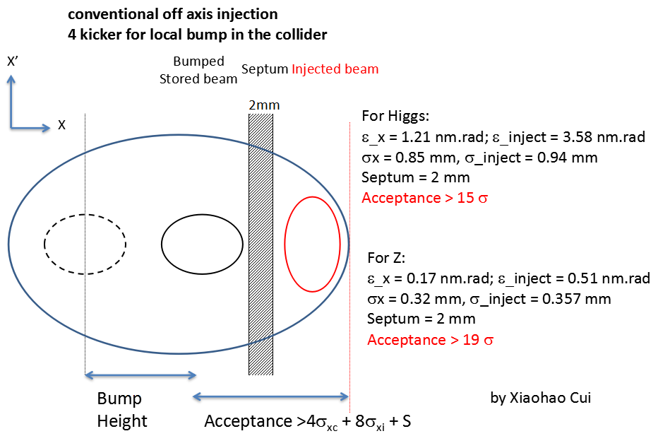
CEPC MDI
Lattice of the CEPC Collider Ring and MDI
  An optics fulfilling requirements of the parameters list, geometry, MDI, background and key hardware
tune= 363.10 / 365.22 (near integer with two IPs)
natural chromaticity= -493 / -1544
Notes:
Update figures

Slide 9
Main Parameters of Injector Linac
Parameter | Symbol | Unit | Designed
e⁻ /e⁺ beam energy | E_{e-}/E_{e+} | GeV | 10
Repetition rate | f_{rep} | Hz | 100
e⁻ /e⁺ bunch population | N_{e-}/N_{e+} |  | > 9.4×10⁹ / >9.4×10⁹
 |  | nC | > 1.5
Energy spread (e⁻ /e⁺ ) | σ_{e} |  | < 2×10⁻³ / < 2×10⁻³
Emittance (e⁻ /e⁺ ) | ε_{r} | nm⋅ rad | < 120
Bunch length (e⁻ /e⁺ ) | σ_{l} | mm | 1 / 1
e⁻ beam energy on Target |  | GeV | 4
e⁻ bunch charge on Target |  | nC | 10
The total beam transfer efficiency from transfer line to the injection point of collider ring is higher than 90%.
The transfer efficiency can be much higher with the application of damping ring which the beam energy is 1.1GeV.

Slide 10
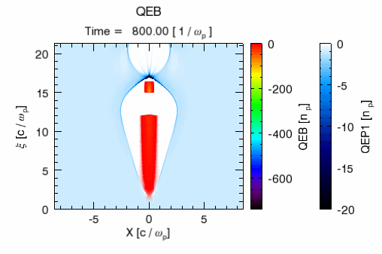
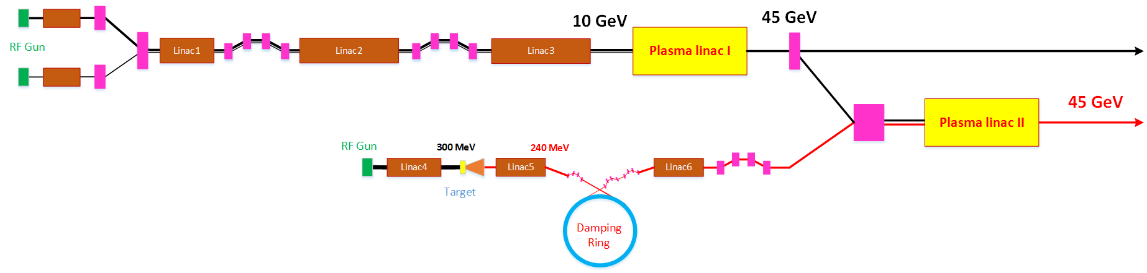
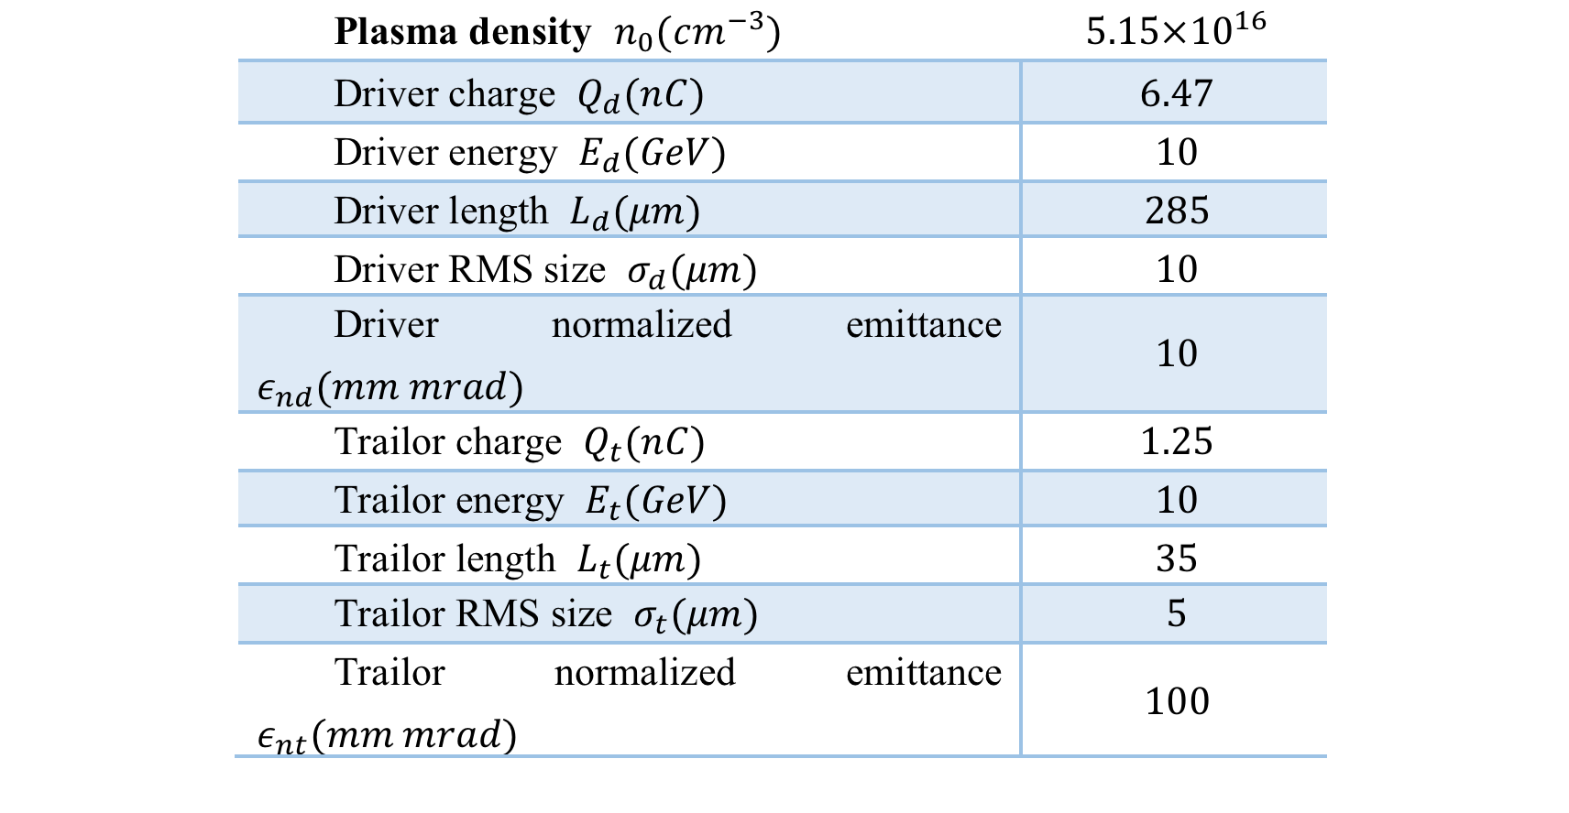
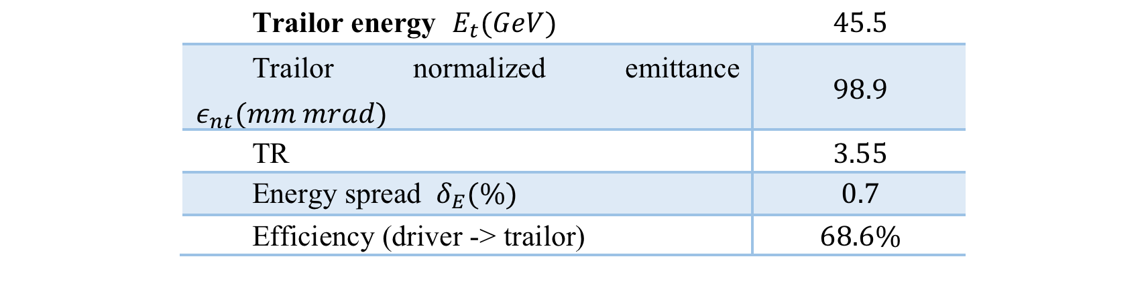
A High Energy CEPC Injector Based on Plasma Wakefield Accelerator
HTR PWFA with good stability (single stage TR=3-4, high efficiency)
Positron generation and acceleration in an electron beam driven PWFA using hollow plasma channel (TR=1)
@45GeV the plasma accelerated electron and
positron beams satisfy the CEPC booster
injection requirments

Slide 11
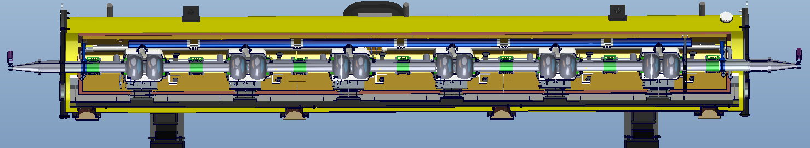
CEPC Collider Ring SRF Parameters
Collider parameters: 20180222 | H | W | Z
SR power / beam [MW] | 30 | 30 | 16.5
RF voltage [GV] | 2.17 | 0.47 | 0.1
Beam current / beam [mA] | 17.4 | 87.9 | 461
Bunch charge [nC] | 24 | 24 | 12.8
Bunch number / beam | 242 | 1220 | 12000
Bunch length [mm] | 3.26 | 6.53 | 8.5
Cavity number (650 MHz 2-cell) | 240 | 2 x 108 | 2 x 60
Cavity gradient [MV/m] | 19.7 | 9.5 | 3.6
Input power / cavity [kW] | 250 | 278 | 276
Klystron power [kW] (2 cavities / klystron) | 800 | 800 | 800
HOM power / cavity [kW] | 0.54 | 0.86 | 1.94
Optimal Q_{L} | 1.5E6 | 3.2E5 | 4.7E4
Optimal detuning [kHz] | 0.17 | 1.0 | 18.3
Total cavity wall loss @ 2 K [kW] | 6.6 | 1.9 | 0.2
Overall length (flange to flange, m) | 8.0
Diameter of vacuum vessel (m) | 1.3
Beamline height from floor (m) | 1.2
Cryo-system working temperature (K) | 2
Number of cavities and tuners | 6
Number of couplers | 6
Number of RT HOM absorbers | 2
Number of 200-POSTs | 6
Static heat loads at 2 K (W) | 5
Alignment x/y (cavities) (mm) | 0.5
Alignment z (mm) | 2
242 2cell SC cavities
40 cryomodules

Slide 12
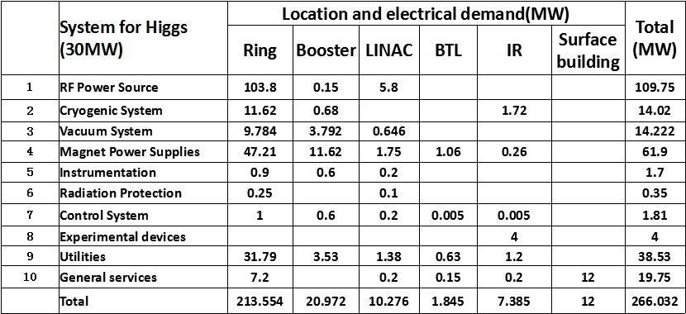
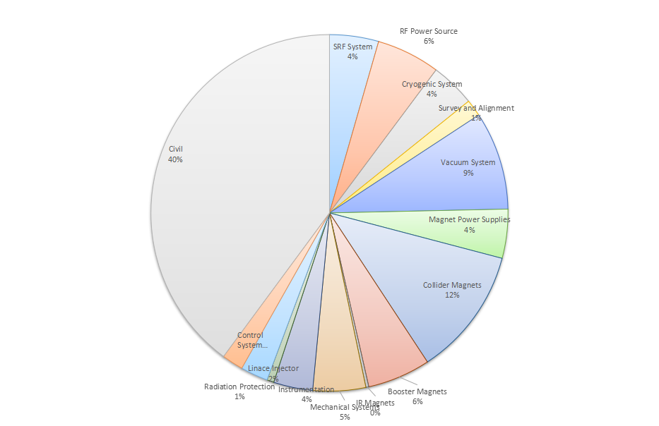
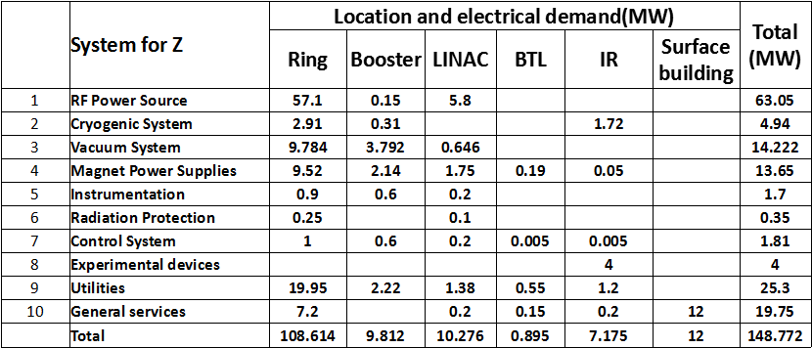
CEPC Power for Higgs and Z
CEPC Cost Breakdwon
(no detector)
S. Jin

Slide 13
Accelerator key technologies R&D
The key accelerator technologies are under studying with dedicated funds
Polarized electron gun
  Super-laIce GaAs photocathode DC-Gun
High current positron source
  bunch charge of ~3nC,
  6Tesla Flux Concentrator peak magnetic field
SCRF system
  High Q cavity - Max operation Q₀ = 2E10 @ 2 K
  High power coupler - 300kW（Variable）
High efficiency CW klystron
  Efficiency goal > 80%
Low field dipole magnet（booster）
  Lmag=5m, Bmin=30Gs, Errors <5E-4
Vacuum system
  6m long cooper chamber
  RF shielding bellows
Electro-static separator
  Maximum operating field strength: 20kV/cm
  Maximum deflection: 145 urad
Large scale cryogenics
  12 kW @4.5K refrigerator, Oversized,
  Custom-made, Site integration
HTS magnet
  Advanced HTS Cable R&D: > 10kA
  Advanced High Field HTS Magnet R&D: main field 12~12T

Slide 14
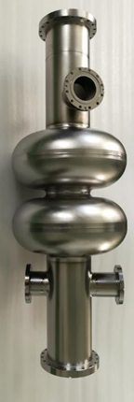
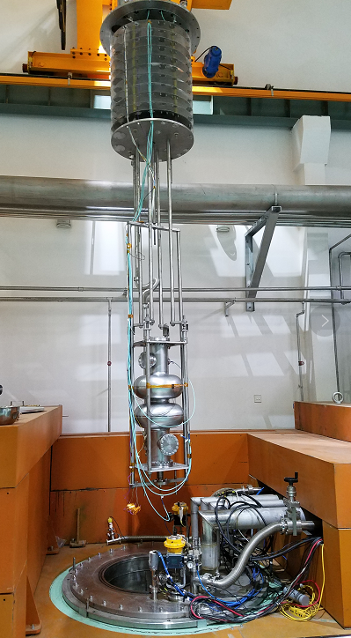
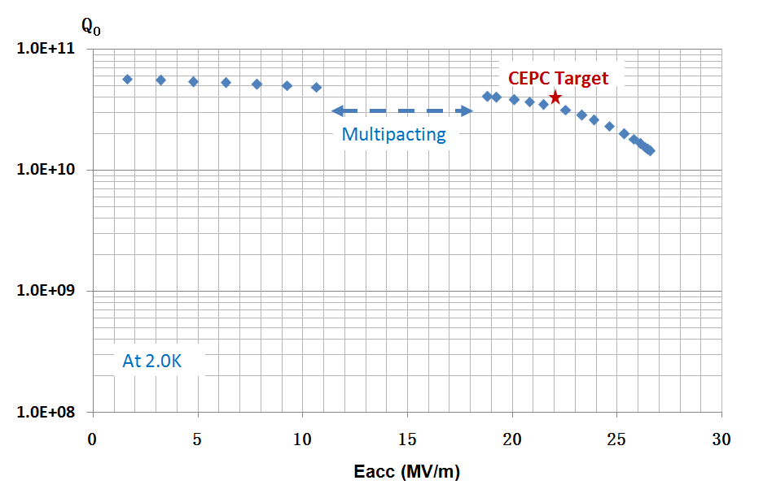
CEPC 650 MHz Cavity development
Vertical test result: Q₀=4.0E10@19.2MV/m，which is close to the CEPC target (Q₀=4.0E10@22.0MV/m).
Next, the CEPC target will be achieved by N-doping and EP, etc.
Vertical test

Slide 15
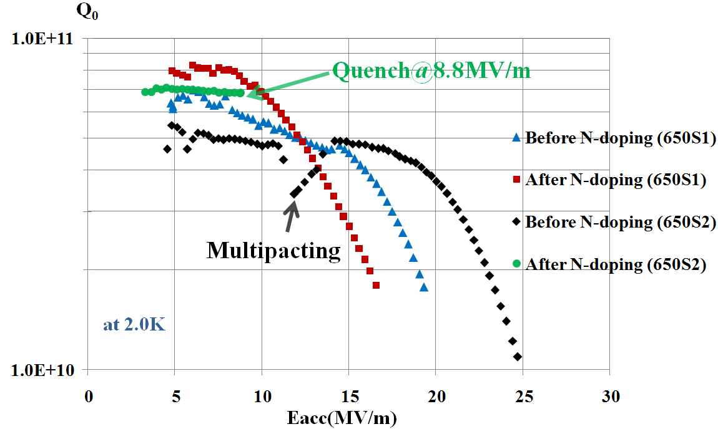
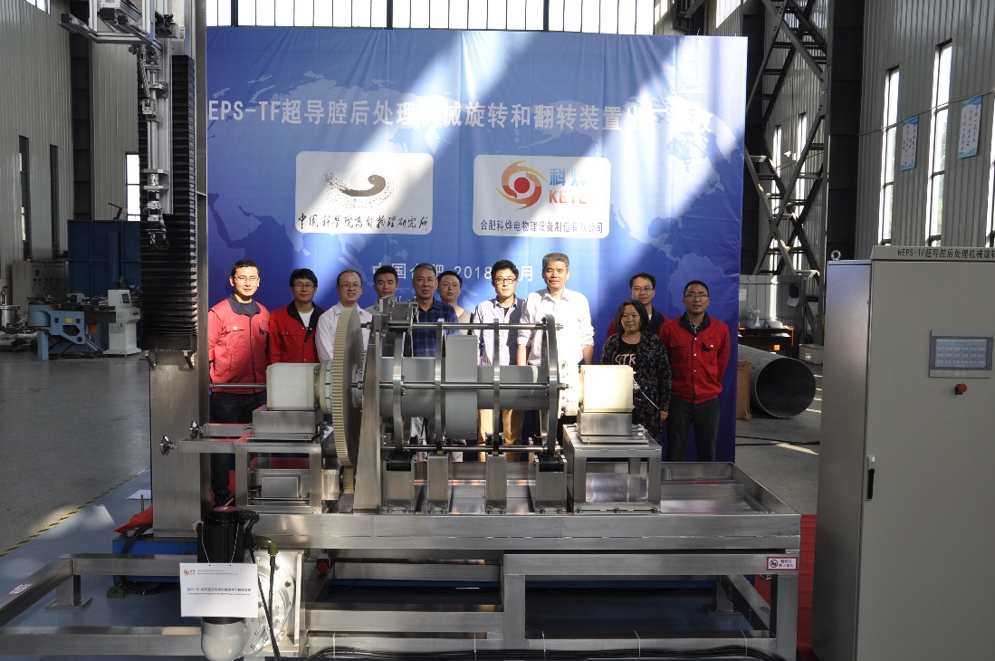
N-doping Research High Q SC Cavity
After N-doping, Q₀ increased obviously at low field for both 650MHz 1-cell cavities.
650S1: Q₀=7e10@Eacc=10MV/m. But Q₀ decreased quickly at high field (>10 MV/m) because of no BCP/EP after N-doping.
650S2: Quench at Q₀=6.9e10@Eacc=8.8MV/m.
The key components of the EP machine have passed the factory acceptance test.
The civil construction of the EP facility is on going, and the commissioning will be on Sep-Oct 2018.
Vertical test results of 650 MHz 1-cell cavities
The first EP facility in China

Slide 16
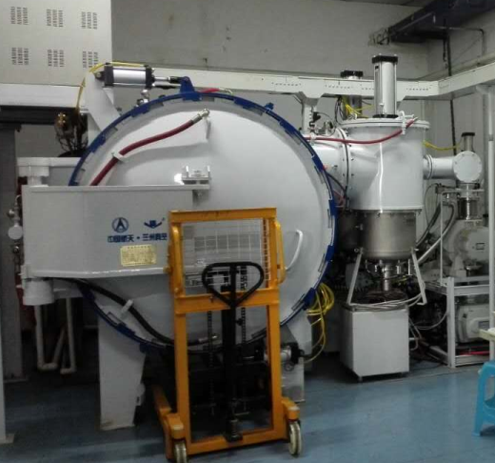
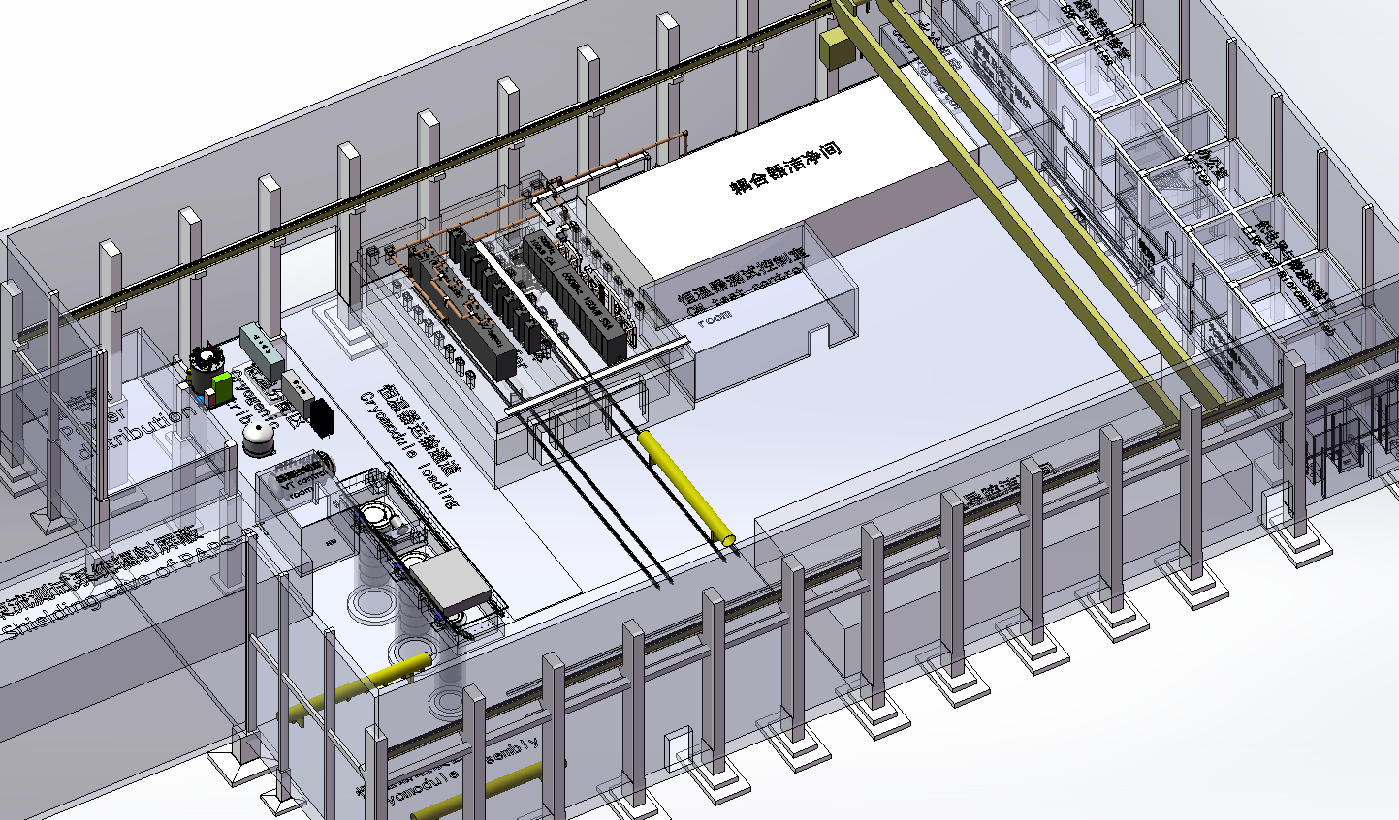
IHEP New SRF Infrastructure
4500 m² SRF lab in the Platform of Advanced Photon Source Technology R&D (PAPS), Huairou Science Park, Beijing.
Mission to be World-leading SRF Lab for Superconducting Accelerator Projects and SRF Frontier R&D.
Mass Production:
  200 ~ 400 cavities & couplers test per year
  20 cryomodules assembly and horizontal test per year.
Construction : 2017 - 2020
N-doping/N-infusion furnace
2 Horizontal test
  3 VT dewars , 2 HT caves,
  500m2 Clean Room
3 Vertical test
Coupler Test
Shanghai city government decided to built Shanghai Coherent Light Facility(SCLF).
432 1.3 GHz cavities
54 Cryomodules
IHEP plans to provide > 1/3 of cavities and cryomodules, an excellent exercise for CEPC
CM Assembly Clean room
Beam tester

Slide 17

PAPS SRF Facility Capacity
PAPS capability: 300 cavities and FPCs, plus 20 CMs per year
Collaboration with Shanghai XFEL:
  >16 cavities and FPCs will be tested at PAPS before Dec 2019
  200-300 cavities and FPCs will tested during mass production phase
PAPS SRF
4500m²
300 cav/y
FNAL
500 cav/y
JLab
300 cav/y
DESY
400 cav/y
◉
◉
◉
◉
◉
◉
Saclay
500 FPC/y
USA
>1000 cavties
LCLS-II, FRIB, SNS,
CEBAF,…
KEK
400 cav/y
Europe
>1000 cavities
EXFEL, ISOLDE,
Flash, …
China
>500 cavities
HEPS, XFEL,
ADS, HIAF, …
ILC
16k cavities

Slide 18
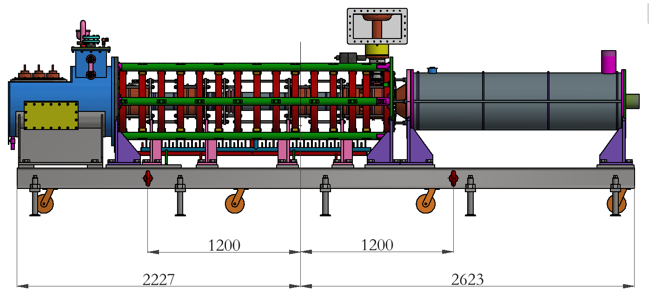
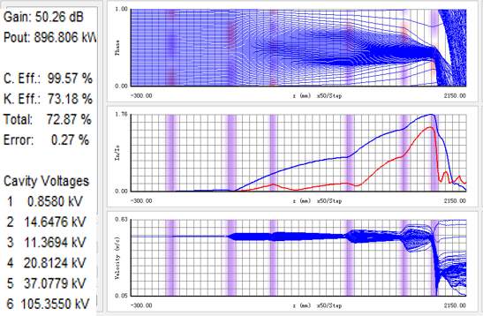
High Efficiency Klystron Development
Established “High efficiency klystron collaboration consortium”, including IHEP & IE(Institute of Electronic) of CAS, and Kunshan Guoli Science and Tech.
  2016 – 2018： Design conventional & high efficiency klystron
  2017 – 2018：Fabricate conventional klystron & test
  2018 - 2019 ：Fabricate 1st high efficiency klystron & test
  2019 - 2020 ：Fabricate 2nd high efficiency klystron & test
  2020 - 2021 ：Fabricate 3rd high efficiency klystron & test
Parameters | Conventional efficiency | High efficiency
Centre frequency (MHz) | 650+/-0.5 | 650+/-0.5
Output power (kW) | 800 | 800
Beam voltage (kV) | 80 | -
Beam current (A) | 16 | -
Efficiency (%) | ~ 65 | > 80
Mechanical design of conventional klystron
73%/68%/65% efficiencies for 1D/2D/3D

Slide 19
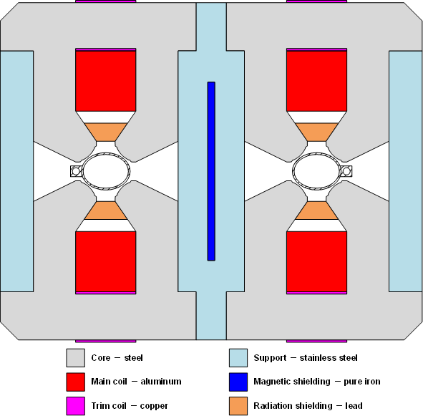
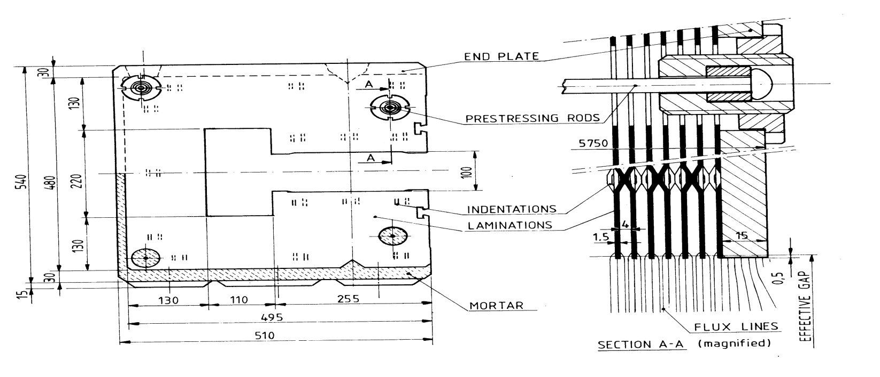
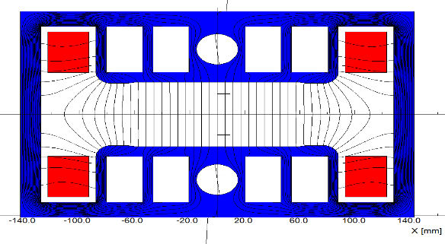
CEPC Collider and Booster Ring Conventional Magnets
Collider ring magnets
 | Dipole | Quad. | Sext. | Corrector | Total
Dual aperture | 2384 | 2392 | - | - | 13742
Single aperture | 80*2+2 | 480*2+172 | 932*2 | 2904*2
Total length [km] | 71.5 | 5.9 | 1.0 | 2.5 | 80.8
Power [MW] | 7.0 | 20.2 | 4.6 | 2.2 | 34
Booster ring low field magnets
Quantity | 16320
Magnetic length(m) | 4.711
Max. strength(Gs) | 338
Min. strength(Gs) | 28
Gap height(mm) | 63
GFR(mm) | 55
Field uniformity | 5E-4

Slide 20
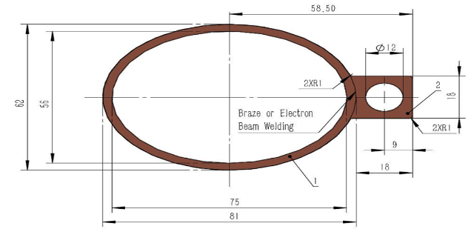
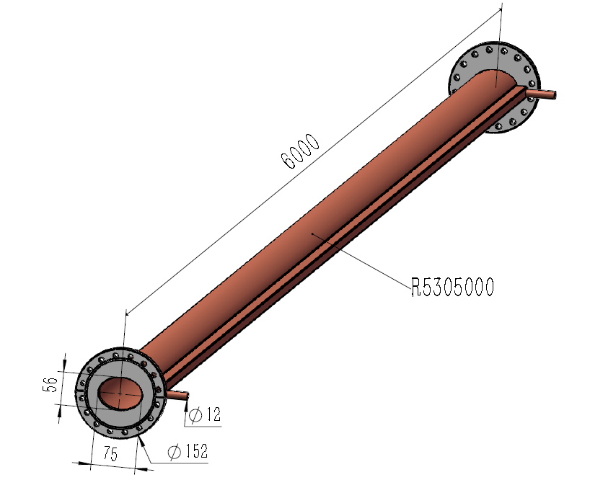
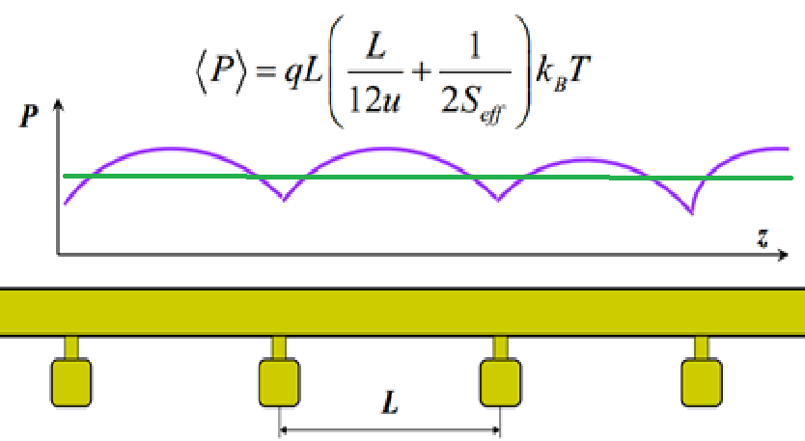
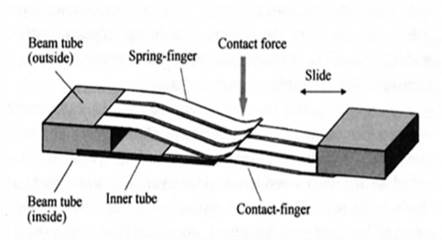
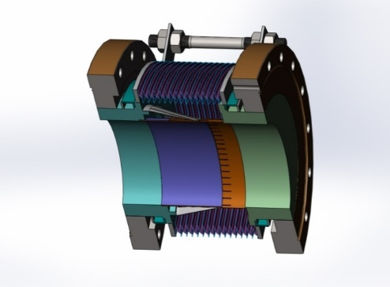
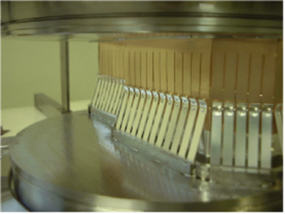
Vacuum System R&D
The vacuum pressure is better than 2 x 10-10 Torr
Total leakage rate is less than 2 x 10-10 torr.l /s.
Positron ring
NEG coating suppresses electron multipacting and beam-induced pressure rises, as well as provides extra linear pumping. Direct Current Magnetron Sputtering systems for NEG coating was chosen.
Copper vacuum chamber (Drawing)
(elliptic 75×56, thickness 3, length 6000)
NEG coating pump
Ion sputtering pump
Function of the bellows module : allow thermal expansion of the chambers and for lateral, longitudinal and angular offsets due to tolerances and alignment,
Providing a uniform chamber cross section to reduce the impedance seen by beam
The Finger contact force of RF shielded bellow is 125±25 g/Finger.

Slide 21
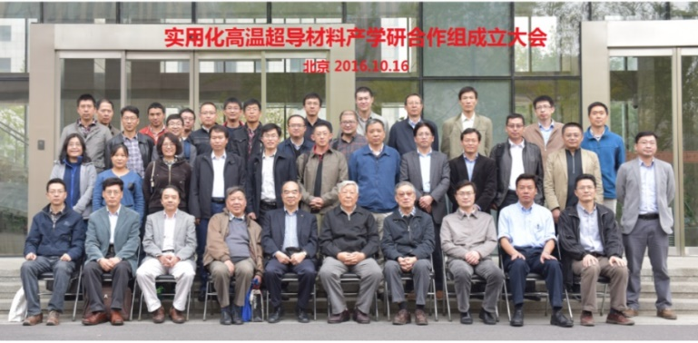
High Field Magnet Based on HTS Material
Huge impact If advanced HTS materials (IBS) can be used for 10-20T magnets
  Huge cost reduction of high field magnets
  Huge applications in other area and industry
Fe-based HTS material (IBS)
  Advantages: Metal, easy to process; Isotropic; Cheap in principle
  Good start at CAS
    World highest Tc Fe-based materials
    World first ~ 115 m Fe-based SC conductor: 12000 A/cm² @ 10 T
A collaboration on “advanced HTS materials ” established
  IOP, USTC, IEE, SC conductor companies
  Two approaches:
    IBS
    ReBCO & Bi-2212
CAS has allocated 25Million RMB on HTS
and ~200Million RMB will be allocated in 2018

Slide 22
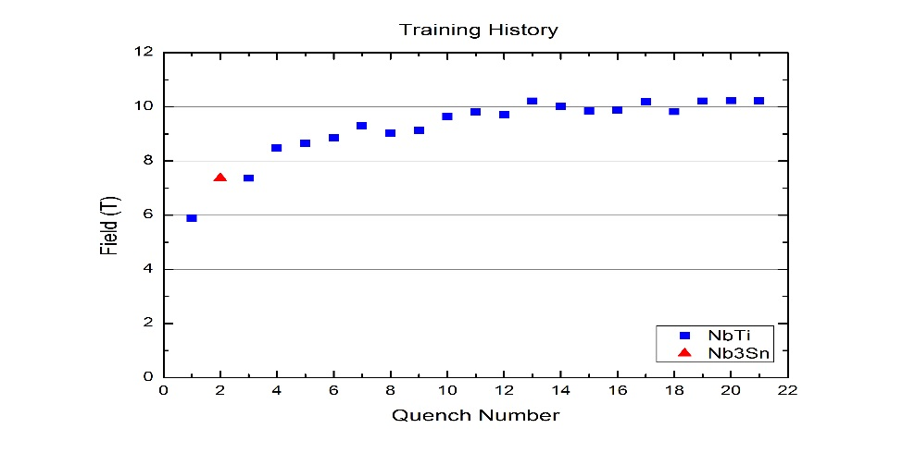
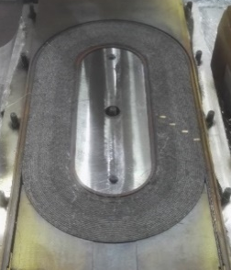
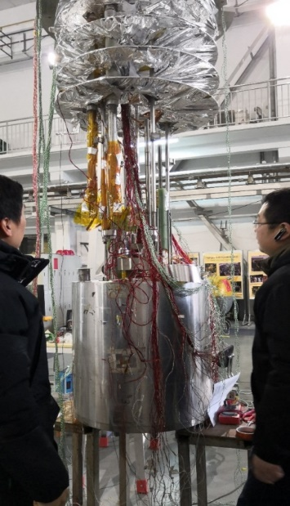
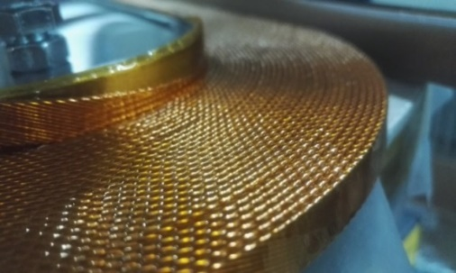
High Field Magnet R&D for SppC
Magnet development for HL-LHC (exercise of the dipole magnet)
  CERN-IHEP collaboration on HiLumi LHC magnets
NbTi+Nb₃Sn, 2*ф10 aperture
Nb₃Sn+HTS, 2*ф30 aperture
All HTS
10.2T @ 4.2K
First dipole magnet in China (NbTi+Nb₃Sn) test successful

Slide 23
CEPC Accelerator Team (IHEP)
Since 2013, IHEP has built a strong team covering all aspects of CEPC accelerators. ~100 scientists in 14 groups involved in the study.
Accelerator managers and sub-system conveners as following:
  Accelerator managers: Jie GAO , Yunlong CHI and Jingyu TANG
 | Systems | Conveners
1 | SRF System | Jiyuan ZHAI/ Peng SHA
2 | RF Power Source | Shilun PEI
3 | Cryogenic System | Shaopeng LI
4 | Survey and Alignment | Xiaolong WANG
5 | Vacuum System | Haiyi DONG
6 | Power Supplies | Bin CHEN
7 | Collider Magnets | Fusan CHEN
 | Systems | Conveners
8 | Booster Magnets | Wen KANG
9 | IR Magnets | Yingshun ZHU
10 | Mechanical Systems | Haijing WANG
11 | Instrumentation | Yanfeng SUI
12 | Radiation Protection | Zhongjian Ma
13 | Linac Injector | Jingru ZHANG
14 | Control System | Gang LI
 | Full Prof. | Staff | Postdoc & Students
CEPC | 3 | 114 | 20
SppC | 1 | 20 | 6

Slide 24
Summary
The CEPC accelerator CDR has been completed satistying the luminosity requirements as Higgs and Z factory.
Key technologies are under R&D and put to prototyping such as SC cavity, high efficiency klystron, low field precision magnet, copper vacuum chamber, HTS and so on.
CEPC civil engineering design, site selection and implementation go well.
About 285 M CNY funding's supported from various resources for CEPC design and key technology development, and about 200~300 M CNY for HTS development.
About 100 people working on CEPC accelerator design and key technology development fully or partially.
After CEPC CDR completion in 2018, from 2018-2022, CEPC TDR will be finished with accelerator key hardwars' R&D completed and industrialization ready for construction from 2022 till 2030, when CEPC will be put to operation till 2040 to start SppC construction.

Slide 25
Thanks for your attention!

Slide 26
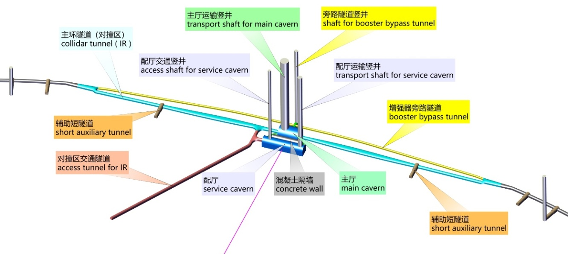
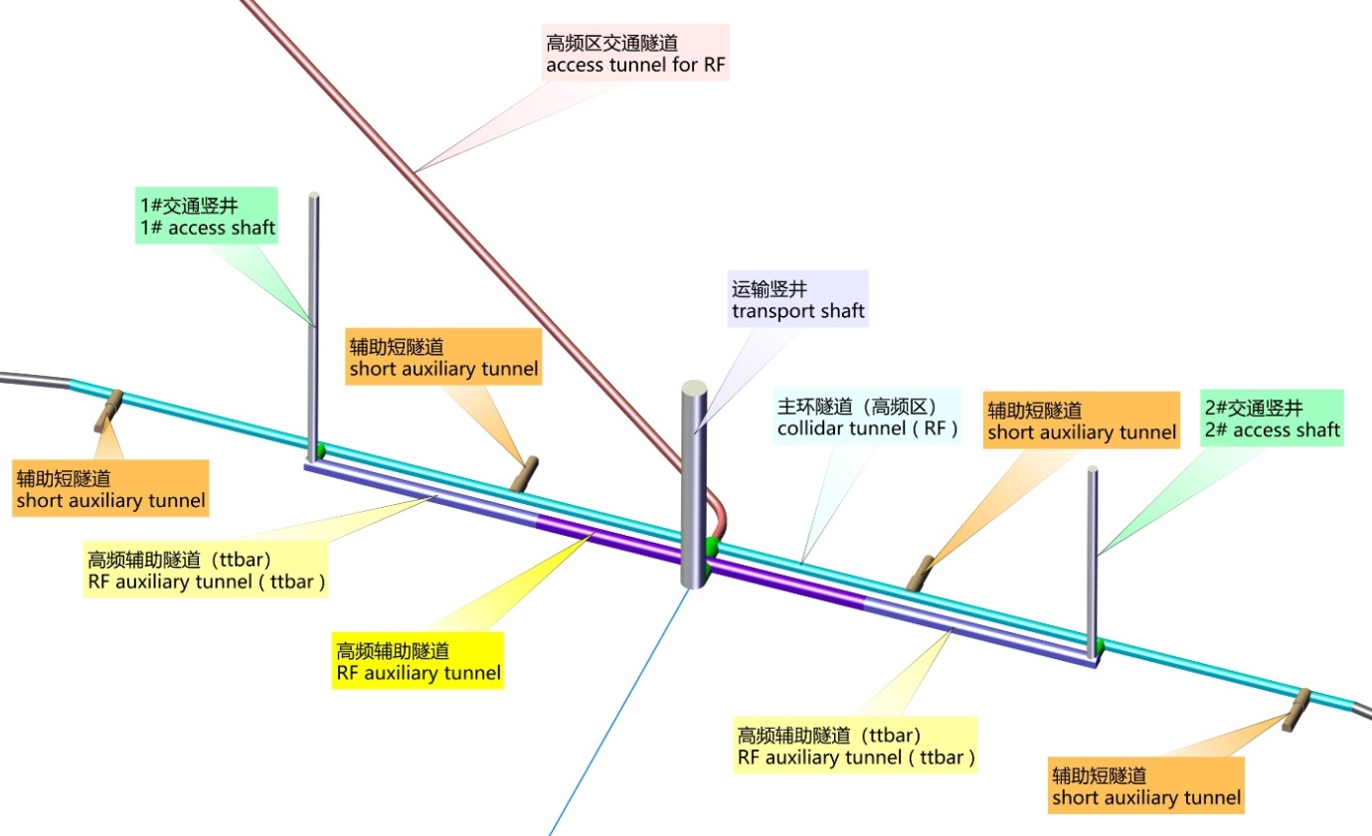



CEPC Civil Engineering Design and Implemtation
dCEPC Interaction Region
dCEPC Injection Region
IP1 / IP3
IP2 / IP4--SCRF region
dCEPC-SppC tunnel
dCEPC Detector Hall
dCEPC SCRF Gallary
Notes:
IR is arranged at IP1/IP3, with the length of 3320.00m for each one. The sections from the intersections of tunnels in the IR and tunnels at the curve sections to the zones within 1532.00m of both sides of halls are linear sections with the width ranging from 6.00m~10.74m and the height of 5.00m. At these linear sections, the routing direction of tunnel will be adjusted according to booster line and transfer lines. The zones within 1532.00m of both sides of halls are divided into two tunnels respectively for arranging positive / negative electron beam and booster beam . The tunnel for arranging positive / negative electron beam is 6.00m~11.40m wide, 4.50m high and 1509.30m long (single side). The tunnel for arranging booster line is 3.50m wide, 3.50m high, and 3018.60m long. The dimension of tunnel section is determined with consideration given to local control, electrical, beam measurement, vacuum and cooling equipment as well as requirements of passage of personnel and maintenance .

