Slide 1
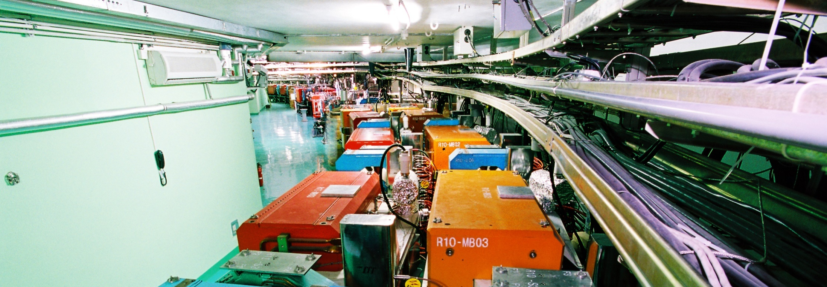
High Energy Photon Source
QIN Qing
Institute of High Energy Physics
June 14 , 2018
International assessment 2018

Slide 2
Contents
1
Introduction
2
Key Technologies of HEPS
3
Project Progress
4
Conclusion

Slide 3
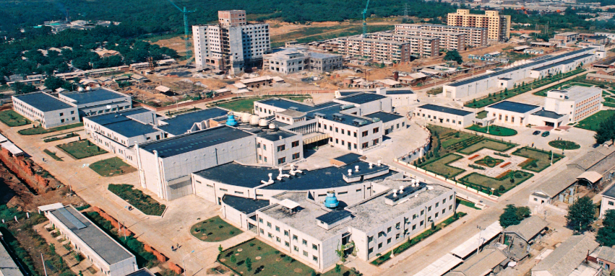
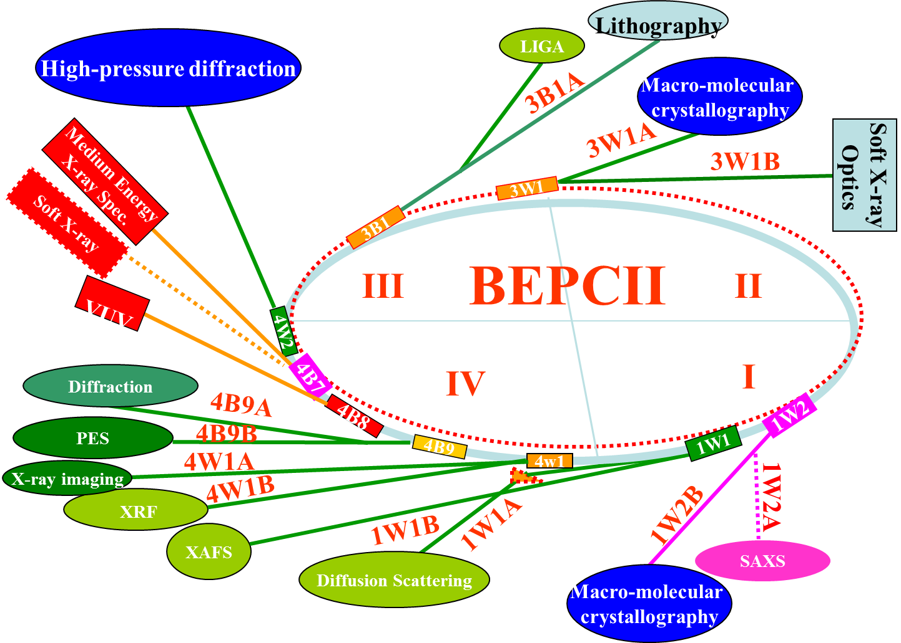
1. Introduction
BEPC/BSRF – the first synchrotron radiation facility in China
  Mid-energy, parasitic machine based on collider
  Users in China were trained from the very beginning of BEPC operation

Slide 4
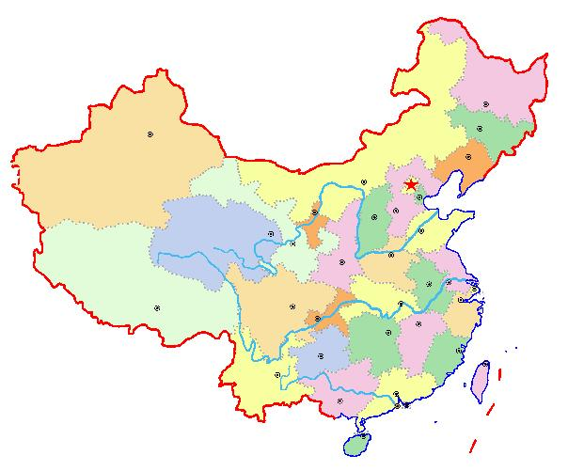
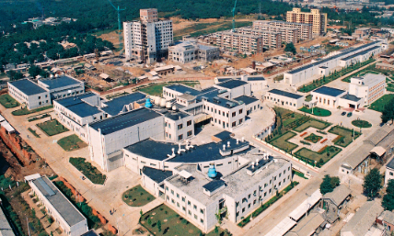
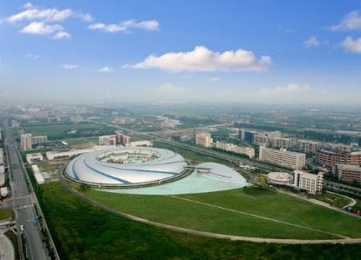
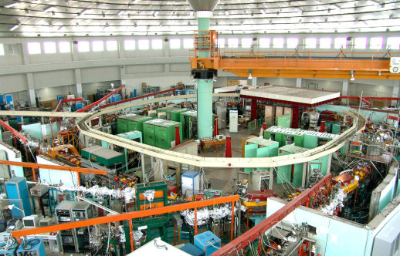
Storage ring-based synchrotron radiation light sources
  Developed in mainland China from the 1980s - BEPC/BSRF, Hefei Light Source, Shanghai Synchrotron Radiation Facility
Beijing Synchrotron Radiation Facility
BSRF
1GLS
Shanghai Synchrotron Radiation Facility
Hefei Light source
SSRF
3GLS
HLS
2GLS

Slide 5
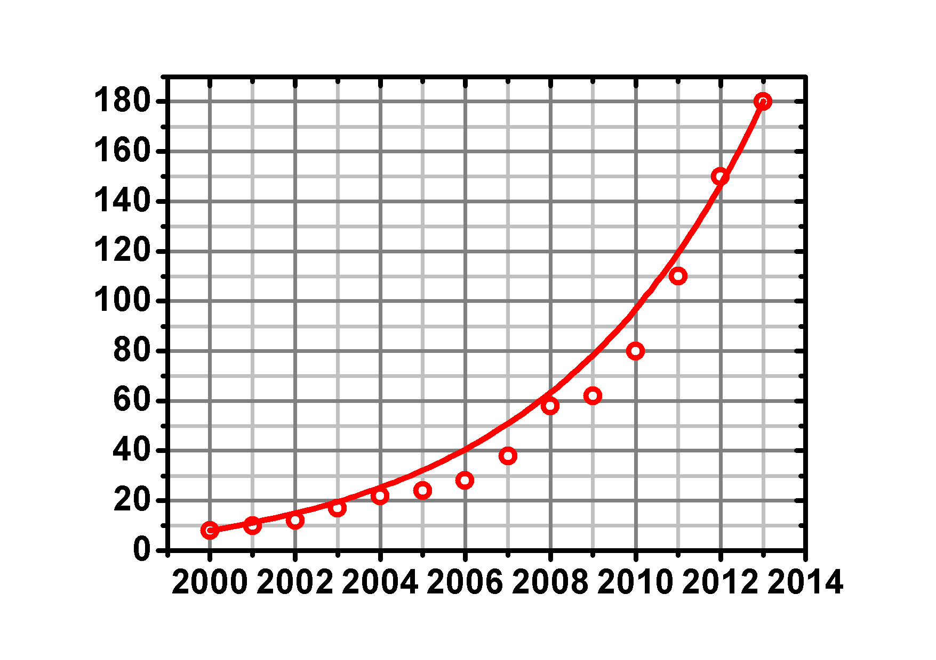
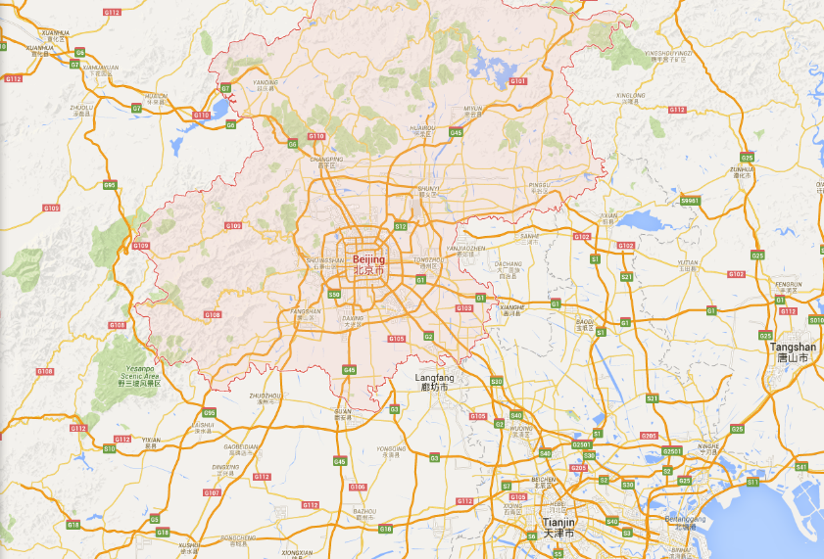
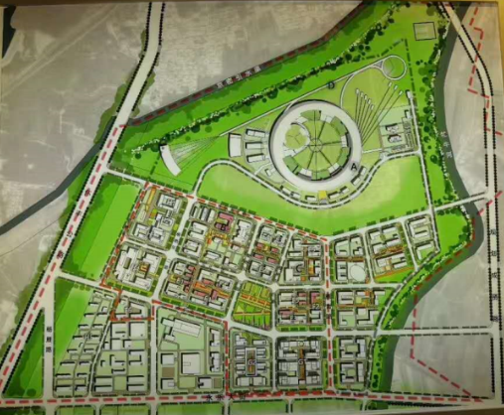

A New Light Source for China — High Energy, High Brightness
Increasing number of users as Chinese science and economy develops
A new photon science research center in north China
IHEP
About 80 km from IHEP
e.g. Increase of structural biology users in China

Slide 6
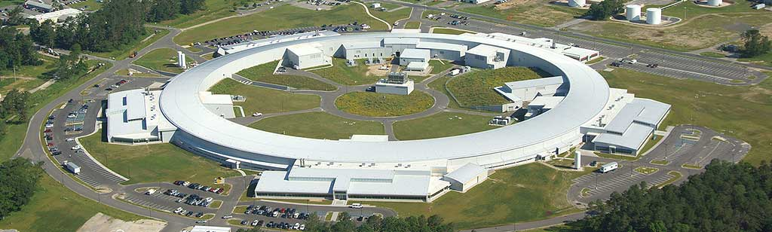
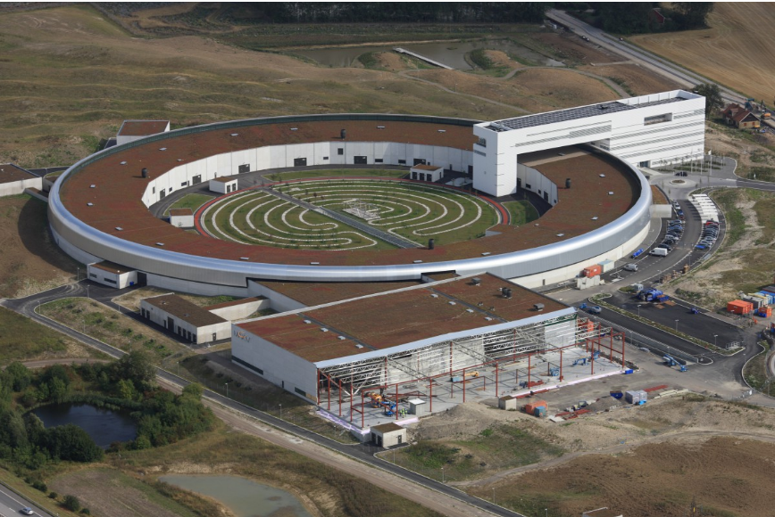
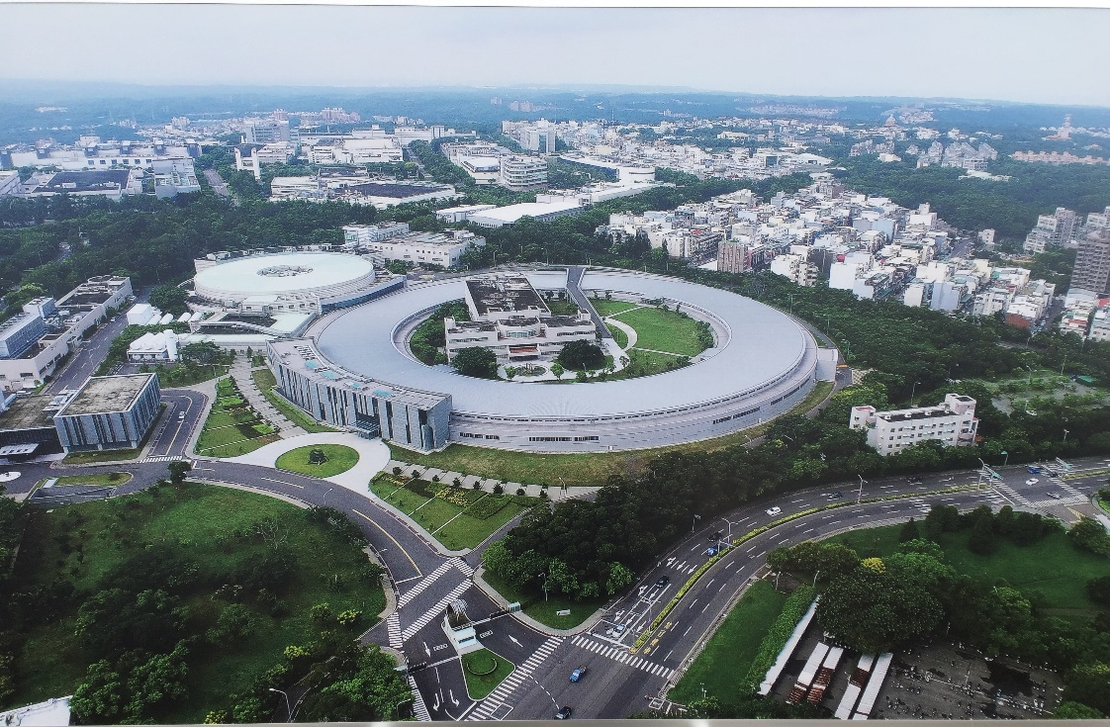
Trends in SR Sources
NSLS-II
MAX-IV
Lower emittance (4  ≤ 0.1 nm·rad)
Higher brilliance (↗2~3 orders)
More advanced beam lines and end-stations (better resolution, higher speeds, etc.)
SR-based research centers
TPS

Slide 7
Two Steps to a World-Leading SR Light Source
HEPS-TF - R&D for the High Energy Photon Source (HEPS) project
  One of the 16 large scientific facilities listed by the National Development and Reform Commission in the 12th 5-Year Plan.
  Officially started in Feb. 2016, should be completed in Oct. 2018.
  Total budget: 321.6 M CNY (~48 M USD)
HEPS project
  Shortlisted in the 13th 5-Year Plan of the National Development and Reform Commission
  Officially approved in Dec. 2017
  Expected to start construction in late 2018, for completion in mid-2025.
  Total budget: 4.5-5 B CNY (~0.7 B USD)

Slide 8
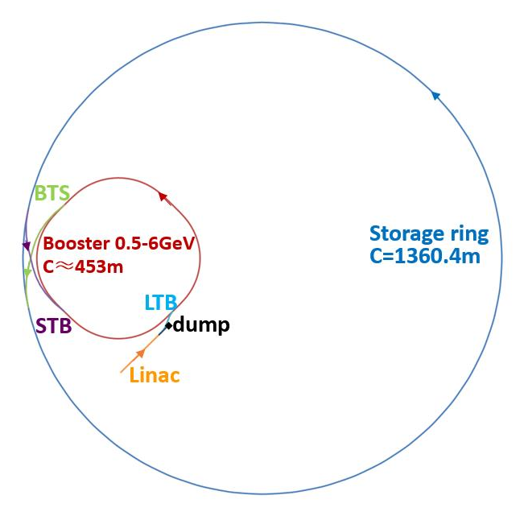
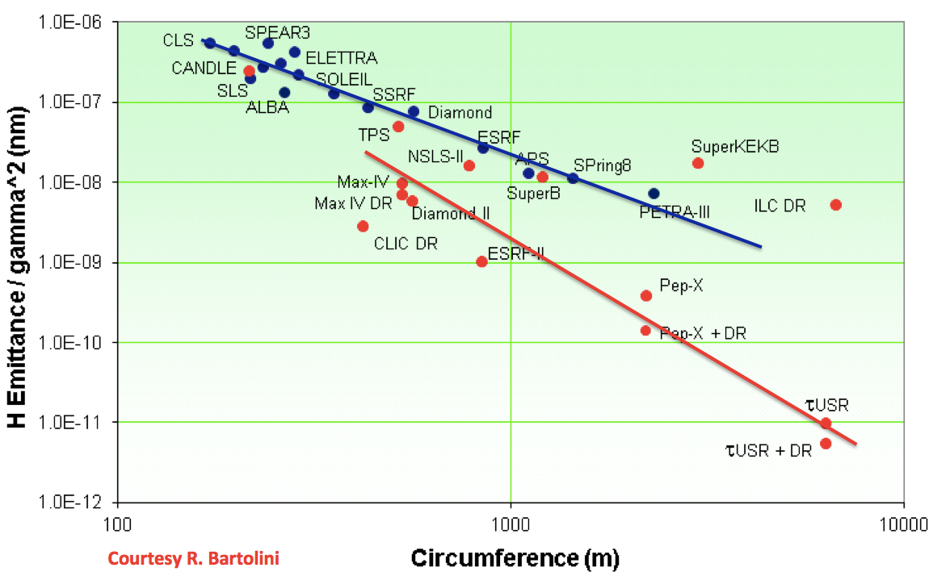
Design goals for HEPS
Beam energy | GeV | 6
Circumference | m | 1360.4
Emittance | pm.rad | < 60
Beam current | mA | 200
Injection |  | Top-up
Brightness | Phs/s/mm² /mrad²/0.1%BW | >10²²
HEPS

Slide 9
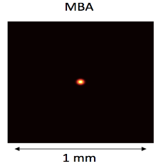


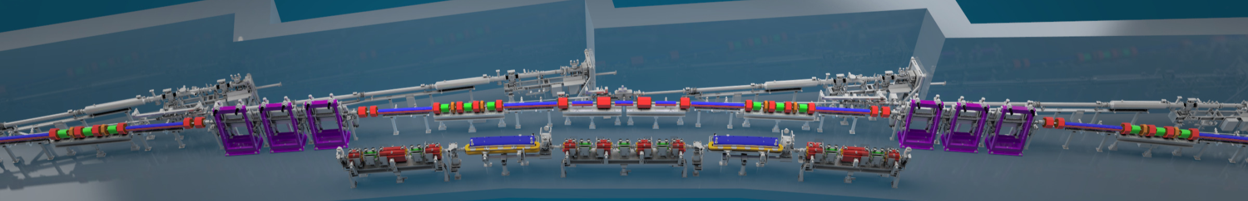
Main Challenges from Tiny Emittance
DBA/TBA
DBA(TBA) => MBA(7BA)
Dipole-quad
High gradient quad
Insertion Device
Long. gradient dipole
7BA
DBA
Accelerator physics: dynamic aperture, error effects, ID, etc.
Technologies: high gradient quad, longitudinal gradient dipole, NEG coating, ID, BI, supports, alignment, etc.
Stability: ground motion, hardware stability, etc.
Commissioning: first beam, ID effect, beam line, etc.
Solved in the HEPS-TF project

Slide 10
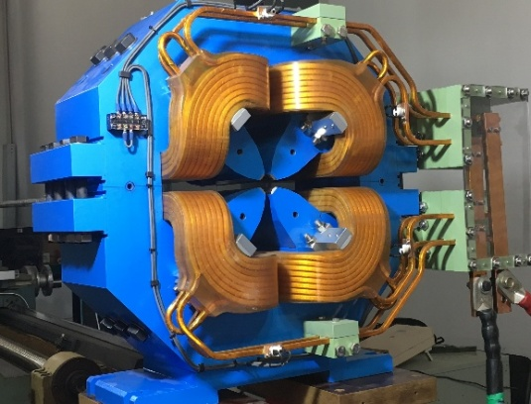
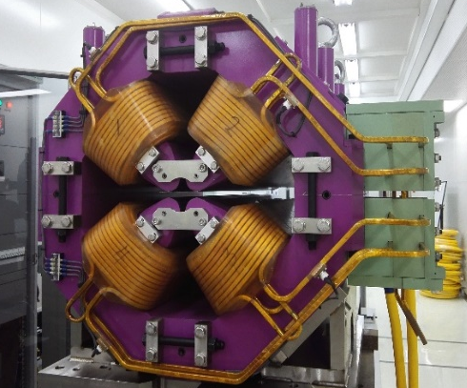
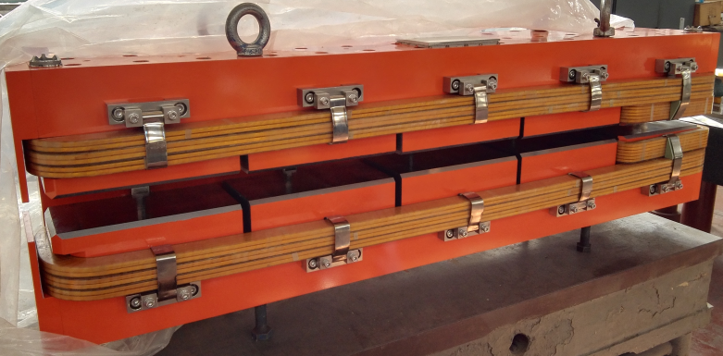
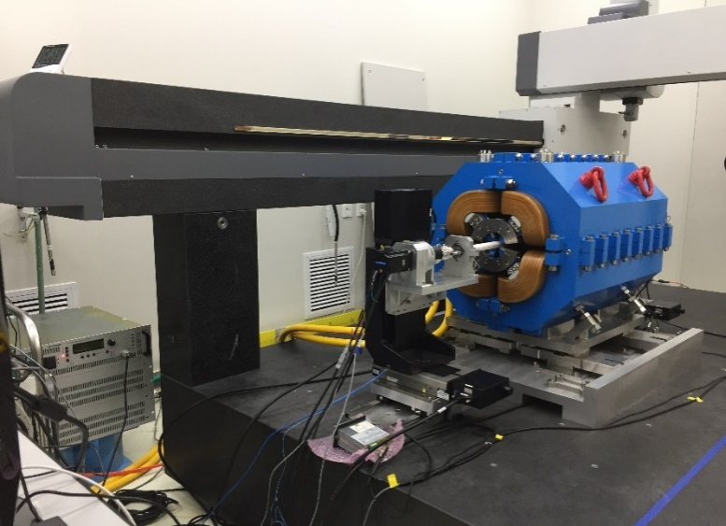
2. Key Technologies for HEPS
Magnets
  High-gradient quadrupole
  Gradient: 88 T/m
  Longitudinal gradient dipole
  Combined function magnets: dipole+quad

Slide 11
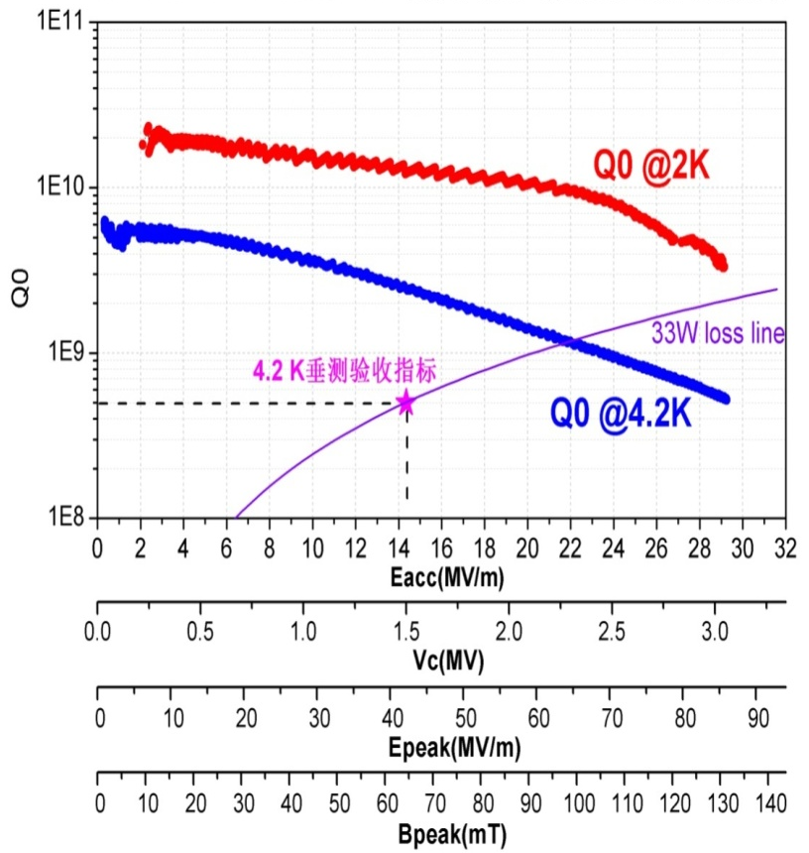
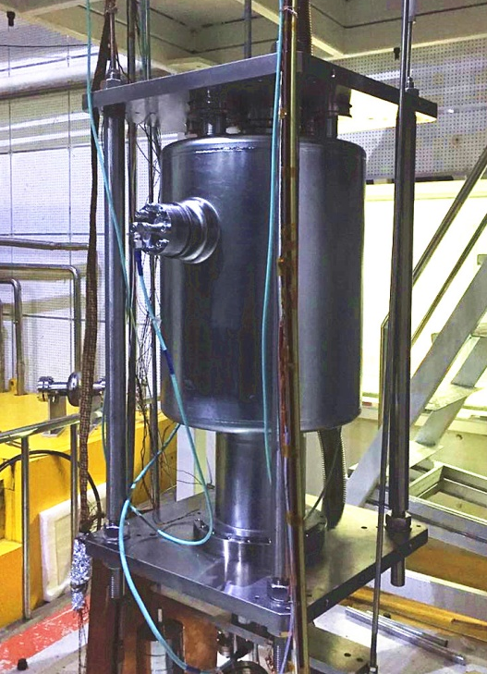
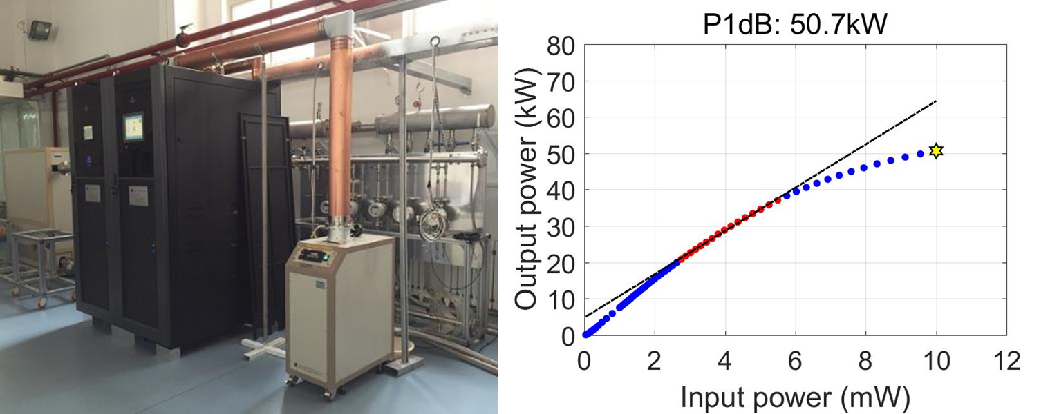
166.6 MHz SRF cavity – for longitudinal injection
  Tested in March 15, 2017
  85 MV/m, 130 mT, 2.3 nΩ
Power source of SRF

Slide 12
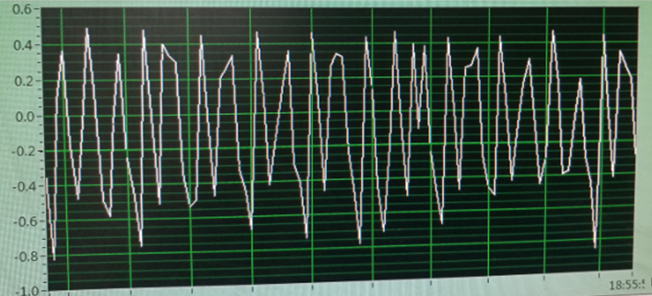
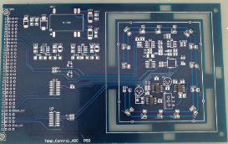
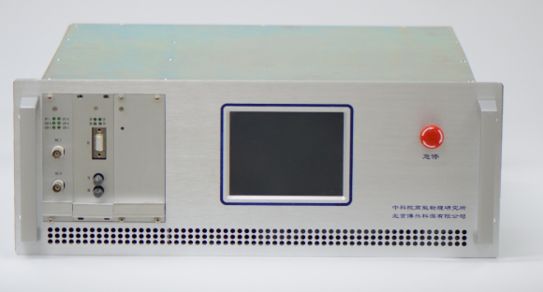
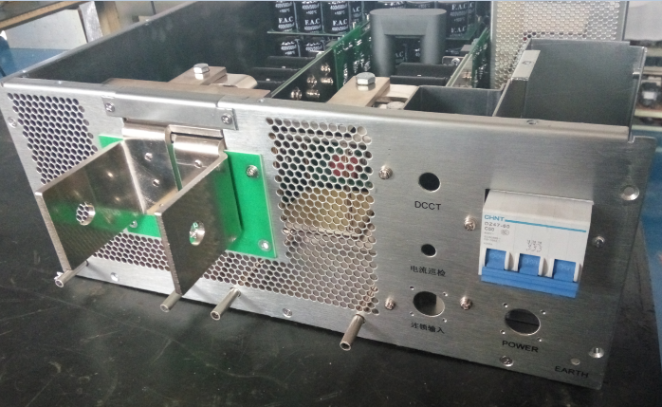
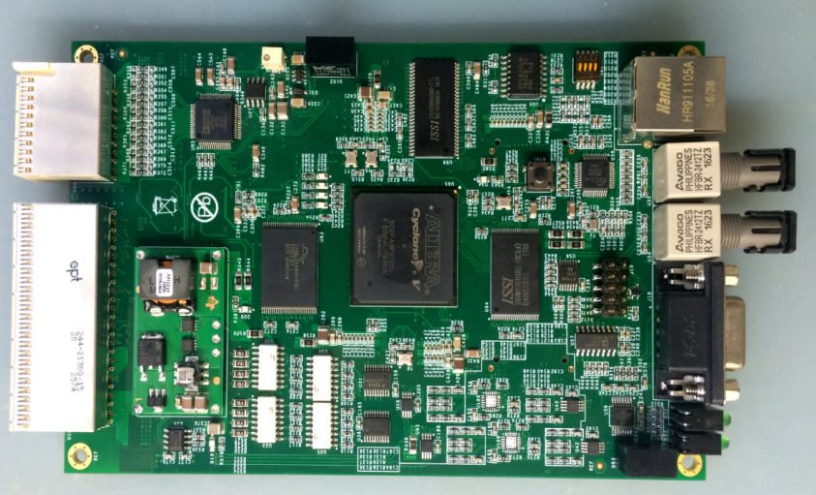
High accuracy power supplies
Prototype of dynamic
PS (acc. =0.1%)
DPSCM-II high acc.
ADC plate
Prototype of 300A 50V
power supply
10ppm high accuracy PS
DPSCMII-MB

Slide 13
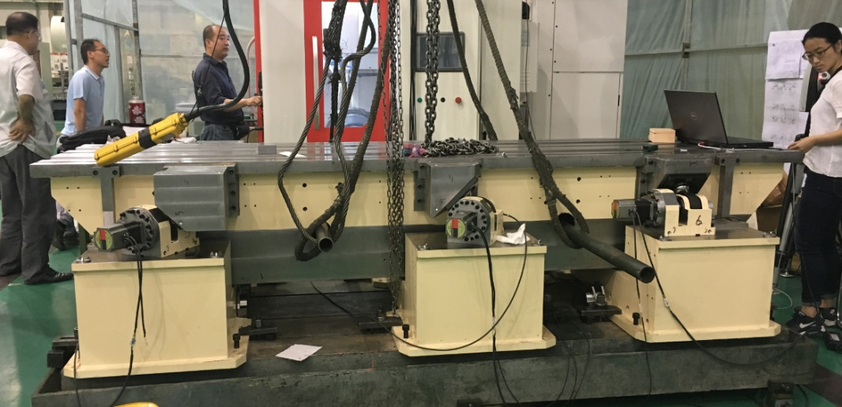
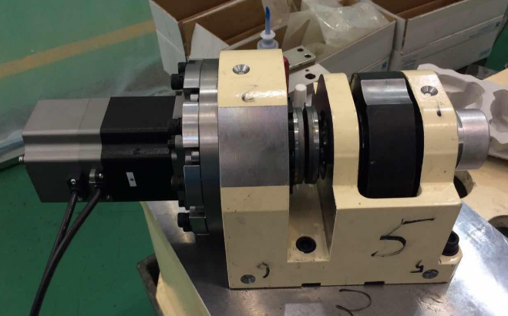
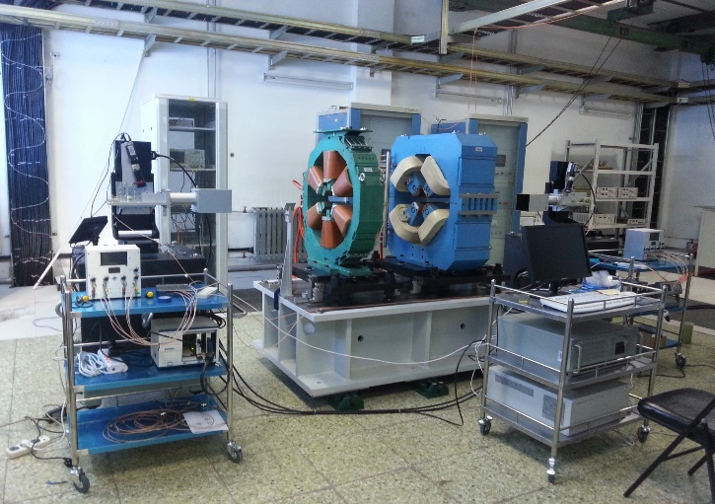
Mechanics & alignment
  Auto-control high precision tunable girder
  Oscillating-line alignment tech

Slide 14
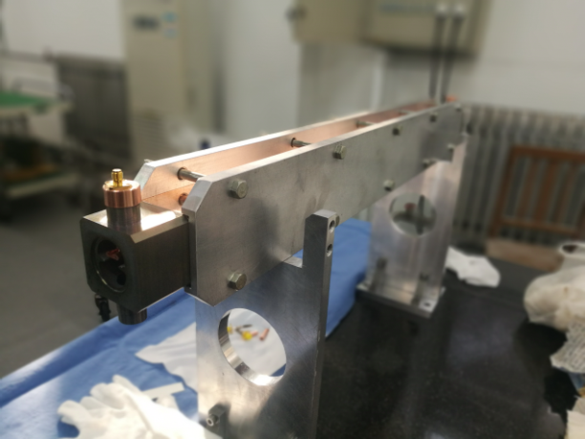
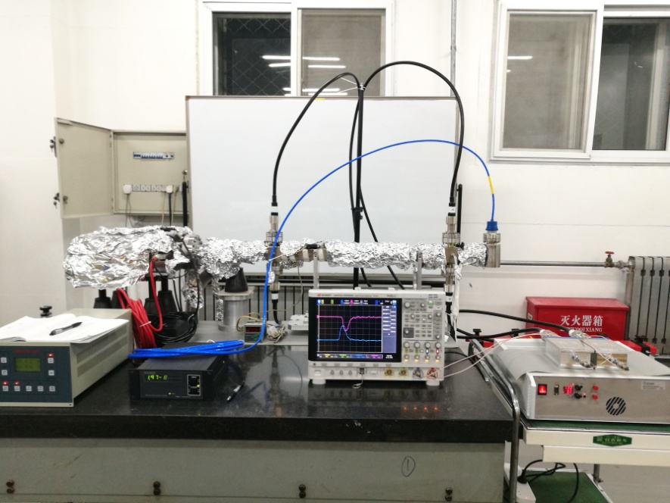
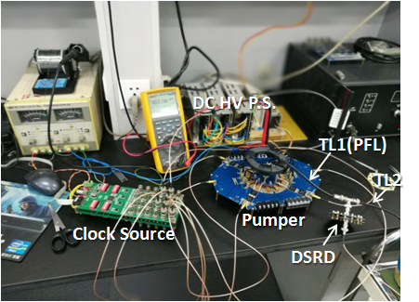
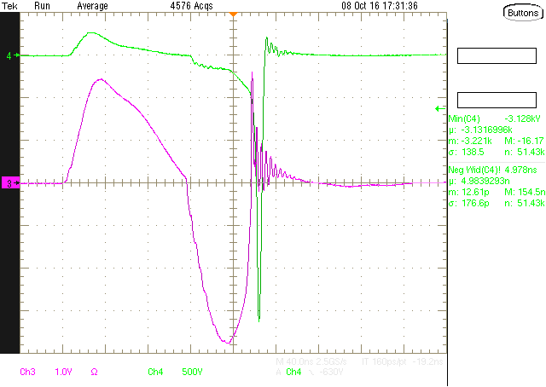
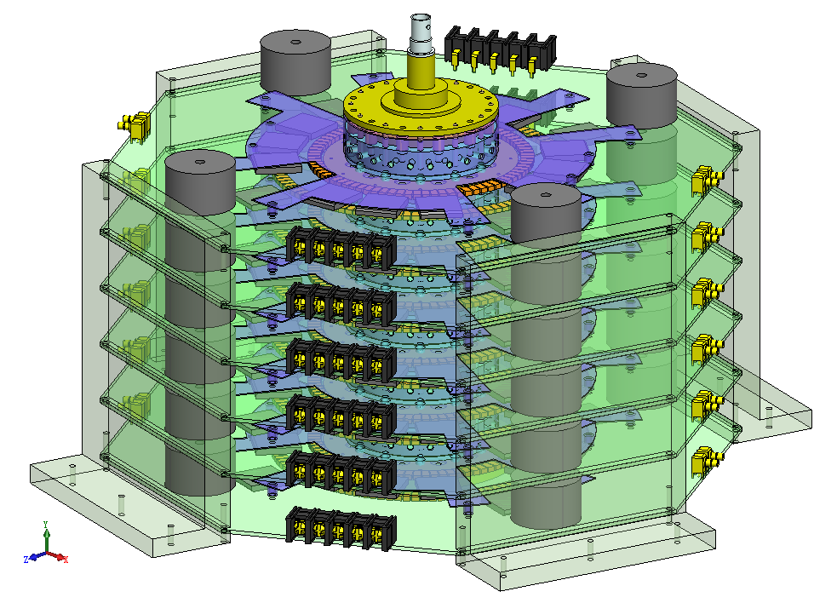
Injection kicker & power supply
  Physics and structure design for the strip-line kicker, on-line test
  DSRD rapid pulse PS – test of single-level circuit & structure design for 6-level iterated circuit

Slide 15
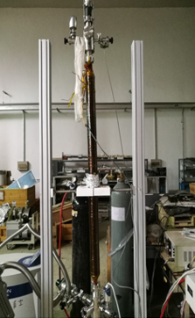
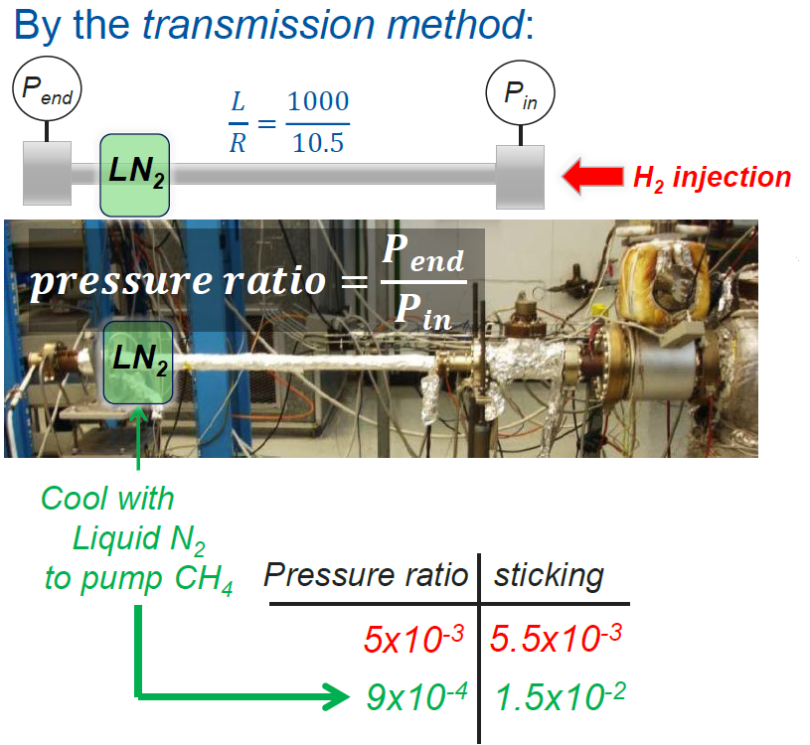
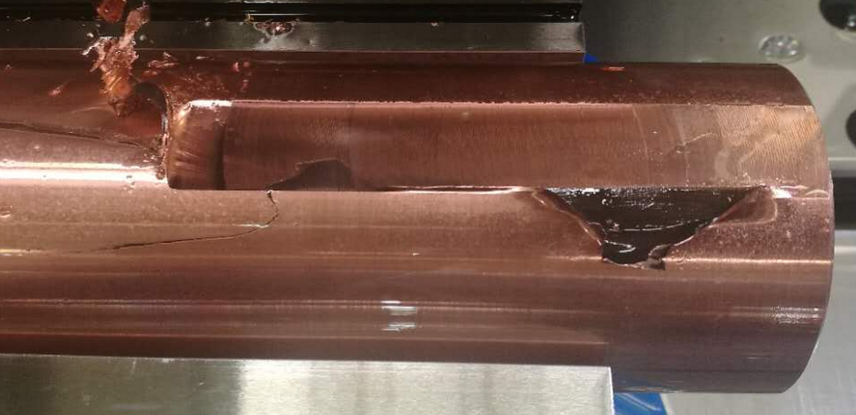
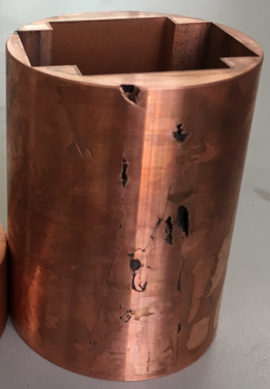
Vacuum technique
  NEG coating device
  Photon absorber

Slide 16
3. Project progress
HEPS milestones
  02/2017, CD0 completed & submitted to CAS
  03/2017, internal review of CD0
  06/2017, CD1 study started
  26/06/2017, national review of CD0
  12/2017, CD0 approved, project officially approved
  06/2018, national review of CD1
  10/2018, national review of CD2
  12/2018, project construction starts, will be completed in 6.5 years

Slide 17
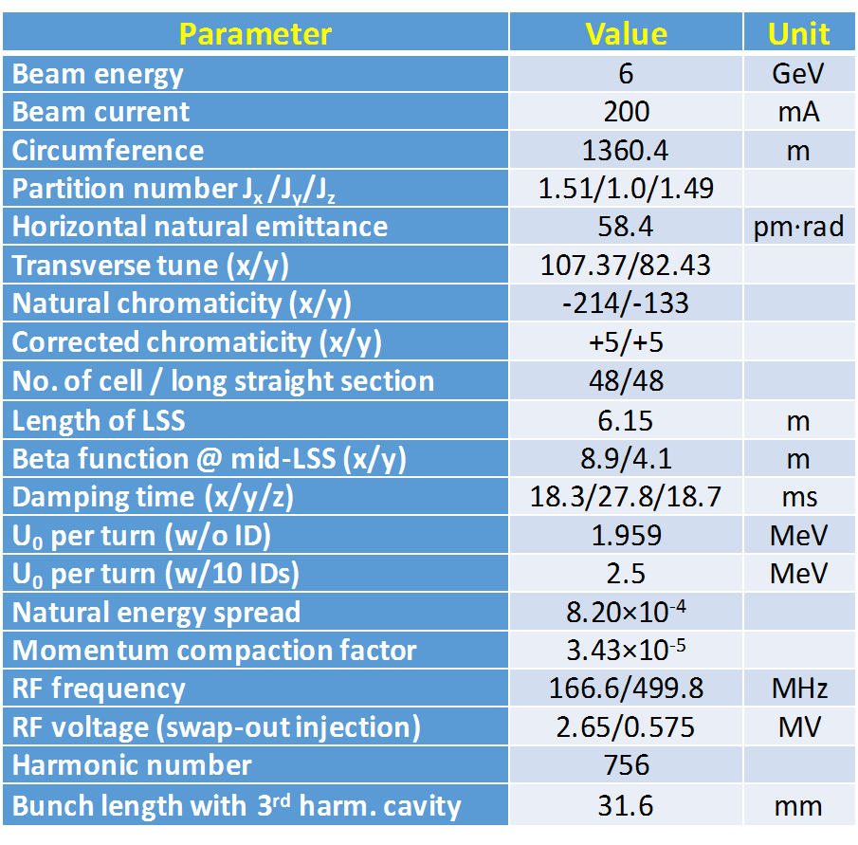
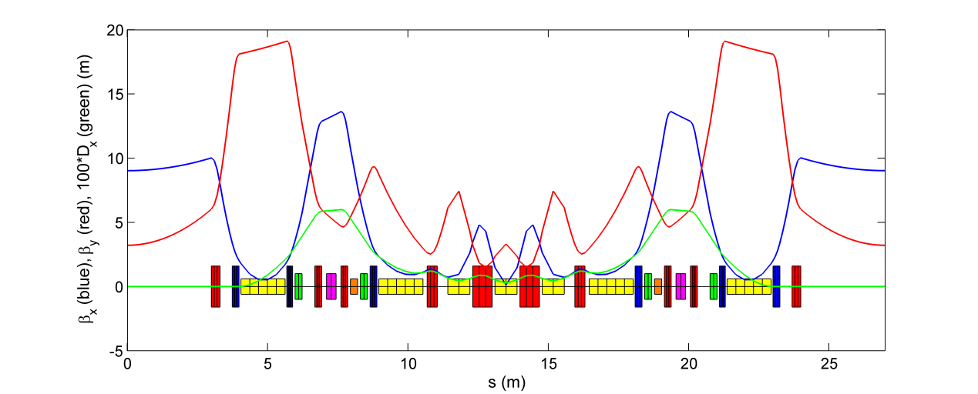
Accelerator Physics of Storage Ring
Linear lattice design
  Find an optimized quasi-DLSR design for the HEPS storage ring.
    compromise between Chinese technology level and innovations (e.g., way to get the lowest emittance)
    compromise between user requirements and accelerator performance
  The AP design of HEPS main
  ring was reviewed by the
  International Review Committee
  in May 2018.

Slide 18
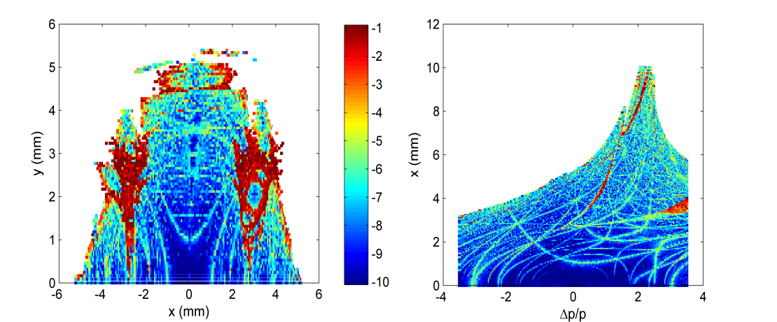
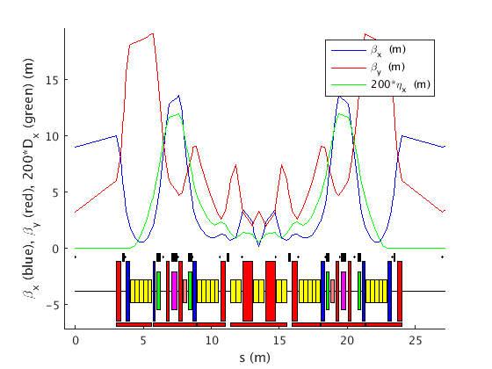
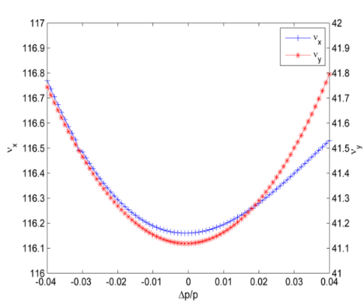
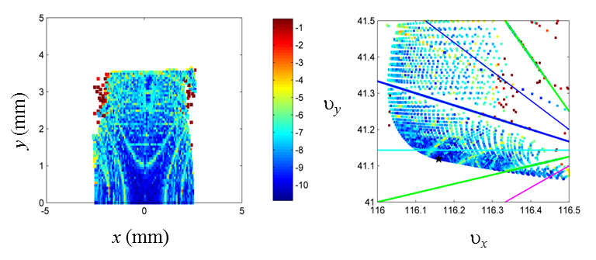
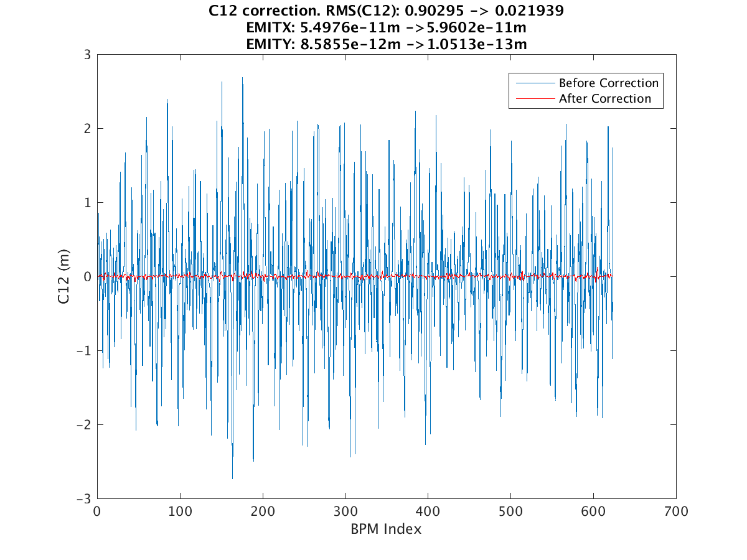
Dynamic aperture study
  Nonlinear optimization w/ 4 families of multipoles
    Effective on-momentum DA: ~2.5 mm in x and 3.5 mm in y;
    effective MA: ~3%.
Error tolerance study
  Alignment error is dominant
  Dispersion in vertical and coupling should be controlled by correcting with skew quads

Slide 19
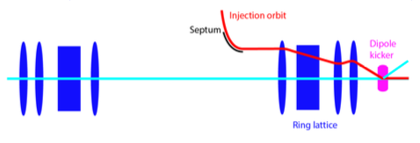
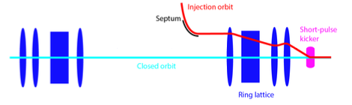
Injection Design – On-Axis Injection Schemes
On-axis transverse injection (swap-out)
  A full charge injector to replace stored bunches in storage ring,
  In particular, HEPS timing mode requires a bunch charge of ~15 nC, generation and acceleration of such high charge bunches is nontrivial.
On-axis longitudinal injection (accumulation)
  Generation of an RF acceptance region which gives large enough temporal separation between injected and stored bunch, so as to accommodate the kicker pulse.
injected bunch
swap-out
injected bunch
longitudinal injection

Slide 20




Collective Effects (e.g. single bunch instability)
Microwave instability
  Simulation studies show that the threshold intensity is around 0.8 mA (3.5 nC) with harmonic cavity. Above threshold, turbulent distributions are observed.
TMCI
  For Gaussian bunches, the instability is evaluated
  with eigenmode analysis.
  The threshold bunch intensity
  is ~0.1 mA with ξ = 0.
  Positive chromaticity is required.
bunch charge=15nC

Slide 21











Design of the HEPS Injector
Linac design
Beam dynamics simulation & optimization
Design/development of the key RF elements
R&D on the solid-state based power source
Design of the other linac systems
  Bunch pulse structure at the linac exit
  Beam spectra for the central bunch

Slide 22





Design of the HEPS Booster
Single bunch current limit
Orbit errors and correction
ϕ=π/2
Impact of ramping-induced
eddy current and its correction
Lattice and DA & MA studies
Impact of steady (up) and varying (down) errors on
tunes
Momentum acceptance at inj.
(left) and ext. (right) energies

Slide 23









Design of Key Booster Components
Deformation analysis and prototypes of vacuum elements
Magnet support
RF cavity used at booster
Physics design of all types of magnets is finished
Prototypes made, using air loading analysis and vacuum design
Magnet supports designed
HOM of the planned RF cavity analyzed
Designs of various magnets

Slide 24
Key Performance Benchmarks from HEPS-TF
 | Achieved in HEPS-TF | World-leading level
High gradient quad | B’ = 98 T/m@φ25 mm | B’ = 97.8 T/m@φ26 mm
Longitudinal gradient dipole | Electronic magnet & Permanent magnet | First electronic one in the world
Pumping speed w/ NEG coating | 0.62 L/s/cm² | 0.5 – 0.66 L/s/cm²
Moving resolution of auto-tuning magnet girder | 1 μm | 1 μm
Measurement precision of vibrating wire alignment | ±3 μm | ±5 μm
Peak field of CPMU | 0.98 T@5 mm gap | 1 T@5 mm gap
Long-term stability of high precision power supply | 7.75 ppm | 10 ppm
Resolution of digital BPM | 0.1 μm | 0.1 μm

Slide 25
HEPS Beamlines
1 | Engineering Materials Beamline | High energy, low emittance
2 | CDI and XPCS
3 | NRS and IXS
4 | Nano-probe
5 | Time-resolved techniques
6 | Hard X-ray imaging
7 | High-pressure
8 | Protein crystallography | Large user communities
9 | XAFS
10 | In situ surface diffraction and scattering
11 | High throughput SAXS
12 | Ultrahigh resolution Electronic-Structure Spectroscopy | Applications in industry, medicine, etc.
13 | Medium energy X-ray micro-spectroscopy
14 | Structure and spectrum imaging

Slide 26


HEPS Site
Huairou District, Beijing area, ~80 km northeast of IHEP
An area of 233 acres, including:
HEPS
SECUF (Synergized Extreme Condition User Facility)
Earth Simulation Facility
Series of research platforms for energy, environment, biology, materials, etc.
UCAS
HEPS
High-Tech Zone , Huairou, Beijing

Slide 27


Campus & Facility Outline

Slide 28
Main Challenges for HEPS Construction
Lack of manpower
  Yearly FTE requirements for HEPS (accelerator part)
  Note: manpower from Dongguan included

Slide 29
Solutions?
Some manpower from ADS & PAPS projects in the near future
Optimize the manpower among different projects
Recruit new staff
Collaborate with other labs (domestic and international)

Slide 30


Outcomes of HEPS Construction
A world-leading synchrotron radiation light source
Develop diffraction-limited storage ring-related accelerator physics and technologies
Initiation of Platform of Advanced Photon Source Technology (PAPS)
  Provide key technical support for the construction of HEPS
  Platform for core technology development, verification and equipment testing for future accelerator
  Output of new technologies for accelerator and X-ray applications

Slide 31
Conclusion
A high energy photon source is requested by users, aiming at lower emittance and higher brightness than existing synchrotron light sources.
R&D for the HEPS project is being carried out, and will be finished by the end of Oct 2018.
HEPS is scheduled to start construction by the end of 2018, and be completed in mid-2025.
The accelerator physics design and development of key technologies for HEPS is nearly ready now.

Slide 32
Thank you for your attention!

