Slide 1
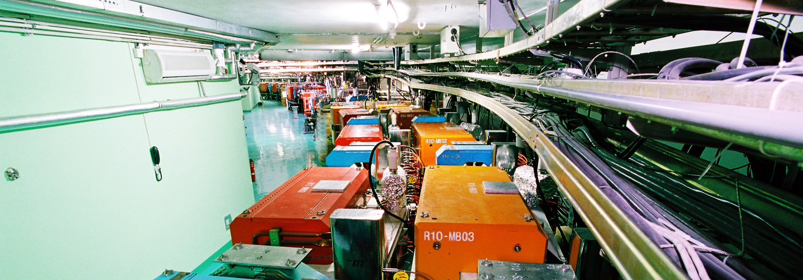
Accelerator Division
QIN Qing
Institute of High Energy Physics
June 14, 2018
International assessment 2018

Slide 2
Contents
1
Mission & Structure
2
Improvements since 2013
3
Main Activities & Achievements
4
Personnel & Budget
5
Vision & Future Plans

Slide 3
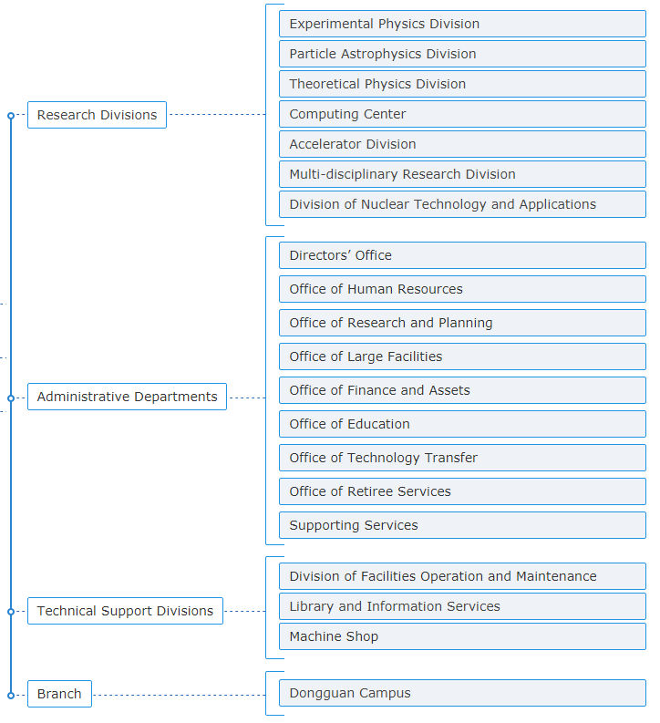
1. Mission and Structure
One of the key divisions in IHEP since 1973, when IHEP was founded.
Main force in large science facility construction since BEPC.
Develop accelerator physics and technology
Design, construct, and operate the accelerator-based large scientific facilities
Support the transfer of accelerator technology to civilian technology
Train students and young scientists/technicians for future projects

Slide 4
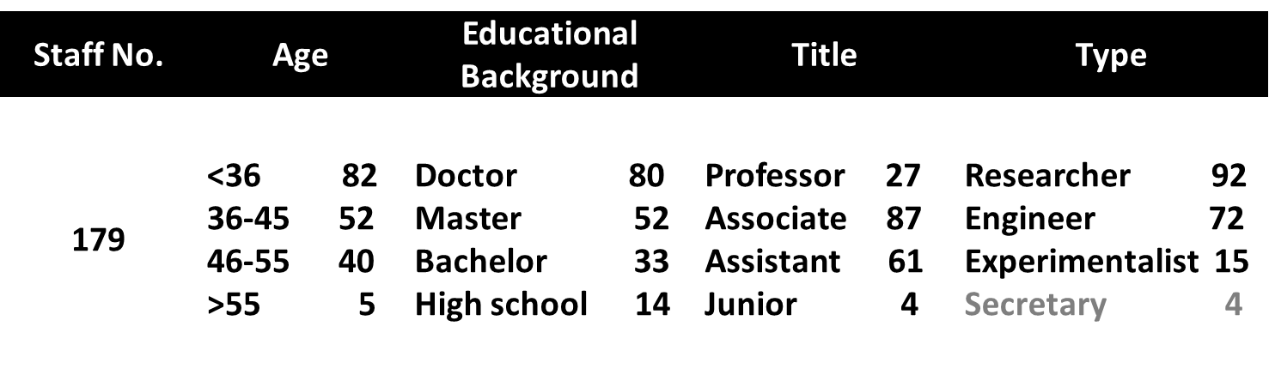
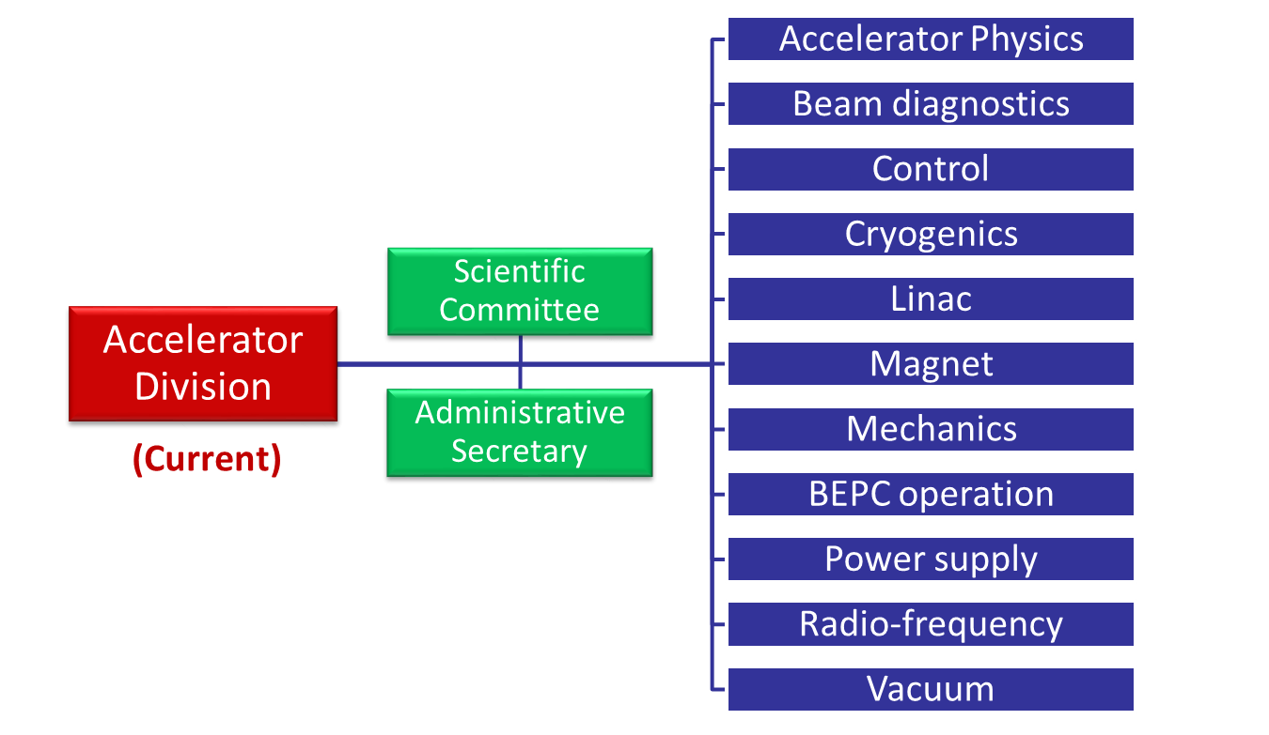
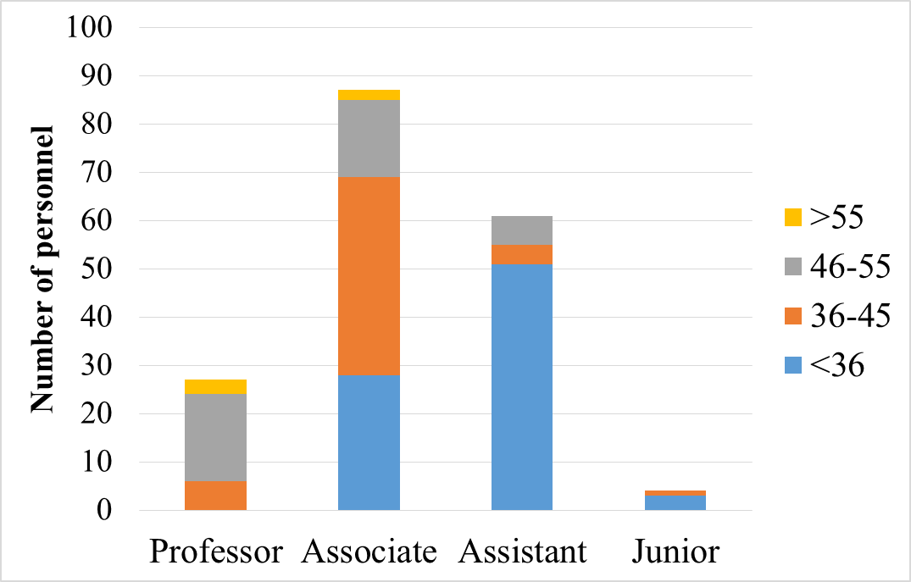
Division Head: Qing Qin
Deputy: Jianshe Cao
Yunlong Chi
Jinhui Chen
Science Committee:
Gang Xu
Graduate students: 75
Temporary staff: 12

Slide 5
Evaluation of International Position
Evaluation of Domestic Position
Reviewers’ suggestions:
  “No direct line of support for Accelerator R&D funding for non-operation and non-project related topics to the Accelerator Division. ……, it would be advisable to create a direct funding line from CAS, similar to general practices in other laboratories.”
    Key Lab of Accelerator Phys & Tech of CAS was founded in 2015.
Position | Please Tick if Applicable | Remarks
Leader infield (international first-tier)
Closely follows the international cutting edge, internationally influential
Making great progress, has distinctive characteristics | X
Ordinary
Position | Please Tick if Applicable | Remarks
Domestic highest level | X
Competitive with its own characteristics
Ordinary

Slide 6
  “Must provide the training of young staff and education of master and PhD students as well as perform general accelerator physics and technology research.”
    Assign experienced staff as senior mentors of young staff, encourage them to pursue high academic degrees.
  “In the face of the many new accelerator initiatives such as CSNS, ADS R&D, and HEPS, it is necessary to have a systematic approach to the recruitment, training, and mentoring of young accelerator physicists.”
    Done
  “Prioritize the number of research topics that the accelerator staff needs to address to reduce the work loading.”
    AP, SRF, SC magnet, BI, VA, etc.
  “To allow for some freedom to pursue new cutting edge accelerator science for young researchers with a separate source of R&D funding, independent from construction projects.”
    Done
  “Provide opportunities for the students to go abroad as part of their education to expand their knowledge and practical experience as well as to increase the depth and the creativity of their research.”
    Significant progress

Slide 7
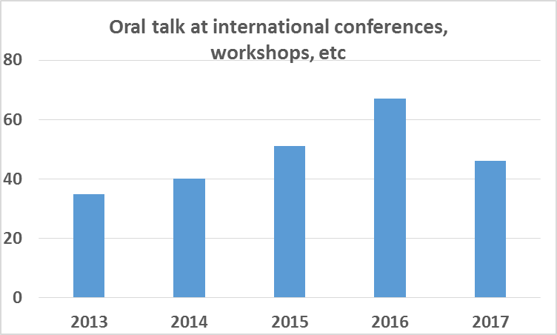
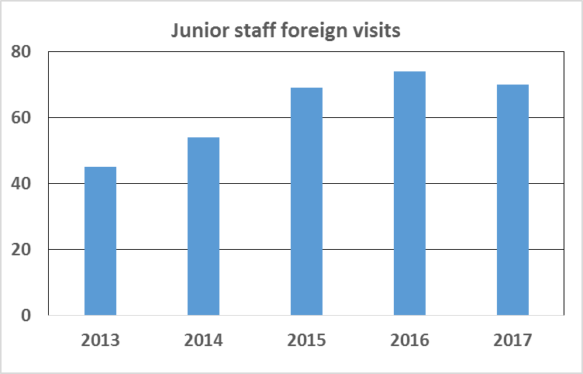
 | Invited | Contributed | Total
2010 | 1 | 1 | 2
2011 | 0 | 0 | 0
2012 | 1 | 0 | 1
2013 | 1 | 0 | 1
2014 | 2 | 2 | 4
2015 | 1 | 2 | 3
2016 | 1 | 4 | 5
2017 | 2 | 2 | 4
Invited + contributed oral talks at IPACs

Slide 8
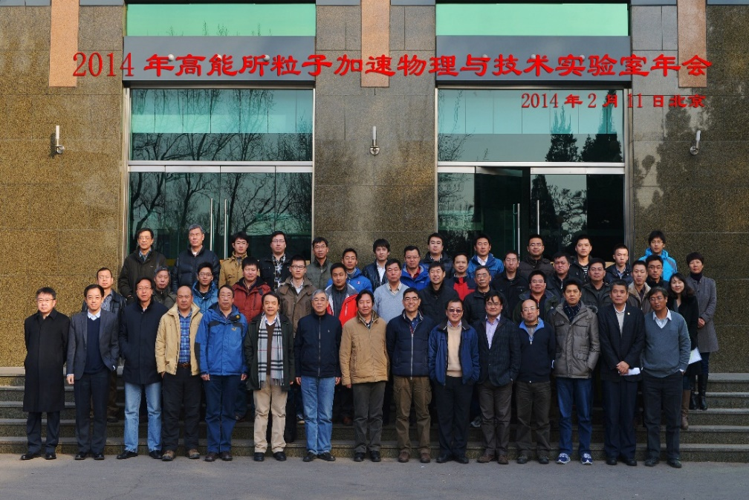
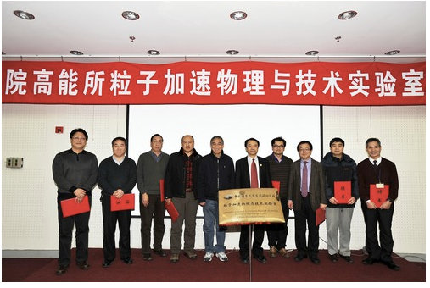
2. Improvements since 2013
Key Laboratory of Particle Acceleration Physics and Technology, CAS, founded in 2014, supports the development of acc. phys. & tech, with an annual budget of 1.2 – 1.5 M CNY.
Tech platform development & accelerator topics study.

Slide 9
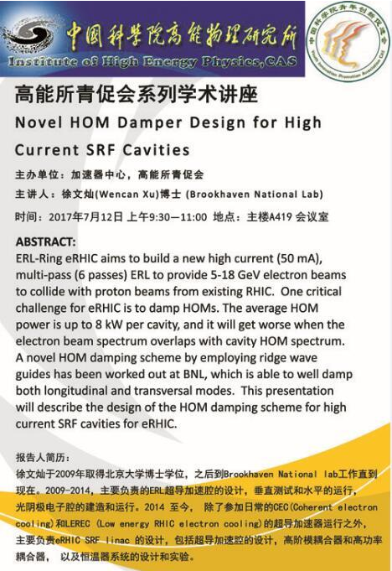
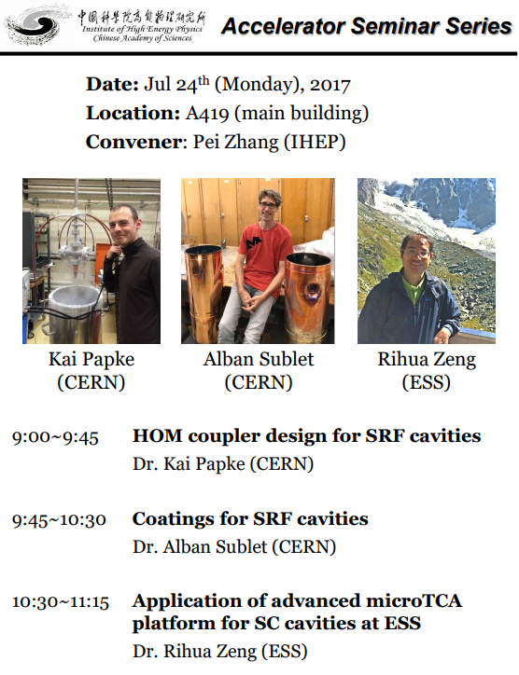
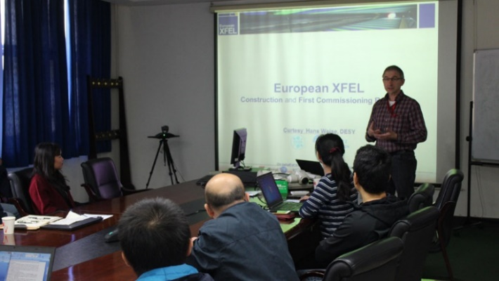
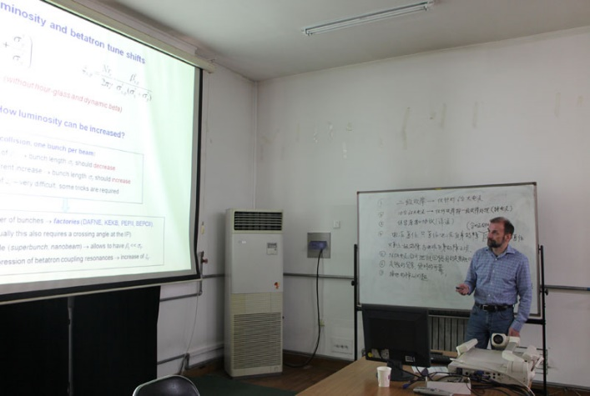
Accelerator Phys. & Tech seminars, salons, symposia, etc

Slide 10
Recruitment and re-organization
  Since last assessment in 2013, we successfully recruited 5 excellent researchers with national and CAS funding supports
  Paul Chu, control technology, from USA
  Ping He, vacuum technology, from USA
  Jingyi Li, AP/commissioning/linac, from USA & USTC
  Pei Zhang, RF technology, from Europe
  Haisheng Xu, AP, from Europe
  Microwave & power source groups merged into Linac Group
  ILC group assimilated into AP & RF groups
  Radiation protection group moved to EPC
  Proton, SC groups joined Dongguan Branch

Slide 11
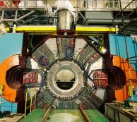
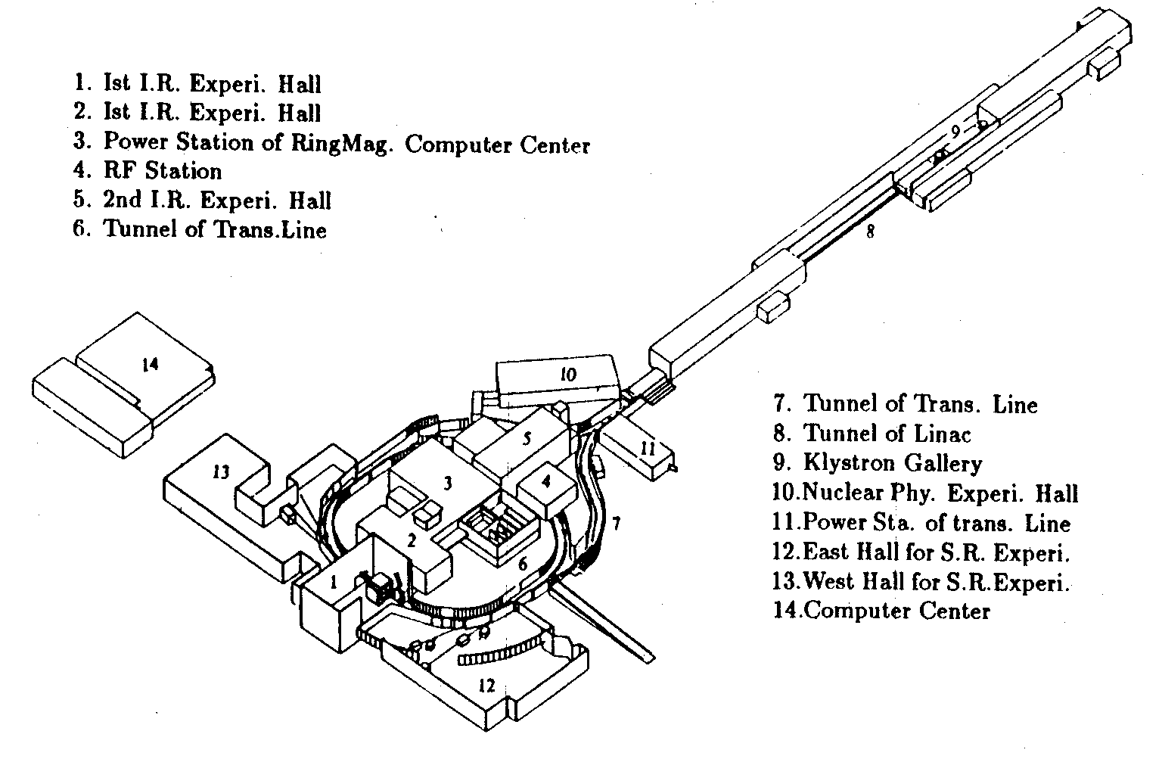
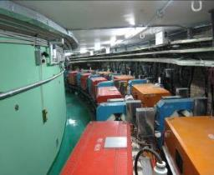
3. Main Activities and Achievements
BEPCII operation
  BEPCII (upgrade project of BEPC, operated from 2009)
    A double-ring factory-like collider
    Deliver beams to both HEP & SR
LINAC
Detector(BESIII)
储存环
Storage Rings

Slide 12
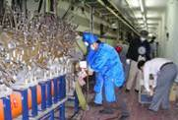
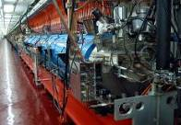
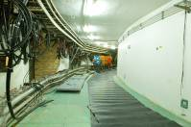
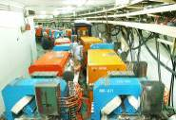
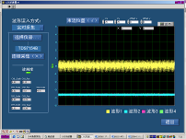
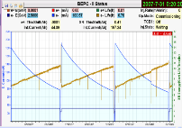
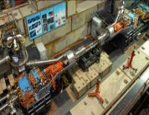
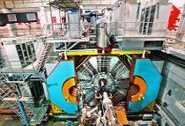
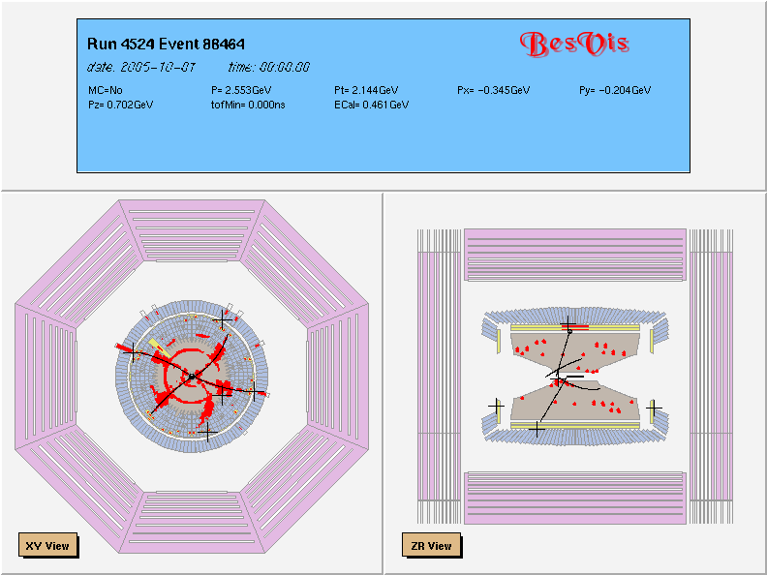
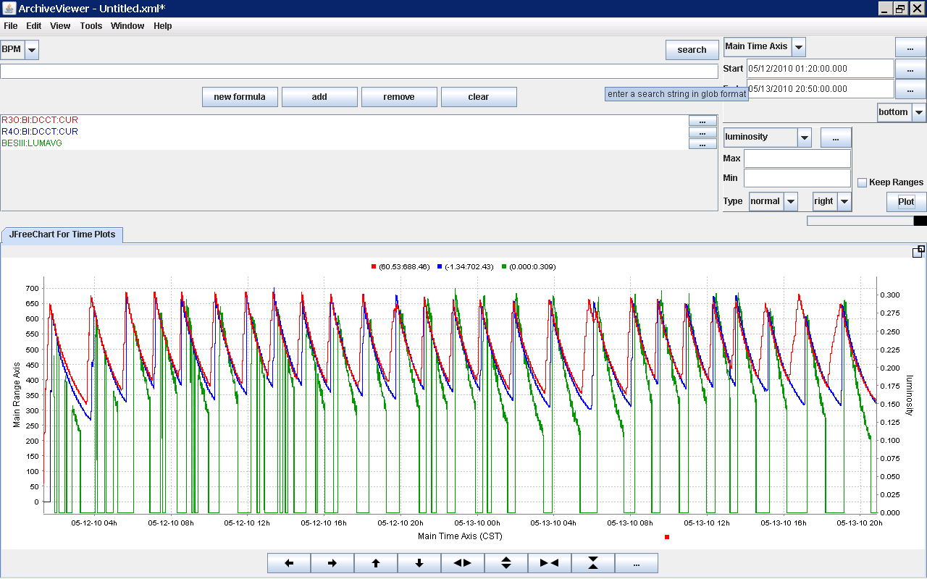
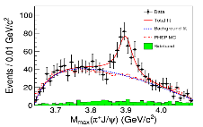
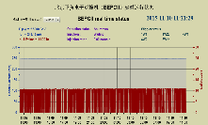
BEPCII Milestones
12
Jan. 2004 | Construction started
May. 4, 2004 | Dismount of 8 linac sections
Dec. 1, 2004 | Linac delivered e⁻ beams to BEPC
July 4, 2005 | BEPC ring dismount started
Mar. 2, 2006 | BEPCII ring installation started
Aug. 3, 2007 | Shutdown for IR-SCQ installation
Mar. 28, 2008 | Shutdown for BESIII installation
July 19, 2008 | First hadron event observed
May 19, 2009 | Luminosity reached 3.3×10³²cm⁻²s⁻¹
July 17, 2009 | Pass the National test & check
April 8, 2011 | Luminosity reached 6.5×10³²cm⁻²s⁻¹
April 2013 | Zc(3900) found & confirmed
Nov. 20, 2014 | Luminosity reached 8.53×10³²cm⁻²s⁻¹
April 5, 2016 | Luminosity reached 10.0×10³²cm⁻²s⁻¹
May 2004
Sep. 2004
Oct. 2005
Oct. 2006
Nov. 2006
July 2007
Oct. 2007
May 2008
July 2008
May 2009
May 2010
2013
Nov. 2015
2010–2016

Slide 13
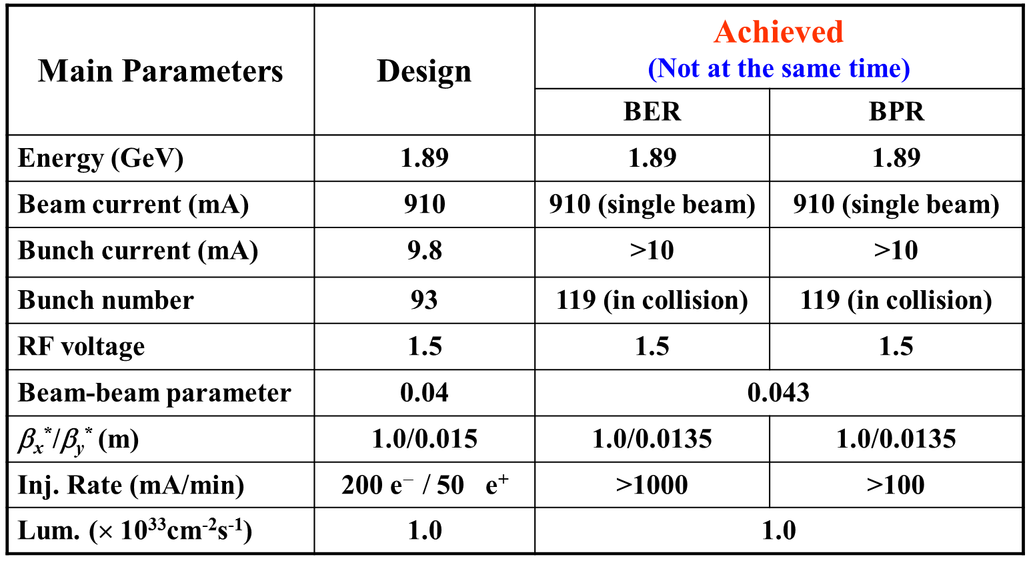
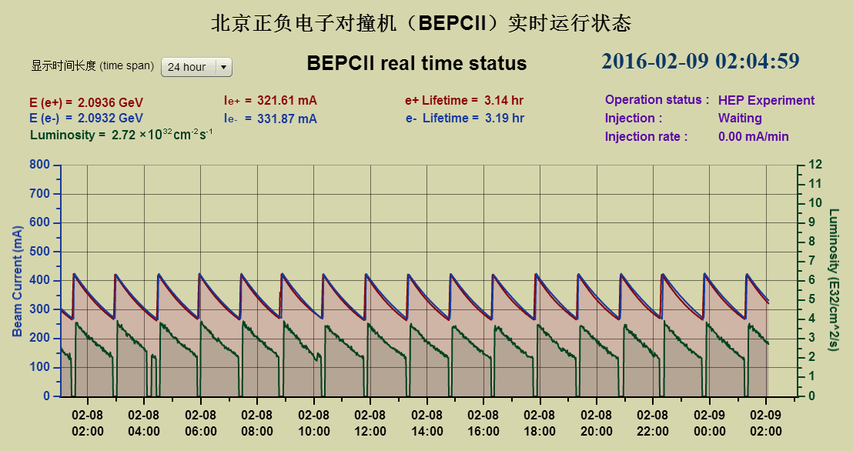
HEP operation
Beam energy | Peak luminosity (world record) | Max. beam-beam para.
1.89 GeV | 10.0 E32 /cm^2/s | 0.040
1.55 GeV | 4.53 E32 /cm^2/s | 0.032
1.84 GeV | 6.75 E32 /cm^2/s | 0.038
2.01 GeV | 6.50 E32 /cm^2/s | 0.032
2.13 GeV | 6.28 E32 /cm^2/s | 0.035, 0.04@450mA
2.18 GeV | 5.37 E32/cm^2/s | 0.037
2.21 GeV | 5.30 E32/cm^2/s | 0.037
2.30 GeV | 3.0 E32/cm^2/s | 0.023

Slide 14
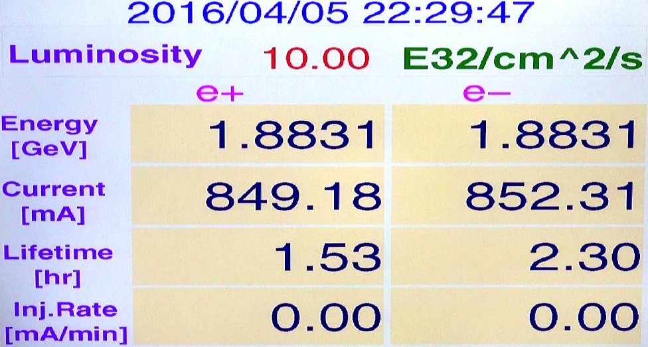
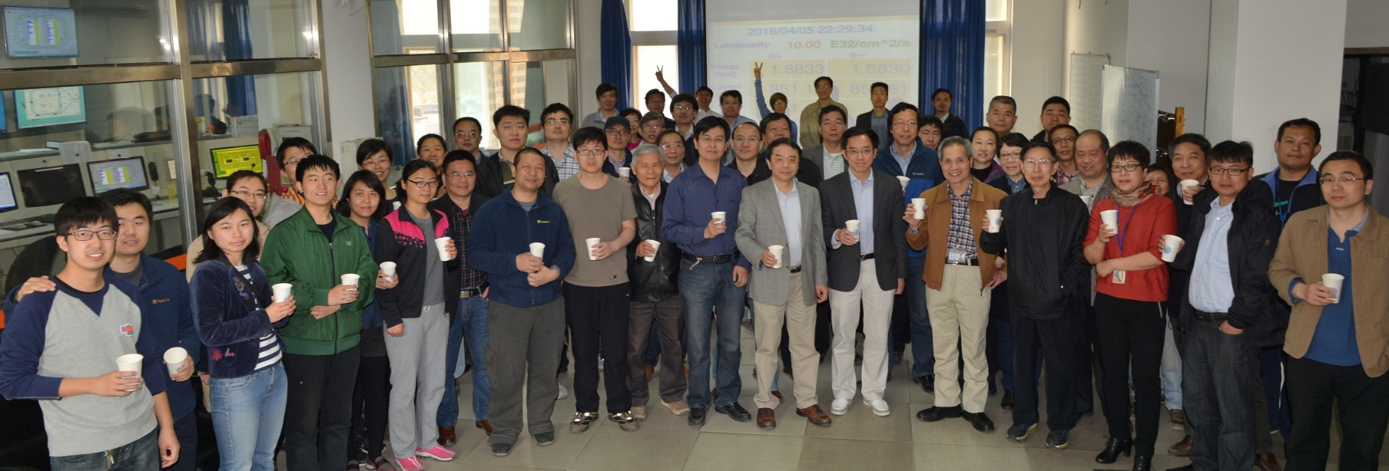
Reached design luminosity at design beam energy in 2016

Slide 15
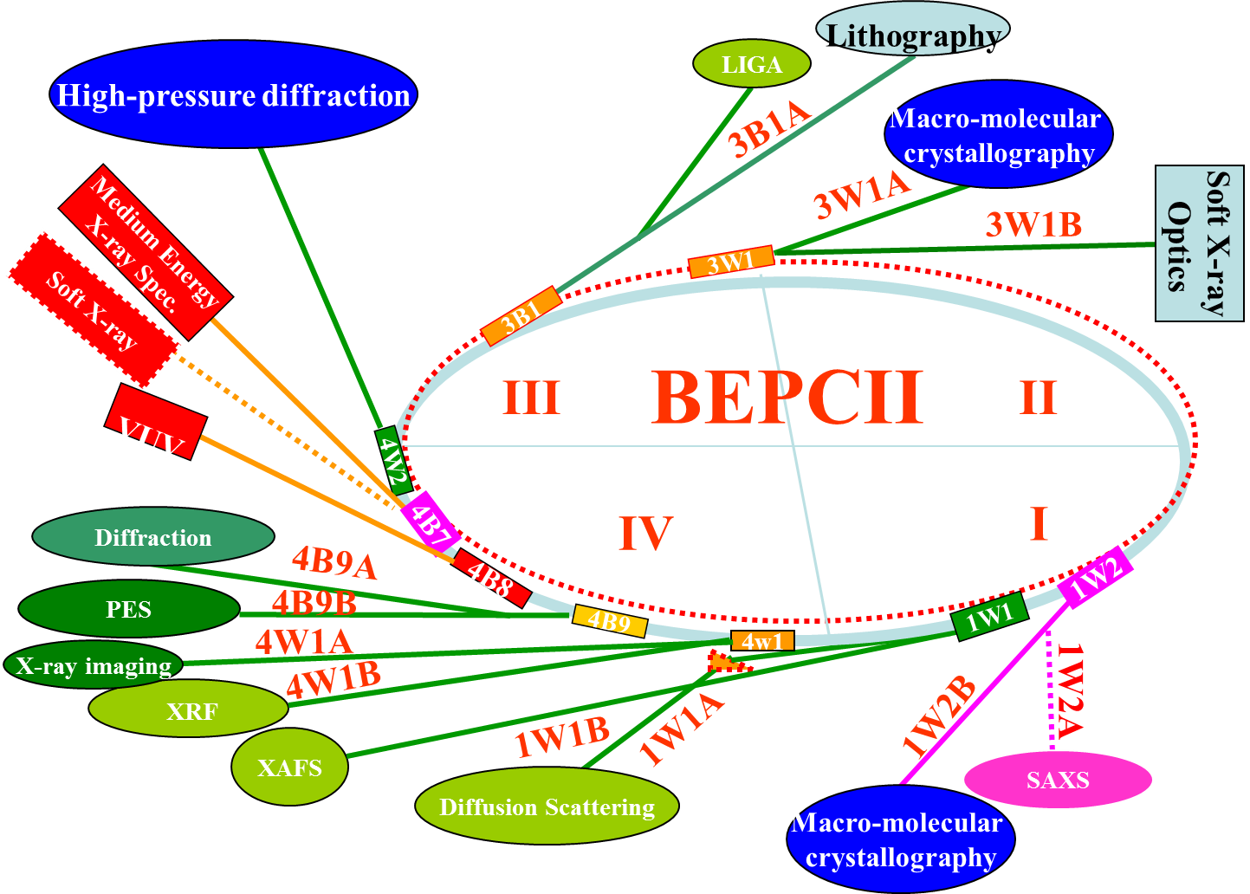
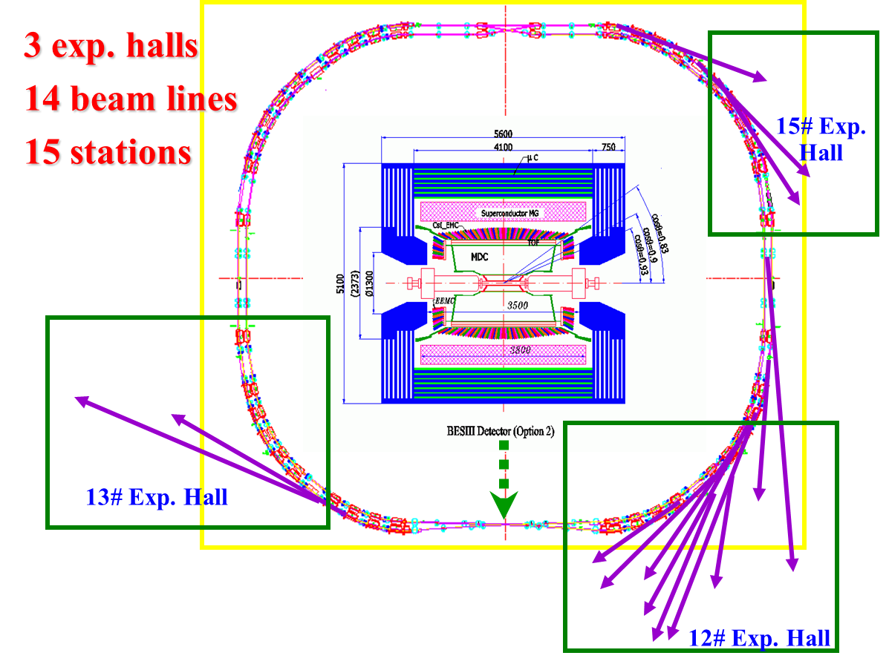
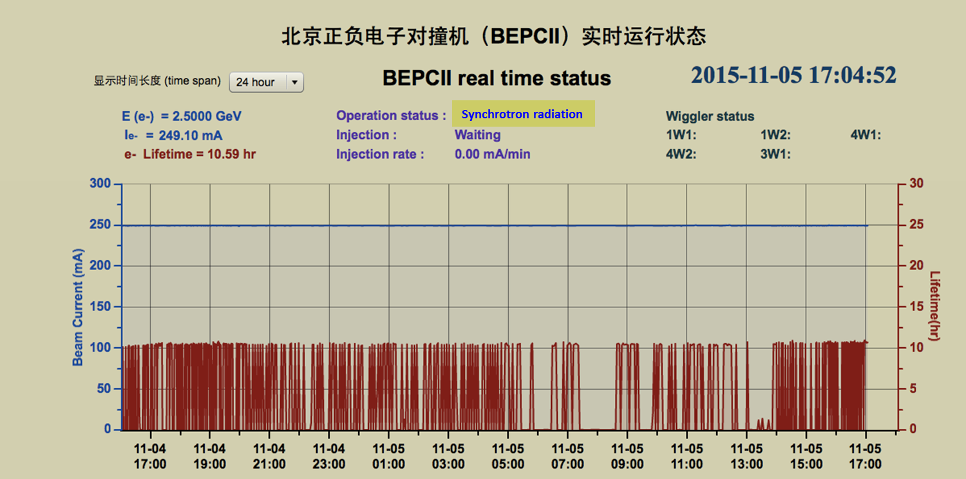
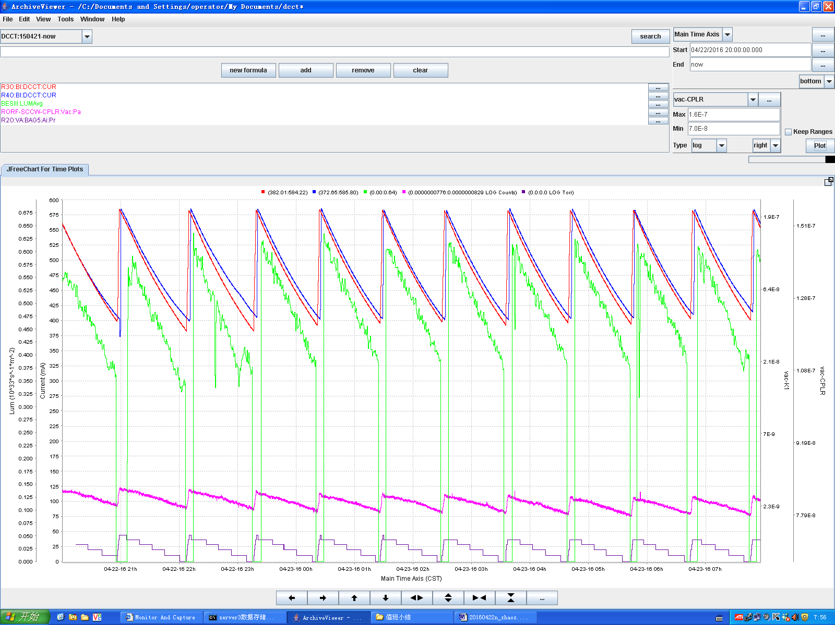
SR operation
Parasitic mode operation w/ 2 wigglers on
& 10 beamlines to users

Slide 16
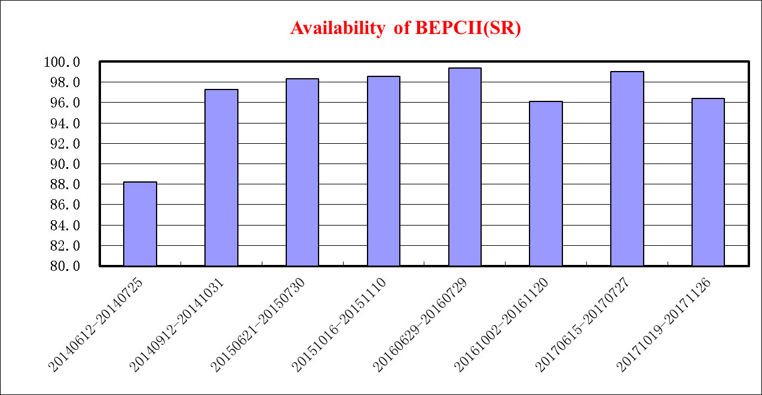
BEPCII operating statistics in last 5 years
 | Experiment | Machine Dev. | Experiment+Machine Dev. | Injection | Tuning | Fault | Open to public
2013 | 60.42% | 10.90% | 71.32% | 8.29% | 4.10% | 15.34% | 0.95%
2014 | 56.75% | 26.26% | 83.01% | 3.97% | 4.76% | 7.98% | 0.27%
2015 | 60.91% | 6.04% | 66.95% | 8.29% | 4.67% | 19.96% | 0.15%
2016 | 66.28% | 6.94% | 73.22% | 3.55% | 15.59% | 7.41% | 0.23%
2017 | 74.70% | 1.79% | 76.49% | 6.04% | 12.02% | 5.30% | 0.15%
M. Sulliven

Slide 17
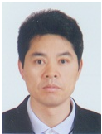
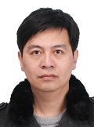
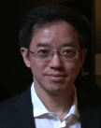
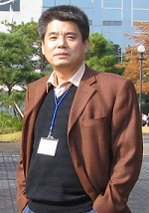
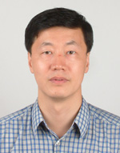
Progress on ADS, HEPS-TF & HEPS will be presented in other talks
Leading scientists of accelerator-based projects:
  BEPCII – Jianshe Cao,
  Chenghui Yu,
  Qing Qin
  ADS – Weimin Pan,
  Yunlong Chi,
  Jianshe Cao

Slide 18
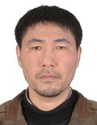
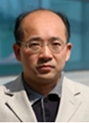
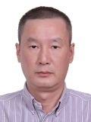
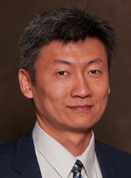
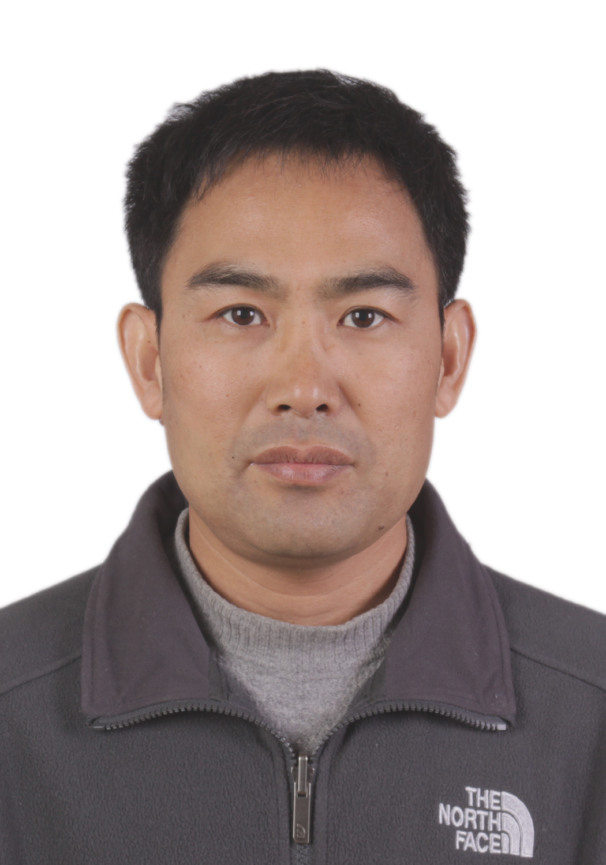
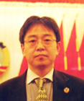
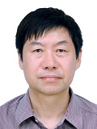
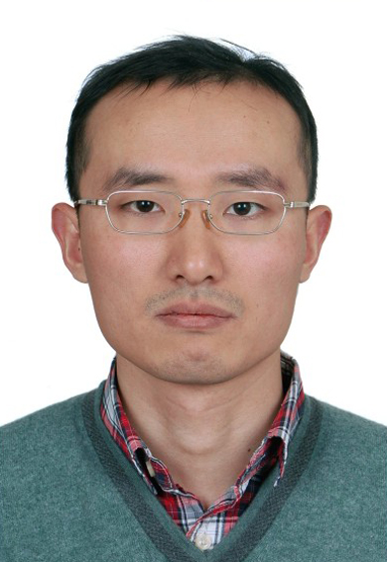
  HEPS-TF/HEPS – Qing Qin,
  Gang Xu,
  Jiuqing Wang,
  Ping He,
  Paul Chu,
  Jingyi Li
  CEPC/SppC – Jie Gao,
  Jingyu Tang,
  Chenghui Yu,
  Yuan Zhang,
  Qing Qin

Slide 19







Develop SRF tech
The first SRF cavity used at the operational
facility in China (500 MHz for e machine)
The first SRF spoke cavity w/ lowest beta (=0.12)
The first 166.6 MHz SRF
cavity in the world

Slide 20












Slide 21




Cryo-module
for EXFEL
Cryo-module for
BEPCII SRF cavity
Cryo-module for 9-cell SC cavity
POST
Vacuum port
He gas return pipe
4.5K forward
8K return
40K forward
80K return
High power coupler
80K shield
8K shield
2K two-phase helium

Slide 22






Microwave Element & Accelerating Tube
C/S-band SLED type
energy doubler

Slide 23






Supporting Platform for Technology Development
Magnet measurement lab, power supply test platform, cryogenics lab, klystron testbed

Slide 24




Superconducting RF test platform, coupler measurement, BI lab

Slide 25
Accelerator Physics Studies
Design study on ADS, HEPS, and CEPC/SppC
Codes developed in AP group:
  Beam-beam simulation – BEPCII & CEPC beam-beam study
  ECI simulation – used to estimate the ECI in BEPCII & CSNS
  ATOM – AP design and simulation, used in HEPS design
  P-TOPO – front-to-end tracking of particle in hadron linac
Nonlinearity optimization – MOPSO (MOGA +PSO)
  Adopted in HEPS design
Join the laser plasma acceleration collaboration in China

Slide 26


P-TOPO -- Parallel Trace Of
Particle Orbit
  Study on high current high power beam dynamics
  Accelerator simulation
  Developed by C++, and Parallelized using MPI/OpenMP
  Includes different Poisson Solvers
Transverse beam emittance and rms size in the RFQ
Transverse beam emittance and rms size in the SC section

Slide 27



HEPS accelerator physics studies
  Linear lattice design -- hybrid 7BAs with antibends and superbends, which leads the smallest emittance of 34 pm.rad with a circumference of 1360 m ring
  MOPSO (Multi-Objective Particle Swarm Optimization) adopted in lattice design and optimization of dynamic aperture
  Longitudinal on-axis injection with 3 RF systems proposed
    166.6 + 333.2
    + 499.8 (MHz)

Slide 28







Outcomes - Accelerator Technology Transfer
Waveguide components
Various kinds of magnets & power supplies
Acceleration tube & turn-key linac for KIPT
Others

Slide 29
















International Collaborations

Slide 30



International collaboration on ILC
ILC damping ring design
Attend KEK ATF-2 beam dynamics and machine study,
ILC 9-cell SRF cavity manufacture and test
SRF related parts, cryomodule, coupler, etc.
ILC damping ring design and fast kicker power supply
L band MarX Modulator and ILC 10MW klystron

Slide 31
4. Personnel & Budget
Human resources
  Staff: 183 (including 4 secretaries, as of April 2018)
  Graduate students: 75
  Temporary staff: 12
Researchers: 50%
Engineers: 40%
Admin. &
Supporting Staff: 10%
2013-18
new staff
↑ >20%
BEPCII: 51
ADS: 13
HEPS-TF: 54
CEPC: 17
PAPS: 15
Other task: 29
Will keep increasing in the near future
Total: 179

Slide 32
Support team
Experienced technicians
80% of technicians have a university/college diploma
Responsible for recruiting and training new technicians with higher degrees
Title/Age | <36 | 36-45 | 46-55 | >55 | Total | Percentage
Senior technician | 0 | 3 | 3 | 2 | 8 | 53.3%
Technician | 0 | 0 | 6 | 0 | 6 | 40.0%
Assistant technician | 0 | 1 | 0 | 0 | 1 | 6.7%
Total | 0 | 4 | 9 | 2 | 15 | 100%

Slide 33
Funding for 2013 – 2017 (Unit: MCNY)
Funding Source | 2013 | 2014 | 2015 | 2016 | 2017 | Total
CSNS | 140 |  |  |  |  | 140
Strategic Priority Research Program of CAS | 43.65 | 40.60 | 91.31 | 21.36 | 2.00 | 198.92
BEPCII Operation | 19.87 | 22.87 | 30.60 | 39.97 | 37.23 | 150.54
Misc. from IHEP | 9.70 | 10.65 | 3.33 | 6.06 | 7.41 | 37.15
Misc. from CAS | 5.66 | 7.63 | 2.80 | 3.05 | 16.71 | 35.85
NSFC Grants | 1.91 | 5.72 | 4.62 | 8.40 | 4.01 | 24.66
MOST Grants |  | 2.20 | 2.97 | 15.61 | 11.09 | 31.87
HEPS-TF |  |  |  | 73.00 | 38.46 | 111.46
PAPS |  |  |  |  | 39.36 | 39.36
Local government |  |  |  | 4.997 | 0.50 | 5.50
Others | 0.35 | 0.047 | 1.40 |  | 0.55 | 2.35
Total | 221.14 | 89.72 | 137.03 | 172.45 | 157.32 | 777.66

Slide 34
Staff & Budget (MCNY)

Slide 35

Education and publication
  Graduate student courses (Accelerator physics, Accelerator technology, etc.) at UCAS
  Accelerator introduction course at the University of Electronic Science and Technology of China, Chengdu
  BEPC training course
  Number of graduate student remains 16-17 /yr, similar to the period 2008 – 2012
Publications in past 5
years

Slide 36
International Academic Service
IAC members
  BINP SuperT-C MAC – Qing Qin
  CERN Machine Advisory Committee – Qing Qin
  KEK SuperKEKB MAC – Qing Qin
  SLAC Accelerator Review Committee -- Jie Gao
International Organizations
  ACFA – Jie Gao, Jingyu Tang
  ICFA BD Panel -- Jiuqing Wang, Jie Gao
  ILC SC – Jie Gao (Chair of Asia LC SC)
  IUPAP member/WG14 – Qing Qin
  LC Board – Jie Gao
  TTC Committee – Jiyuan Zhai, Jie Gao
Editorial boards of journals
  PRAB – Qing Qin (2013-2016)
  CPC – Jianping Dai, Chenghui Yu, Weimin Pan, Qing Qin

Slide 37
5. Vision & Future Plans
Aim to be a world-leading accelerator team, with the opportunity for new accelerator-based projects to be constructed by IHEP, and the CAS Key Lab platform, although there is still a long way to go.
With the development of AP and key accelerator tech., we are confident of the future light source (HEPS) and collider (CEPC) projects as our mid- and long-term plan.
Try to attract more excellent researchers from around the world to join the Accelerator Division, influencing our young scientists and technicians.

Slide 38
Summary
In the past 5 years, the Accelerator Division has made progress, not only on project-oriented tasks (BEPCII, ADS, HEPS-TF, etc), but on accelerator physics studies and key technologies, with the continuous support from CAS and other funding.
Research funding has increased annually, while manpower has remained nearly the same in these 5 years.
5 top researchers from other countries joined the AD, strengthening the accelerator research team.
Education & output are similar to 2008-2012.

Slide 39
Thank you for your attention!

