Slide 1
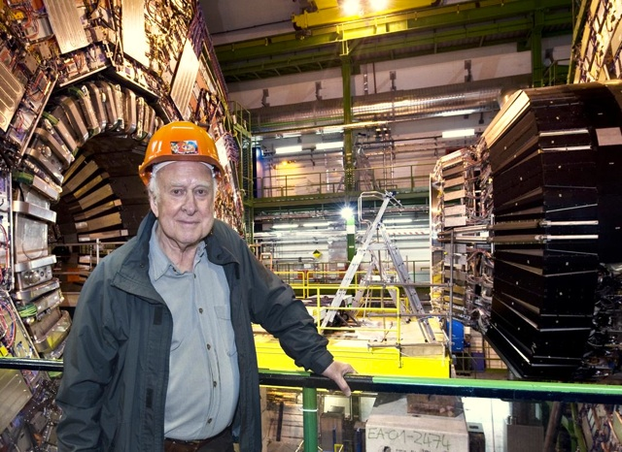
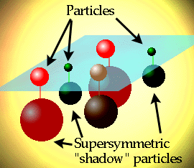
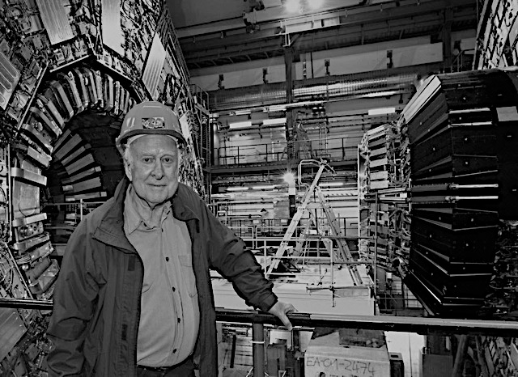



Supersymmetry (SUSY)
SUSY Search at LHC
and beyond
Xuai Zhuang (庄胥爱)
xuai.zhuang@cern.ch
IHEP B305, Beijing, China
22 Nov. 2017

Slide 2
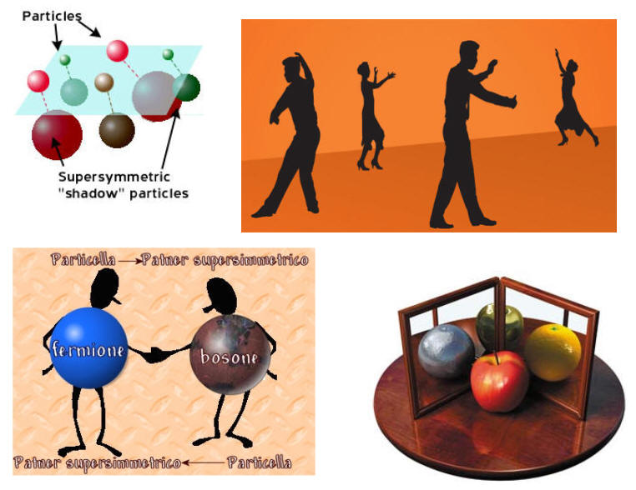
Outline
SUSY Introduction
The LHC and ATLAS
SUSY search strategy
SUSY search @ LHC
Longer term prospects @ LHC and Future Colliders (14, 33, 100 TeV)
Outlook and Summary

Slide 3
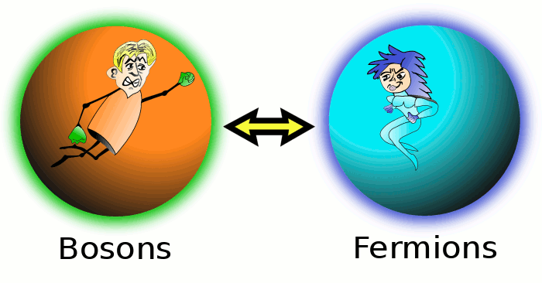
Outline
SUSY Introduction
The LHC and ATLAS
SUSY search strategy
SUSY search @ LHC
Longer term prospects @ LHC and Future Colliders (14, 33, 100 TeV)
Outlook and Summary

Slide 4
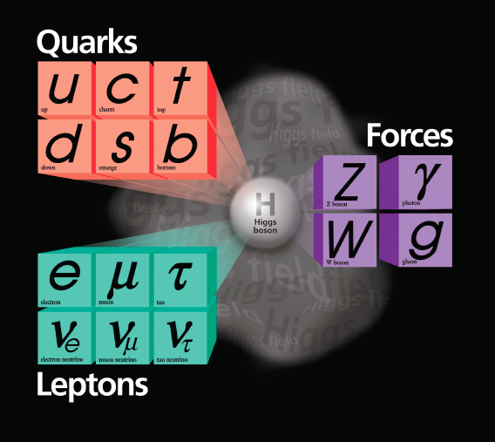
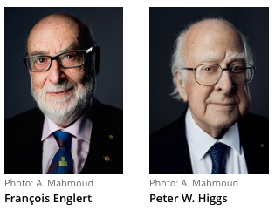

SM and Beyond
Higgs boson observed, SM fits the experimental data very well ➔ big success in EW scale
While has problem in Planck scale:
  Naturalness and “hierarchy” problem
  Unification of gauge coupling
  Dark Matter
  ……
Need a more fundamental theory in which SM is only a low-energy approximation ➔ New Physics

Slide 5
在超出标准模型的新物理模型中，
SUSY理论是唯一能够回答绝大多数Big Question的理论
  SUSY search is one of the most hot topic at LHC and beyond
5

Slide 6
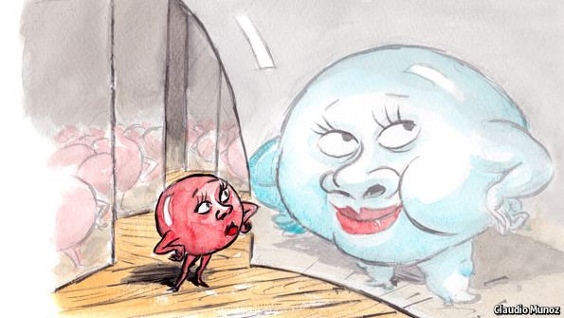
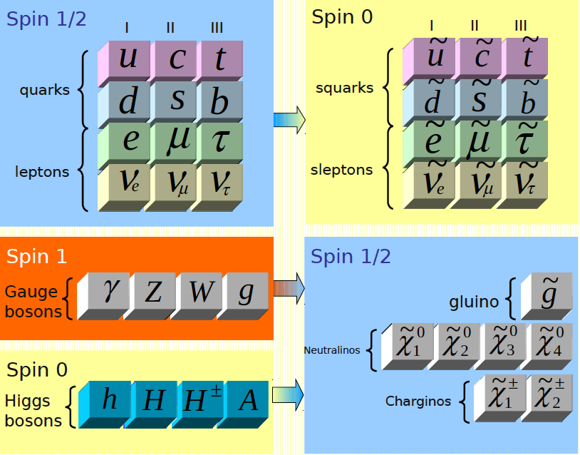
SUSY Introduction (1)
OUR WORLD…
NEW WORLD?
Q |boson> = |fermion>
Q |fermion> = |boson>
(Julius Wess and Bruno Zumino, 1974)
Establishes a symmetry between fermions (mater) and bosons (forces)
  Each particle has a super-partner
  Number of elementary particles doubled
  Spin differs by ½ between SUSY and SM particles
  Identical gauge numbers and couplings
A more fundamental theory: compatible with SM in EW scale, solve most problems in Planck scale

Slide 7
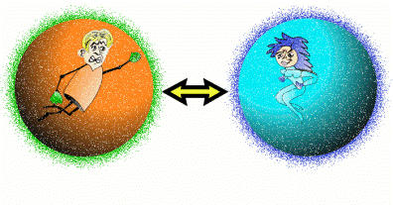
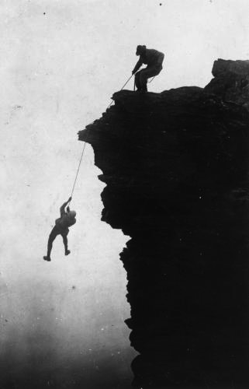
SUSY Introduction (2)
Solve hierarchy problem without “fine tuning”
  Fermion and boson loops contribute with different signs to the Higgs radiative corrections
  Supersymmetric partner contributions to Higgs mass cancel SM contributions
Mrs. SUSY
Fermion loop
Mr. Higgs
Boson loop

Slide 8
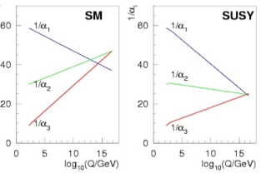
SUSY Introduction (3)
Unification of gauge couplings
  New particle content changes running of couplings
  Requires SUSY masses at few TeV

Slide 9
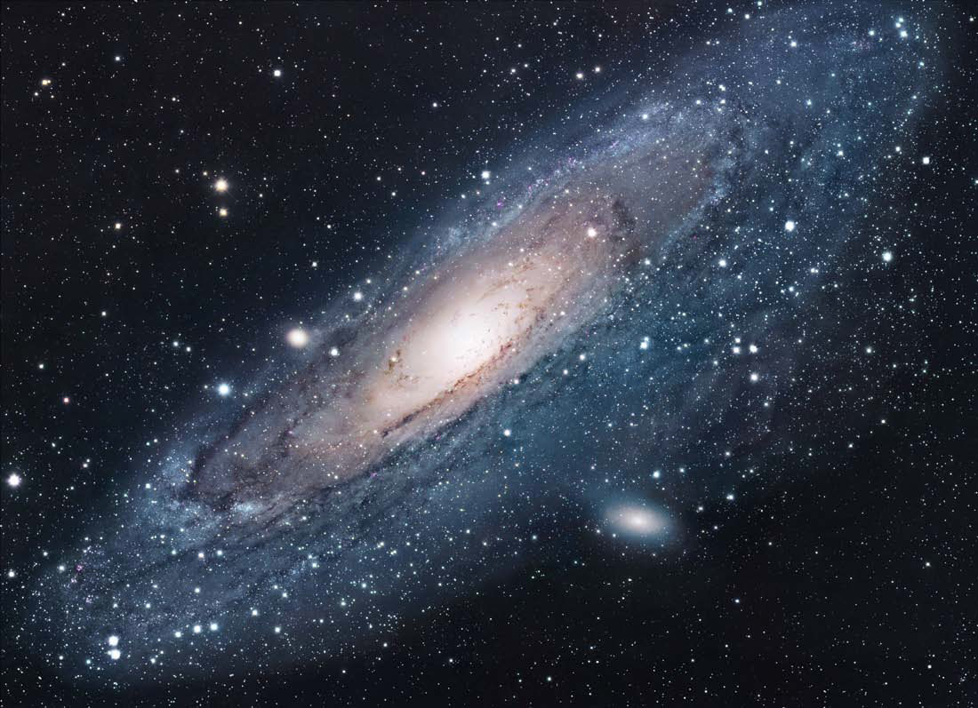
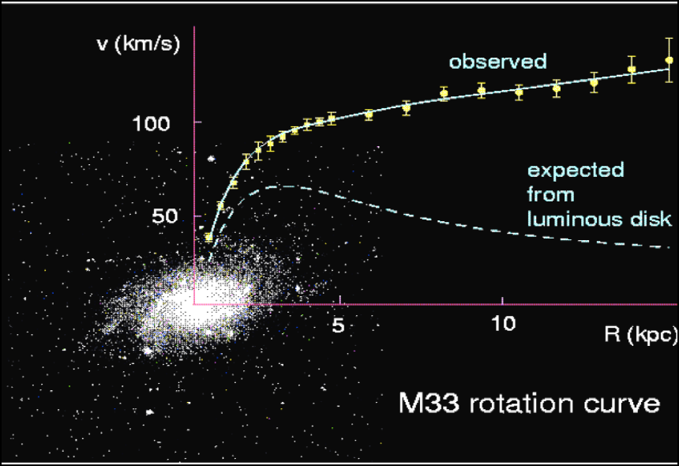
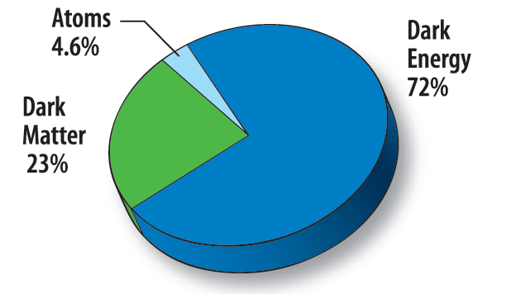
Astronomers found that most of the matter in the Universe must be invisible Dark Matter
‘Supersymmetric’ particles ?
SUSY can provide perfect dark mater candidate – WIMP (lightest neutralino in RPC models)
  Stable
  Electrically neutron
  Same density as DM
0.094 < Ω_{CDM}h² < 0.136 (95% CL)
9

Slide 10
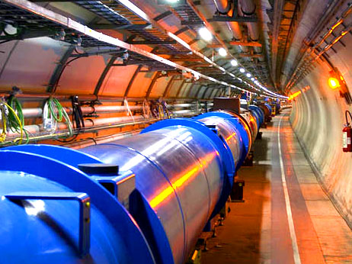
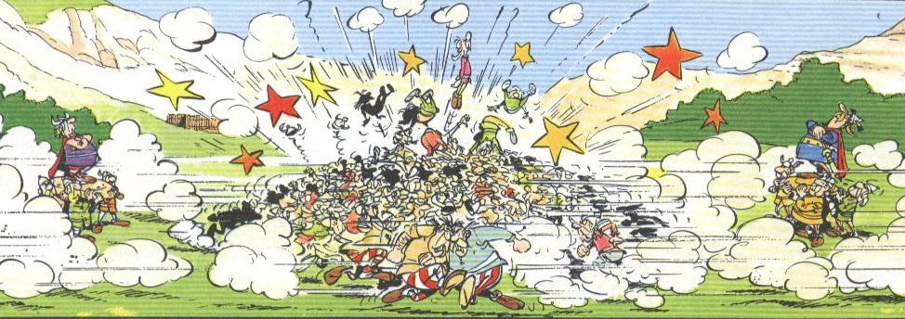
Outline
SUSY Introduction
The LHC and ATLAS
SUSY search strategy
SUSY search @ LHC
Longer term prospects @ LHC and Future Colliders (14, 33, 100 TeV)
Outlook and Summary

Slide 11

Large Hadron Collider——LHC
@CERN, Geneva
Large Hadron Collider
Lake of Geneva
CMS
LHCb
airport
ALICE
ATLAS
CERN
The Large Hadron Collider is a 27 km long collider ring housed in a tunnel about 100 m underground near Geneva
11

Slide 12
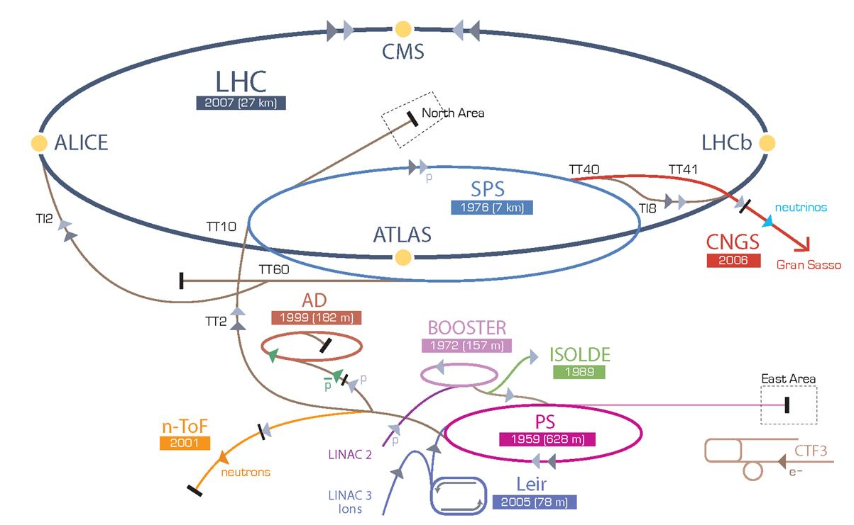
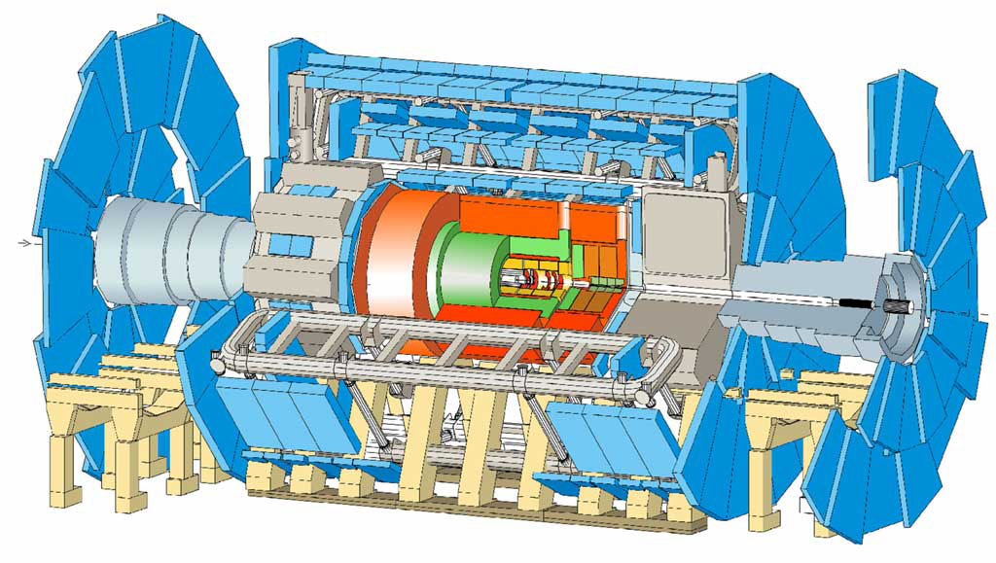
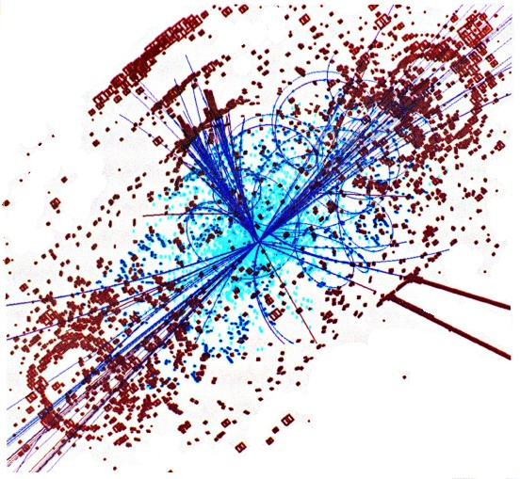
CERN’s particle accelerator chain
12
12

Slide 13
25 ns
Event rate:
N = L x σ (pp) ≈ 10⁹ interactions/s
Mostly soft (low p_{T}) events
Interesting hard (high-p_{T}) events are rare
Interesting events are very, very rare
One needs highly sophisticated instruments to find them

Slide 14
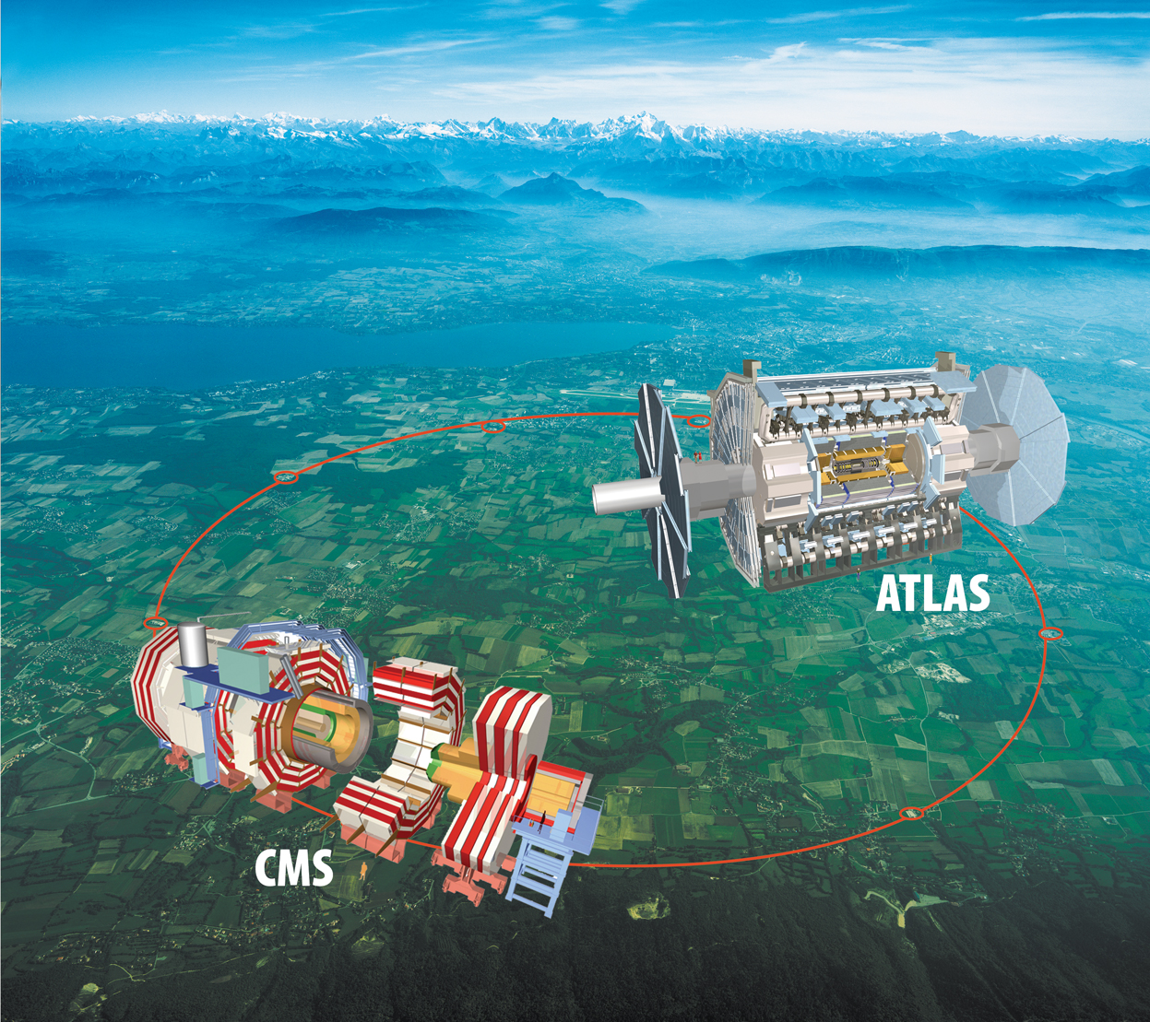
ATLAS and CMS detector @ LHC
ATLAS and CMS: two multi-purpose detectors @LHC
A Toroidal LHC ApparatuS
- 42m×22m, 7000 ton
- Solenoid + Toroidal magnet (2T)
- Fine granularity liquid Ar/Tile calorimeters
Compact Muon Spectrometer
- 21m×15m, 125000 ton
- All silicon trackers, 4T solenoid magnet
- PbWO4+Tile calorimeters

Slide 15
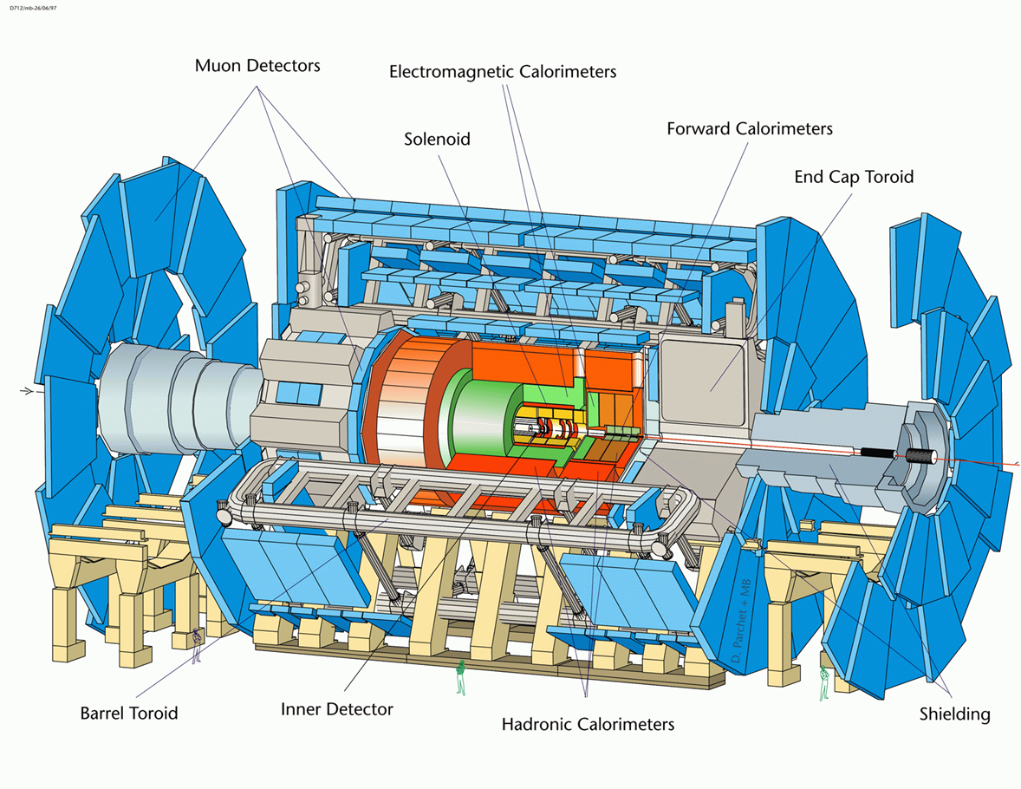
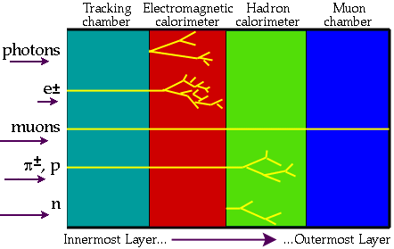
ATLAS
A Toroidal LHC ApparatuS
Length : ~ 46 m
Radius : ~ 12 m
Weight : ~ 7000 tons
~ 10⁸ electronic channels
~ 3000 km of cables
Tracking (|η|<2.5, B=2T) :
  Si pixels and strips
  Transition Radiation Detector (e/π separation)
Calorimetry (|η|<5) :
  EM : Pb-LAr
  HAD: Fe/scintillator (central), Cu/W-LAr (fwd)
Muon Spectrometer (|η|<2.7) :
  air-core toroids with muon chambers

Slide 16
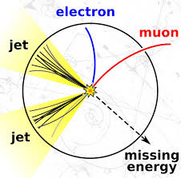

MET: Missing Transverse Energy
At the LHC an unknown proportion of the energy of the colliding protons escapes down the beam-pipe
Invisible particles (neutrinos, neutralinos?) are created their momentum can be constrained in the plane transverse to the beam direction
Missing Transverse Energy

Slide 17
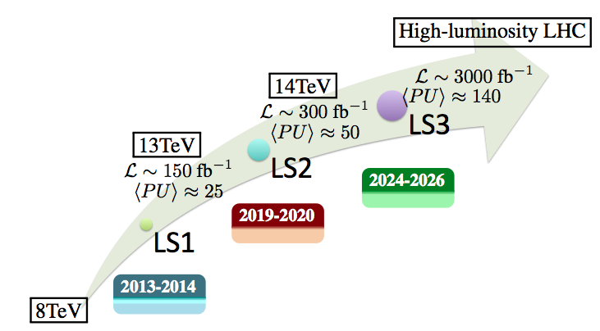
Run3
Run2
Run4-5 …
Run1
Long Stop

Slide 18
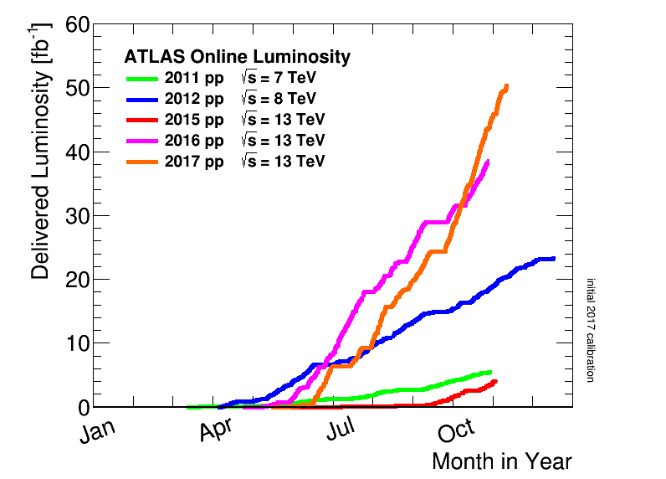
Since 2010, ATLAS&CMS have invested huge efforts in SUSY search @LHC : Great Luminosity recorded
We are here:
~80 fb⁻¹ 13 TeV data
~ 3% of total
Run2
Run1:
  ~ 35 pb⁻¹ 7 TeV data (2010)
  ~ 5 fb⁻¹ 7 TeV data (2011)
  ~ 20 fb⁻¹ 8 TeV data (2012)
Run2:
  ~ 3 fb⁻¹ 13 TeV data (2015)
  ~ 33 fb⁻¹ 13 TeV data (2016)
  ~ 50 fb⁻¹ 13 TeV data (2017)
The results are based on 36 fb⁻¹ @ 13 TeV (RUN2 2015-2016)
Run1
Long Stop

Slide 19

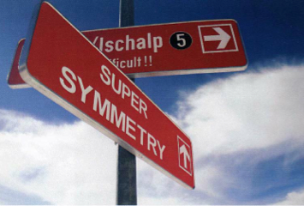
Outline
SUSY Introduction
The LHC and ATLAS
SUSY search strategy
SUSY search @ LHC
Longer term prospects @ LHC and Future Colliders (14, 33, 100 TeV)
Outlook and Summary

Slide 20
Where do we start?
Huge parameter space, but guiding principles
Strong SUSY production
Electroweak SUSY production
SUSY searches strategy driven by cross section and luminosity
Early analyses dominated by broad and inclusive searches for gluino and squark production
Increasing luminosity gave access to rare production channels. Additional motivation from Natural SUSY paradigm
If 1st and 2nd squark and gluino is too heavy, EWK SUSY production may dominant in LHC
Strong production
(1+2 gen. squarks, and gluinos)
Strong production
(3rd gen. squarks)
EW production

Slide 21
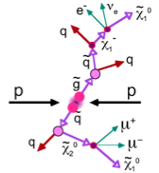

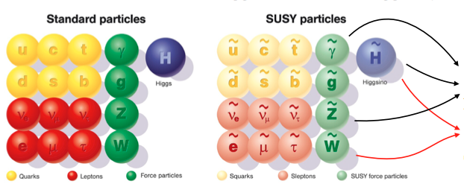
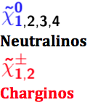
How do we start? - SUSY Signature
Conserved R parity (RPC): (originally introduced for stability of proton)
  SUSY particles produced/annihilated in pairs
  Lightest SUSY particle (LSP) stable (DM candidate)
  Typical signature: jets/leptons/photons + MET (key signature: large MET)
Violated R parity (RPV): no Dark Matter candidate
R=+1 (SM)
R=-1 (SUSY)

Slide 22
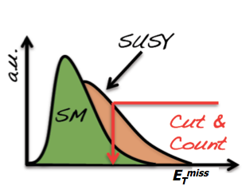
SUSY Signature & Search Strategy
SUSY search strategy: search for deviation from SM
  SUSY sensitive variables: Try to establish excess of events in some sensitive kinematic distribution (E_{T}^{miss}, Meff, mT …)
  SM background: SUSY searches rely on accurate modeling of the Standard Model backgrounds

Slide 23
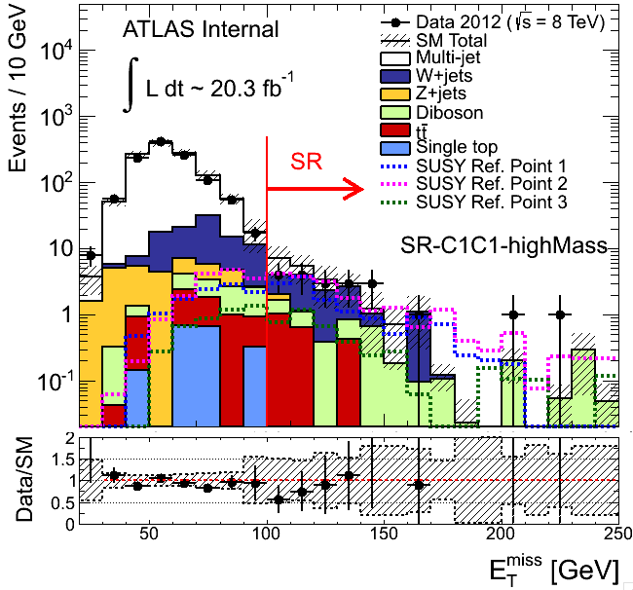
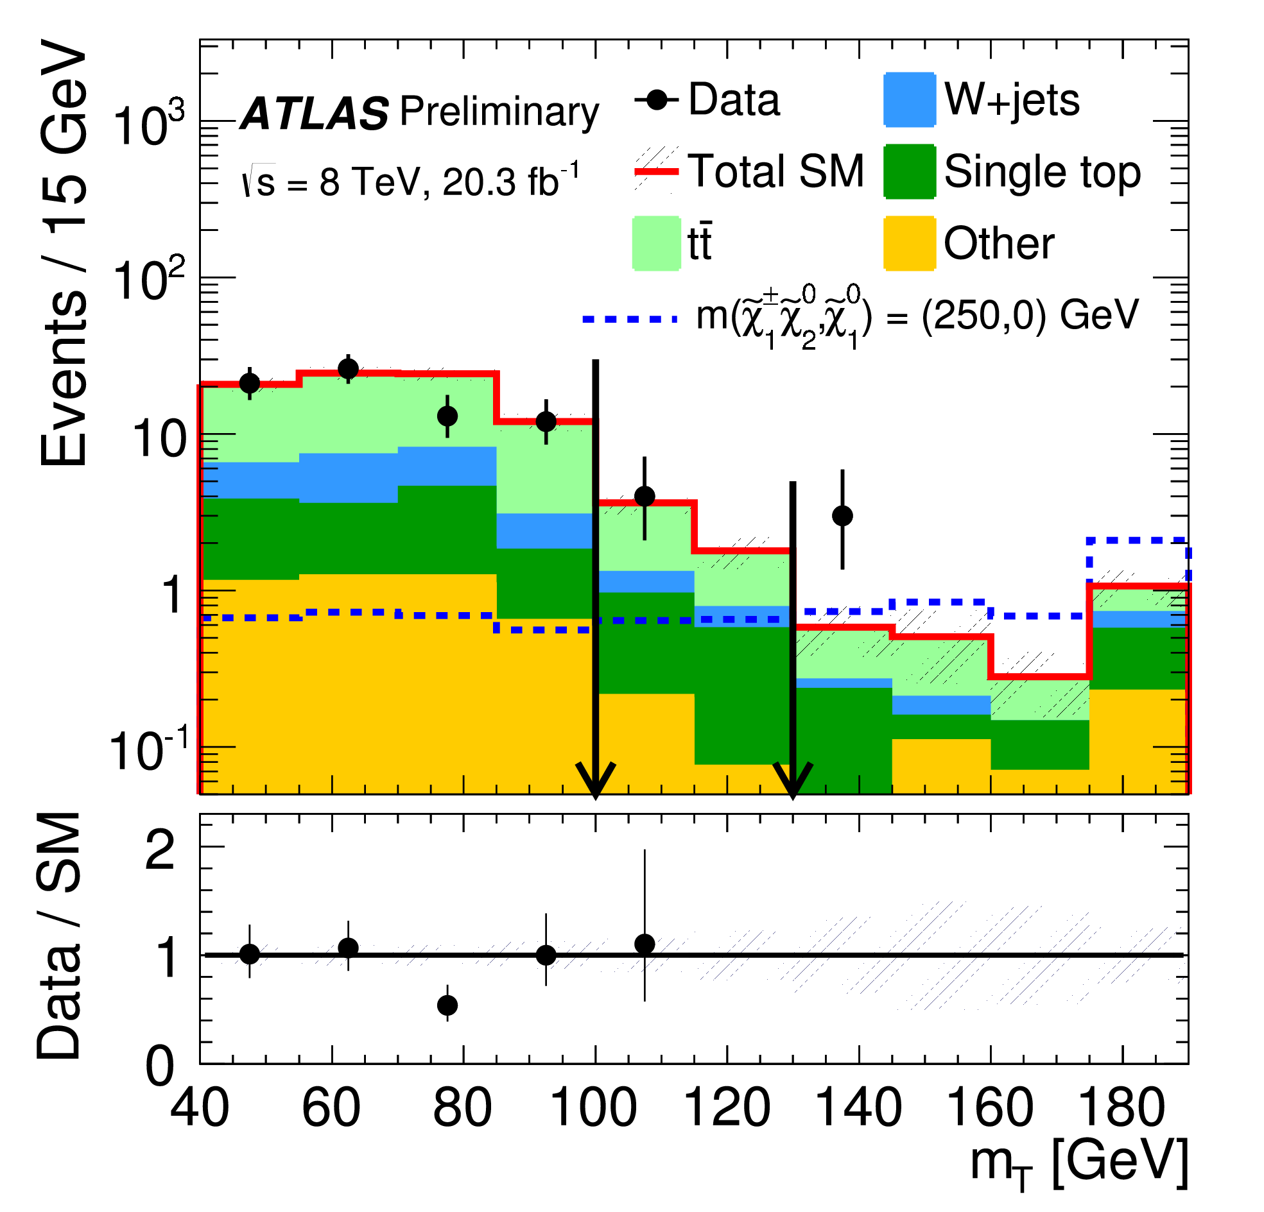
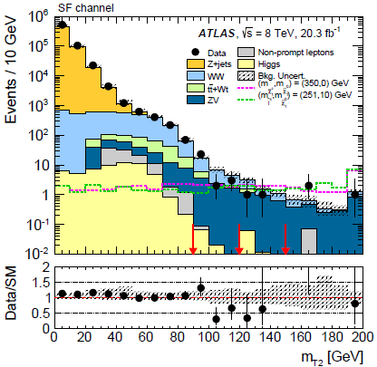

SUSY Sensitive Variables
E_{T}^{miss}
M_{eff}
E_{T}^{miss} from escaping LSP, to suppress bg from mis-measured jets and oth. SM BG
Related to the sparticle mass scale, like effective mass (M_{eff})
mT, mT2 (stransverse mass): suppress BG with Ws
Many others …
mT
mT2

Slide 24
SM Background Modeling
Standard Model
Top, multijets
V, VV, VVV, Higgs & combinations of these
Combined fit of all regions and bgs, and including systematic exp. and theory uncertainty as nuisance parameters
Reducible backgrounds
Determined from data
Backgrounds and methods depend on analyses
Irreducible backgrounds
Dominant sources:
  Mulit-jet: data-driven
  Non-Multi-jet: normalise MC in data control regions
Subdominant sources: MC
Validation
Validation regions used to cross check SM predictions with data
blinded
Signal regions
blinded
24

Slide 25
SM Background Modeling
Standard Model
Top, multijets
V, VV, VVV, Higgs & combinations of these
Multijet background: “ABCD method” or jet smearing method
Fake leptons or heavy-flavour jets determined with “matrix method” in different-purity samples using “real” and “fake” probabilities measured in data.
Charge flip rate measured in Z events
Combined fit of all regions and bgs, and including systematic exp. and theory uncertainty as nuisance parameters
Reducible backgrounds
Determined from data
Backgrounds and methods depend on analyses
Irreducible backgrounds
Dominant sources:
  Mulit-jet: data-driven
  Non-Multi-jet: normalise MC in data control regions
Subdominant sources: MC
Validation
Validation regions used to cross check SM predictions with data
blinded
Signal regions
blinded
25

Slide 26
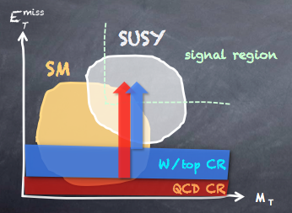
SM Background Modeling
Standard Model
Top, multijets
V, VV, VVV, Higgs & combinations of these
Normalise MC prediction in SRs using dedicated CRs ωιτη transfer factor: T
Combined fit of all regions and bgs, and including systematic exp. and theory uncertainty as nuisance parameters
Reducible backgrounds
Determined from data
Backgrounds and methods depend on analyses
Irreducible backgrounds
Dominant sources:
  Mulit-jet: data-driven
  Non-Multi-jet: normalise MC in data control regions
Subdominant sources: MC
Validation
Validation regions used to cross check SM predictions with data
blinded
Signal regions
blinded
26

Slide 27
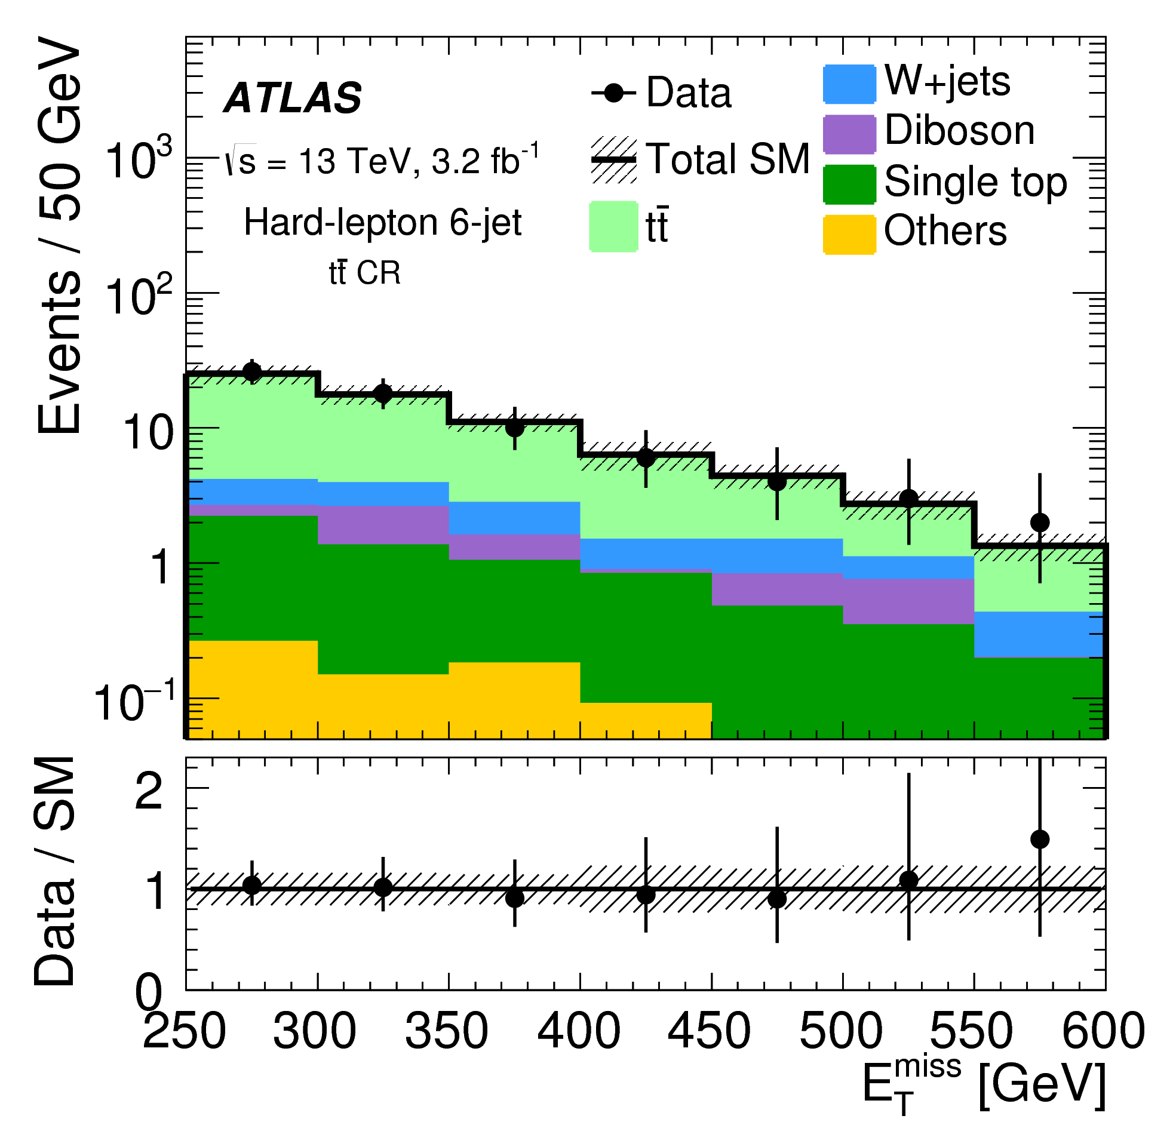
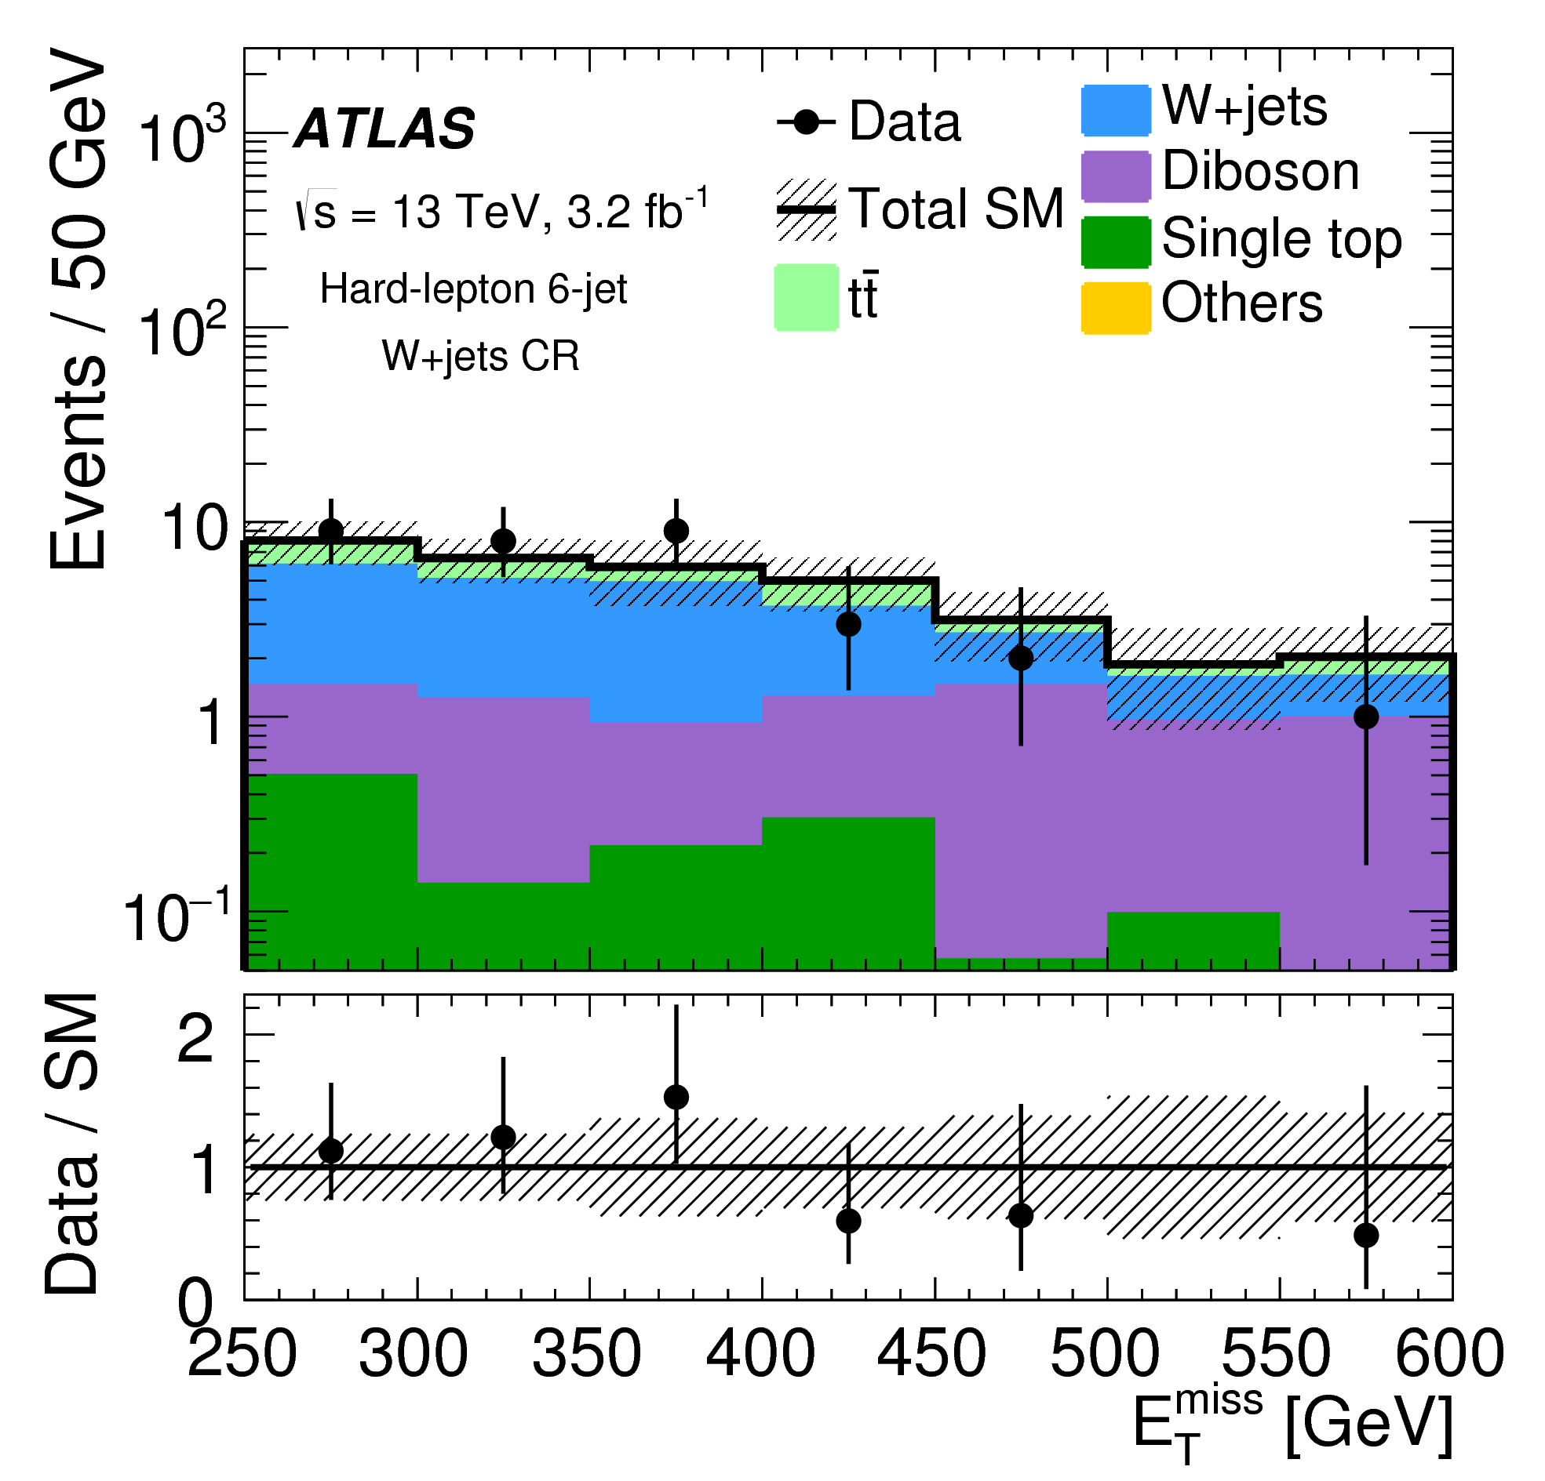
SM Background Modeling
Top CR
Standard Model
Top, multijets
V, VV, VVV, Higgs & combinations of these
Normalise MC prediction in SRs using dedicated CRs ωιτη transfer factor: T
Combined fit of all regions and bgs, and including systematic exp. and theory uncertainty as nuisance parameters
Reducible backgrounds
Determined from data
Backgrounds and methods depend on analyses
Irreducible backgrounds
Dominant sources:
  Mulit-jet: data-driven
  Non-Multi-jet: normalise MC in data control regions
Subdominant sources: MC
W CR
Validation
Validation regions used to cross check SM predictions with data
blinded
Signal regions
blinded
27

Slide 28
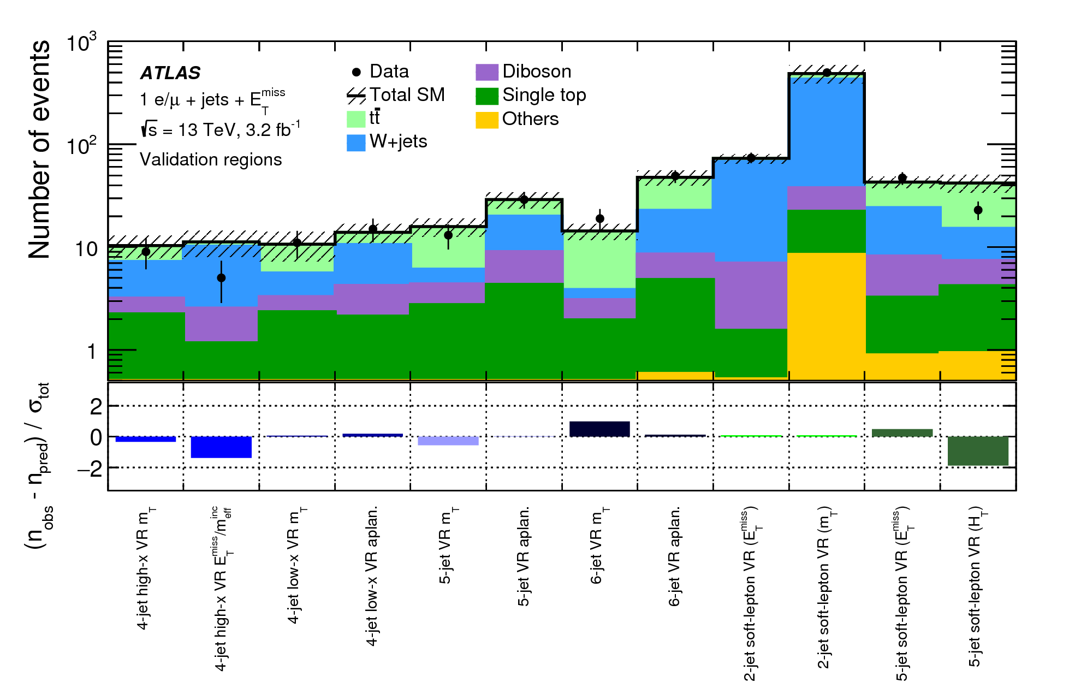
SM Background Modeling
Standard Model
Top, multijets
V, VV, VVV, Higgs & combinations of these
Combined fit of all regions and bgs, and including systematic exp. and theory uncertainty as nuisance parameters
Reducible backgrounds
Determined from data
Backgrounds and methods depend on analyses
Irreducible backgrounds
Dominant sources:
  Mulit-jet: data-driven
  Non-Multi-jet: normalise MC in data control regions
Subdominant sources: MC
Validation
Validation regions used to cross check SM predictions with data
blinded
Signal regions
blinded
28

Slide 29

Outline
SUSY Introduction
The LHC and ATLAS
SUSY search strategy
SUSY search @ LHC
Longer term prospects @ LHC and Future Colliders (14, 33, 100 TeV)
Outlook and Summary

Slide 30
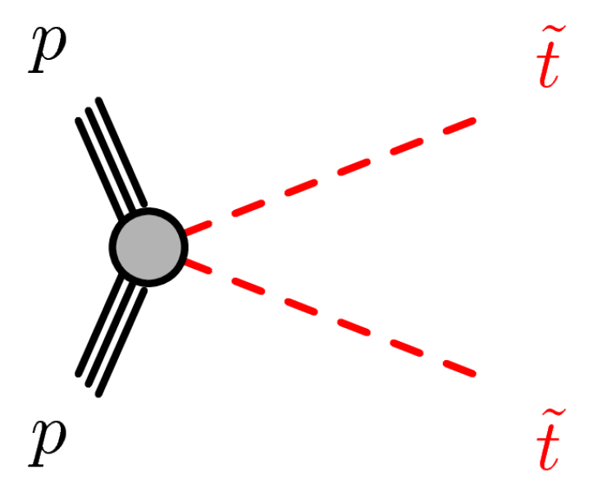
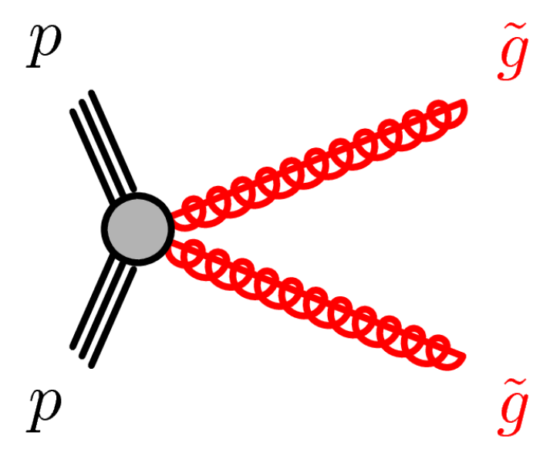
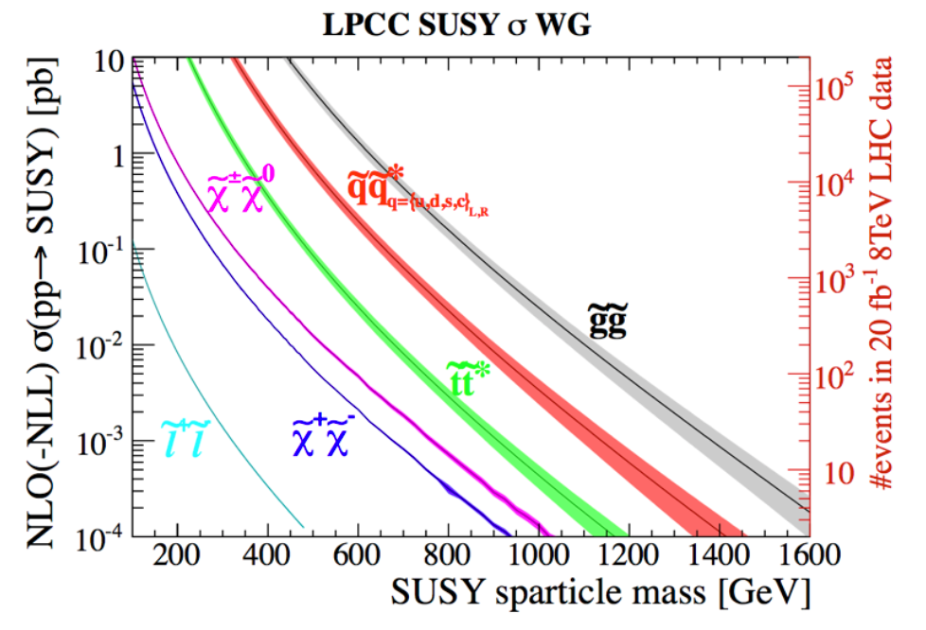
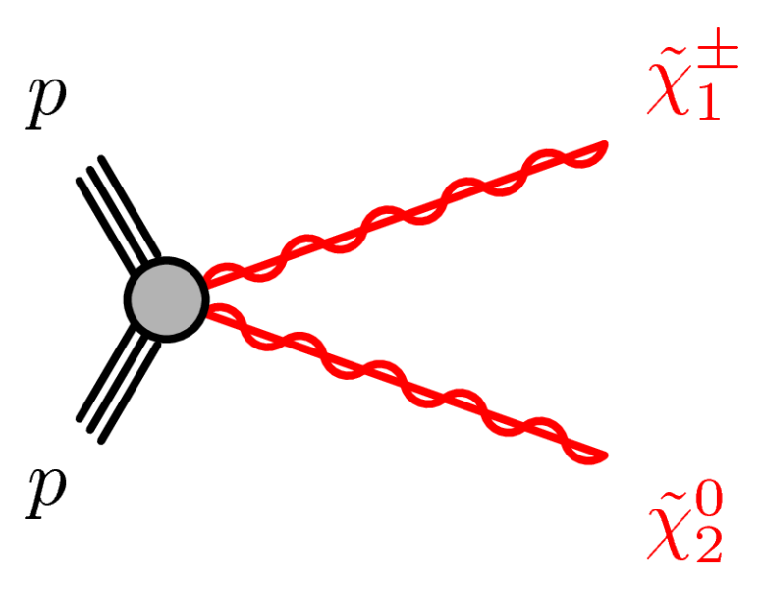
SUSY Search @ LHC
ATLAS public link
CMS public link
Strong production:
targeting gluinos and 1st and 2nd generation squarks
by far largest cross-sections
3rd generation:
targeting stop and sbottoms
Should be lowest mass squarks for naturalness reasons
Electroweak production:
targeting Electroweakinos, sleptons
Lowest mass sparticles, clean signature
RPV/LL:
targeting R-parity violating models and long lived sparticles
More exotic models
arXiv:1206.2892

Slide 31
SUSY Search @ LHC
Strong production:
targeting gluinos and 1st and 2nd generation squarks
by far largest cross-sections
3rd generation:
targeting stop and sbottoms
Should be lowest mass squarks for naturalness reasons
Electroweak production:
targeting Electroweakinos, sleptons
Lowest mass sparticles, clean signature
RPV/LL:
targeting R-parity violating models and long lived sparticles
More exotic models

Slide 32
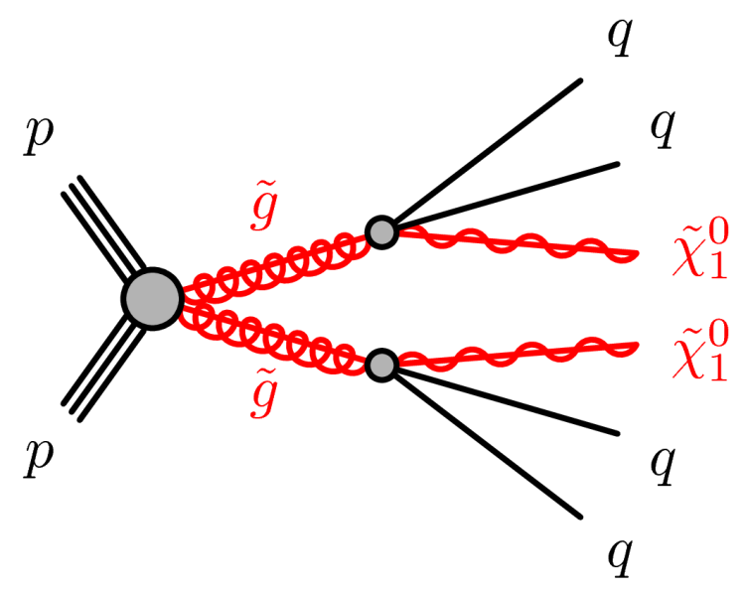
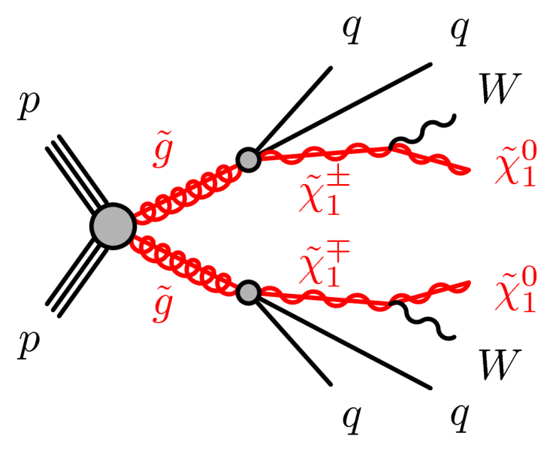
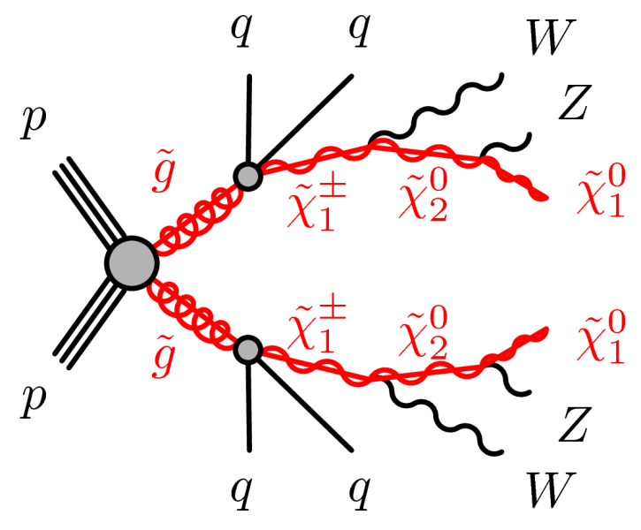
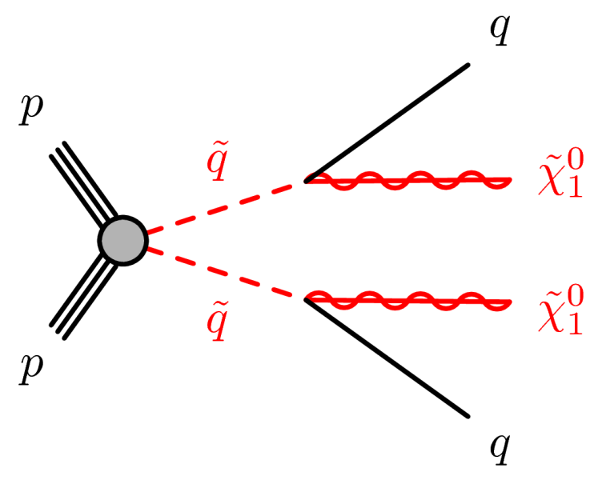
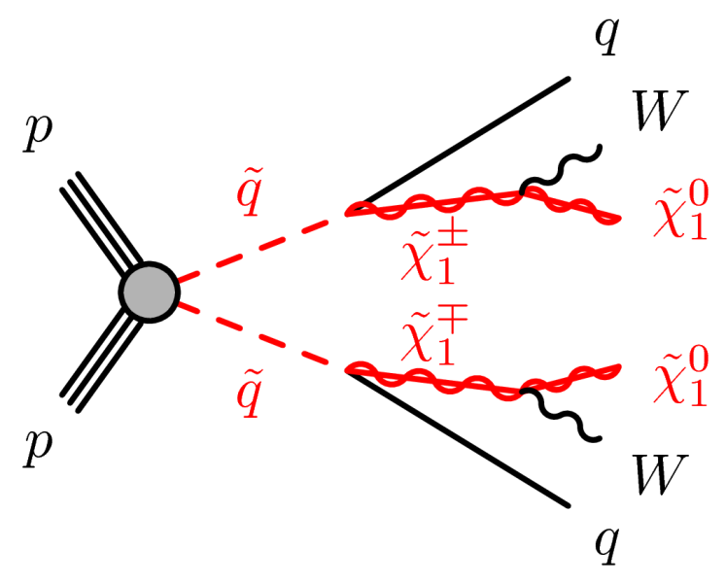
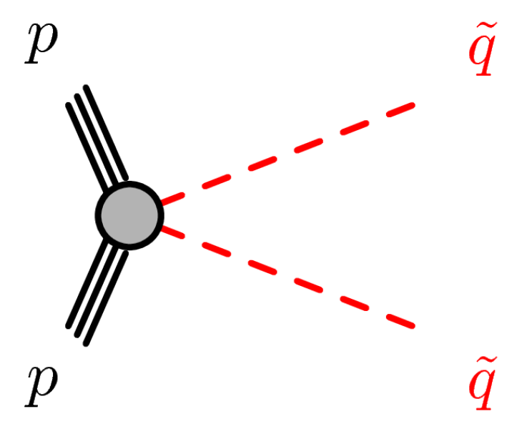
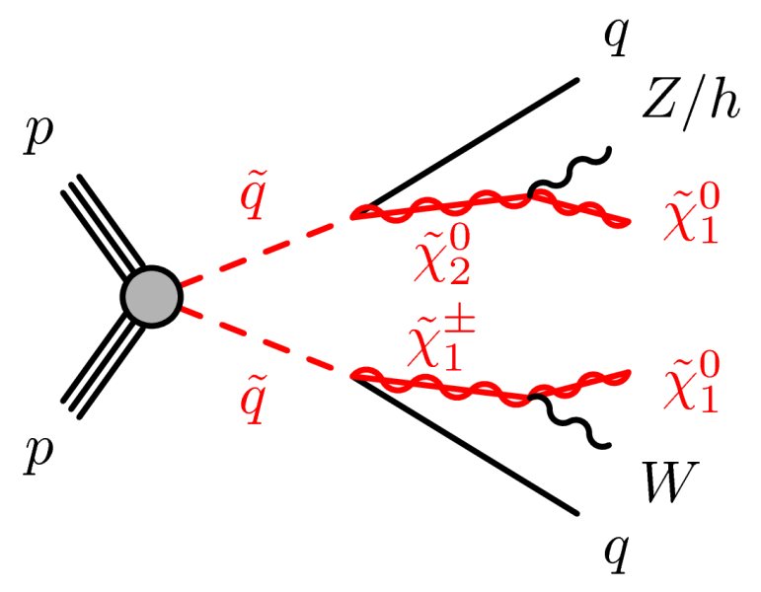
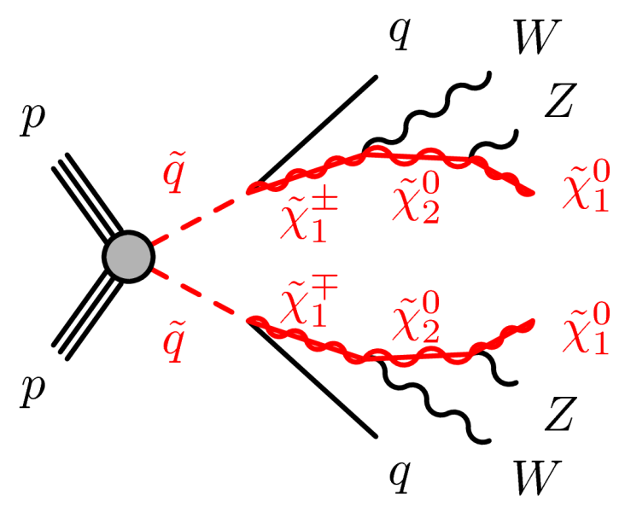
Electroweakino Production
Generic signatures :
Multi -jets + n_lepton/n_photon (n=0,1, ≥2) + large E_{T}^{miss} (0L,1 L, >=2L)

Slide 33



Strong Production: All hadronic
ATLAS has two searches based on different scenarios: ATLAS-CONF-2017-022(SS,GG), arXiv:1711.01901 (Gtt, Gbb), arXiv:1708.02794 (GG, 7-11jets)
Signal/BG discrimination based on:
  Large/medium mass split: Meff, MET,
  Compressed region: R Jigsaw
Huge #signal regions (SRs) defined targeting above different search scenarios and phase space
CMS has several searches based on different kinematics:
H_{T}^{miss} (PhysRevD.96.032003):
  binned in jet and b-jet multiplicity.
  In each bin, bin further in H_{T} and H_{T}^{miss}
mT₂ search (Eur. Phys. J C 77 (2017) 710):
  binned in H_{T}, jet and b-jet multiplicity.
  In each bin, look at tails of mT2

Slide 34




All hadronic: ATLAS | CMS results
ATLAS-CONF-2017-022
Eur. Phys. J C 77 (2017) 710

Slide 35



All hadronic: ATLAS | CMS results
Eur. Phys. J C 77 (2017) 710
ATLAS-CONF-2017-022

Slide 36



All hadronic: ATLAS | CMS results
arXiv:1711.01901
Phys. Rev. D 96 (2017) 032003

Slide 37



Strong Production: leptonic signatures
We can use lepton(s) to probe for strong production signals
  suppressed hadronic backgrounds
  single lepton, OS, SS di-leptons, multi-leptons (+ jets+ MET)
Single Lept.
arXiv:1709.09814
arXiv:1708.08232

Slide 38


Strong Production: leptonic signatures
We can use lepton(s) to probe for strong production signals
  suppressed hadronic backgrounds
  single lepton, OS, SS di-leptons, multi-leptons (+ jets+ MET)
SS Di-lept.
Eur. Phys. J. C 76 (2016) 259
EPJC 77 (2017) 578

Slide 39



Strong Production: photonic signatures
We can use photon(s) to probe for strong production signals
  suppressed hadronic backgrounds
  N-photons + jets+ MET (N >= 1)
photons
ATLAS-CONF-2016-066
CMS-PAS-SUS-16-046

Slide 40

Strong Production (summary)

Slide 41

Prospects at HL-LHC
14 TeV, 300-3000 fb⁻¹
ATL-PHYS-PUB-2014-010
For exclusions:
Gluinos: ~ 2 TeV now
2.5 TeV @ 300 fb-1
3 TeV @ 3000 fb-1
13 TeV
~36 fb⁻¹
ATLAS-CONF-2017-022

Slide 42

Places to hunt for SUSY?
For discovery potential:
We explored 85% of our mass reach (2 → 2.5 TeV)
with a small window remaining between 1－2 TeV
300/fb 5σ discovery case is practically excluded

Slide 43
SUSY Search @ LHC
Strong production:
targeting gluinos and 1st and 2nd generation squarks
by far largest cross-sections
3rd generation:
targeting stop and sbottoms
Should be lowest mass squarks for naturalness reasons
Electroweak production:
targeting Electroweakinos, sleptons
Lowest mass sparticles, clean signature
RPV/LL:
targeting R-parity violating models and long lived sparticles
More exotic models
43

Slide 44






3rd Generation: stop
Search for stop directly from ~t~t production
Large spectrum of possible stop decays, covering range from low to heavy stop mass, various decay modes.
On-shell top

Slide 45


3rd Generation: stop (fully hadronic)
arXiv:1709.04183
JHEP 10 (2017) 005

Slide 46


3rd Generation: stop (leptonic)
ATLAS-CONF-2017-037
JHEP10(2017)019

Slide 47

3rd Generation (summary)
For bottom squarks: exclusion limits beyond 1 TeV (CMS-PAS-SUS-16-032)
Still <600 GeV for compressed region, also for stop→charm+MET (ATLAS-CONF-2017-038)

Slide 48


Prospects at HL-LHC
ATL-PHYS-PUB-2013-011
14 TeV, 300-3000 fb⁻¹
For exclusions (all hadronic):
stop: ~ 1 TeV now
1.2 TeV @ 300 fb-1
1.4 TeV @ 3000 fb-1
For discovery:
1.0 TeV @ 300 fb-1
1.2 TeV @ 3000 fb-1
Moriond
~36 fb⁻¹
ATLAS-CONF-2017-020

Slide 49

SUSY Search @ LHC
Strong production:
targeting gluinos and 1st and 2nd generation squarks
by far largest cross-sections
3rd generation:
targeting stop and sbottoms
Should be lowest mass squarks for naturalness reasons
Electroweak production:
targeting Electroweakinos, sleptons
Lowest mass sparticles, clean signature(multi-lept, Low jet act)
RPV/LL:
targeting R-parity violating models and long lived sparticles
More exotic models
If coloured sparticles much heavier than EW partners, EWK prod. will be dominant at LHC

Slide 50



Electroweakino Production
ATLAS: ATLAS-CONF-2017-039, ATLAS-CONF-2017-035, JHEP 04 (2014)169
CMS: CMS-PAS-SUS-16-039, CMS-PAS-SUS-17-004
ATLAS: ATLAS-CONF-2017-039, ATLAS-CONF-2017-035, JHEP 05 (2014)071
CMS: EPJC 74 (2014) 3036
ATLAS: 2l (e/μ): ATLAS-CONF-2017-039; ≥2τ:Phys. Rev. D 93, 052002 (2016)
CMS: EPJC 74 (2014) 3036

Slide 51




Chargino-Neutralino Pairs: via sleptons
ATLAS-CONF -2017-039
arXiv:1709.05406
arXiv:1708.07875
arXiv:1709.05406

Slide 52


Chargino-Neutralino Pairs: via WZ or WH
arXiv:1709.05406

Slide 53


Chargino-Chargino Pairs: via sleptons
ATLAS-CONF-2017-039
arXiv:1708.07875

Slide 54




Direct slepton pair
ATLAS-CONF-2017-039
Phys. Rev. D 93, 052002 (2016)
CMS-PAS-SUS-17-003

Slide 55

EWK Production (summary)
Powerful exclusions in decays via sleptons (C1/N2 up to 0.6-1.1 TeV)
Exclusions is not so large in decays via bosons (up to 150-400 GeV)
Mass limit on selectron/smuon up to 500 GeV, not yet on staus

Slide 56

ATL-PHYS-PUB-2014-010
Prospects at HL-LHC
14 TeV, 300-3000 fb⁻¹
For exclusions:
chargino: ~ 0.45 TeV now
0.8 TeV @ 300 fb-1
1.1 TeV @ 3000 fb-1
For discovery:
0.55 TeV @ 300 fb-1
0.8 TeV @ 3000 fb-1
Some room for discovery
13 TeV
~36 fb⁻¹

Slide 57


ATL-PHYS-PUB-2016-021
Direct stau
14 TeV, 300-3000 fb⁻¹
For exclusions:
stau: ~ 0.1 TeV now
0.7 TeV @ 3000 fb-1
For discovery:
0.5 TeV @ 3000 fb-1
Very promising at LHC
100 GeV

Slide 58

2015+2016 – A milestone for SUSY
This means:
  We explored 85% of our mass reach for gluino pair production, about 75% for stop
  ~60% for gauginos, and just above 50% for higgsinos

Slide 59
Outline
SUSY Introduction
The LHC and ATLAS
SUSY search strategy
SUSY search @ LHC
Longer term prospects @ LHC and Future Colliders (14, 33, 100 TeV)
Outlook and Summary

Slide 60

Prospects at Future Proton Colliders
arXiv:1311.6480, 1406.4512, 1410.6287
Long term prospects for 4 collider scenarios have been studied (14, 33, 100 TeV @3000 fb⁻¹)
Use same search strategy as 8-13TeV @LHC
Use simple analysis strategies, avoid assumption on detector design, pileup sensitivity, etc

Slide 61

Gluino pair (Gqq) – light flavor
Search for gluinos with fully hadronic final states
Discover (Exclude) 11 (13) TeV gluino
Increasing the center-of-mass energy has a tremendous impact on the experimentally available parameter space (~5 x beyond 14 TeV @100 TeV)
arXiv:1311.6480
Discover 11 TeV gluino
Exclude 13 TeV gluino
LHC 13 TeV limit ~2 TeV
20% systematic uncertainty, no pileup

Slide 62

Gluino pair (Gtt) – heavy flavor
Search for gluinos with Same Sign 2 lepton, 2b-jets, large missing transverse momentum
Discover (Exclude) 6 (8) TeV gluino
Increasing the center-of-mass energy has a tremendous impact on the experimentally available parameter space (~3 x beyond 14 TeV @100 TeV)
arXiv:1311.6480
Discover 6 TeV gluino
Exclude 8 TeV gluino
LHC 13 TeV limit ~1.5 TeV
20% systematic uncertainty, no pileup

Slide 63


Squark pair
Search for squarks with no lepton, multi-jets, large missing transverse momentum
Signal to BG discrimination based on: MET, HT (Σjet pt)
Discover (Exclude) 2.5 (8) TeV squark
Increasing the center-of-mass energy has a tremendous impact on the experimentally available parameter space (~3 x beyond 14 TeV @100 TeV)
arXiv:1311.6480
Discover 2.5 TeV squark
Exclude 8 TeV squark
20% systematic uncertainty, no pileup
LHC 13 TeV limit ~1 TeV

Slide 64


Stop pair
Search for stop with on-shell top decay @ 100 TeV
Tops are very boosted at 100 TeV, the search strategy with isolated leptons, b-tags or top-tagging are sensitive to detector granularity/performance, pileup conditions etc. → So use simple handles with hard jets, MET and muon-in-jet
Two scenarios with high mass stop and compressed region designed
Discover (Exclude) 6.5 (8) TeV stop @100TeV
arXiv:1406.4512
ATL-PHYS-PUB-2014-010
Discover 6.5 TeV stop
Exclude 8 TeV stop
14 TeV, 3000 fb-1:
Exclude 1. 4 TeV stop
LHC 13 TeV limit ~1 TeV

Slide 65


EWK Signature
Increasing bounds on colored SUSY particles, maybe only electroweakinos in the low energy spectrum. LHC has limited reach for direct produced EWK particles
Potential search for electroweakinos with multi-lepton signatures: 3L || OS2L || SS2L @100 TeV
Discover (Exclude) 2.1 (3.2) TeV electroweakinos for wino NLSP
arXiv:1410.6287
ATL-PHYS-PUB-2013-011
Exclude 3.2 TeV EWKino
Discover 2.1 TeV EWKino
14 TeV, 3000 fb-1:
Exclude 1. 1 TeV EWKino
LHC 8 TeV limit ~0.45 TeV

Slide 66

Outline
SUSY Introduction
The LHC and ATLAS
SUSY search strategy
SUSY search @ LHC
Longer term prospects @ LHC and Future Colliders (14, 33, 100 TeV)
Outlook and Summary

Slide 67
Summary and Outlook
[LHC 13 TeV ~36 fb⁻¹] In canonical scenarios, sensitivity is achieved to ~2 TeV gluinos, ~1 TeV stops and ~400-1000 GeV EWKinos
[LHC 14 TeV ~3000 fb⁻¹] Discovery potential up to 2.2 TeV gluinos, 1.2 TeV stop and 800 GeV EWKinos
[100 TeV ~3000 fb⁻¹] Discover (Exclude) 11 (13) TeV gluino, 6.5 (8) TeV stop, 2.1 (3.2) TeV EWKinos
  LHC is a discovery machine, new physics may come at any time , stay tuned!
Thanks for your attention!

Slide 68

68

Slide 70

The journey into new physics territory
has just only begun (only using 2% data),
and for sure, exciting times are
ahead of us!
J Blaeu 1664

Slide 71
ATLAS IHEP Team Members
Total of 43 members:
13 physicist staff
8-10 Post-doc
16 PhD students
4 engineer staff
Staffs: Joao Guimaraes da Costa, Xuai Zhuang, Hongbo Zhu, Yaquan Fang, Xinchou Lou, Qun Ouyang, Feng Lu, Lianyou Shan, Zhijun Liang, Yanping Huang, Da Xu, Xin Shi
General Management and Boards
Xinchou Lou ATLAS ITK Steering Committee member
Xuai Zhuang ATLAS CB Chair Advisory Group member (2016 - 2018)
Detector Operations and R&D
JuanAn Pascual Pixel DAQ coordinator (2016.5 – 2018.1)
JuanAn Pascual Deputy Run Coordinator (2017.11 – 2018. 10)
Jason Mansour Inner detector online and DAQ coordinator
Physics and Performance
Xuai Zhuang EWK SUSY Group Convener (2015.4 - 2016.4)
Joao Costa HWW Group Convener (2016.4 - 2017.3)
Yanping Huang Photon ID group convener (2016. 10 - now)

Slide 72
Recent group activities
Detector Upgrade
    Phase II ITK strip upgrade
Detector operation, Core software and Performance
    Pixel Detector DAQ and Operations, offline studies
    Inner detector data quality and tracking CP
    Photon ID
    Tau reconstruction and data quality
    Second vertex finder
    MET performance
Physics Analysis
    Higgs: H→γγ, Zγ, WW, bb, ttH(bb), di-Higgs in WWγγ, WWWW, bbbb
    New resonance search: γγ, Zγ
    SUSY searches：di-tau, 1L, SS/2L&3L, tau+jets
    SM measurement: Zγ VBS, Z+jet

Slide 73










IHEP SUSY Group
2 graduated this year
Staffs
  Xuai ZHUANG Shan JIN Da XU Feng LU
Postdoc + students
Mohamad Kassem AYOUB
Huan REN Huajie Cheng Peng Zhang Yang Liu
Chenzheng
Zhu

Slide 74

SUSY Search Topics @ IHEP
Strong production: targeting gluino and squarks (Inc. 3rd gen. squarks)
Generic signatures :
  Multi -jets + n_lepton/n_photon(n=0,1, ≥2) + large E_{T}^{miss} (0L,1 L, >=2L)
IHEP topics:
  * 1L +jets +MET (Run1+Run2)
  SS/3L +jets +MET (Run2)
  Tau +jets +MET (Run1)
*Analysis Contacts
very wide coverage on SUSY search from IHEP: strong + EW
Weak production: targeting charginos, neutralinos and slepton
Generic signatures:
  low–jet multiplicity + ≥ 2leptons + large E_{T}^{miss} (2/3/4L, >=2tau)
IHEP topic:
  * >=2tau+MET (Run1 + Run2)

Slide 75
SUSY models: good sale in market
Simplified Models:
  Not really a model (Br~100%, most masses fixed at high scales)
  Important tool for interpretation
Phenomenological models:
  pMSSM: captures “most” of phenomenologic features of R-parity conserving MSSM
    19 free parameters: M1,M2,M3 ; tan β, μ and m_{A;} 10 sfermion mass parameters; A_{t}, A_{b} and A_{τ}
    Comprehensive and computationally realistic approximation of the MSSM with neutralino LSP
  GGM (gravitino)
Complete SUSY models: mSUGRA, GMSB …

Slide 76
A change of perspective
Develop more complex analysis (compressed, small cross section …)
Are there topologies of strong production (including 3rd gen.) not covering?
  PRV signatures? Long-lived signatures? …
EW signatures have still more room to be discovered
  Significant gain in sensitivity still expected for conventional C1N2 via WZ, WH decay
  No proven sensitivity yet in run2 for a number of well-motivated signatures: direct stau, C1C1 via WW … (PhysRevD.93.052002 )
  Higgsino LSP signatures
  RPV signatures of EW production
  …

Slide 77


Excellent LHC performance
is a (nice) challenge for the
experiment:
- Trigger
- Pile-up
- Maintain accuracy of the
the measurements in this
environment
Inner Detector for a Z → μμ event with 25 primary vertices
77

Slide 78

希腊神话中的怪物“Uroboros”与格拉肖的“宇宙圈”
SUSY?
引力主导，
爱因斯坦的广义相对论
粒子“微观世界”，强弱相互作用主导，理论模型是标准模型
引力和电磁力占主导地位
78

Slide 79

An attempt to map out the SUSY model space with all the ATLAS
analyses, giving an impression of where SUSY could still hide …
JHEP 10 (2015) 134
79

Slide 80


80

Slide 81


Long term prospects
ATL-PHYS-PUB-2014-010
ATLAS studied long term prospects for the (HL-)LHC with 300, 3000 fb⁻¹@14TeV
Discovery potential up to 2.5 TeV gluinos, 1.3 TeV squarks/sbottom and 800 GeV Electroweakinos, 500 GeV stau (IHEP)
2023:~300 fb⁻¹
2037:~3000 fb⁻¹
ATL-PHYS-PUB-2016-021
IHEP

Slide 82


C1N2 via slepton: dependent with x
arXiv:1709.05406
x=0.5
x=0.05
x=0.95

Slide 83


The CLs significance as a function of x
arXiv:1708.07875
a) C1C1
b) C1C1
When only C1C1 production is considered, the benchmark scenario with large mass-splitting (600,0) can be excluded for x up to 0.75. For larger values of x, the pT spectra of the tau from the chargino decay become very soft.
The compressed benchmark scenario (250,100) can only be excluded for the extreme cases with x = 0.05 or x = 0.95 since the mT2 requirement is more eﬀective for models with large mass-splittings between C1 or the staus and N1.

Slide 84


The CLs significance as a function of x
arXiv:1708.07875
C1N2+C1C1
C1N2+C1C1
For combined production of C1C1 and C1N2, the same general features are observed, but due to the higher signal yields with respect to C1C1 production alone, both benchmark scenarios can be excluded for all considered values of x.

Slide 85



Slide 86



RJigsaw
the complementary search using the Recursive Jigsaw Reconstruction (RJR) techniques in the construction of a discriminating variable set (‘RJR-based search’). By using a dedicated set of selection criteria, the RJR-search improve the sensitivity to supersymmetric models with small mass splittings between the sparticles (models with compressed spectra).

Slide 87


A Toroidal LHC ApparatuS
- 42m×22m, 7000 ton
Inner Detector: Highly segmented silicon strips, determine very accurately charged particles trajectories
Solenoid Magnet: Solenoid coil that generates a 2T magnetic field in the region of the Inner Detector
Electromagnetic Calorimeter: Electron and photon energies are measured through electromagnetic showers
Hadronic Calorimeter: Hadrons interact with dense material and produce a shower of charged particles
Toroid Magnets: 8 toroidal coils that create a 0,4T magnetic field in the area of the Muon Spectrometer
Muon Spectrometer: Muons traverse the rest of the detector and are measured in its outer layers

Slide 88
“ABCD”
Method
Data-driven background estimation
One approach to data-driven bg estimation is to use uncorrelated
model-independent variables to extrapolate the background from a background-dominated control region to the signal region.
Nbg in signal region D = (A/B)*C
Normalization Region
Normalize Factor
Control Sample
Other variable
Key points:
• The two variables should have good discrepancy and uncorrelated
• Control Sample selection: enough statistics;lower susy contamination; unbiased estimation of SM background
• Normalization region selection: enough statistics;lower susy contamination; flat ratio(A/B) distribution with ETmiss
Signal
Region
(blinded)
A(bg)
D(S+bg)
B(bg)
C(bg)
ETmiss
Control Region
88

Slide 89




Background Estimation Strategy
ATLAS-CONF-2013-062
W/Z/ttbar background (dominant)
Semi-data driven approach
Normalize MC to Data in W/T-CR
Extrapolate to SR using MC: assuming shape is described correctly
Extrapolation done in simultaneous fit.
QCD background (small bg)
Fullly-data driven approach
Measure real and fake efficiencies in QCD-CRs
Apply Matrix Method to get contribution in SR
Other small BGs (diboson, single top etc) are directly estimated from MC.

Slide 90

Gluino-Neutralino Signature
Impact of Systematic Uncertainties
It is likely that the experiments will significantly reduce these uncertainties with larger datasets and an improved understanding of their detectors
Varying the systematic background uncertainty from 30% to 5%, the discovery reach increases by roughly 600 GeV (3.4 TeV) in m(~g) at 14 TeV (100 TeV) and the coverage in LSP direction is roughly doubled

Slide 91

Impact of Pileup
Compared the results with 140 additional minimum-bias interactions
The Delphes based Snowmass simulation includes a pileup suppression algorithm that primarily impacts the Emiss resolution (Snowmass detector:ArXiv:1309.1057)
Given that the HT and ETmiss distributions are effectively unchanged, it is not surprising that the results are very similar with and without pileup

Slide 92






Interpretation strategy
Likelihood function: L(μ,θ)
μ: signal strength (POI);
θ: nuisance parameters(NP)
Profile Likelihood: constrain uncertainty (NP) as part of a likelihood fit
Construct test statistics t_{μ} based on likelihood ratio λ:
Construct the PDF of test statistic t_{μ:} generate toy Monte Carlo or using asymptotic formula
From the constructed distribution of test statistic for s+b, find the p-value of the observation
Based on the number of observed, expected events in all regions with all uncertainties: Probability density function (PDF)
If CLs<0.05: the value of signal is excluded at 95% CL……….
The above check has been done for each signal grid points on the SUSY model.
The line can be drawn for the area where points are excluded
Find the observed test statistic for tested μ: t_{μ,obs}

Slide 93
arXiv:1407.5066
Theory cross sections for selected SUSY processes

