Slide 1
Work Report
Miao Nannan
2017.11.23

Slide 2
Avalanche & Gain
P$\left(G\right)=C_{0}\frac{{\left(1+θ\right)}^{1+θ}}{Γ\left(1+θ\right)}{\left(\frac{G}{G_{0}}\right)}^{θ}exp\left[−\left(1+θ\right)\frac{G}{G_{0}}\right]$
----Polya Distribution
The gain of electrons can be described by Polya distribution.${ (C}_{0}$ is a constant ; $G_{0}$ is the average gain of a single electron; $θ$ is a parameter which determines the variance of the distribution).

Slide 3
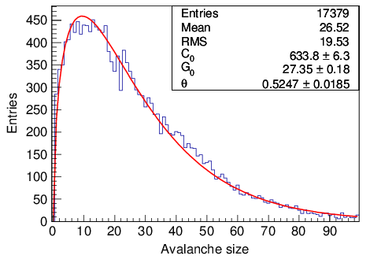
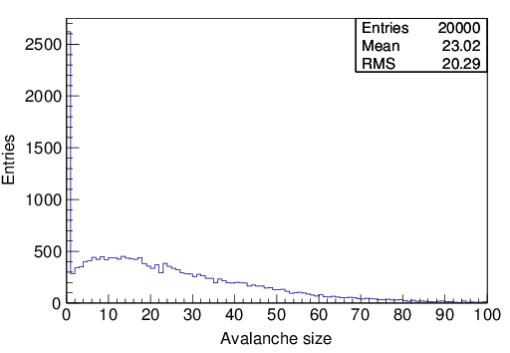
Avalanche & Gain ----Gem1
The produced electrons do not get through the Gem foil.
Set an electron 2.25mm before the Gem1 foil and count multiplied electrons 150 μm after the Gem1 foil. Then get the right plot Avalanche size.
Effective gain: Number of multiplied electrons which can leave the Gem1 foil. It is sampled from a Polya.
Transparency: The percentage of original electrons with whose multiplied electrons can leave the Gem1 foil, is about 86.90%.

Slide 4
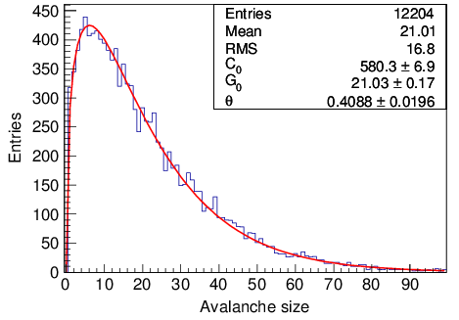
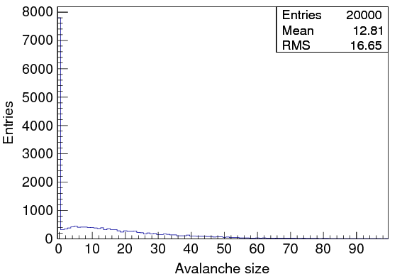
Avalanche & Gain ----Gem2
The produced electrons do not get through the Gem foil.
Set an electron 150 μm after the Gem1 foil and count multiplied electrons 150 μm after the Gem2 foil. Then get the right plot Avalanche size.
Effective gain: Number of multiplied electrons which can leave the Gem2 foil . It is sampled from a Polya.
Transparency: The percentage of original electrons with whose multiplied electrons can leave the Gem2 foil, is about 61.02%.

Slide 5
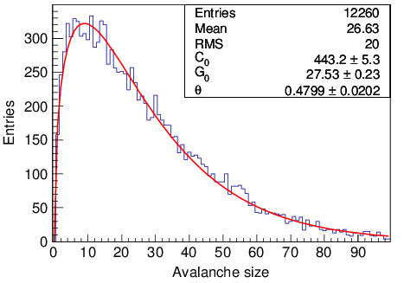
Avalanche & Gain ----Gem3
The produced electrons do not get through the Gem foil.
Set an electron 150 μm after the Gem2 foil and count multiplied electrons 150 μm after the Gem3 foil. Then get the right plot Avalanche size.
Effective gain: Number of multiplied electrons which can leave the Gem3 foil. It is sampled from a Polya.
Transparency: The percentage of original electrons with whose multiplied electrons can leave the Gem3 foil, is about 61.30%.

Slide 6
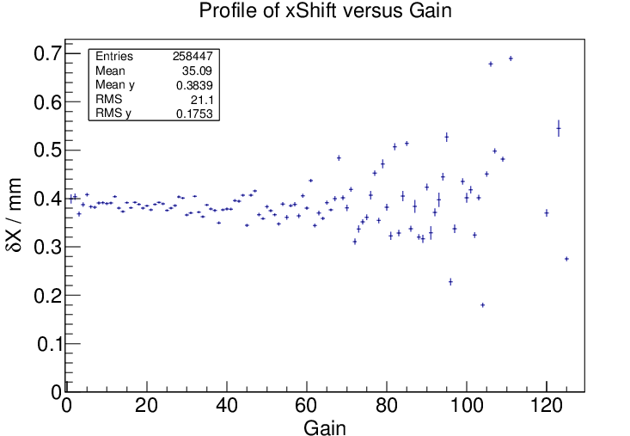
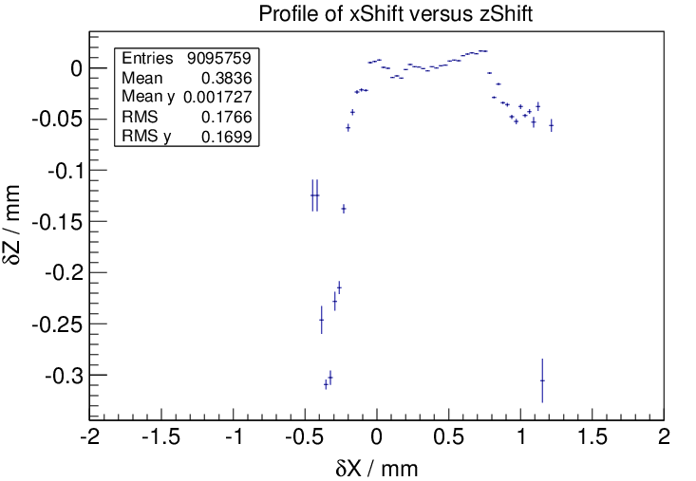
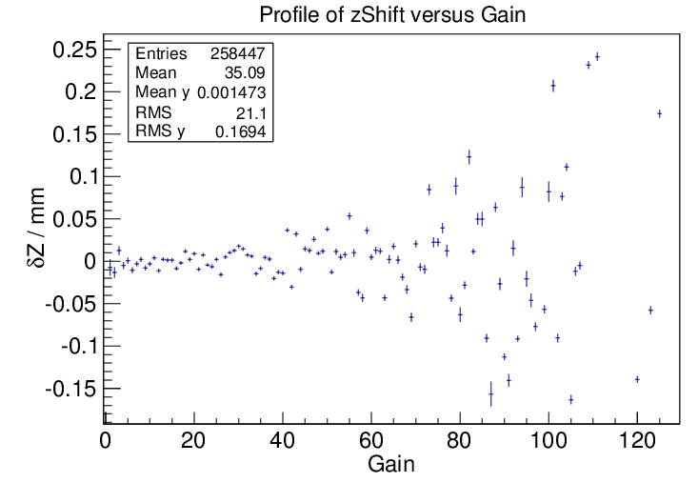
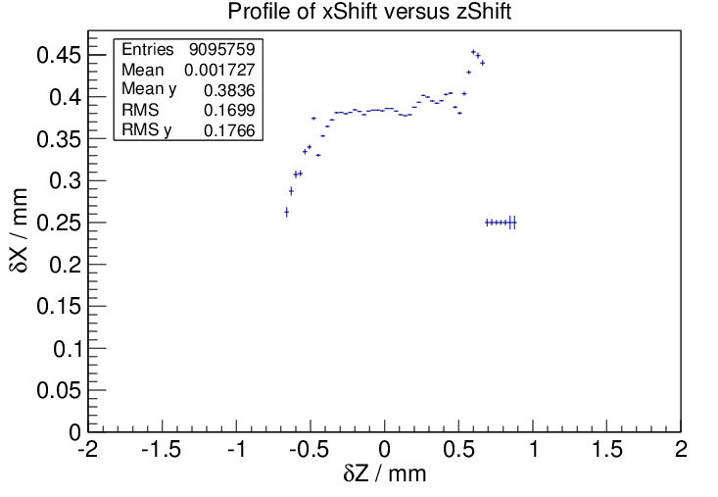
Profile of zShift versus xShift

