Slide 1
$Υ(5S)$ and $Υ(6S)$ decays at Belle
Speaker: Junhao Yin (IHEP, yinjh@ihep.ac.cn)
强子与重味物理理论实验联合研讨会
2018-04-01

Slide 4
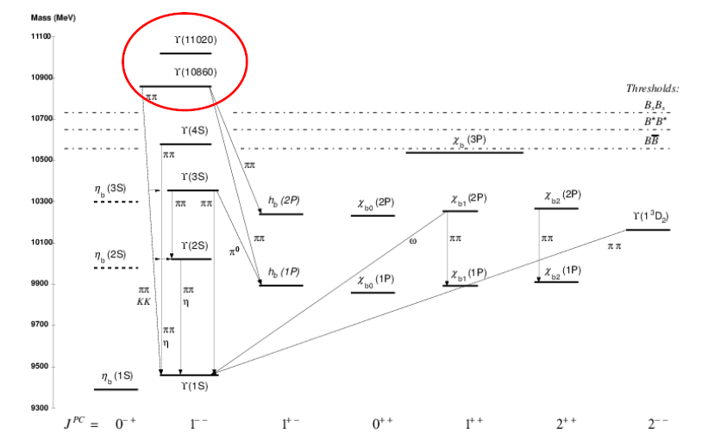
Hadronic Transitions

Slide 5
$$Υ\left(5S\right)→ππΥ(1S)$$
Data: 21.7 $fb^{−1}$ @ $Υ(5S)$
Belle: PRL 100, 112001(2008)
 | Partial width (MeV) | Born Cross section ($pb$) | Significance
$$ππΥ(1S)$$ | $$0.54±0.04±0.09$$ | $$1.61±0.10±0.12$$ | $$20σ$$
$$ππΥ(1S)$$ | $$0.78±0.06±0.01$$ | $$2.35±0.19±0.32$$ | $$14σ$$
$$ππΥ(1S)$$ | $${0.48}_{−0.015}^{+0.18}±0.07$$ | $${1.44}_{−0.45}^{+0.55}±0.19$$ | $$3.2σ$$
$$KKΥ(1S)$$ | $${0.061}_{−0.014}^{+0.016}±0.028$$ | $${0.185}_{−0.014}^{+0.048}±0.010$$ | $$4.9σ$$
Higher transition rate than $Υ\left(1,2,3S\right)→ππΥ(1S)$
$$(×{10}^{2})$$
Amplitude wave analysis based on 121 $fb^{−1}$ sample:
dominant
Mode | $$πZ_{b}(10610)$$ | $$πZ_{b}(10650)$$ | $$f_{2}Υ(nS)$$ | $${\left(ππ\right)}_{S}Υ(nS)$$ | $$f_{0}Υ(nS)$$
$$ππΥ(1S)$$ | $$4.8\%$$ | $$0.87\%$$ | $$14.6\%$$ | $$86.5\%$$ | $$6.9\%$$
$$ππΥ(2S)$$ | $$18.1\%$$ | $$14.5\%$$ | $$4.09\%$$ | $$101.0\%$$ | $$−$$
$$ππΥ(3S)$$ | $$30.0\%$$ | $$9.3\%$$ | $$−$$ | $$44.0\%$$ | $$−$$
PRD, 91, 072003

Slide 6
$$e^{+}e^{−}→ππΥ\left(nS\right)$$
PRD 93, 011101(2016)
Clear signal of $Υ\left(6S\right)→ππΥ(nS)$
 | $$R_{Υ\left(nS\right)ππ}$$
$$M_{5S}(MeV/c^{2})$$ | $$10891.1±{3.2}_{−1.7}^{+0.6}$$
$$Γ_{5S}(MeV)$$ | $${53.7}_{−5.6−5.4}^{+7.1+1.3}$$
$$M_{6S}(MeV/c^{2})$$ | $${10987.5}_{−2.5−2.1}^{+6.4+9.0}$$
$$Γ_{6S}(MeV)$$ | $${61}_{−19−20}^{+9 +2}$$
$$φ_{6S}−φ_{5S}(rad)$$ | $$−1.0±{0.4}_{−0.1}^{+1.4}$$
$$χ^{2}/dof$$ | $$51/56$$

Slide 7
$$Υ\left(5S\right)→ππh_{b}(nP)$$
PRL.108 032001(2012)
$$12.4σ$$
$$6.2σ$$
Should be suppressed by HQSS violation

Slide 8
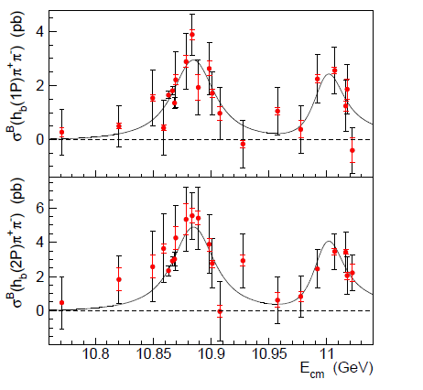
$$e^{+}e^{−}→ππh_{b}(nP)$$
PRL 117, 142001(2016).
Similar to $e^{+}e^{−}→Υ\left(nS\right)ππ$ lineshapes.
Contribution from continuum component is considered in systematic uncertainty estimation
Parameters | $π^{+}π^{−}h_{b}(nP)$
$$M_{5S}(MeV/c^{2})$$ | $${10884.7}_{−3.4−1.0}^{+3.6+8.9}$$
$$Γ_{5S}(MeV)$$ | $${40.6}_{− 8.0−19.1}^{+12.7+1.1}$$
$$M_{6S}(MeV/c^{2})$$ | $${10999.0}_{−7.8− 1.0}^{+7.3+16.9}$$
$$Γ_{6S}(MeV)$$ | $${27}_{−11−12}^{+27+5}$$
$$φ_{6S}−φ_{5S}(π)$$ | $${0.1}_{−0.8}^{+0.4}±0.3$$
$$a$$ | $${0.65}_{−0.12−0.10}^{+0.36+0.17}$$

Slide 9
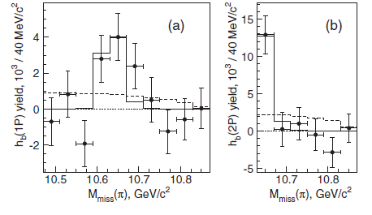
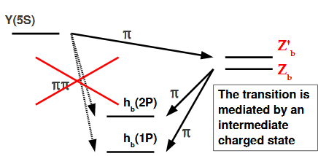
Yield the $h_{b}$ in bins of $M{\left(π\right)}_{miss}$.
$$π^{+}π^{−}h_{b}(1P)$$
$$π^{+}π^{−}h_{b}(2P)$$
PRL 117, 142001(2016).
The hypothesis that only $Z_{b}(10610)$ if produced in $π^{+}π^{−}h_{b}(1P)$ channel is excluded at the 3.3$σ$ level.

Slide 10
$$Υ\left(5S\right)→ηΥ_{J}(1D)$$
$η$ transitions VS. $ππ$ transitions from $Υ(nS)$: theory VS exp.

Slide 11
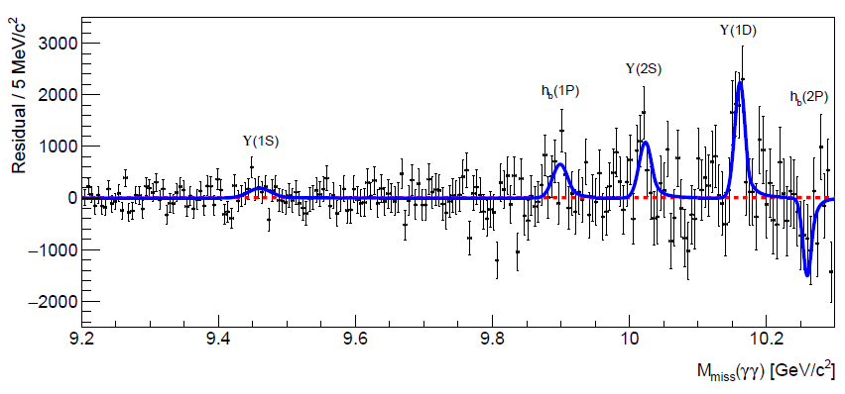
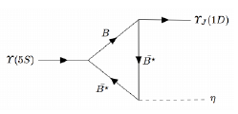
arXiv: 1803.03225
New!
$$5.3σ$$
$$3.3σ$$
$$2.7σ$$
$$1.5σ$$
$B\left(Υ\left(5S\right)→ηΥ\left(1D\right)\right)=\left(4.82±0.92±0.67\right)×{10}^{−3}$ agree with prediction (PRD 94, 094039 (2016)).

Slide 12
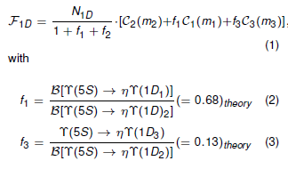
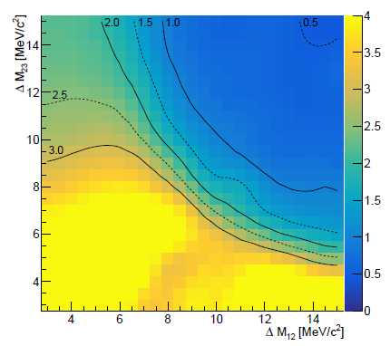
Investigation on $Υ(1D)$ triplet
$f_{1}=0.23±1.42$ and $f_{2}=−0.31±0.53$
Compatible with 0.
90% C.L. ULs on $f_{1}$, $f_{3}$ as function of $ΔM_{12}$ and $ΔM_{23}$
$f_{1}$ favored value exclude $ΔM_{23}<7$ and $ΔM_{12}>14$ MeV.

Slide 13
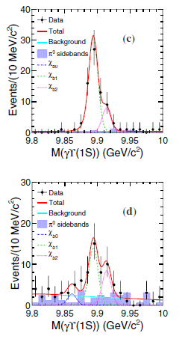
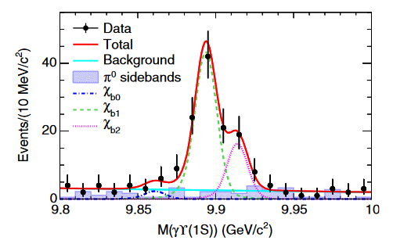
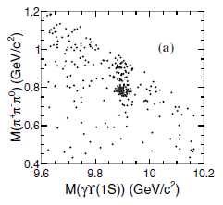
$$Υ\left(5S\right)→ωχ_{bJ}$$
Use $Υ(5S)$ on-resonance data.
$ωχ_{b1/b2}$ are observed for the first time in $e^{+}e^{−}$ annihilation.
Fully construction, $χ_{bJ}→Υ\left(1S\right)γ$, $Υ\left(1S\right)→l^{+}l^{−}$
PRL 113, 142001(2014)
$12σ$
$$5.9σ$$
Out of signal region

Slide 14
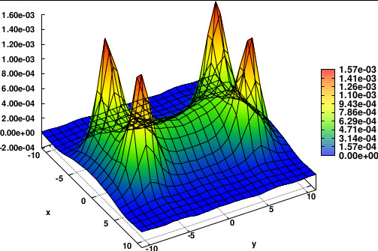
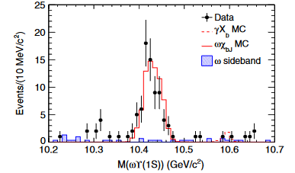
From the 2D fit of the $M\left(π^{+}π^{−}π^{0}\right) vs M(γΥ(1S))$:
PRL 113, 142001(2014)
$\frac{σ(e^{+}e^{−}→ωχ_{b2})}{σ(e^{+}e^{−}→ωχ_{b1})}=0.38±0.16±0.09$, where the common systematic uncertainties cancel.
$X_{b}$, $X$(3872) counterpart in the bottomonium sector.
$X_{b}$ is above $ωΥ(1S)$ threshold, should be a more promising (PRD 88, 054007(2013)).
$X$(3872)
No significant signal of $X_{b}$ is observed.
$−0.4±2.0$ $X_{b}$ from the fit.
$ℬ\left(Υ\left(10860\right)→γX_{b}\right)ℬ\left(X_{b}→ωΥ\left(1S\right)\right)<2.9×{10}^{−5}$ at 90% C.L.

Slide 15
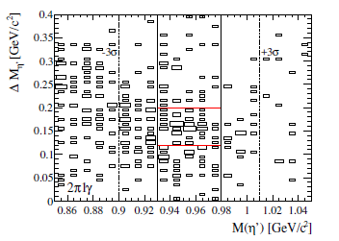
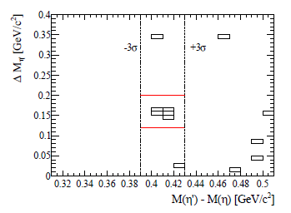
$$Υ\left(4S\right)→η^{′}Υ(1S)$$
Few non-$B\overline{B}$ processes from $Υ(4S)$ have been measured.
$Υ\left(4S\right)→η^{′}Υ\left(1S\right)$ expected to be enhanced as $Υ\left(4S\right)→ηΥ\left(1S\right)$
BDT is used to select suppress $γ_{ISR}Υ\left(2,3S\right)→γ_{ISR}ππΥ(1S)$
Based on $\left(538±8\right)×{10}^{6} Υ(4S)$ data:
$$η^{′}→γππ$$
$$η^{′}→γγππ$$
arXiv: 1803.10303

Slide 16
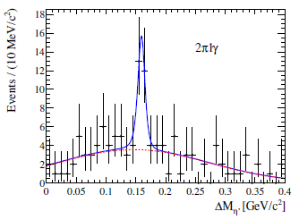
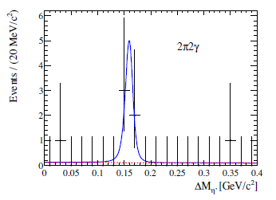
Statistical significance: 5.8$σ$, after considering systematic uncertainty: 5.7$σ$.
First observation of $η′$ transition between bottomonia.
$$B\left(Υ\left(4S\right)→η′Υ\left(1S\right)\right)=\left(3.43±0.88±0.21\right)×{10}^{−5}$$
$$R_{η^{′}/η}=\frac{B(Υ\left(4S\right)→η^{′}Υ(1S))}{B(Υ\left(4S\right)→ηΥ(1S))}=0.20±0.06$$
$$R_{η^{′}/ππ}=\frac{B(Υ\left(4S\right)→η^{′}Υ(1S))}{B(Υ\left(4S\right)→ππΥ(1S))}=0.42±0.11$$
arXiv: 1803.10303

Slide 17
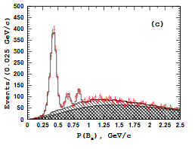
$$Υ(5S)→B_{s}^{\left(∗\right)}B_{s}^{\left(∗\right)}$$
arXiv: 1609.08749
Four decay modes are used to reconstruct $B_{s}$ candidates:
$B_{s}→D_{s}^{\left(∗\right)−}π^{+}, J/ψK^{+}K^{−}, J/ψπ^{+}π^{−}$ and $ψ\left(2S\right)K^{+}K^{−}$
$B_{s}^{∗}$ and $B_{s}$ are distinguished based on $B_{s}$ momentum.
$$l^{+}l^{−}$$
$$J/ψπ^{+}π^{−}$$
$D_{s}^{\left(∗\right)}→D_{s}γ$, $D_{s}→K^{+}K^{−}π^{−}, K_{S}^{0}K^{−}$ and $K_{S}^{0}K^{+}π^{−}π^{−}$
@$\sqrt{s}=10.866 GeV$
Measured relative ratio
HQSS expectation
${e^{+}e^{−}→B}_{s}^{∗}{\overline{B}}_{s}^{∗}$ 7 7
${e^{+}e^{−}→B_{s}\overline{B}}_{s}^{∗}+{\overline{B}}_{s}B_{s}^{∗}$ $0.853±0.106±0.053$ 4
$e^{+}e^{−}→B_{s}{\overline{B}}_{s}$ $0.683±0.094±0.033$ 1

Slide 18
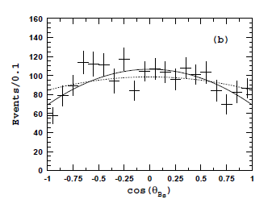
The $cos⁡(θ_{B_{s}^{∗}})$ distribution provide relative fractions of $S=0$ and $S=2$ states:
arXiv: 1609.08749
$S=0$: $1−\cos^{2}{(θ_{B_{s}^{∗}})}$
$S=2$: $7−\cos^{2}{(θ_{B_{s}^{∗}})/10}$
Fraction of S=0: $r=0.175±{0.057}_{−0.018}^{+0.022}$
$$e^{+}e^{−}→B_{s}^{\left(∗\right)}{\overline{B}}_{s}^{(∗)}$$
$${e^{+}e^{−}→B}_{s}^{∗}{\overline{B}}_{s}^{∗}$$
Sideband
Strong signal of $Υ(10860)$ with no significant signal of $Υ(11020)$
Peak of $Υ(5S)$ shifted about -15 MeV compared with $ππΥ(nS)$ or $ππh_{b}(nP)$

Slide 19
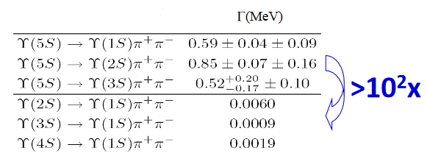
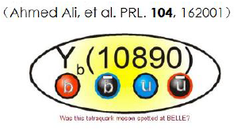
Summary
$Υ\left(5S\right)$ has unexpectedly high mass and abnormally high rate of hadronic bottomonium transitions.
$Υ(5S)$ mass measured from bottomonia transitions and open flavor decays are different.
Belle: PRL 100, 112001(2008)
exotic structure?

Slide 20
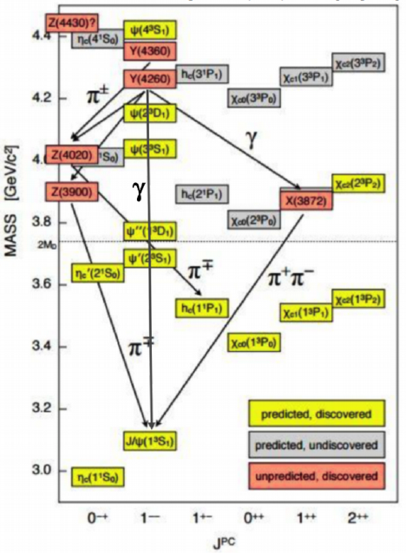
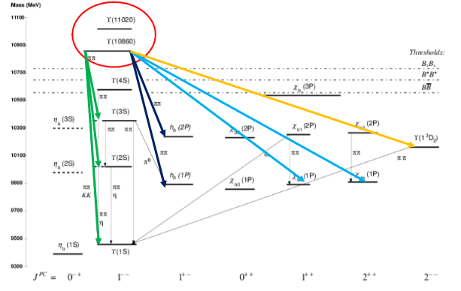
Bottomonia VS. charmonia
Where are the partners of $X\left(3872\right) or Y(4260)$?
Belle II is online.
A huge wave of zombie data is coming!

