Slide 1
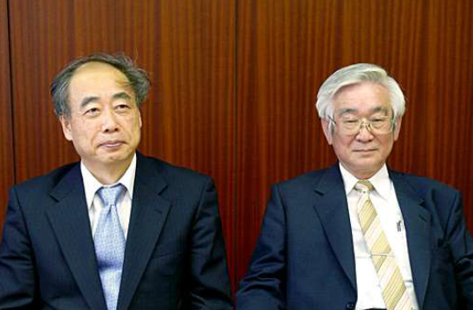
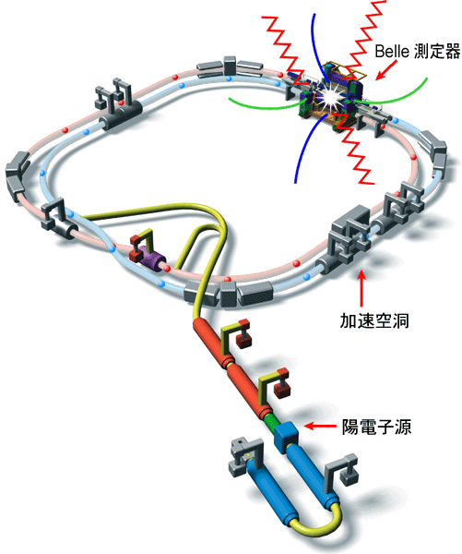
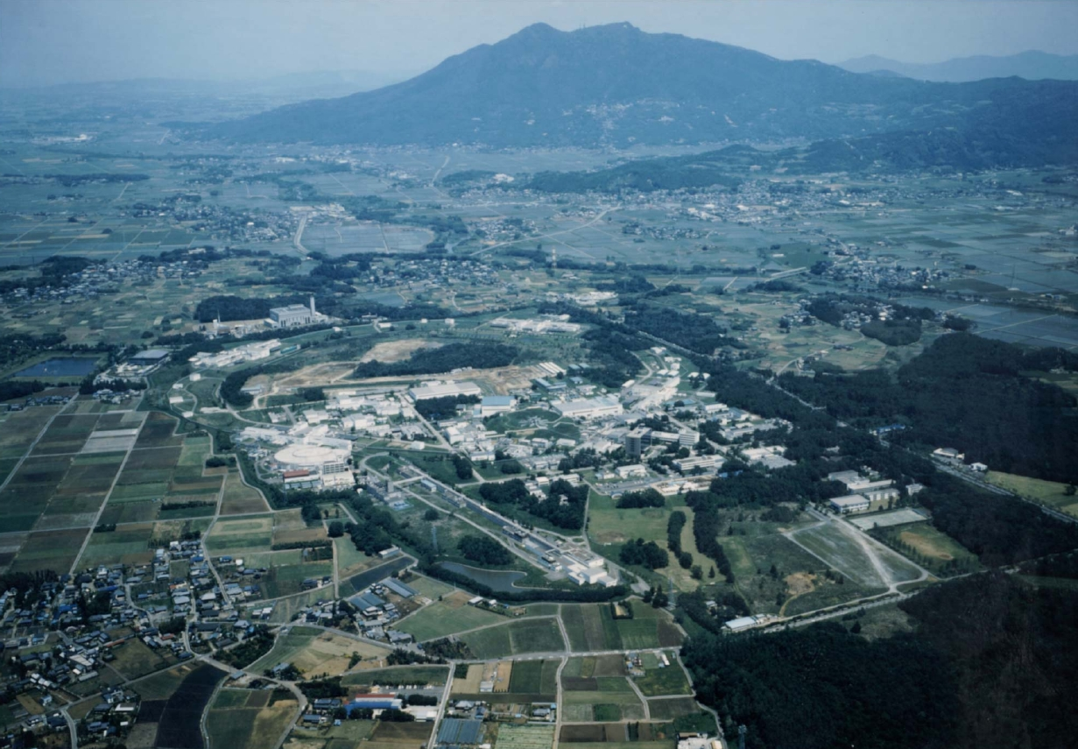
Belle实验 ➔ 2008诺贝尔奖[小林-益川]
SCC RF(HER)
Belle detector
亮度世界纪录:
L = 2.1 x 10³⁴/cm²/sec
ARES(LER)
Mt. Tsukuba
Ares RF
cavity
8 x 3.5 GeV
22 mrad crossing
KEKB
Belle
e⁺ source
1999-2010
1014/fb
~ 1 km in diameter
The KEKB Collider
Notes:
Here is a nice picture of the KEK Laboratory, with the sacred Mt. Tsukuba in the background.

Slide 2
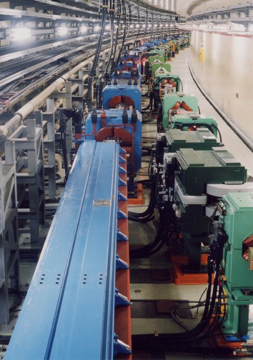
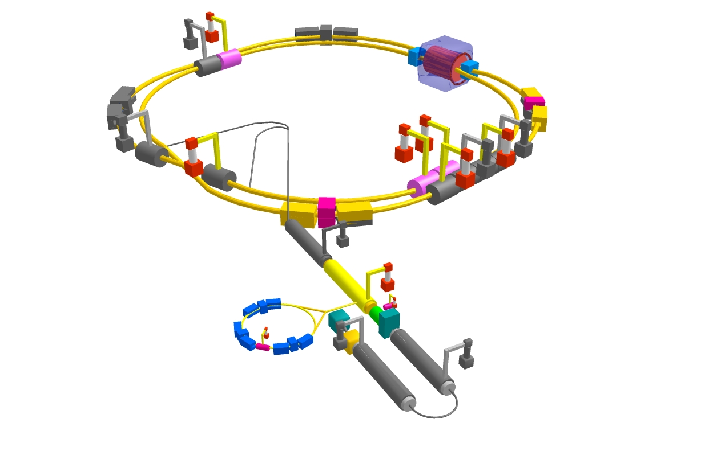
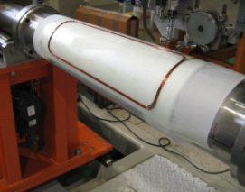
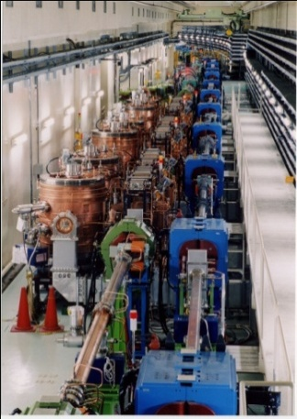
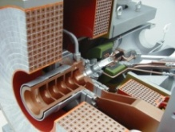
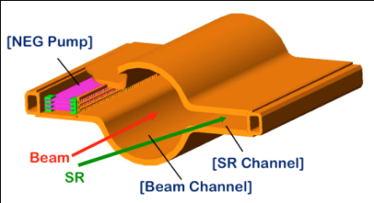
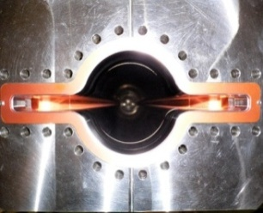
2010年起加速器升级为SuperKEKB
Grey is recycled, colored is new
e⁺ 4 GeV 3.6A
Colliding bunches
Belle II
New IR
New superconducting / permanent final focusing quads near the IP
e⁻ 7 GeV 2.6A
New beam pipe
& bellows
Replace short dipoles with longer ones (LER)
Add / modify RF systems for higher beam current
Low emittance positrons to inject
Positron source
Redesign the lattices of HER & LER to squeeze the emittance
New positron target / capture section
Damping ring
TiN-coated beam pipe with antechambers
Low emittance gun
Low emittance electrons to inject
Target: L = 8x10³⁵/cm²/s
Notes:
2

Slide 3
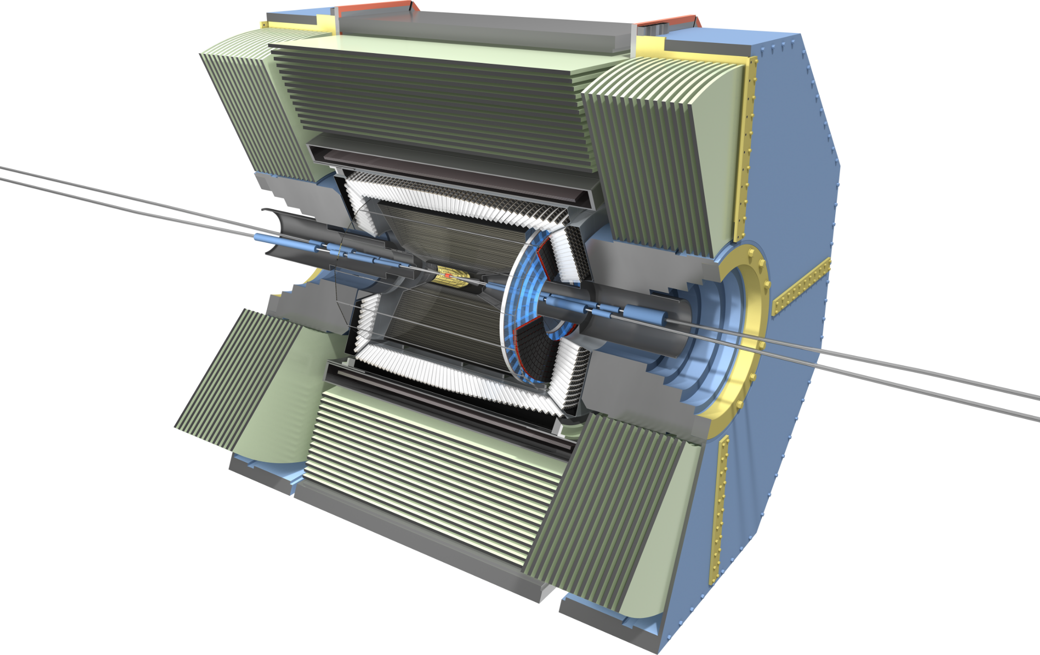
Belle II 探测器升级 [高计数率、高本底、高辐照]
RPC μ & K_{L} counter:
scintillator + Si-PM
for end-caps
CsI(Tl) EM calorimeter:
waveform sampling
electronics
7.4 m
3.3 m
1.5 m
Beryllium beam pipe
2cm diameter,
QCSR and QCSL
7.1 m
4 layers DSSD →
2 layers PXD
(DEPFET) +
4 layers DSSD
Time-of-Flight, Aerogel
Cherenkov Counter →
Time-of-Propagation counter (barrel),
proximity focusing Aerogel RICH (forward)
Central Drift Chamber:
smaller cell size,
long lever arm, fast electronics

Slide 4
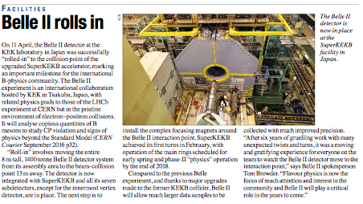
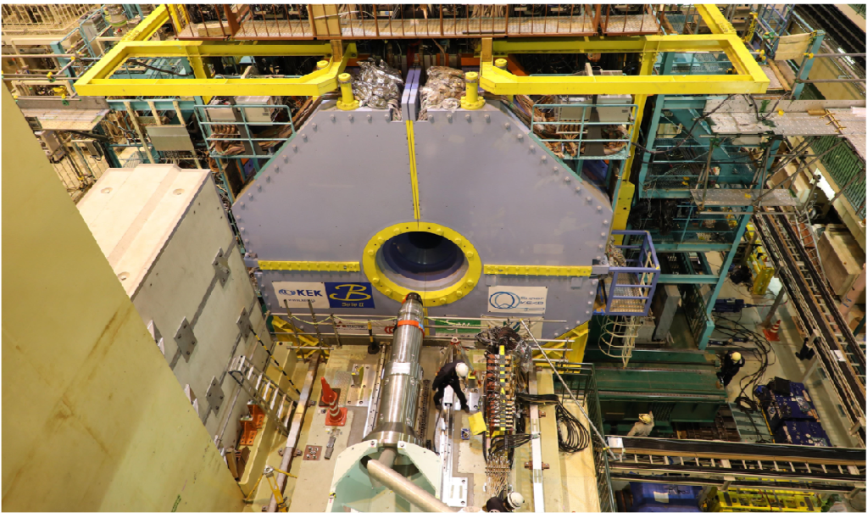
Belle II Milestones
April 11th, 2017, Belle II at IP!
March, 2018, Phase II commissioning
first collision very soon!
Notes:
we reached on april 11， 2017， the very important milestone of rolling-in of belle2 in the collision point on the beam line

Slide 5
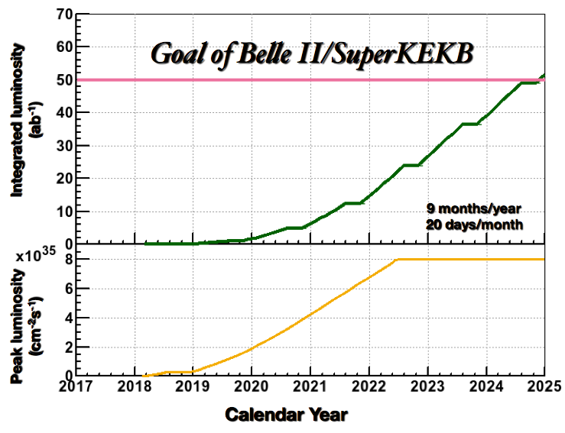
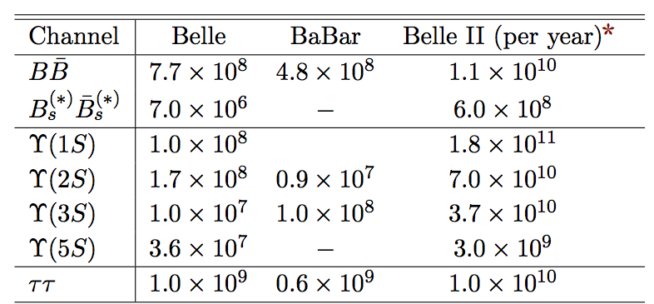
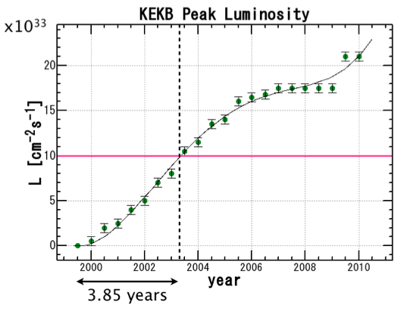
SuperKEKB 亮度预期
Expected data sample @ full luminosity
2018年4月对撞，
2019年初物理运行！
Assumptions:
same commission time to reach design lum. as KEKB
9 months/year running
20 days/month
逐步增加的数据量将逐步提高物理研究的灵敏度！
目标数据量为 Belle 实验的 50-100 倍!
Notes:
The plot on the right shows the luminosity profile of SuperKEKB, assuming the same commissioning time to reach nominal luminosity as in KEKB, 9 months/year of running time and 20 days/month of physics operations.
With this assumption the goal of 50 ab-1 will be reached in the year 2025.

Slide 6
Belle II实验关注度较高的热点问题
★CKM矩阵元的精确测量，新物理？
★是否存在新的CP破坏的相角？b→s过程新的时间依赖的CP破坏的测量：B→$ΦK^{0}$,$η^{′}K^{0}$.
★新物理是否对right-handed currents过程中有贡献？ 关键性的过程包括$B→K^{∗}γ$，VV; $B →$Vl$ν$ (V=$D^{∗},ρ$)
★超出标准模型的夸克味改变的中性流过程？ b→s$ν\overline{ν}$： $B → K^{(∗)}ν\overline{υ}$
★超出标准模型的LFV过程？$τ→γμ$
★测量前后端的不对成性寻找新物理的迹象： b→sl⁺l⁻
★B介子的纯轻半轻衰变：带电轻Higgs的作用 ？
★CPV的测量在$D−\overline{D}$混合？
★ 暗物理暗能量的寻找：e+e- →$A^{′}$l⁺l⁻
之前中国组在B的衰变中参与的不多。将来在B物理中对新物理的寻找会投入
更多的资源。竞争程度增加，难度加大，希望得到理论学家的指导！

Slide 7
Past at Belle (only physics!)
‾DD mixing (PKU, USTC)
XYZ & quarkonium (IHEP)
ISR, continuum production
Two-photon processes
Y(nS) decays
Light hadron spectroscopy (PKU, IHEP)
Two-photon processes
J/psi recoil, double-vector production
B decays

Slide 8
Now at Belle
‾DD mixing (USTC, IHEP)
Heavy flavor (Fudan, BUAA)
Bs decay
B semileptonic decays
XYZ & quarkonium (IHEP, BUAA, Fudan)
ISR, continuum production
Two-photon processes
Y(nS) radiative decays, transitions ωχ_{b}, φχ_{b, …}
hadron spectroscopy (BUAA, PKU, IHEP)
Two-photon processes (η’ππ)
Charmed baryons (Ξ_{c}), Tcs, Tcc, …
Glueballs, light tetraquarks, …

Slide 9
感兴趣的一些问题
★XYZ: 更多的衰变和产生模式 ？Y(1S,2S,3S,5S,6S)衰变 ？衰变率？
★4.6 GeV上以上XYZ的态 ？双重子态？重子+介子？粲重子+介子 ？产生的过程？
★Missing的激发态的重子？ Y(1S,2S,3S,5S,6S)衰变 ？衰变率？
★Missing的窄共振的底夸克偶素/粲夸克偶素 ？$η_{b2}$, $η_{c2}$
★B介子标记方法的改进 ？（欢迎实验物理学家的更多的讨论）
★具有更加明显特征的多夸克态：Tcc, Tcs, …
★五夸克态，六夸克态的寻找：$η_{c}+N$ ,$χ_{CJ}+N,$ …
★具有奇异量子数的胶球？ 更多的衰变产生过程？
★$τ$衰变的CPV的测量 ？
★暗物理暗能量在Y(1S,2S,3S）的衰变 ？
欢迎理论学家和实验物理学家的参与和指导！

