Slide 1
Charmonium-like states in e⁺e⁻ annihilation
Dian-Yong Chen
Southeast University
EPJC74,3208;78,136; PRD91,094023;93,034028
In Collaboration with Xiang Liu, T. Matsuki et al.

Slide 2
Outline
Brief review of experimental status
Fanno interference as a resonance killer
Y(4220): Missing 𝜓(4S)
Summary

Slide 3
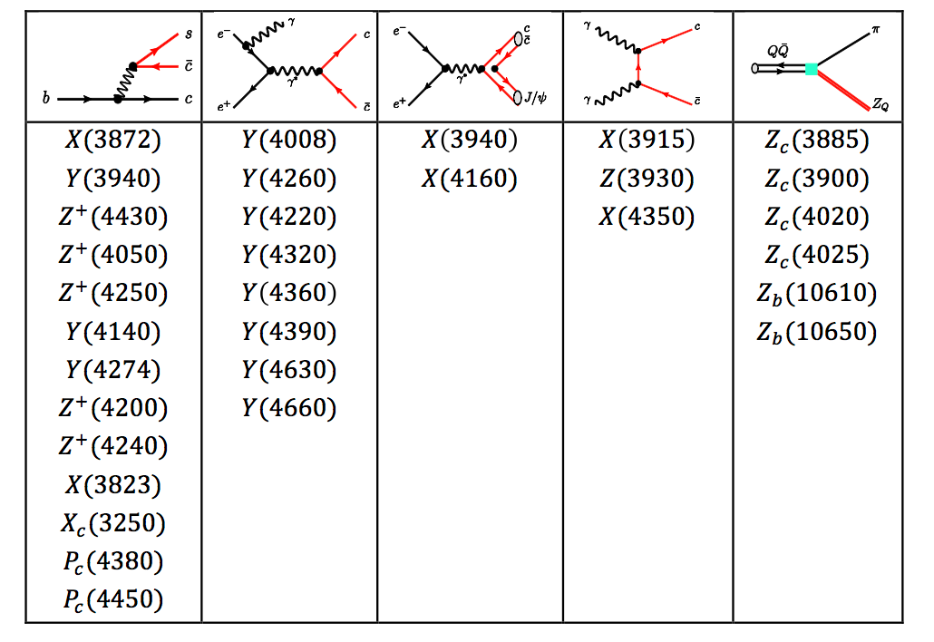
New Hadron States

Slide 4
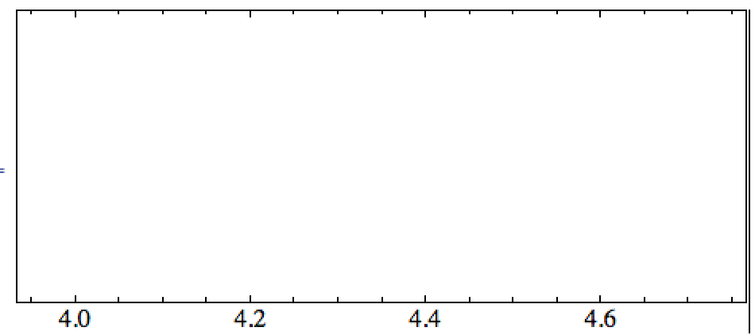
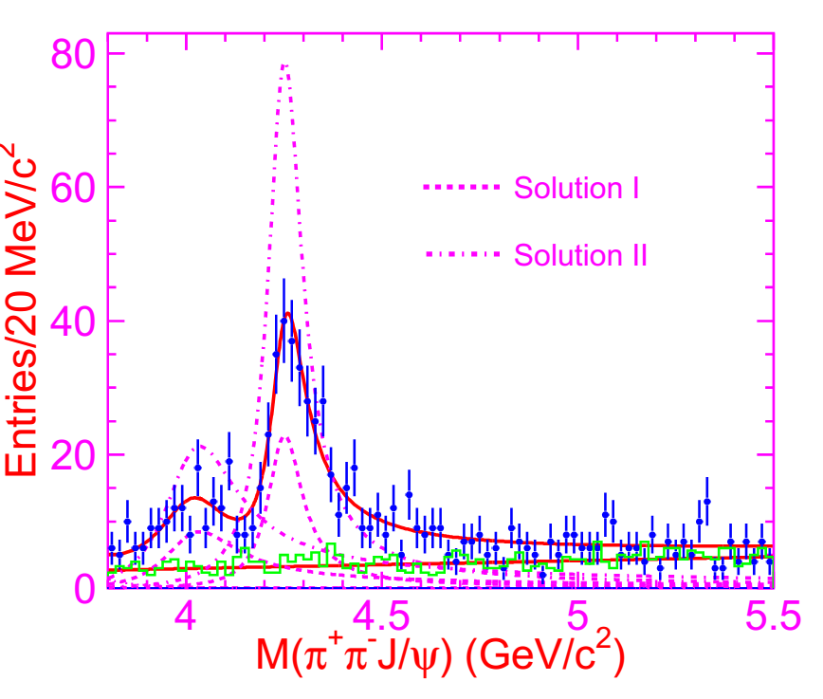


New Hadron States in e⁺e⁻ annihilation: Round I
Y(4008)
Y(4260)
PRL95, 142001 (2005)
PRL99,182004(2007)
$$e^{+}e^{−}→π^{+}π^{−}J/ψ$$

Slide 5


New Hadron States in e⁺e⁻ annihilation: Round I
Y(4008)
Y(4260)
Y(4360)
Y(4660)
PRL98, 212001 (2007)
PRL99, 142002 (2007)
$$e^{+}e^{−}→π^{+}π^{−}ψ(2S)$$

Slide 6
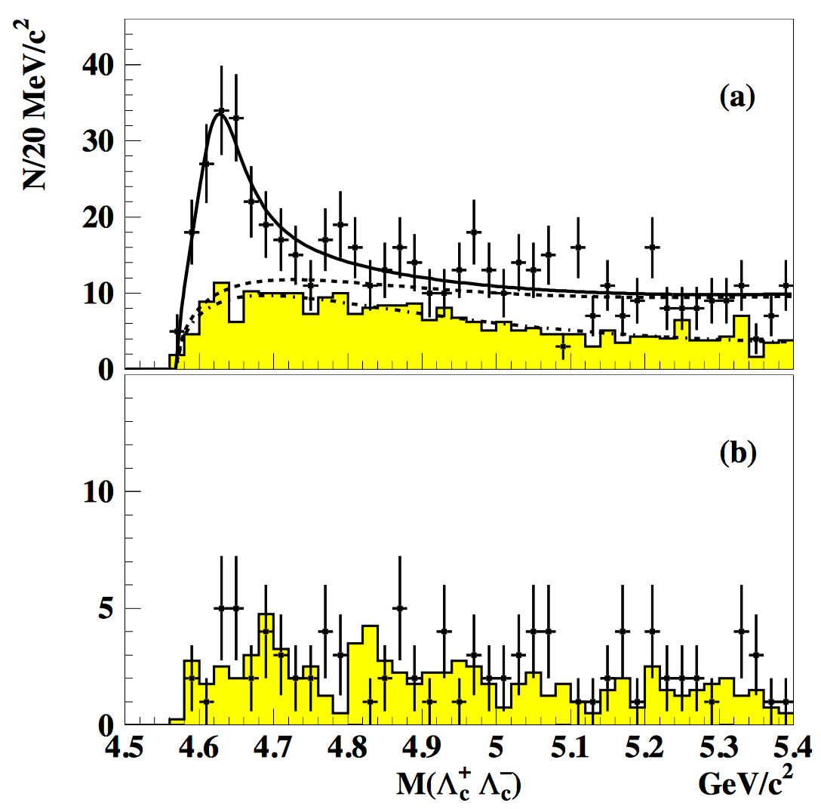

New Hadron States in e⁺e⁻ annihilation: Round I
Y(4008)
Y(4260)
Y(4360)
Y(4630)
Y(4660)
PRL101,172001 (2008)
Same State ?
$$e^{+}e^{−}→Λ_{c}^{+}Λ_{c}^{−}$$

Slide 7
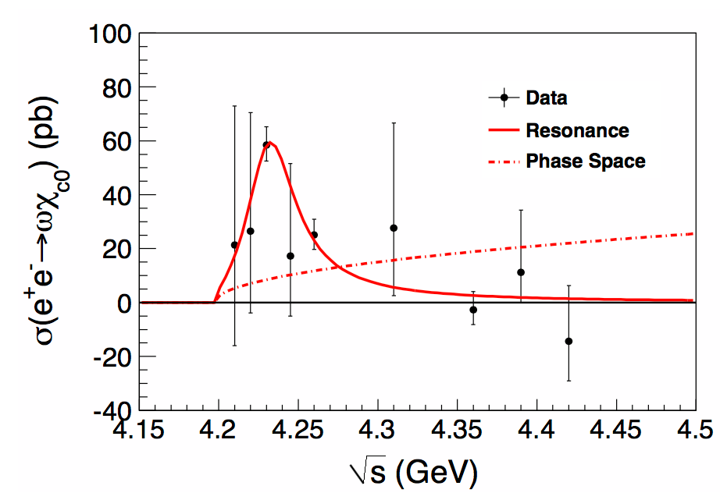

New Hadron States in e⁺e⁻ annihilation: Round II
Y(4220)
Y(4008)
Y(4260)
Y(4360)
Y(4630)
Y(4660)
PRL114, 092003 (2015)
$$e^{+}e^{−}→ωχ_{c0}$$

Slide 8
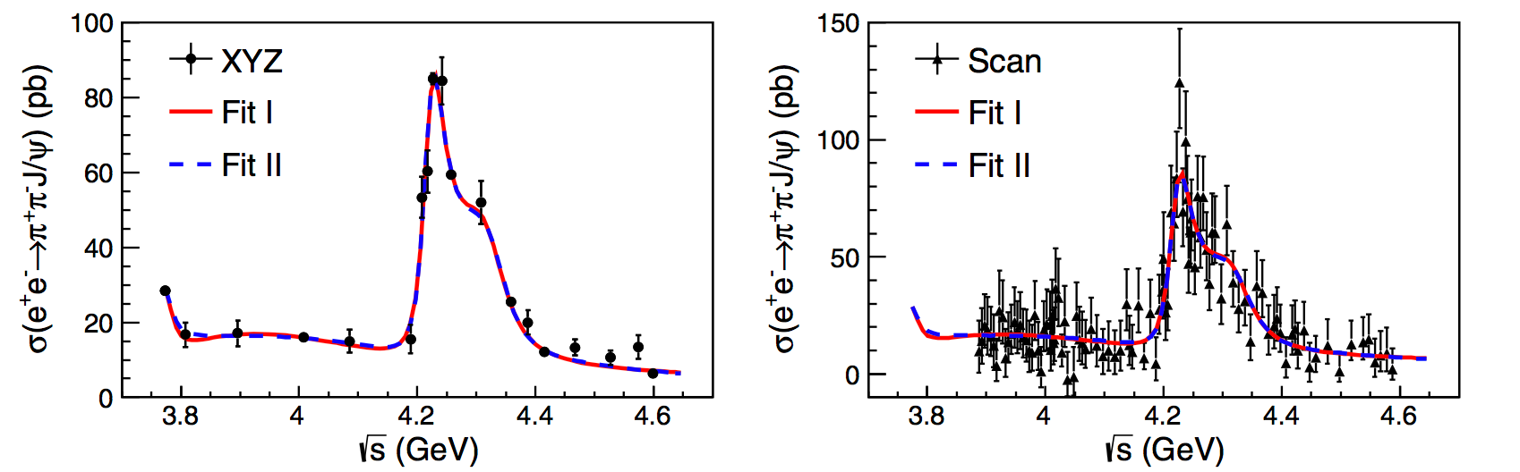
New Hadron States in e⁺e⁻ annihilation: Round II
Y(4220)
Y(4320)
Y(4008)
Y(4260)
Y(4360)
Y(4630)
Y(4660)
PRL118, 092001 (2017)
$$e^{+}e^{−}→π^{+}π^{−}J/ψ$$

Slide 9
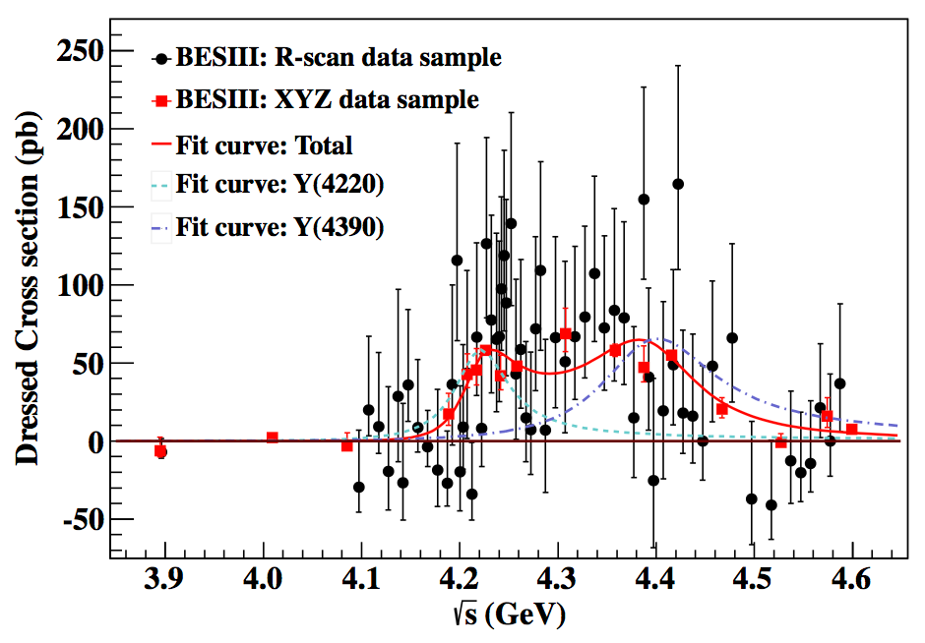

New Hadron States in e⁺e⁻ annihilation: Round II
Y(4220)
Y(4320)
Y(4390)
Y(4008)
Y(4260)
Y(4360)
Y(4630)
Y(4660)
PRL118, 092002 (2017)
$$e^{+}e^{−}→π^{+}π^{−}h_{c}$$

Slide 10
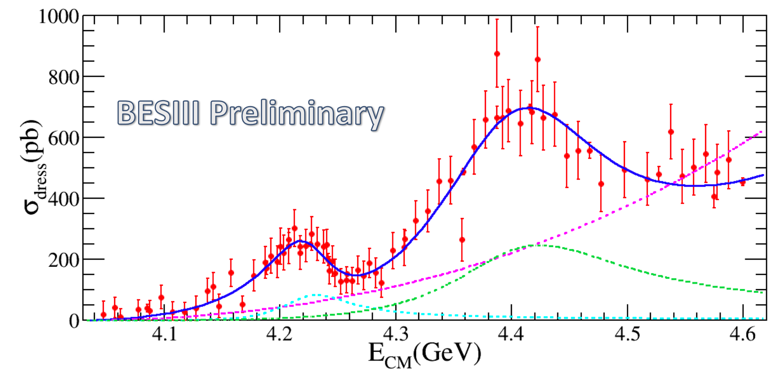

New Hadron States in e⁺e⁻ annihilation: Round II
Y(4220)
Y(4320)
Y(4390)
Y(4008)
Y(4260)
Y(4360)
Y(4630)
Y(4660)
PRL114, 092003 (2015)
$$e^{+}e^{−}→π^{+}D^{0}D^{∗−}$$

Slide 11
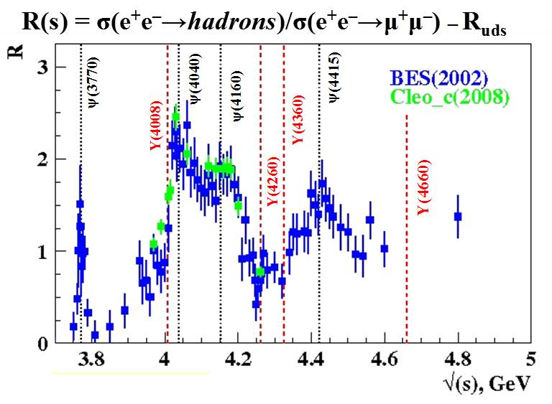
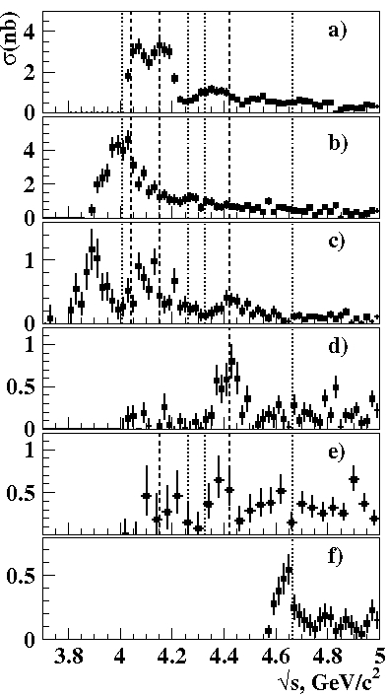

Y(4260)
D*D*
Y(4008)
ψ(4040)
ψ(4160)
PRL98, 092001 (2007)
Y(4360)
DD*
PRD77,011103(2008)
DD
?
PRL100,062001(2008)
ψ(4415)
DDπ
Great challenge:
No evidence of most charmonium like states in the obtained two body open-charm process and R-value scan
DD*π
arXiv:0908.0231
New
PRL101,172001(2008)
Y(4660)
Λ_{c}⁺Λ_{c}–

Slide 12



New Hadron States in e⁺e⁻ annihilation : Round II
$ψ$(4040)
$ψ$(4160)
$ψ$(4415)
Y(4220)
Y(4320)
Y(4390)
Y(4008)
Y(4260)
Y(4360)
Y(4630)
Y(4660)
All three well established charmonia were not observed in above hidden charm and open charm pion channels, Why?
Almost all the charmonium-like states are absent in the two-body open charm process and R scan, why?
4 charmonium-like states, 2 charmonium between 4.19 -4.415 GeV, Over crowed. What are they?

Slide 13
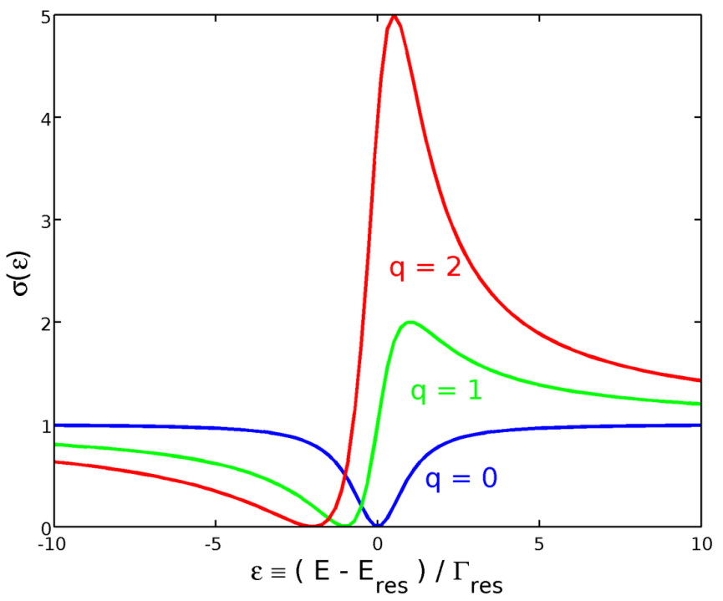
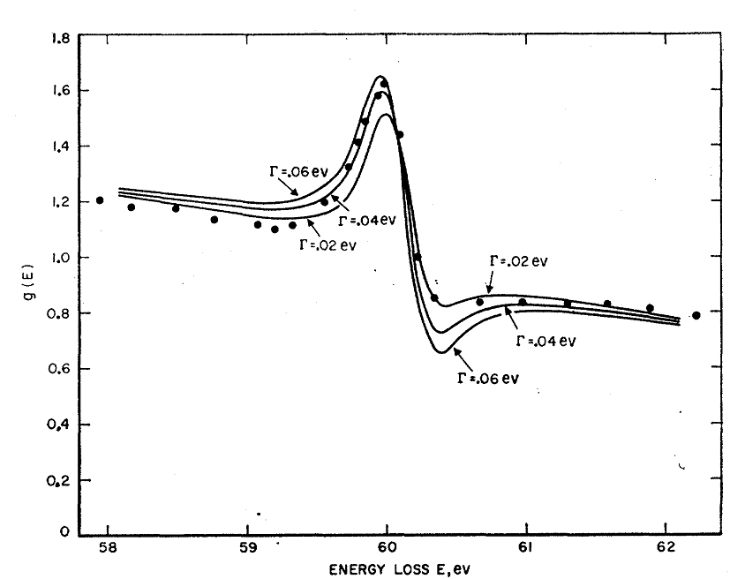
Fano Interference
Fano interference:
interference between continuum
process (background) and
resonant process.
Property: change the line shape to asymmetry.
General quantum phenomena, could be found in atomic physics, nuclear physics, condensed matter physics
Example: line shape in inelastic electron and Helium
U. Fano, Phys.Rev. 124,1866 (1961).

Slide 14
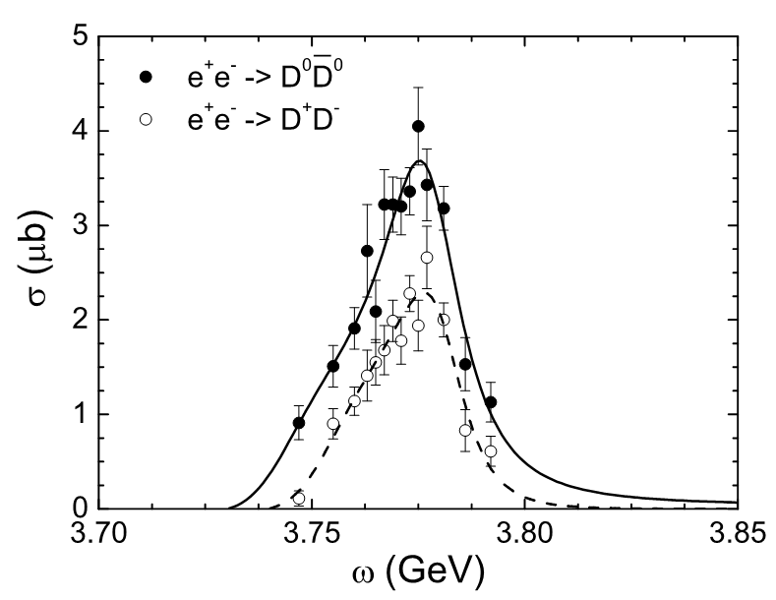
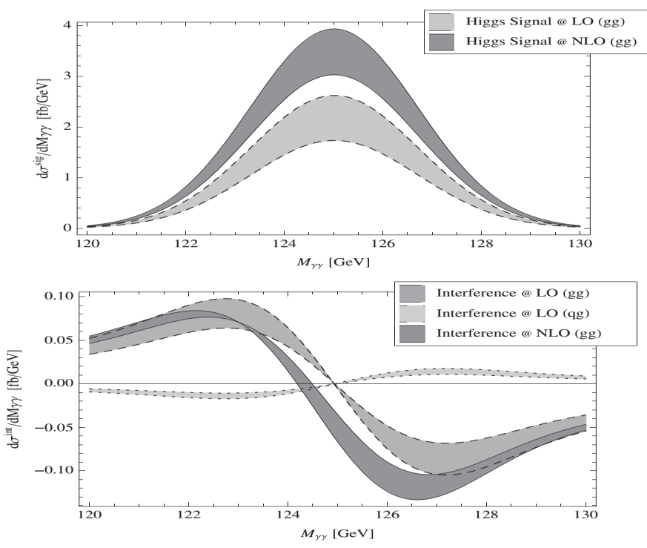
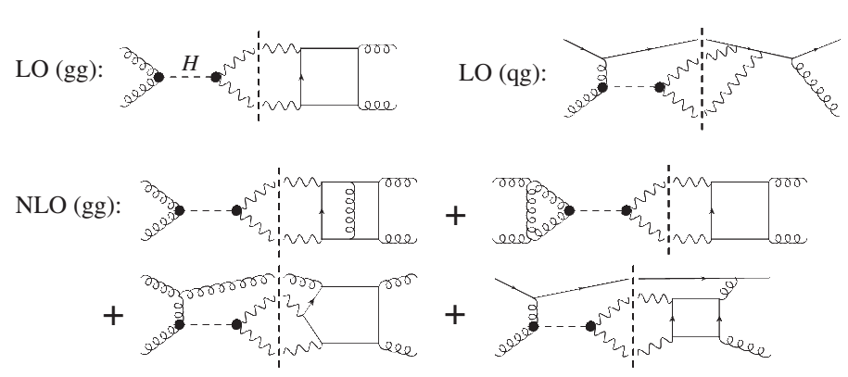
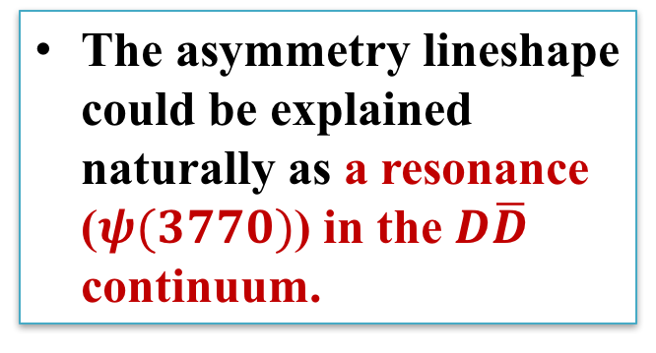
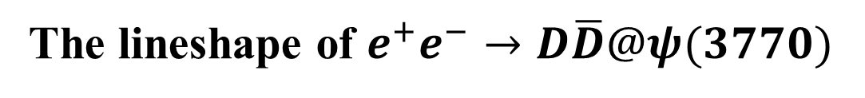
The lineshape of $e^{+}e^{−}→D\overline{D}@ψ(3770)$
The asymmetry lineshape could be explained naturally as a resonance ($ψ(3770)$) in the $D\overline{D}$ continuum.
Xu Cao and H. Lenske, arXiv:1410.1375
The lineshape of the Higgs signals could be asymmetry due to the interference with the continuum contributions
Higgs signal
Interference
L. J. Dixon and Ye Li PRL. 111,111802 (2013)

Slide 15
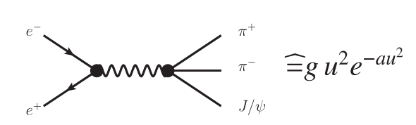
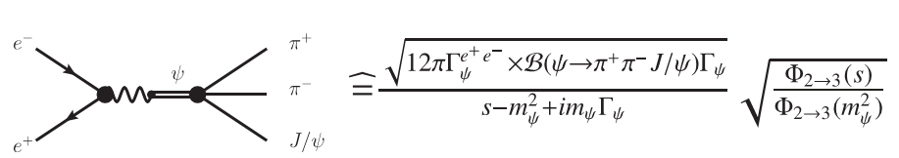

Fano-interference as a resonace killer
$ψ$(4040)
$ψ$(4160)
$ψ$(4415)
Y(4220)
Y(4320)
Y(4390)
Y(4008)
Y(4260)
Y(4360)
Y(4630)
Y(4660)

Slide 16
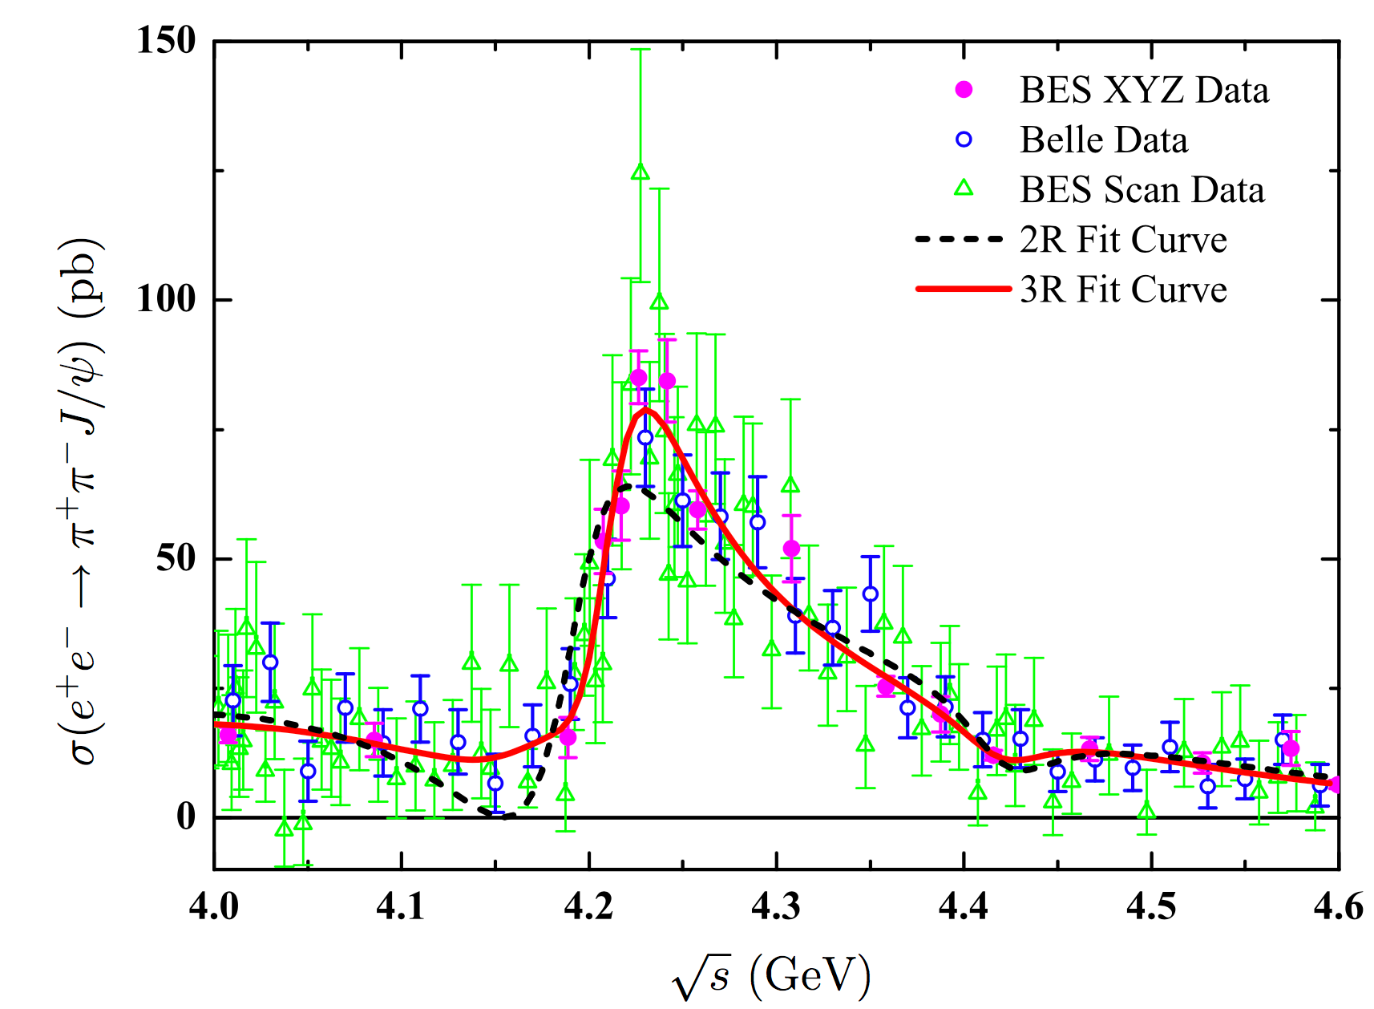
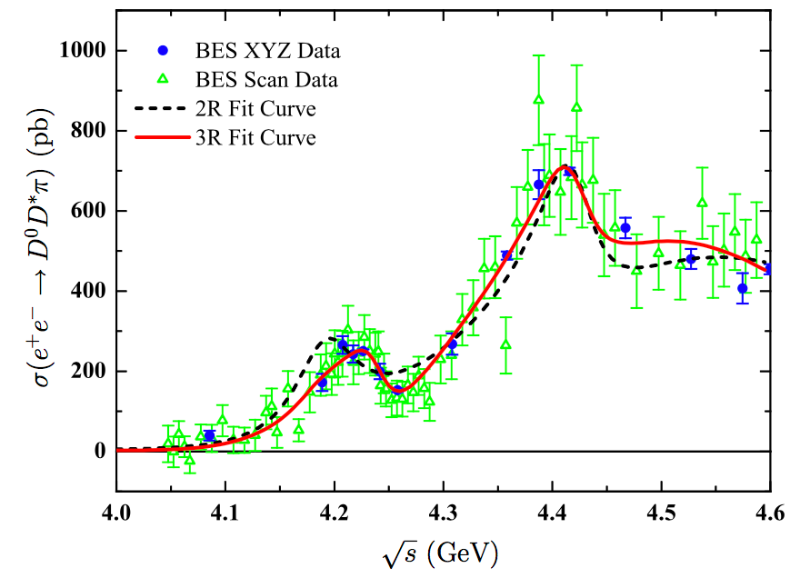
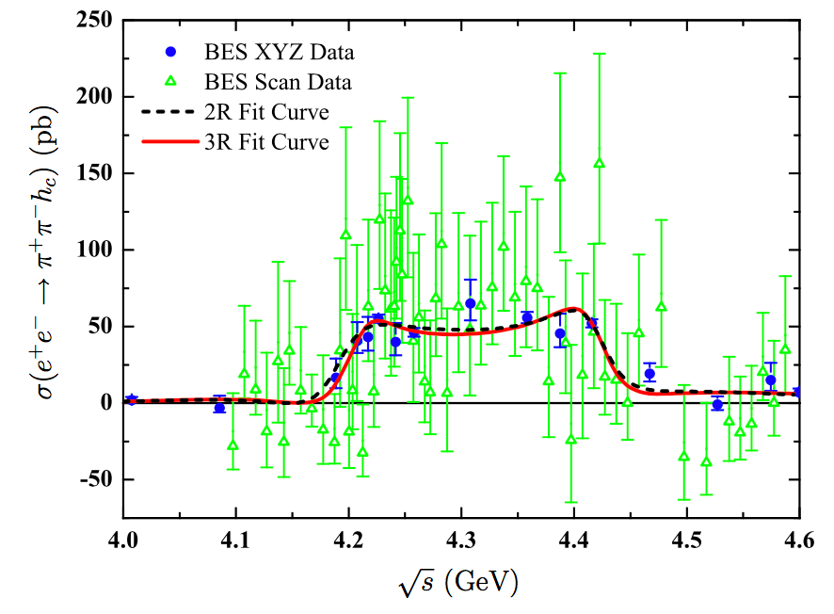



fit to BES data
EPJC78,136
$e^{+}e^{−}→π^{+}π^{−}J/ψ$
$e^{+}e^{−}→π^{+}D^{0}D^{∗−}$
$e^{+}e^{−}→π^{+}π^{−}h_{c}$

Slide 17
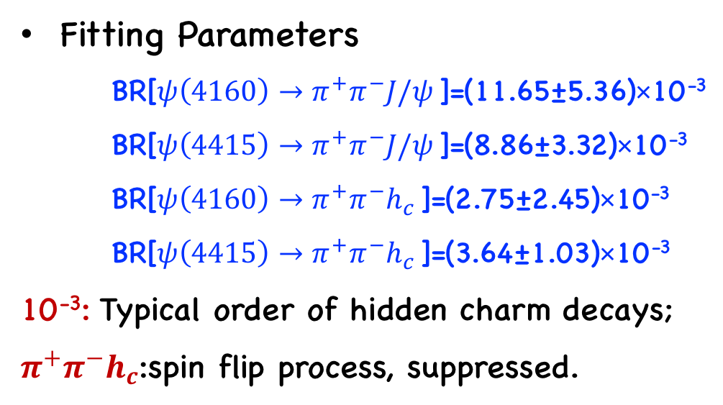
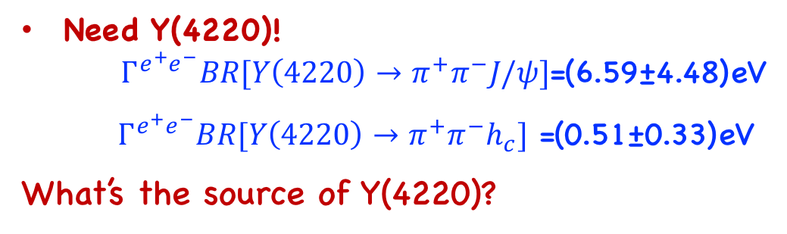
Fitting Parameters
BR[${ψ\left(4160\right)→π}^{+}π^{−}J/ψ$ ]=(11.65±5.36)×10⁻³
BR[${ψ\left(4415\right)→π}^{+}π^{−}J/ψ$ ]=(8.86±3.32)×10⁻³
BR[${ψ\left(4160\right)→π}^{+}π^{−}h_{c}$ ]=(2.75±2.45)×10⁻³
BR[${ψ\left(4415\right)→π}^{+}π^{−}h_{c}$ ]=(3.64±1.03)×10⁻³
10⁻³: Typical order of hidden charm decays;
$π^{+}π^{−}h_{c}$:spin flip process, suppressed.
Need Y(4220)!
${Γ^{e^{+}e^{−}}BR[Y\left(4220\right)→π}^{+}π^{−}J/ψ]$=(6.59±4.48)eV
${Γ^{e^{+}e^{−}}BR[Y\left(4220\right)→π}^{+}π^{−}h_{c}]$ =(0.51±0.33)eV
What’s the source of Y(4220)?

Slide 18
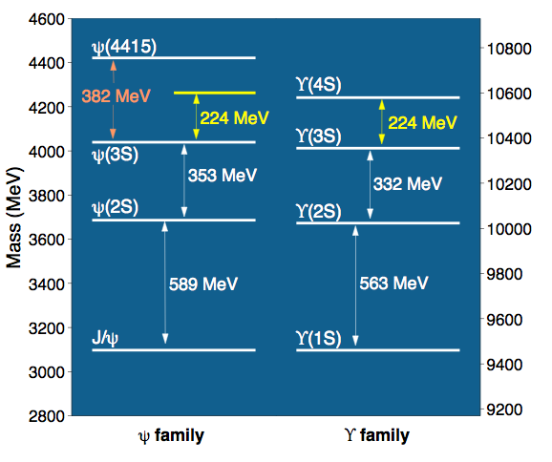

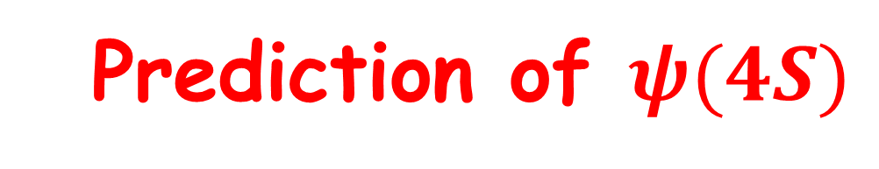
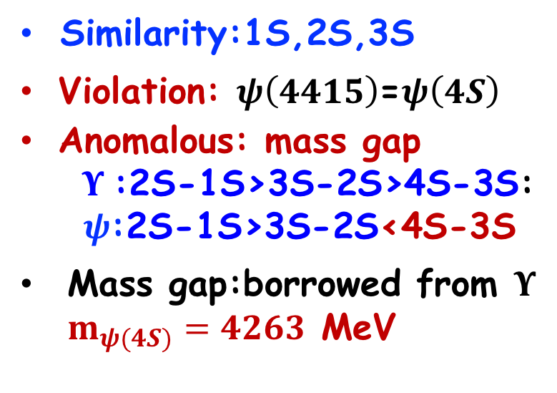
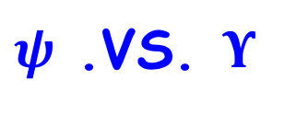
  Prediction of $ψ(4S)$
$ψ$ .VS. $Υ$
Similarity:1S,2S,3S
Violation: $ψ\left(4415\right)$=$ψ\left(4S\right)$
Anomalous: mass gap
$Υ$:2S-1S>3S-2S>4S-3S:
$ψ$:2S-1S>3S-2S<4S-3S
Mass gap:borrowed from $Υ$ $m_{ψ(4S)}=4263$ MeV
EPJC74,3208(2014)
Consistent!!
The screening potential prediction of ψ(4S) mass:
4273 MeV Li&Chao PRD79, 094004 (2009)
4247 MeV Dong et al., PRD49, 1642 (1994)

Slide 19
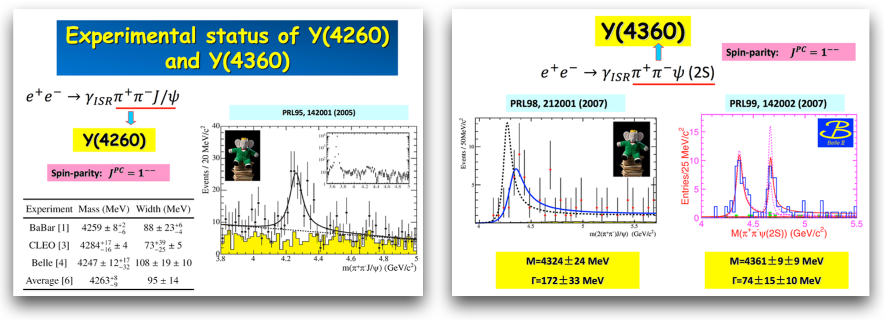
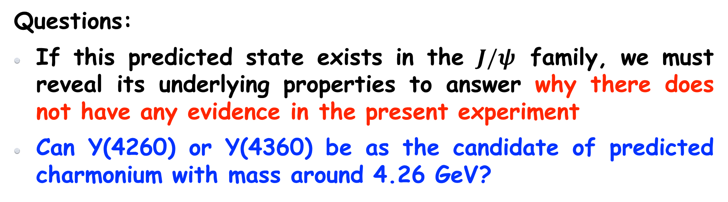

Questions:
If this predicted state exists in the $J/ψ$ family, we must reveal its underlying properties to answer why there does not have any evidence in the present experiment
Can Y(4260) or Y(4360) be as the candidate of predicted charmonium with mass around 4.26 GeV?
Charmonium-like state around 4.26 GeV

Slide 20
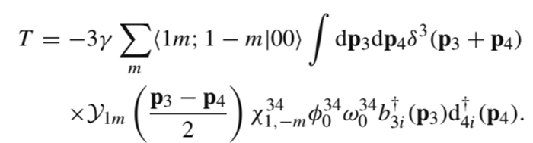
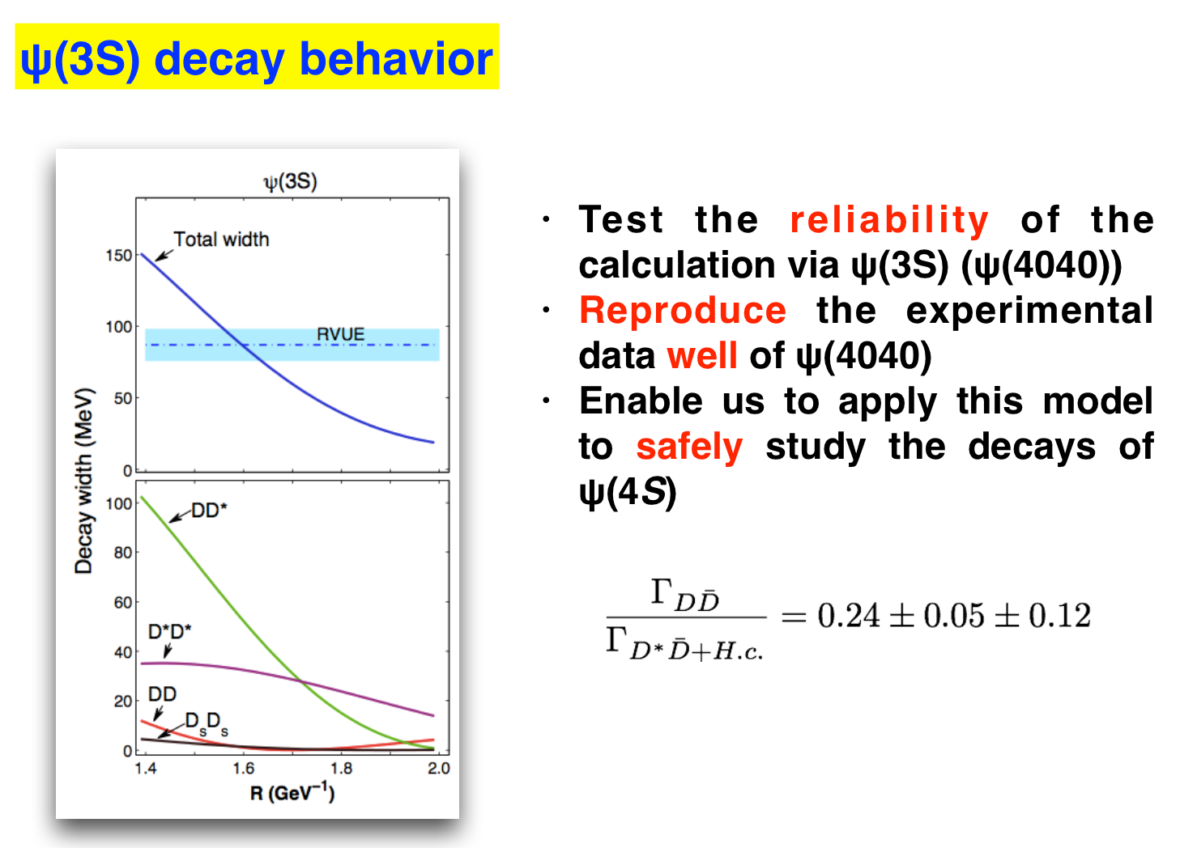
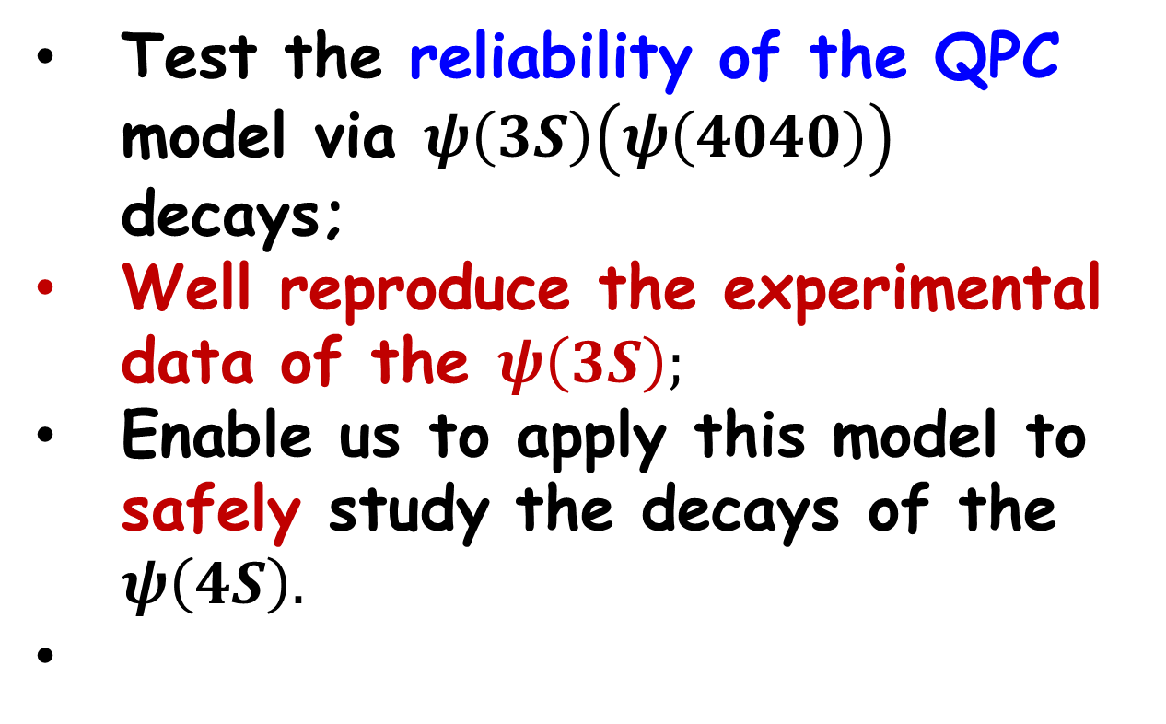
decay behavior:
QPC model:
L. Micu, NPB 10, 521 (1969)
Test the reliability of the QPC model via $ψ\left(3S\right)\left(ψ\left(4040\right)\right)$ decays;
Well reproduce the experimental data of the $ψ\left(3S\right);$
Enable us to apply this model to safely study the decays of the $ψ\left(4S\right).$

Slide 21
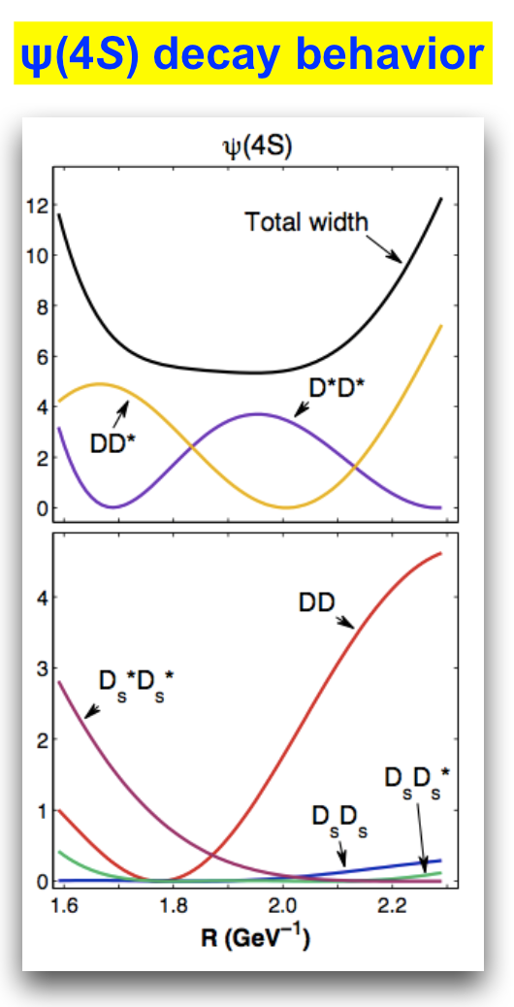

Partial Width: strongly dependent on R, node effect
total decay width: stable ;
ψ(4S): Narrow State, Unusual;
ψ(4040): 80 ± 10 MeV, ψ(4160): 70 ± 10 MeV. ψ(4415): 62 ± 20 MeV, ψ(3770): 27.2 MeV
Exclude Y(4260)/Y(4360) as the candidate of ψ(4S)

Slide 22
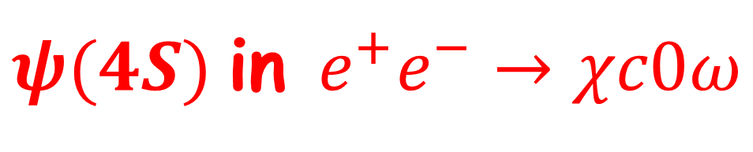
$ψ(4S)$in $e^{+}e^{−}→χc0ω$
BESIII, arXiv:1410.6538
If taking the mass of ψ(4S) to be 4230 MeV (Expt.), we find:
ψ(4S)→χc0ω is allowed
ψ(4S)→χc1ω and ψ(4S) →χc2ω are forbidden kinematically
Explain why only e⁺e⁻→χc0ω was reported by BESIII
e⁺e⁻→χc1ω and e⁺e⁻→χc2ω are not significant

Slide 23
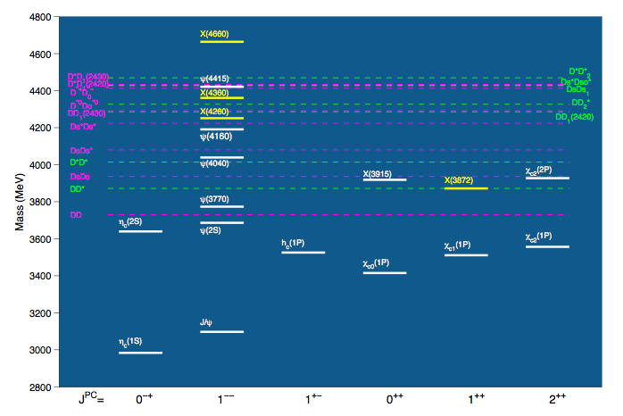
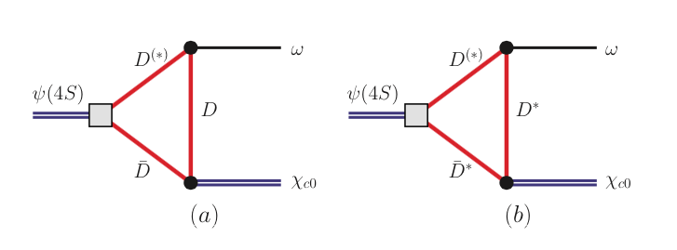
The study of the transition ψ(4S ) → ωχc0
For higher charmonia and bottomonia, the unquenched effect becomes more and more important since more channels are open
Coupled-channel effect
Non-perturbative properties of QCD
Hadronic loop is an effective description for this effect

Slide 24

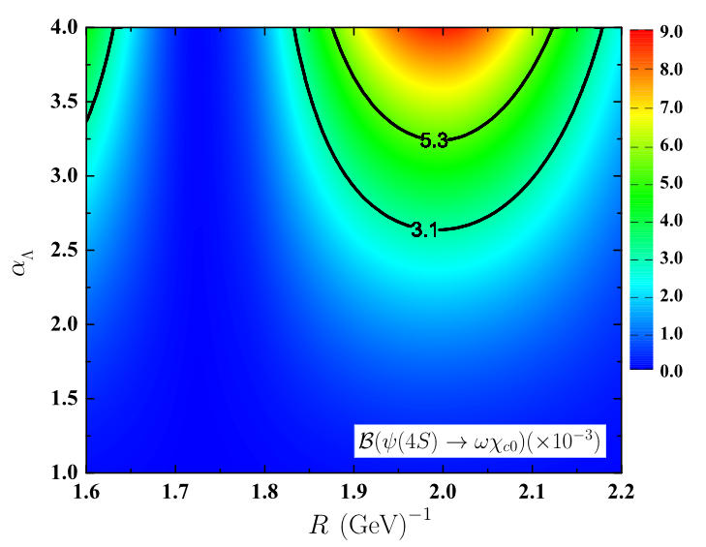
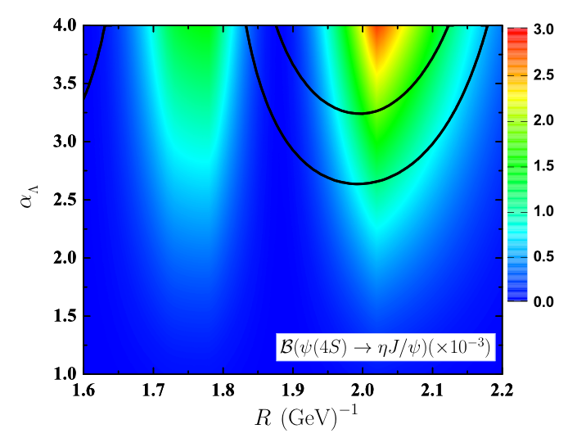


BESIII result (assuming the enhancement from ψ(4S)):
Li&Chao PRD79, 094004
Dong et al., PRD49, 1642
$$ψ\left(4S\right)→ηJ/ψ$$
$$<1.9×10^{−3}$$
$$ψ\left(4S\right)→χ_{c0}ω$$
Phys.Rev.D91,094023

Slide 25
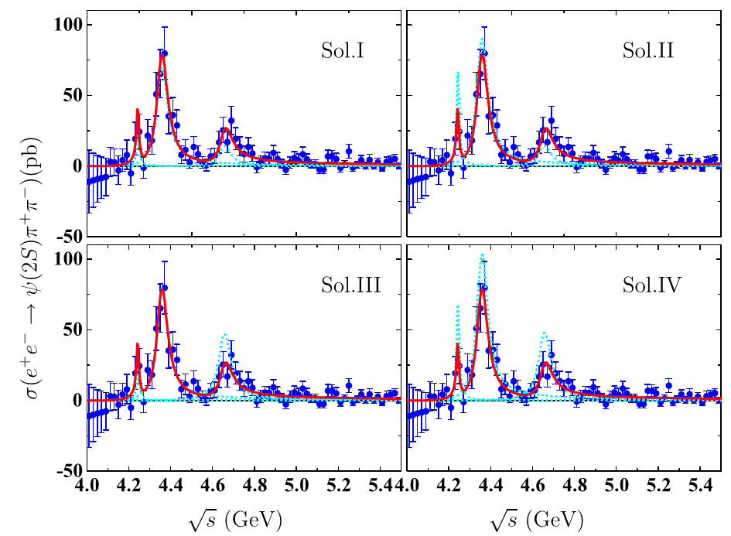
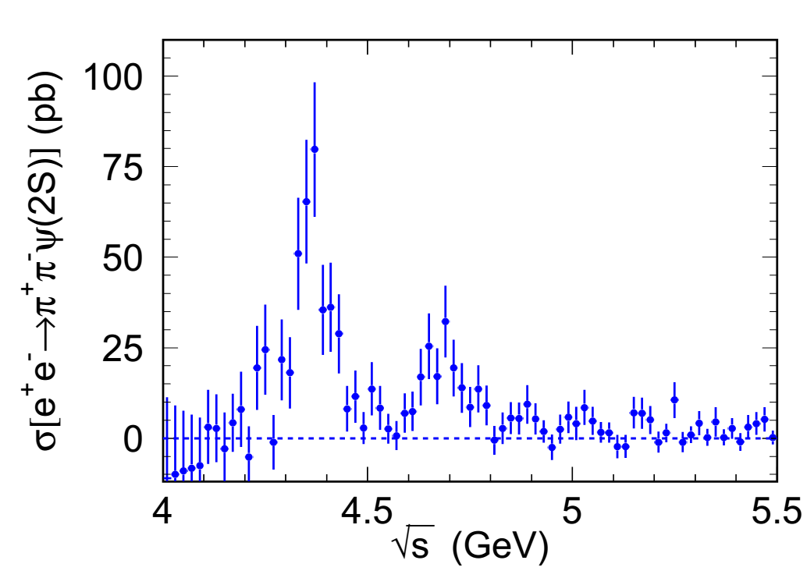
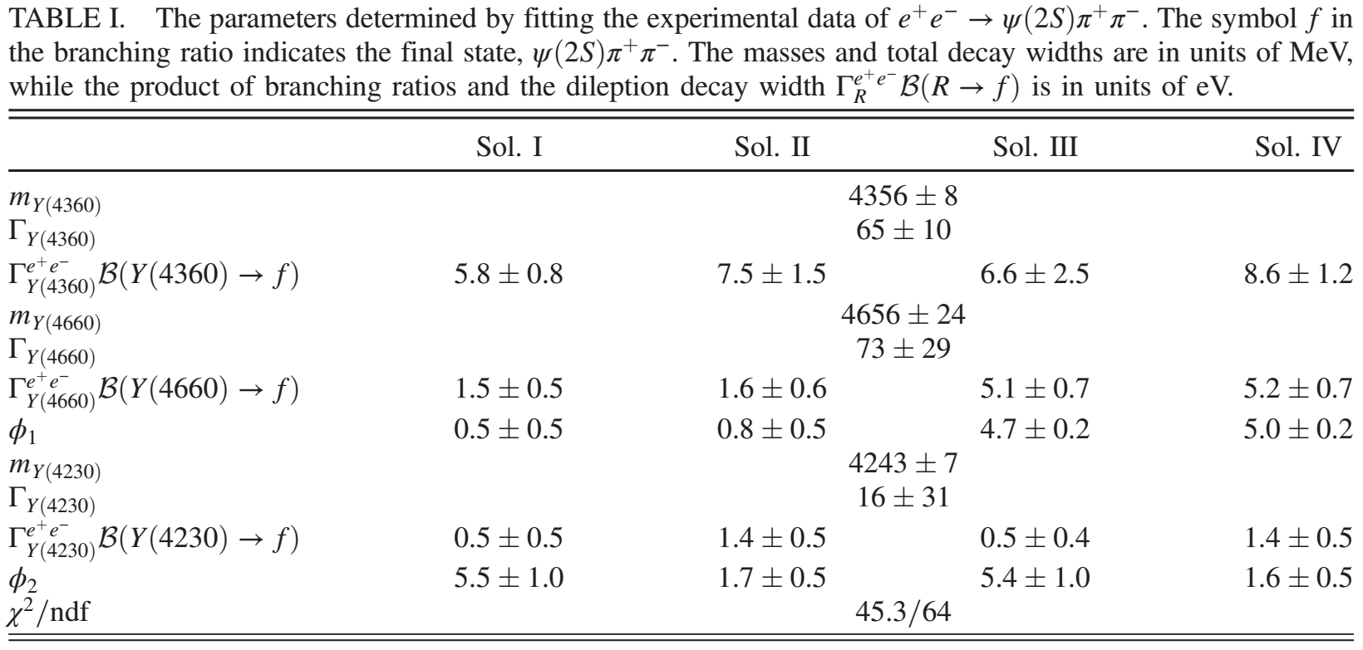
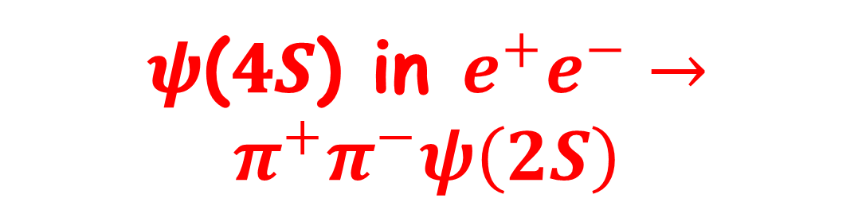
𝝍(𝟒𝑺) in $e^{+}e^{−}→π^{+}π^{−}ψ\left(2S\right)$
Fit the cross section with 𝜓(4𝑆)
Belle, PRD91,112007 (2015)
Y(4360)
New?
Y(4660)
Phys.Rev.D93,034028
Two confirmed structrue Y(4360) and Y(4660)
A new narrow structure around 4.2 GeV
The new structure may correspond to 𝜓(4𝑆)

Slide 26
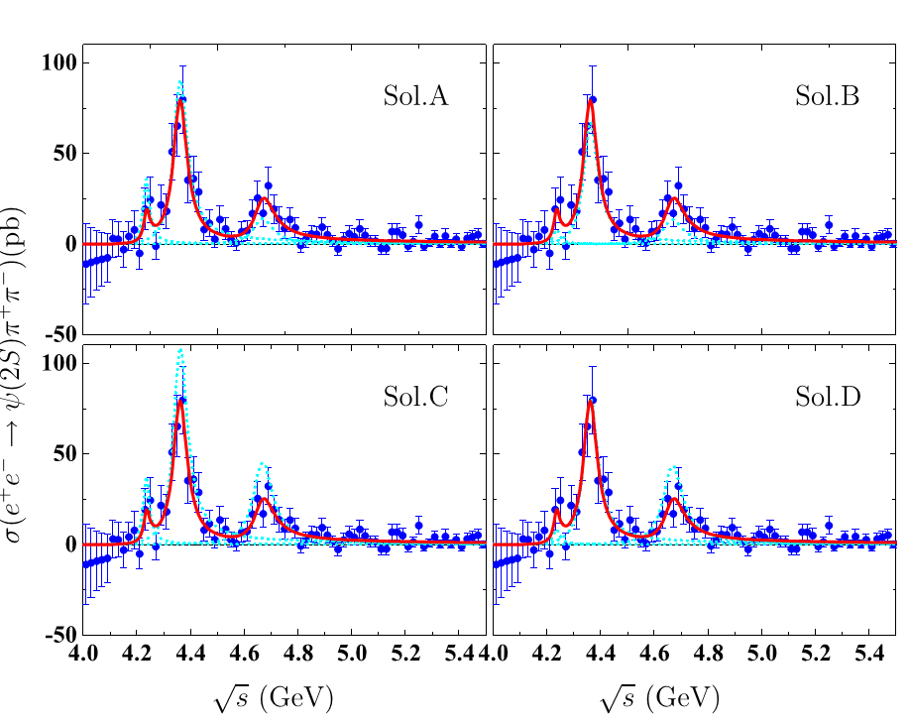
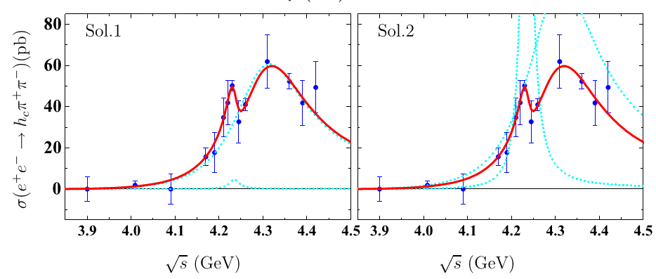
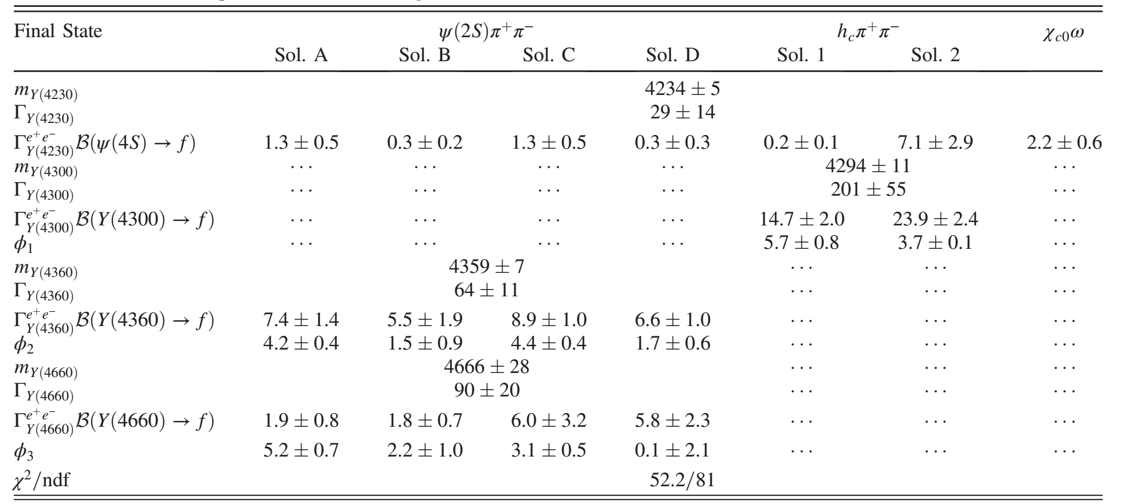
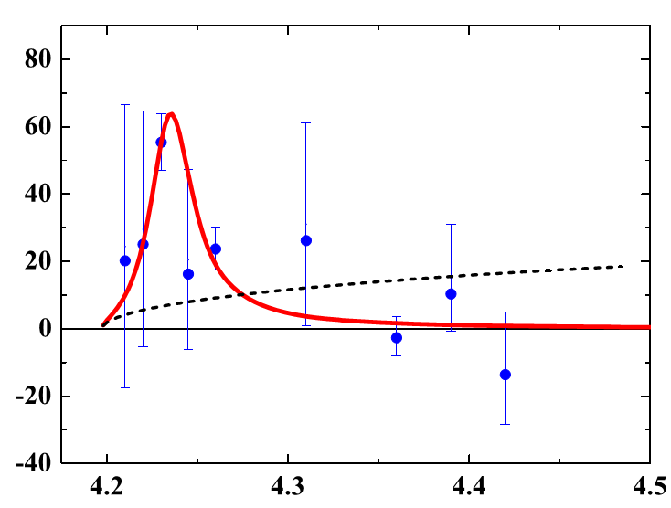



Combined fit to $e^{+}e^{−}→χ_{c0}ω, π^{+}π^{−}h_{c}$ and $π^{+}π^{−}ψ(2S)$ Scheme-I
$${e^{+}e^{−}→π}^{+}π^{−}ψ(2S)$$
$${e^{+}e^{−}→π}^{+}π^{−}h_{c}$$
Narrow structure
$${e^{+}e^{−}→χ}_{c0}ω$$

Slide 27
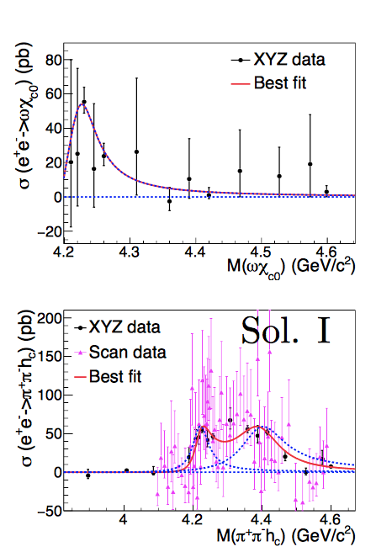
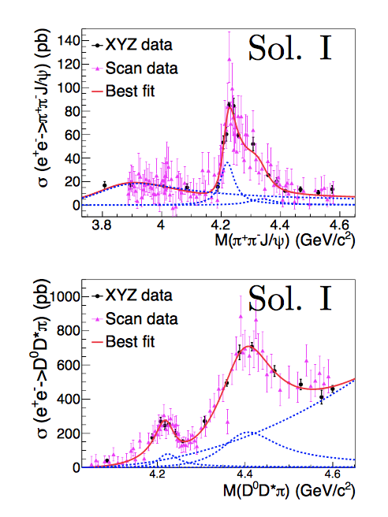

Combined fit to $e^{+}e^{−}→χ_{c0}ω, π^{+}π^{−}h_{c} , π^{+}π^{−}J/ψ$ and $πDD^{∗}$
Gao, Shen, Yuan, Arxiv: 1703.10351

Slide 28
Summary
A growing number of charmonium-like states have been observed;
What are they:
  Fanno interferences: Y(4260,4320,4360,4390);
  𝝍(𝟒𝑺): Y(4220);
3. Need more effort:
2-body open charm process at BESIII &Belle II

Slide 29
Thank you
for your attention!

