Slide 1
Effect of Construction Steel Rebars on Residue of the Magnetic Field

Slide 2
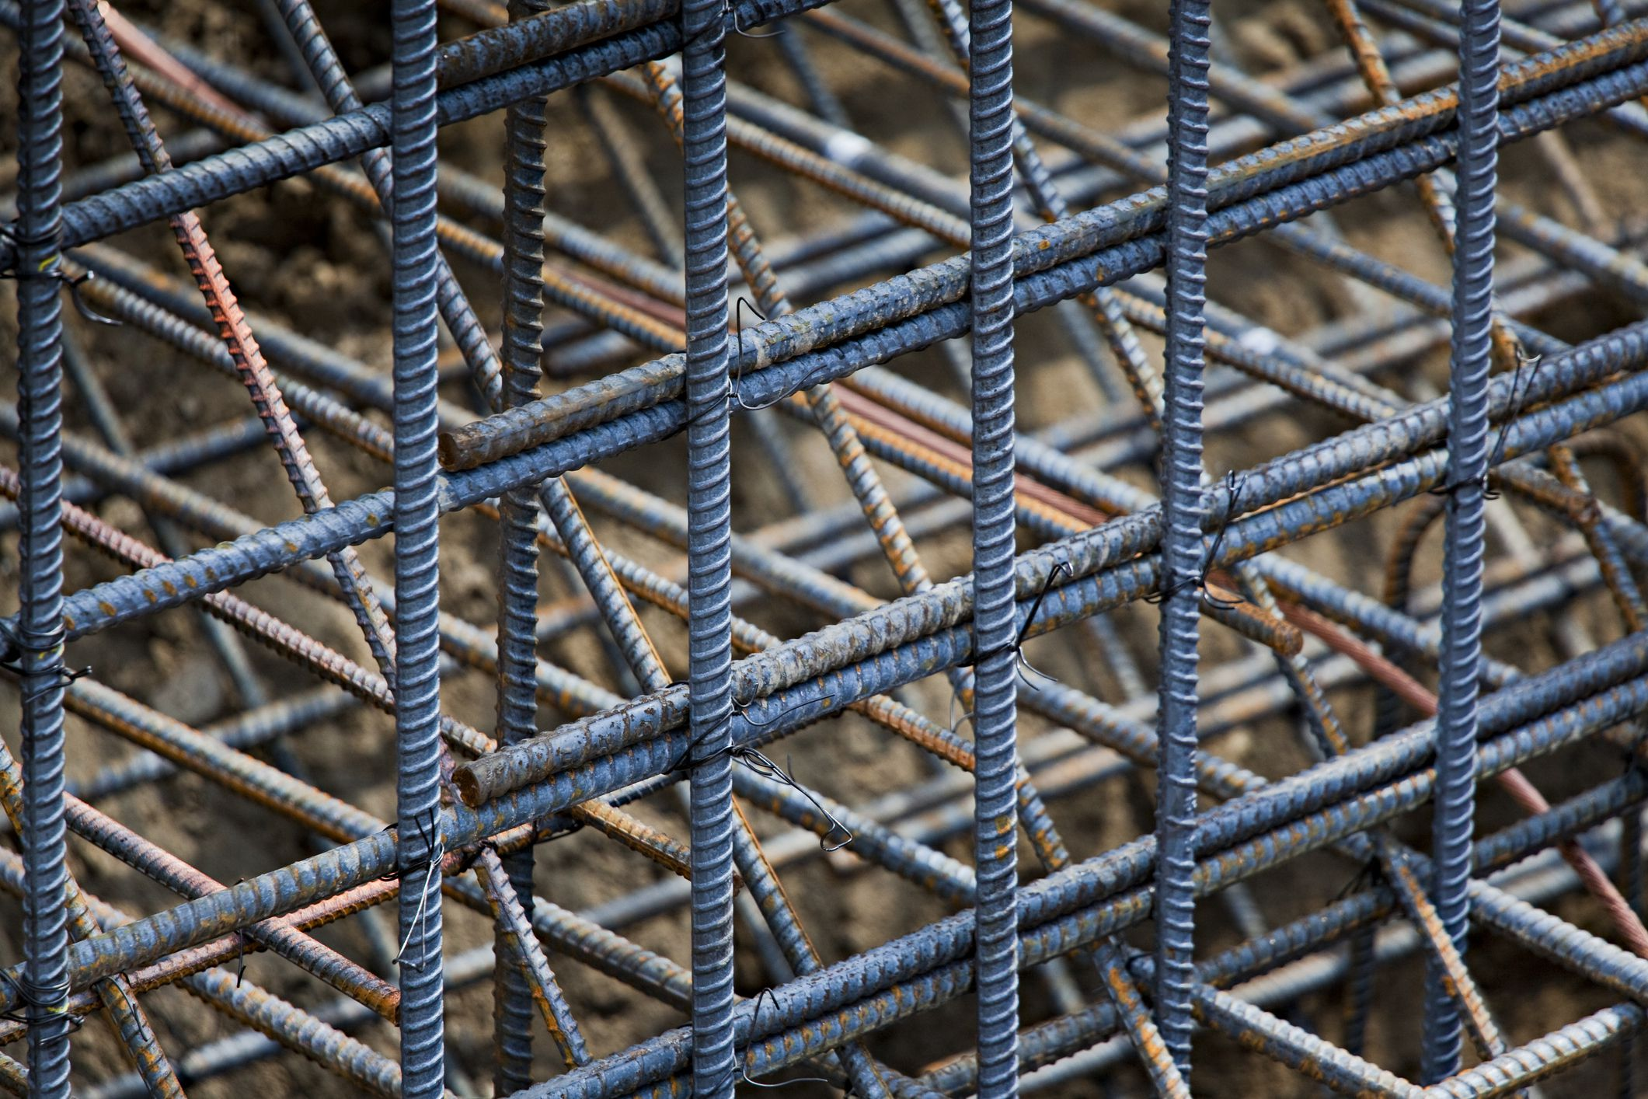
Rebars?

Slide 3
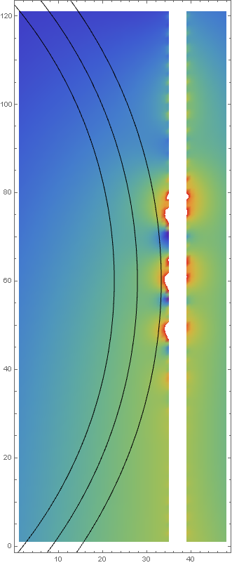


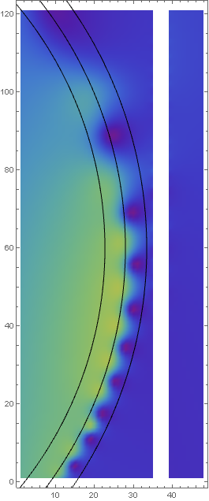
Effect on magnetic field

Slide 4
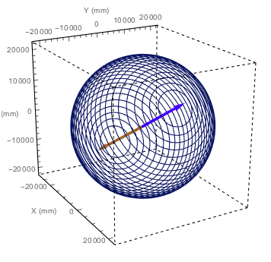
Layout 5 | 32 Coils | Equal Space
Spherical coil consists of 32 circular coils laying 32.017° (inclination) in the same manner as the EMF.
All of the circular coils have the same value of space with the coil next to them (1.35 m).
Optimize for the currents at the surface of diameter 39.5 m
coil | Radius (m) | Location (m) | Current (A)
1 | 21.64 | 0.68 | 72.43
2 | 21.55 | 2.03 | 72.42
3 | 21.38 | 3.38 | 72.43
4 | 21.13 | 4.74 | 72.42
5 | 20.78 | 6.09 | 72.43
6 | 20.33 | 7.44 | 72.42
7 | 19.78 | 8.80 | 72.44
8 | 19.12 | 10.15 | 72.40
9 | 18.43 | 11.50 | 72.47
10 | 17.42 | 12.85 | 72.35
11 | 16.34 | 14.21 | 72.59
12 | 15.05 | 15.56 | 72.12
13 | 13.51 | 16.91 | 73.06
14 | 11.62 | 18.27 | 71.11
15 | 9.15 | 19.62 | 76.13
16 | 5.37 | 20.97 | 57.87

Slide 5
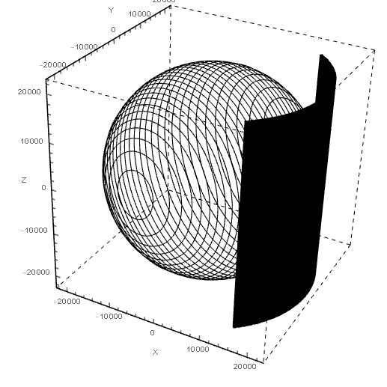
Rebar arrangement
Top down view
1. CD PMT
19.5m (39m)
2. Veto PMT
20.55m (41.1m)
3. Coil
21.64m (43.28m)
4. 3-Layers of Rebar
22m (44m)
22.2m (44.4m)
22.4m (44.8m)
1
2
3
4

Slide 6
Rebar arrangement
Top down view
1. CD PMT
19.5m (39m)
2. Veto PMT
20.55m (41.1m)
3. Coil
21.64m (43.28m)
4. 3-Layers of Rebar
22m (44m) 19.19cm
22.2m (44.4m) 19.37cm
22.4m (44.8m) 19.55cm
0.5 degrees apart
1
2
3
4

Slide 7
Rebar arrangement
Side view
1. CD PMT
19.5m (39m)
2. Veto PMT
20.55m (41.1m)
3. Coil
21.64m (43.28m)
4. 3-Layers of Rebar
22m (44m) 19.19cm
22.2m (44.4m) 19.37cm
22.4m (44.8m) 19.55cm
44m long
2cm diameter
1
2
3
4

Slide 8
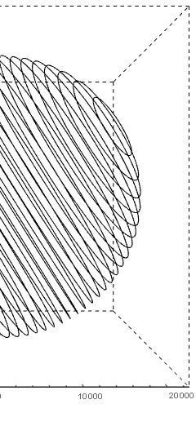
Effect on magnetic field
12m
12m
-12m
-12m
15m
24.5m
15m
24.5m

Slide 9
Residue of Magnetic Field
12m
Angle (Degrees) | Magnetic field residue (Gauss) |  | % of residue (% of Earth magnetic field) |  | Ratio (Without Rebar : With Rebar)
 | Without Rebar | With Rebar | Without Rebar | With Rebar
0 | 0.01511 | 0.05108 | 3.37 | 11.39 | 3.38
15 | 0.01506 | 0.05159 | 3.36 | 11.51 | 3.43
30 | 0.01520 | 0.04561 | 3.39 | 10.17 | 3.00
-12m
15m
24.5m

