Slide 1
Work Report
Miao Nannan
2017.12.14

Slide 2
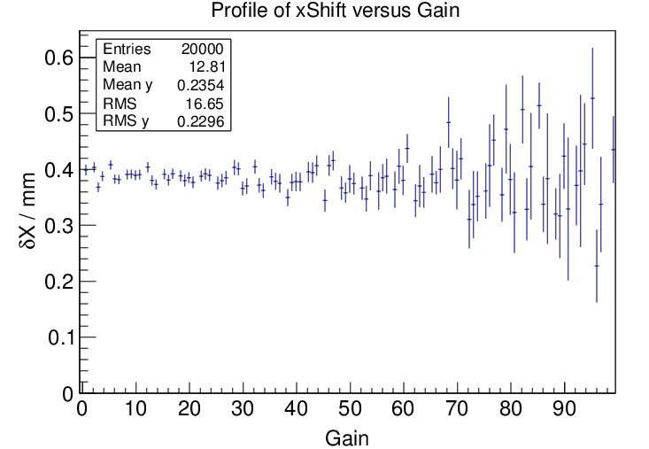
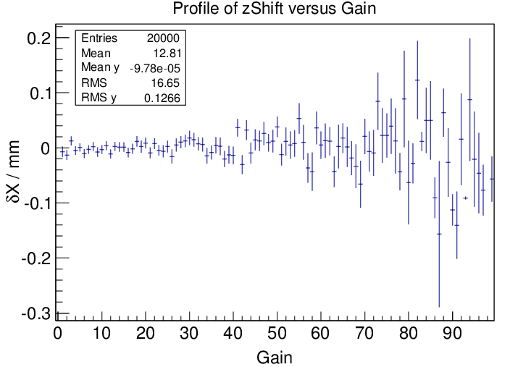
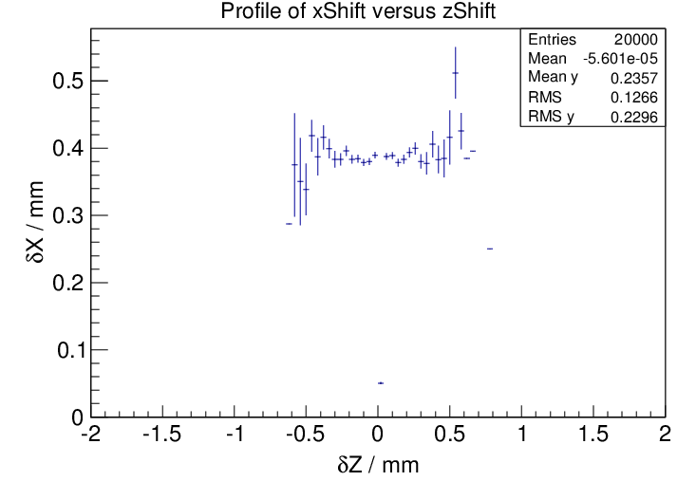
增益相关性检查
B⊙
x
y
Gem2
δX

Slide 3
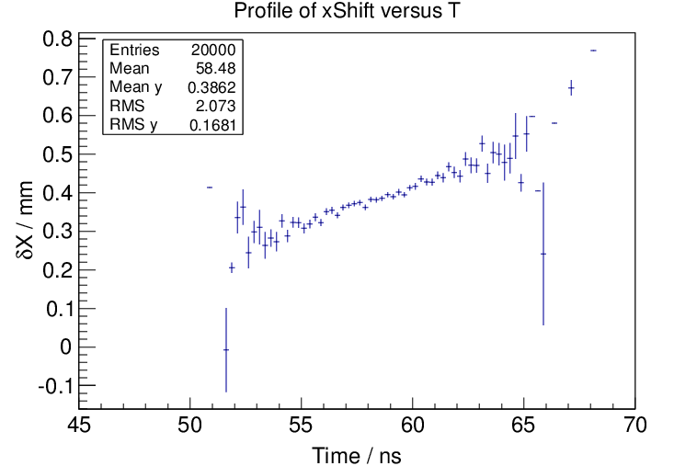
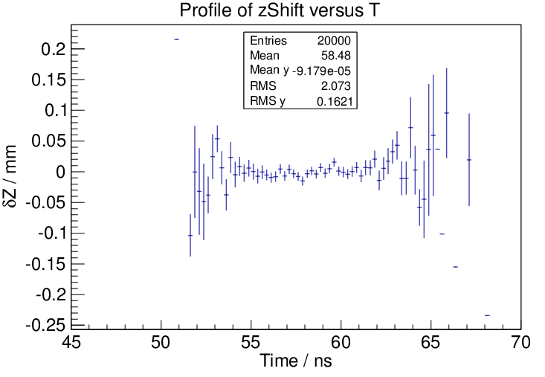
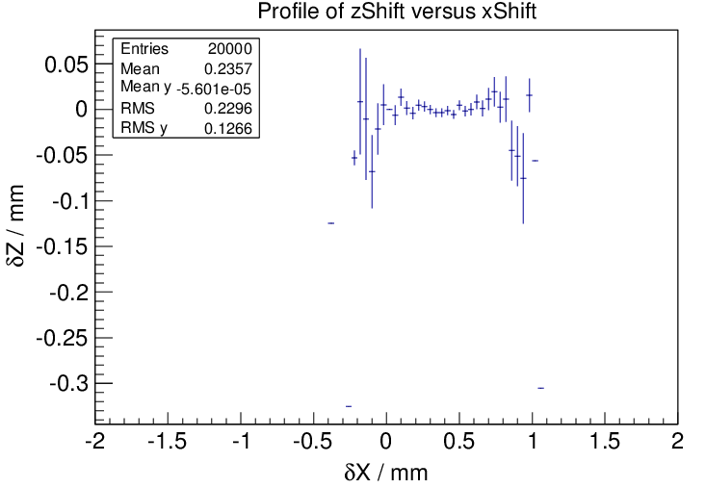
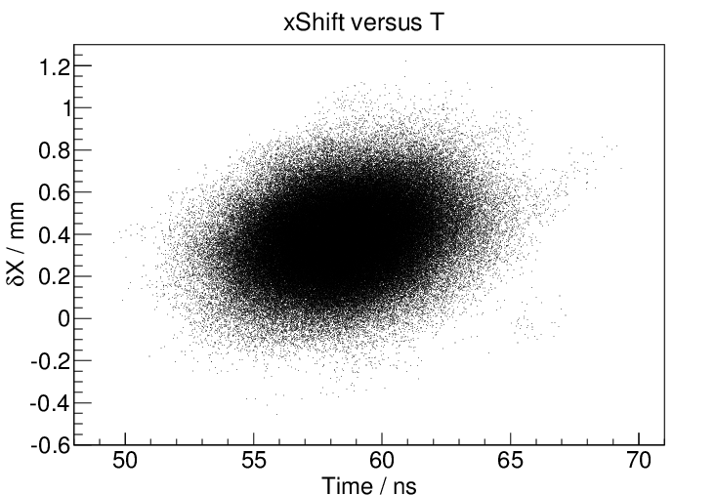
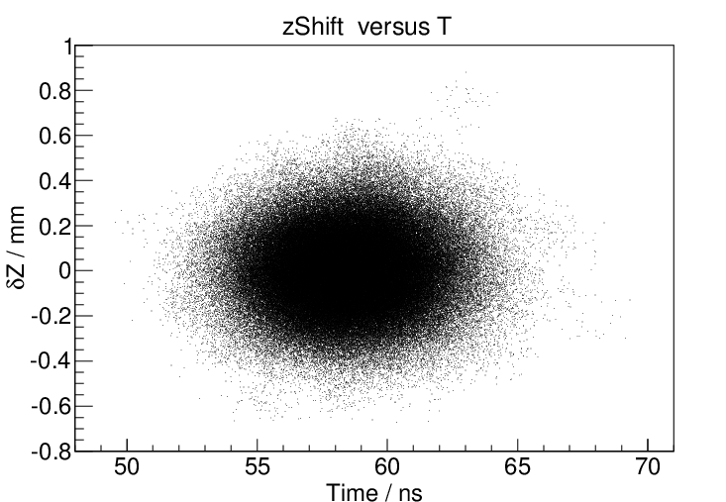
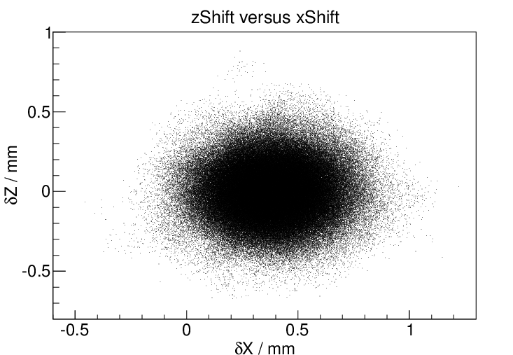
增益相关性检查

Slide 4
Transparency
Gem | Effective Gain | Transparency τ(%)
1 | 27.93 | 86.73
2 | 21.18 | 61.02
3 | 27.72 | 61.30
My .lis files
number of original electrons
N_{Orig}
τ = N_{T} / N_{Orig}
Gem | Effective Gain | Transparency τ (%)
1 | 31.48 | 81.44
2 | 23.84 | 63.53
3 | 26.53 | 62.88
150μm
N_{G}
number of multiplied electrons which can leave the gem foil
Lia’s .lis files

Slide 5
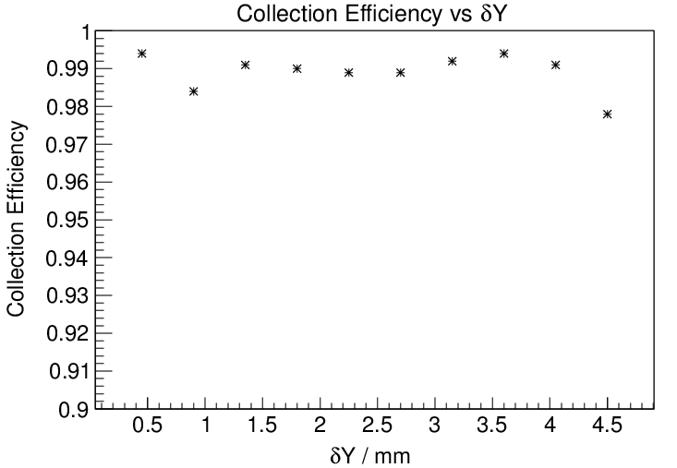
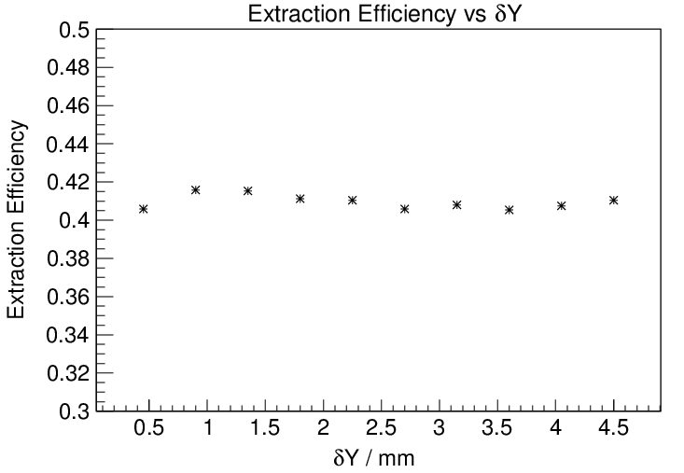
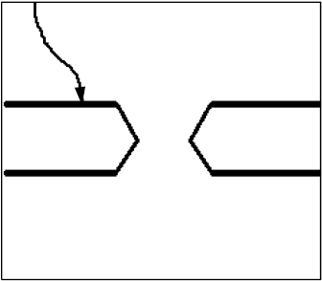
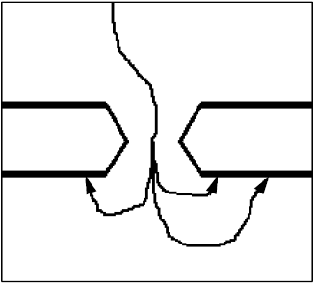
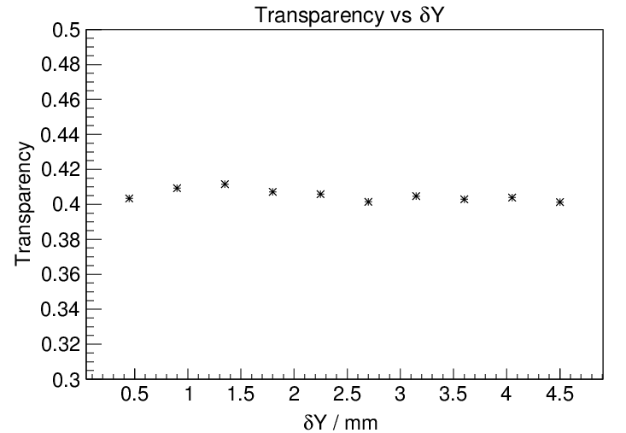
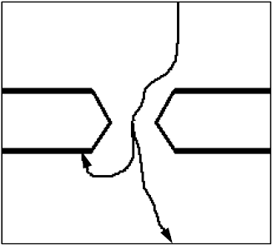
Transparency
B⊙
Drift region
Drift region
x
y
δY
distance between the original electron and gem foil
Gem 1
150μm
×
×
Geff = Gintr * Transparency
Transparency = Collection Efficiency *Extraction Efficiency
Drift region
Gem | Collection Efficiency(%) | Extraction Efficiency(%) | Transparency (%)
1 | 98.92 | 40.96 | 40.51
2 | 77.38 | 40.51 | 31.34
3 | 77.76 | 51.68 | 40.19
*
=
√

