Slide 1
Status of DA Optimization wyw170414
ZHANG, Yuan WANG, Yiwei WANG, Dou GENG, Huiping
2017-06-30

Slide 2
Todo in last report
FLUC analysis, why so much DA loss
Why so limited DA-on-momentum with FLUC
Multipole knob enlarge MA and DA-on-momentum
Check DA at different position

Slide 3
Different Position

Slide 4
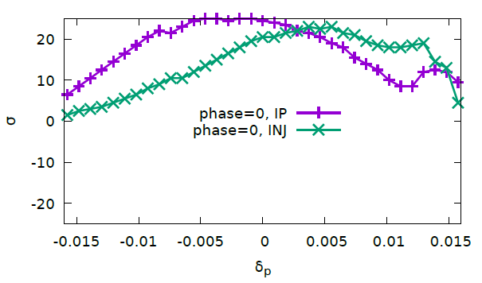
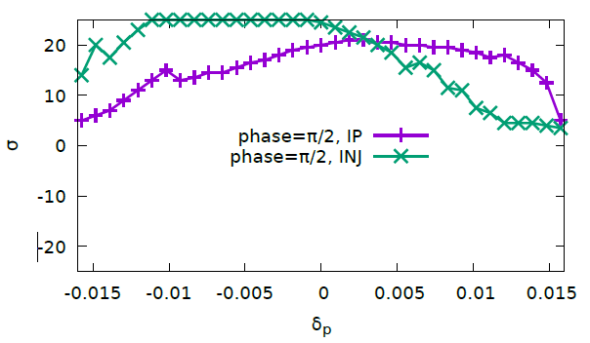
DA at Different Position, INJ (1)
200turns
@INJ, bx = 129m, by=23m

Slide 5
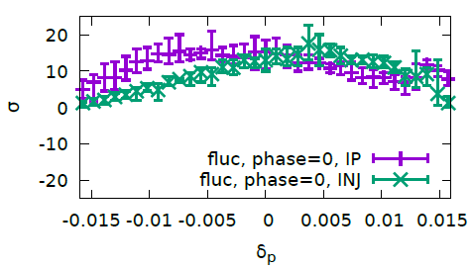
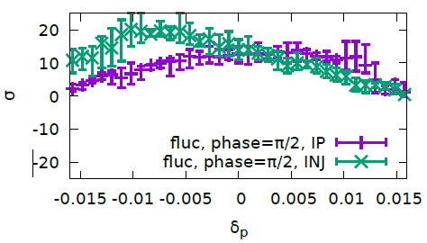
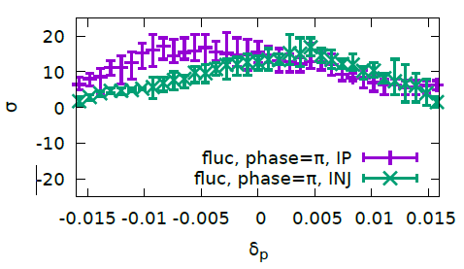
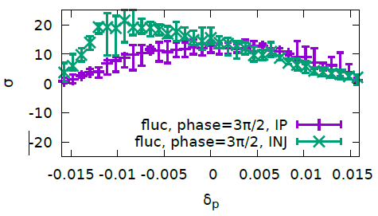
DA at Different Position, INJ(2)

Slide 6
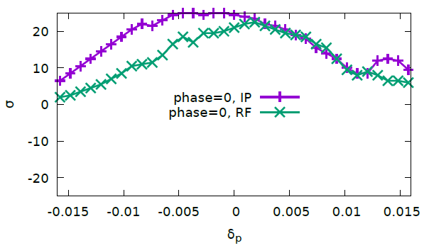
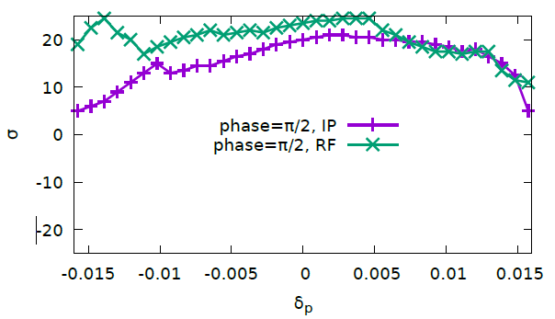
DA at Different Position, RF(1)
RF, Ax=-1, Bx=32m, Ay=-1, By=180m

Slide 7
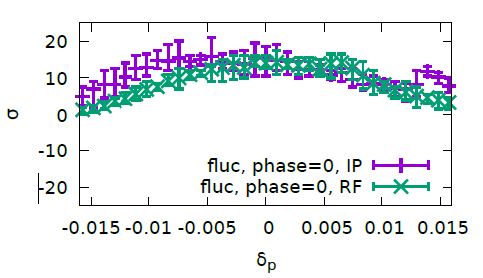
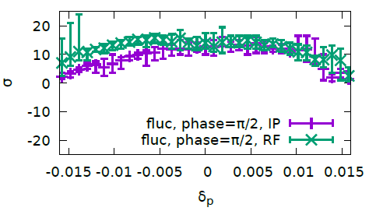
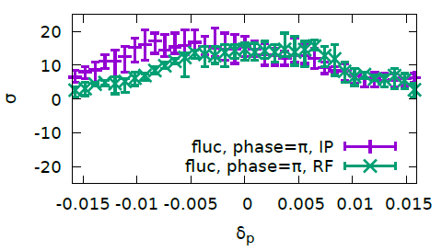
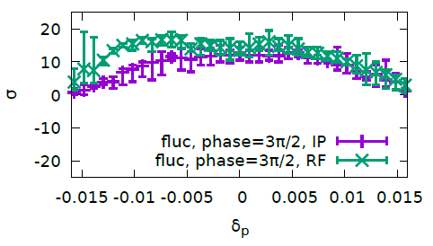
DA at Different Position, RF(2)

Slide 8
Track with higher voltage

Slide 9
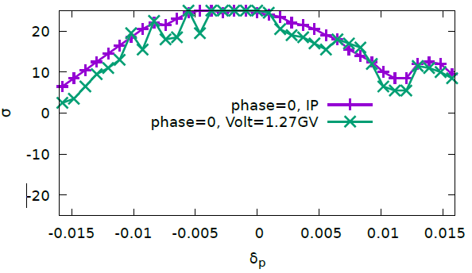
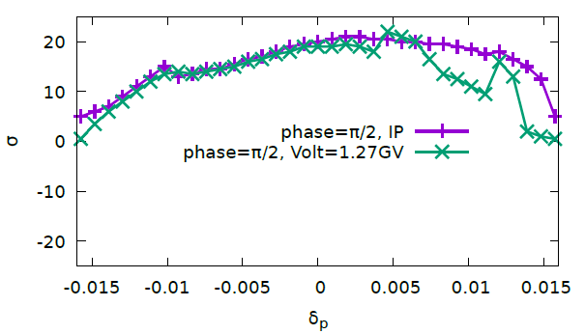
Higher RF Voltage – Vrf=1.27GV(halfring), nus=0.044, (1)

Slide 10
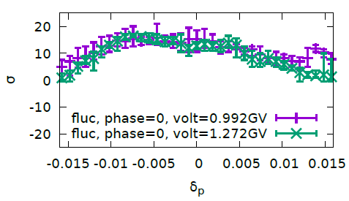
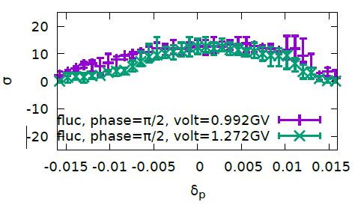
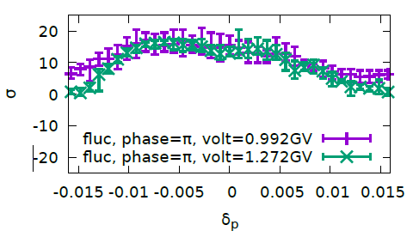
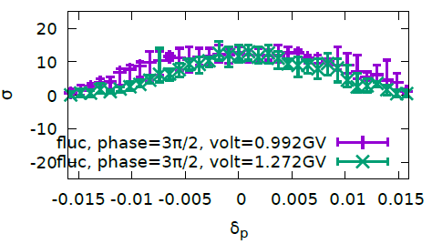
Higher RF Voltage – Vrf=1.27GV(halfring), nus=0.044, (2)
Higher voltage do not help enlarge DA area, but
Squeeze the error-bar of fluc noise?
Notes:
Cmst-3-clip1-400t

Slide 11
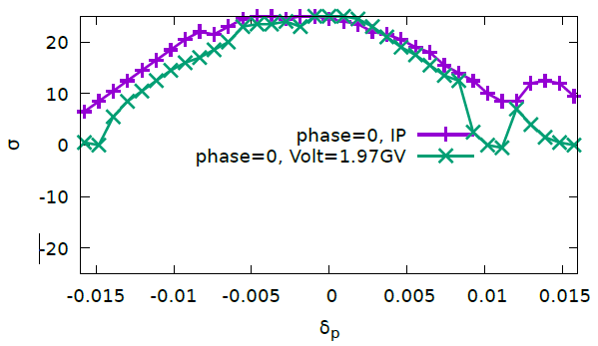
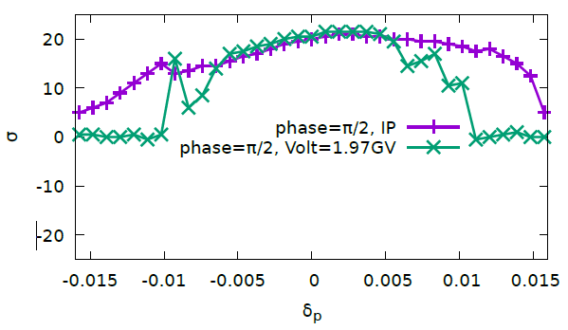
Higher RF Voltage – Vrf=1.97GV(halfring), nus=0.058, (1)

Slide 12
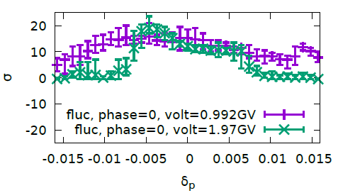
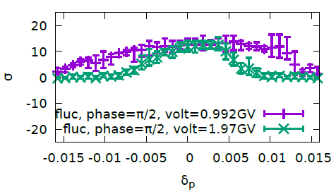
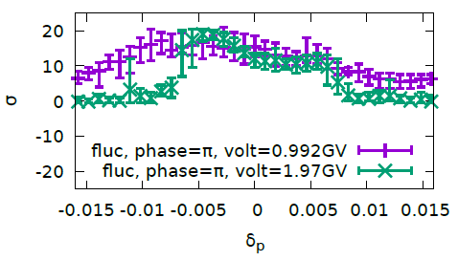
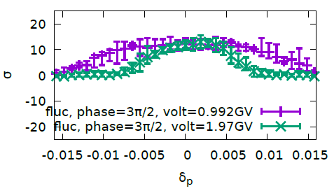
Higher RF Voltage – Vrf=1.97GV(halfring), nus=0.058, (2)

Slide 13
Ref: Oide (170428)

Slide 14
Optimization in one-step (32 arc sextupole familiy)
Notes:
wyw-170410-pcmst-3-one，使用原始的one.x，即不是 pcmst-3 优化得到的。

Slide 15
memo

Slide 16
FCC-ee MDI Workshop, 2017

Slide 17
FCC-ee MDI Workshop, 2017

