Slide 1
FLUC
ZHANG, Yuan WANG, Yiwei WANG, Dou GENG, Huiping
2017-07-07

Slide 2
以 cmst-3-clip1-400t/x.107.22 为例

Slide 3
起因：damponly vs fluc

Slide 4
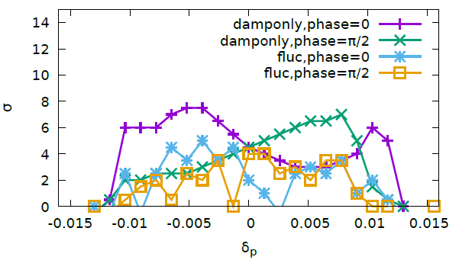
120GeV vs 168 GeV 175GeV no closed orbit?!
$${\left(\frac{168}{120}\right)}^{}=1.4$$
$${\left(\frac{168}{120}\right)}^{2}=2$$
5 times higher RF voltage
Nus=0.079*2

Slide 5
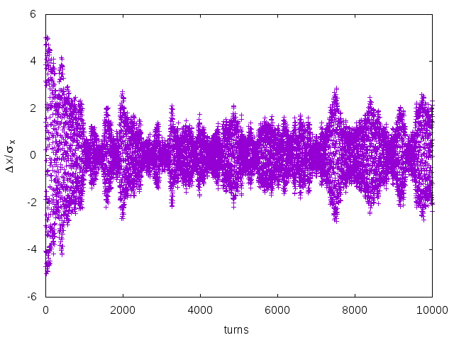
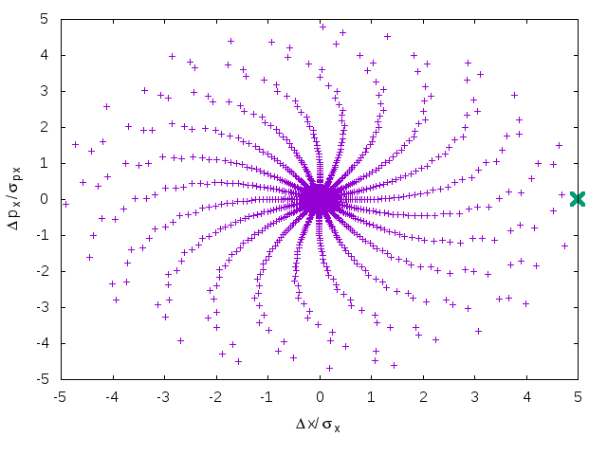
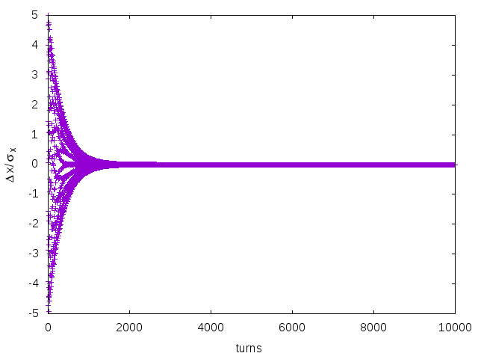
Ini: On-momentum, 5$σ$
FLUC
DAMPNLY

Slide 6
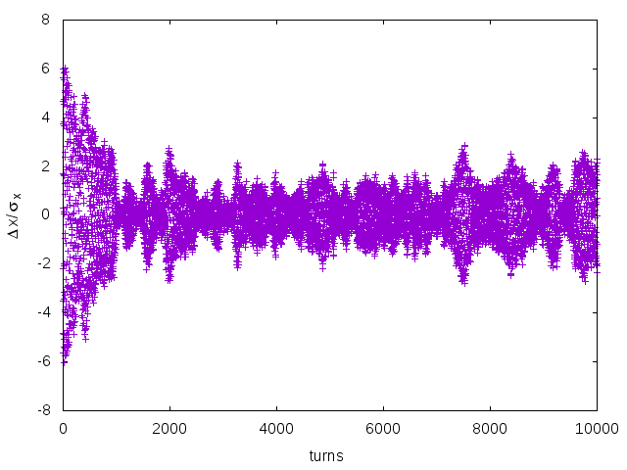
Ini: On-momentum, $6σ$
FLUC
DAMPNLY

Slide 7
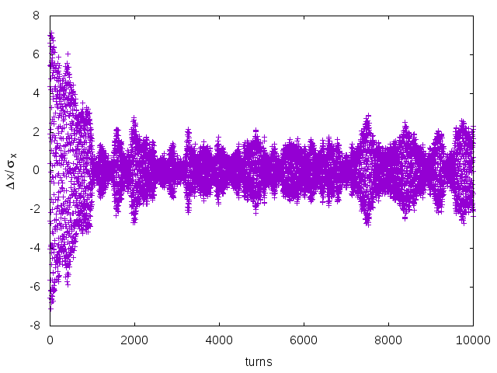
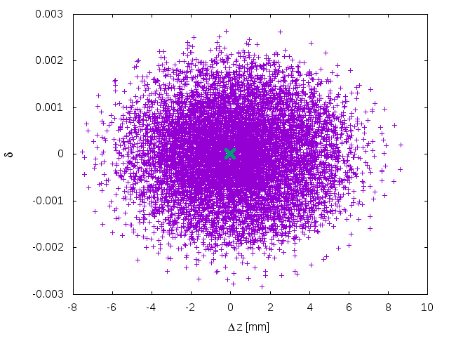
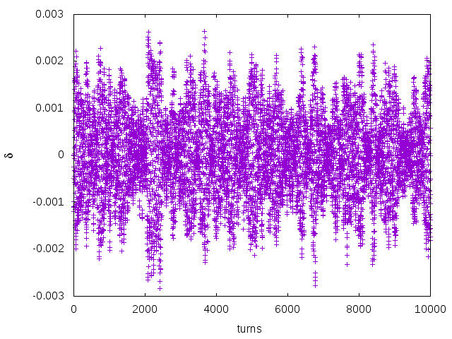
Ini: On-momentum, $7σ$
FLUC

Slide 8
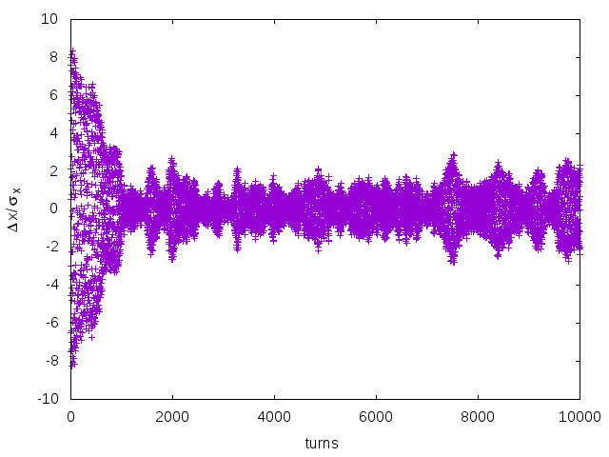
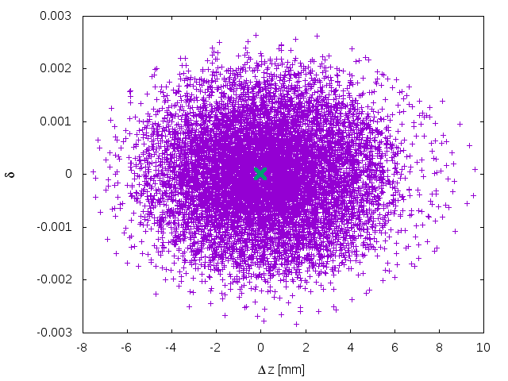
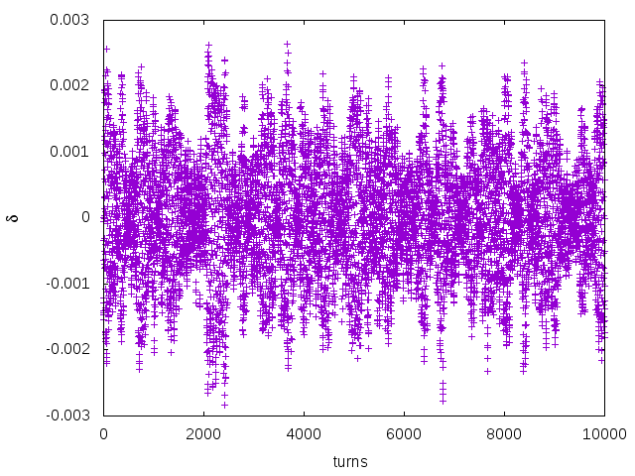
Ini: On-momentum, $8σ$
FLUC

Slide 9
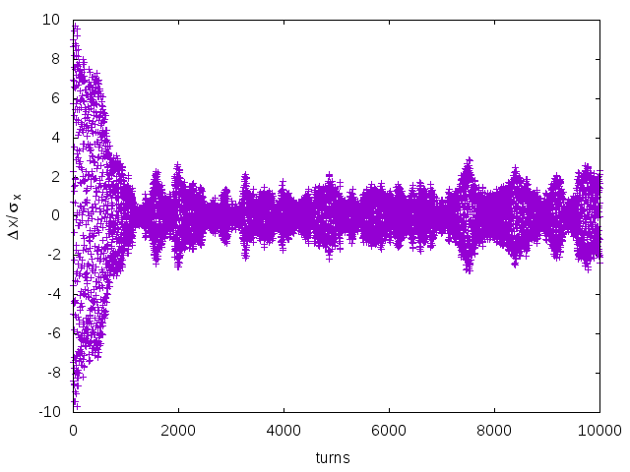
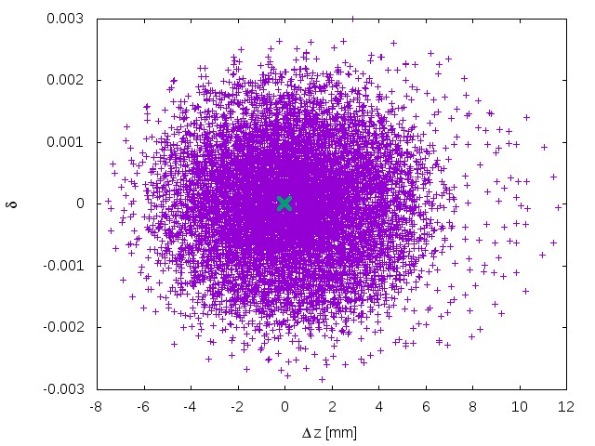
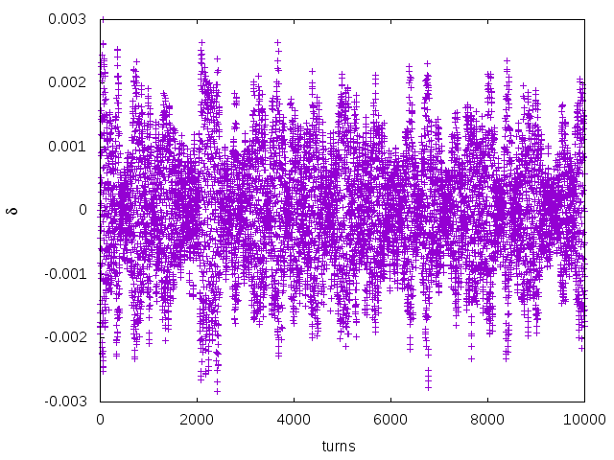
Ini: On-momentum, $9σ$
FLUC

Slide 10
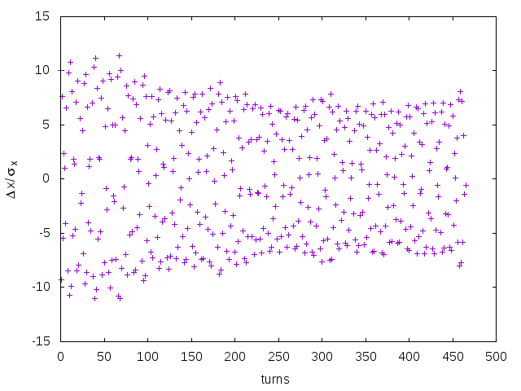
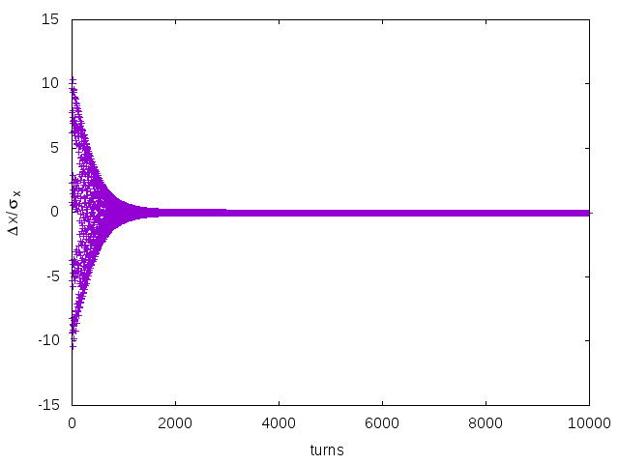
Ini: On-momentum, $10σ$ (1)
FLUC
DAMPONLY

Slide 11
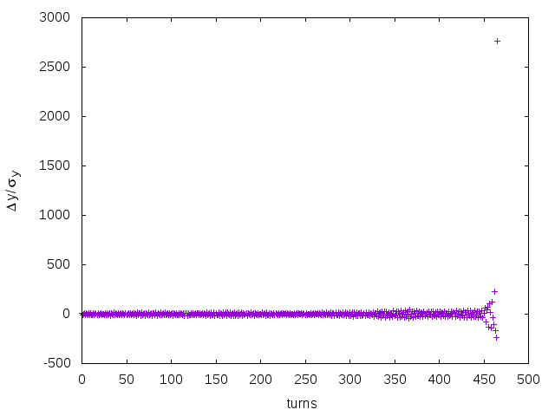
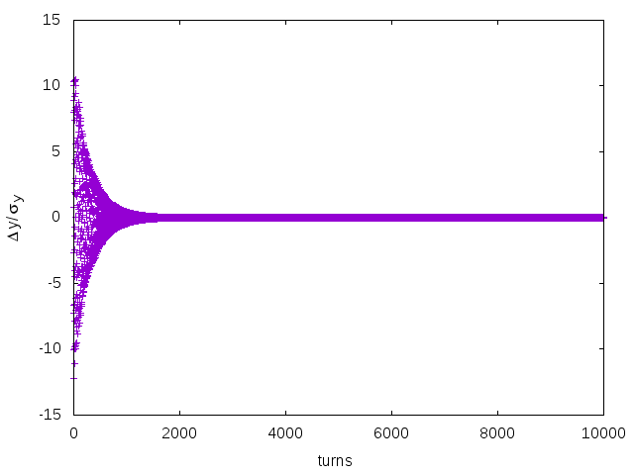
Ini: On-momentum, $10σ$ (2)
FLUC
DAMPONLY

Slide 12
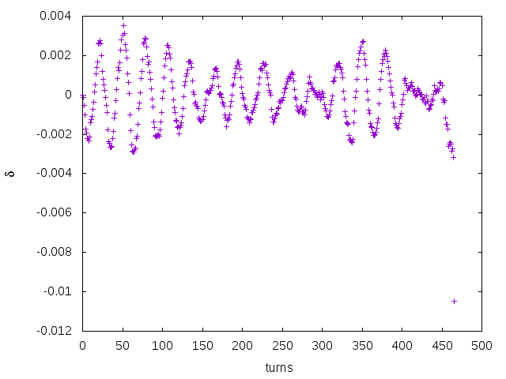
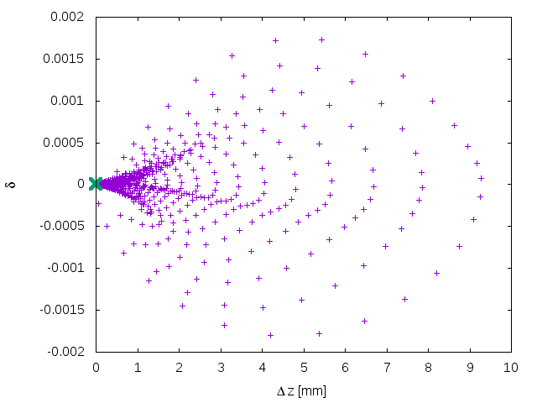
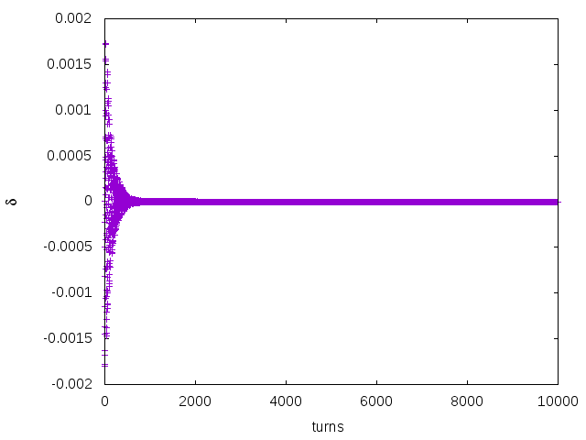
Ini: On-momentum, $10σ$ (3)
FLUC
DAMPONLY

Slide 13
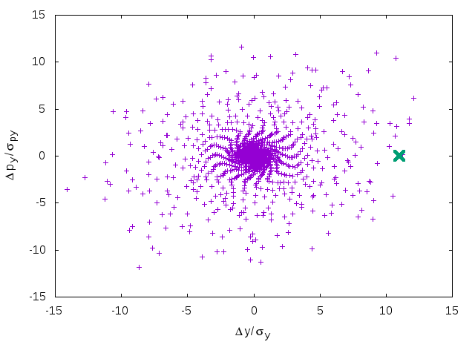
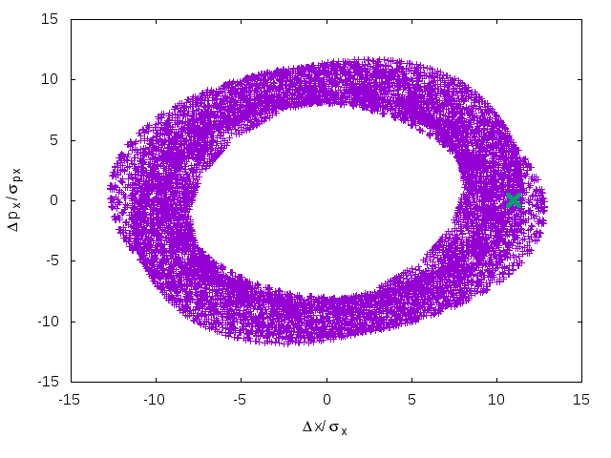
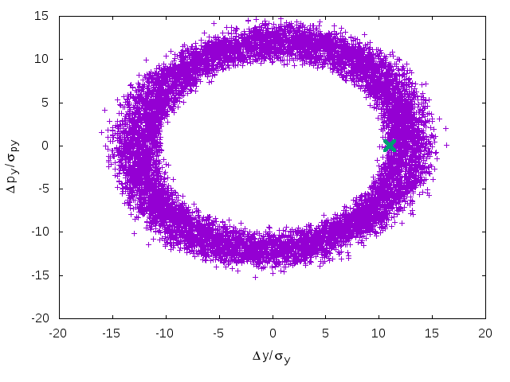
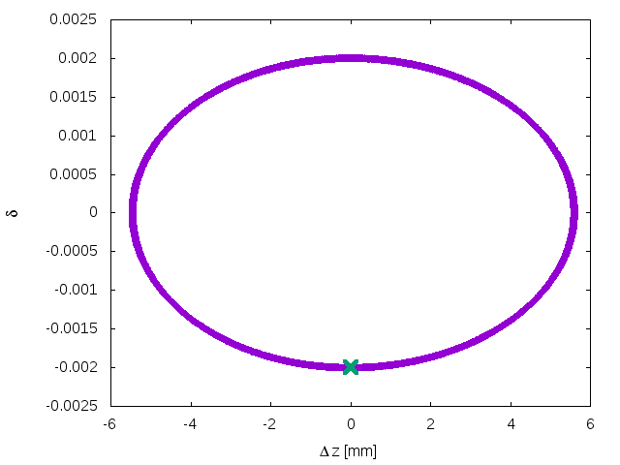
Ini: $11σ$
Damponly, delta=0
RFSW, delta=-0.002

Slide 14
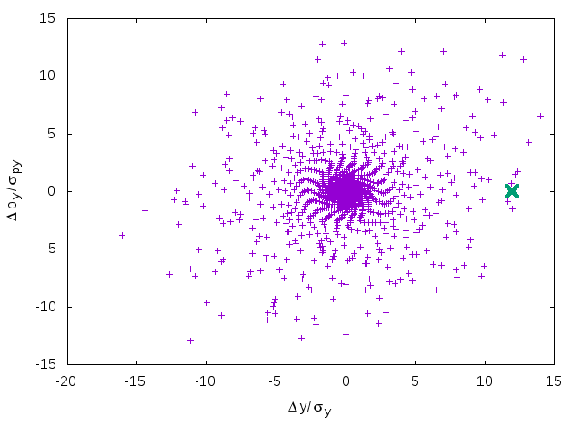
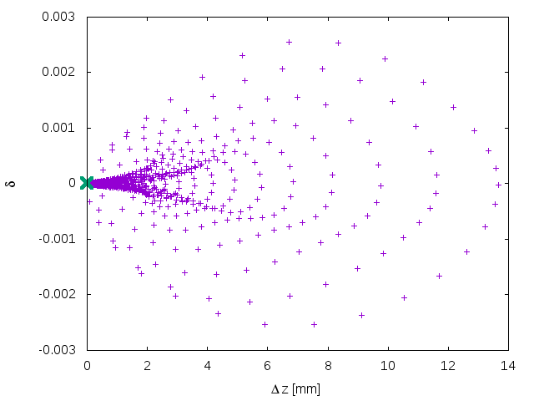
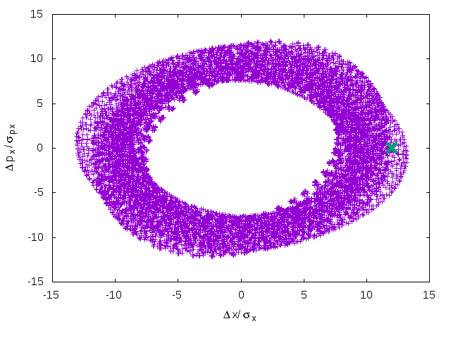
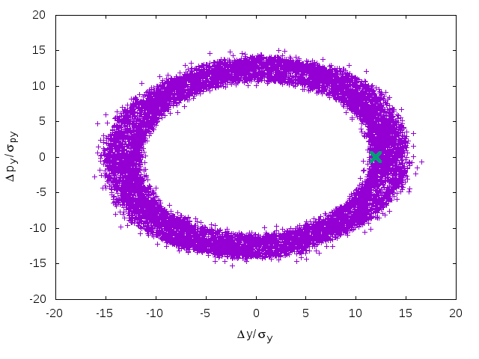
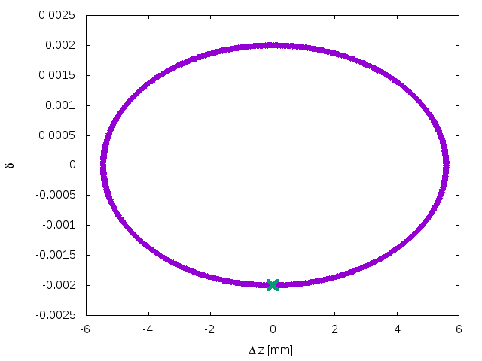
Ini: $12σ$
Damponly, delta=0
RFSW, delta=-0.002

Slide 15
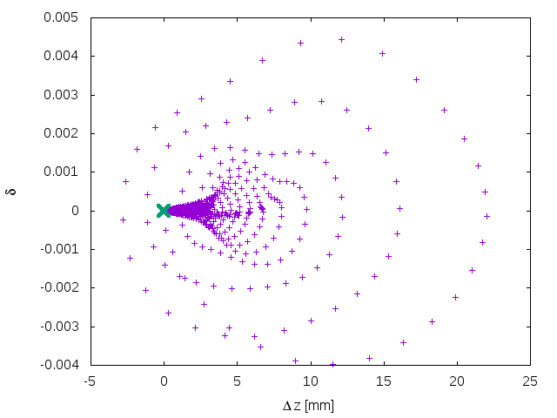
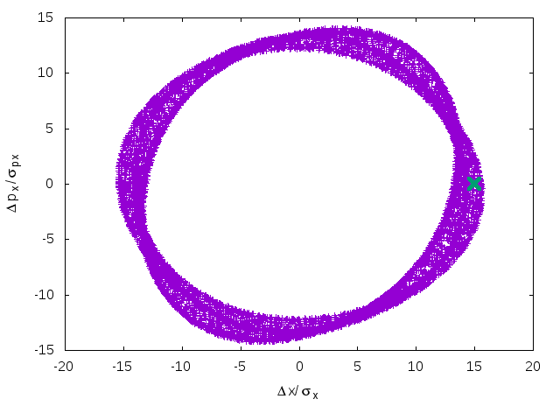
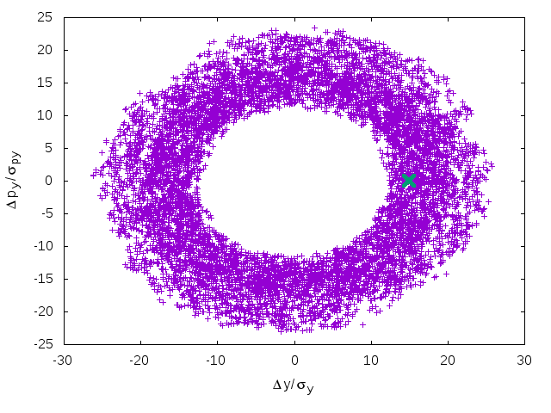
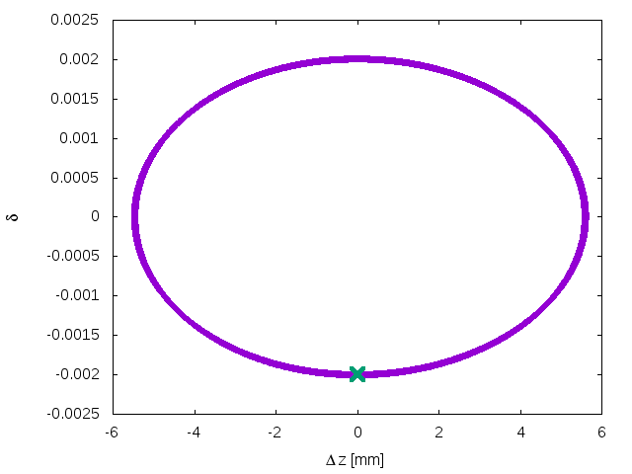
Ini: $15σ$
Damponly, delta=0
RFSW, delta=-0.002

Slide 16
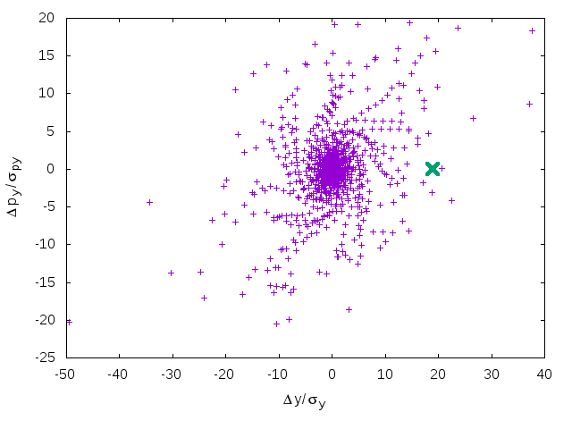
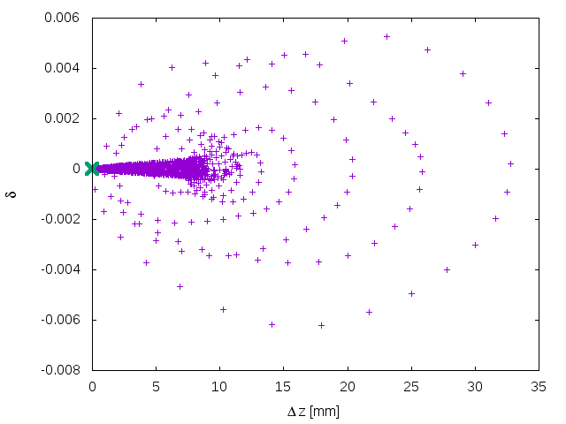
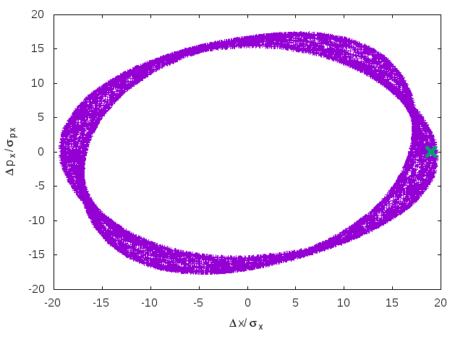
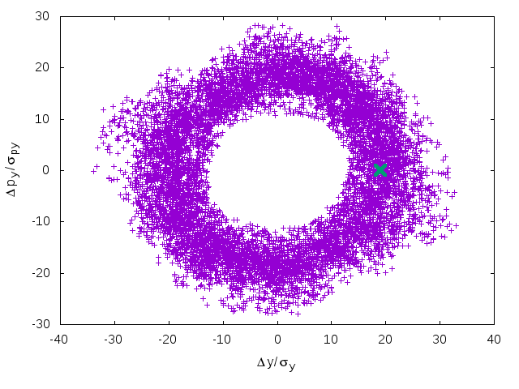
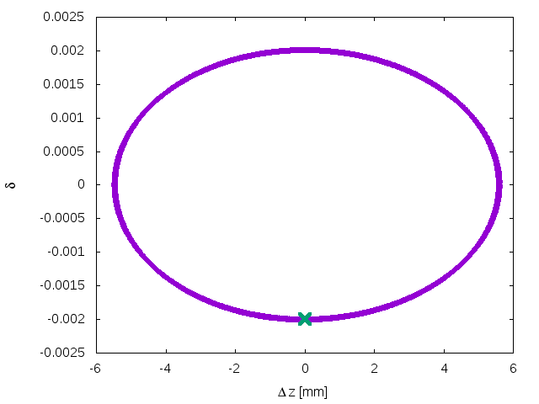
Ini: $19σ$
Damponly, delta=0
RFSW, delta=-0.002

Slide 17
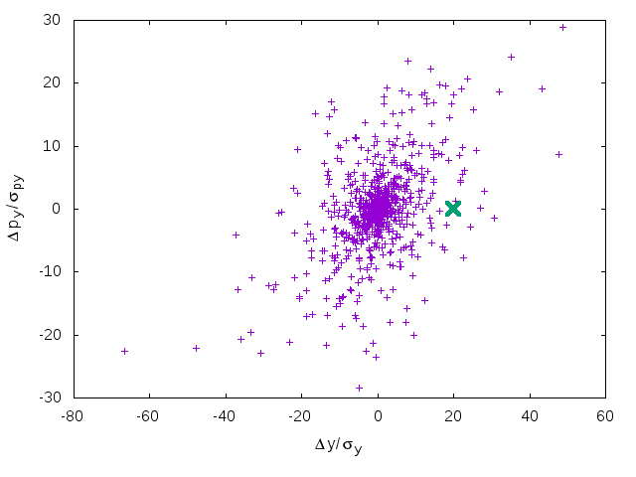
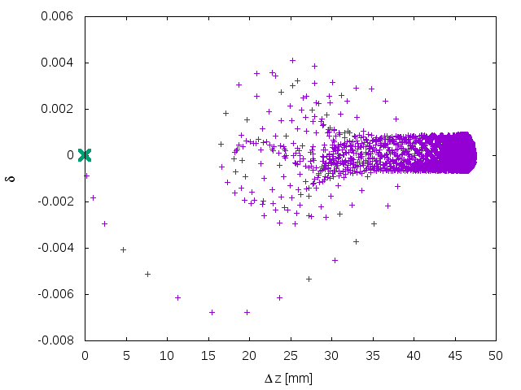
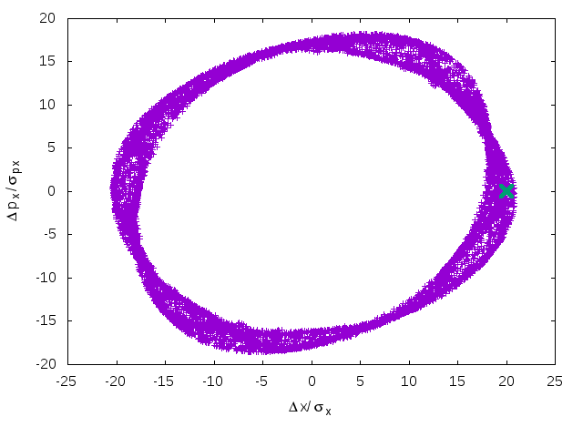
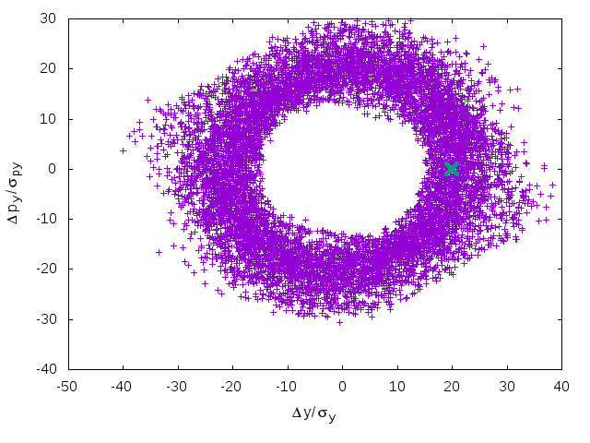
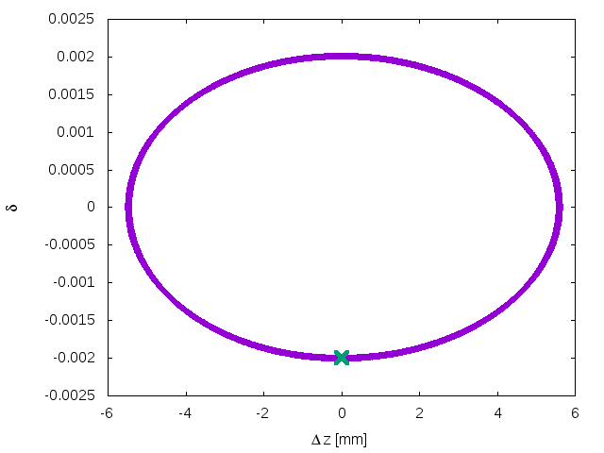
Ini: $20σ$
Damponly, delta=0
RFSW, delta=-0.002

Slide 18
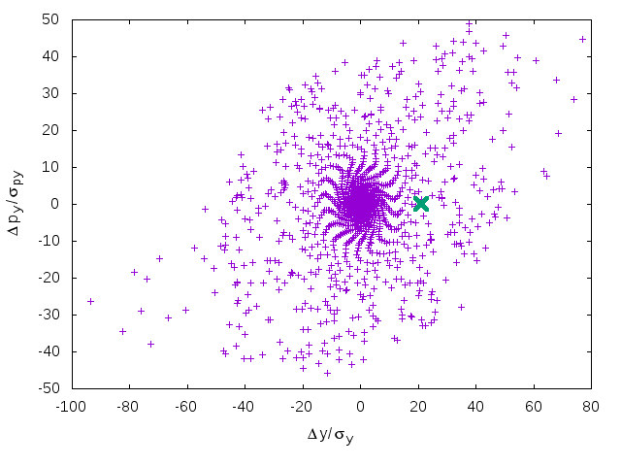
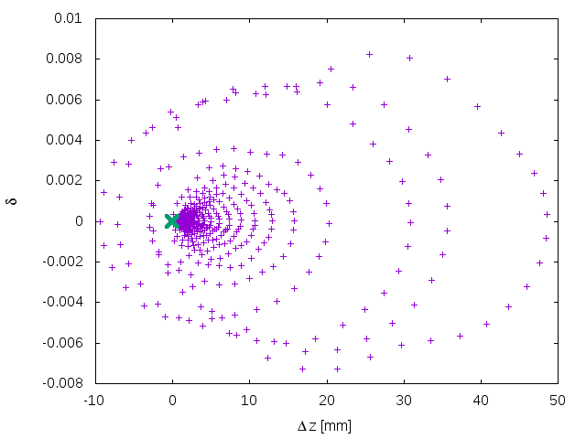
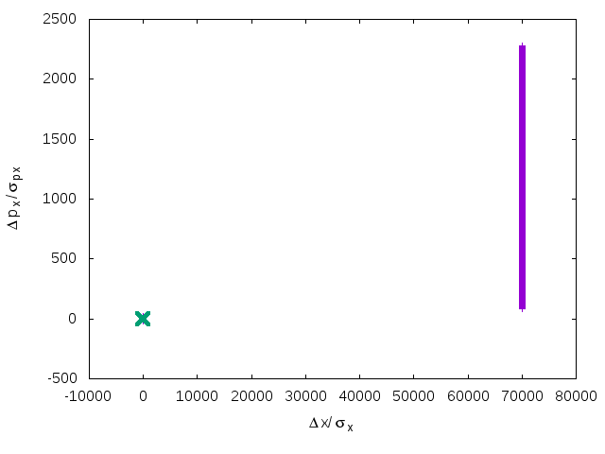
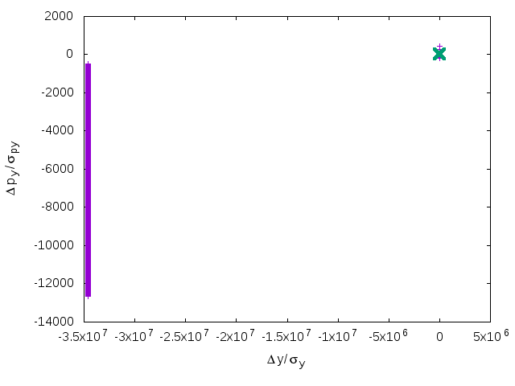
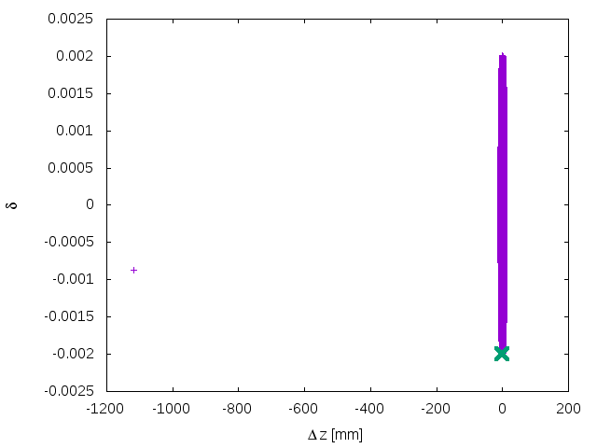
Ini: $21σ$
Damponly, delta=0
RFSW, delta=-0.002

Slide 19
memo

Slide 20
Optimize with FLUC ON
Pcmst-2-fluc
50 turns
200 turns
Notes:
Pcmst-2-fluc

Slide 21
Optimize with FLUC ON
Pcmst-3-fluc
50 turns
200 turns
Notes:
Pcmst-2-fluc

Slide 22
Optimize with DAMPONLY
CMST-3-CLIP1-400t
50 turns
200 turns

Slide 23
FCC-ee MDI Workshop, 2017

Slide 24
FCC-ee MDI Workshop, 2017

Slide 25
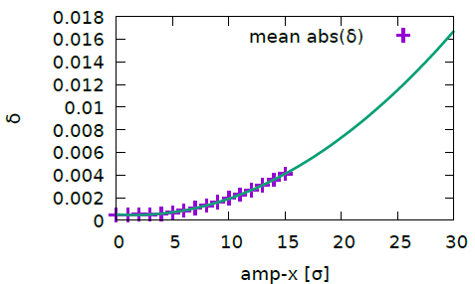
Momentum deviation versus amplitude
Machine Main Parameters?!
If we achieve 30$σ$(even less), we need higher RF voltage to provide enough RF bucket height
This could explain why the DA with (FLUC) is flat versus $δ$
For example, if we want to achieve $20σ@δ=0$, the DA should be also about $20σ@δ=0.01$
We need to try achieve a rectangular DA boundary
Notes:
Cmst-3-clip1-400t

Slide 26
FCC

Slide 27
Discussion
There exist unstable orbit inside the DA (damponly)
DA optimization with fluc is preferred
Noise : ~10 samples for on-momentum particles
Rectangular DA boundary
Higher RF voltage is necessary if we want larger DA

