Slide 1
CEPC lattice design and DA optimization
Dou Wang, Yuan Zhang, Yiwei Wang, Huiping Geng,Chenghui Yu, Jie Gao
2017.07.07

Slide 2
Layout of CEPC double ring

Slide 3
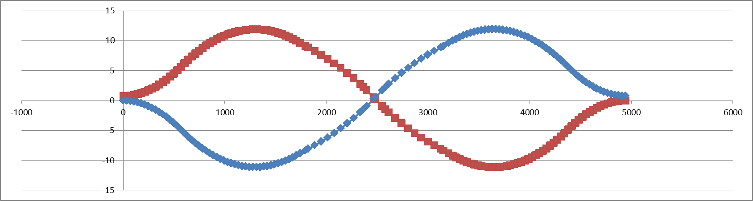
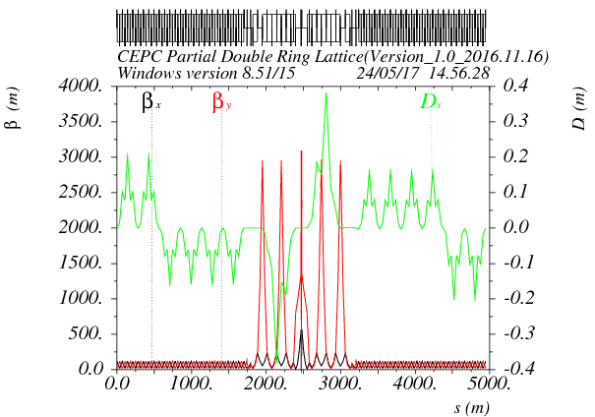
对撞区lattice及几何
SPPC
e-
e+
SPPC need a long straight at CEPC IR.
CEPC and SPPC is compatible in IP1 and IP3!

Slide 4
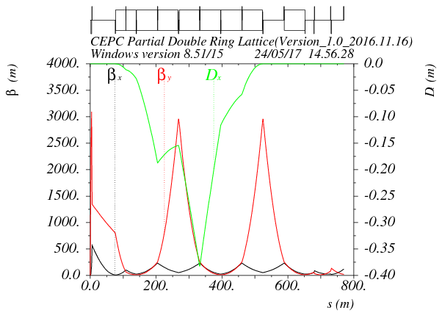
FFS lattice设计
Asymmetric dispersion
Shared sextupole for chromaticity correction and crab waist
Ec < 100 keV within 800m
Crab sextupole
Betax=0.171m
Betay=0.002m
L*=2.2m
K1(QD0)=150T/m

Slide 5
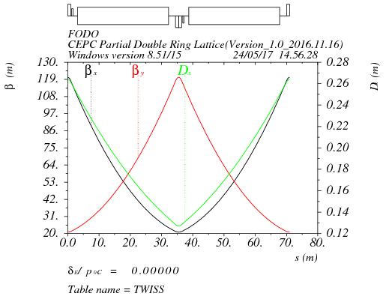
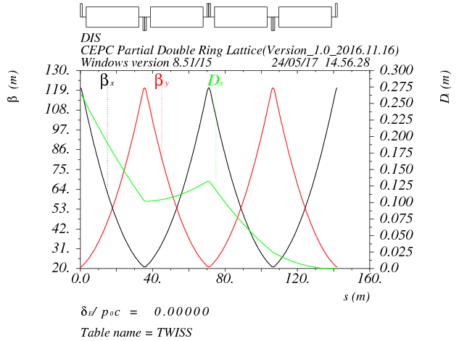
弧区lattice设计
90/90 FODO cell
Non-interleave sextupoles
Distance of two ring : 0.77 m

Slide 6
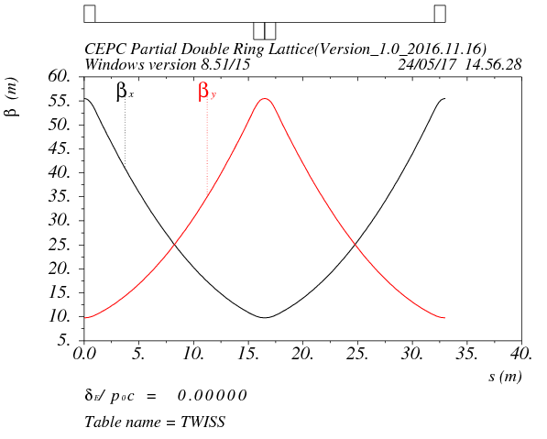
高频区lattice设计
90/90 FODO cell
Smaller beta than arc to suppress the multi-bunch instability (βmax: 55.5 m/βmin: 9.8 m)
Distance between quadrupole : 14.5m
Length of cryo-module: 12m

Slide 7
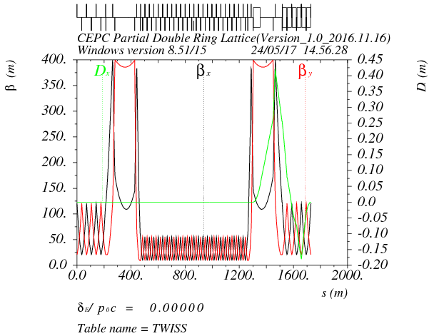
共享高频段lattice设计
Shared RF cavities for e- and e+ ring (Higgs)
Separator bending cancel that of dipoles for the beam of opposite direction
Δx=26cm at first quadrupole
Seperation at the end of seperator section: 0.77m
separator combined with a dipoles
beam
RF
RF

Slide 8
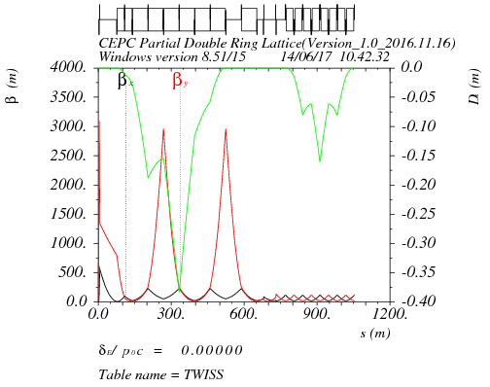
Final doublet + triplet+CCY+matching+CCX
μx=1.5, μy=1.25
μx=2.5, μy=2.375
IP
CCY
CCX
matching

Slide 9
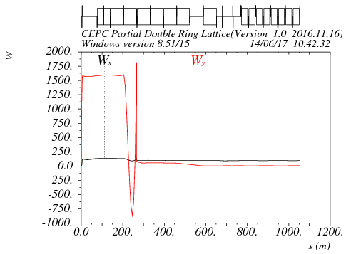
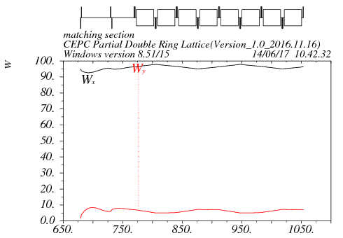
Chromaticity correction
Residual chromaticity: Wx=95

Slide 10
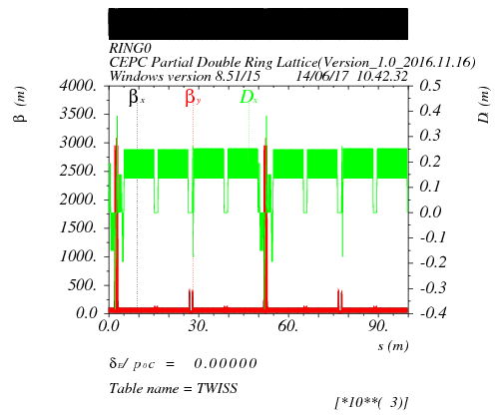
Whole ring lattice
Working point : Qx = 353.10 Qy = 354.22
Circumference：99685m
Emittance from the real lattice：1.33nm

Slide 11
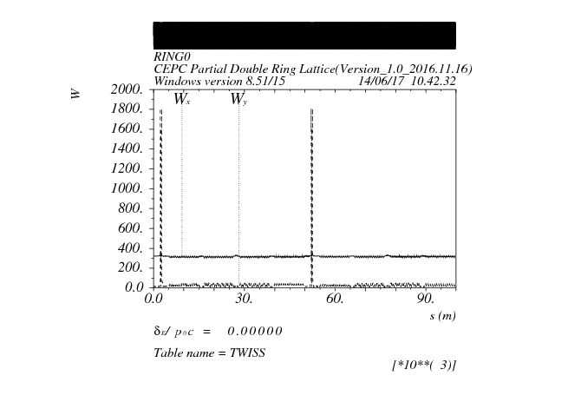
W function of the whole ring
Residual Wx from FFS leak to the whole ring.

Slide 12
DA optimization
2fam(IR)+224fam(arc)
No correction for horizontal chromaticity in IR.

Slide 13
Final doublet + triplet+CCY+matching+CCX
μx=1.5, μy=1.25
μx=2.75, μy=2. 5
IP
CCY
CCX
matching

Slide 14
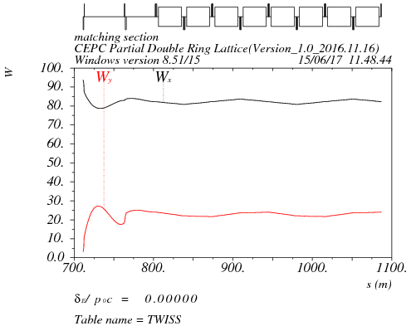
Chromaticity correction
Residual chromaticity: Wx=80

Slide 15
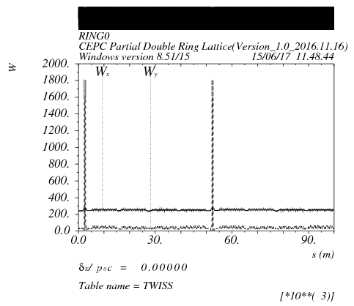
W function of the whole ring
Residual Wx from FFS leak to the whole ring.

Slide 16
Final doublet + triplet+CCY+matching+CCX
μx=1.5, μy=1.25
μx=2.75, μy=2. 5
IP
CCY
CCX
matching

Slide 17

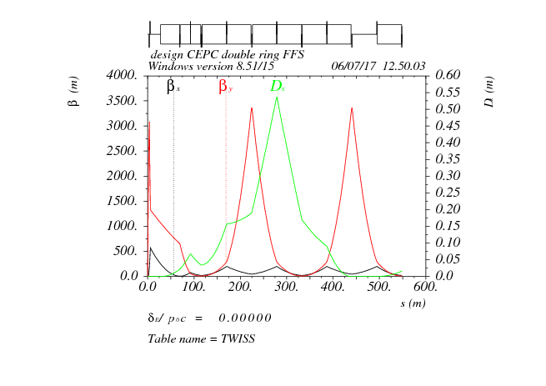
FFS design
Final doublet + triplet+CCY

Slide 18
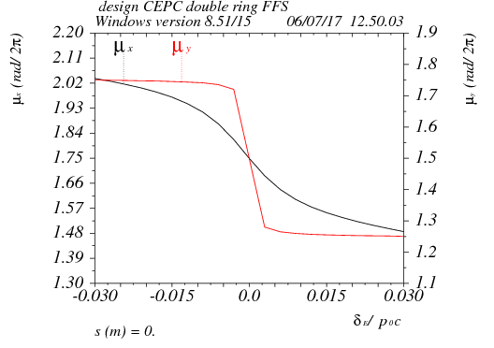
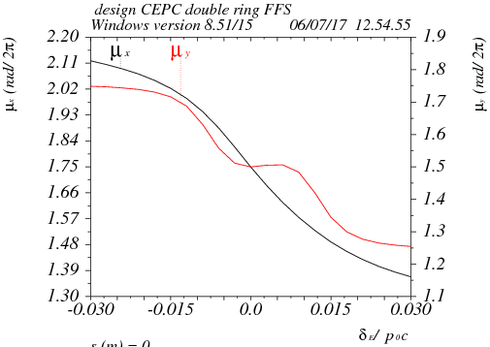
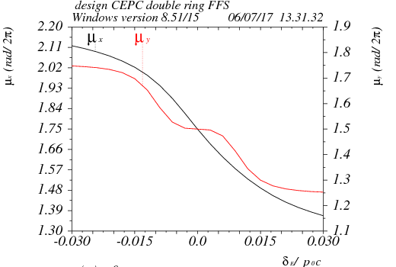
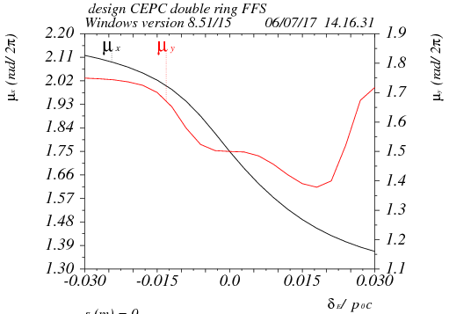
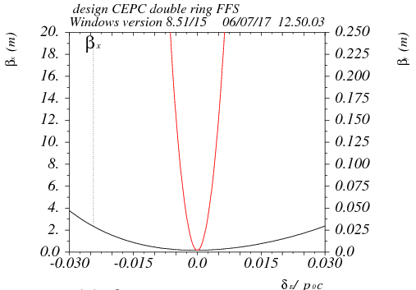
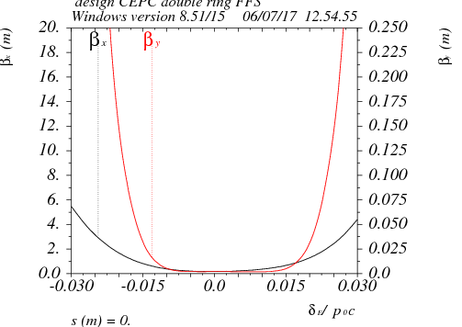
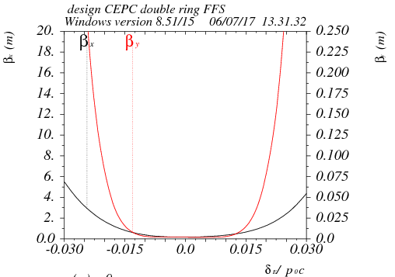
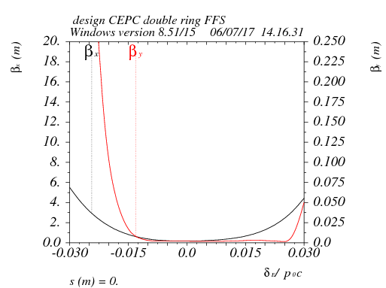
Vertical chromaticity

Slide 19
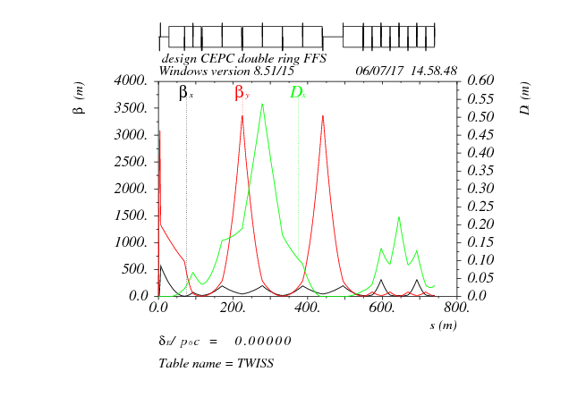
FFS design
Final doublet + triplet+CCY+CCX
μx=2.0, μy=1.75

Slide 20
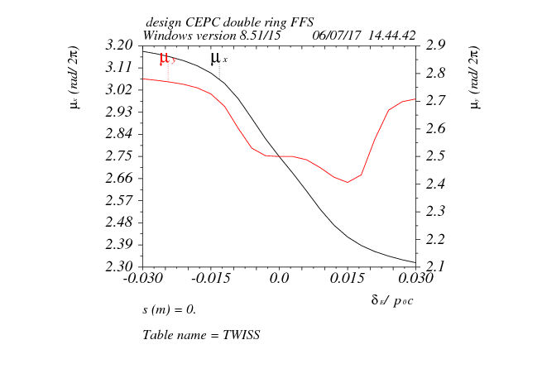
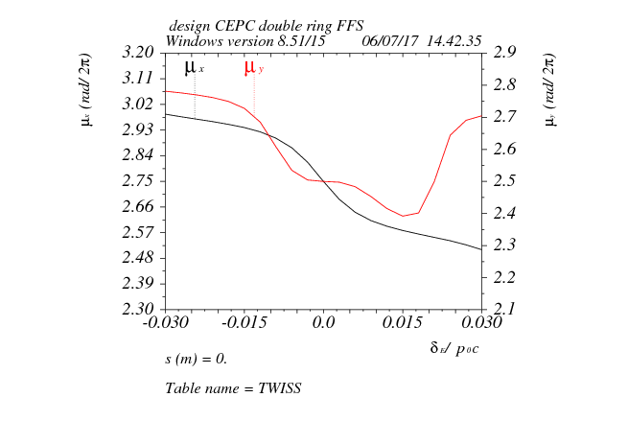
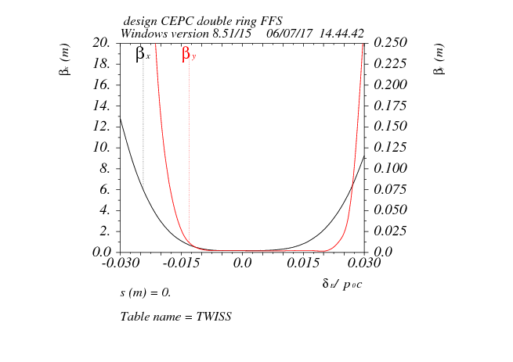
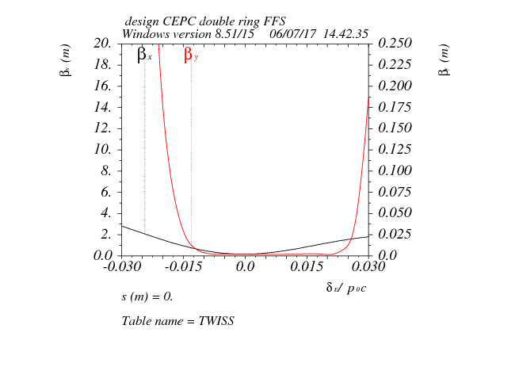
Horizontal chromaticity

Slide 21

FFS design
Final doublet + triplet+CCY+Matching+CCX
μx=2.25, μy=2.25

Slide 22
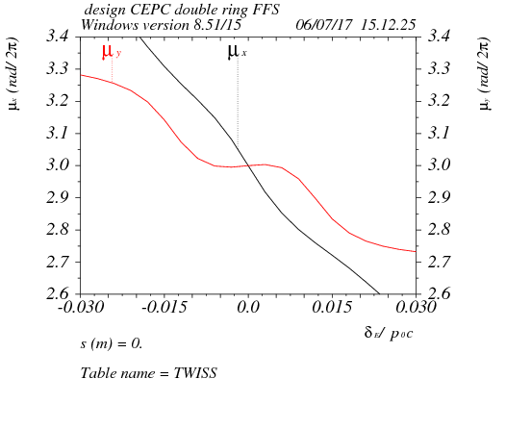
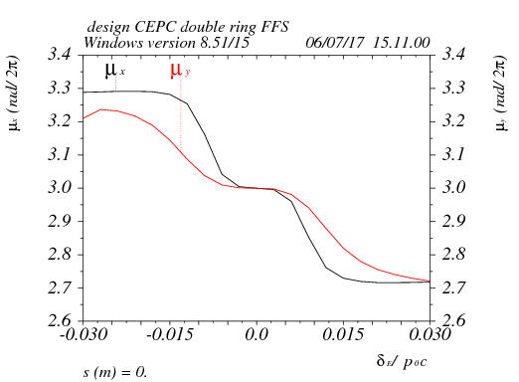
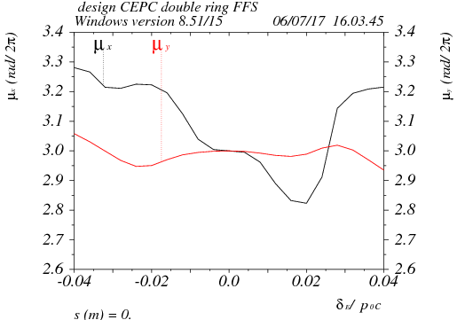
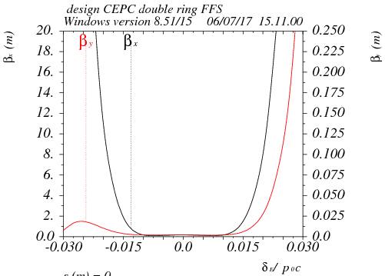
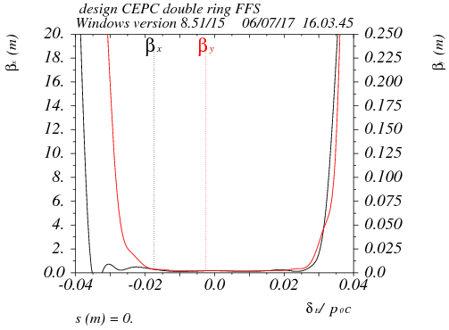
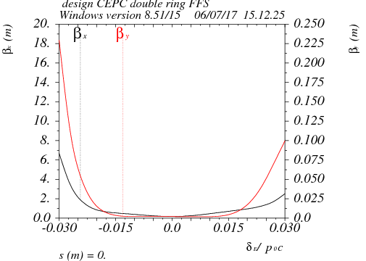
Horizontal chromaticity
K2H=110

