Slide 1
CEPC parameters with larger betax*
Dou Wang, Chenghui Yu, Yuan Zhang, Yiwei Wang, Huiping Geng, Sha Bai, Jie Gao
2017.07.14

Slide 2
Higgs parameters with larger betax* （wangdou20170713-100km_2mmβy）
 | Higgs | βx*=0.37m | βx*=0.6m | βx*=1.0m
Number of IPs | 2
Energy (GeV) | 120
Circumference (km) | 100
SR loss/turn (GeV) | 1.67
Half crossing angle (mrad) | 16.5
Piwinski angle | 3.19 | 2.17 | 1.71 | 1.32
N_{e}/bunch (10¹¹) | 0.968
Bunch number | 412
Beam current (mA) | 19.2
SR power /beam (MW) | 32
Bending radius (km) | 11
Momentum compaction (10⁻⁵) | 1.14
β_{IP} x/y (m) | 0.171/0.002 | 0.371/0.002 | 0.6/0.002 | 1.0/0.002
Emittance x/y (nm) | 1.31/0.004
Transverse σ_{IP} (um) | 15.0/0.089 | 22.0/0.089 | 28.0/0.089 | 36.2/0.089
ξ_{x}/ξ_{y}/IP | 0.013/0.083 | 0.025/0.079 | 0.036/0.075 | 0.051/0.069
RF Phase (degree) | 128
V_{RF} (GV) | 2.1
f _{RF} (MHz) (harmonic) | 650
Nature σ_{z} (mm) | 2.72
Total σ_{z} (mm) | 2.9
HOM power/cavity (kw) | 0.41(2cell)
Energy spread (%) | 0.098
Energy acceptance (%) | 1.5 | 1.0 | 0.77 | 0.58
Energy acceptance by RF (%) | 2.1
n_{γ} | 0.26 | 0.18 | 0.14 | 0.11
Life time due to beamstrahlung_cal (minute) | 52 | 60 | 60 | 60
F (hour glass) | 0.96 | 0.92 | 0.89 | 0.84
L_{max}/IP (10³⁴cm⁻²s⁻¹) | 2.0 | 1.81 | 1.65 | 1.45

Slide 3
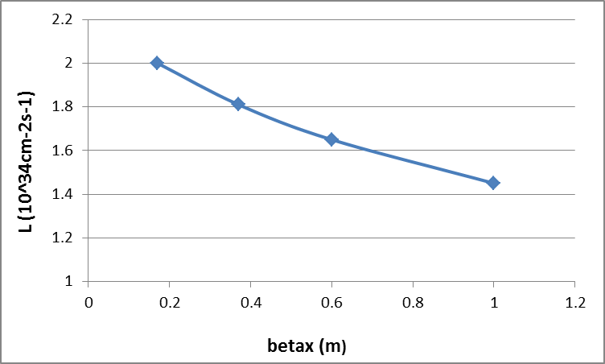
Luminosity vs. betax*

Slide 4
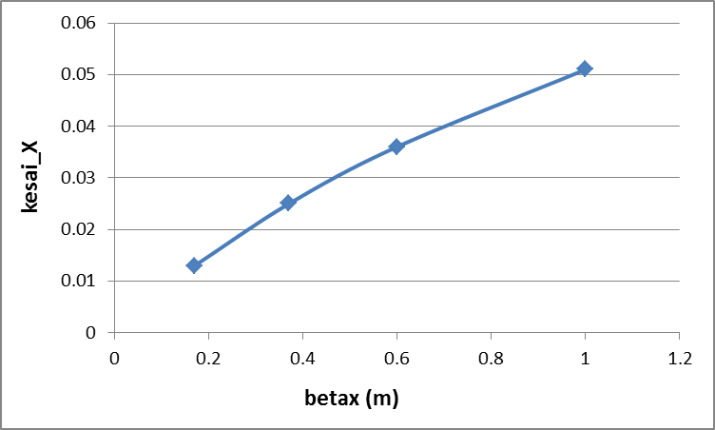
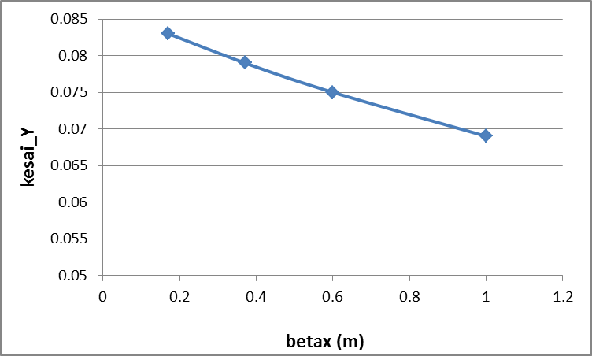
ξ vs. betax*

Slide 5
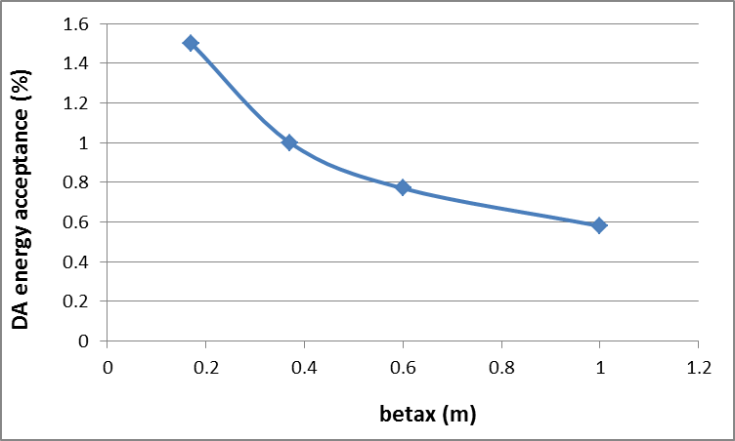
Energy acceptance vs. betax*

Slide 6
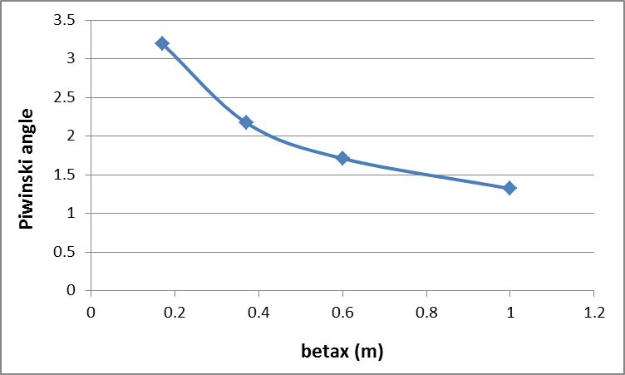
Piwinski angle vs. betax*

Slide 7
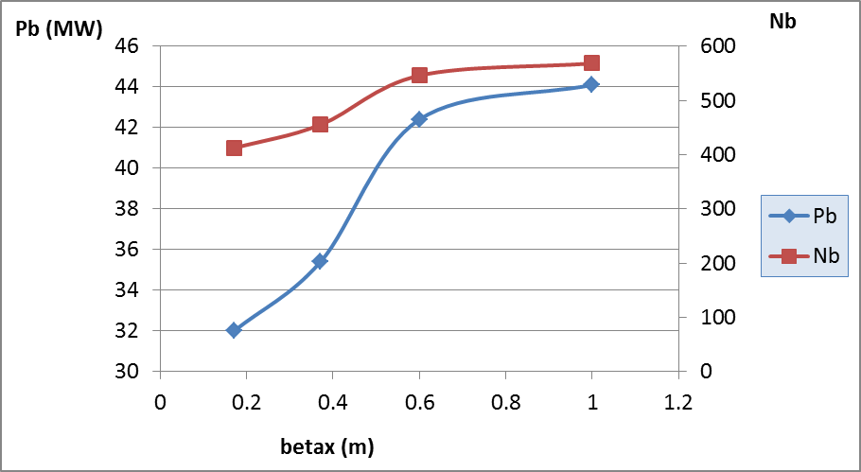
Beam power corresponding to 2×10³⁴cm⁻²s⁻¹

