Slide 1
DA Optimization of v170713
ZHANG, Yuan WANG, Yiwei WANG, Dou GENG, Huiping
2017-07-21

Slide 2
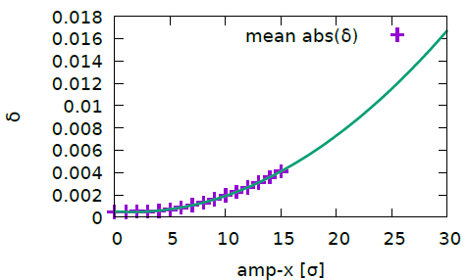
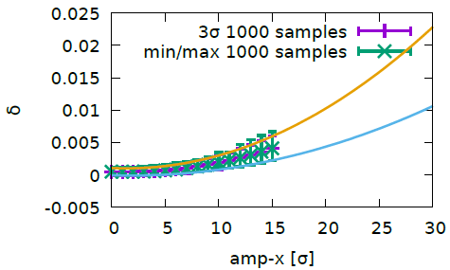
Momentum deviation versus amplitude
Machine Main Parameters?!
If we achieve 30$σ$(even less), we need higher RF voltage to provide enough RF bucket height
This could explain why the DA with (FLUC) is flat versus $δ$
For example, if we want to achieve $20σ@δ=0$, the DA should be also about $20σ@δ=0.01$
We need to try achieve a rectangular DA boundary
Notes:
Cmst-3-clip1-400t

Slide 3
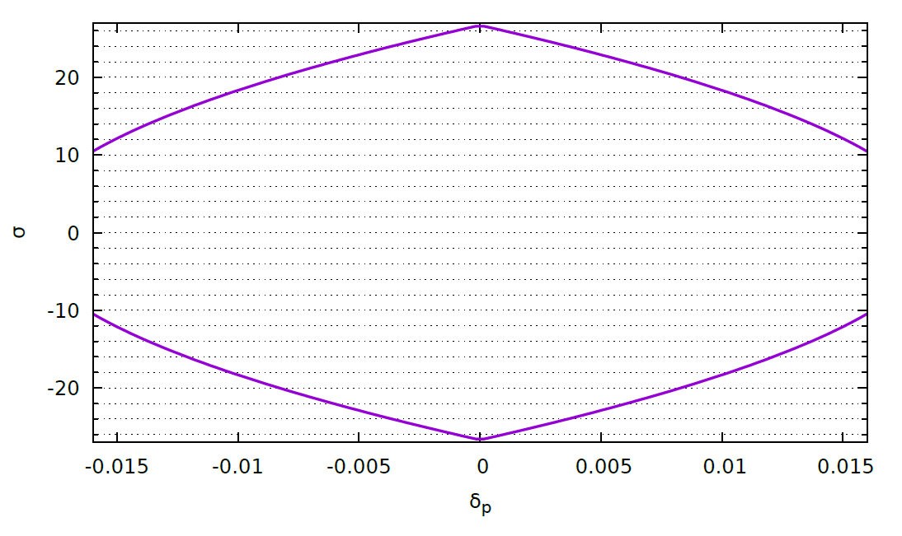
DA objective
$\left|δ\right|+2.651x^{2}+1.07×{10}^{−3}=0.02$

Slide 4
Variables (59)
Tune: (173.55, 174.61)
IR sextupoles, 4 families
IR octupoles, 13 families
IR higher order chromaticity knob(Cai), 2 families
Phase advance between different sections, 8 variables
Arc sextupoles, 32 families

Slide 5
Optimize with FLUC ON wyw-170713
wyw-170713-1

Slide 6
Different Chromaticity Constraint

Slide 7
Different Chromaticity Constraint (2)

Slide 8
memo

Slide 9
Optimize with FLUC ON wyw-170414
Pcmst-3-fluc
50 turns
200 turns
Notes:
Pcmst-2-fluc

Slide 10
FCC-ee MDI Workshop, 2017

Slide 11
FCC-ee MDI Workshop, 2017

