Slide 1
Parameters of CECP main ring lattice (CEPC_RING_bx0.171m_v20170721)
Yiwei Wang
CEPC AP meeting, 28 July 2017

Slide 2
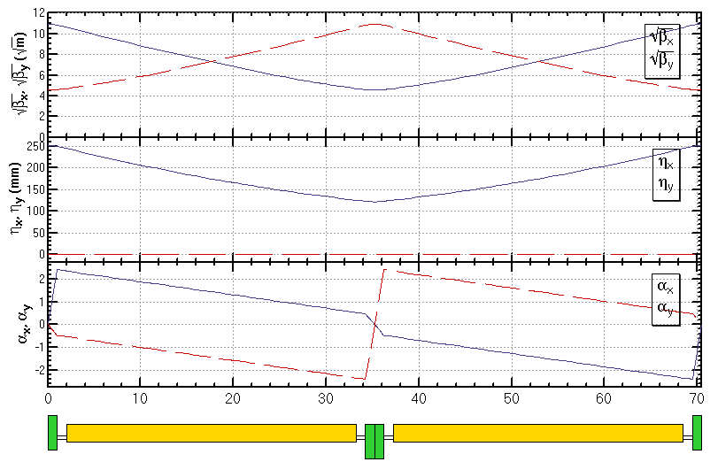
Main bends in the ARC region (outter ring)
five B0O consist of a long bend in the half FODO cell
5*B0O
LQ=2m
LB=5*6.245738310216311 m
LD=1m (0.3+0.4+0.3)

Slide 3
Parameters of B0O
Parameters of the center of each B0O
Energy is roughly 120 GeV and the energy deviation along the whole ring within ±0.4GeV
Sigma=Sqrt[emit*beta+(sigmae*disp)^2], where sigmae=0.098 %
Parameters of B0I is almost the same with B0O.
E [GeV] 120 120 120 120 120
B [T] .034069019852 .034069019852 .034069019852 .034069019852 .034069019852
emit_x [m*rad] 1.31E-9 1.31E-9 1.31E-9 1.31E-9 1.31E-9
emit_y [m*rad] 3.93E-12 3.93E-12 3.93E-12 3.93E-12 3.93E-12
beta_x [m] 98.215388489486 73.434533320678 53.169969317456 37.421719386542 26.189801329495
beta_y [m] 26.189799994312 37.421697512383 53.169946294958 73.434546342037 98.21549765362
alfa_x 2.164595320581 1.803046550349 1.441495741982 1.079943304173 .718389645615
alfa_y -.71838759808 -1.079942232631 -1.441496867182 -1.803051501733 -2.164606136284
gamma_x [m^-1] .057887801386 .057887980906 .057888127709 .057888241795 .057888323163
gamma_y [m^-1] .057888213786 .057888213786 .057888213786 .057888213786 .057888213786
disp_x [m] .229617722397 .200703865724 .175110170746 .152836644694 .133883293862
sigma_x [m] 4.23436624705E-4 3.67268446119E-4 3.1480462871E-4 2.67313438448E-4 2.2698800972E-4
sigma_y [m] 1.01452409522E-5 1.21271295542E-5 1.44553757799E-5 1.6988165502E-5 1.96465494624E-5

Slide 4
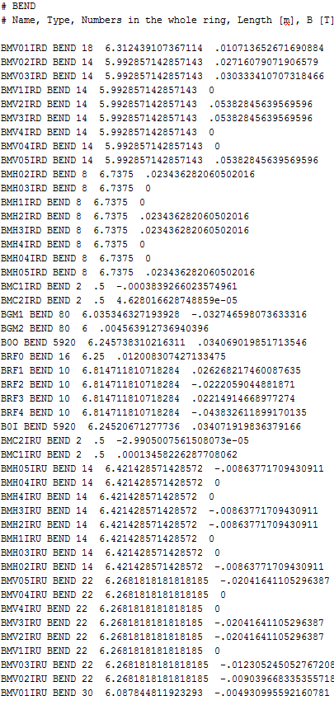

Slide 5
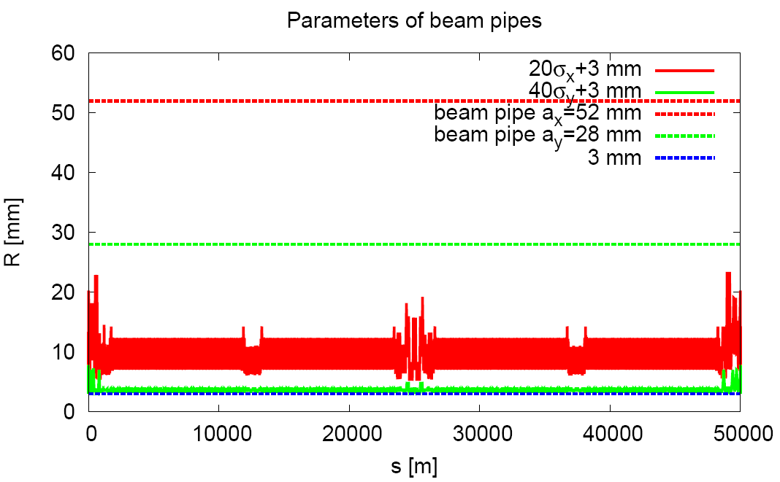
Beam stay clear region and beam pipe
Beam pipe of interaction region TBD

Slide 6
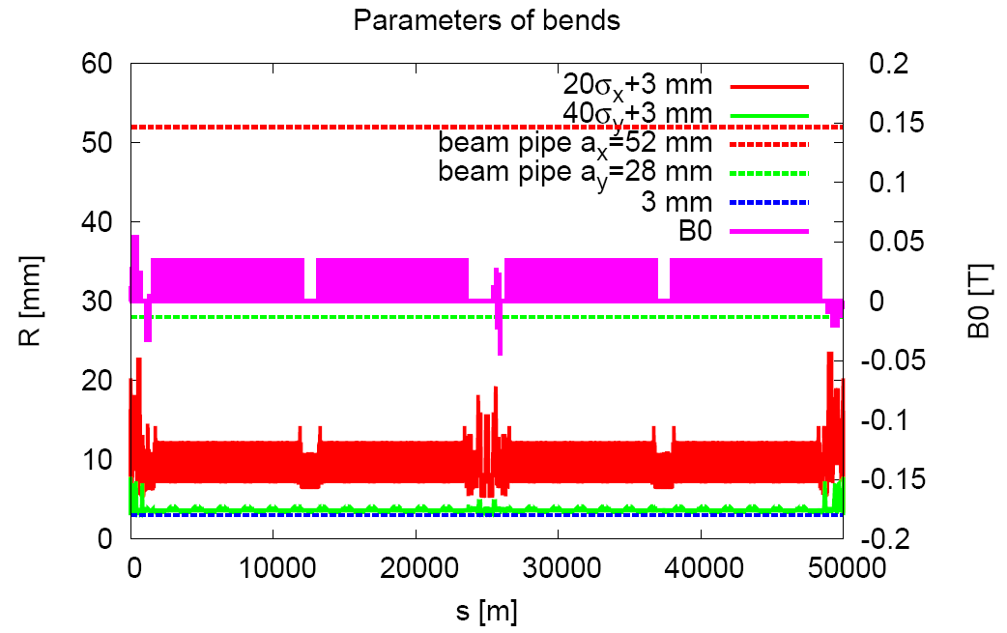
Bend

Slide 7
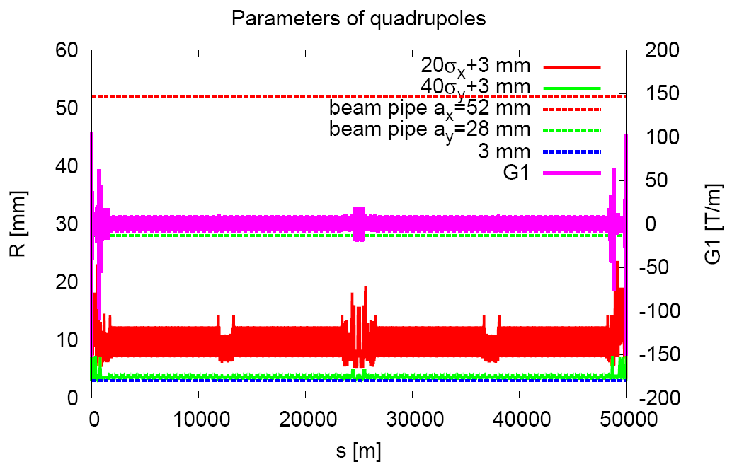
Quad

Slide 8
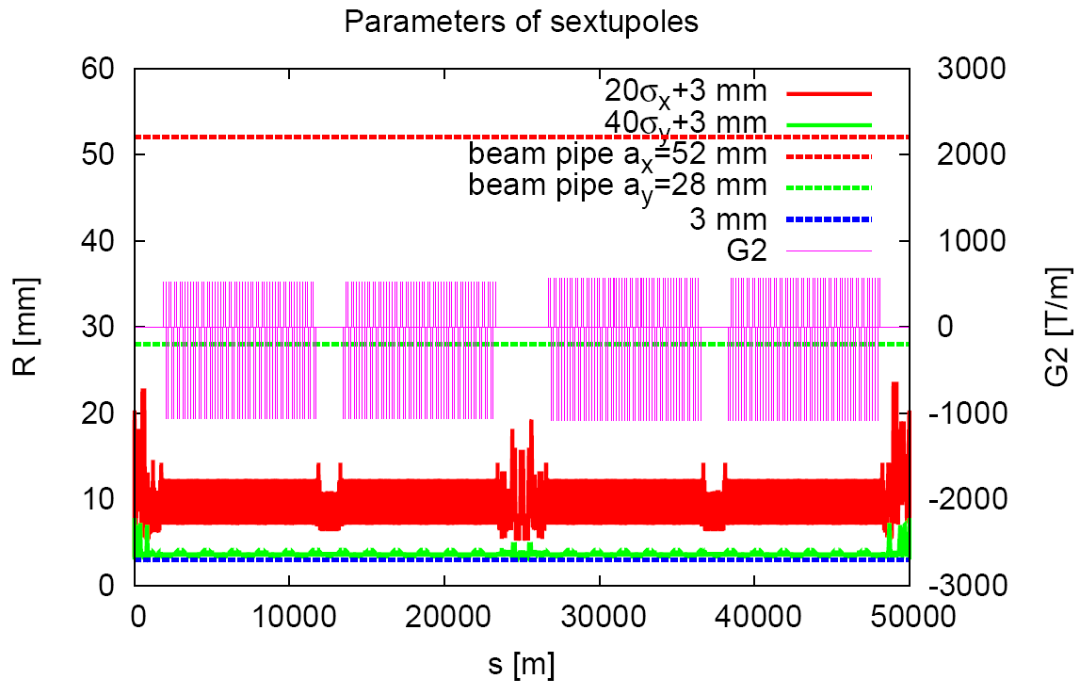
Sext
Sextupole in interaction region not included
VS10IRD MULTIPOLE 2 .3 -2321.9081375005253
VS20IRD MULTIPOLE 2 .3 -2321.9081375005253
HS10IRD MULTIPOLE 2 .3 2381.173465170351
HS20IRD MULTIPOLE 2 .3 2381.173465170351
SC0IRD MULTIPOLE 2 .3 0
SC0IRU MULTIPOLE 2 .3 0
HS20IRU MULTIPOLE 2 .3 -2040.1856393530168
HS10IRU MULTIPOLE 2 .3 -2040.1856393530168
VS20IRU MULTIPOLE 2 .3 2210.155833401611
VS10IRU MULTIPOLE 2 .3 2210.155833401611

