Slide 1
CEPC AP group meeting
Geng Huiping
2017.7.28

Slide 2
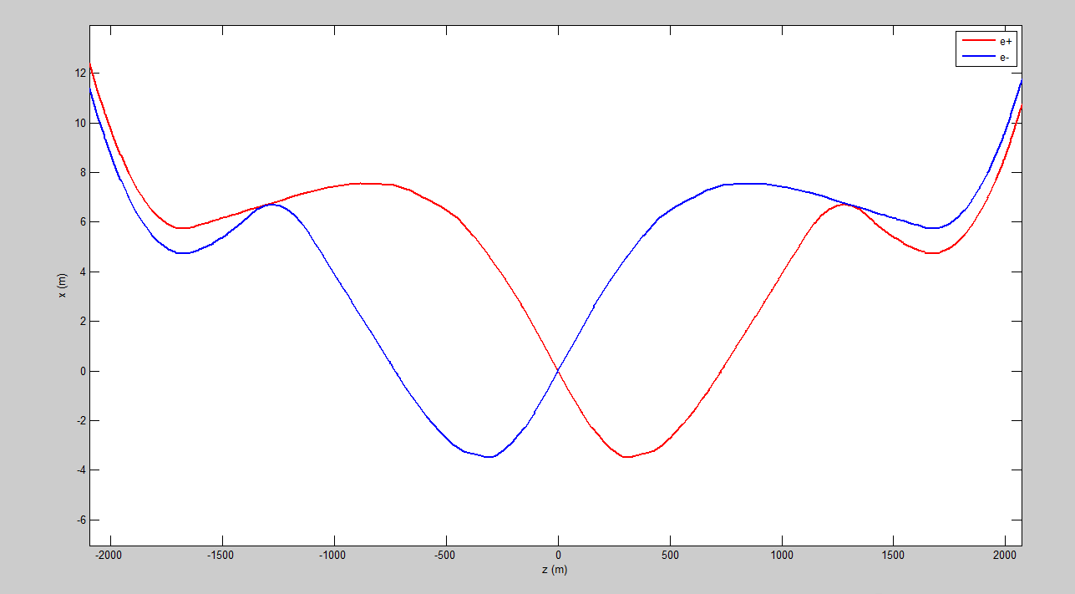
IP3 bx*=0.37
chi0=16.5e-3*180/Pi;

Slide 3
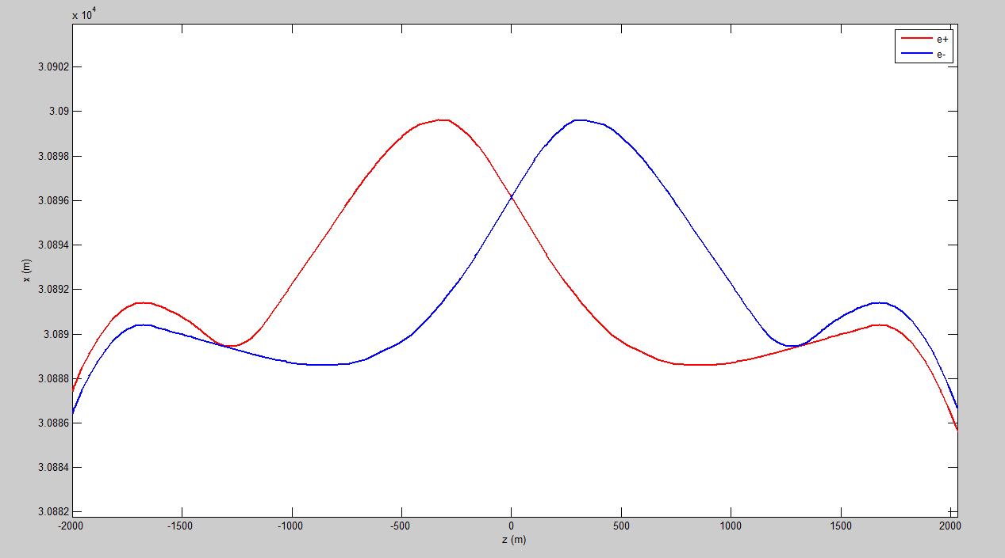
IP1

Slide 4
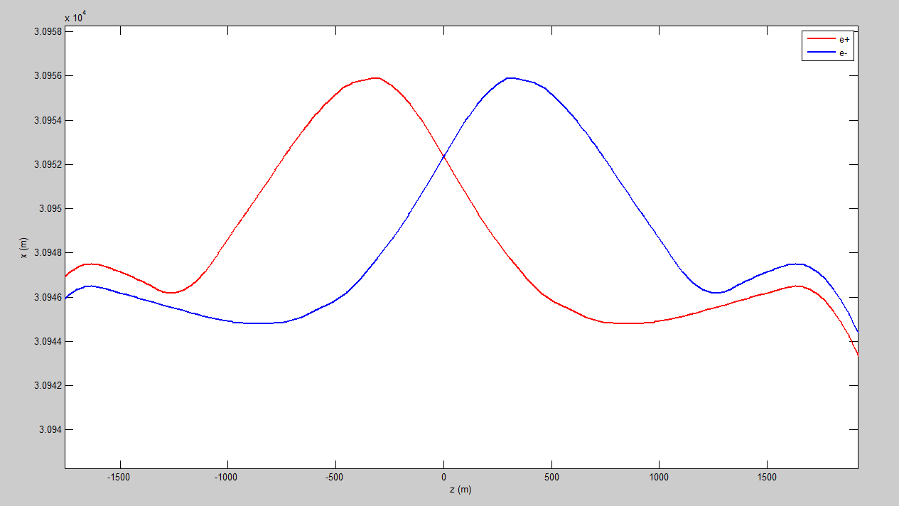
IP1 bx*=0.17

Slide 5
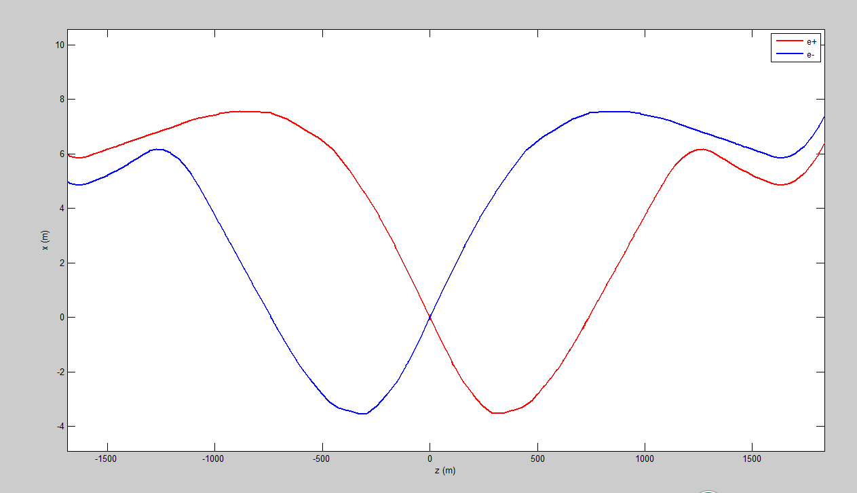
IP3

