Slide 1
CEPC parameters with larger betax*
Dou Wang, Chenghui Yu, Yuan Zhang, Yiwei Wang, Huiping Geng, Sha Bai, Jie Gao
2017.07.28

Slide 2
Higgs parameters with larger betax*
（wangdou20170713-100km_2mmβy）
 | Higgs | βx*=0.37m | βx*=0.6m | βx*=1.0m
Number of IPs | 2
Energy (GeV) | 120
Circumference (km) | 100
SR loss/turn (GeV) | 1.67
Half crossing angle (mrad) | 16.5
Piwinski angle | 3.19 | 2.17 | 1.71 | 1.32
N_{e}/bunch (10¹¹) | 0.968
Bunch number | 412
Beam current (mA) | 19.2
SR power /beam (MW) | 32
Bending radius (km) | 11
Momentum compaction (10⁻⁵) | 1.14
β_{IP} x/y (m) | 0.171/0.002 | 0.371/0.002 | 0.6/0.002 | 1.0/0.002
Emittance x/y (nm) | 1.31/0.004
Transverse σ_{IP} (um) | 15.0/0.089 | 22.0/0.089 | 28.0/0.089 | 36.2/0.089
ξ_{x}/ξ_{y}/IP | 0.013/0.083 | 0.025/0.079 | 0.036/0.075 | 0.051/0.069
RF Phase (degree) | 128
V_{RF} (GV) | 2.1
f _{RF} (MHz) (harmonic) | 650
Nature σ_{z} (mm) | 2.72
Total σ_{z} (mm) | 2.9
HOM power/cavity (kw) | 0.41(2cell)
Energy spread (%) | 0.098
Energy acceptance (%) | 1.5 | 1.0 | 0.77 | 0.58
Energy acceptance by RF (%) | 2.1
n_{γ} | 0.26 | 0.18 | 0.14 | 0.11
Life time due to beamstrahlung_cal (minute) | 52 | 60 | 60 | 60
F (hour glass) | 0.96 | 0.92 | 0.89 | 0.84
L_{max}/IP (10³⁴cm⁻²s⁻¹) | 2.0 | 1.81 | 1.65 | 1.45

Slide 3
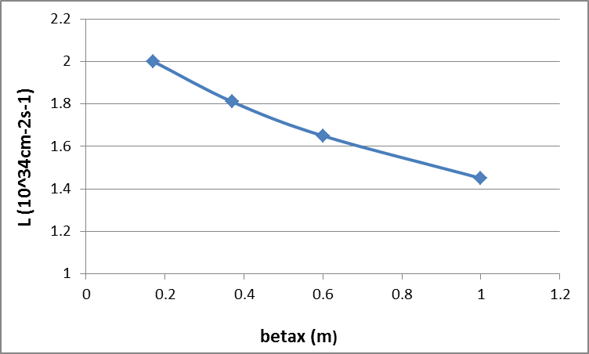
Luminosity vs. betax*

Slide 4
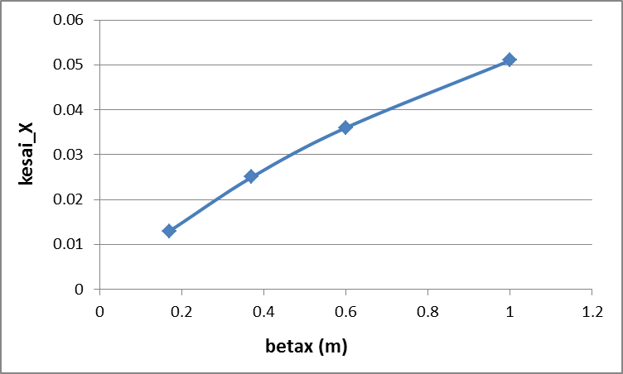
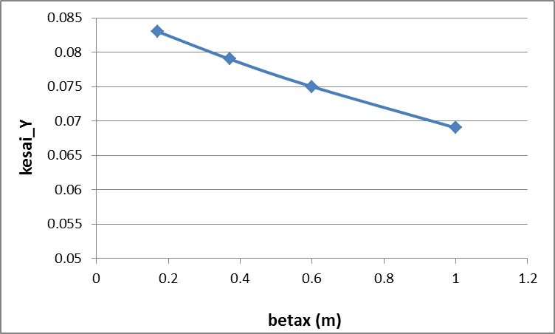
ξ vs. betax*

Slide 5
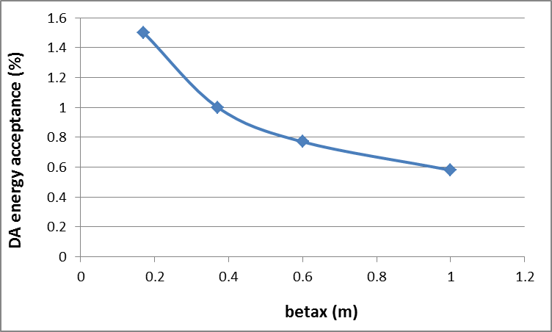
Energy acceptance vs. betax*

Slide 6
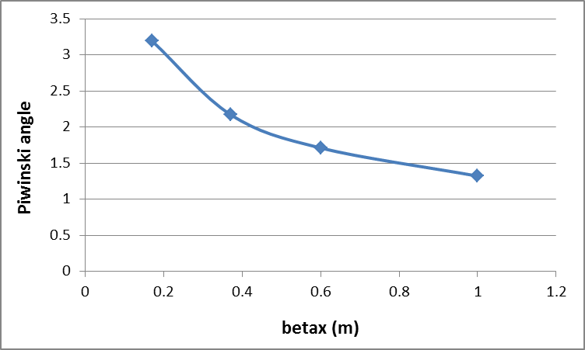
Piwinski angle vs. betax*

Slide 7
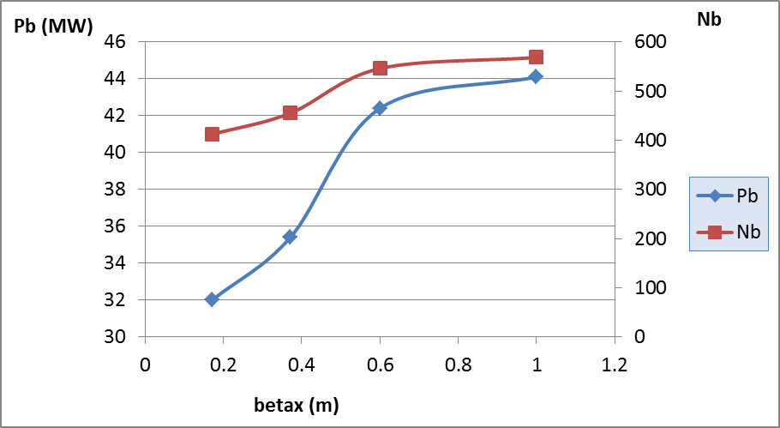
Beam power corresponding to 2×10³⁴cm⁻²s⁻¹

Slide 8
Check Higgs parameters for FCCee
 | CEPC-Higgs | FCC-Higgs | Check FCC | FCC-smaller βx*
Number of IPs | 2 | 2
Energy (GeV) | 120 | 120
Circumference (km) | 100 | 97.75
SR loss/turn (GeV) | 1.67 | 1.72
Half crossing angle (mrad) | 16.5 | 15
Piwinski angle | 3.19 |  | 1.31 | 2.94
N_{e}/bunch (10¹¹) | 0.968 | 0.71 | 0.73
Bunch number | 412 | 826
Beam current (mA) | 19.2 | 29 | 28
SR power /beam (MW) | 32 | 50 | 50
Bending radius (km) | 11 | 10.747
Momentum compaction (10⁻⁵) | 1.14 | 0.731
β_{IP} x/y (m) | 0.171/0.002 | 1.0/0.002 |  | 0.2/0.002
Emittance x/y (nm) | 1.31/0.004 | 0.63/0.00126
Transverse σ_{IP} (um) | 15.0/0.089 |  | 25.1/0.05 | 11.2/0.05
ξ_{x}/ξ_{y}/IP | 0.013/0.083 | 0.081/0.14 | 0.081/0.135 | 0.023/0.16
RF Phase (degree) | 128 |  | 139
V_{RF} (GV) | 2.1 | 2.62
f _{RF} (MHz) (harmonic) | 650 | 400
Nature σ_{z} (mm) | 2.72 | 2.0
Total σ_{z} (mm) | 2.9 | 2.2
HOM power/cavity (kw) | 0.41(2cell)
Energy spread (%) | 0.098 | 0.099
Energy acceptance (%) | 1.5 |  | 2 (1) | 2
Energy acceptance by RF (%) | 2.1 | 2.2 | 5.3
n_{γ} | 0.26 |  | 0.12
Life time due to beamstrahlung_cal (minute) | 52 |  | 4.45×10⁸ (460) | 50
F (hour glass) | 0.96 |  | 0.89 | 0.97
L_{max}/IP (10³⁴cm⁻²s⁻¹) | 2.0 | 4.6 | 4.54 | 5.88

Slide 10
Higgs parameters with smaller emit.（wangdou20170719-100km_2mmβy）
 | Higgs | βx*=0.3m | βx*=0.6m | βx*=1.0m
Number of IPs | 2
Energy (GeV) | 120
Circumference (km) | 100
SR loss/turn (GeV) | 1.67
Half crossing angle (mrad) | 16.5
Piwinski angle | 3.19 | 2.67 | 1.89 | 1.46
N_{e}/bunch (10¹¹) | 0.968
Bunch number | 412
Beam current (mA) | 19.2
SR power /beam (MW) | 32
Bending radius (km) | 11
Momentum compaction (10⁻⁵) | 1.14 | 0.95 | 0.95 | 0.95
β_{IP} x/y (m) | 0.171/0.002 | 0.3/0.002 | 0.6/0.002 | 1.0/0.002
Emittance x/y (nm) | 1.31/0.004 | 1.0/0.003 | 1.0/0.003 | 1.0/0.003
Transverse σ_{IP} (um) | 15.0/0.089 | 17.3/0.078 | 24.5/0.078 | 31.6/0.078
ξ_{x}/ξ_{y}/IP | 0.013/0.083 | 0.023/0.096 | 0.04/0.091 | 0.059/0.085
RF Phase (degree) | 128 | 124 | 123 | 122
V_{RF} (GV) | 2.1 | 2.02 | 1.99 | 1.975
f _{RF} (MHz) (harmonic) | 650
Nature σ_{z} (mm) | 2.72 | 2.66 | 2.73 | 2.76
Total σ_{z} (mm) | 2.9 | 2.8 | 2.8 | 2.8
HOM power/cavity (kw) | 0.41(2cell) | 0.42 | 0.42 | 0.42
Energy spread (%) | 0.098
Energy acceptance (%) | 1.5 | 1.35 | 0.92 | 0.7
Energy acceptance by RF (%) | 2.1 | 1.89 | 1.77 | 1.7
n_{γ} | 0.26 | 0.23 | 0.16 | 0.13
Life time due to beamstrahlung_cal (minute) | 52 | 60 | 60 | 60
F (hour glass) | 0.96 | 0.94 | 0.91 | 0.87
L_{max}/IP (10³⁴cm⁻²s⁻¹) | 2.0 | 2.27 | 2.05 | 1.83

Slide 11
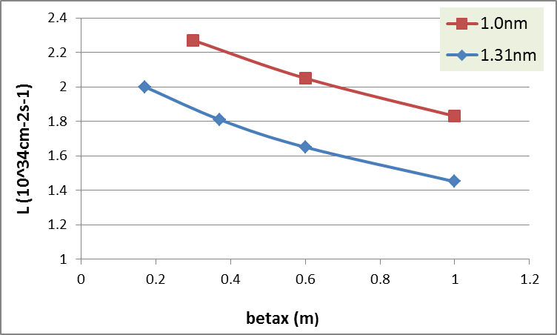
Luminosity vs. betax*

Slide 12
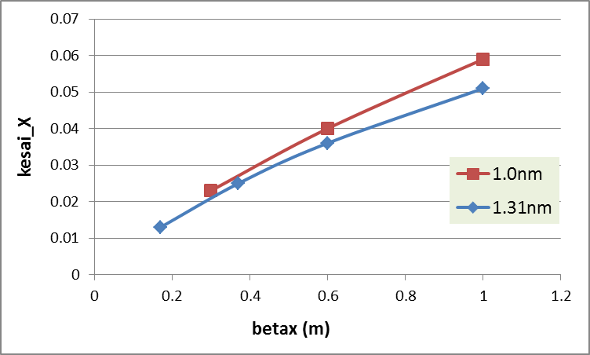
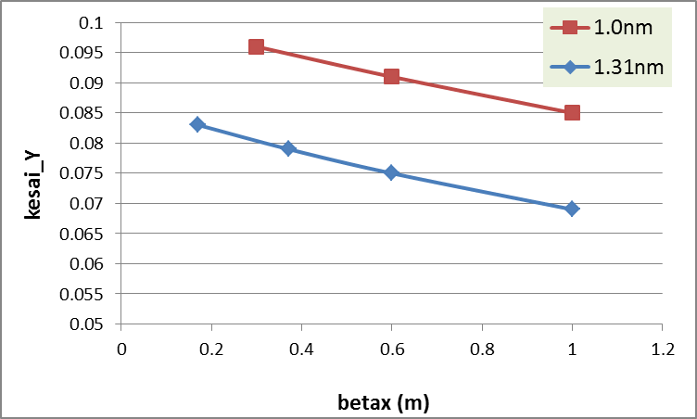
ξ vs. betax*

Slide 13
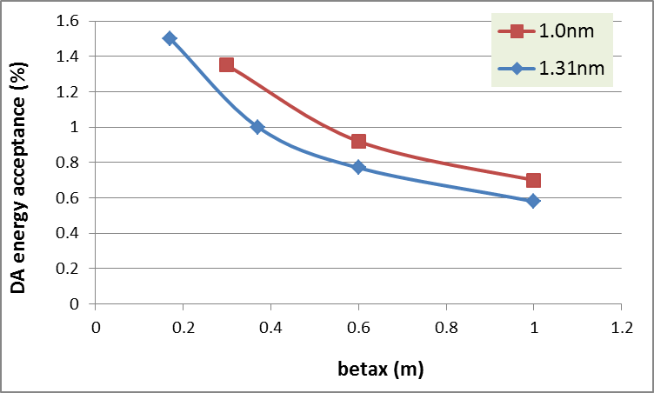
Energy acceptance vs. betax*

Slide 14
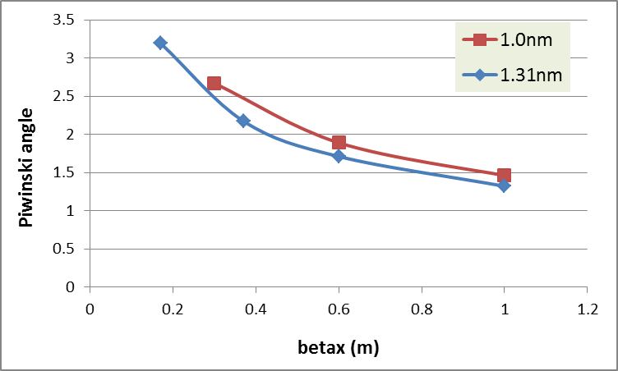
Piwinski angle vs. betax*

Slide 15
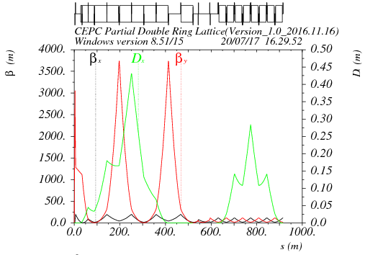
FFS optics with larger betax*
betax*=0.5m, betay*=2mm

Slide 16
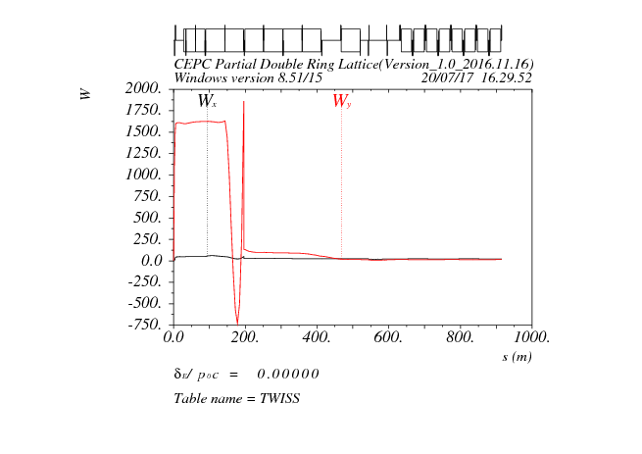
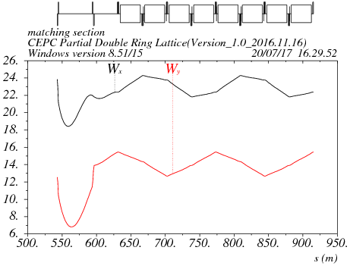

Slide 17
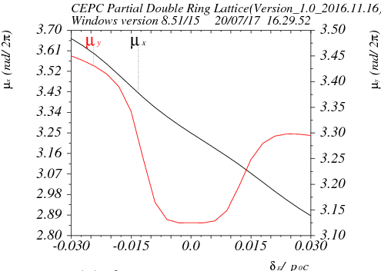
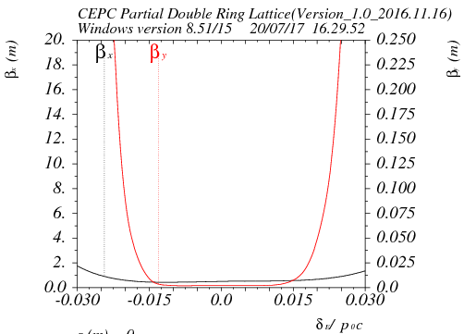

Slide 18
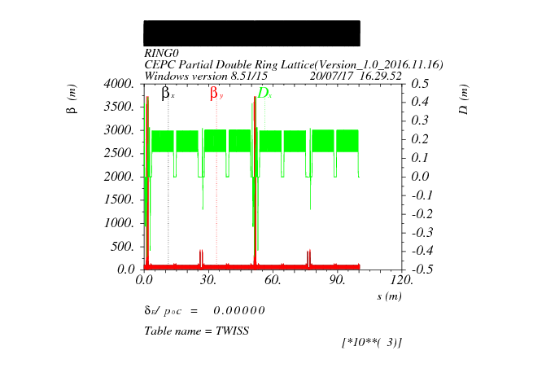

Slide 19
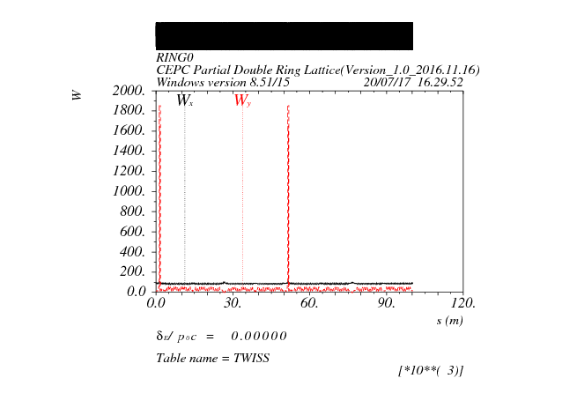

Slide 21
DA before optimization
4 fam in FFS
2 fam in arc
Damping
200 turns

Slide 22
DA after optimization

Slide 23
DA after optimization-open sawtooth

Slide 24
sawtooth+fluc
50 seeds

Slide 25
Strength of crab sextupole
Strength of crab sextupole: ~13% of main sextupoles
Upstream of IP : negative
Downstream of IP: positive

Slide 26
Open crab sextupoles

Slide 27
Crab+sawtooth

Slide 30
Crab+sawtooth+fluc
50 seeds

Slide 32
cross-section for radiative Bhabha scattering

Slide 33
lifetime due to radiative Bhabha
For CEPC(Pre-CDR) and FCCee,
Life time of FCCee: 72 min
Life time of CEPC(Pre-CDR) : 55 min
For CEPC(CDR)
Life time of CEPC(CDR) : 100 min

