Slide 1
CEPC Linac
Positron source
C. Meng ,Y. Chi, G. Pei, J. Zhang, X. Li, S. Pei, J. Gao
Institute of High Energy Physics, CAS, Beijing

Slide 2
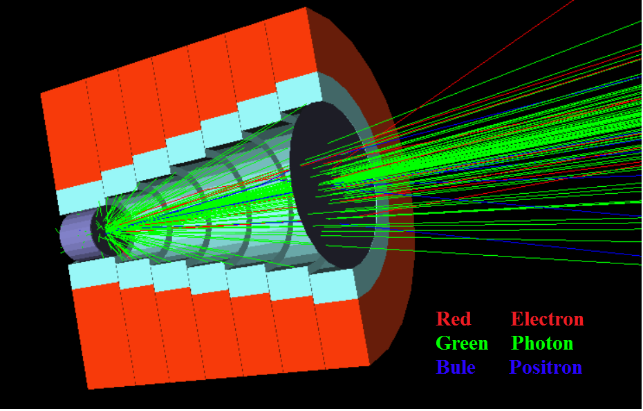
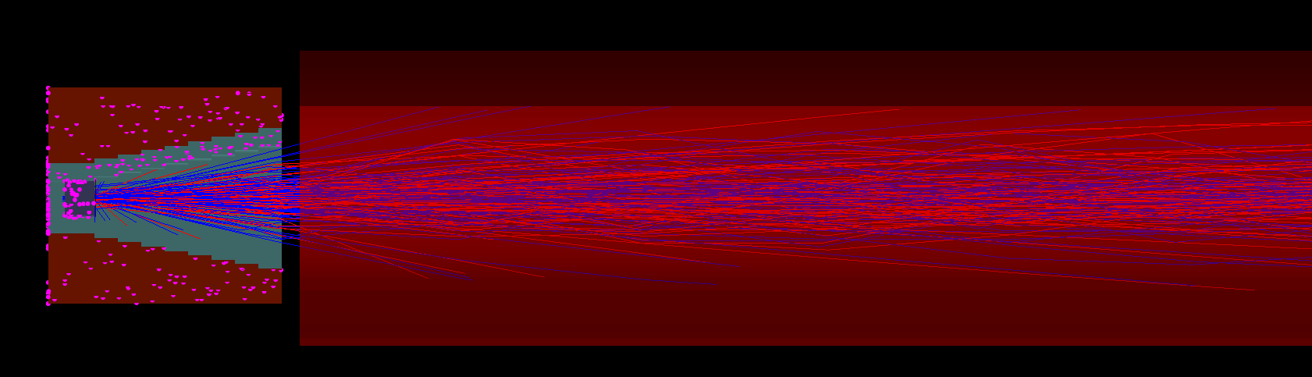
CEPC linac
Positron source design
FC (Flux concentrator)
Positron pre-accelerating section
  Magnetic field map
  5.5 T→0.5T

Slide 3
CEPC linac
Positron source design
2 m加速管
  不同梯度
  不同能量
  不同初始相位（腔的加速相位）
  出口相位和能量，以得到较好的梯度和相位设置

Slide 4
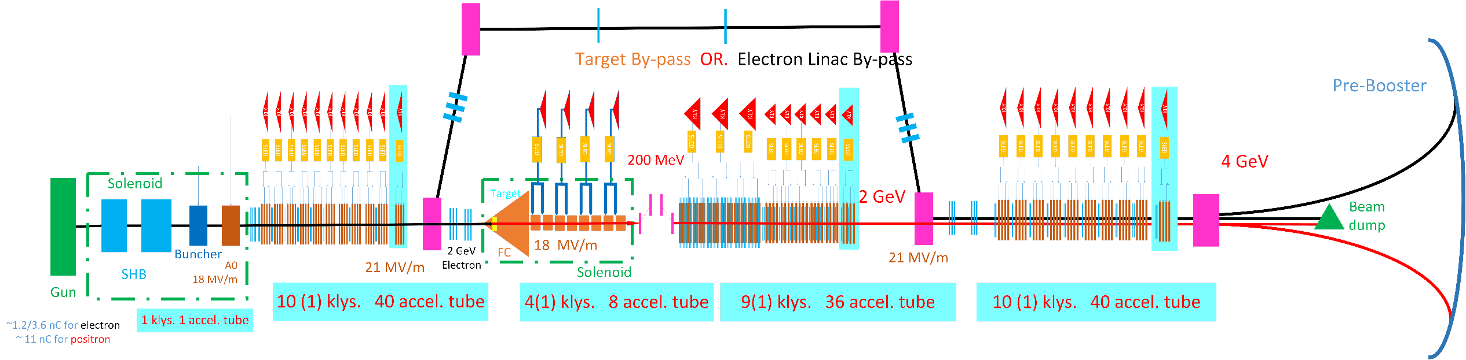
CEPC linac
4 GeV scheme
Parameter | Symbol | Unit | Value
e⁻ /e⁺ beam energy | E_{e-}/E_{e+} | GeV | 4
Repetition rate | f_{rep} | Hz | 100
e⁻ /e⁺ bunch population | Ne-/Ne+ |  | >6.25×10⁹
 |  | nC | >1.0
Energy spread (e⁻ /e⁺ ) | σ_{E} |  | <2×10⁻³
Emittance (e⁻ /e⁺ ) | ε_{r} | mm⋅ mrad
e⁻ beam energy on Target |  | GeV | 2
e⁻ bunch charge on Target |  | nC | 10

Slide 5
CEPC linac
Positron linac
Electron beam on target: 2 GeV
  Bunch charge: 1 nC
  Target: 15 mm
Linac exit energy: 4 GeV
Damping Ring?
  Emittance requirement of Pre-Booster

