Slide 1
Status of DA Optimization
Wyw170724-bx0.37
ZHANG, Yuan WANG, Yiwei WANG, Dou GENG, Huiping
2017-08-18

Slide 2
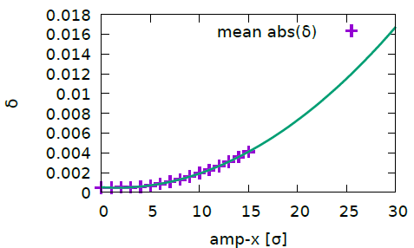
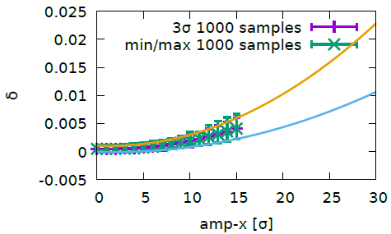
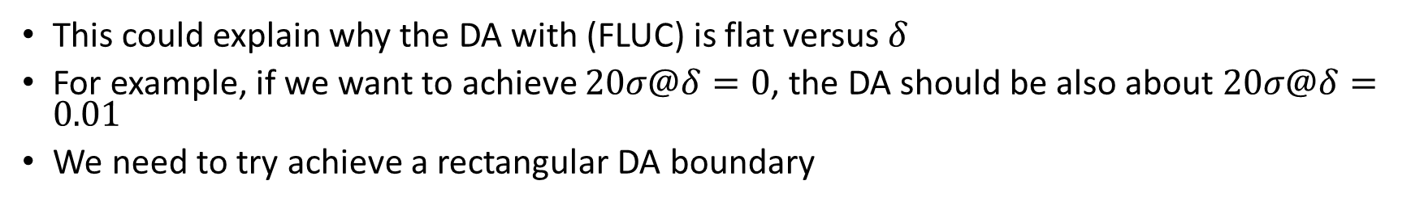
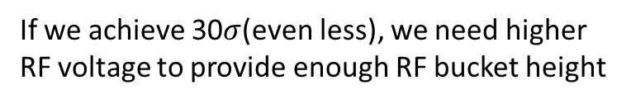
Momentum deviation versus amplitude
Machine Main Parameters?!
If we achieve 30$σ$(even less), we need higher RF voltage to provide enough RF bucket height
This could explain why the DA with (FLUC) is flat versus $δ$
For example, if we want to achieve $20σ@δ=0$, the DA should be also about $20σ@δ=0.01$
We need to try achieve a rectangular DA boundary
Notes:
Cmst-3-clip1-400t

Slide 3
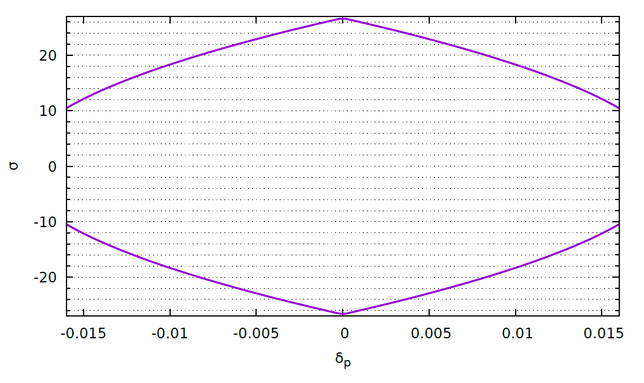

DA objective
$\left|δ\right|+2.651x^{2}+1.07×{10}^{−3}=0.02$

Slide 4
Variables (59)
Tune: (173.55, 174.61)-0713, (177.55, 177.61)-0719/24
IR sextupoles, 4 families
IR octupoles, 13 families
IR higher order chromaticity knob(Cai), 2 families
Phase advance between different sections, 8 variables
Arc sextupoles, 32 families

Slide 5
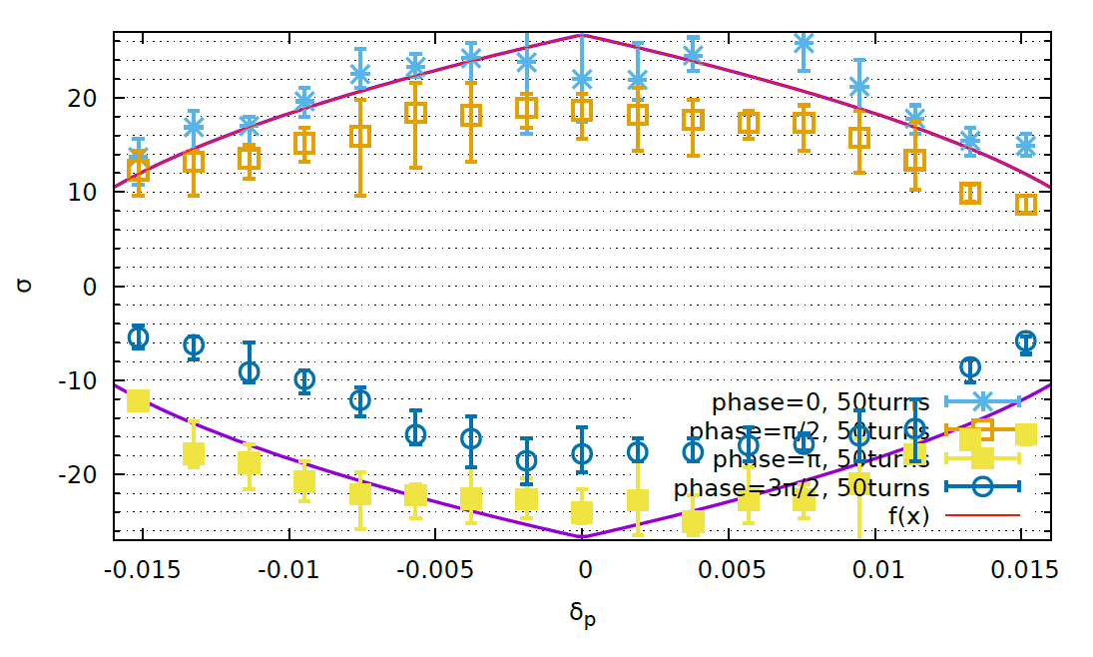
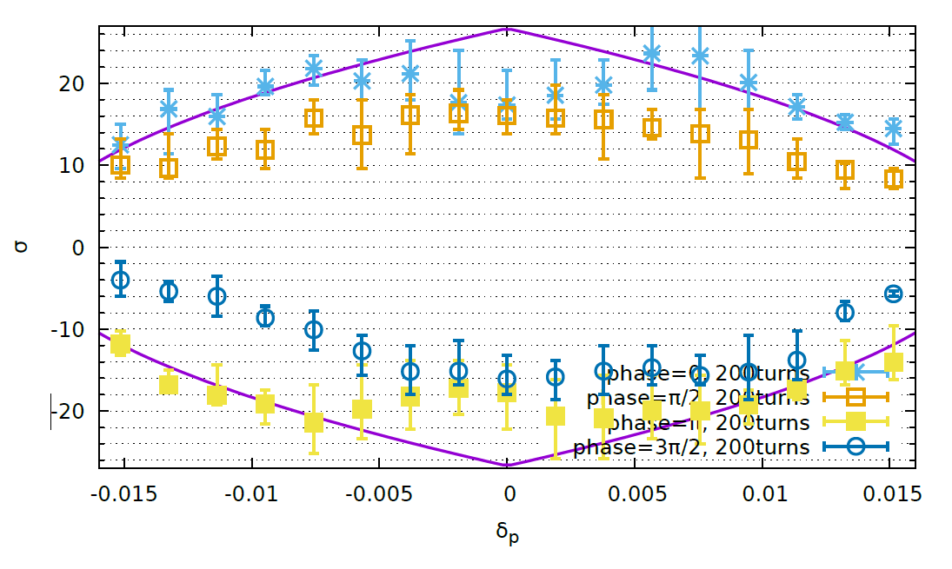
Optimize with FLUC ON wyw-170724-bx0.37

Slide 6
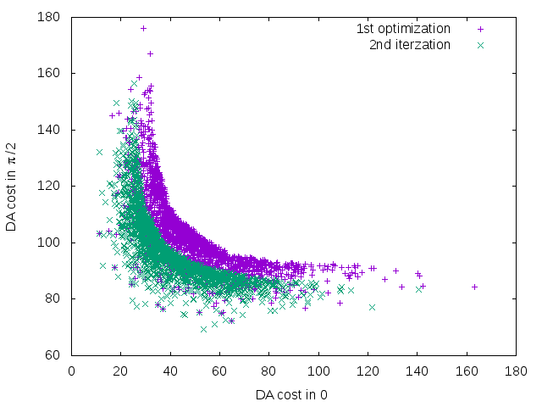
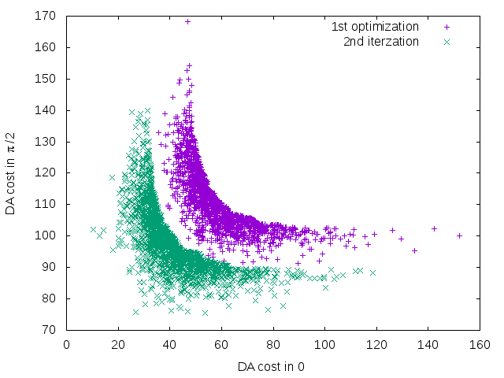
Optimize Iteration with Pareto Front Solution
Non-dominated solution achieved + Other initialized solutions are randomly generated
No clear further optimization
Bx= 0.37m
Bx= 0.50m

Slide 7
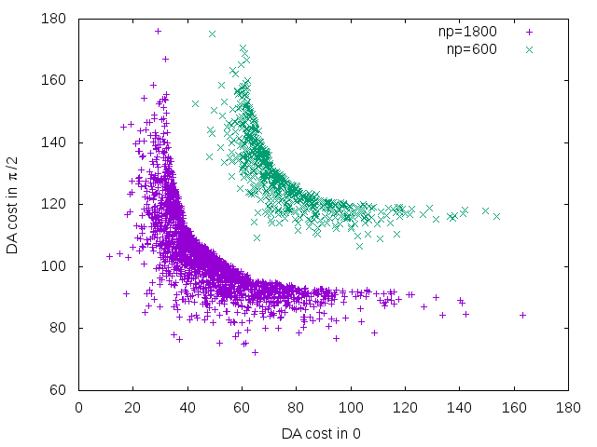
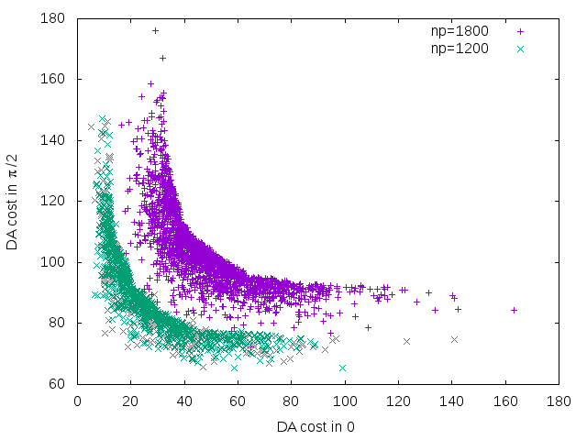
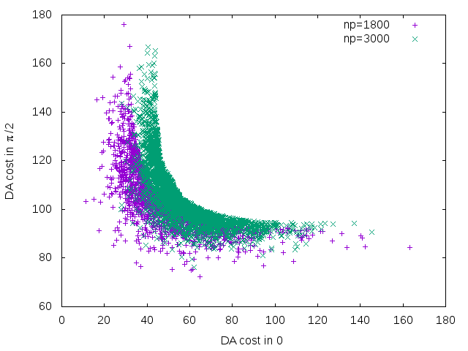
Optimize with different population size:
Np=1200~1800 (20-30 times variable number) is good enough

Slide 8
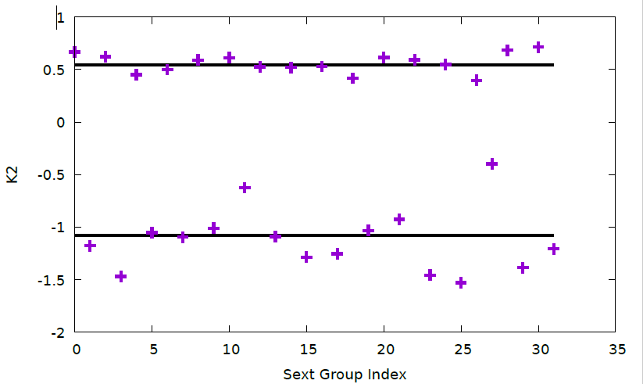
Arc Sextupole Stregnth
1.5 times chromaticity correction strength

Slide 9
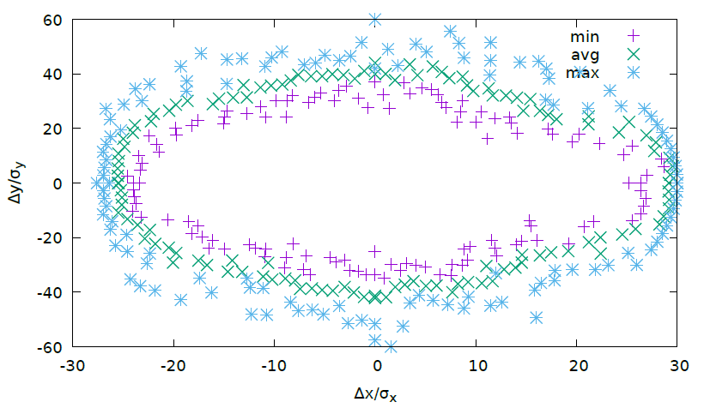
Dynamic Aperture (XY) – On Momentum
50 turns
10 times

Slide 10
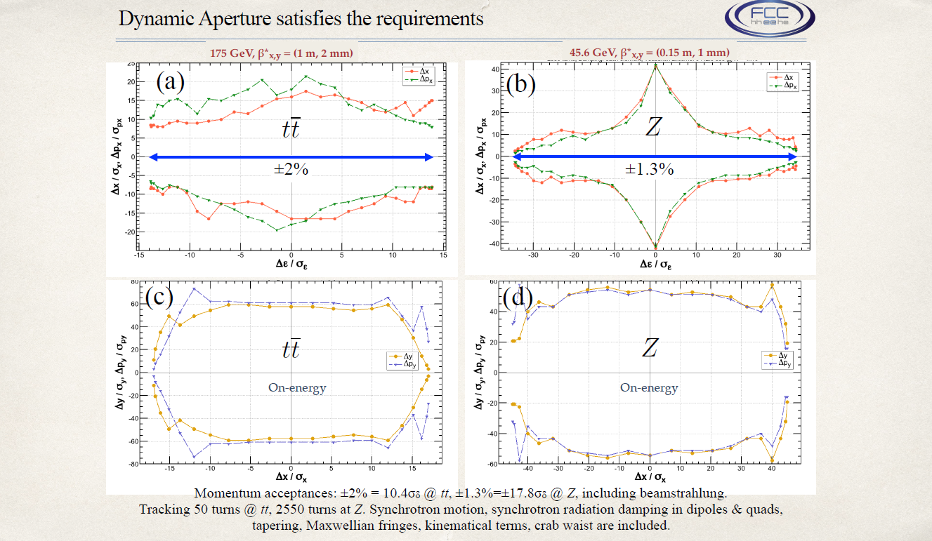
FCC WEEK 2017

Slide 11
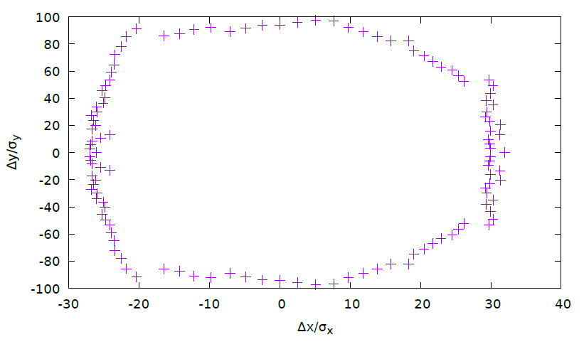
Dynamic Aperture (XY) – On Momentum
DAMPONLY

Slide 12
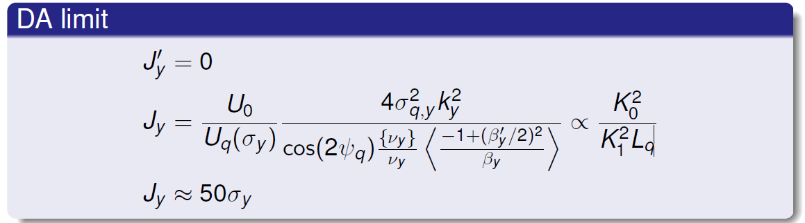
Dynamic Aperture Limited by Radiation
A. Bogomyagkov (BINP)
Proposal: Increase Lq by 25% or 50%.
A tradeoff between chromaticity and radiation.

Slide 13
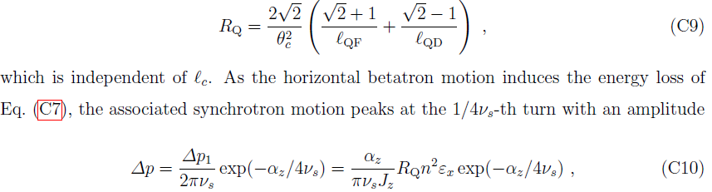
Effect of Synchrotron Radiation in Quadrupoles on Dynamic Aperture
K. Oide

Slide 14

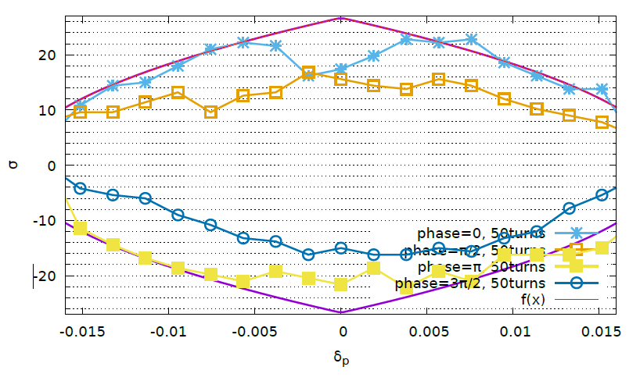
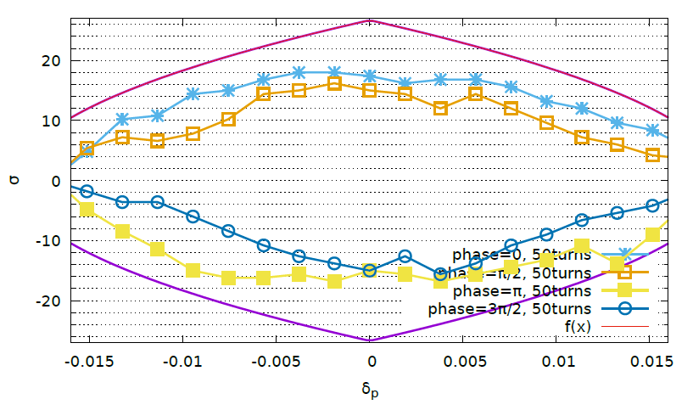
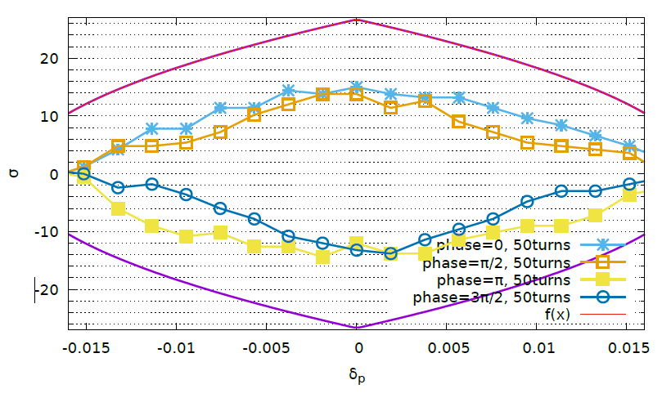
Crab Waist
IP Downstream: K2 = 0.69 m⁻²
IP Upstream: K2 =-0.69 m⁻²
CW=0
CW=0.5
CW=1.0

Slide 15
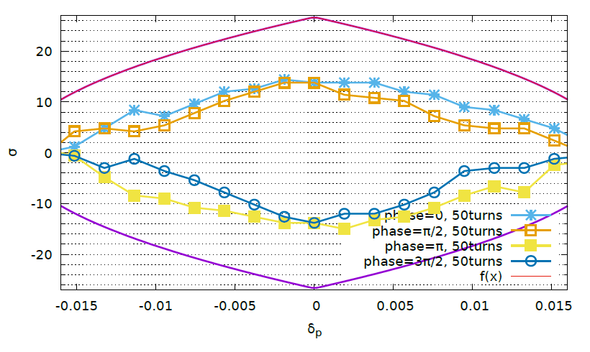
Crab Waist Sextupole Length (CW=1)
L = 0
L = 0.2m
The finite length seems does not squeeze DA.

Slide 16
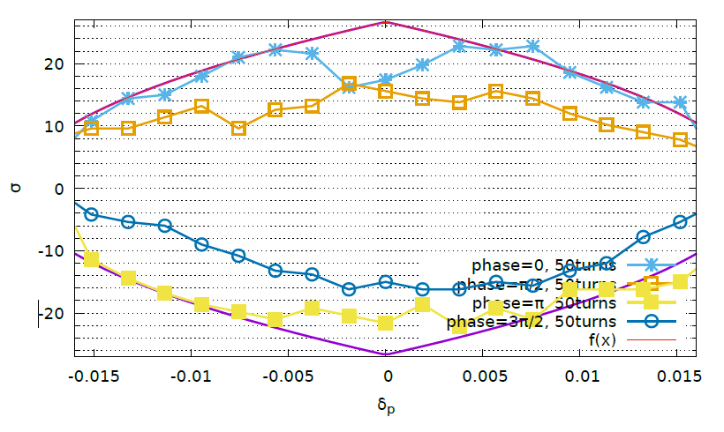
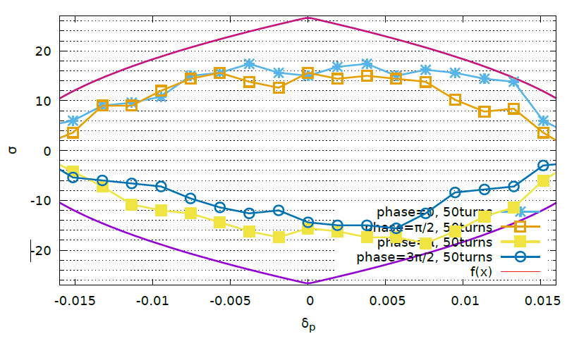
Optimize DA with Crab Waist
CW=0
CW=1
CW=1

Slide 17
Optimize DA with Crab Waist
CW=0
CW=0.5
CW=0.5

Slide 18
Discussion
Observation point instead of IP
Lq

Slide 19
memo

Slide 20
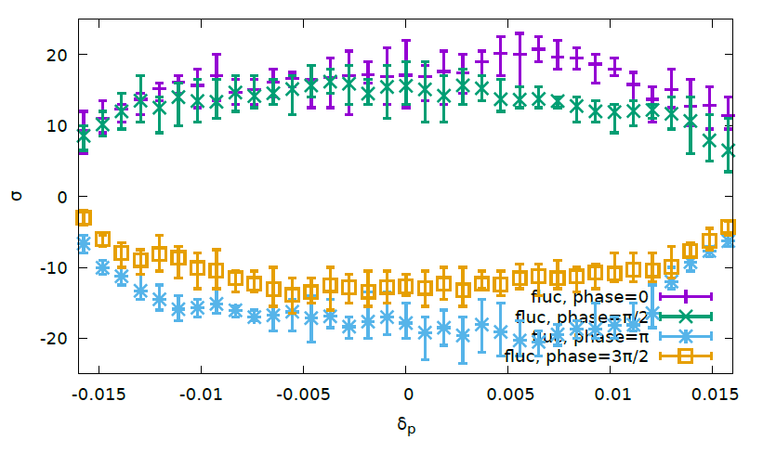
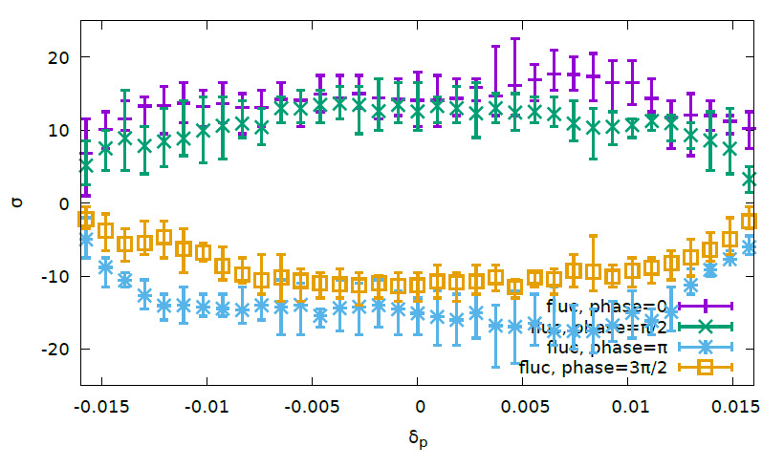
Optimize with FLUC ON wyw-170414
Pcmst-3-fluc
50 turns
200 turns
Notes:
Pcmst-2-fluc

Slide 21
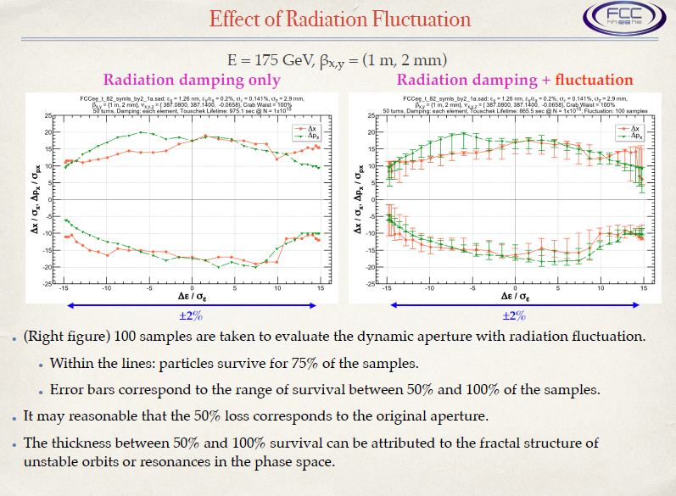
FCC-ee MDI Workshop, 2017

Slide 22
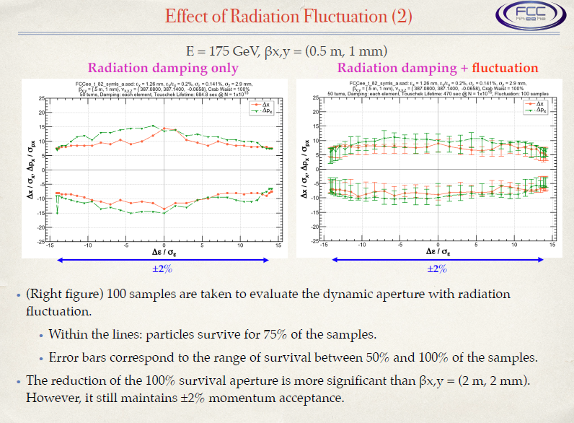
FCC-ee MDI Workshop, 2017

Slide 23
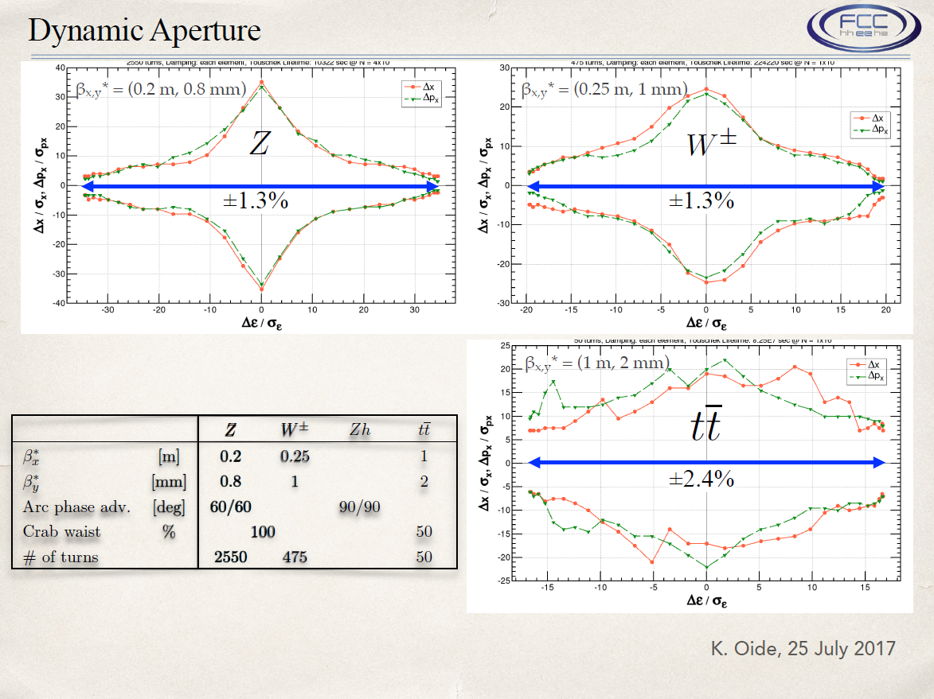

Slide 24
Crab-waist, 161202-100km-2mm-h-highlum, (0.545,0.61, 0.037)
The effect of crab-waist is more clear when the horizontal tune is far from half integer.

Slide 25
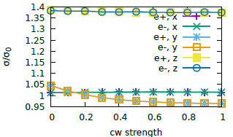
Crab-waist, 161202-100km-1mm-w (0.535,0.61,0.0425)
Crab-waist transformation increase luminosity about 15% by suppressing the vertical beam size blow up

Slide 26
Crab-waist, 161202-100km-1mm-z (0.54,0.61,0.0256)
Crab-waist transformation increase luminosity about 25% by suppressing the vertical beam size blow up

