Slide 1
CEPC new parameters
Dou Wang, Chenghui Yu, Yuan Zhang, Yiwei Wang, Huiping Geng, Sha Bai, Jie Gao

Slide 2
CEPC new parameter - Higgs
 | εx*=1.31m | εx*=1.18m (lattice)
Number of IPs | 2 | 2
Energy (GeV) | 120 | 120
Circumference (km) | 100 | 100
SR loss/turn (GeV) | 1.67 | 1.61
Half crossing angle (mrad) | 16.5 | 16.5
Piwinski angle | 2.14 | 2.28
N_{e}/bunch (10¹¹) | 0.968 | 0.968
Bunch number | 444 | 420
Beam current (mA) | 20.6 | 19.5
SR power /beam (MW) | 34.5 | 31.4
Bending radius (km) | 11 | 11.4
Momentum compaction (10⁻⁵) | 1.18 | 1.15
β_{IP} x/y (m) | 0.36/0.002 | 0.36/0.002
Emittance x/y (nm) | 1.31/0.004 | 1.18/0.0036
Transverse σ_{IP} (um) | 21.7/0.089 | 20.6/0.085
ξ_{x}/ξ_{y}/IP | 0.025/0.081 | 0.025/0.085
RF Phase (degree) | 129 | 128
V_{RF} (GV) | 2.15 | 2.03
f _{RF} (MHz) (harmonic) | 650 | 650
Nature σ_{z} (mm) | 2.72 | 2.75
Total σ_{z} (mm) | 2.81 | 2.85
HOM power/cavity (kw) | 0.45 | 0.42
Energy spread (%) | 0.098 | 0.096
Energy acceptance (%) | 1.05 | 1.1
Energy acceptance by RF (%) | 2.1 | 1.98
n_{γ} | 0.18 | 0.19
Life time due to beamstrahlung_cal (minute) | 60 | 63
F (hour glass) | 0.92 | 0.93
L_{max}/IP (10³⁴cm⁻²s⁻¹) | 2.0 | 2.0

Slide 3
 | Higgs | W | Z
Number of IPs | 2 | 2 | 2
Energy (GeV) | 120 | 80 | 45.5
Circumference (km) | 100 | 100 | 100
SR loss/turn (GeV) | 1.61 | 0.32 | 0.033
Half crossing angle (mrad) | 16.5 | 16.5 | 16.5
Piwinski angle | 2.28 | 3.6 | 6.33
N_{e}/bunch (10¹⁰) | 9.68 | 3.6 | 2.3
Bunch number | 420 | 5700 | 27000
Beam current (mA) | 19.5 | 98.6 | 298.5
SR power /beam (MW) | 31.4 | 31.3 | 9.9
Bending radius (km) | 11.4 | 11.4 | 11.4
Momentum compaction (10⁻⁵) | 1.15 | 1.15 | 1.15
β_{IP} x/y (m) | 0.36/0.002 | 0.36/0.002 | 0.36/0.002
Emittance x/y (nm) | 1.18/0.0036 | 0.52/0.0017 | 0.17/0.0038
Transverse σ_{IP} (um) | 20.6/0.085 | 13.7/0.059 | 7.81/0.087
ξ_{x}/ξ_{y}/IP | 0.025/0.085 | 0.014/0.068 | 0.017/0.053
RF Phase (degree) | 128 | 134.7 | 151
V_{RF} (GV) | 2.03 | 0.45 | 0.069
f _{RF} (MHz) (harmonic) | 650 | 650 | 650 (217800)
Nature σ_{z} (mm) | 2.75 | 2.98 | 2.92
Total σ_{z} (mm) | 2.85 | 3.0 | 3.0
HOM power/cavity (kw) | 0.42 (2cell) | 0.38 (2cell) | 0.74 (2cell)
Energy spread (%) | 0.096 | 0.064 | 0.036
Energy acceptance (%) | 1.1
Energy acceptance by RF (%) | 1.98 | 1.46 | 1.2
n_{γ} | 0.19 | 0.11 | 0.12
Life time due to beamstrahlung_cal (minute) | 63
F (hour glass) | 0.93 | 0.963 | 0.987
L_{max}/IP (10³⁴cm⁻²s⁻¹) | 2.0 | 5.6 | 7.7

Slide 4
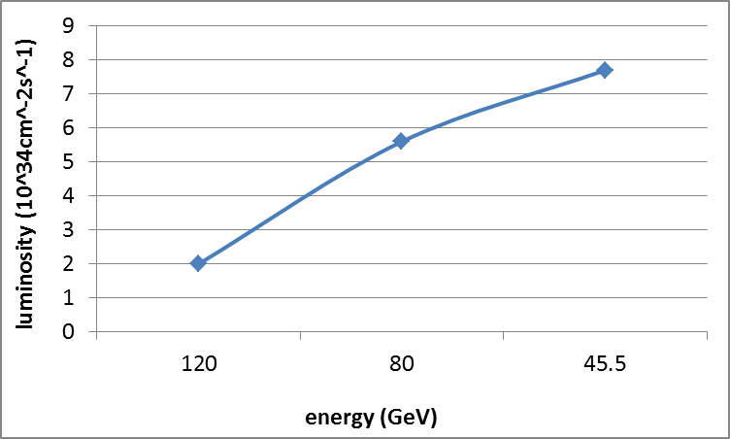
Luminosity vs energy

Slide 5
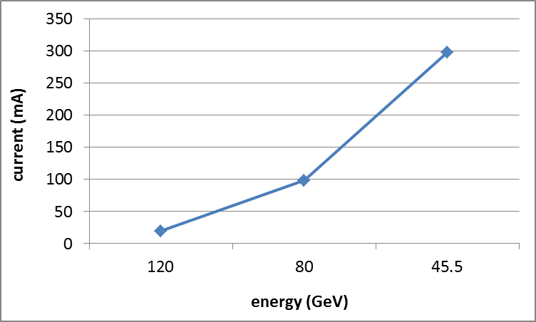
Beam current vs energy

Slide 6
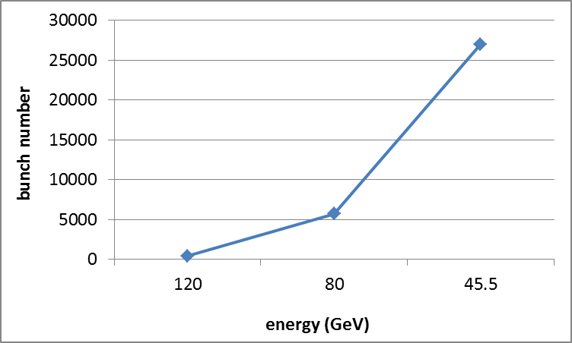
Bunch number vs energy

