Slide 1
Update of Lattice Design for CEPC Main Ring
Yiwei Wang, Yuan Zhang, Chenghui Yu, Jie Gao
CEPC AP meeting, 18 Aug 2017

Slide 2
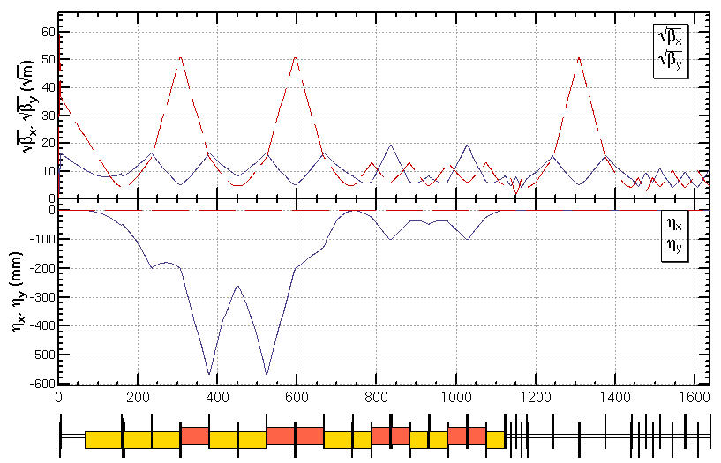
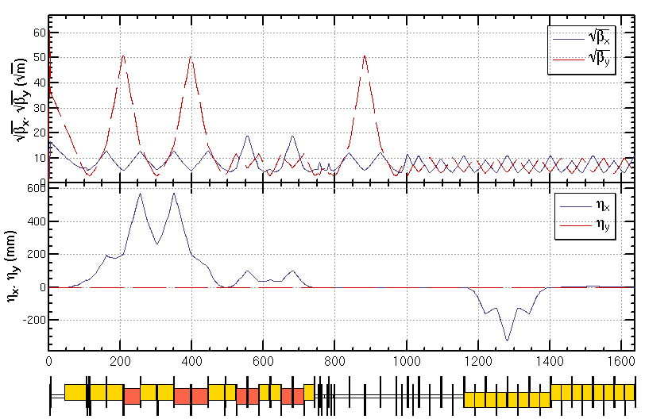
1) bx*=0.36m 2) fix bug of crossing at non-IP
IR upstream
IR downstream
IR geometry

Slide 3
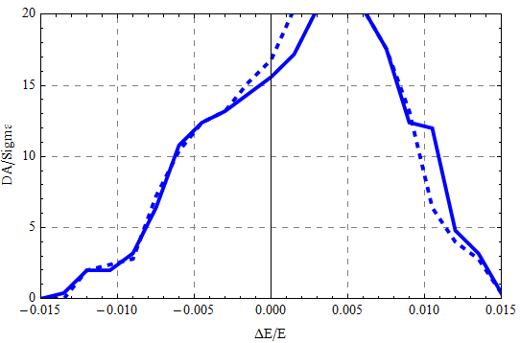
DA w/ damping, w/o fluctuation, 100 turns,
4 families in ARC
Hard line bx*=0.36m
Dashed line bx*=0.37m

Slide 4
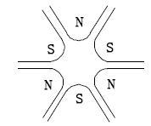
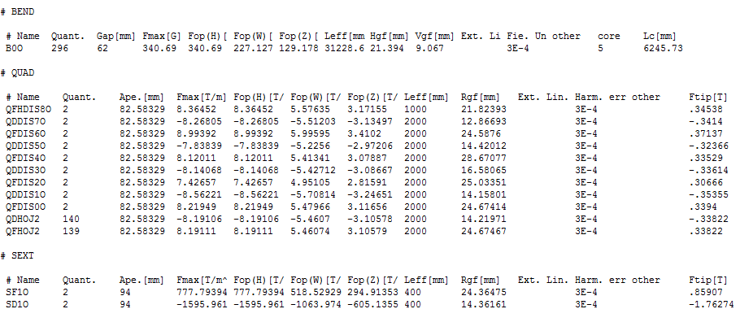
相切椭圆和六极铁极面曲线
Rx=52+3mm
Ry=28+3mm
LSF=0.4m
LSD=0.4m

Slide 5
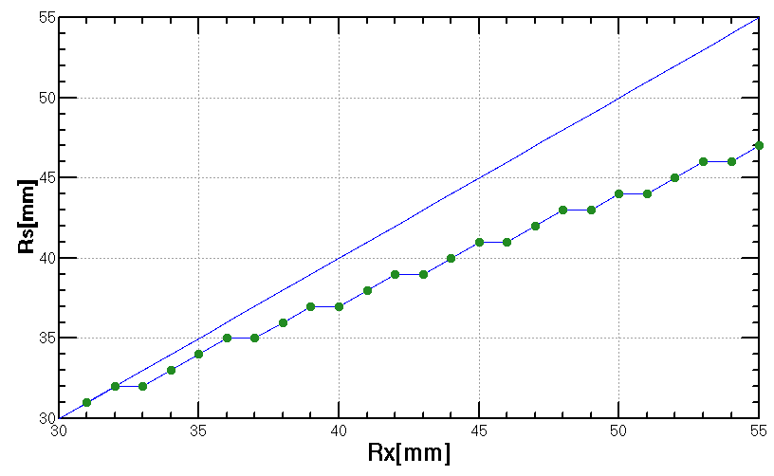
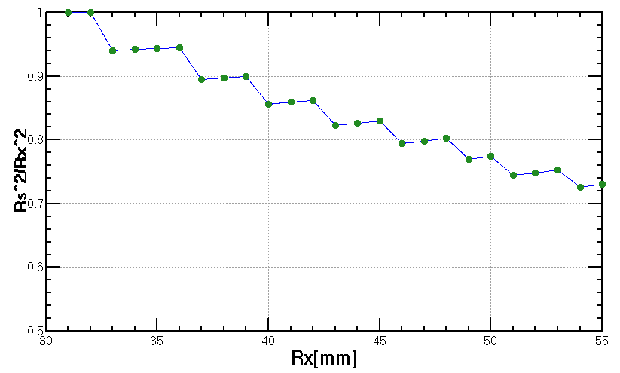
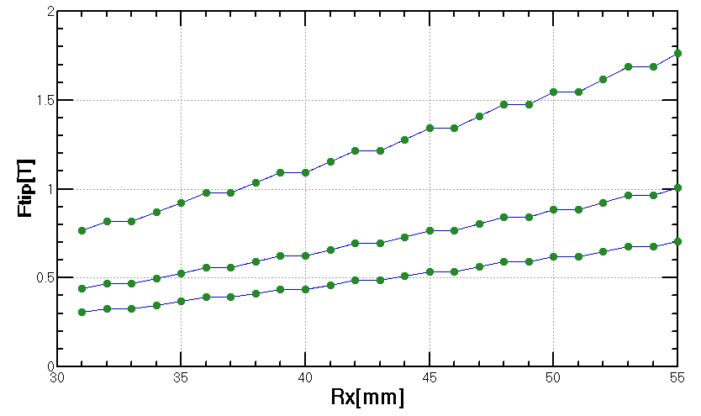
相切椭圆和六极铁极面曲线
Ry=28+3mm
Ftip ∝ R^2/L
LSD=0.4m
If limit Ftip<=0.6T
LSF=0.6m
LSD=1.2m
LSD=0.7m
LSD=1.0m

Slide 6
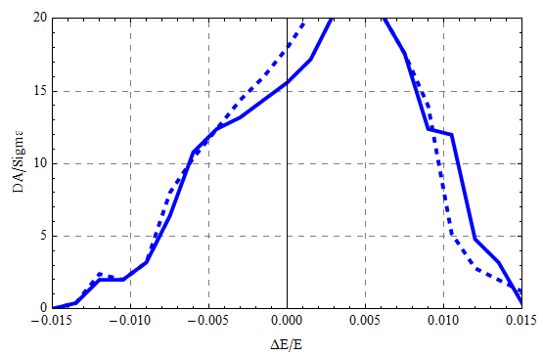
DA w/ damping, w/o fluctuation, 100 turns
Hard line bx*=0.36m , Lsext=0.4m
Dashed line bx*=0.36m, Lsf=0.6m, Lsd=1.2m

