Slide 1
Pre-booster
Cui Xiaohao
2017/08/25

Slide 2
Space Charge Tune shift (4 GeV)

Slide 3
Current in the ring with 50s injection time, 1mA per injection

Slide 4
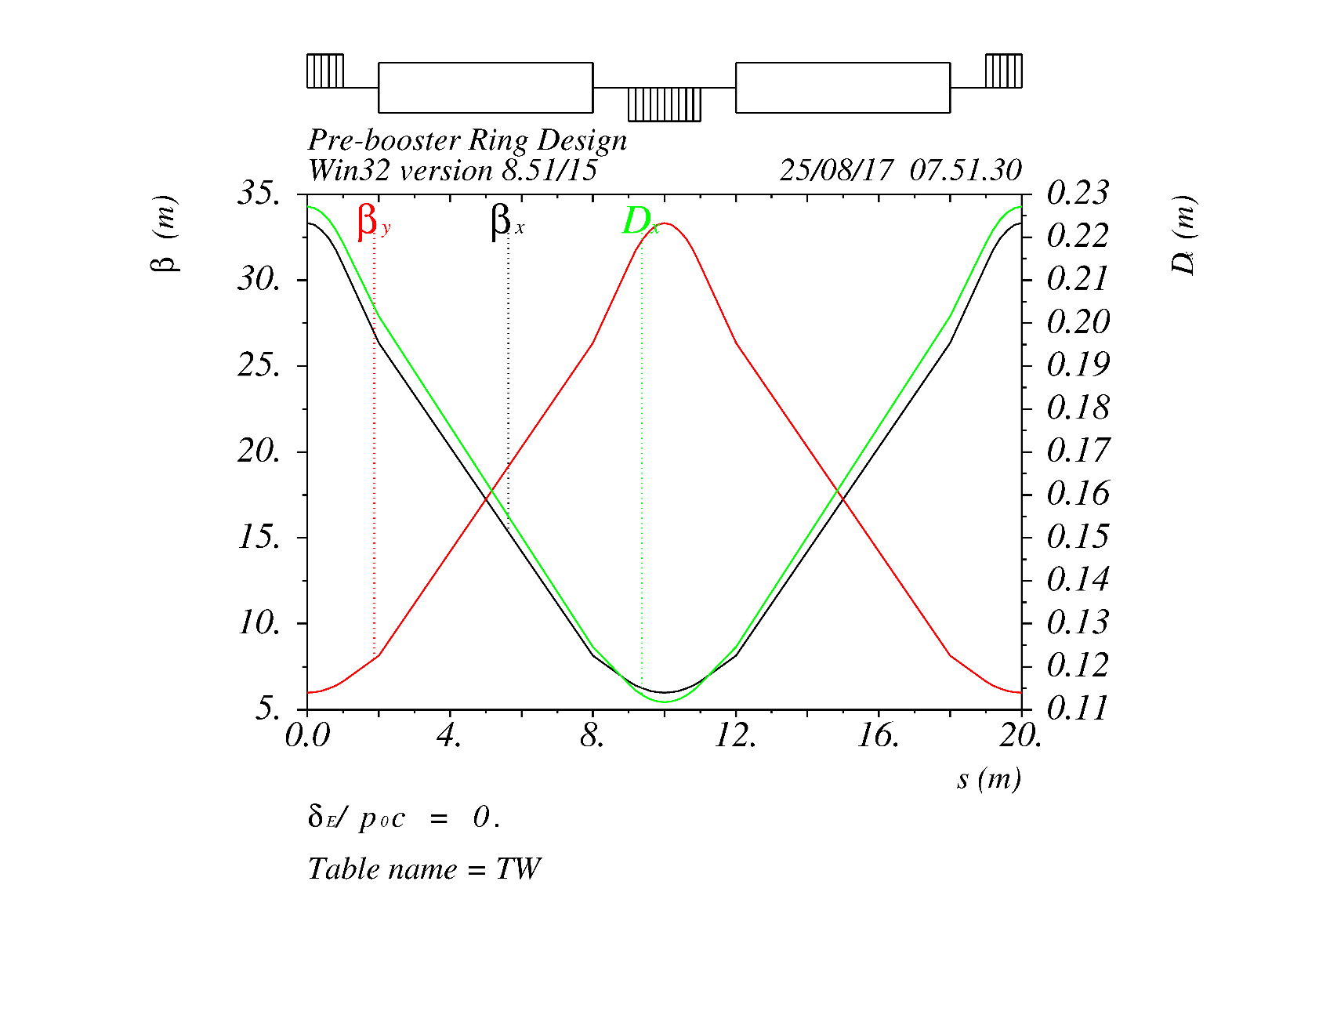
FODO

Slide 5
Tune Vs Delta

