Slide 1

中国科学院高能物理研究所
INSTITUTE OF HIGH ENERGY PHYSICS
CEPC advanced partial double ring
ARC design
Dengjie Xiao Jie Gao Feng Su
Tianjian Bian Yiwei Wang
Dou Wang Dianjun Gong
CEPC AP meeting, 2017.8.25

Slide 2
Layout comparison :

Slide 3
CEPC Partial Double Ring Layout
1/2RF
1/2RF
IP1_ee
RF
RF
3.7Km
1/2RF
1/2RF
Bypass
about 42m
IP4_pp
IP2_pp
Bypass
about 42m
1/2RF
1/2RF
IP1_ee/IP3_ee, 3.7Km
IP2_pp/IP4_pp, 1132.8m
4 Short Straights, 141.6m
4 Medium Straights, 566.4m
4 Long Straights, 944m
2 Short ARC, 24*FODO, 1132.8m
4 Medium ARC, 112*FODO, 5286.4m
4 Long ARC, 124*FODO, 5852.8m
C=60830.4m
RF
RF
IP3_ee
1/2RF
1/2RF
SU Feng
2016.9.15

Slide 4
CEPC Advanced Partial Double Ring Option II
RF
RF
IP1_ee
ARC
APDR
APDR
RF
3.7Km
RF
APDR
C=65640.2m
APDR
RF
RF
APDR
APDR
IP1_ee/IP3_ee, 3703.46m
IP2_pp/IP4_pp, 1132.8m
APDR, 1426m
RF Station, 188.8m
ARC1, 6041.6m
ARC1, 4902.87m
IP3_ee
RF
RF
SU Feng
2016.9.30

Slide 5
CEPC Advanced Partial Double Ring
RF
RF
ARC, 8425m
IP1_ee
ARC
APDR
APDR
4300m
RF
RF
APDR
C=100km
APDR
APDR, 4000m
RF
RF
APDR
APDR
IP3_ee
RF
RF

Slide 6
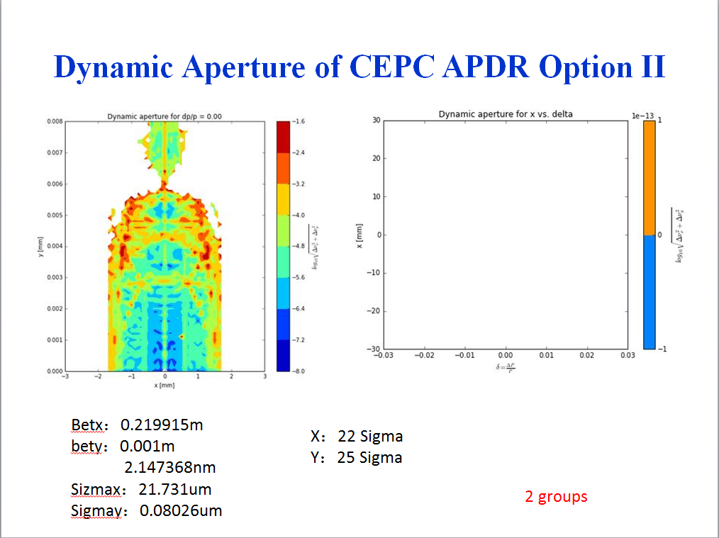
Previous results of APDR 60km

Slide 7
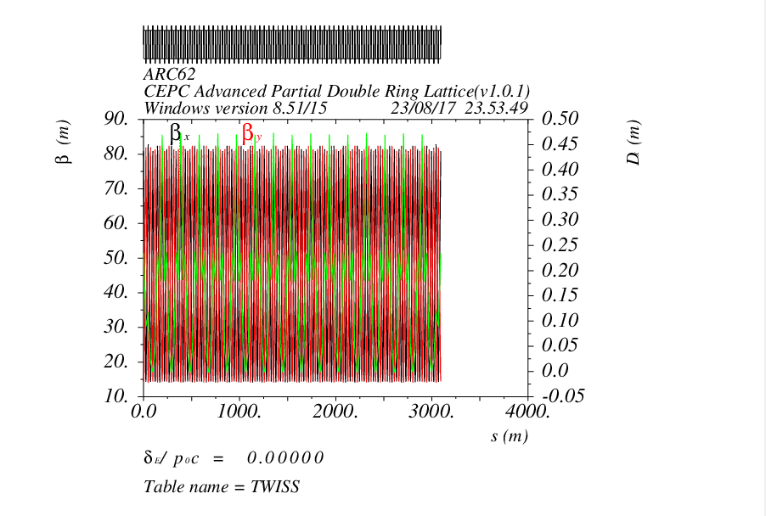
Repeat the previous work on 60km APDR

Slide 8
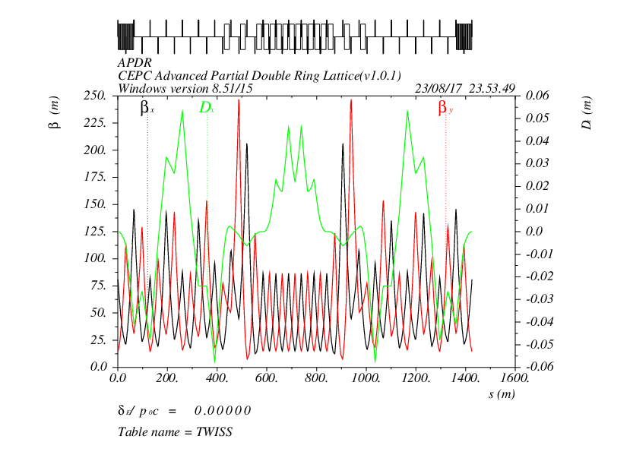

Slide 9
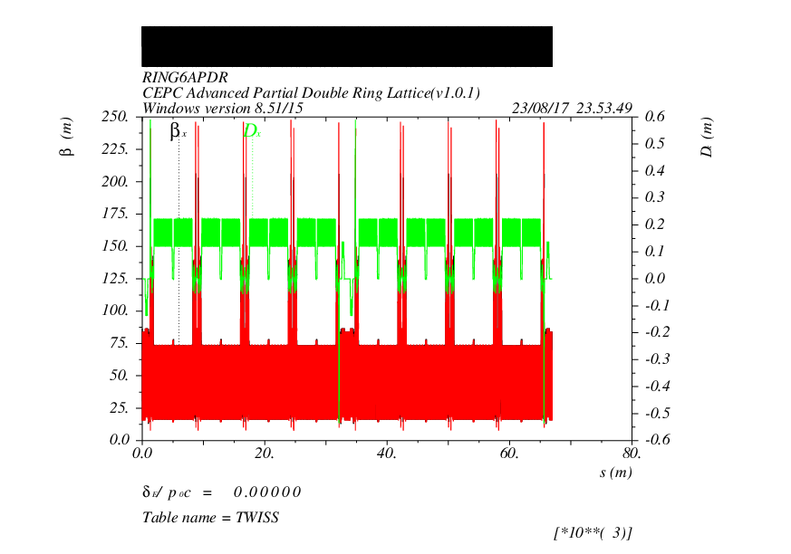

Slide 10
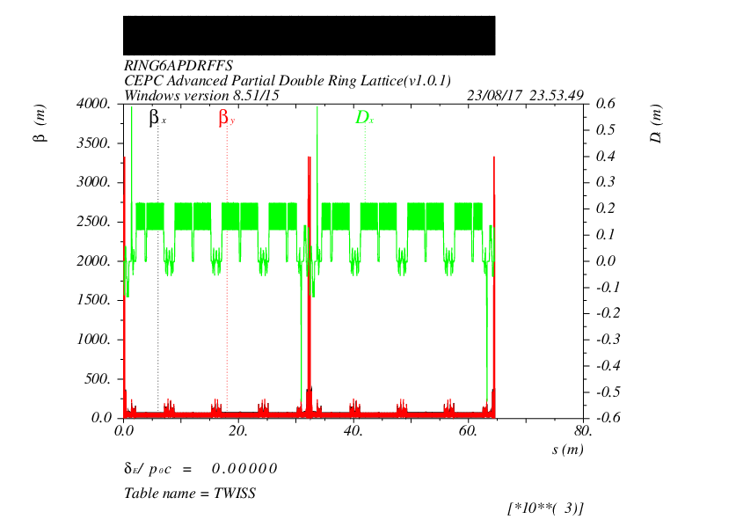

Slide 11
CEPC Advanced Partial Double Ring
RF
RF
ARC, 8425m
IP1_ee
ARC
APDR
APDR
4300m
RF
RF
APDR
C=100km
APDR
APDR, 4000m
RF
RF
APDR
APDR
IP3_ee
RF
RF
2017.8.22

Slide 12
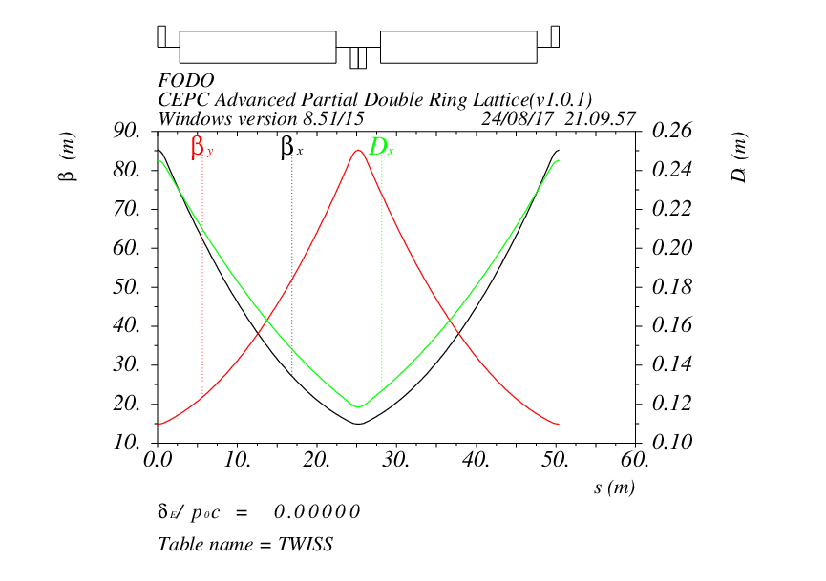
ARC design

Slide 13
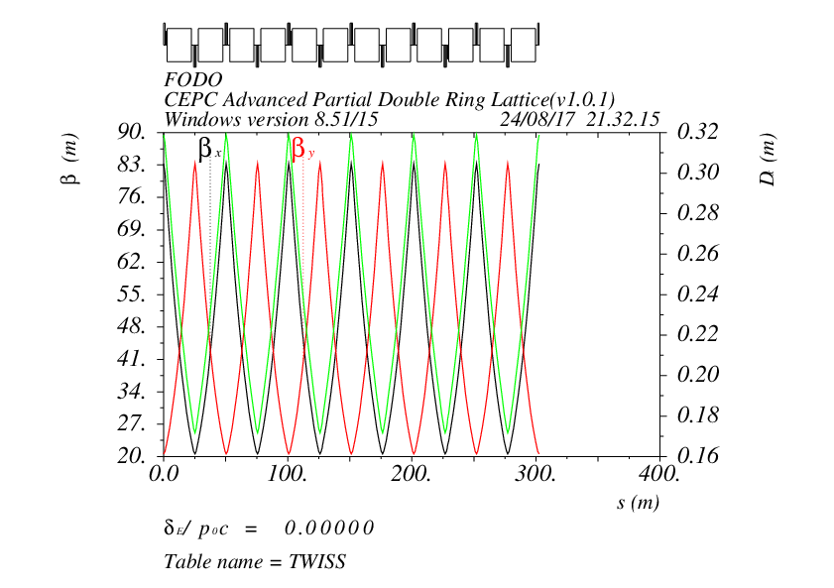

Slide 14
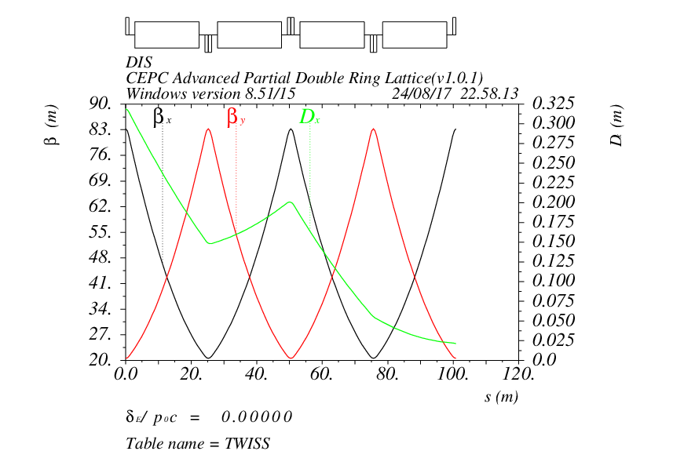

Slide 15
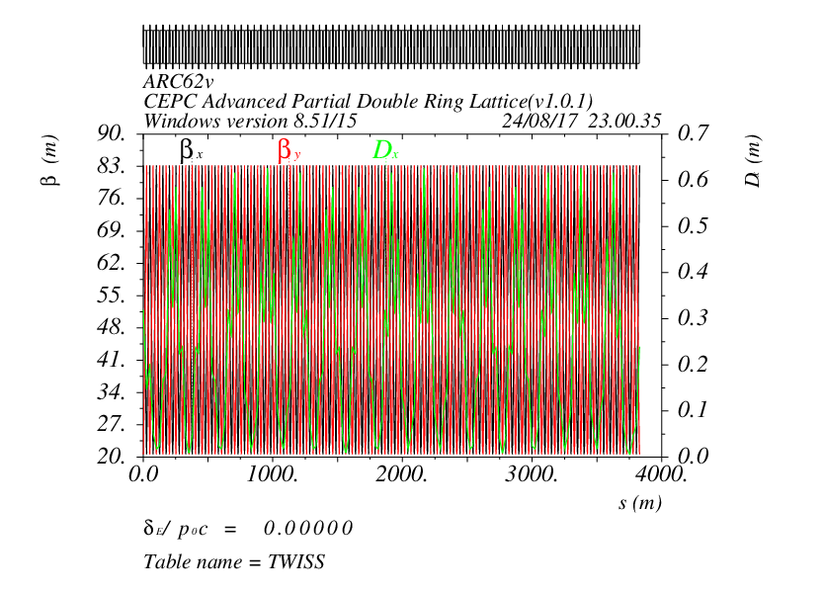
ARC62=-DIS+2*6*FODO(300m)+DIS

Slide 16
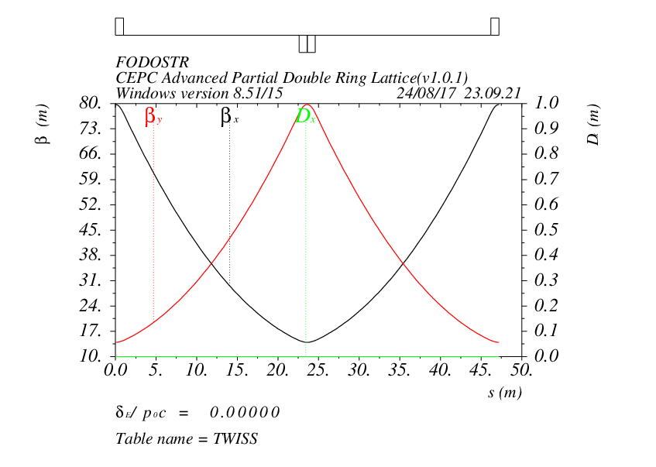

Slide 17
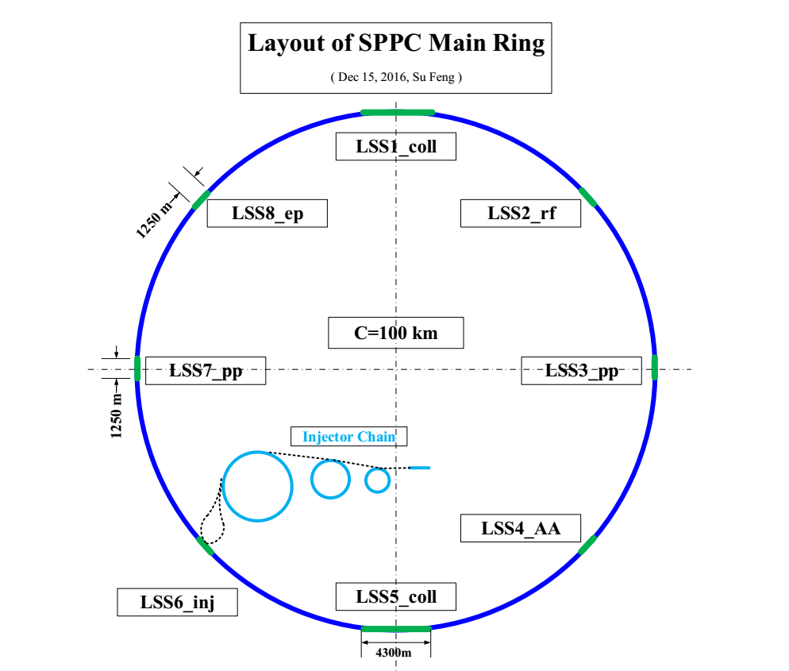
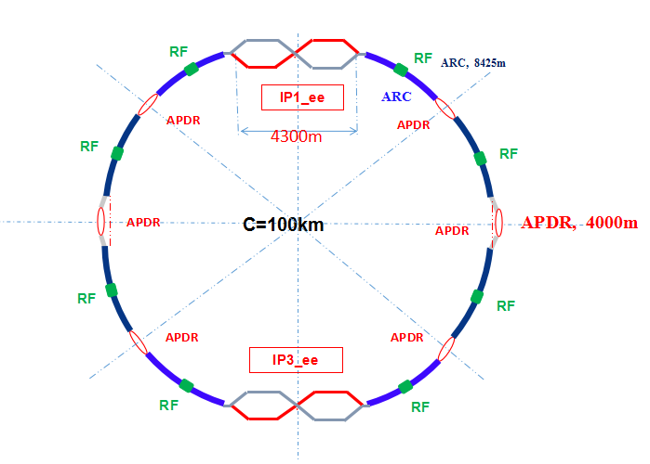
Some question ?
Compatibility problem ?

Slide 18
Parameters of CEPC double ring
 | Higgs | W | Z
Number of IPs | 2 | 2 | 2
Energy (GeV) | 120 | 80 | 45.5
SR loss/turn (GeV) | 1.67 | 0.33 | 0.034
Half crossing angle (mrad) | 16.5 | 16.5 | 16.5
Piwinski angle | 3.19 | 5.69 | 4.29
N_{e}/bunch (10¹¹) | 0.968 | 0.365 | 0.455
Bunch number | 412 | 5534 | 21300
Beam current (mA) | 19.2 | 97.1 | 465.8
SR power /beam (MW) | 32 | 32 | 16.1
Bending radius (km) | 11 | 11 | 11
Momentum compaction (10⁻⁵) | 1.14 | 1.14 | 4.49
β_{IP} x/y (m) | 0.171/0.002 | 0.171 /0.002 | 0.16/0.002
Emittance x/y (nm) | 1.31/0.004 | 0.57/0.0017 | 1.48/0.0078
Transverse σ_{IP} (um) | 15.0/0.089 | 9.9/0.059 | 15.4/0.125
ξ_{x}/ξ_{y}/IP | 0.013/0.083 | 0.0055/0.062 | 0.008/0.054
RF Phase (degree) | 128 | 126.9 | 165.3
V_{RF} (GV) | 2.1 | 0.41 | 0.14
f _{RF} (MHz) (harmonic) | 650 | 650 (217800) | 650 (217800)
Nature σ_{z} (mm) | 2.72 | 3.37 | 3.97
Total σ_{z} (mm) | 2.9 | 3.4 | 4.0
HOM power/cavity (kw) | 0.41(2cell) | 0.36(2cell) | 1.99(2cell)
Energy spread (%) | 0.098 | 0.065 | 0.037
Energy acceptance (%) | 1.5
Energy acceptance by RF (%) | 2.1 | 1.1 | 1.1
n_{γ} | 0.26 | 0.15 | 0.12
Life time due to beamstrahlung (min) | 52
F (hour glass) | 0.96 | 0.98 | 0.96
L_{max}/IP (10³⁴cm⁻²s⁻¹) | 2.0 | 5.15 | 11.9
Chenghui Yu
Apr. 19, 2017

Slide 19
parameter for CEPC partial double ring
（wangdou20161115-100km）
 | Pre-CDR | H-high lumi. | H-low power | Z
Number of IPs | 2 | 2 | 2 | 2
Energy (GeV) | 120 | 120 | 120 | 45.5
Circumference (km) | 54 | 100 | 100 | 100
SR loss/turn (GeV) | 3.1 | 1.67 | 1.67 | 0.034
Half crossing angle (mrad) | 0 | 15 | 15 | 15
Piwinski angle | 0 | 2.9 | 2.9 | 5.69
N_{e}/bunch (10¹¹) | 3.79 | 0.97 | 0.97 | 0.46
Bunch number | 50 | 644 | 425 | 1100
Beam current (mA) | 16.6 | 29.97 | 19.8 | 24.3
SR power /beam (MW) | 51.7 | 50 | 33 | 0.84
Bending radius (km) | 6.1 | 11 | 11 | 11
Momentum compaction (10⁻⁵) | 3.4 | 1.3 | 1.3 | 3.3
β_{IP} x/y (m) | 0.8/0.0012 | 0.144 /0.002 | 0.144 /0.002 | 0.12/0.001
Emittance x/y (nm) | 6.12/0.018 | 1.56/0.0047 | 1.56/0.0047 | 0.93/0.0049
Transverse σ_{IP} (um) | 69.97/0.15 | 15/0.097 | 15/0.097 | 10.5/0.07
ξ_{x}/IP | 0.118 | 0.0126 | 0.0126 | 0.0075
ξ_{y}/IP | 0.083 | 0.083 | 0.083 | 0.054
V_{RF} (GV) | 6.87 | 2.0 | 2.22 | 0.11
f _{RF} (MHz) | 650 | 650 | 650 | 650
Nature σ_{z} (mm) | 2.14 | 2.72 | 2.72 | 3.93
Total σ_{z} (mm) | 2.65 | 2.9 | 2.9 | 4.0
HOM power/cavity (kw) | 3.6 | 0.64 | 0.42 | 0.21
Energy spread (%) | 0.13 | 0.098 | 0.098 | 0.037
Energy acceptance (%) | 2 | 1.5 | 1.5
Energy acceptance by RF (%) | 6 | 2.2 | 2.2 | 1.1
n_{γ} | 0.23 | 0.26 | 0.26 | 0.18
Life time due to beamstrahlung_cal (minute) | 47 | 52 | 52
F (hour glass) | 0.68 | 0.95 | 0.95 | 0.91
L_{max}/IP (10³⁴cm⁻²s⁻¹) | 2.04 | 3.1 | 2.05 | 1.19

Slide 20
CEPC APDR Main Ring
RF Parameters
100 km, APDR, crossing angle 33 mrad, 2 IPs, 8 RF stations, 8*4km DR. | H (baseline) | Z(large emittance) | Z(Small emittance)
Beam Energy [GeV] | 120 | 45.5 | 45.5
Luminosity / IP [10³⁴ cm⁻²s⁻¹] | 2 | 1.03 | 1.03
SR power / beam [MW] | 32 | 2.9 | 1.8
RF freqeuncy [MHz] | 650 | 650 | 650
RF voltage [GV] | 2.1 | 0.135 | 0.049
Beam current / beam [mA] | 19.2 | 85.0 | 53.9
Pulse current/ beam [mA] | 119.7 | 531.0 | 336.6
Bunch charge [nC] | 15.5 | 4.80 | 3.52
Bunch length [mm] | 2.9 | 4 | 4
Bunches / beam | 412 | 5900 | 5100
Bunches/ train | 103 | 1475 | 1275
Bunch spacing in a train [ns] | 129.4 | 9.0 | 10.5
Train spacing Tg [us] | 28.3 | 28.3 | 28.3
SR loss / turn [GV] | 1.67 | 0.034 | 0.034
Syncrotron phase from crest [deg] | 37.3 | 75.4 | 46.1
Loss factor / cell [V/pC] | 0.34 | 0.27 | 0.27
Effective length per cavity [m] | 0.46 | 0.46 | 0.46
R/Q per cavity [Ω] | 213 | 213 | 213
Cell number / cavity | 2 | 2 | 2
Cavity number / RF station | 42 | 3 | 2
RF station number | 8 | 8 | 8
Cavity number (total) | 336 | 24 | 16
For APDR Z-pole baseline, only the large emittance case can work.

Slide 21
100 km, APDR, crossing angle 33 mrad, 2 IPs, 8 RF stations, 8*4km DR. | H (baseline) | Z(large emittance) | Z(Small emittance)
Acc. Gradient [MV/m] | 13.59 | 12.23 | 6.66
Cavity voltage [MV] | 6.25 | 5.63 | 3.06
Input power / cavity [kW] | 190 | 241 | 229
Cavity per klystron | 2 | 2 | 2
HOM power / cavity [kW] | 0.40 | 0.22 | 0.10
Q₀ at operating gradient | 1E+10 | 1E+10 | 1E+10
Wall loss / cavity @ 2 K [W] | 19 | 15 | 5
Pb/ cavity [MW] | 0.75 | 2.99 | 1.03
Opt. QL | 1.0E+06 | 6.4E+05 | 2.0E+05
Opt. detuning [kHz] | 0.25 | 1.96 | 1.70
Cavity bandwidth [kHz] | 0.7 | 1.0 | 3.3
Cavity stored energy [J] | 46 | 38 | 11
Ng/N | 2.1 | 2.1 | 2.1
Ng | 218 | 3133 | 2708
Max relative voltage drop for 4+4 APDR | 7.2% | 36.0% | 41.9%
Max bunch train phase shift for 4+4 APDR [deg] | 6.3 | 8.6 | #NUM!
Advanced partial double ring parameters ?

Slide 22
Thank you !

