Slide 1
DA Optimization/
Beam-Beam Tail
Wyw170816/0823-bx0.36
ZHANG, Yuan WANG, Yiwei WANG, Dou GENG, Huiping
2017-9-1

Slide 2
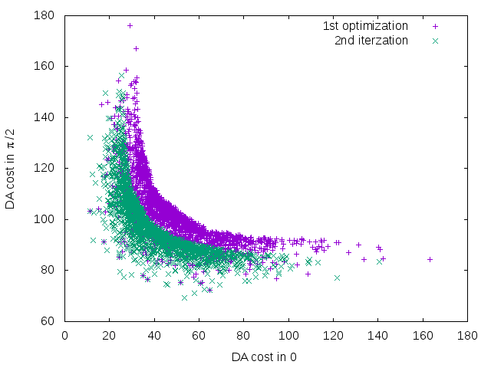
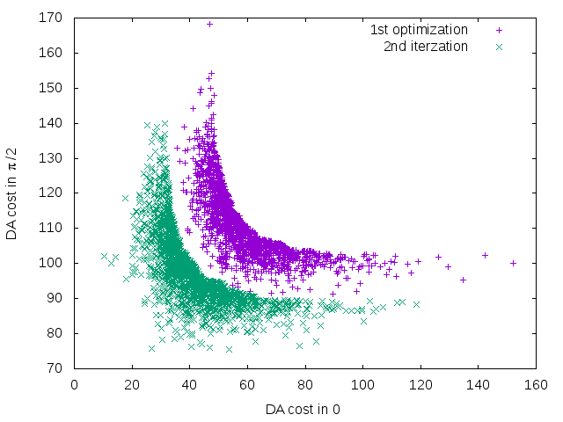
Optimize Iteration with Pareto Front Solution
Non-dominated solution achieved + Other initialized solutions are randomly generated
No clear further optimization?
Bx= 0.37m
Bx= 0.50m

Slide 3
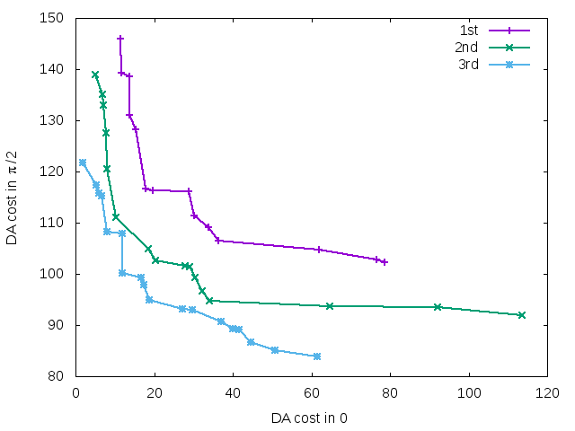
Optimize Iteration with Pareto Front Solution
170823,bx=0.36
Notes:
170823

Slide 4
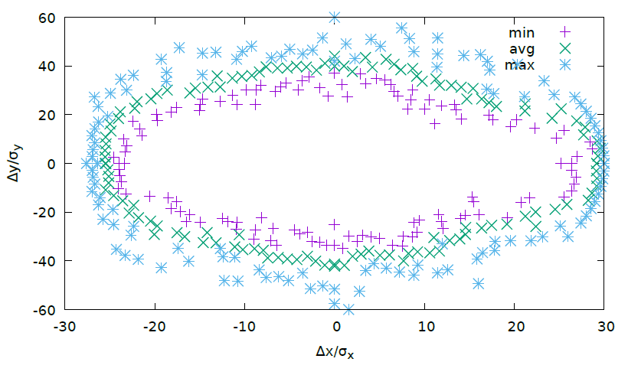
Dynamic Aperture (XY) – On Momentum
50 turns
10 times
Notes:
170724-bx037-1

Slide 5
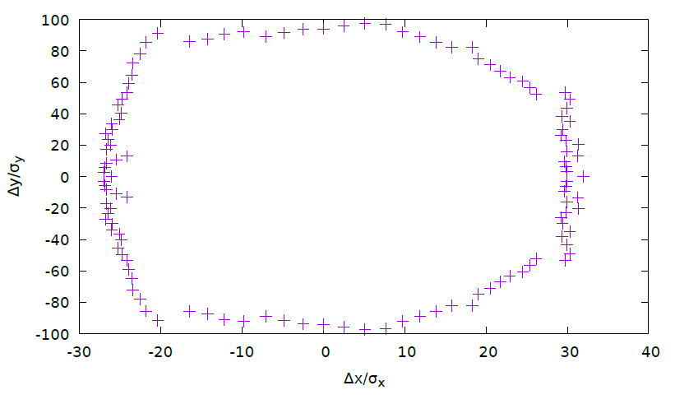
Dynamic Aperture (XY) – On Momentum
DAMPONLY

Slide 6
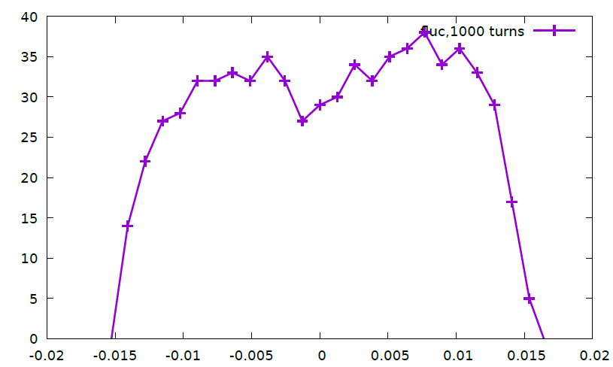
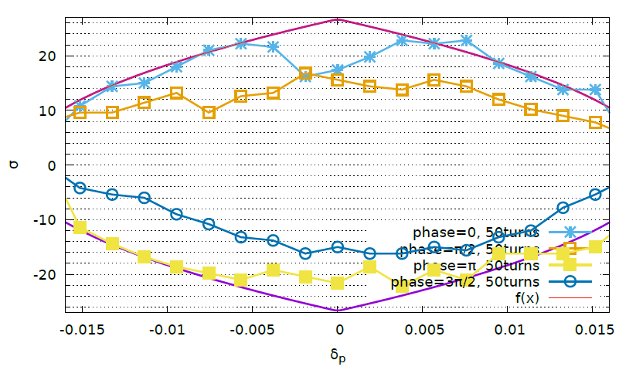
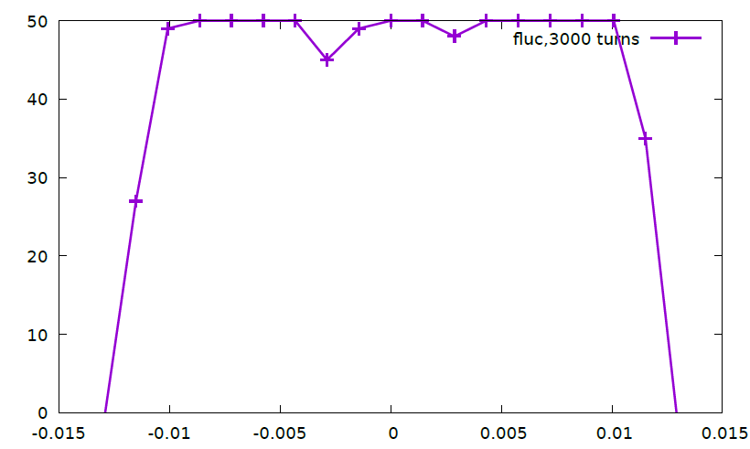
DA, H/W/Z(bx=0.37, 170724)
W
H
Z
Notes:
x.149.4

Slide 7
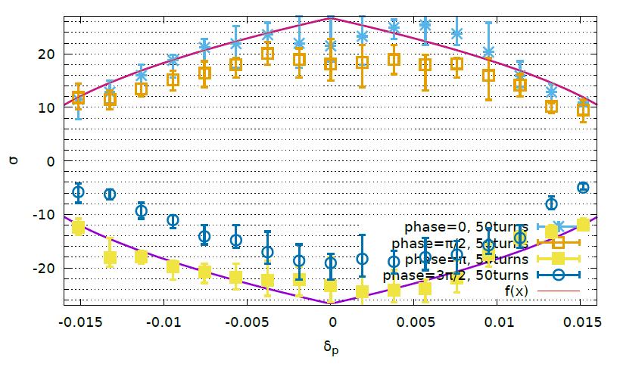
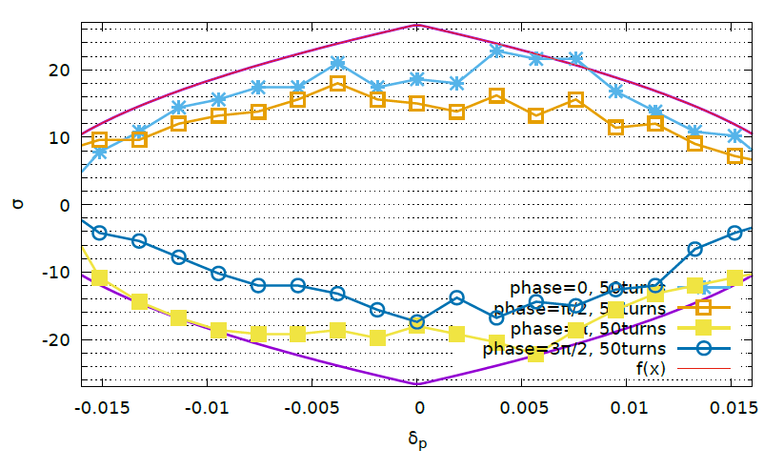
Bx=0.36m, 170816

Slide 8
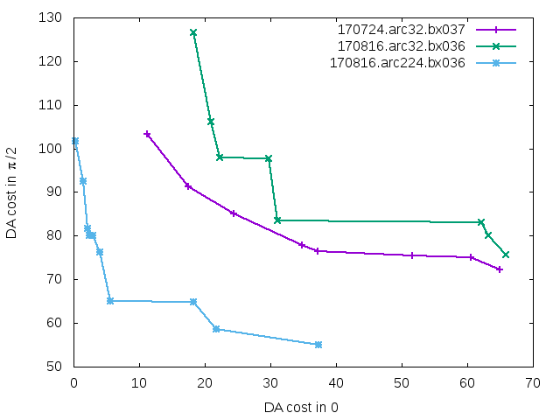
Bx=0.36m, 170816, arc sext 224
No contribution from more sextupole groups ?

Slide 9
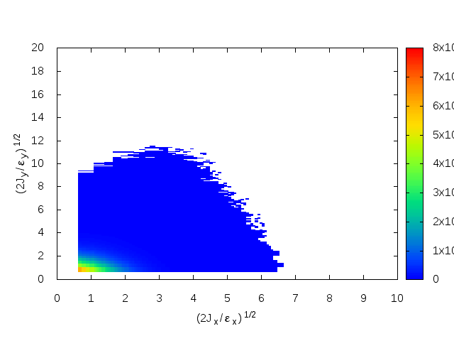
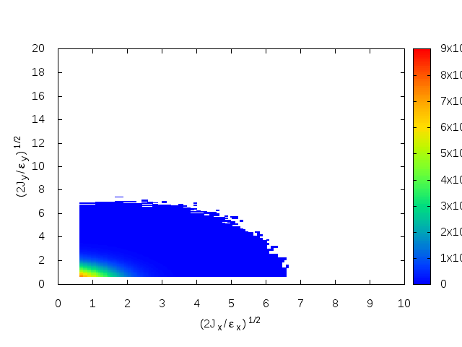
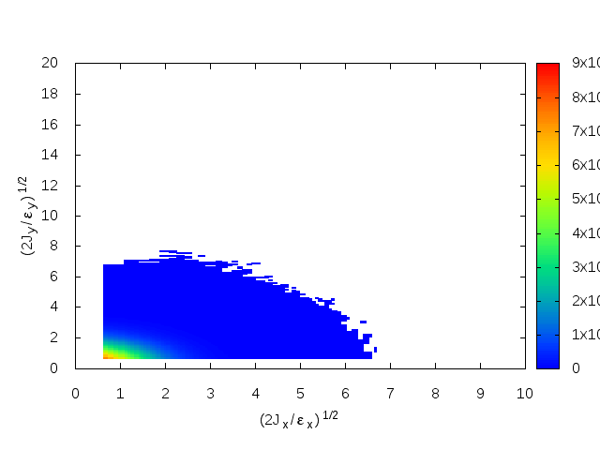
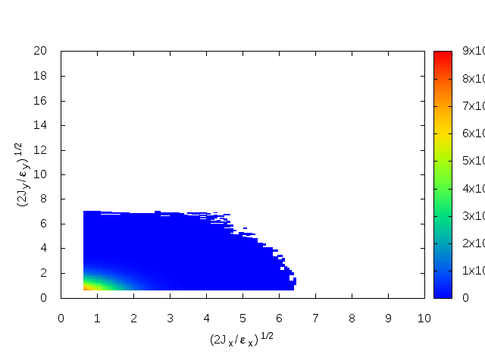

Beam Tail (Main Parameter 170825)
CW=0
CW=0.5
CW=1
e+
e-

Slide 10

Discussion
? $15σ_{x}×30σ_{y}$ (CW=0.5)
Gain from 32 -> 224 sext
Gain from iteration

Slide 11
memo

Slide 12
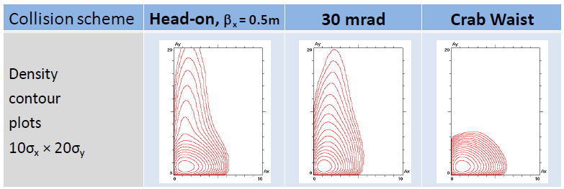

DA requirements
E. Levichev
Beam lifetime due to bb effects.
Recommendation from simulations by D.Shatilov:
DA ≈ 10σ_{x} x 50σ_{y}
(incl.errors, misalignments,etc.)
Vertical beam tail growth example due to bb effects in FCC-ee at 120 GeV (D. Shatilov)
Effective injection (conventional type, on-energy, off-axis)
M. Aiba et al. FCCee review at CERN, 14.10.2015
Ax ≈ 13 mm N ≈ 16σ_{x}
J. Seeman. FCC week, Washington DC, March 25, 2015
Ax ≈ 16 mm N ≈ 15σ_{x}
K. Oide. FCC-ee Optics Meeting, CERN, 11 Sep. 2015
N ≈ 14.6σ_{x} @175 GeV N ≈ 30σ_{x} @45.6 GeV (@2.5σ_{e})
Required DA ≈ 20σ_{x} x 50σ_{y}

Slide 13
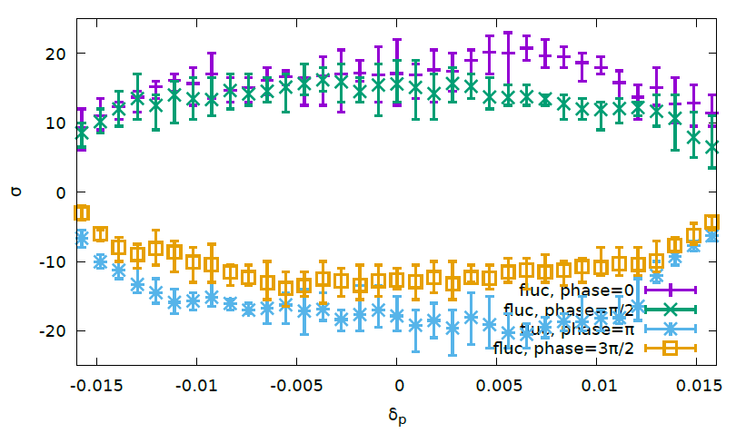
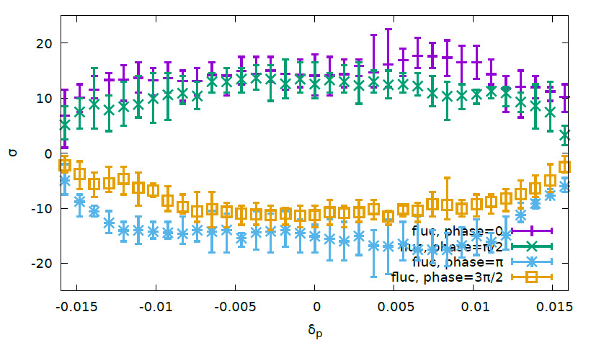
Optimize with FLUC ON wyw-170414
Pcmst-3-fluc
50 turns
200 turns
Notes:
Pcmst-2-fluc

Slide 14
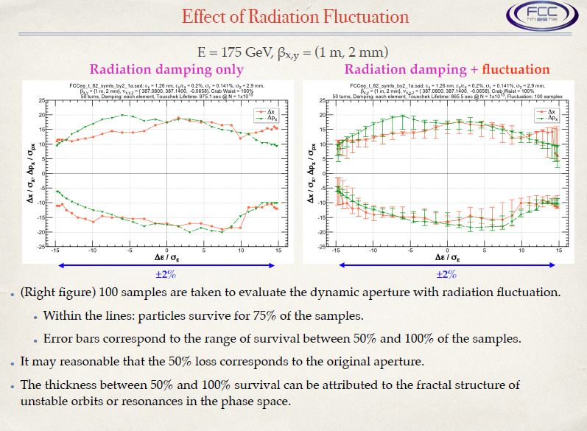
FCC-ee MDI Workshop, 2017

Slide 15
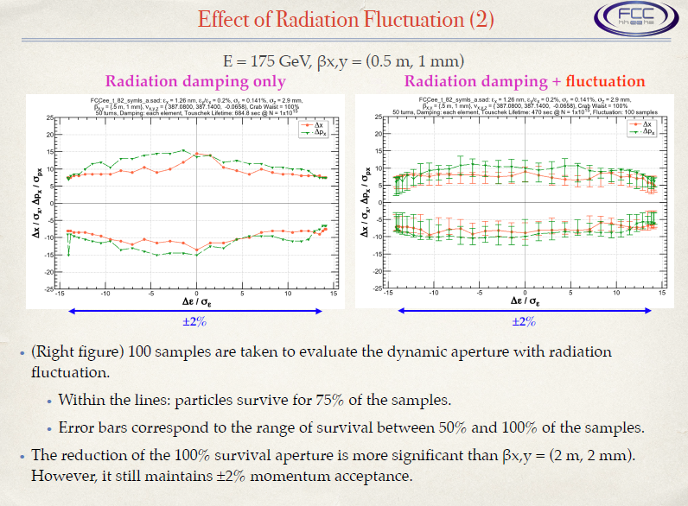
FCC-ee MDI Workshop, 2017

Slide 16
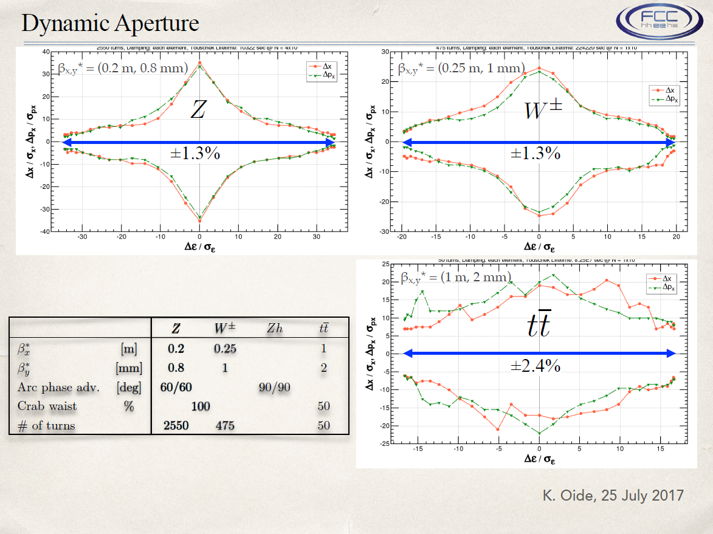

Slide 17
Crab-waist, 161202-100km-2mm-h-highlum, (0.545,0.61, 0.037)
The effect of crab-waist is more clear when the horizontal tune is far from half integer.

Slide 18
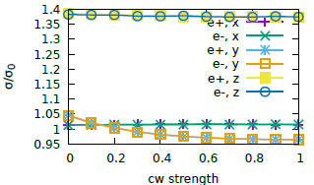
Crab-waist, 161202-100km-1mm-w (0.535,0.61,0.0425)
Crab-waist transformation increase luminosity about 15% by suppressing the vertical beam size blow up

Slide 19
Crab-waist, 161202-100km-1mm-z (0.54,0.61,0.0256)
Crab-waist transformation increase luminosity about 25% by suppressing the vertical beam size blow up

