Slide 1
MDI study of CEPC double ring β_{x}*=0.36m
Sha Bai, Yiwei Wang, Chenghui Yu, Jie Gao
2017-09-01
CEPC AP meeting

Slide 2
QD0/QF1物理设计参数 ~150T/m, L*=2.2m
QD0 | 水平束流清晰区 2（20σ_{x}+3） | 垂直束流清晰区 2（40σ_{y}+3） | 正负电子 束流中心间距
入口 | 11.31 mm | 20.24 mm | 72.61 mm
磁长度的1/2处 | 14.19 mm | 23.61 mm | 100.99 mm
出口 | 19.50 mm | 22.13 mm | 129.70 mm
所需好场区范围 | 水平方向19.50 mm；垂直方向23.61 mm
磁铁有效长度 | 1.73m
线圈起点距离IP | 2.2000m
最高磁场梯度 | 151 T/m
QF1 | 水平束流清晰区 2（20σ_{x}+3） | 垂直束流清晰区 2（40σ_{y}+3） | 正负电子 束流中心间距
入口 | 23.49 mm | 19.88 mm | 146.20 mm
磁长度的1/2处 | 28.06 mm | 17.46 mm | 170.63 mm
出口 | 29.57 mm | 16.65 mm | 195.05 mm
所需好场区范围 | 水平方向29.57 mm；垂直方向19.88 mm
磁铁有效长度 | 1.48m
线圈起点距离IP | 4.43m
最高磁场梯度 | 102 T/m

Slide 3
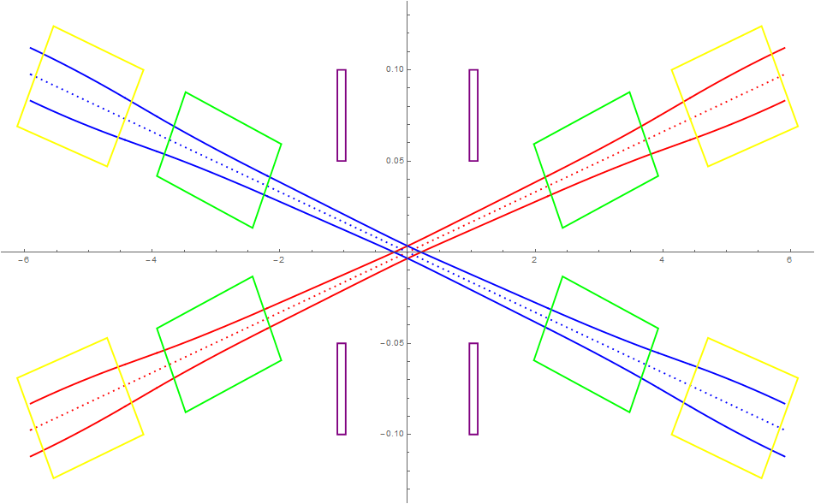
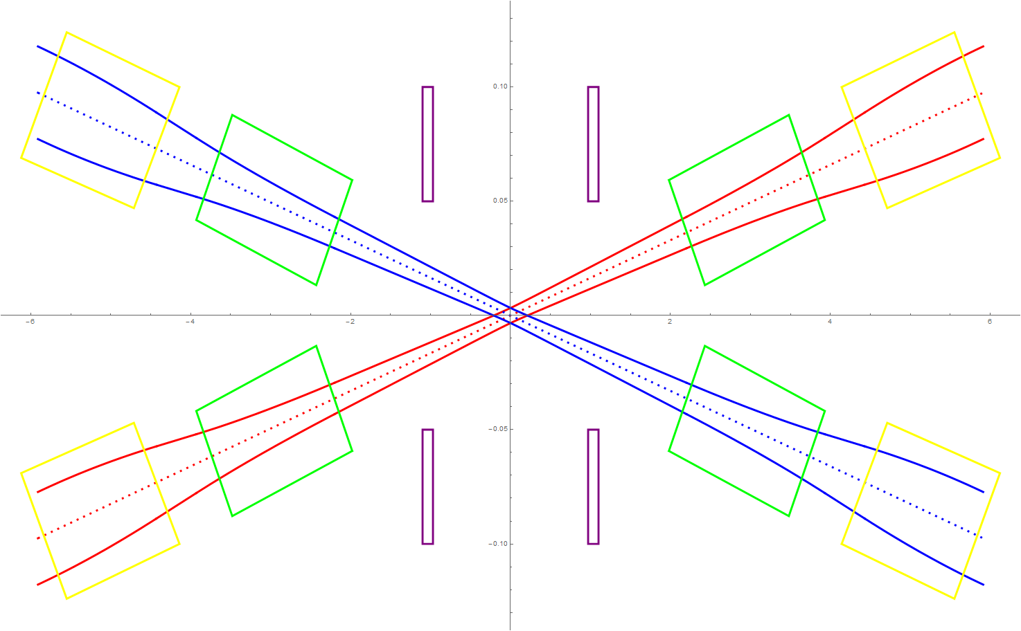
Beam stay clear region
Lumical
QF1
QF1
Lumical
QD0
QD0
β_{x}*=0.36m
β_{x}*=0.171m

Slide 4
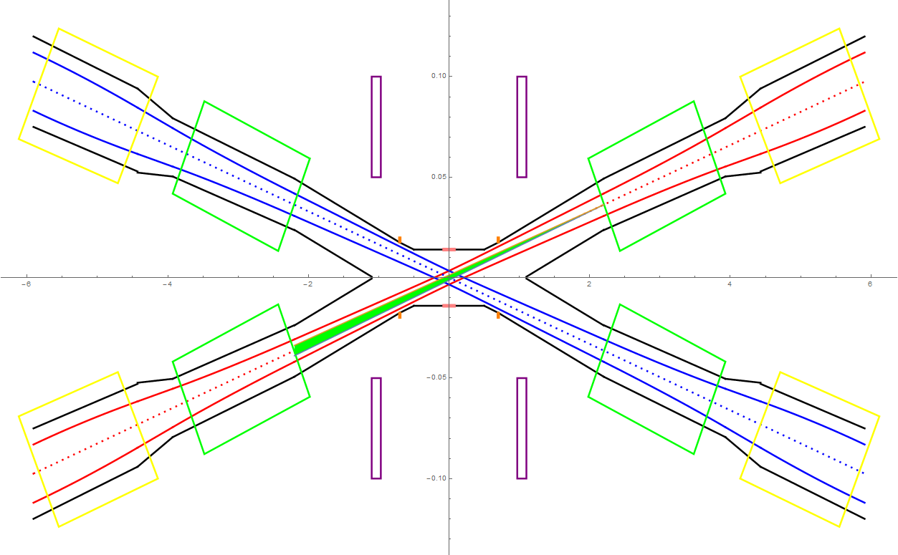
SR from QD0 in horizontal plane
Lumical
QF1
In the Gaussian distribution beam, particles in 3σ occupies 99.7% of the total amount, 1σ occupies 68.7%, and 2σ occupies 95.5%.
The total SR power generated by the QD0 magnet is 646.3W in horizontal. The critical energy of photons is about 1308.3keV. (Slice into 6 pieces)
QD0

Slide 5
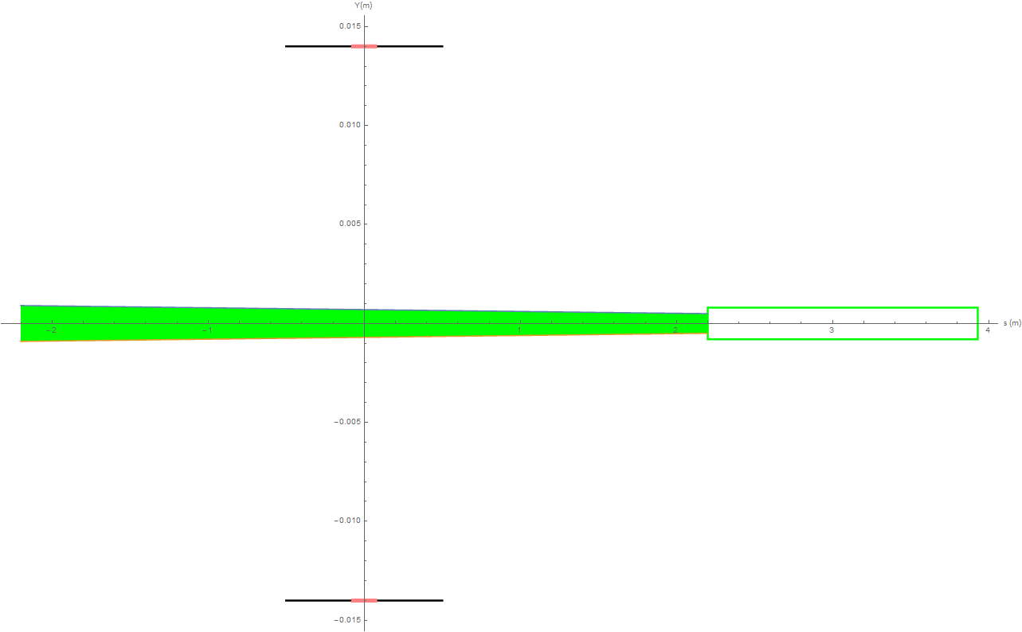
SR from QD0 in vertical plane
In the Gaussian distribution beam, particles in 3σ occupies 99.7% of the total amount, 1σ occupies 68.7%, and 2σ occupies 95.5%.
The total SR power generated by the QD0 magnet is 168.4W in vertical. The critical energy of photons is about 423.1keV. (Slice into 6 pieces)

Slide 6
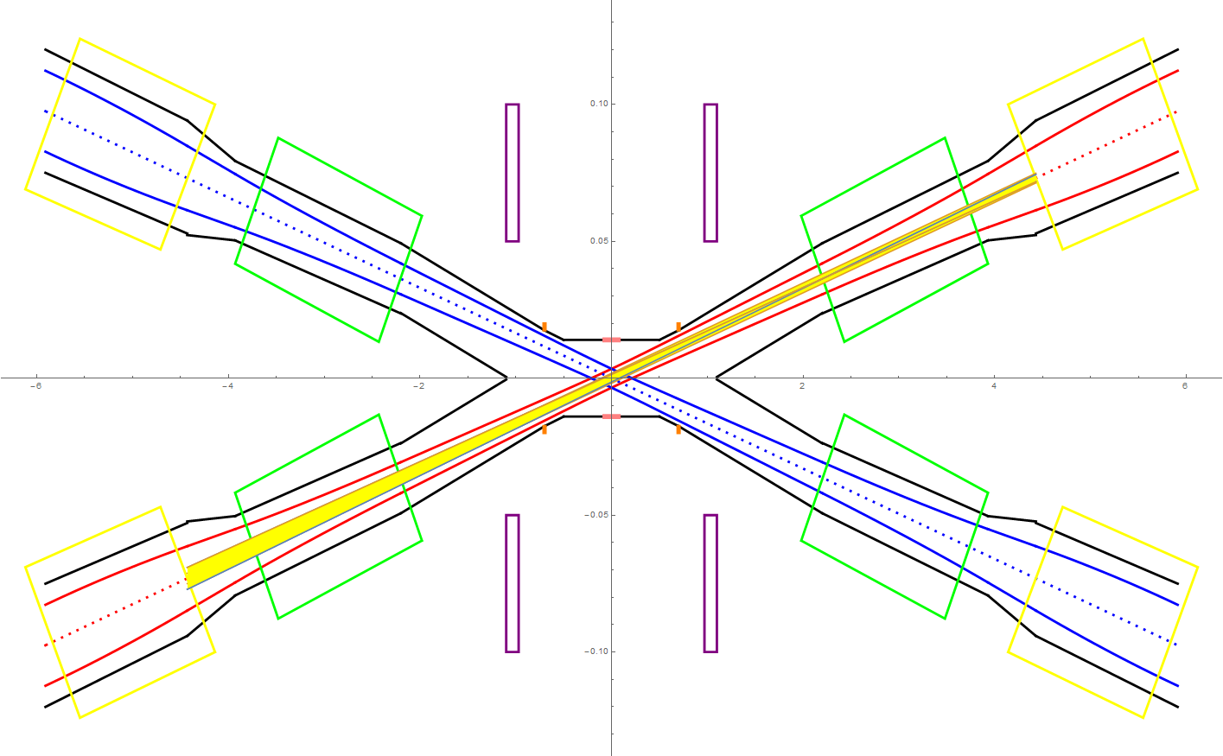
SR from QF1 in horizontal plane
QF1
In the Gaussian distribution beam, particles in 3σ occupies 99.7% of the total amount, 1σ occupies 68.7%, and 2σ occupies 95.5%. Slice into 6 pieces.
The total SR power generated by the QF1 magnet is 1487.4W in horizontal. The critical energy of photons is about 1545.7keV.
The total SR power generated by the QF1 magnet is 32.2W in vertical. The critical energy of photons is about 188.9keV.
Lumical
QD0

Slide 7
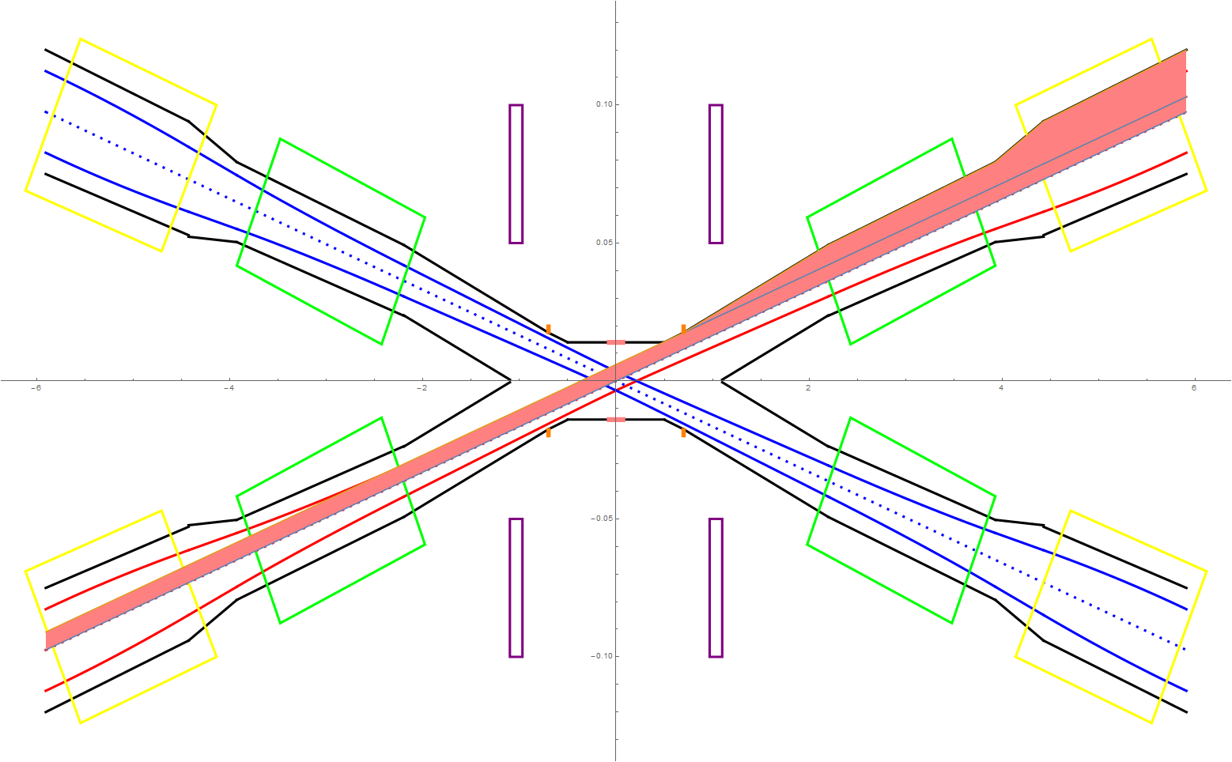
SR from B, FD in horizontal plane ~ last bending magnet upstream of IP and final doublet
QF1
Lumical
QD0

Slide 8
SR power and critical energy of FD in different slices
~ β_{x}*=0.36m
Slices(3sigma) | QD0_SR_power_X (W) | QD0_SR_power_Y (W) | QD0_critical_energy_X(KeV) | QD0_critical_energy_Y(KeV)
3 | 685.07 | 178.49 | 1189.35 | 384.64
6 | 646.34 | 168.4 | 1308.29 | 423.10
9 | 639.19 | 166.54 | 1347.94 | 435.92
12 | 636.69 | 165.89 | 1367.76 | 442.33
18 | 634.91 | 165.42 | 1387.58 | 448.74
Slices(3sigma) | QF1_SR_power_X (W) | QF1_SR_power_Y (W) | QF1_critical_energy_X(KeV) | QF1_critical_energy_Y(KeV)
3 | 1576.49 | 34.16 | 1405.21 | 171.79
6 | 1487.36 | 32.23 | 1545.74 | 188.97
9 | 1470.93 | 31.87 | 1592.58 | 194.69
12 | 1465.18 | 31.75 | 1616.0 | 197.56
18 | 1461.08 | 31.65 | 1639.42 | 200.42

Slide 9
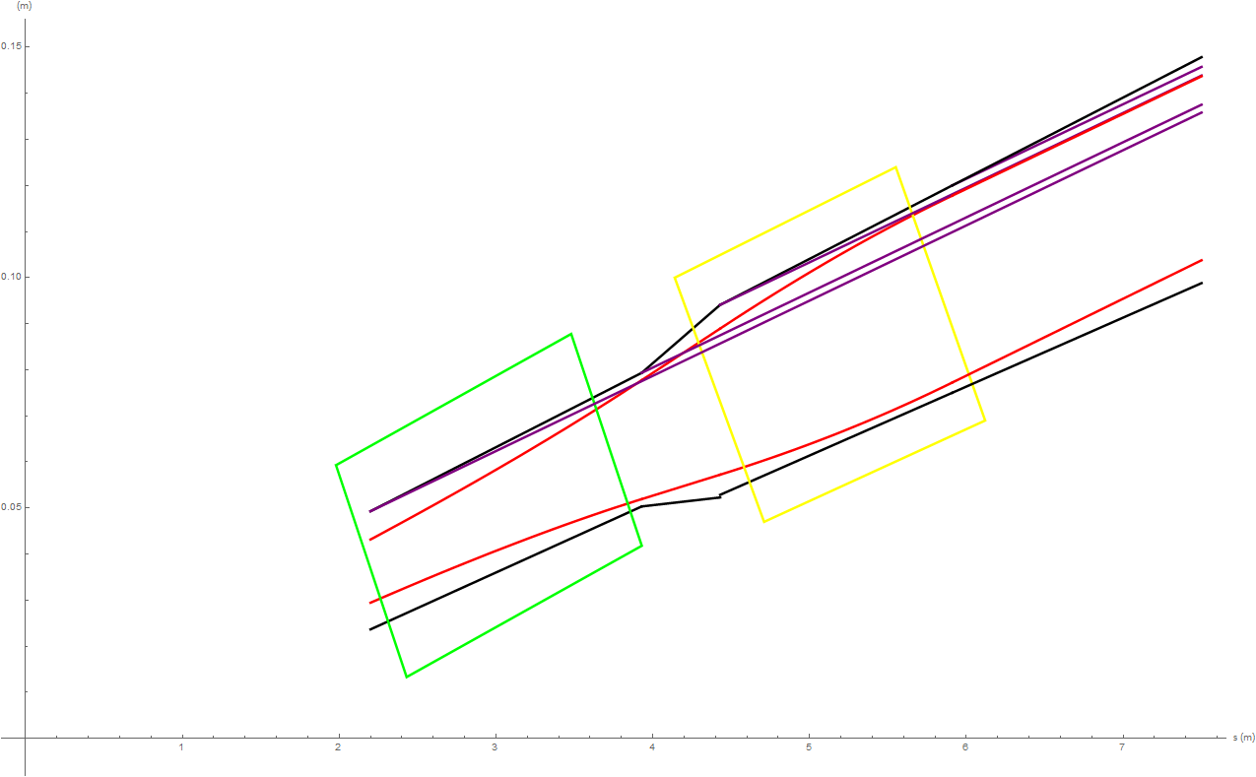
The synchrotron radiation in the IR ~ β_{x}*=0.36m
Cold vacuum chamber has to be adopted within SC magnet for the sufficient coils space. The design has been accepted by cryogenic system.
5.7W
90 W
3.9W
QF1
QD0
The synchrotron radiation power within QD0 is 3.9W along 1.73m, on QF1 is 5.7W along 1.48m. The region between QD0 and QF1 is 90 W (0.5m) where has special cooling structure.

