Slide 1
中国科学院高能物理研究所
INSTITUTE OF HIGH ENERGY PHYSICS
CEPC advanced partial double ring
update
Dengjie Xiao Jie Gao Feng Su
Tianjian Bian
CEPC AP meeting, 2017.9.1

Slide 2
CEPC Advanced Partial Double Ring
RF
RF
ARC, 8425m
IP1_ee
ARC
APDR
APDR
4300m
RF
RF
APDR
C=100km
APDR
APDR, 4000m
RF
RF
APDR
APDR
IP3_ee
RF
RF

Slide 3
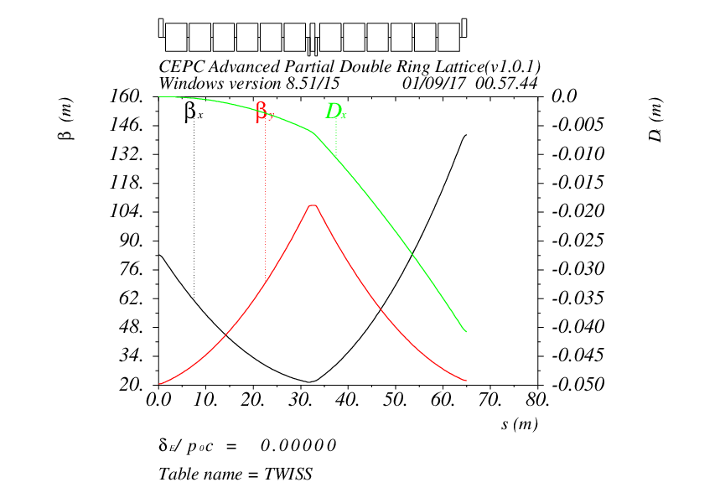

Slide 4
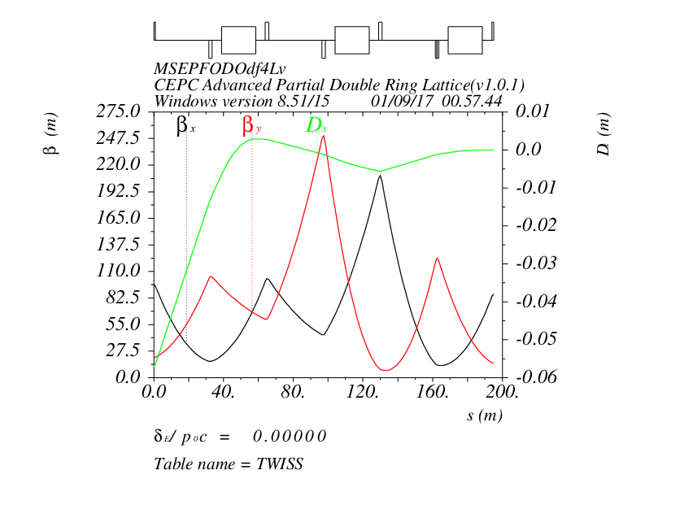

Slide 5
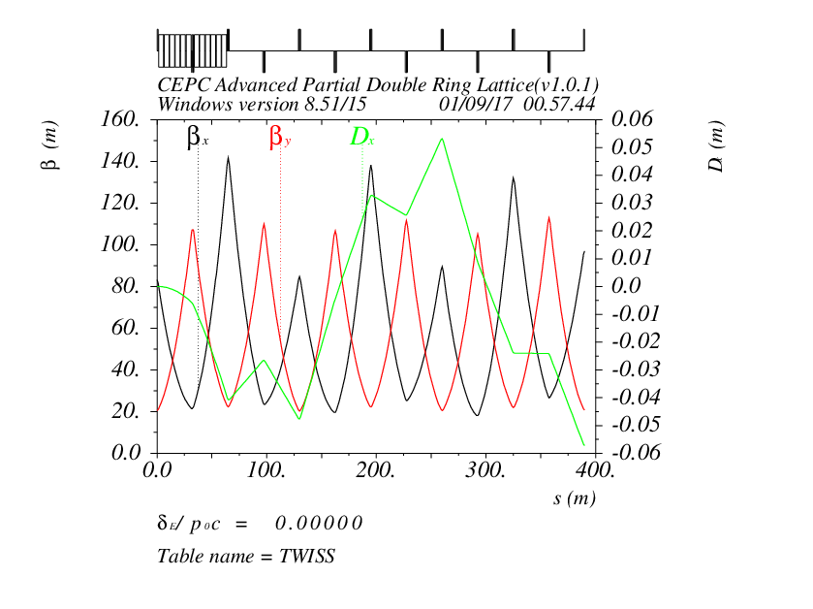

Slide 6
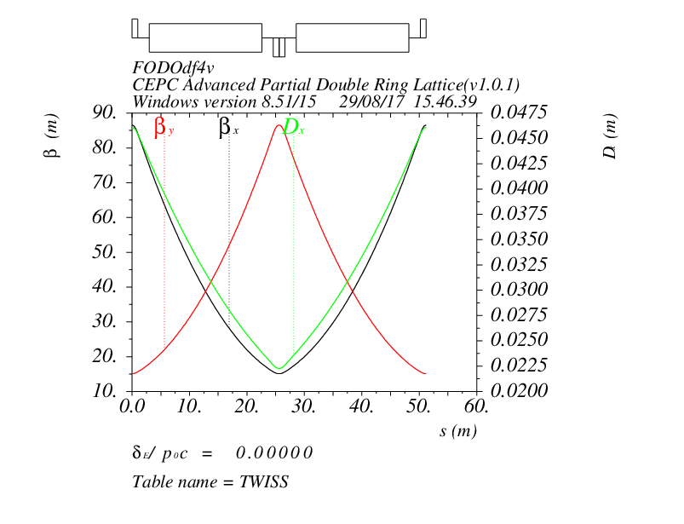

Slide 7
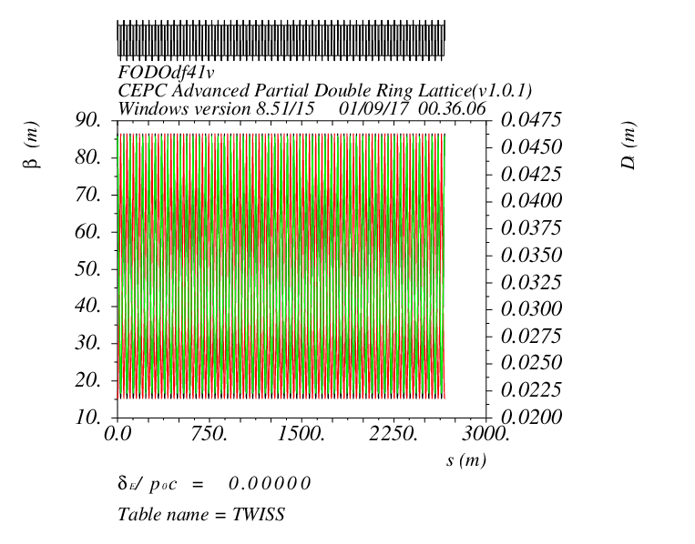

Slide 8
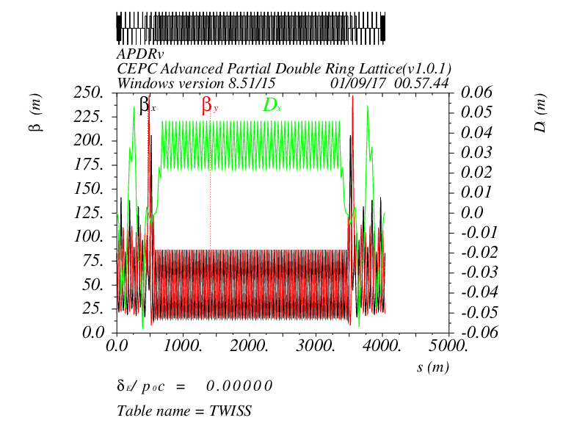

Slide 9
Thank you !

