Slide 1
CEPC Injector positron source
September 15th, 2017
C. Meng, G. Pei, J. Zhang, X. Li, S. Pei, Y. Chi, J. Gao
Institute of High Energy Physics, CAS, Beijing

Slide 2
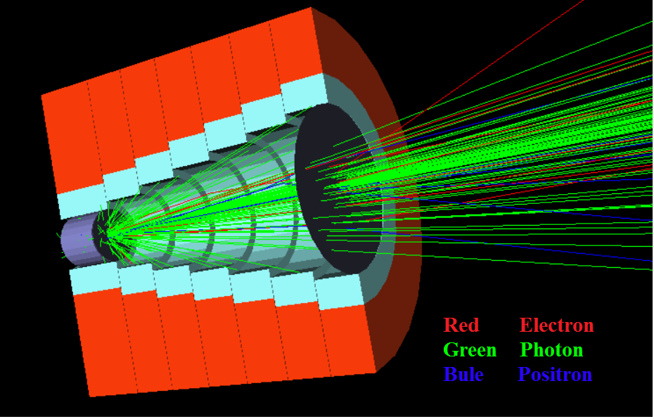
Sources design
Positron source and capture section
Layout
Target
FC (Flux concentrator)
Capture section
Large aperture accelerating tube
r=15 mm
FC (Flux concentrator)

Slide 3
Source design
Positron source performances
 | SLC | LEP (LIL) | KEKB/SUPER KEKB | FCC-ee (conv.)* | CEPC
Incident e- beam energy | 33 GeV | 200 MeV | 3.3/3.3 GeV | 4.46 GeV | 4 GeV
e-/bunch [10¹⁰] | 3-5 | 0.5 - 30 (20 ns pulse) | 6.25/6.25 | 5.53 | 6.25
Bunch/pulse | 1 | 1 | 2/2 | 2 | 1
Rep. rate | 120 Hz | 100 Hz | 50 Hz/50 Hz | 200 Hz | 100Hz
Incident Beam power | ~20 kW | 1 kW (max) | 3.3 kW | 15 kW | 2.5 kW
Beam size @ target | 0.6 - 0.8 mm | < 2 mm | />0.7 mm | 0.5 mm | 0.5 mm
Target thickness | 6X0 | 2X0 | /4X0 | 4.5X0 | 4.5X0
Target size | 70 mm | 5 mm | 14 mm |  | 10mm
Target | Moving | Fixed | Fixed/Fixed |  | Moving/Fixed
Deposited power | 4.4 kW |  | /0.6 kW | 2.7 kW | 0.45kW
Capture system | AMD | λ/4 transformer | /AMD | AMD | AMD
Magnetic field | 6.8T->0.5T | 1 T->0.3T | /4.5T->0.4T | 7.5T->0.5T | 6T->0.5T
Aperture of 1st cavity | 18 mm | 25mm/18 mm | /30 mm | 20 mm | 30 mm
Gradient of 1st cavity | 30-40 MV/m | ~10 MV/m | /10 MV/m | 30 MV/m | 30~40 MV/m
length of 1st cavity | 1m | 3m | 2m | 3m | 1.5m
Linac frequency | 2855.98 MHz | 2998.55 MHz | 2855.98 MHz | 2855.98 MHz | 2856.75 MHz
e+ yield @ CS exit | ~1.6 e+/e- | ~0.003 e+/e- (linac exit) | /~0.5 e+/e- | ~0.7 e+/e- | ~0.6 e+/e-
Positron yield @ DR | ~1.1 e+/e- |  | 0.4 e+/e-
DR energy acceptance | +/- 2.5 % | +/- 1 % (EPA) | +/- 1.5 % (1 σ) | +/- 8 %
Energy of the DR | 1.15 GeV | 500 MeV | NO/1.1 GeV | 1.54 GeV

