Slide 1
CEPC 注入
崔小昊

Slide 2
注入方式：4 Bump off-axis injection
Injected Beam
Circulating Beam
Closed orbit kickers

Slide 3
注入对bump 高度及孔径的要求：
Bumped
Stored beam
Septum
Injected beam
Acceptance
X’
Bump Height
X
X DA

Slide 4
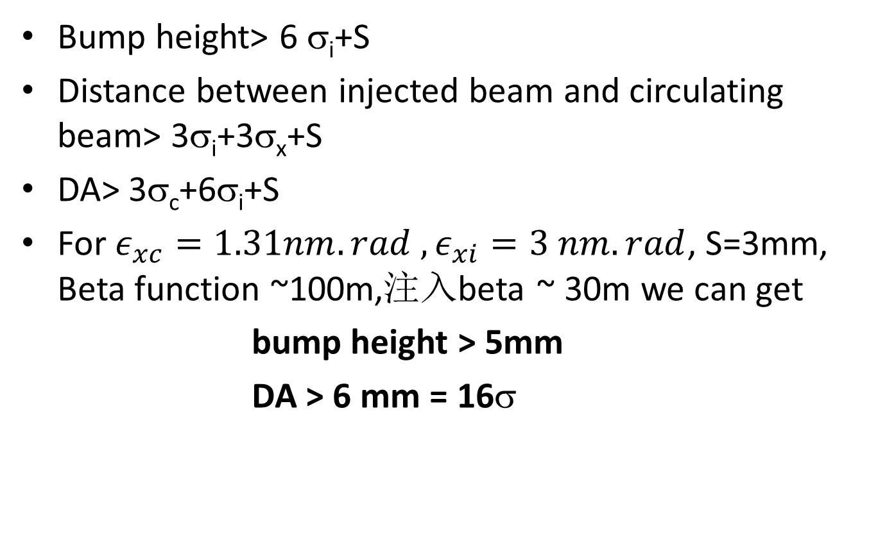
Bump height> 6 σ_{i}+S
Distance between injected beam and circulating beam> 3σ_{i}+3σ_{x}+S
DA> 3σ_{c}+6σ_{i}+S
For $ε_{xc}=1.31nm.rad{ ,ε}_{xi}=3 nm.rad$, S=3mm, Beta function ~100m,注入beta ~ 30m we can get
bump height > 5mm
DA > 6 mm = 16σ

Slide 5
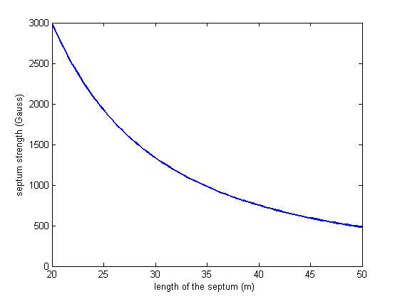
Septum 强度：
Septum 长度同磁场强度的关系

Slide 6
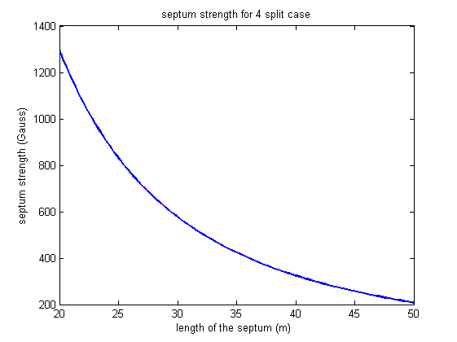
分段Septum：
4段不同厚度切割板的Septum, 强度分别为：400 Gauss,800 Gauss,1600 Gauss, 3200 Gauss
分段Septum 长度同磁场强度的关系

Slide 7
Kicker 强度：
Kicker 长度 2m, beta 函数 ~ 100m, 磁场强度200 Gauss

