Slide 1
Background and collimator study in CEPC double ring
Sha Bai, Chenghui Yu, Yuan Zhang, Yiwei Wang, Jie Gao
CEPC AP meeting
2017-09-15

Slide 2
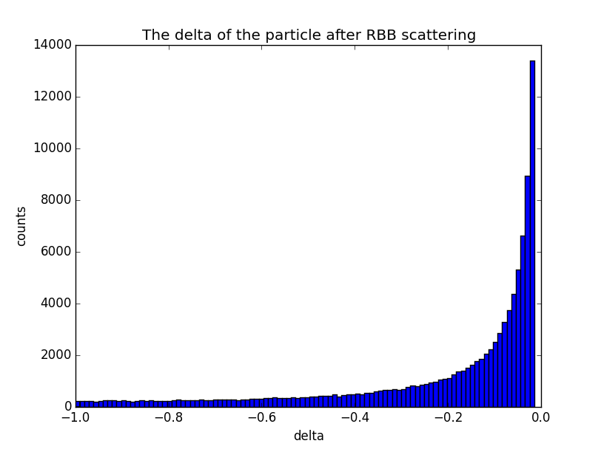
Radiative Bhabha scattering events
βx*=0.36m的energy acceptance~1.5%.
Generate 100000 particles~ energy spread

Slide 3
Lost particles statistic β_{x}*=0.36m
Lattice version：cepc.lat.bx036.242.9.sad
Gaussian distribution energy spread adding to the 100000 particles generated by RBB generator
Set aperture according to beampipe
RBB generated at IP1, tracking in SAD
The number of particle lost in the downstream and upstream of 1st turn is: 3192/223
The number of particle lost in downstream and upstream of 2nd turn is: 18/32
The number of particle lost in downstream and upstream of 3rd turn is: 0/5

Slide 4
Loss particles due to RBB in turns

Slide 5
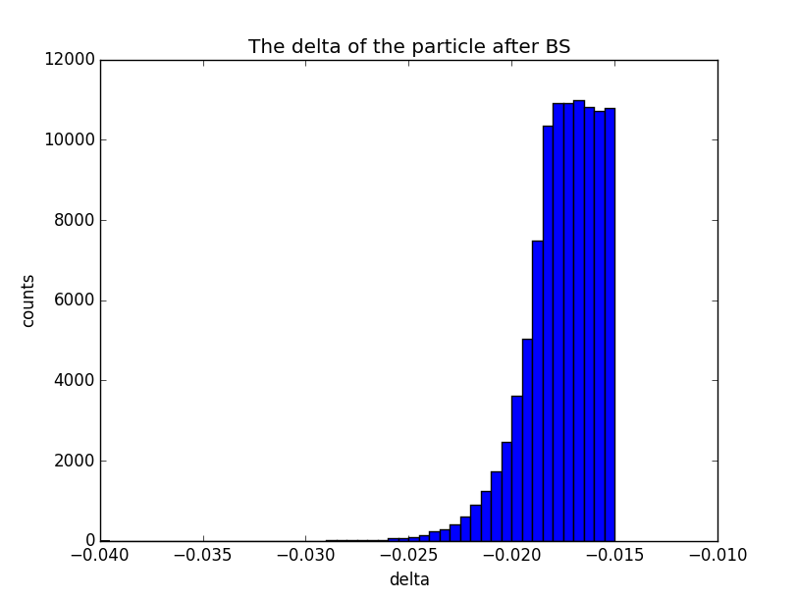
Beamstrahlung events
βx*=0.36m的energy acceptance~1.5%.
与RBB输出的粒子的能散相比，beamstrahlung效应随能散呈指数增加，所以绝大多数的粒子的能散都分布在略大于1.5%的区域里。
Generate 100000 particles~ energy spread

Slide 6
Lost particles statistic β_{x}*=0.36m
Lattice version：cepc.lat.bx036.242.9.sad
Gaussian distribution energy spread adding to the 100000 particles generated by BS generator
Set aperture according to beampipe
BS generated at IP1, tracking in SAD
The number of particle lost in downstream and upstream of 1st turn is: 0/84
The number of particle lost in the downstream and upstream of 2nd turn is: 2/17
The number of particle lost in downstream and upstream of 3rd turn is: 0/10
The number of particle lost in downstream and upstream of 4th turn is: 5504/566

Slide 7
Loss particles due to BS in turns

Slide 8
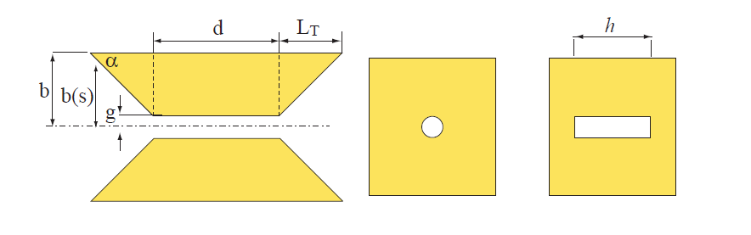
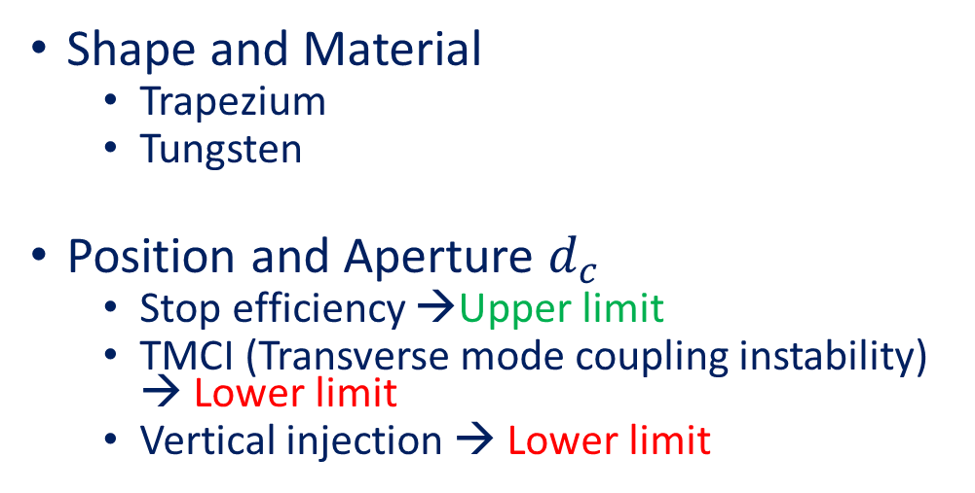
Preliminary Design of Collimators
Shape and Material
  Trapezium
  Tungsten
Position and Aperture $d_{c}$
  Stop efficiency →Upper limit
  TMCI (Transverse mode coupling instability) → Lower limit
  Vertical injection → Lower limit
There are two kinds of collimator aperture,
round and rectangular.
Upper Limit:
TMCI:
Injection:

Slide 9
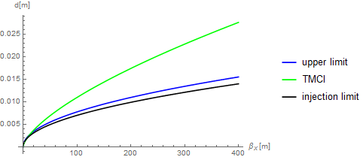
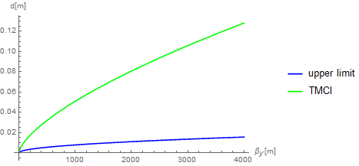
Preliminary design of collimators
~β_{x}*=0.36m
Since the low gradient of final doublet in IR, the beta function are much larger than in the single ring. In this case, the upper limit are much high, and there seems no space for collimators to choose for both horizontal and vertical.

Slide 10
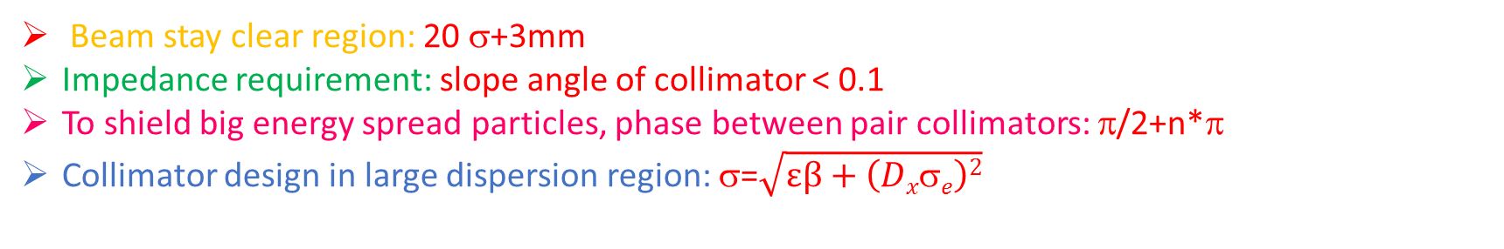
Collimator design in ARC
Beam stay clear region: 20 σ+3mm
Impedance requirement: slope angle of collimator < 0.1
To shield big energy spread particles, phase between pair collimators: π/2+n*π
Collimator design in large dispersion region: σ=$\sqrt{εβ+\left(Dxσe\right)2}$
name | Position | Distance to IP/m | Beta function/m | Horizontal Dispersion/m | Phase | BSC/2/m | Range of half width allowed/mm
APTX1 | D1I.1884 | 2203.06 | 108.36 | 0.24 | 349.16 | 0.010242 | 1~10
APTX2 | D1I.1909 | 1710.79 | 104.65 | 0.24 | 350.91 | 0.010117 | 1~10
APTY1 | D1I.1897 | 1953.13 | 116.82 | 0.12 | 349.85 | 0.003752 | 1~3.5
APTY2 | D1I.1908 | 1742.15 | 125.21 | 0.16 | 350.60 | 0.003778 | 1~3.5

Slide 11
Beam loss with collimators

Slide 12
RBB loss with collimators
horizontal collimator half width 1cm, vertical collimator half width 3mm

Slide 13
RBB loss with collimators
horizontal collimator half width 6mm, vertical collimator half width 2mm

Slide 14
RBB loss with collimators
horizontal collimator half width 5mm, vertical collimator half width 2mm

Slide 15
Conclusions and Prospects
Radiative Bhabha scattering and Beamstrahlung events are generated and lost particles information got after tracking in SAD.
Beam loss background in β_{x}*=0.36m lattice seems serious, especially in the upstream of multi-turn tracking.
With two pairs of horizontal and vertical collimators in ARC(half width 5mm and 2mm), beam loss reduced significantly.

