Slide 1
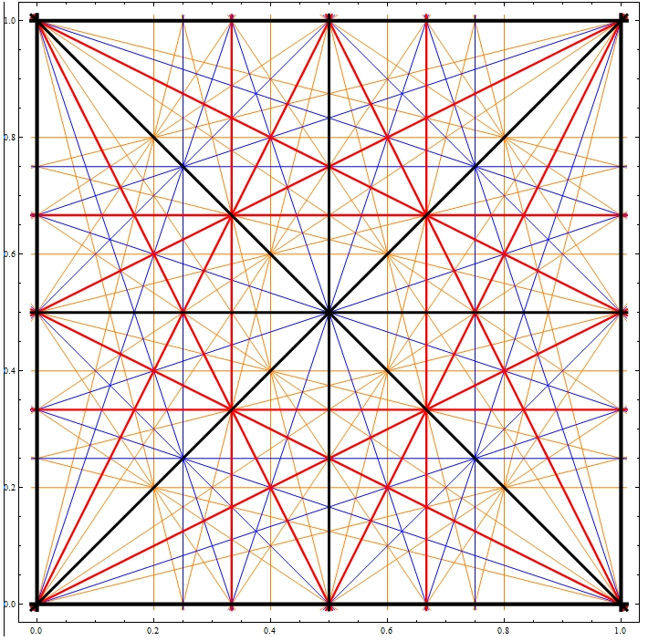

Slide 2
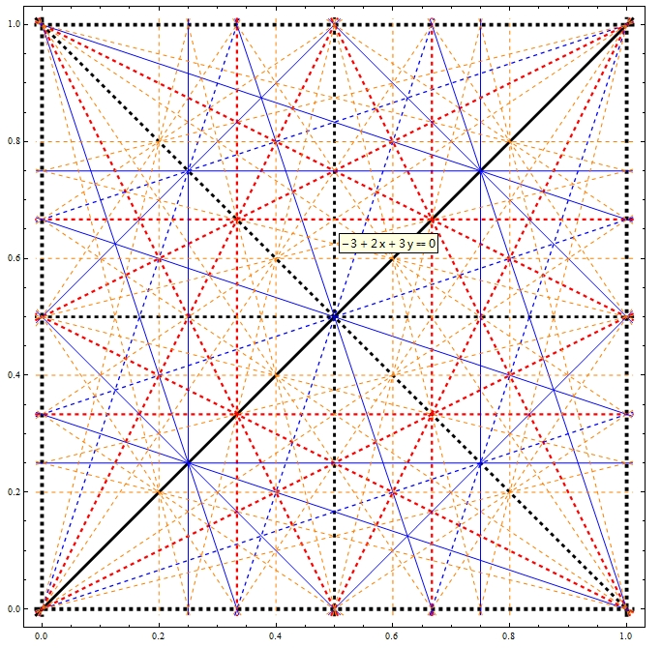

Slide 3
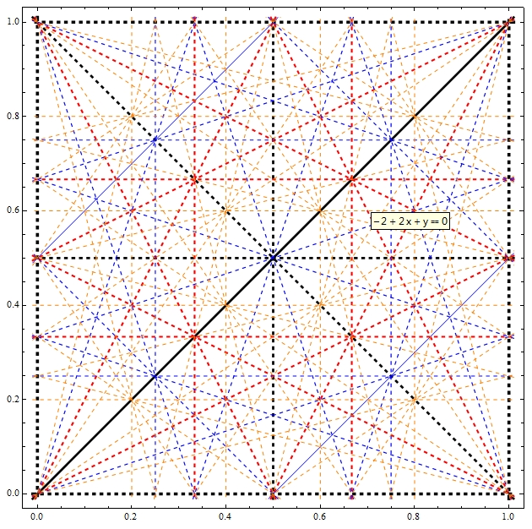

Slide 4
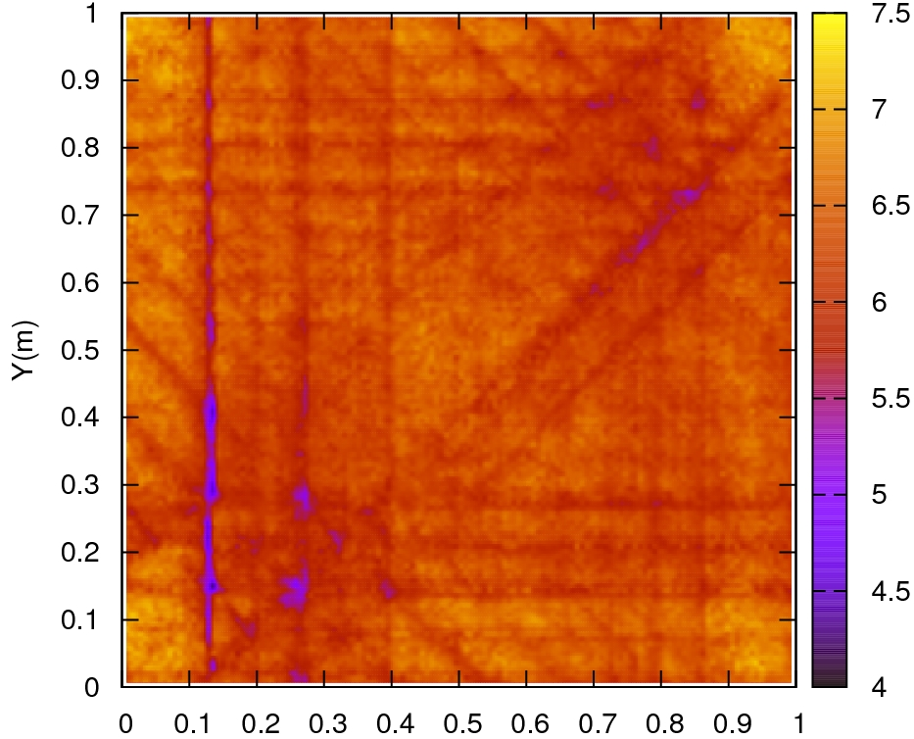

Slide 9
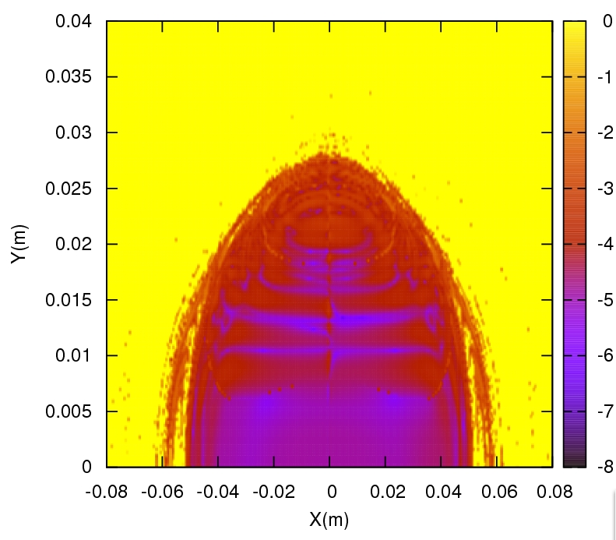

Slide 10
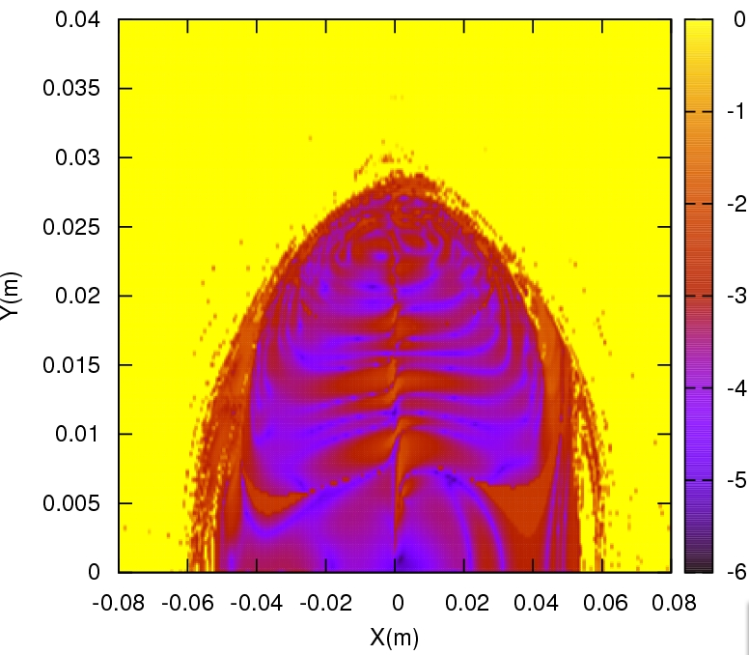

Slide 11
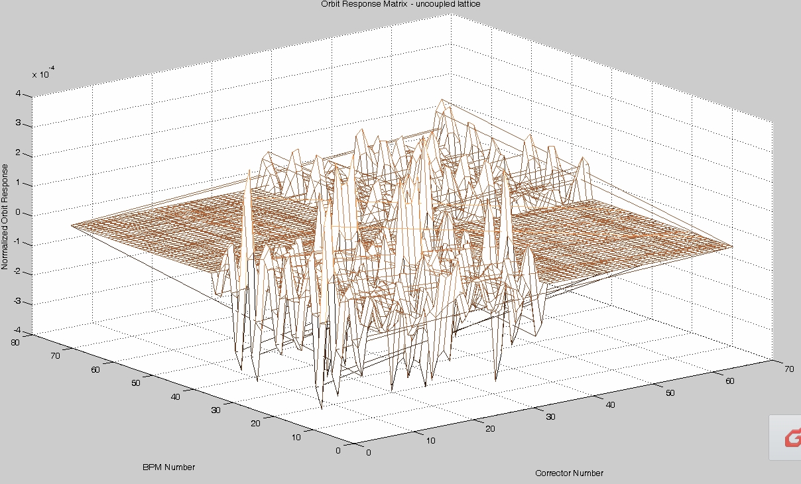
Booster prograss
Code in Mathematica: from thin to thick.
SVD and response matrix.
Code for orbit correct is in progress.

Slide 12
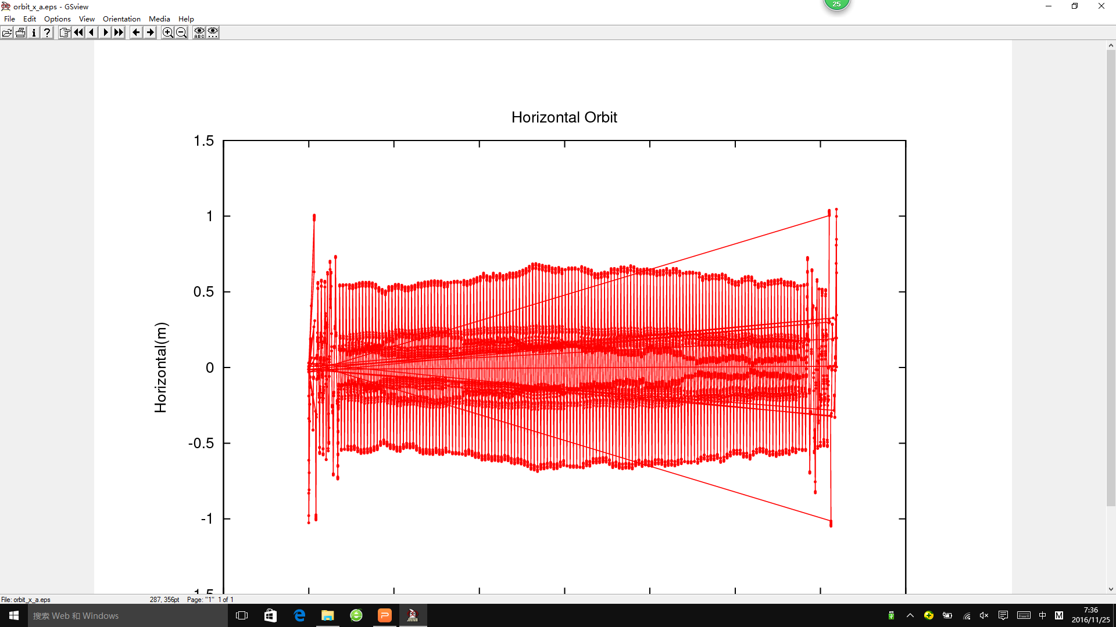
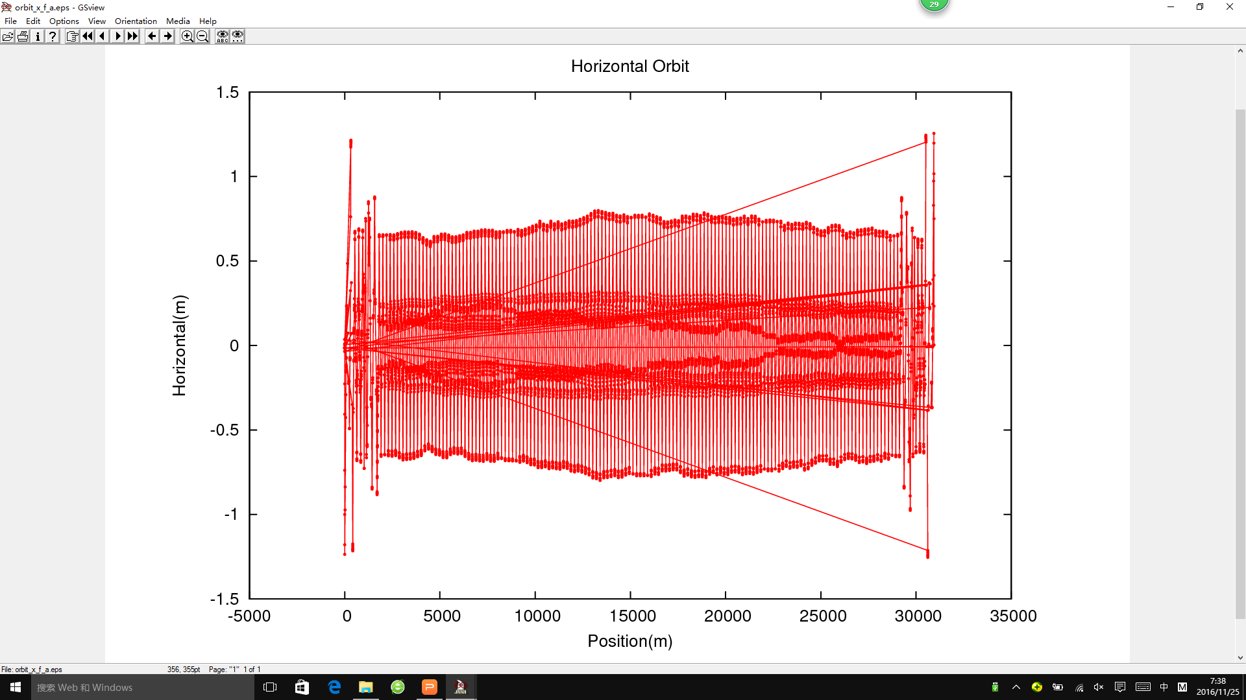
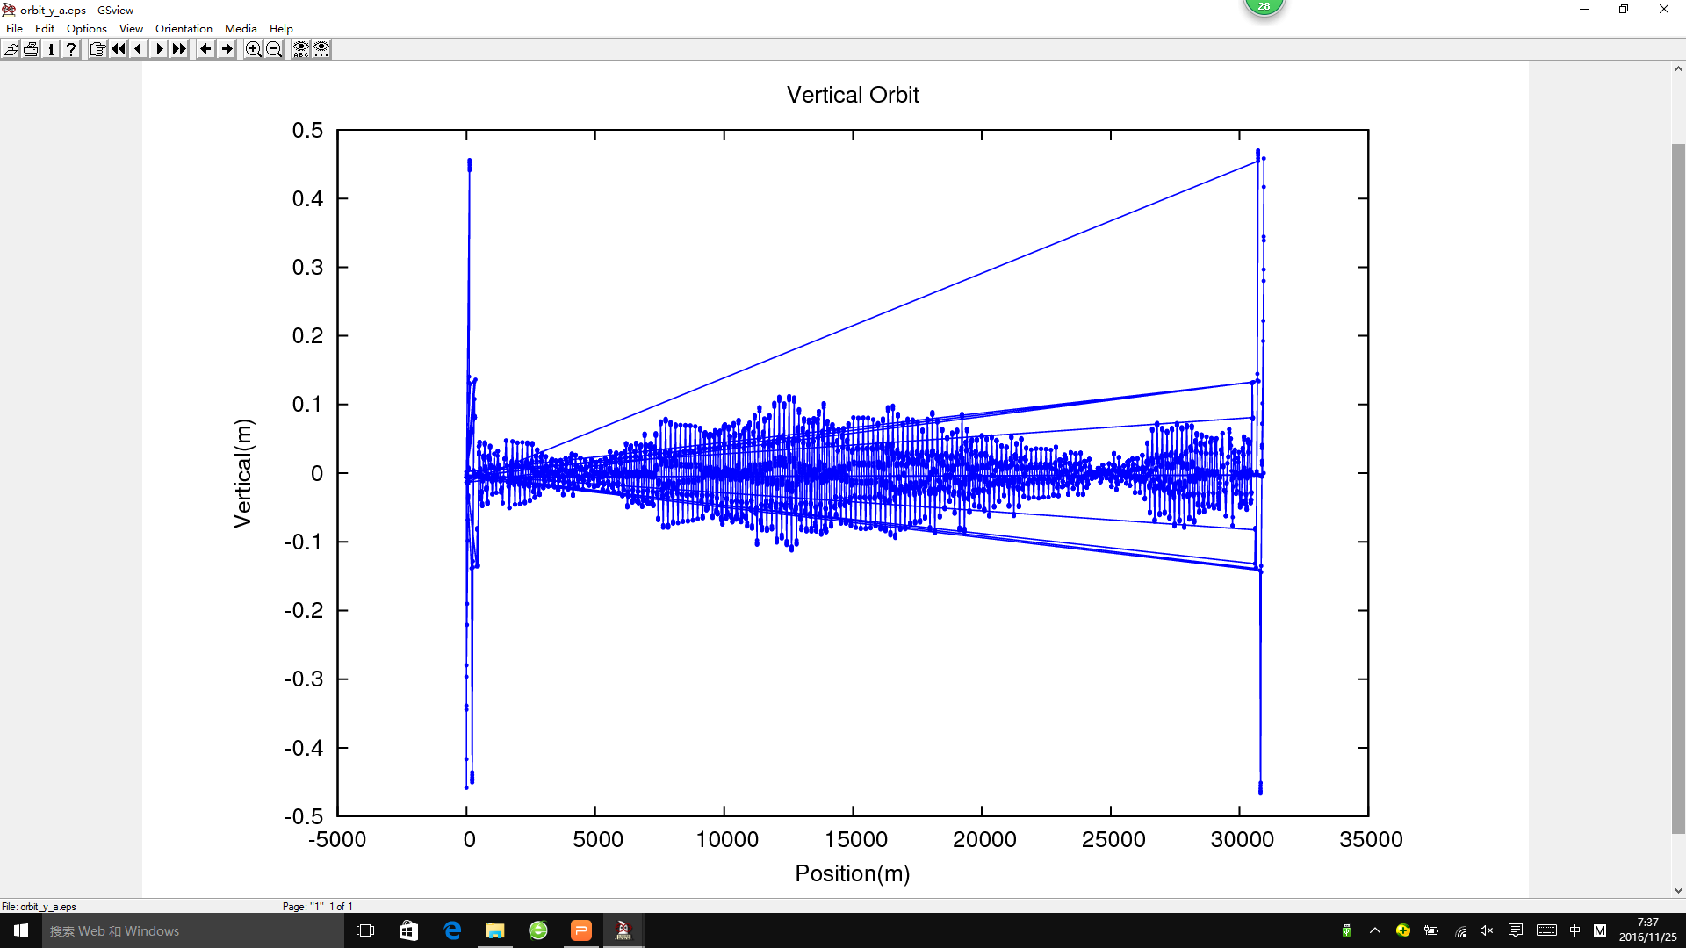
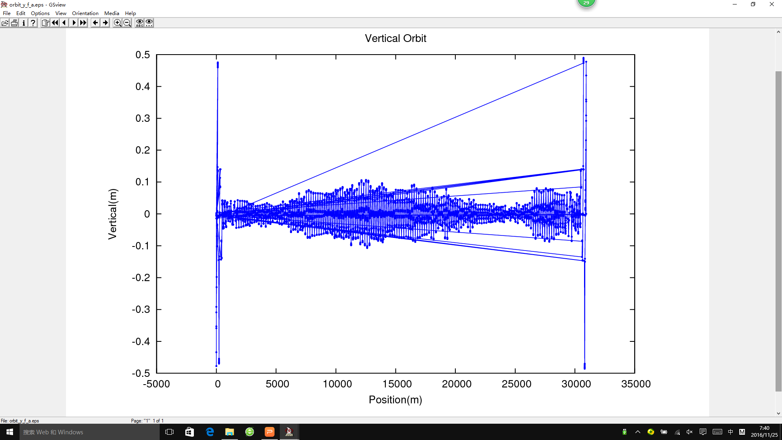

Slide 13
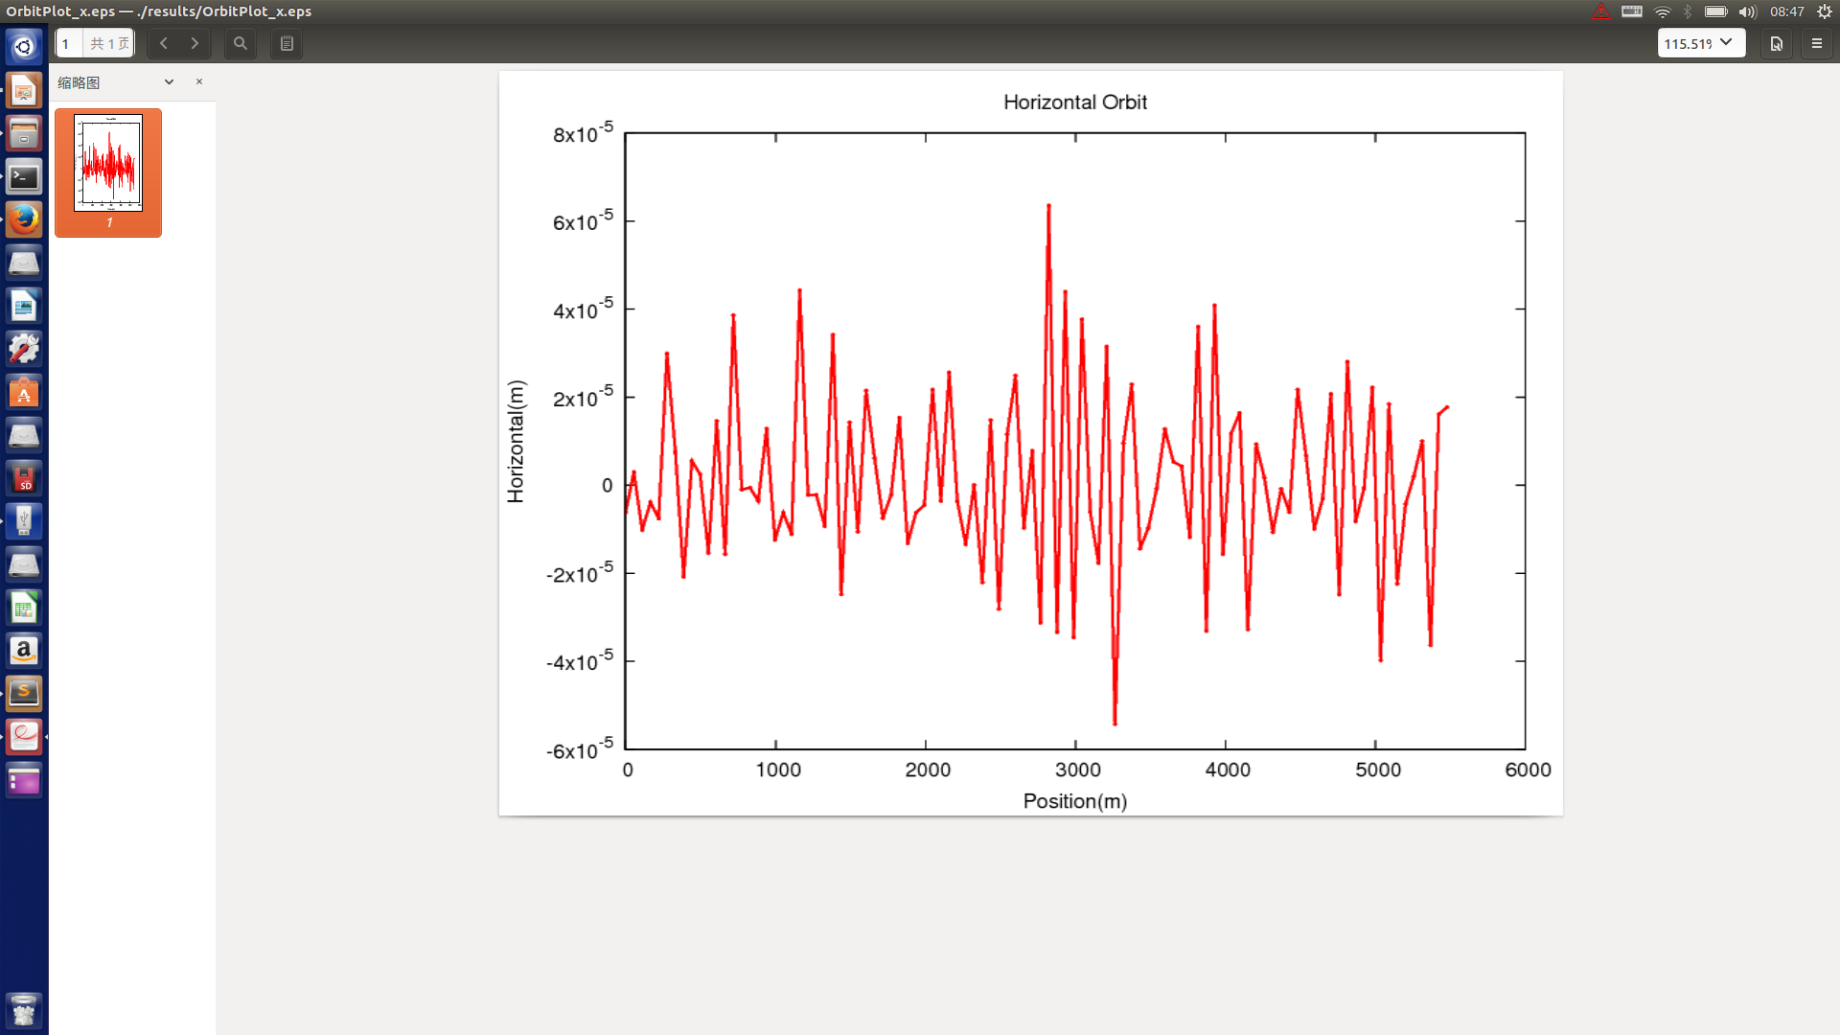

Slide 14
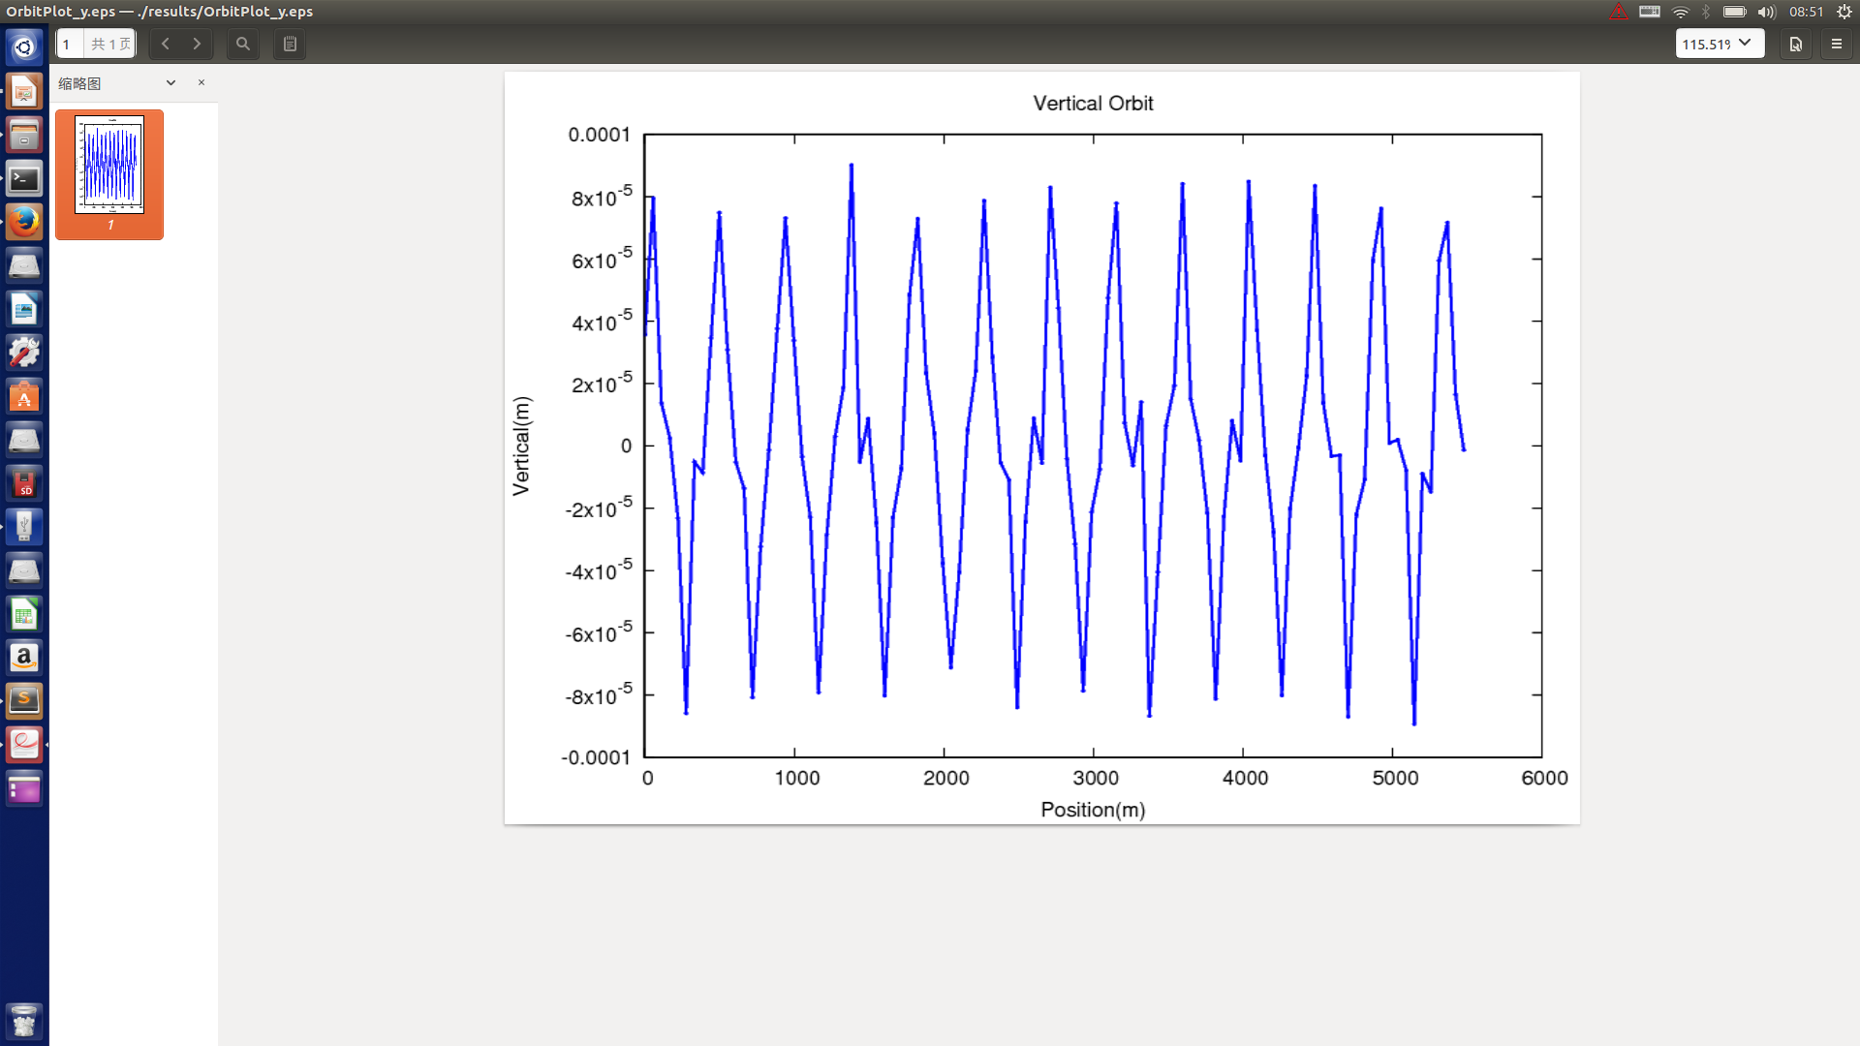

Slide 15
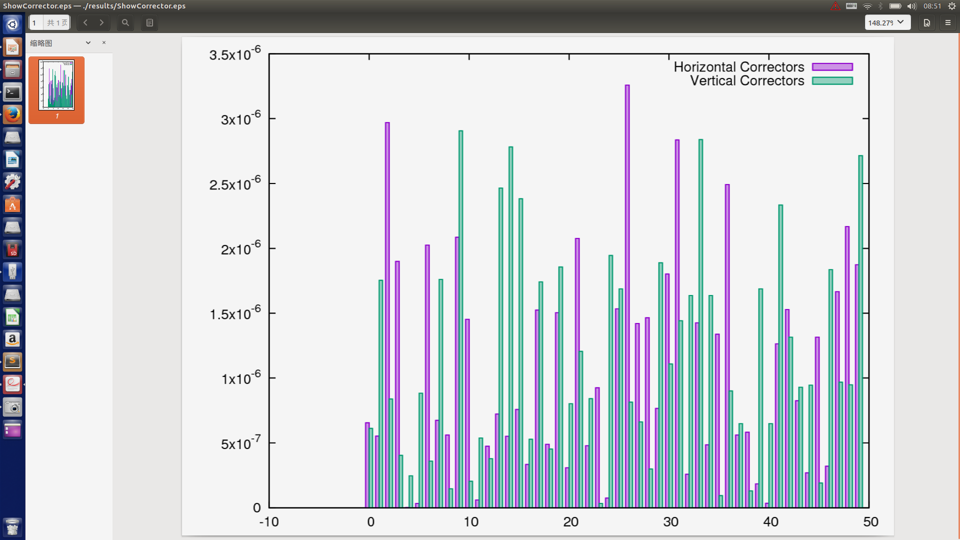

Slide 16
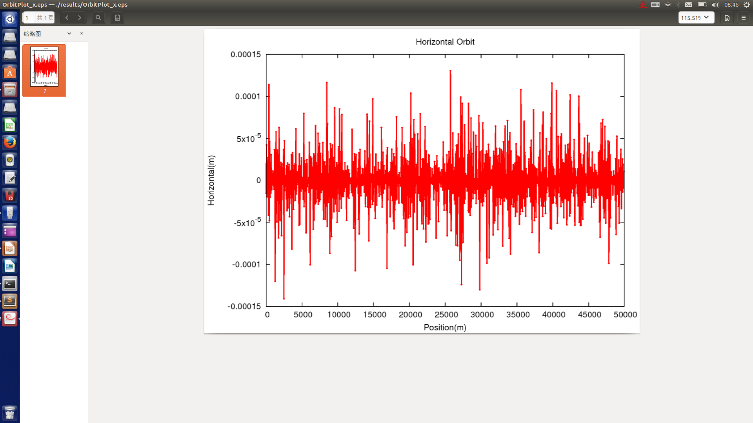
BoosterError->setBendFieldErrDefine(1e-3);
BoosterError->setAlignErrFlag(true);
BoosterError->setShiftErrDefine(60e-6);
BoosterError->setTiltErrDefine(1e-6);

Slide 17
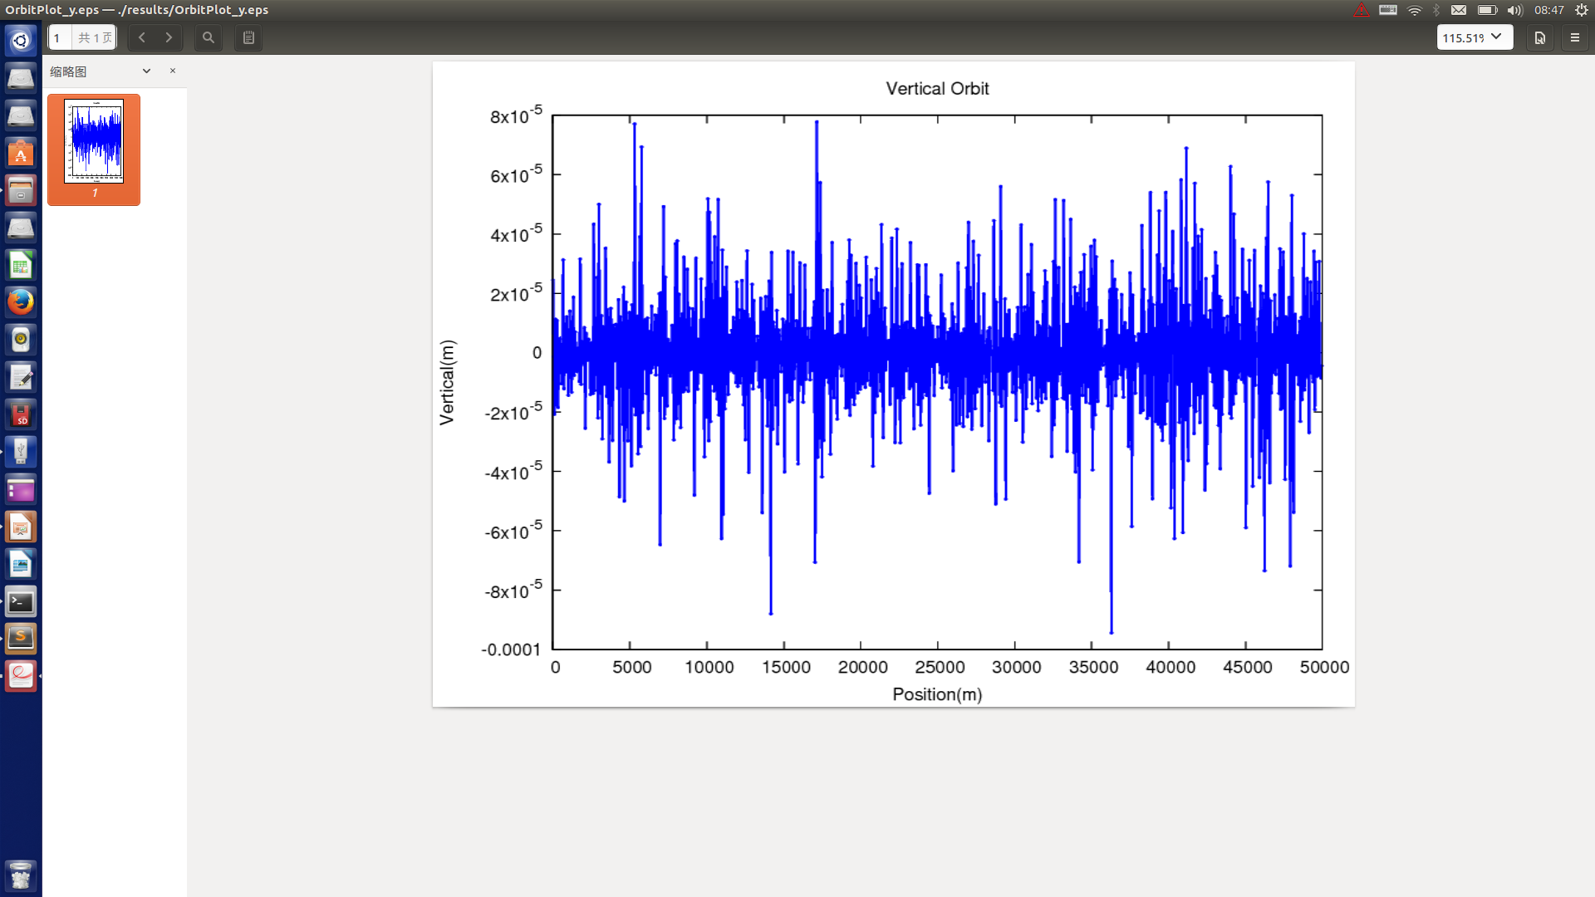
BoosterError->setBendFieldErrDefine(1e-3);
BoosterError->setAlignErrFlag(true);
BoosterError->setShiftErrDefine(60e-6);
BoosterError->setTiltErrDefine(1e-6);

Slide 18
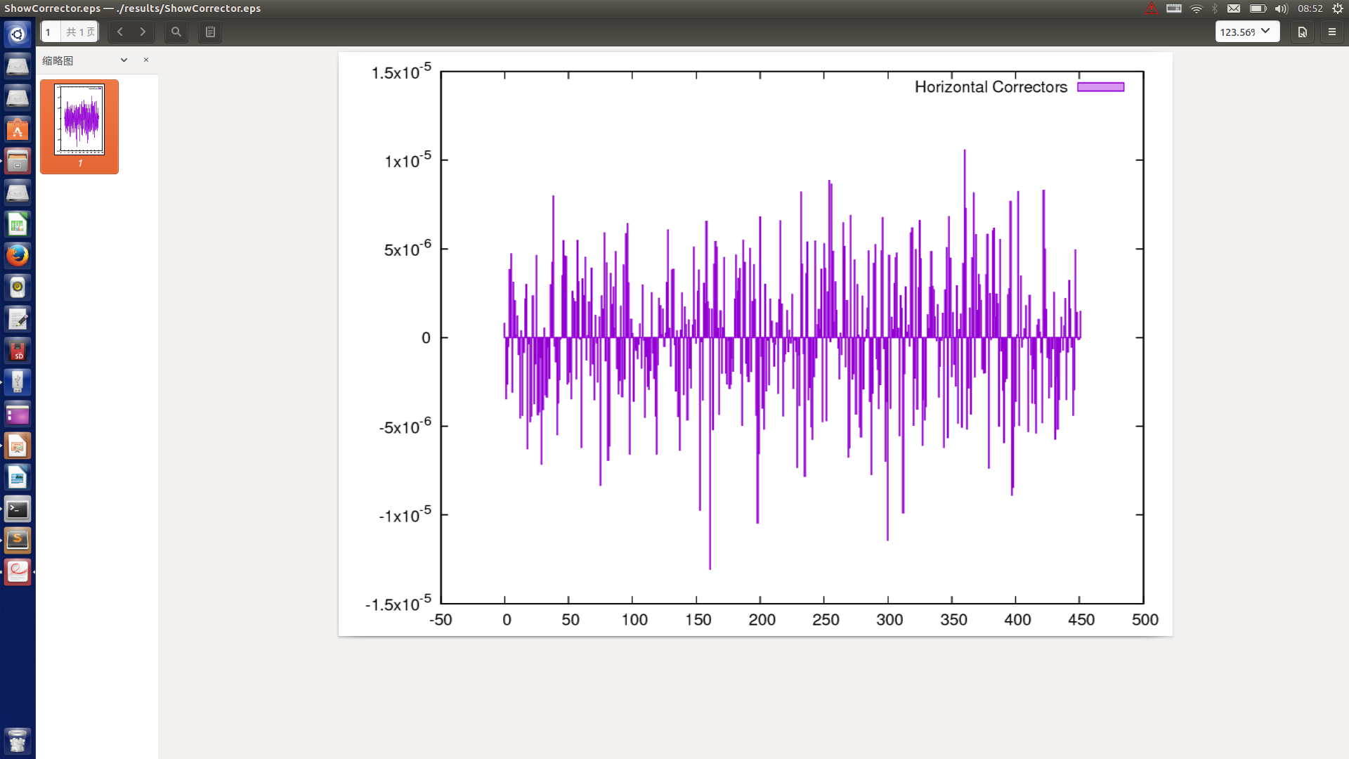
BoosterError->setBendFieldErrDefine(1e-3);
BoosterError->setAlignErrFlag(true);
BoosterError->setShiftErrDefine(60e-6);
BoosterError->setTiltErrDefine(1e-6);

Slide 19
BoosterError->setBendFieldErrDefine(1e-3);
BoosterError->setAlignErrFlag(true);
BoosterError->setShiftErrDefine(60e-6);
BoosterError->setTiltErrDefine(1e-6);

Slide 20
BoosterError->setBendFieldErrDefine(1e-3);
BoosterError->setAlignErrFlag(true);
BoosterError->setShiftErrDefine(60e-6);
BoosterError->setTiltErrDefine(1e-6);

Slide 21
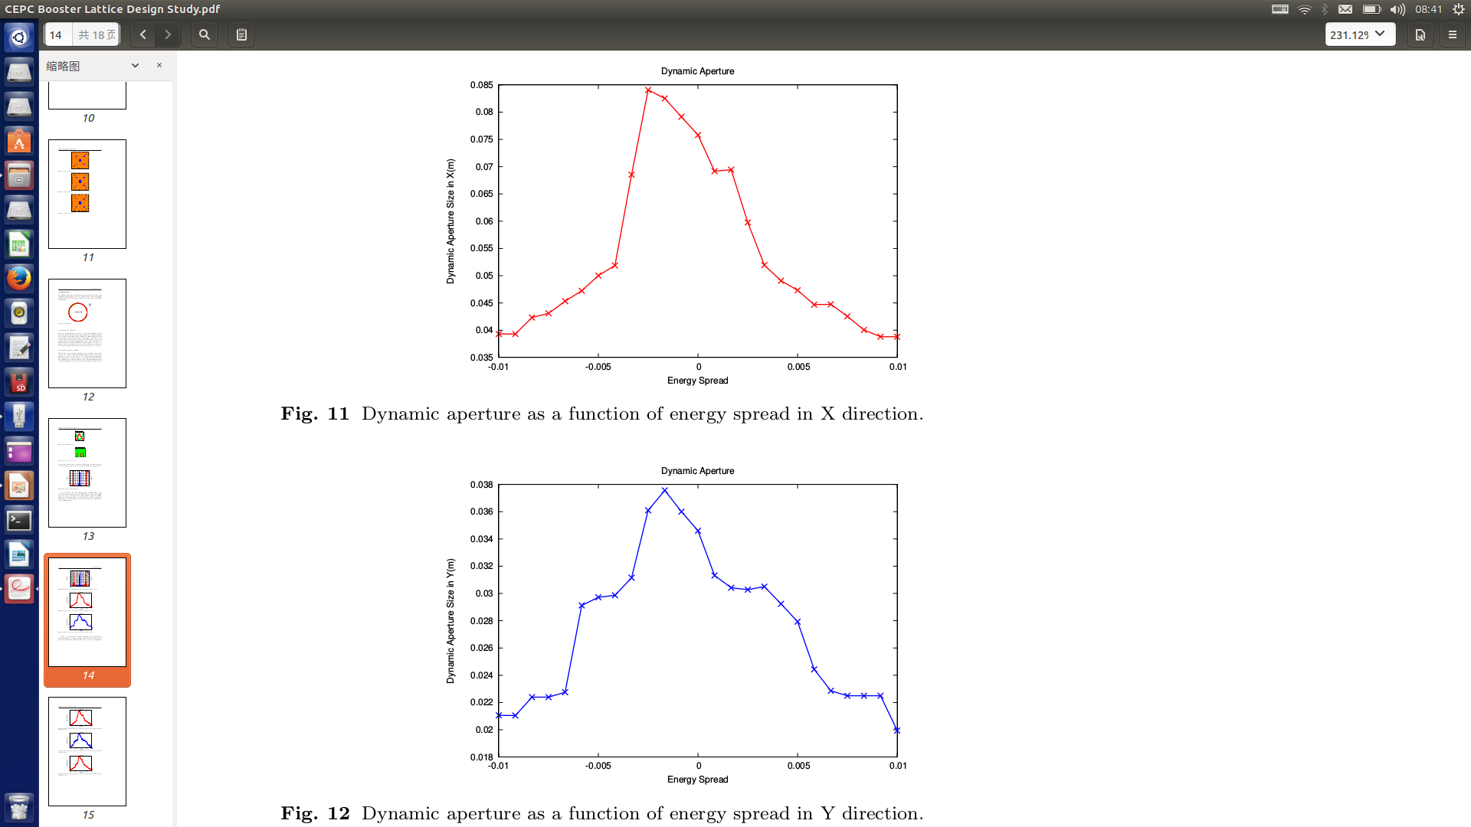

Slide 22
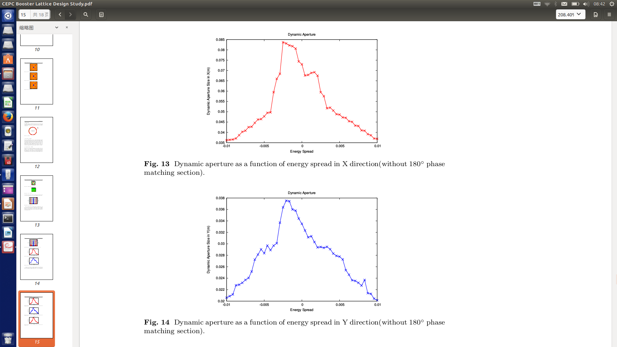

Slide 23
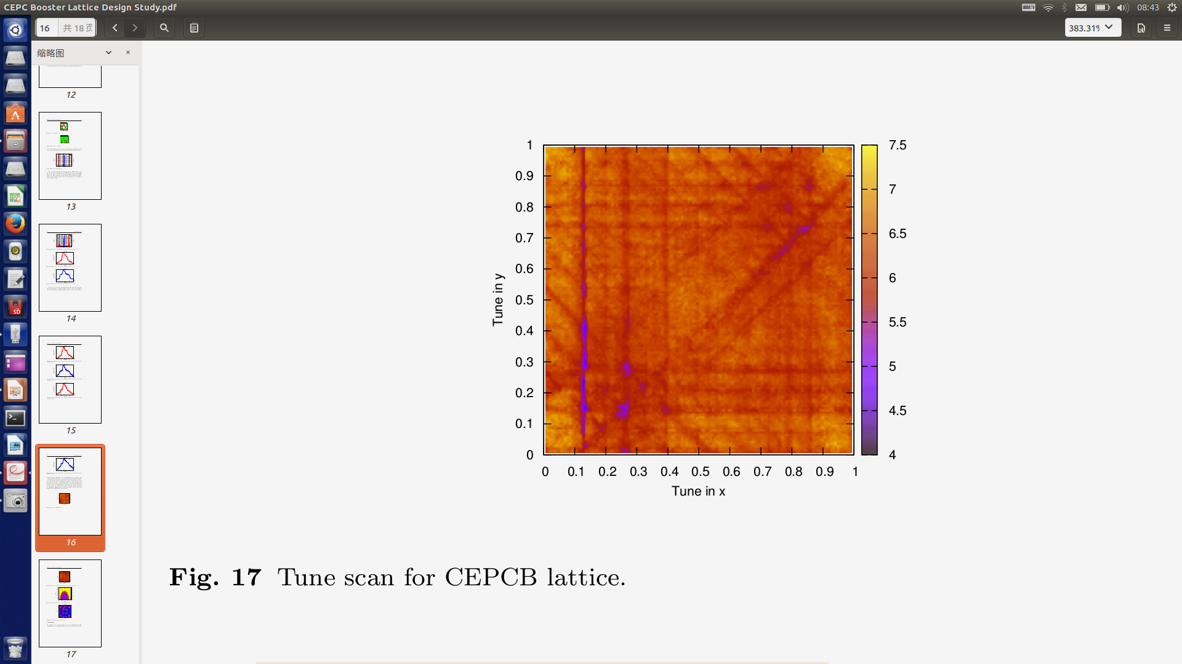
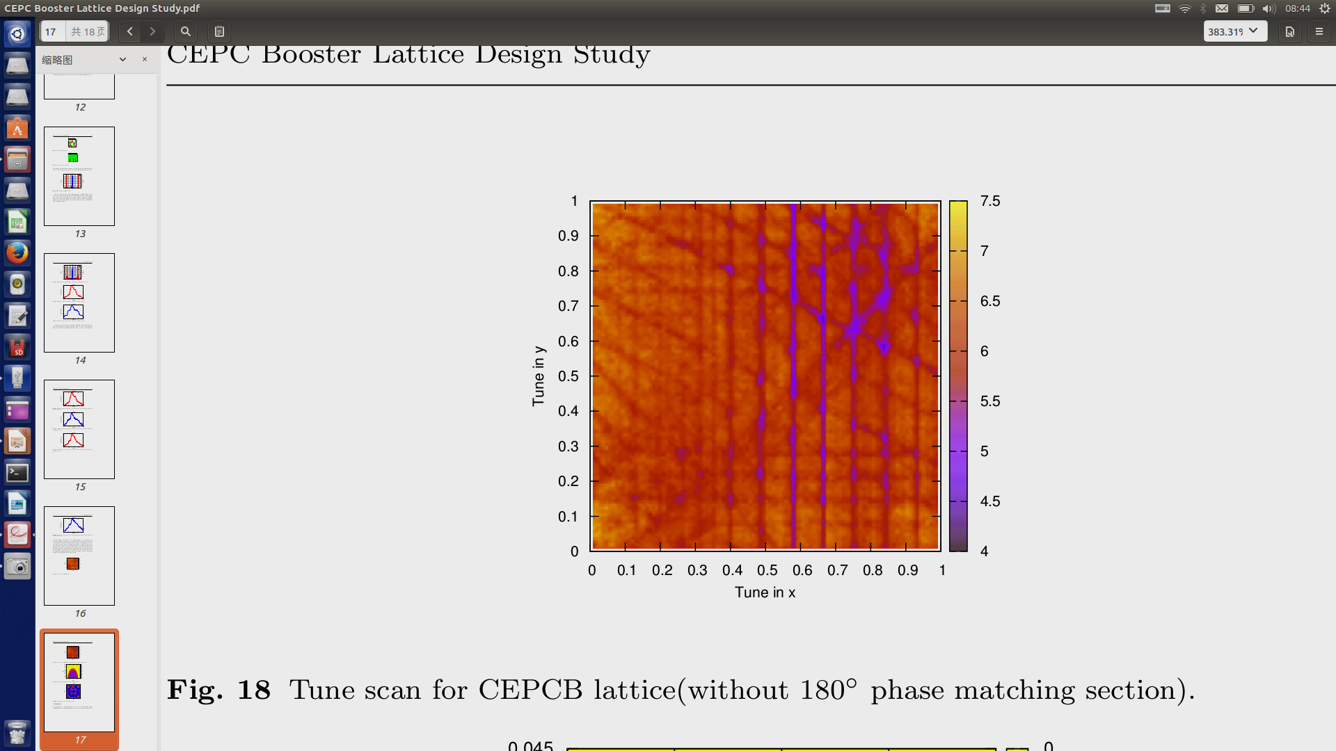

Slide 24
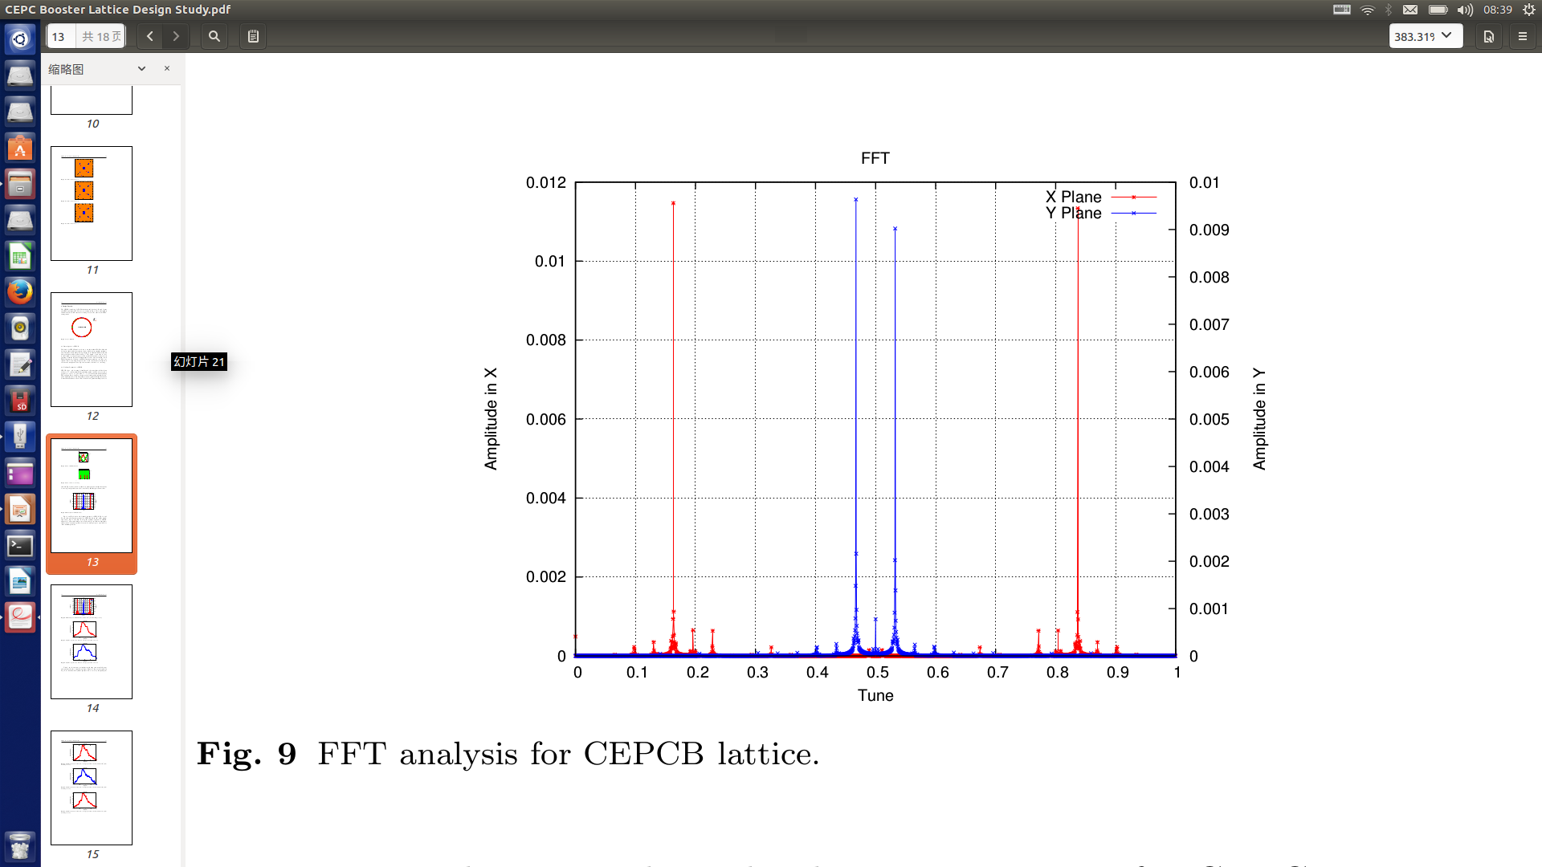
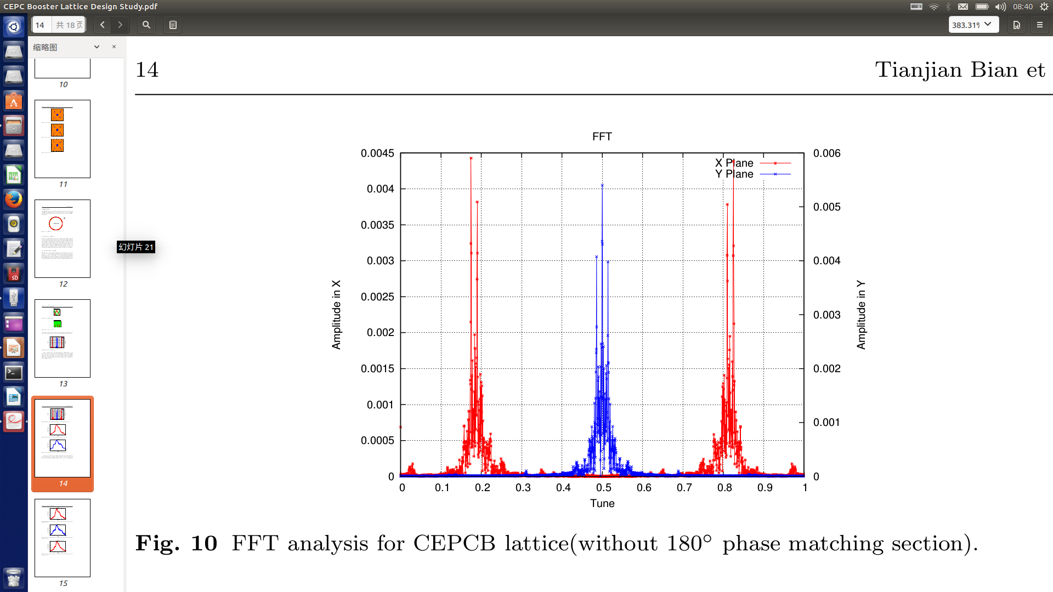

Slide 25
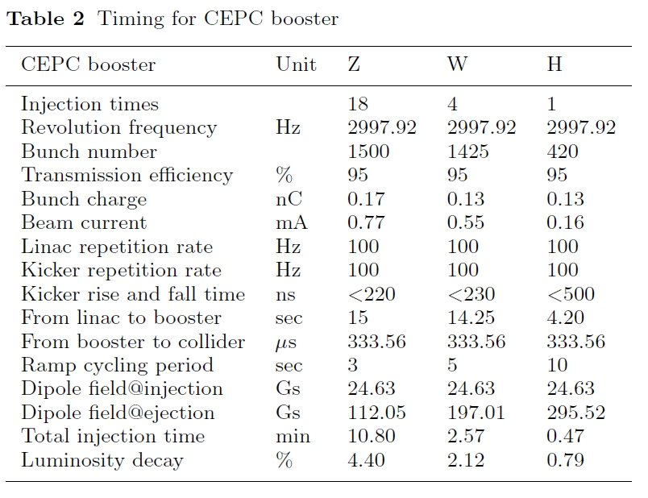
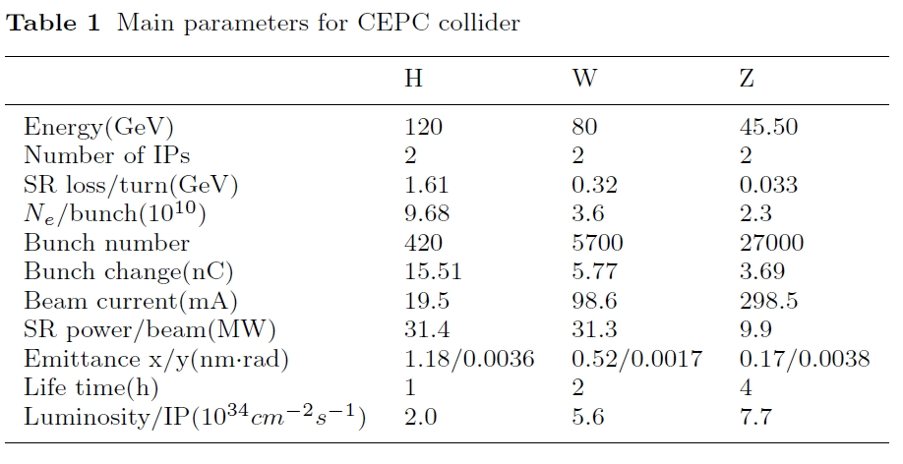

Slide 26
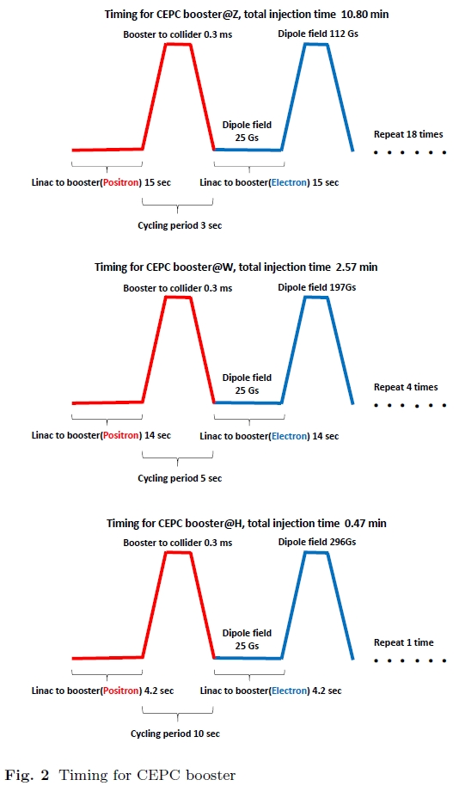
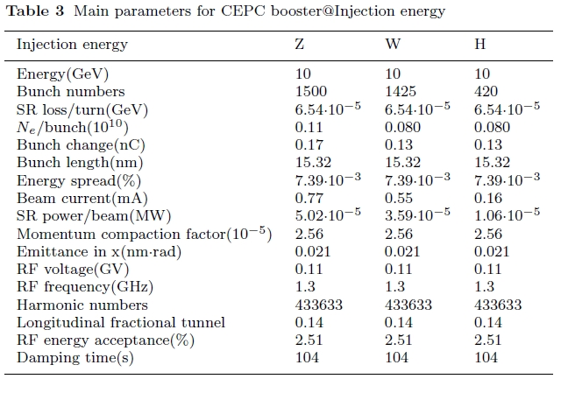
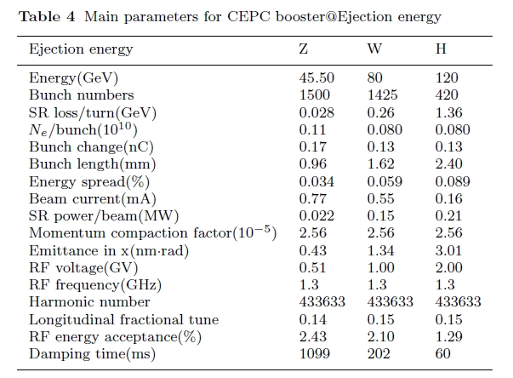

Slide 27
