Slide 1
Solenoid/Tail/DA
ZHANG, Yuan WANG, Yiwei WANG, Dou GENG, Huiping
2017-9-21

Slide 2
Vertical Emittance excited by Solenoid
Solenoid: 170412
Lattice：170823
H: 1.21/0.0036 nm (design)
W: 0.54/0.0017 nm(design)
Z: 0.17/0.0038 nm (design)

Slide 3
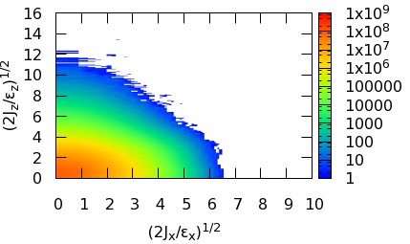
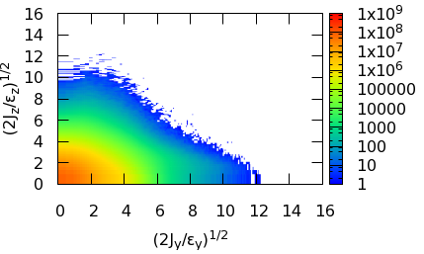
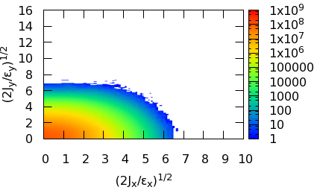
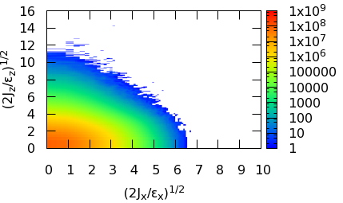
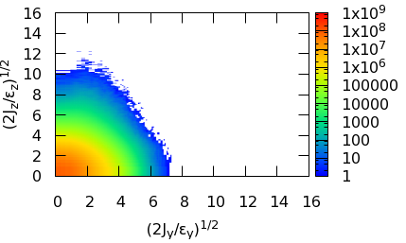
Beam Tail (Crab Waist)
Particle*Turn = 1e9
Only help suppress the vertical tail
X-Y
X-Z
Y-Z
CW=0
CW=0
CW=0
CW=0.5
CW=0.5
CW=0.5

Slide 4
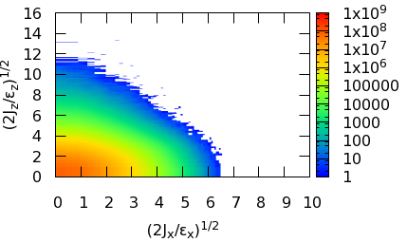
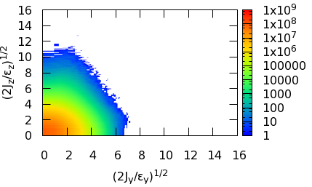
Beam Tail (Crab Waist)
Particle*Turn = 1e9
Half of crab waist strength is enough!
CW=0.5
CW=0.5
CW=0.5
CW=1
CW=1
CW=1

Slide 5
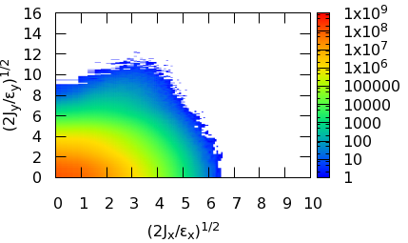
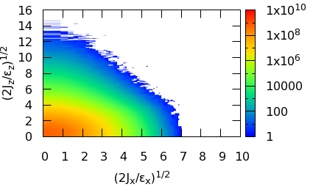
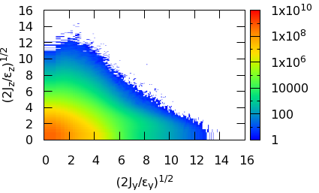
Beam Tail (Particle*Turn)
X-Y
X-Z
Y-Z
CW=0, 1e9
CW=0, 1e9
CW=0, 1e9
CW=0, 1e10
CW=0, 1e10
CW=0, 1e10

Slide 6
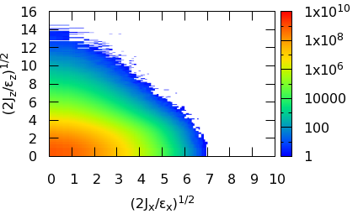
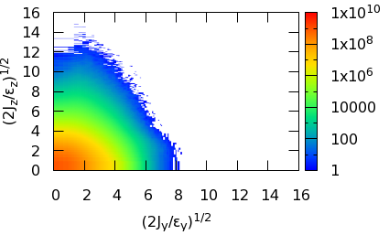
Beam Tail (Particle*Turn)
CW=0.5,
1e9
CW=0.5,
1e9
CW=0.5,
1e9
CW=0.5, 1e10
CW=0.5, 1e10
CW=0.5, 1e10

Slide 7
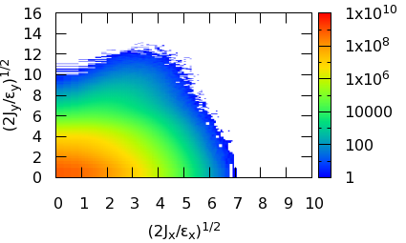
Beam Tail (Start Turn)
There exist no clear difference. Need more detailed comparision.
X-Y
X-Z
Y-Z
CW=0, STurn = 0
CW=0, STurn = 0
CW=0, STurn=0
CW=0, STurn = 900
CW=0, STurn = 900
CW=0, STurn = 900

Slide 8
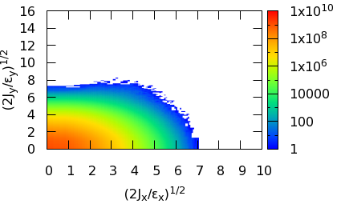
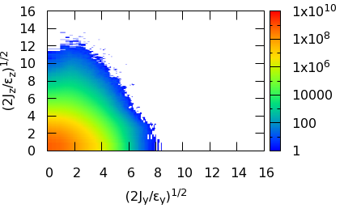
Beam Tail (Start Turn)
There exist no clear difference. Need more detailed comparision.
CW=0.5, STurn = 0
CW=0.5, STurn = 0
CW=0.5, STurn = 0
CW=0.5, STurn = 900
CW=0.5, STurn = 900
CW=0.5, STurn = 900

Slide 9
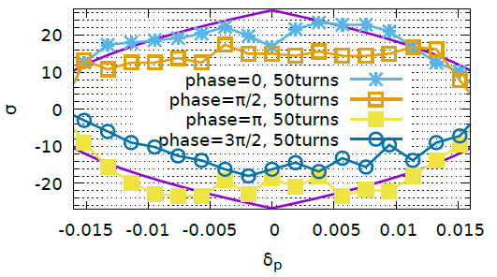
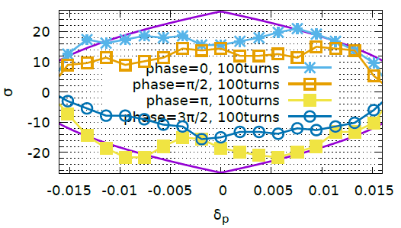
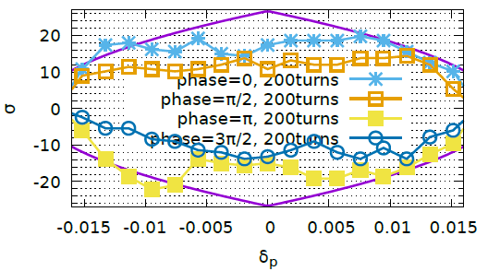
DA, Lattice 170823, Optimized with 50turns
CW = 0

Slide 10
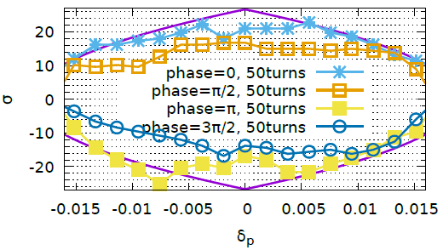
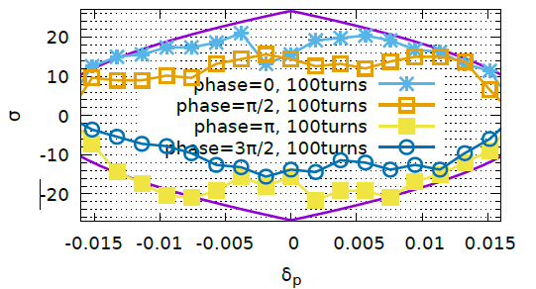
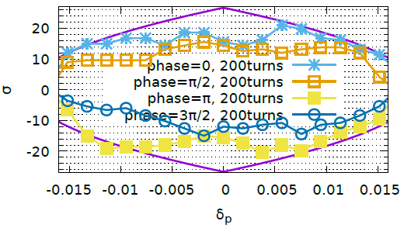
DA, Lattice 170823, Optimized with 100turns
CW = 0

Slide 11
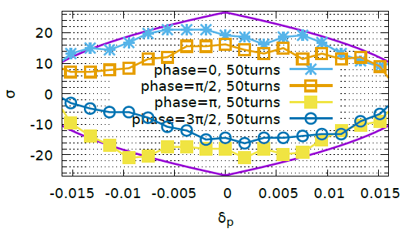
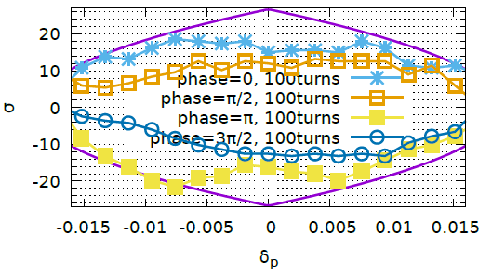
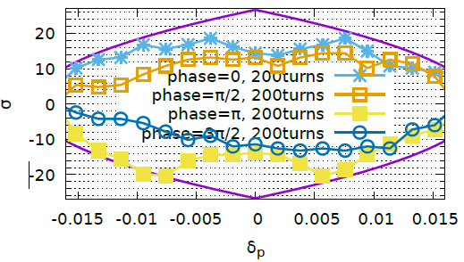
DA, Lattice 170823, Optimized with 50turns, CW=0.5

Slide 12
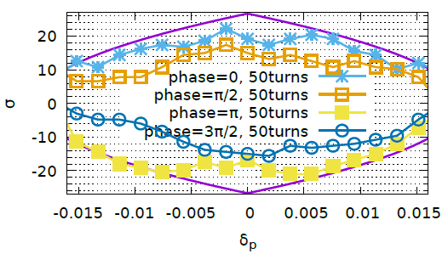
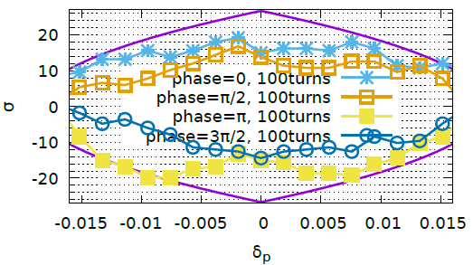
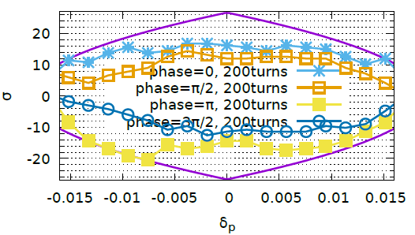
DA, Lattice 170823, Optimized with 100turns, CW=0.5

Slide 13
Discussion
DA result is far from satisfaction
Fluctuation(NOISE) too strong
Need to restart the optimization
New lattice (Weaker Q)

