Slide 1
DA 170823
ZHANG, Yuan WANG, Yiwei WANG, Dou GENG, Huiping
2017-9-29

Slide 2
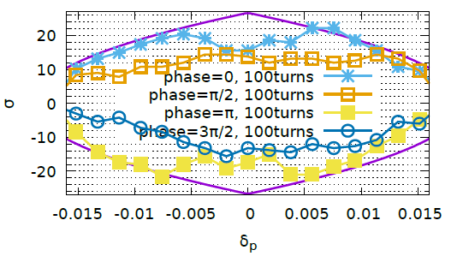
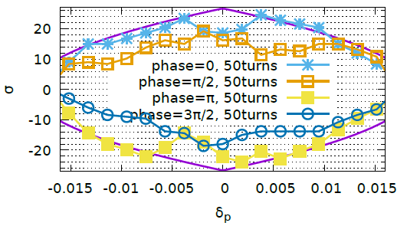
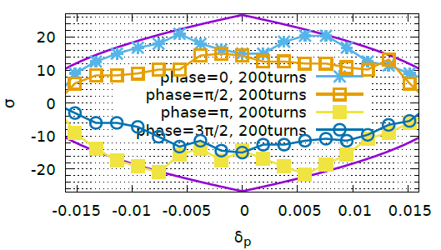
X-Z DA, 100turn, 10 samples

Slide 3
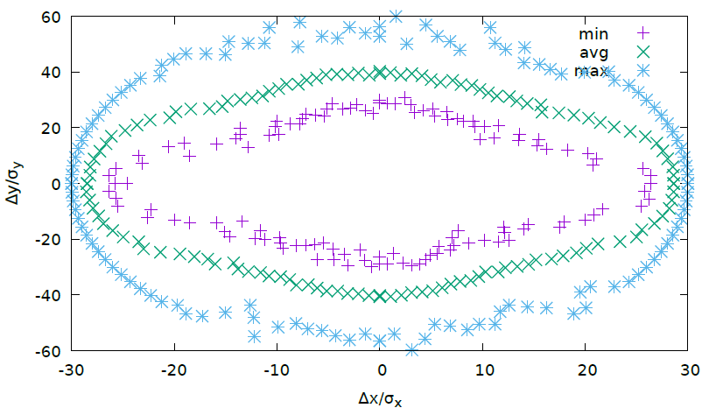
XY-DA, 100 turn，Phase=0 100 samples

Slide 4
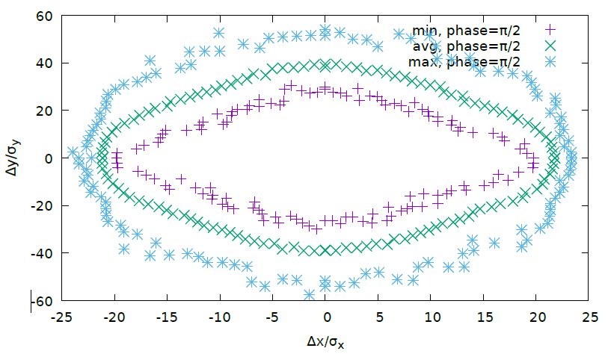
XY-DA, 100 turn，Phase=Pi/2 100 samples

Slide 5
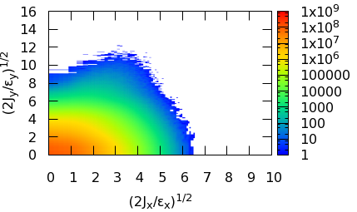
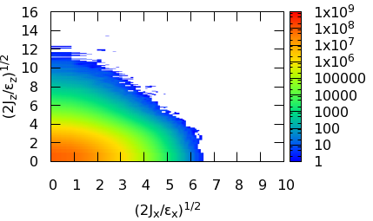
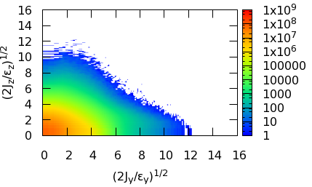
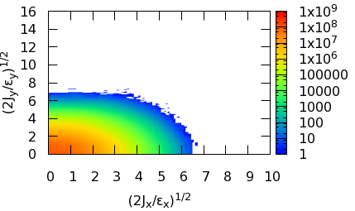
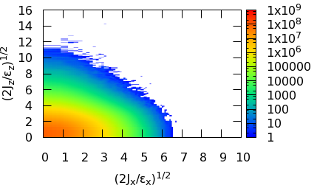
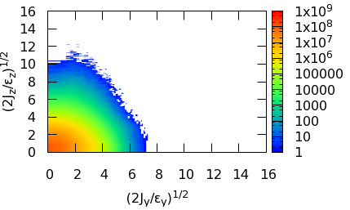
Beam Tail (Crab Waist)
Particle*Turn = 1e9
Only help suppress the vertical tail
X-Y
X-Z
Y-Z
CW=0
CW=0
CW=0
CW=0.5
CW=0.5
CW=0.5

Slide 6
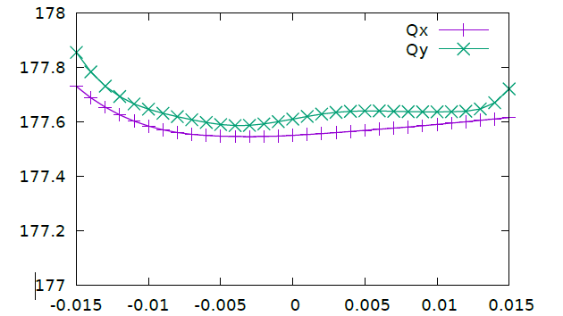
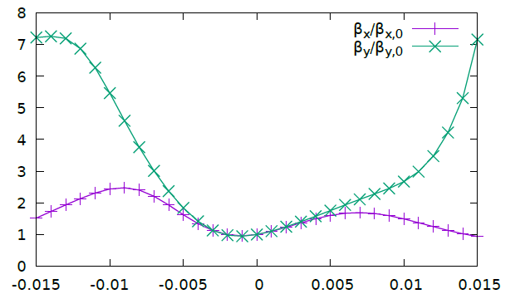
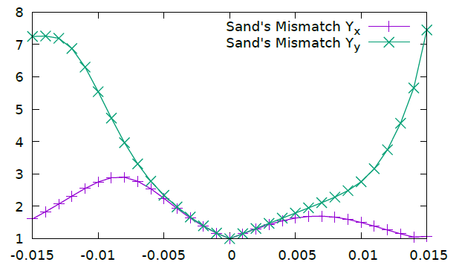
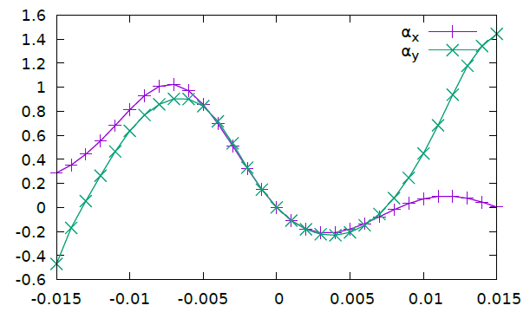
Chromaticity
Notes:
x.217.12, 参考

Slide 7
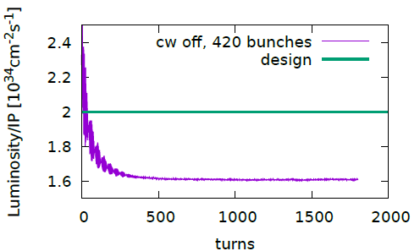
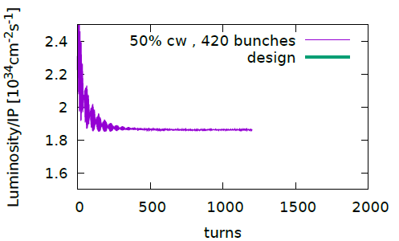
Main Parameters 170825， Higgs Luminosity @0.55,0.61

