Slide 1
CEPC Injector positron source
September 29th, 2017
C. Meng, G. Pei, J. Zhang, X. Li, S. Pei, Y. Chi, J. Gao
Institute of High Energy Physics, CAS, Beijing

Slide 2
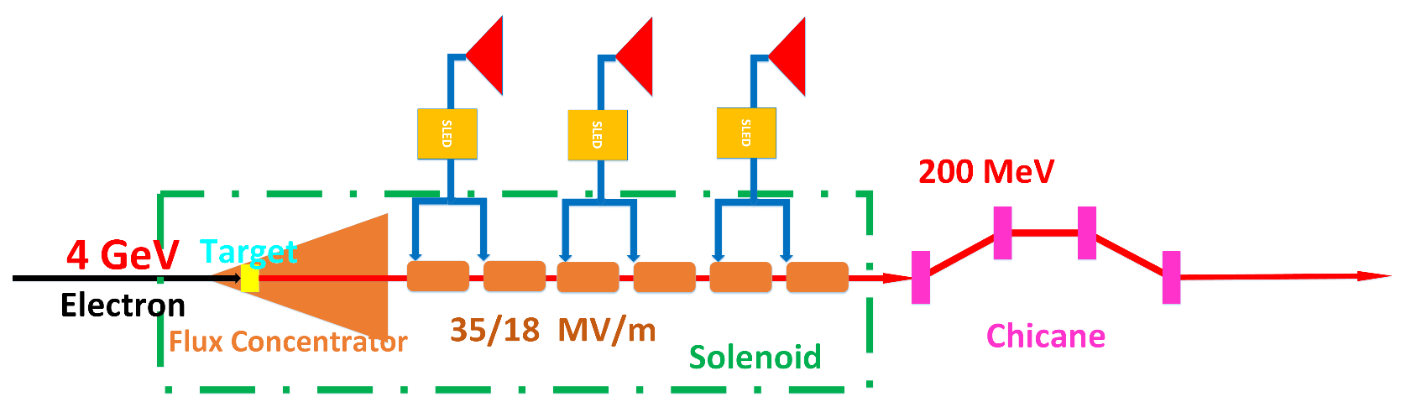
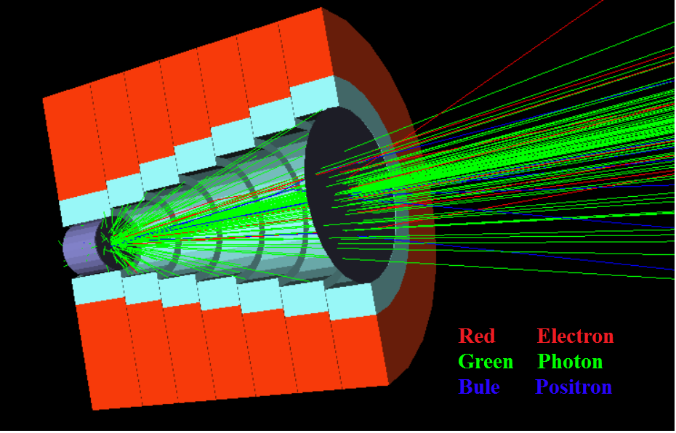
Sources design
Positron source and capture section
Layout
  Target
  FC (Flux concentrator)
  Capture section
    Large aperture accelerating tube
    r=15 mm
FC (Flux concentrator)

Slide 3
Source design
Positron source performances
 | SLC | LEP (LIL) | KEKB/SUPER KEKB | FCC-ee (conv.)* | CEPC
Incident e- beam energy | 33 GeV | 200 MeV | 3.3/3.3 GeV | 4.46 GeV | 4 GeV
e-/bunch [10¹⁰] | 3-5 | 0.5 - 30 (20 ns pulse) | 6.25/6.25 | 5.53 | 6.25
Bunch/pulse | 1 | 1 | 2/2 | 2 | 1
Rep. rate | 120 Hz | 100 Hz | 50 Hz/50 Hz | 200 Hz | 100Hz
Incident Beam power | ~20 kW | 1 kW (max) | 3.3 kW | 15 kW | 2.5 kW
Beam size @ target | 0.6 - 0.8 mm | < 2 mm | />0.7 mm | 0.5 mm | 0.5 mm
Target thickness | 6X0 | 2X0 | /4X0 | 4.5X0 | 4.5X0
Target size | 70 mm | 5 mm | 14 mm |  | 10mm
Target | Moving | Fixed | Fixed/Fixed |  | Moving/Fixed
Deposited power | 4.4 kW |  | /0.6 kW | 2.7 kW | 0.45kW
Capture system | AMD | λ/4 transformer | /AMD | AMD | AMD
Magnetic field | 6.8T->0.5T | 1 T->0.3T | /4.5T->0.4T | 7.5T->0.5T | 6T->0.5T
Aperture of 1st cavity | 18 mm | 25mm/18 mm | /30 mm | 20 mm | 25 mm
Gradient of 1st cavity | 30-40 MV/m | ~10 MV/m | /10 MV/m | 30 MV/m | 25 MV/m
length of 1st cavity | 1m | 3m | 2m | 3m | 2m
Linac frequency | 2855.98 MHz | 2998.55 MHz | 2855.98 MHz | 2855.98 MHz | 2856.75 MHz
e+ yield @ CS exit | ~1.6 e+/e- | ~0.003 e+/e- (linac exit) | /~0.5 e+/e- | ~0.7 e+/e- | ~0.6 e+/e-
Positron yield @ DR | ~1.1 e+/e- |  | 0.4 e+/e-
DR energy acceptance | +/- 2.5 % | +/- 1 % (EPA) | +/- 1.5 % (1 σ) | +/- 8 %
Energy of the DR | 1.15 GeV | 500 MeV | NO/1.1 GeV | 1.54 GeV

Slide 4
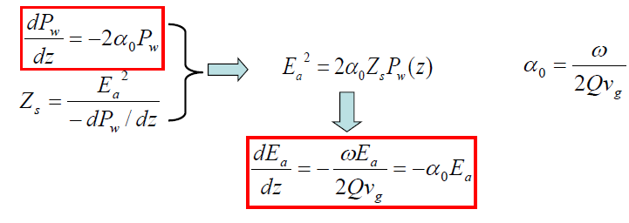

Accelerating tube
Constant impedance
Same size for each cell, same Q、υ_{g}、Z_{s}、α₀

Slide 5
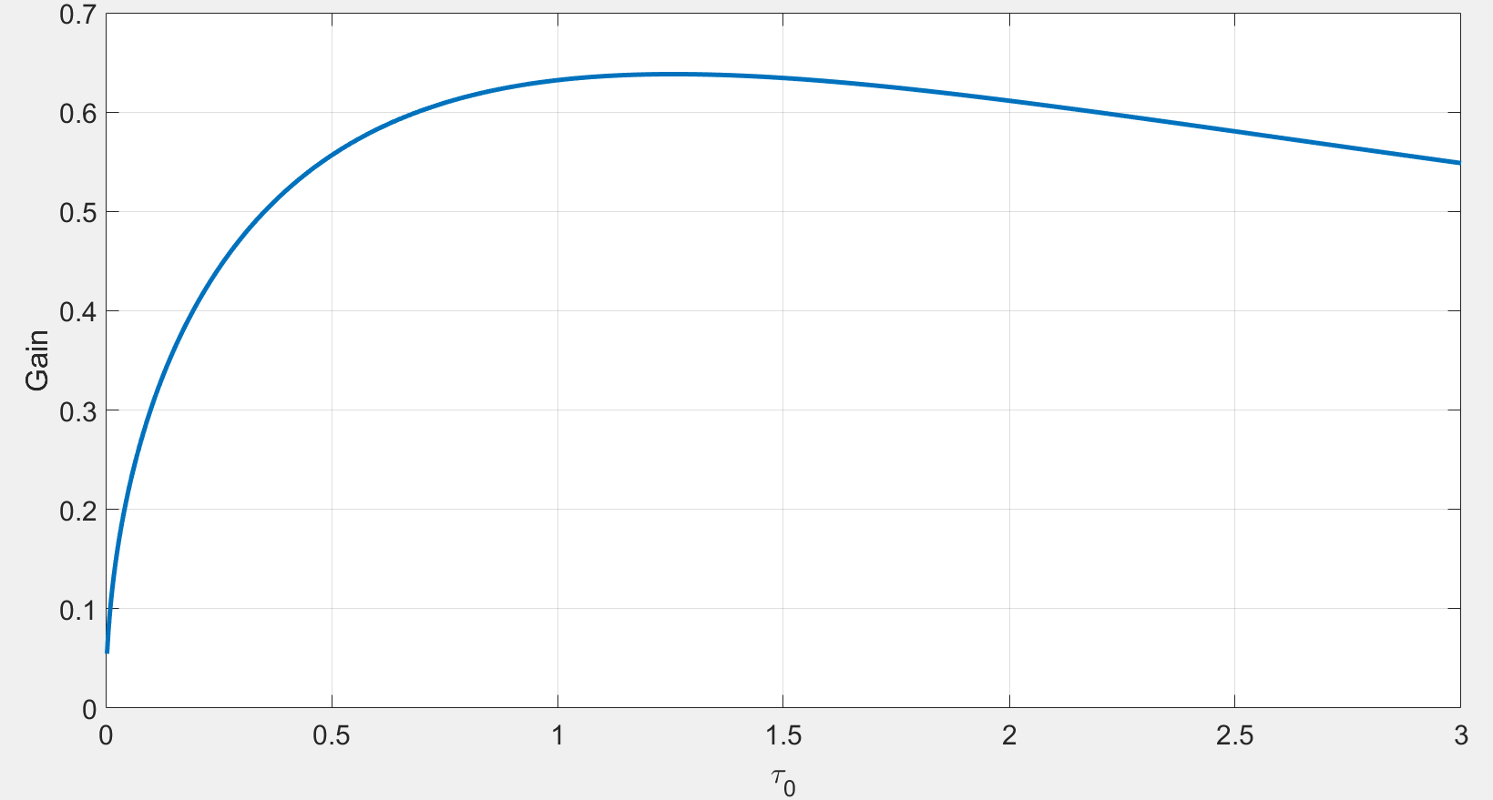
Accelerating tube
Constant impedance
R=30 mm
  υ_{g}=0.034
  α₀=0.054
  18 MV/m
R=25 mm
  υ_{g}=0.019
  α₀=0.1
  25 MV/m
Length
  1.5m~1.8m
τ₀ ~ 0.5-0.8

Slide 6
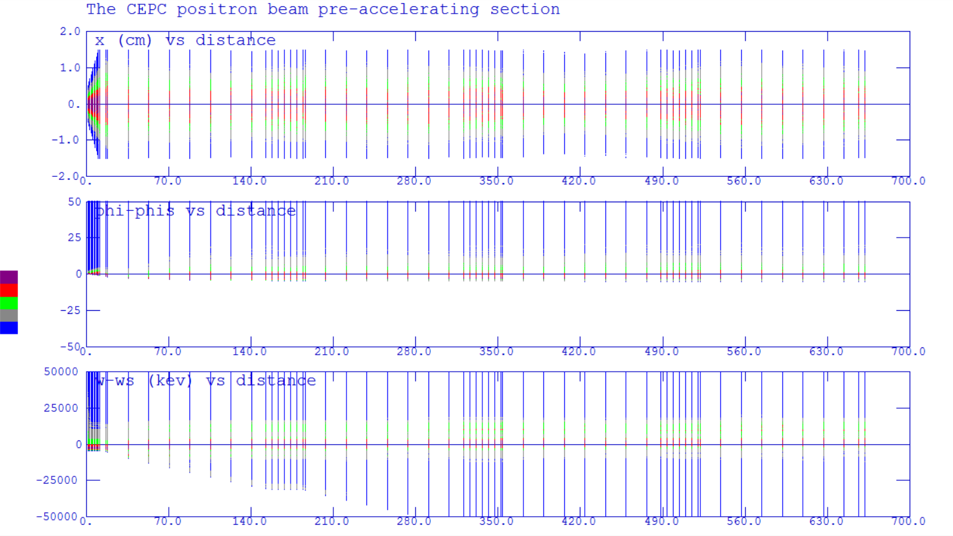
Pre-accelerating section
R=30 mm

Slide 7
Pre-accelerating section
R=30mm

Slide 8
Pre-accelerating section
R=30mm
Phase [-5,10]
Energy [100 130] MeV
Ne+/Ne-=0.66
Beam size <10 mm
Ne+/Ne-=0.57
→3.2nc, 100%
→3.2nc, 70%

Slide 9
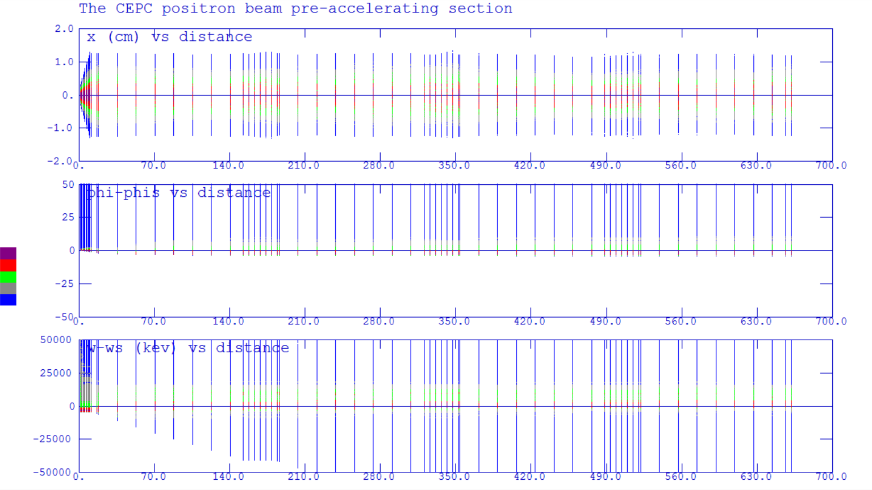
Pre-accelerating section
R=25 mm

Slide 10
Pre-accelerating section
R=25mm

Slide 11
Pre-accelerating section
R=25mm
Phase [-5,10]
Energy [140 170] MeV
Ne+/Ne-=0.52
Beam size <10 mm
Ne+/Ne-=0.5
→3.2nc, 60%
→3.2nc, 50%

Slide 12
Pre-accelerating section
Summary
Larger accelerating gradient, higher positron capture efficiency
Larger aperture of accelerating tube, higher positron capture efficiency
Considering power efficiency and positron capture efficiency, maybe the accelerating tube (R=25mm, Ea=25 MV/m, L=1.5m) is better.
Need more cavity (200 MeV) simulation and further optimization.

Slide 13
Parameters
Energy spread: 0.2%
  10 GeV→20 MeV
  4 GeV→ 8 MeV
Emittance: 0.3 mm-mrad
  10 GeV→ 6000 mm-mrad
  4 GeV→ 2400 mm-mrad (small aperture)
    Small acceptance @ positron capture and pre-accelerating section

Slide 14
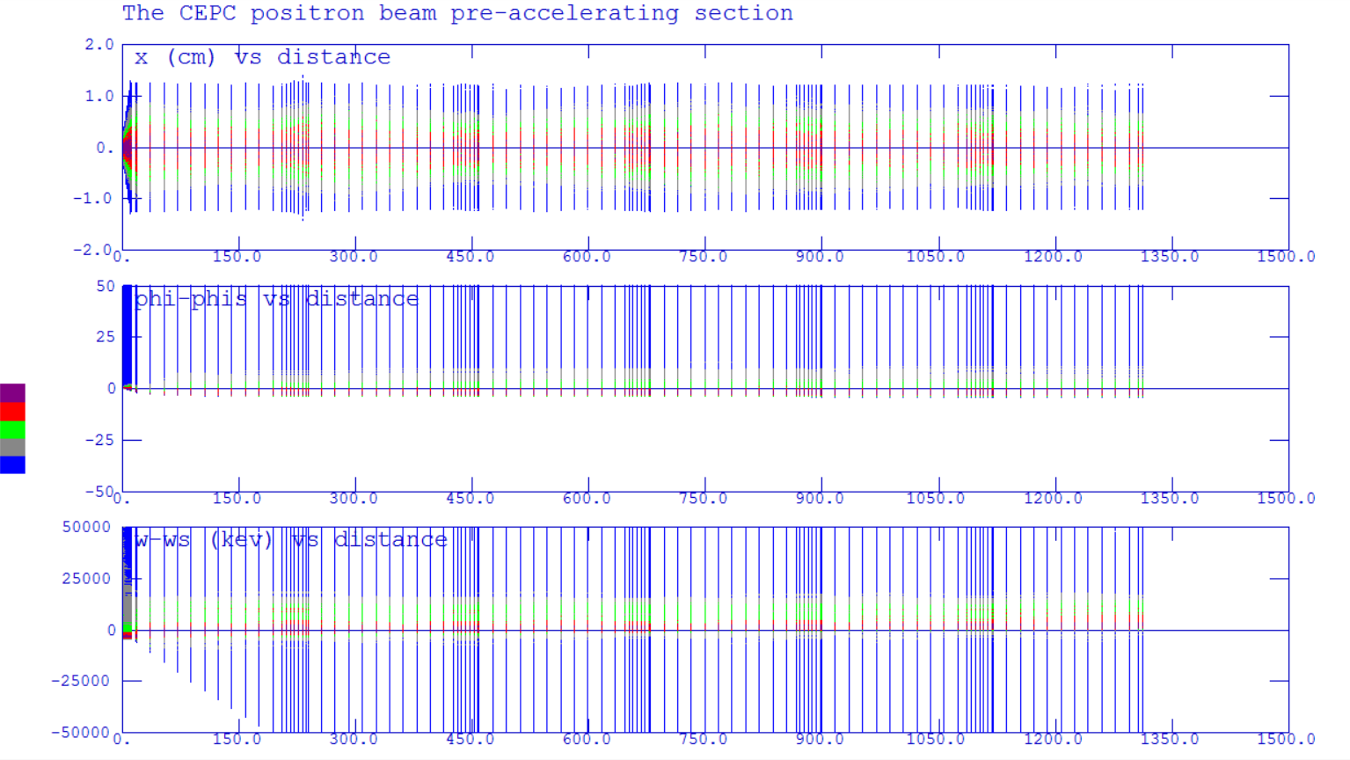
Pre-accelerating section
R=25 mm Eacc=25 MV/m Length=2 m

Slide 15
Pre-accelerating section
R=25 mm Eacc=25 MV/m Length=2 m
Ne+/Ne-=0.5

