Slide 1
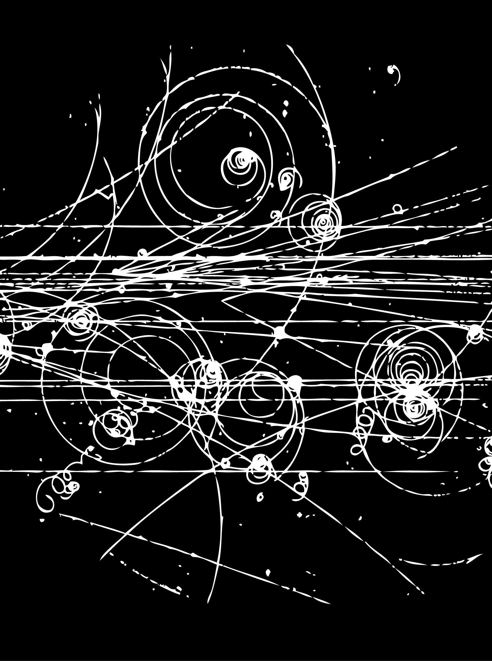
Hadron Spectroscopy
Lecture 2
Stephen Lars Olsen
Institute for Basic Science (KOREA)
University of the Chinese Academy of Science
Weihai August 16-19, 2018

Slide 2
Summary (lecture 1)
Experiments showed that the spin and parity of the π-, K- and η- mesons are all J^{P}=0⁻.
A matching set of meson resonances with J^{P}=1⁻., the ρ-, K*- and
ω-mesons, were found in bubble chamber experiments.
A set of spin=3/2 baryon resonances, the Δ(1232), Y*(1385) (now called the Σ(1385)) and Ξ(1530) were also discovered.
Mesons come in octets; baryons come in octets and decuplets.
Gell-Mann and Nee’man identified the octets and decuplets as representations of the SU(3) symmetry group.
The Okubo - Gell-Mann model for SU(3) breaking predicted an Ω⁻ mass of ≈1863 MeV. Brookhaven found it with m _{Ω−} =1872 MeV.
The φ(1020) meson was found at Brookhaven. For some unknown reason, its decay width to K⁺K⁻ was enhanced & to π⁺π⁻π⁰ was suppressed

Slide 3
some comments on yesterday’s lecture

Slide 4
spin of the ρ meson
my slide was correct

Slide 5

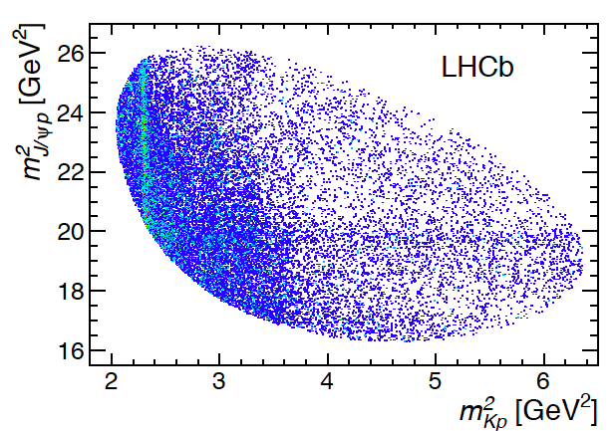
Dalitz Plot usefulness for n_{dof}>2 reactions
3 spin states
2 spin states
3
P_{c}

Slide 6
discovery of B⁰-B⁰ mixing
_

Slide 7
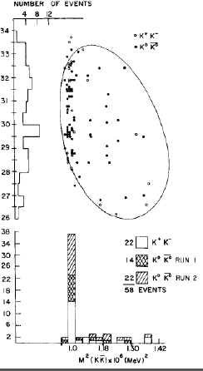
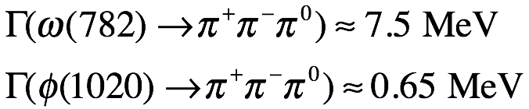
back to φ(1020) mesons that don’t like to decay to π⁺π⁻π⁰
φ has more phase space
what’s the difference between
the ω(782) and the φ(1020)?

Slide 8
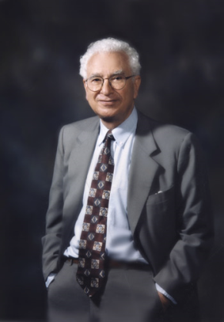

“totalitarian” principle
极权主义
What isn’t forbidden,
is mandatory
Gell-Mann
What enhances φ→K⁺K⁻ &
suppresses φ→π⁺π⁻π⁰ ?

Slide 9
early attempts to identify hadron constituents

Slide 10
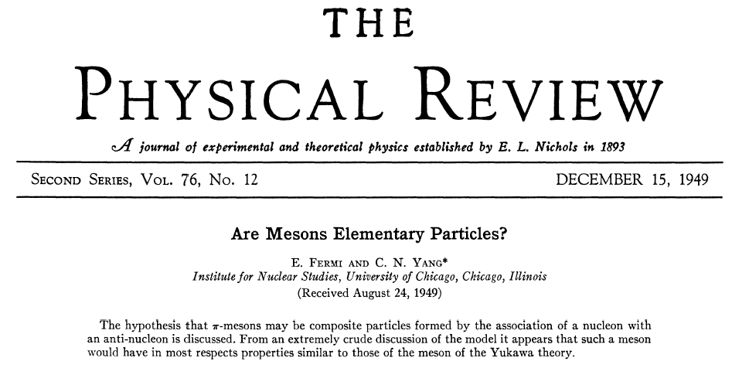
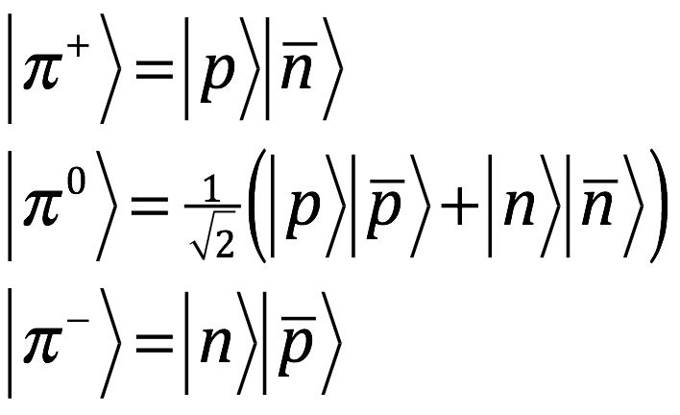
1st attempt to identify hadron constituents: Fermi-Yang
Fermi & Yang in 1949
(7 years before p discovery):
if NN potential is attractive, N & N
could bind to form a π-meson.
pg 1739

Slide 11
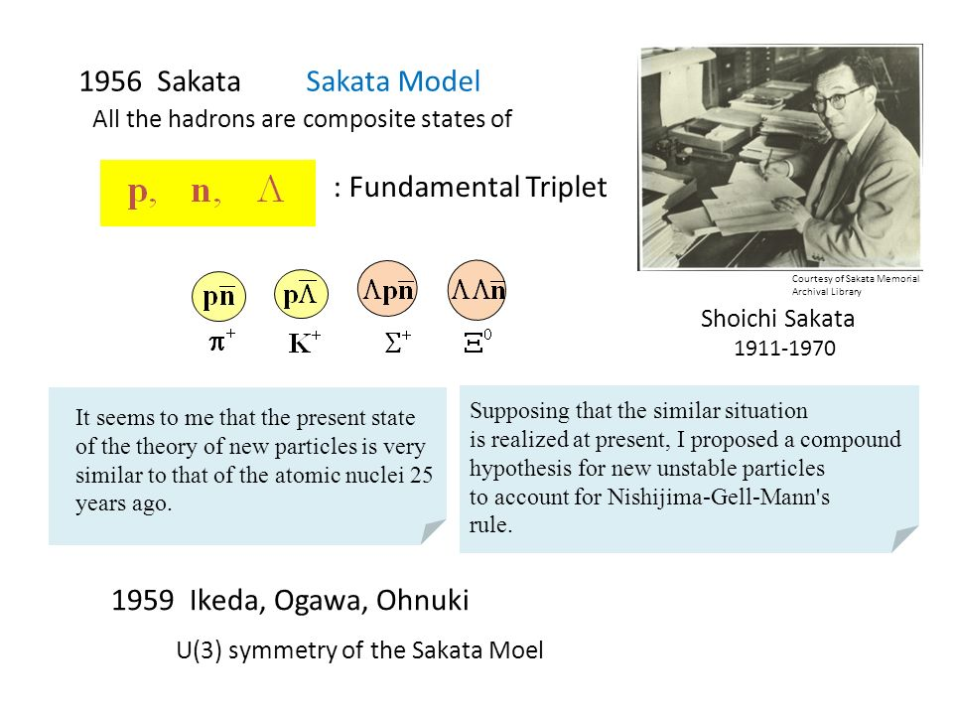
2nd attempt to identify hadron constituents: Sakata

Slide 12
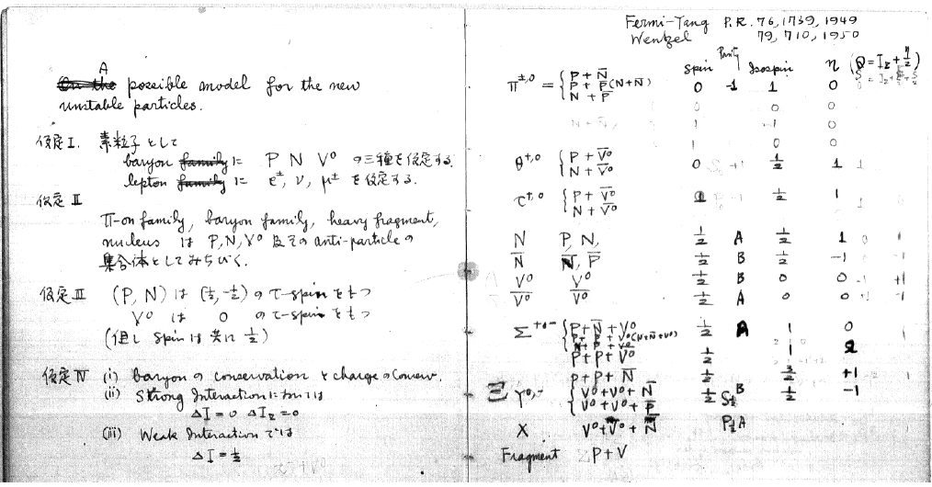
Sakata’s Notebook
Fermi-Yang paper
prominently cited
Sakata calls the Λ⁰ and the K mesons by their old names: V⁰, θ^{+,}0 and τ^{+,0}

Slide 13
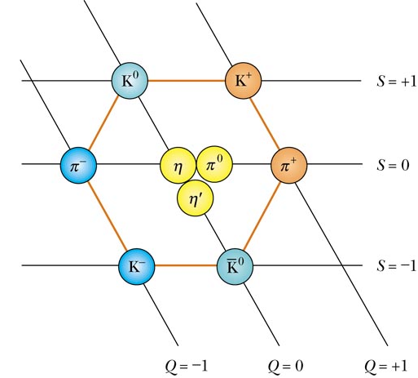
Sakata model produces meson octets
J^{P}=0⁻ meson octet
Y
Y
nΛ
pΛ
_
_
np
nn±pp
pn
_
_
_
_
I₃
I₃
Λn
nΛ
_
_

Slide 14
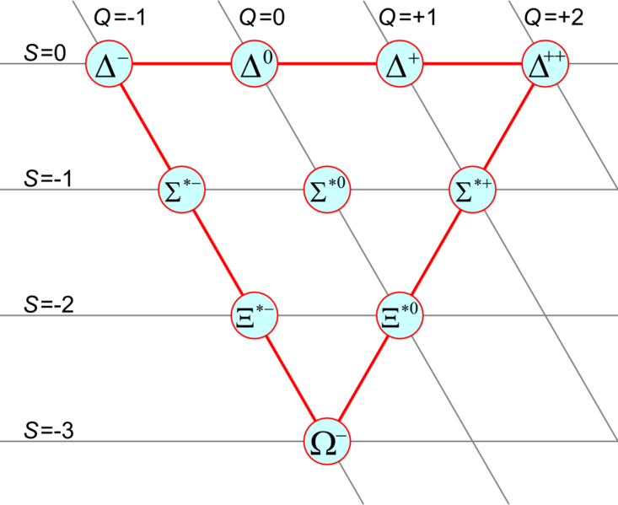
But has problems with the Decuplet
Sakata’s decuplet
Q=-1
Q=0
Q=+1
Q=+2
_
_
_
_
ppp
npn
nnn
pnp
_
ppn
nnp
_
_
nnΛ
npΛ
_
pnΛ
_
ppΛ
_
ΛpΛ
ΛnΛ
_
_
???
mass splitting is uniform and
≈m_{Λ}-m_{N}=175 MeV, not so bad
S=-3 requires ΛΛΛ
but ΛΛΛ has B=3 &Q=0

Slide 15
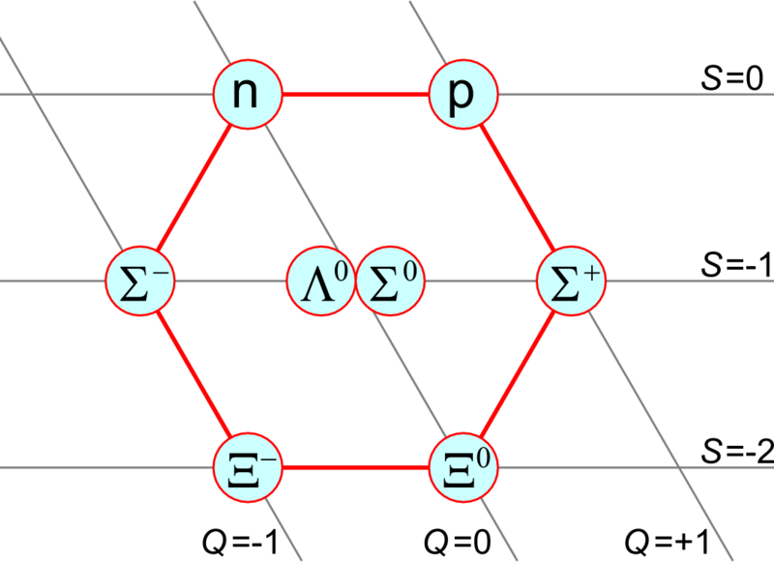
Sakata’s baryon octet is also peculiar
Sakata’s baryon octet
Q=0
Q=+1
multiple nucleon
states
_
_
_
_
nnn
ppp
S=0
ppn
nnp
_
_
npΛ
_
pnΛ
S=-1
_
nnΛ
_
ppΛ
ΛpΛ
ΛnΛ
S=-2
_
_

Slide 16
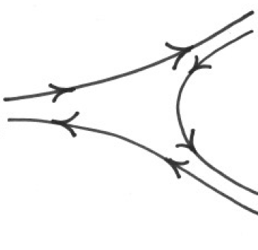
But Sakata can explains why φ→K⁺K⁻ and ω→π⁺π⁻π⁰
π⁰
nn
_
ρ⁻
np
np
_
_
π⁻
ω
for φ→π⁺π⁻π⁰ , the initial Λ and Λ
have to somehow disappear
_
nn
_
Λp
K⁻
_
φ
pn
_
ΛΛ
_
π⁺
pΛ
K⁺
_

Slide 17
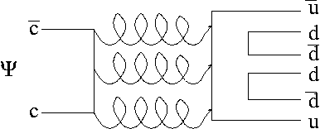
OZI suppression in the Sakata model
initial state
initial state
p
π⁺
Λ
n
_
n
π⁰
φ
n
_
n
π⁻
Λ
_
p
_
processes in which there are no constituent lines
connecting the initial &final states are suppressed

Slide 18
Comments on the Sakata model
It reproduces the meson octets
it can explain the φ-ω puzzle
It can produce baryon octets and decuplets, but with
an S=-3 state with B=3 & charge shifted by ΔQ=+1
It treats the p. n and Λ as special, for no obvious reason
It contains some truth but it is not the whole story

Slide 19
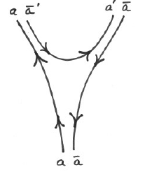
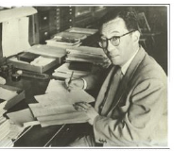
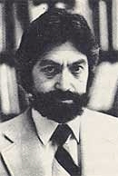
Quarks (Aces?)
SU(3)-group
structure
“Quarks”
ω-φ puzzle
“Aces
Sakata
Gell-Mann
Zwieg
B = 1
B = 1/3
n
p
d^{-1/3}
u^{2/3}
Y=1
Y=+1/3
Λ
Y=-0
s^{-1/3}
λ^{-1/3}
Y=-2/3
Q =-0
Q =+1
Fractional
charges!!
Q =-1/3
Q =+2/3

Slide 20
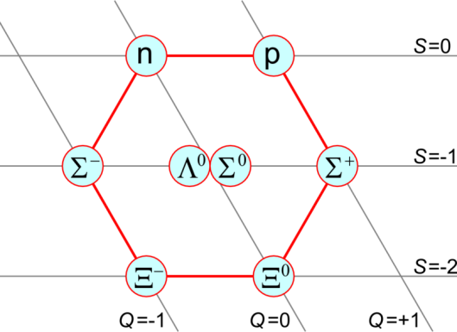
1964: triplet = the most fundamental representation of SU(3)
B = 1/3
Y=+1
n^{-1/3}
p^{-2/3}
Y=+1/3
Y=0
λ^{-1/3}
Y=-2/3
Y=-1
Fractional
charges!!
Q =-1/3
Q =+2/3
Y=-2
“Quarks”
Gell-Mann
“Aces”
Zwieg

Slide 21
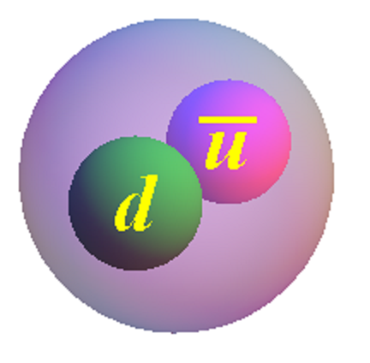
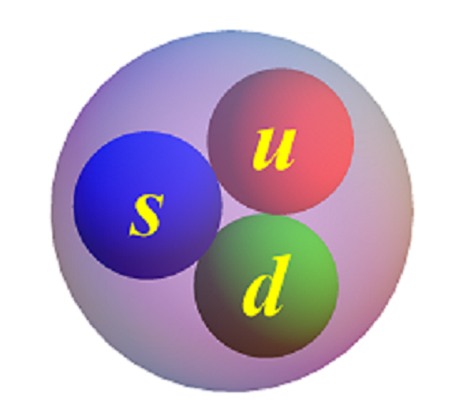
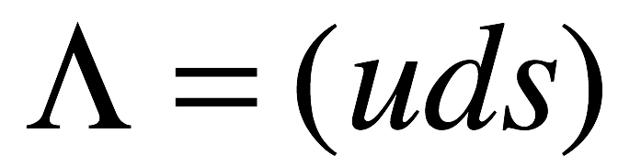
Textbooks: Quark-Parton-Model
mesons = quark-antiquark
baryons = quark-quark-quark
(qq)
(qqq)
_

Slide 22
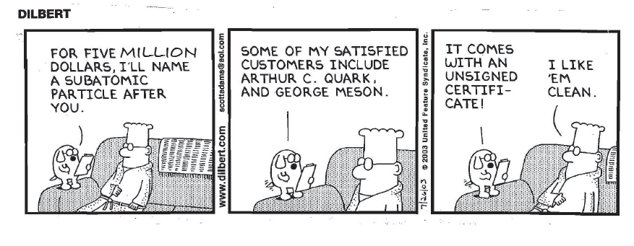
Fabulously successful
Quarks are probably the most
well known particle physics quantity
among the general public
Google Search: quark: 25,500,000 results
Yao Ming:
17,300,000 results

Slide 23
Quarks & Antiquarks in I_{z}-Y space
Y
Y
_
s
d
_
u
I_{z}
I_{z}
_
_
u
d
s
I_{z=} z component of Isospin
Y=hypercharge (=Baryon# + Strangeness)
quarks have Baryon#=⅓

Slide 24
Make mesons from quark-antiquark
_
_
_
us
ds
s
d
_
u
_
dd
_
_
_
uu
ud
du
u
d
_
ss
s
_
_
sd
su
_
Q=electric-charge (=I_{z}+Y/2)
9 states:
SU(3) singlet
+ SU(3) octet

Slide 25

Ground state mesons
J^{P}=0⁻
J^{P}=1⁻
498
494
892
896
K*⁰
K*⁺
548
135
776
783
776
776
139
139
ρ⁻
ω
ρ⁰
ρ⁺
958
φ
1020
_
494
498
K*⁻
K*⁰
892
896
(π⁺,π⁰,π⁻)=lightest
(ρ⁺,ρ⁰,ρ⁻)=lightest
no s-quarks
no s-quarks
n_{r}=0
n_{r}=0
S-wave
S-wave

Slide 26
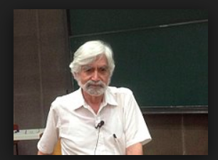
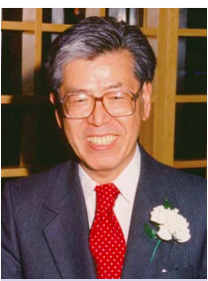
OZI suppression in the quark model
initial state
final state
George Zweig
u
π⁺
s
d
_
d
π⁰
φ
d
_
d
π⁻
s
_
u
Susumu Okubo
_
processes in which there are no constituent
quark lines that connect the initial and final
states are suppressed
Jugoro Iizuka

Slide 27
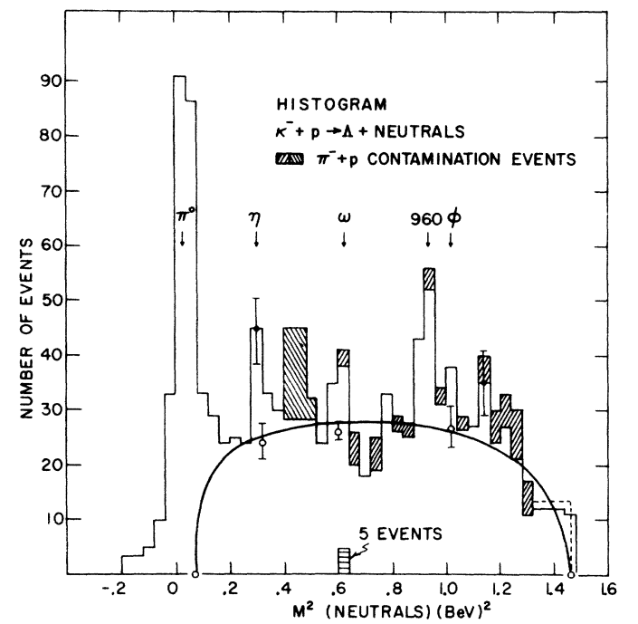
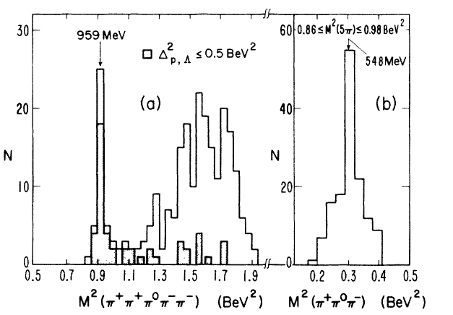

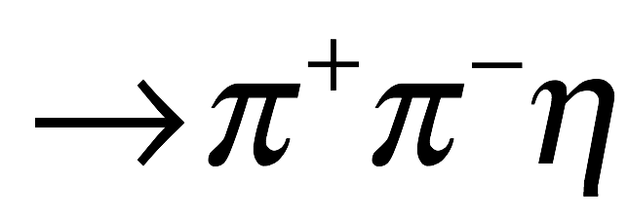
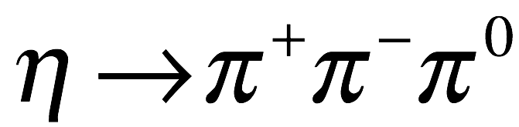
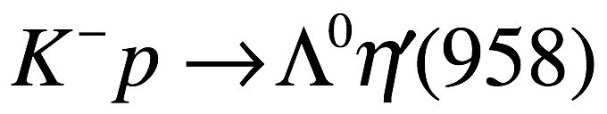
Discovery of the η’ meson
Phys.Rev.Lett. 12, 527 (1964)
Phys.Rev.Lett. 12, 546 (1964)
Brookhaven 80” BC
Berkeley 72” BC
|
M=957.8 ±1 MeV Γ=0.20 ±0.01 MeV J^{P}=0⁻

Slide 28
meson “nonet” = octet + singlet
J^{P}=0⁻ meson octet
J^{P}=0⁻ meson singlet
Y
Y
I₃
η₈
η₁
I₃
the η₈ and η₁ differ only
by SU(3) quantum numbers
→ they mix!

Slide 29
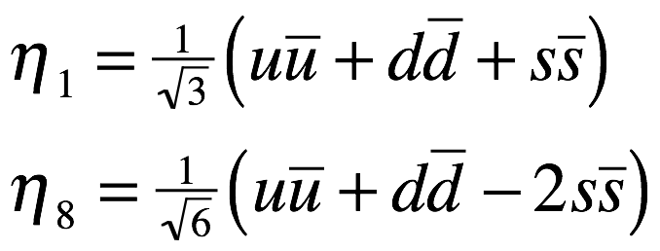
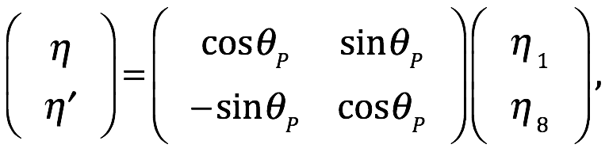
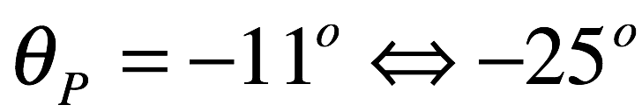
η-η’mixing
SU(3) has two η-mesons, an “octet” η₈, and a singlet η₁, where:
However, SU(3) is a broken symmetry, so η₁ an η₈ “mix”. Thus
the physical η and η’ mesons are each mixtures of η₁ and η₈ :
where θ_{P} is the “pseudoscalar mixing angle.” The range of
of allowed values is:
_
_
_
For θ_{P}=-9.7º, the η & η’ have same ss and (uu+dd)/√2 content
(but with opposite relative sign).

Slide 30
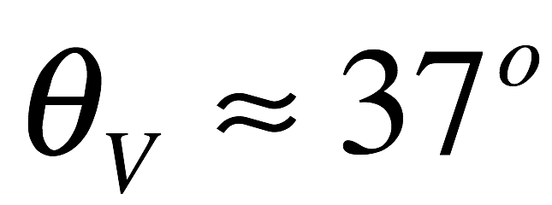
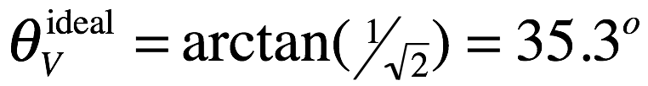
ω-φ mixing
The ω and φ also mix, but in this case θ_{V}, the “vector mixing
angle” is large and positive:
this is very close to the “ideal” mixing angle
_
in which case the φ-meson would be 100% ss while the
ω-meson would be 100% (uu+dd)/√2. In fact the ss content
of the ω is about 3% of (uu+dd)/√2.
_
_
_
_
_

Slide 31
How about the baryons=qqq model?

Slide 32
Make baryons from 3 quarks
duu
uuu
d
u
d
u
d
u
s
uus
s
s
HW: Finish the procedure

Slide 33
Answer
ddd
dud
uud
uuu
dud
uud
sdd
sud
suu
sdd
sud
suu
sud
ssd
ssd
ssu
ssu
sss
1 SU(3) decuplet
+2 SU(3) octets
+1 SU(3) singlet
27 states:

Slide 34
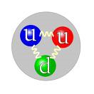
Ground state Baryons
939
938
M=1232 MeV
1115
M=1385 MeV
1189
1192
1197
M=1533 MeV
1321
1315
M=1672 MeV
J^{P}=1/2⁺
J^{P}=3/2⁺
all S-waves
all n_{r}=0
all n_{r}=0
34
all S-waves

Slide 35
How about excited mesons & baryons?

Slide 36
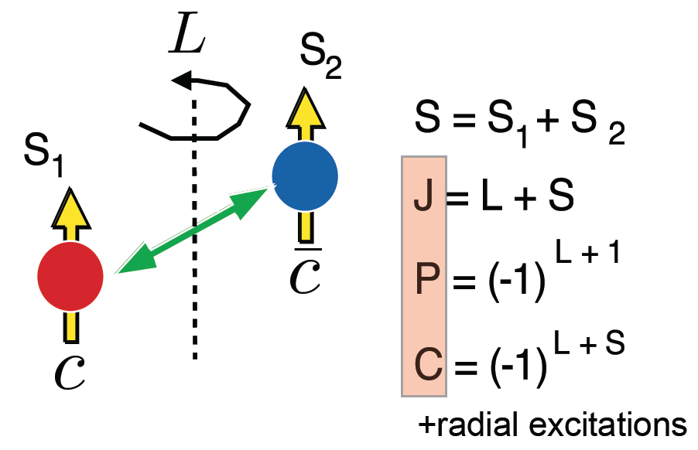
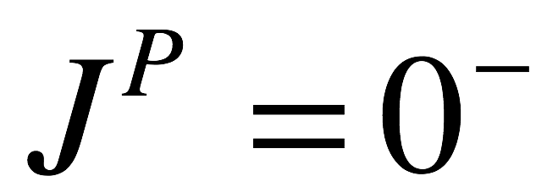
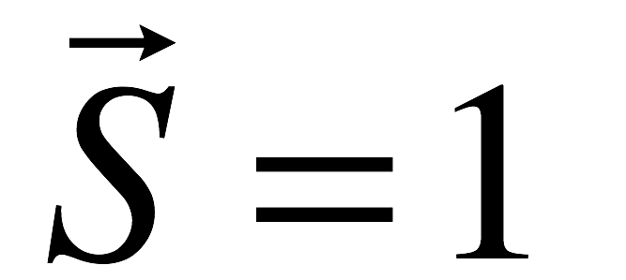
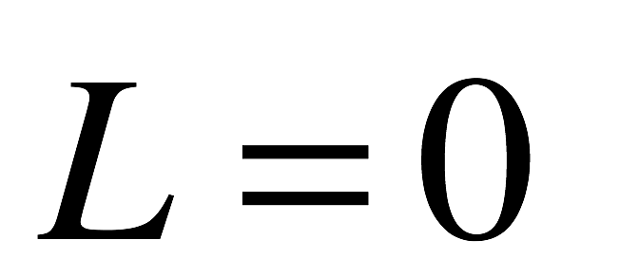
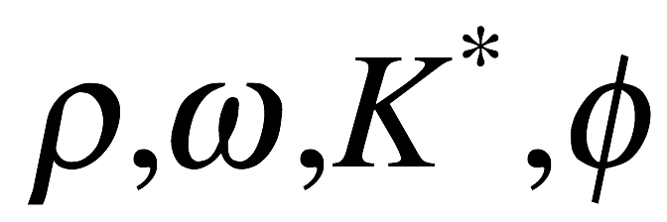
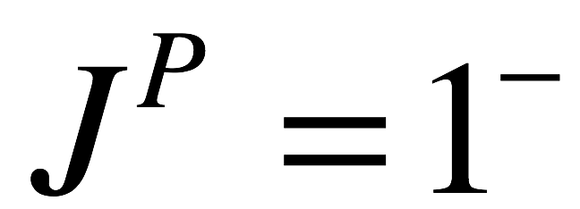
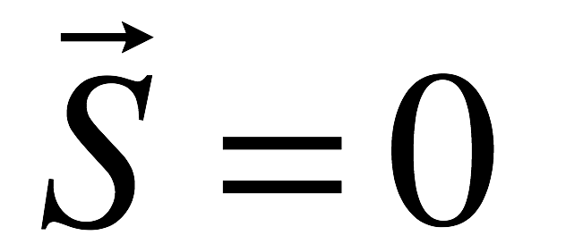
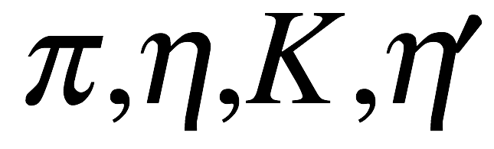
J^{PC} quantum numbers of qq mesons
_
_
→
→
→
q
→
→
→
q
if q & q are the
same flavor
_
pseudoscalars
vectors

Slide 37
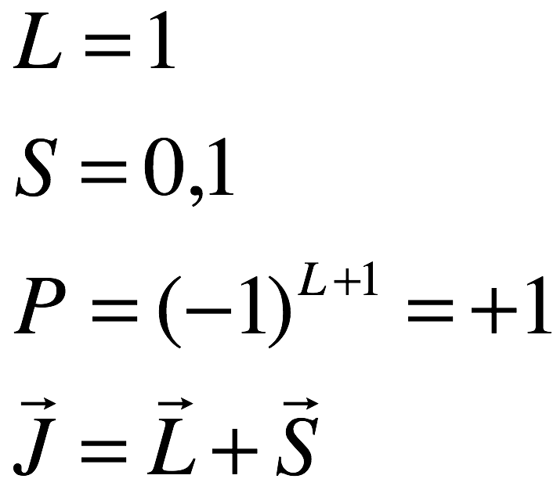
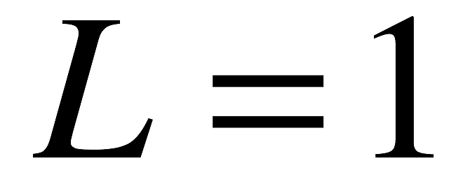
What about P-wave mesons?
S=1
S=0
J=2
J=1
J=1
J=0
triplet
singlet

Slide 38
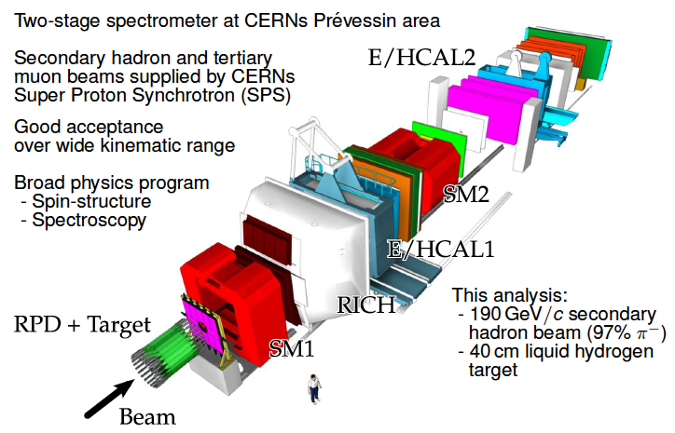
COMPASS Experiment at CERN

Slide 39
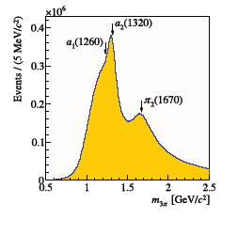
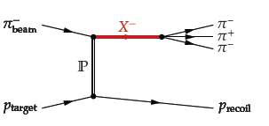
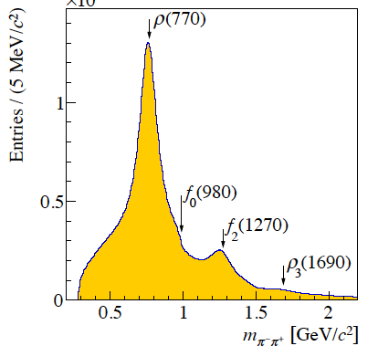
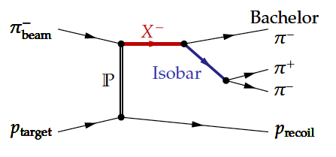
P-wave mesons via π⁻p→π⁺π⁻π⁻p
5×10⁷ evts
Mostly 2-body process
L
ρ,f₀,f₂,…
Phys.Rev.Lett. 115,082001 (2015)

Slide 40

The J^{P}=1⁺ a₁(1260)→π⁻ρ⁰ meson
J^{P}=1⁺
L=0
ρ
/////
a₁(1260)

Slide 41

The BESII experiment
(not BESIII)

Slide 42



J/ψ→π⁺π⁻ω at BESII
f₂(1270)
BESII
σ
M²(π⁺π⁻)
b₁(1235)
Phys.Lett. B598, 149 (2004)

Slide 43




The J^{P}=1⁺ b₁(1235)→π⁻ω meson
J^{P}=1⁺
b₁(1235)
ω

Slide 44

Difference between a₁(1260) & b₁(1235)
both have J^{P}=1⁺; both have Ispin=1
C-parity of I₃=0
neutral meson
=-1 for I=1
L=1
a₂
a₁
b₁
a₀

Slide 45

Other 1⁺ mesons from BESII
f₁(1285) and η(1420)
η(1440) ⎝γρ
I= 0; J^{P}=1⁺
I= 0; J^{P}=0⁻
f₁(1285) ⎝γρ
1⁺
0⁻
J/ψ ⎝γγπ⁺π⁻
M(γπ⁺π⁻⁾

Slide 46



1⁺ mesons with |S|=1
K₁(1270) = cosθ_{K} K_{1A} + sinθ_{K} K_{1B}
K₁(1400) = cosθ_{K} K_{1B} – sinθ_{K} K_{1A}
The K₁(1270) & K₁(1400)
K₁(1270) ⎝ Kπ⁺π⁻
B ➔ Κπ⁺π⁻J/ψ
K₁(1400) ⎝ Kπ⁺π⁻
M²(Κπ⁻)
M²(π⁺π⁻)
H. Guler et al. (Belle) PRD 83, 032005 (2011)

Slide 47
Axial Vector (J^{P}=1⁺) octets
J^{P}=1⁺; G_{a1}=-1
J^{P}=1⁺; G_{b1}=+1
Y
Y
o
+
o
+
K_{1A}
K_{1A}
K_{1B}
K_{1B}
-
o
o
+
-
o
o
+
a₁
f₁
a₁
a₁
b₁
h₁
b₁
b₁
I₃
I₃
-
o
-
o
K_{1A}
K_{1A}
K_{1B}
K_{1B}
_
_

Slide 48


What are the K_{1A} and K_{1B} mesons?
The K_{1A} mesons are the |S|=1
octet partners of the a₁ & f₁
The K_{1B} mesons are the |S|=1
octet partners of the b₁ & h₁
L=1
L=1
s
these differ by C- and G-parity
s
➔ C- and G-parity do not apply to strange mesons
only SU(3) quantum numbers distinguish
K_{1A} from K_{1B}, but SU(3) is badly broken
➔ K_{1A} and K_{1B} mix
some model-dependent analysis of K_{1A} & K_{1B} masses and decay
widths estimate the ”strange axial-vector mixing angle, θ_{K}, to be:
see, e.g., Eur. Phys. J A28,369 (2006)

Slide 49



K₁(1270) and K₁(1400)
K₁(1400) decays
K₁(1270) decays

Slide 50
the J=0 and J=2 SU(3) partners of the a₁(1270) octet

Slide 51



The J^{P}=2⁺ a₂(1320)→π⁻ρ⁰ meson
J^{P}=2⁺
L=2
ρ
/////
a₂(1320)

Slide 52




two-photon reactions
e⁻
e⁻
sharply peaked at Θ₋=0
Θ₋
Yang’s theorem says that
1^{±+} is not allowed
0^{± +},2^{±+}
Θ₊
e⁺
e⁺
sharply peaked at Θ₊=0
For almost “real” photons, Θ₋ and Θ₊≈0, the scattered e⁻ and e⁺ are very
forward and remain in the beam pipe. The produced particles have a net
transverse momentum of zero. production of 0⁺⁺ and 2⁺⁺ is favored although
0⁻⁺ and 2⁻⁺ are also allowed.

Slide 53


a₀(980) and a₀(1450) ⎝ηπ
γγ➔ηπ⁰ Belle
a₀(980) ⎝ηπ⁰
a₂(1450)
a_{0,2}
⎝ηπ⁰
a₀(1450) ⎝ηπ⁰

Slide 54


γγ→f₂(1270)→π⁺π⁻ / π⁰π⁰
γγ➔π ⁺π⁻ / π⁰π⁰ at Belle
f₂(1270)
f₂
⎝π⁺π⁻ / π⁰π⁰

Slide 55





K₀*(1430)±→K±η’(958)
BESIII
K₀*(1430)
J^{P}=0⁺
Phys.Rev. D89, 074030 (2014)

Slide 56




K₂*(1430)→Kπ
K*₂(1430)
LASS expt (at SLAC)
J^{P}=2⁺
Nucl.Phys. B296, 493 (1988)

Slide 57
The scalar P-wave octet
J^{P}=0⁺
*
K₀(1430)⁰
K₀(1430)⁺
*
a₀(1450)⁰
a₀(1450)⁻
a₀(1450)⁺
f₀(1370)⁰
_
K₀(1430)⁻
*
K₀(1430)⁰
*

Slide 58
The tensor P-wave octet
J^{P}=2⁺
*
K₂(1430)⁰
K₂(1430)⁺
*
a₂(1320)⁰
a₂(1320)⁻
a₂(1320)⁺
f₂(1270)⁰
_
K₂(1430)⁻
*
K₂(1430)⁰
*

Slide 59




Some features of the P-wave states
S-Wave
P-Wave
ΔM ≈ +400~500 MeV
S→P costs about 500MeV
Axial Vector
Scalar
δM ≈ 100~200 MeV
Tensor
splitting between same L
states is ~100MeV

Slide 60
Excited baryons
radial excitation has 2× the energy from addition of one unit of L

Slide 61

ψ’(3686)→ppπ⁰ at BESIII
_
π⁰
Ispin=½ filter
ψ’→ p N*
p
ψ’
N*
_
e⁻
e⁺
I=0
I=½
I(N*) must be ½
_
p
BESIII
Phys.Rev.Lett. 110, 02001 (2013)

Slide 62

Excited nucleon states
½⁺
BESIII
½⁻
½⁻

Slide 63

ψ’(3686)→ΛΣ⁺π⁻ at BESIII
_
π⁻
_
ψ’
Λ
Σ*
e⁻
e⁺
Σ⁺
BESIII
Phys.Rev. D88, 112007 (2013)

Slide 64



Excited Σ states
Σ(1580) 3/2⁻?
BESIII
Σ(1660) ½⁺
Σ(1385) 3/2⁺
Phys.Rev. D88, 112007 (2013)

Slide 65



exicited Ξ states
Ξ(1835) ½⁻?
Ξ(1820)3/2⁻ ?
BESIII
Phys.Rev. D91, 092006 (2015)

Slide 66
Problems with excited Baryons

Slide 67



1st excited nucleon (I=½) state
-- The “Roper” resonance --
N*(1440); J^{P}=½⁺
(Roper Resonance)
L. David Roper’s
MIT PhD Thesis
in 1964
L. D. Roper PRL 12, 340 (1964)

Slide 68
N*(1440) in the qqq model
N*(1440); J^{P}=½⁺ ➔ same spin-parity as proton
all n_{r}=1
n_{r}=2
all S-waves
all S-waves
proton
N*(1440)
Minimal excitation that conserves J^{P} : n_{r}=0 → n_{r}=1

Slide 69




1st excited Λ predicted in 1959
--pre SU(3); pre quarks--
1959!!
pg 425
S.F. Tuan
R. Dalitz
1925-2006
Analytic continuation of KN data → below KN threshold
KN threshold
Predicted a πΣ
resonance @ 1405
1405 MeV

Slide 70




Λ(1405) discovered in 1961
pg 698
m_{K}+m_{N} threshold
J^{P}=½⁻
Isospin=0
M(πΣ)⁰
M(πΣ)±

Slide 71
Λ(1405) in the qqq model
Λ(1405); J^{P}=½⁻ ➔ same spin, opposite-parity as Λ
S
S
all n_{r}=1
all n_{r}=1
all S-waves
one P-wave
Λ
Λ(1405)
Minimal excitation that conserves J^{P}: L=0 → L=1

Slide 72
Λ(1405) discovered in 1961
pg 698
m_{K}+m_{N} threshold
J^{P}=½⁻
Isospin=0
M(πΣ)⁰
M(πΣ)±

Slide 73
Λ(1405) in the qqq model
Λ(1405); J^{P}=½⁻ ➔ same spin, opposite-parity as Λ
S
S
all n_{r}=1
all n_{r}=1
all S-waves
one P-wave
Λ
Λ(1405)
Minimal excitation that conserves J^{P}: L=0 → L=1

Slide 74
excited baryon octets?
proton
J^{P}=1/2⁺
all S-waves
all n_{r}=1
δL=1
δn_{r}=1
J^{P}=1/2⁻
J^{P}=1/2⁺
all n_{r}=1
all S-wave
one P-wave
one n_{r}=2
(δL=1)
(δn_{r}=1)
1/2⁻ | 1/2⁺
N*(1535) | N*(1440)
Λ(1405) | Λ(1620)
Σ(1580) | Σ(1660)
Ξ(?) | Ξ(?)
ΔE=595 MeV
???
ΔE=500 MeV
???
???
ΔE for δn_{r}=1 should be 2x ΔE for δL=1

Slide 75

“Missing” baryon states
Eur.Phys.J. A!0, 395 (2010)
Predicted I=1/2, S=0 states
Observed:
uncertainty
***
quality

Slide 76
Problems with mesons

Slide 77

problem with low-mass scalar mesons
the “light” scalar-meson nonet
J^{P}=0⁺
800
800
κ⁰
κ⁺
The “light” scalar mesons
980
a₀⁻
980
f₀
a₀⁰
a₀⁺
980
σ
600
_
800
κ⁻
κ⁰
800

Slide 78

The f₀(600) (the “σ”)
From a Partial Wave Analysis of J/ψ→ωπ⁺π⁻
BESII PLB 598, 149 (2004)
J/ψ→ωσ
J/ψ→f₂ω
↳ππ
↳ππ
↳ππ
↳ππ
J/ψ→b₁π
↳ωπ
↳ωπ
M(ππ)
M(ππ)
σ pole position: (541±39) – i(252±42) MeV

Slide 79

K₀(800)± (the “κ±”)
From a Partial Wave Analysis of J/ψ→K⁺π⁰ K_{S}π⁻
with either M(K⁺π⁰) or M(K_{S}π⁻) = M(K*±) ± 80 MeV
BESII PLB 693, 88 (2010)
J/ψ→K*K*
_
J/ψ→K*K₂*
_
J/ψ→KK₁(1270)
_
↳Kππ
J/ψ→K*κ
1⁻⁻
2⁺⁺
↳Kπ
0⁺⁺
κ pole position: (849±77⁺¹⁸₋₁₄) – i(256±40⁺⁴⁶₋₂₂) MeV
Bf(J/ψ→K*⁺κ⁻) = 10 ± 3 x 10⁻⁴

Slide 80


Signals for f₀(980)⎝ππ &
⎝K⁺K⁻
BESII PLB 607, 243 (2005)
f’₂(1525)+f₀(1710) ⎝ Κ⁺Κ⁻
f₀(980) ⎝ Κ⁺Κ⁻
strong f₀(980)
coupling to KK
_
g_{KK}
g_{ππ}
f₀(980) ⎝π⁺π⁻
=4.2±0.3
f₂(1270)+f₀(1370) ⎝π⁺π⁻
f₀(1790) ⎝π⁺π⁻
Bf(J/ψ→φf₀(980) = 0.32±0.09 x 10⁻³

Slide 81


Signal for a₀(980)➔ηπ
Signal for a₀(980)⎝K⁺K⁻
Belle Collab:
PRD 80, 032001 (2009)
γγ➔ηπ⁰ Belle
a₀
⎝ηπ
Crystal Barrel Collab: PRD 57, 3860 (1998)
a₀(980) ⎝ Κ±Κ_{Λ}
a₀(980) ⎝ηπ⁰
a₀(1450) ⁰ηπ
strong a₀(980)
coupling to KK
g_{KK}
g_{ηπ}
=1.03±0.14

Slide 82
light scalar nonet masses are inverted
scalars
pseudoscalars
typical
unique
Also:
No “light” J^{P}=1⁺ and 2⁺⁺ partner nonets in the same mass range.
In qq meson nonets, the I=1 mesons have no s-quarks and are the
lightest. However, the a₀(980) I=1 mesons are the nonet’s heaviest.
The a₀(980) triplet has strong couplings to KK.
m(f₀(980))~m(a₀(980)) implies “ideal” mixing & small s-quark content in f₀(980).
_
_
_
_
strong KK couplings of the a₀(980) & f₀(980) violate OZI-rule for qq mesons

Slide 83



Problems with mesons = qq model
_
pseudoscalars
vectors
scalars
(a₀⁺,a₀⁰,a₀⁻)=heaviest
OK
OK
NG!

Slide 84
Some fundamental problems with the quark model:
Individual quarks are not seen
why only qqq and qq combinations?
violation of spin-statistics theorem?

Slide 85
Are quarks real objects? or just mathematical mnemonics?
助记符
Are quarks actually real objects?" Gell-Mann asked.
"My experimental friends are making a search for them
in all sorts of places -- in high-energy cosmic ray reactions
and elsewhere. A quark, being fractionally charged,
cannot decay into anything but a fractionally charged
object because of the conservation law of electric charge.
Finally, you get to the lowest state that is fractionally
charged, and it can't decay. So if real quarks exist, there is
an absolutely stable quark. Therefore, if any were ever
made, some are lying around the earth."
But since no one has yet found a quark, Gell-Mann
concluded that we must face the likelihood that quarks are
not real.

Slide 86


The Nobel Prize in Physics 1969
"for his contributions and discoveries concerning the
classification of elementary particles and their interactions"
Nobel citation:
This classification of the elementary particles and their interaction
discovered by Gell-Mann has turned out to applicable to all strongly
interacting particles found later and these are practically all particles
discovered after 1953. His discovery is therefore fundamental in
elementary particle physics.
No mention of quarks; no prizes for Zweig, Sakata, or Fermi-Yang.

Slide 87


Ω⁻
s^{-1/3}
s^{-1/3}
s^{-1/3}
three s-quarks
in the same
quantum state
Das ist verboten!!

Slide 88


The strong interaction “charge” of each quark comes in 3 different varieties
Y. Nambu
M.-Y. Han
Ω⁻
s^{-1/3}
s^{-1/3}
1
2
s^{-1/3}
3
the 3 s^{-1/3} quarks in the
Ω⁻ have different strong
charges & evade Pauli

Slide 89
Attractive configurations
Baryons:
Mesons:
ε_{ijk} e_{i}e_{j}e_{k}
ε_{ijk}= 1 for i≠j≠k
=0 otherwise
i
j
δ_{ij} e_{i}
e_{j}
i
j
k
δ_{ij} =1 for i=j
=0 otherwise
same as the rules for combining colors to get white:
add 3 primary colors or add color+complementary color
quarks: e_{i}e_{j}e_{k} ➔ color charges
antiquarks: ➔ anticolor charges
e_{i}
e_{j}
e_{k}
ε_{ijk} e_{i}e_{j}e_{k}
δ_{ij} e_{i}
e_{j}

Slide 90


QPM Superseded by QCD in the 1970s: observed particles are color singlets
color + complementary color ➔
3 primary colors ➔
white
white
blue-yellow
green-magenta
red-cyan
Λ= (uds)
Baryons are red-blue-green triplets
Mesons are color-anticolorpairs
90

Slide 91
A few remarks about QCD

Slide 92

Quantum Chromodynamics
e_{r}
e_{b}
e_{g}
QED: scalar charge e
QCD triplet charge:
e_{j}
α_{QED}
Non-Abelian
extension of QED
α_{s}
g_{ij}
single
photon
eight
“gluons”
e_{i}

Slide 93

Quantum Chromodynamics
e_{r}
e_{b}
e_{g}
QED: scalar charge e
QCD triplet charge:
e_{j}
α_{QED}
Non-Abelian
extension of QED
α_{s}
g_{ij}
single
photon
eight
“gluons”
e_{i}
QED gauge transform
1 vector
field
(photon)

Slide 94

Quantum Chromodynamics
e_{r}
e_{b}
e_{g}
QED: scalar charge e
QCD triplet charge:
e_{j}
α_{QED}
Non-Abelian
extension of QED
α_{s}
g_{ij}
single
photon
eight
“gluons”
e_{i}
QED gauge transform
QCD gauge transform
1 vector
field
(photon)
eight 3x3 SU(3)
matrices
8 vector
fields
(gluons)

Slide 95
Quantum Chromodynamics
e_{r}
e_{b}
e_{g}
QED: scalar charge e
QCD triplet charge:
e_{j}
α_{QED}
Non-Abelian
extension of QED
α_{s}
g_{ij}
single
photon
eight
“gluons”
e_{i}
QED gauge transform
QCD gauge transform
QED photons are
electrically neutral
QCD gluons have
color charges
1 vector
field
(photon)
eight 3x3 SU(3)
matrices
8 vector
fields
(gluons)

Slide 96



Vacuum polarization QED vs QCD
QED
QCD
2n_{f}
11C_{A}
in QCD: C_{A}=3, & this dominates
α_{s} increases with distance

Slide 97

QED: photons have no charge
coupling decreases at large distances
QCD: gluons carry color charges
gluons interact with each other
coupling increases at large distances
α
Coupling strengths
distance

Slide 98


Test QCD with 3-jet events
(& deep inelastic scattering)
α_{s}
gluon
rate for 3-jet events should
decrease with E_{cm}

Slide 99

“running” α_{s}
short
distance
Large
distance

Slide 100

“running” α_{s}
short
distance
Large
distance
2004 Nobel prize

Slide 101
The QCD particle spectrum hasn’t been computed from 1st principles
Quark-binding into
hadrons occurs here
(Q≈m_{π}≈140 MeV)
α_{s} (m_{π}) ~ 0.5
perturbation theory can’t be used
Theorists make “QCD-motivated” models
that must be tested by experiment

Slide 102
Summary (lecture 2)
The fractionally charged quark model explains the patterns
and properties of the ground state mesons and baryons.
The qq=mesons and qqq=baryon prescriptions work well
for the lowest-lying mesons & baryons, but fail otherwise
- the mass hierarchy of the lowest-lying scalar mesons
is opposite to expectations for qq=mesons
- The masses of the N*(1440), the 1st excited state of the
nucleon, and the Λ(1405), the lowest excited sate of the Λ,
disagree with QM predictions for qqq=baryons
The quark model seriously violates the Pauli Principle
Quark model is superseded by Quantum ChromoDynamics
Quarks come in 3 colors; color force is mediated by 8 gluons
The QCD coupling constant increases at large distances.
Perturbation theory is not applicable at the hadron size scale
_
_
_

Slide 103
Discussion/HW items
Why is φ(1020)→ππ forbidden?
In octet-singlet meson mixing there are two extreme cases:
--in one, called “Ideal mixing,” one of the physical mesons is
purely ss, while the other is purely (uu+dd)/√2.
--in the other extreme, the two physical mesons have equal
ss and (uu+dd)/√2 content, with opposite relative sign.
Show that ideal mixing occurs when the mixing angle θ=35.3º
and the equal ss-content cases occurs when θ=-9.7º.
_
_
_
_
_
_
_

Slide 104
what is this line?

Slide 105
a resonance in the pπ channel would
form a band parallel to this line
3 equal masses
3 unequal masses

