Slide 1
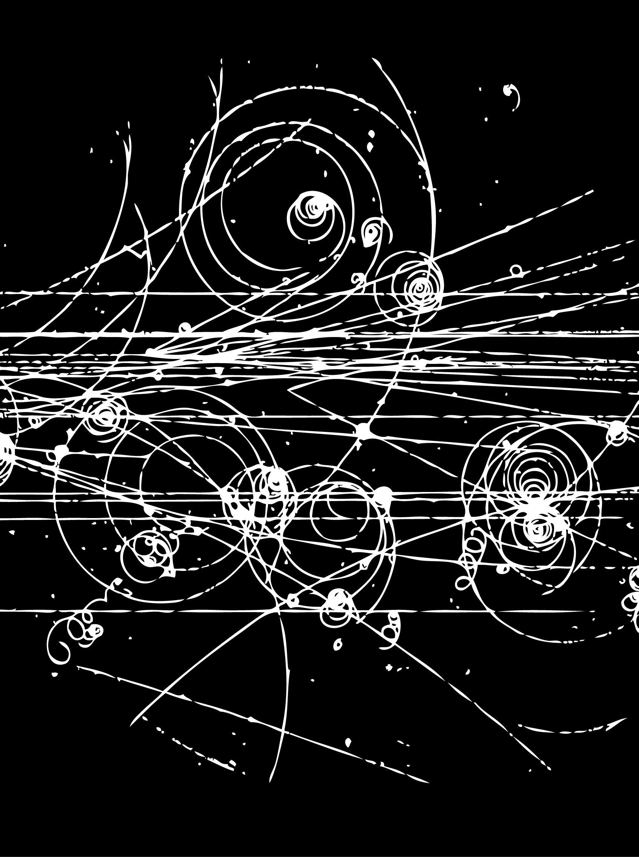
Hadron Spectroscopy
Lecture 3
Stephen Lars Olsen
Institute for Basic Science (KOREA)
University of the Chinese Academy of Science
Weihai August 16-19, 2018

Slide 2
Summary (lecture 2)
The fractionally charged quark model explains the patterns
and properties of the ground state mesons and baryons.
The qq=mesons and qqq=baryon prescriptions work well
for the lowest-lying mesons & baryons, but fail otherwise
- the mass hierarchy of the lowest-lying scalar mesons
is opposite to expectations for qq=mesons
- The masses of the N*(1440), the 1st excited state of the
nucleon, and the Λ(1405), the lowest excited sate of the Λ,
disagree with QM predictions for qqq=baryons
The quark model seriously violates the Pauli Principle
Quark model is superseded by Quantum ChromoDynamics
Quarks come in 3 colors; color force is mediated by 8 gluons
The QCD coupling constant increases at large distances.
Perturbation theory is not applicable at the hadron size scale
_
_

Slide 3
Lecture 3: Quarkonium
-- the simplest hadrons --
Discovery of the J/ψ and charm
Properties of Charmonium
  -- detailed (sorry, but important for BESIII )
A little bit about Bottomonium
>> BESIII’s “bread and butter” (主要的生計來源)

Slide 4
hadrons in QCD
Theory works here
We live here

Slide 5

A prediction of the quark model:
-- pre color --

Slide 6
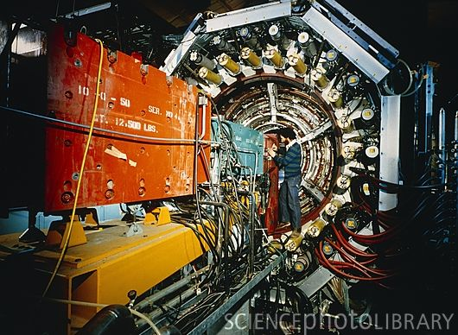
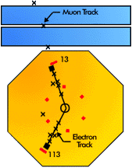
Mark I detector (1974)
At SLAC’s “SPEAR” e⁺e⁻ collider
e⁻
e⁺

Slide 7
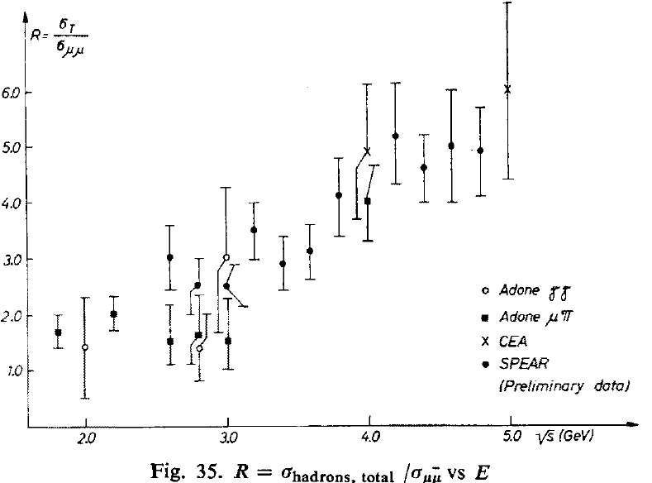
R data in June 1974
hadrons
R
e⁺
E_{cm}
e⁻
Big data fluctuations
around 3.0 GeV
Not even close to 2/3
R= 2/3
(σ≈7 nb)
E_{cm}
Compilation by: L. Paoluzi Acta Physica Polonica B5, 829 (1974)

Slide 8
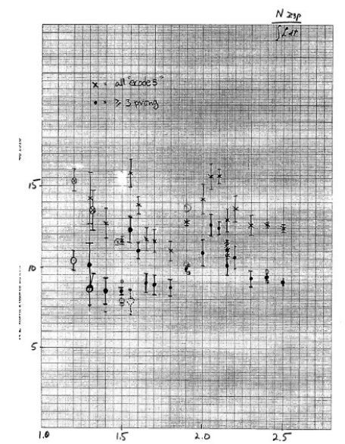

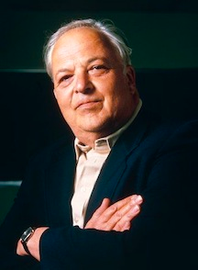
Inconsistent data ?
Let’s do a
careful energy
scan
From the Mark-I
experiment’s
notebook
No. Let’s
go to higher
energy.
Roy Schwitters
-- post-doc --
Burton Richter
- group leader -

Slide 9
OK, do an energy scan, but only for one weekend

Slide 10
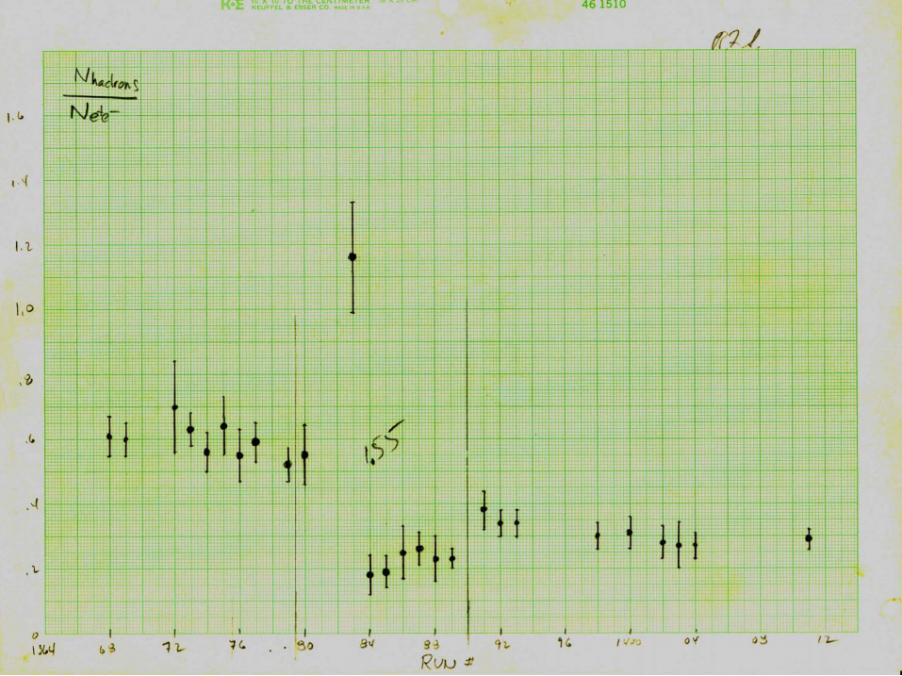
What?
From the Mark-I
experiment’s
notebook

Slide 11
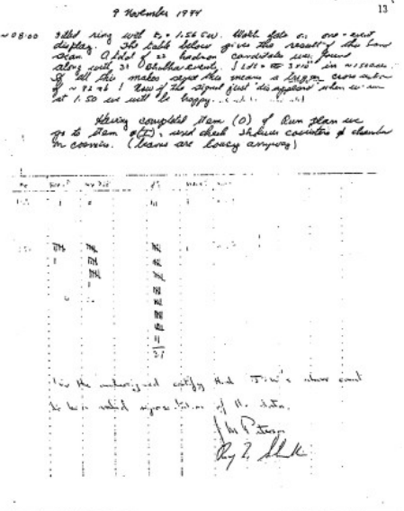
do a careful fine-step energy scan
From the Mark-I
experiment’s
notebook

Slide 12
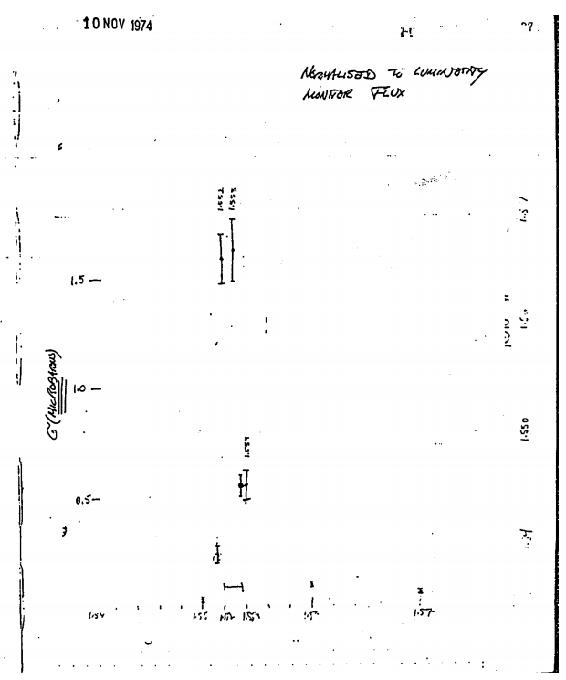
Wow!!
From the Mark-I
experiment’s
notebook
σ≈2μb
σ at nearby energies are
about 7 nb, 300x smaller!

Slide 13
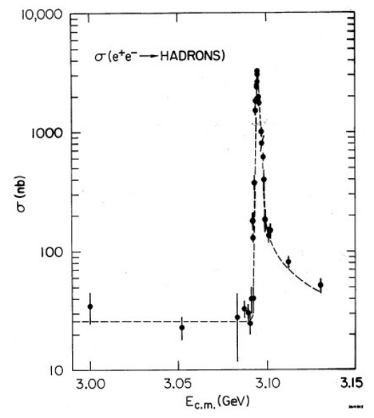
A needle in a haystack!!
ψ
x200
3= number of
quark colors
R=2.2 ≈ 3×2/3
J.E. Augustine et al., PRL 33, 1406 (1974)

Slide 14
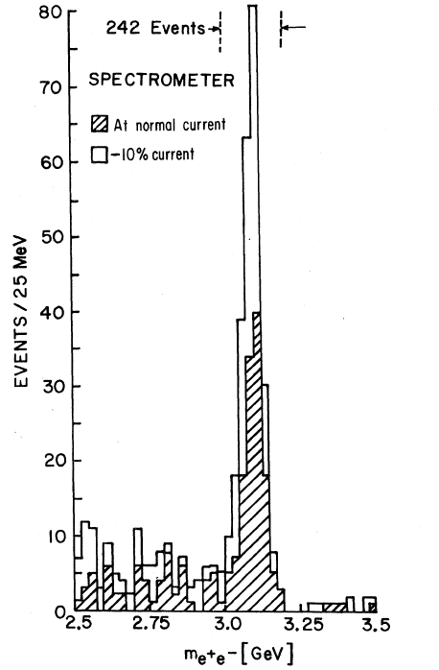
Same time, at Brookhaven
huge 3.1GeV M(e⁺e⁻) peak in pN→e⁺e⁻X
J
M(e⁺e⁻)
J.J. Aubert et al., PRL 33, 1404 (1974)

Slide 15
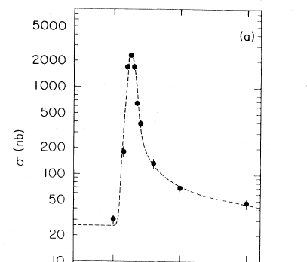

The “J/ψ” meson
SLAC:
Brookhaven:
ψ
J
R=2.2 ≈ 3×2/3
M(e⁺e⁻)
10
J.J. Aubert et al., PRL 33, 1404 (1974)
J.E. Augustine et al., PRL 33, 1406 (1974)

Slide 16
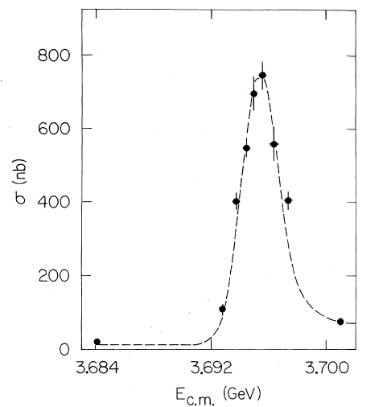
Mark-I: Another peak near 3.69 GeV
ψ’
3.686 GeV
G.S. Abrams et al., PRL 33, 1453 (1974)
← About 2 weeks later

Slide 17
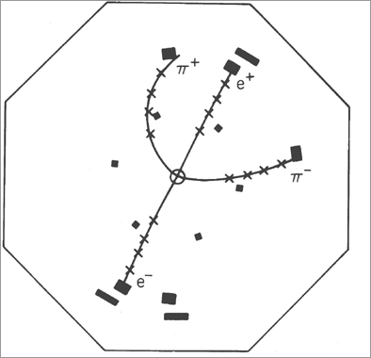
Why is the J/ψ called the J/ψ?
Event in Mark I
ψ’→π⁺π⁻ J/ψ
→e⁺e⁻
Mark-I detector

Slide 18
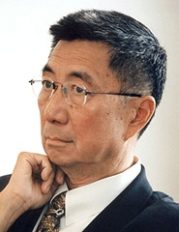

Why is the J/ψ called the J/ψ?
Event in Mark I
Group leader of the
Brookhaven expt
ψ’→π⁺π⁻ J/ψ
→e⁺e⁻
Samuel C.C. Ting
Mark-I detector
Chinese character for Ting:

Slide 19
Why is the J/ψ called the J/ψ?
Event in Mark I
Group leader of the
Brookhaven expt
ψ’→π⁺π⁻ J/ψ
→e⁺e⁻
Samuel C.C. Ting
Mark-I detector
Chinese character for Ting:
now, the Particle Data Group has claimed the right to name all particles.

Slide 20
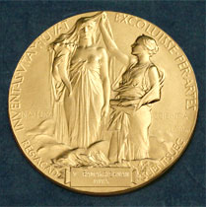
1976 Nobel Prize
Samuel C.C. Ting
Burton Richter-
no prize for
Roy Schwitters

Slide 21
Interpretation of J/ψ and ψ’
charmed-quark anticharmed-quark mesons
c
c
1³S₁
c
c
2³S₁
n_{r}=1
M=3.097 GeV
n_{r}=2
M=3.686 GeV
S-wave
S-wave
charmed quark ➔ q= +2/3 partner of the s-quark
before 1974

Slide 22
Interpretation of J/ψ and ψ’
charmed-quark anticharmed-quark mesons
c
c
1³S₁
c
c
2³S₁
n_{r}=1
M=3.097 GeV
n_{r}=2
M=3.686 GeV
S-wave
S-wave
charmed quark ➔ q= +2/3 partner of the s-quark
after 1974

Slide 23
Interpretation of J/ψ and ψ’
charmed-quark anticharmed-quark mesons
c
c
1³S₁
c
c
2³S₁
n_{r}=1
M=3.097 GeV
n_{r}=2
M=3.686 GeV
S-wave
S-wave
charmed quark ➔ q= +2/3 partner of the s-quark
after 1974
A q=+2/3^{rds} partner
of the s quark had
been suggested by
many theorists

Slide 24
Charmonium
mesons formed from c- and c-quarks
c
r
c
c-quarks are heavy: m_{c} ~ 1.5 GeV ✕ 2m_{p}
velocities small: v/c~1/4
non-relativistic, undergraduate-level QM applies

Slide 25
QM of cc mesons
c
r
c
What is V(r) ??
“derive” from QCD

Slide 26
“Cornell” potential
c
c
r
V(r)
linear “confining”
long distance
component
slope~1GeV/fm
~0.1 fm
r
1/r “coulombic”
short distance
component
2 parameters:
slope & intercept

Slide 27
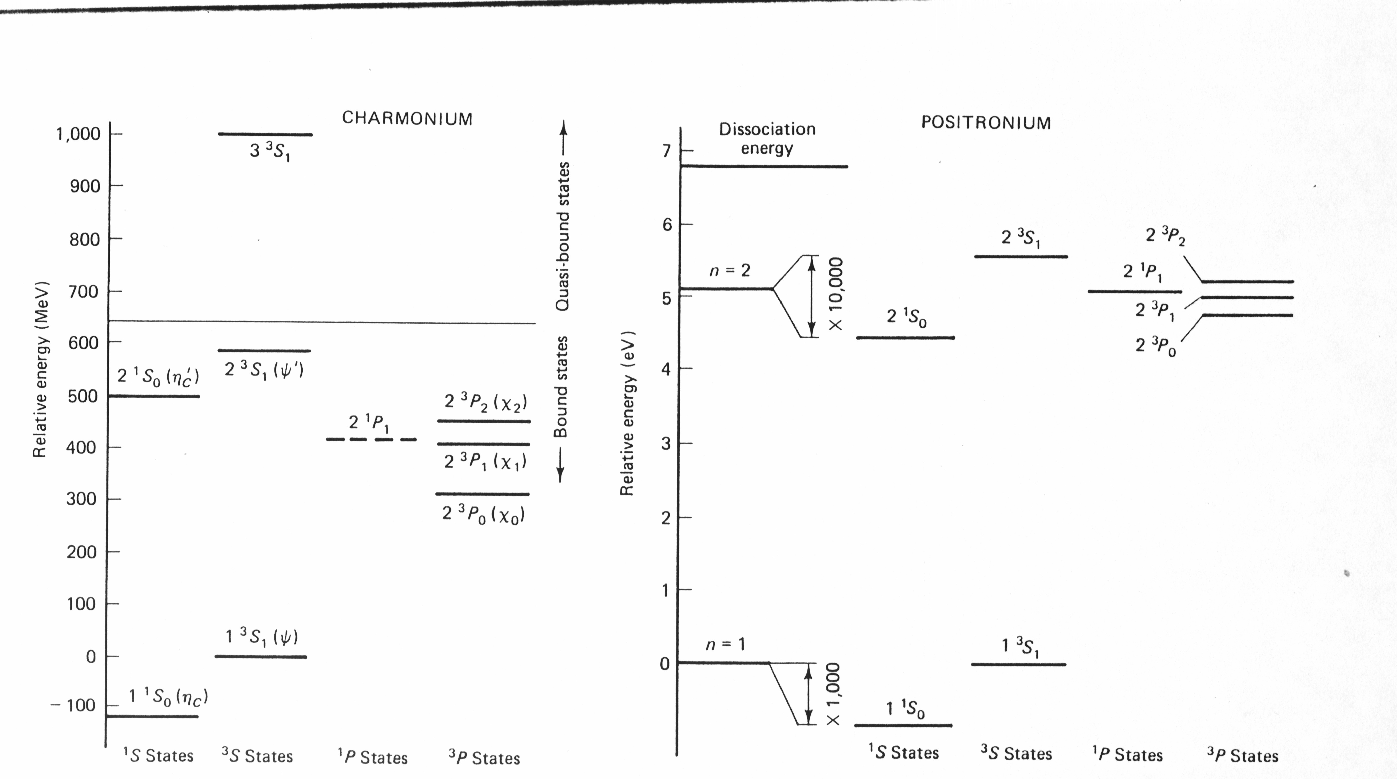
Charmonium (cc) Positronium (e⁺e⁻)
_
hypefine
ψ’
2m _{D}
hypefine
P-wave states
spin-orbit+tensor-force
“fine” splitting
P-wave states
J/ψ
spin-spin “hyperfine”
splitting
spin-spin “hyperfine”
splitting

Slide 28
ABC’s of Charmonium mesons

Slide 29
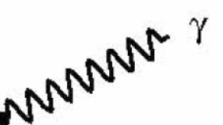
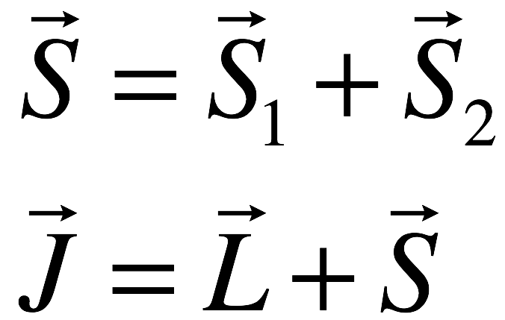
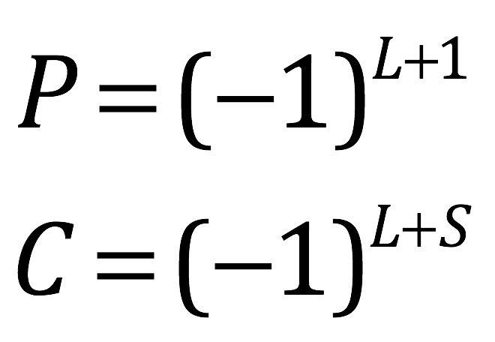


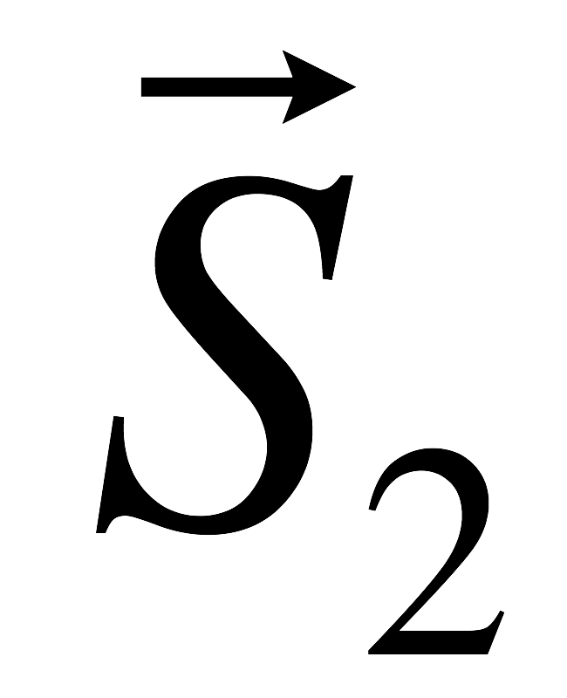
ABC part I: J^{PC} of charmonium mesons
J^{PC} quantum numbers
c
c
c
S=1 ➔ triplet of state
S=0 ➔ singlet
Parity (x,y,z) ↔ (-x,-y,-z)
C-Parity quark ↔ antiquark
J/ψ (ψ’):
J^{PC} = 1⁻ ⁻
photon:
J^{PC} = 1⁻ ⁻
e⁺
X
J/ψ (ψ’)
e⁻

Slide 30
ABC part I: J^{PC} of charmonium mesons
J^{PC} quantum numbers
c
c
c
S=1 ➔ triplet of state
S=0 ➔ singlet
Parity (x,y,z) ↔ (-x,-y,-z)
C-Parity quark ↔ antiquark
J/ψ(ψ’):
J^{PC} = 1⁻ ⁻
photon:
J^{PC} = 1⁻ ⁻
e⁺
X
J/ψ (ψ’)
e⁻
e⁺e⁻ annihilation only produces J^{PC}=1⁻⁻ states

Slide 31
ABC’s part II
spectroscopic notation
c
c
c
ψ’ = 2³S₁
η_{c} = 2¹S₀
’
S= spin (0 or 1)
J= total ang. mom.
n_{r}^{(2S+1)}L_{J}
J/ψ = 1³S₁
n_{r}=radial q.n.
L= S, P, D, …
η_{c} = 1¹S₀

Slide 32
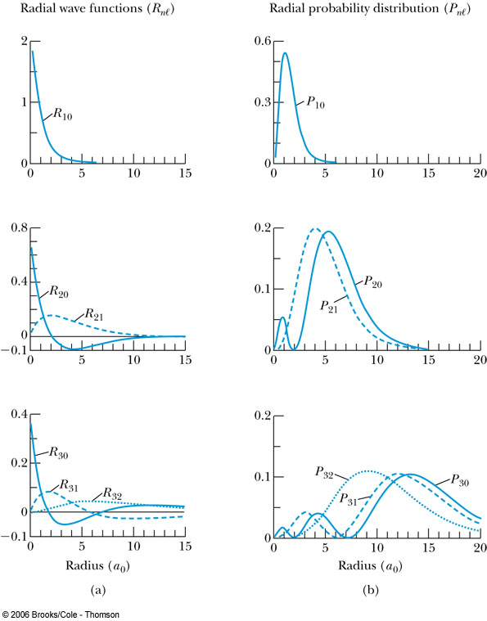
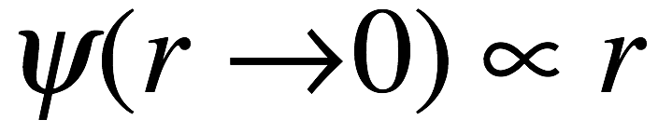
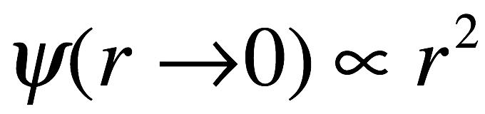
ABC’s part III
“wave function at the origin”
_
In J/ψ decay, the c and c quarks
have to annihilate each other
S-wave
n=1
e⁺
c
α
c
S-wave
e⁻
n=2
P-wave
This only can happen when they
are on top of each other:
S-wave
P-wave
D-wave
n=3

Slide 33
ABC’s part III
“wave function at the origin”
_
J/ψ decay: the c and c quarks
annihilate each other
S-wave
n=1
e⁺
c
α
c
S-wave
e⁻
n=2
P-wave
Only happens when they
are on top of each other:
S-wave
many J/ψ (& ψ’) processes are ∞ |ψ(0)|²,
the “wave function at the origin,”
or, when ψ(0)=0, derivatives of ψ(0),
which are usually small.
P-wave
D-wave
n=3

Slide 34
Immediate questions:
Can the other meson states be found?
Why are the J/ψ and ψ’ so narrow?

Slide 35
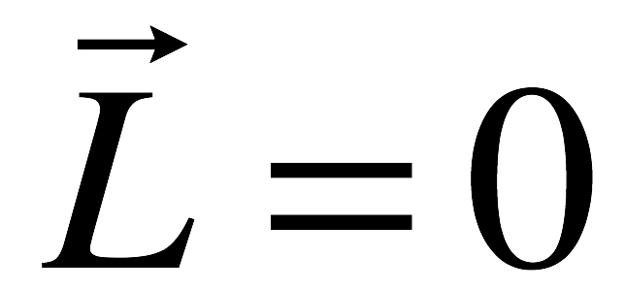
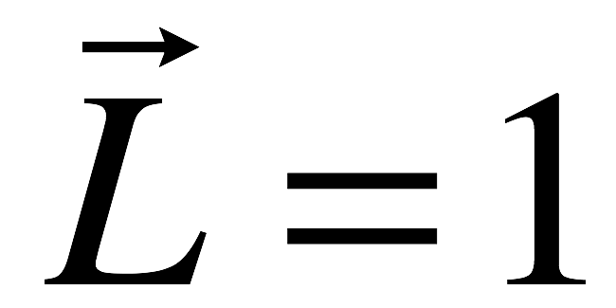
Finding other states
These states have
been identified
What about these?
ψ’ = 2³S₁ 1⁻⁻
χ_{c2} = 1³P₂ 2⁺⁺
χ_{c1} = 1³P₁ 1⁺⁺
c
c
c
χ_{c0} = 1³P₀ 0⁺⁺
c
c
c
ΔL=1, ΔP=1, ΔC=1
E1 selection rules
J/ψ = 1³S₁ 1⁻⁻

Slide 36
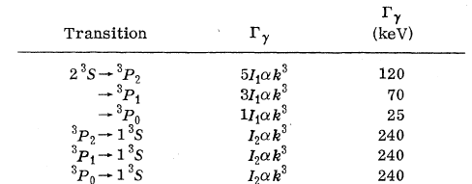
E-dipole γ transitions to 1³P_{0,1,2}
e⁺
1.843GeV
ψ’
1.843GeV
e⁻
QM textbook formula:
24.
e⁻
ψ’
24.
29.
26.
313.
239.
114.
J/ψ
E. Eichten et al., PRL 34, 369(1975)

Slide 37
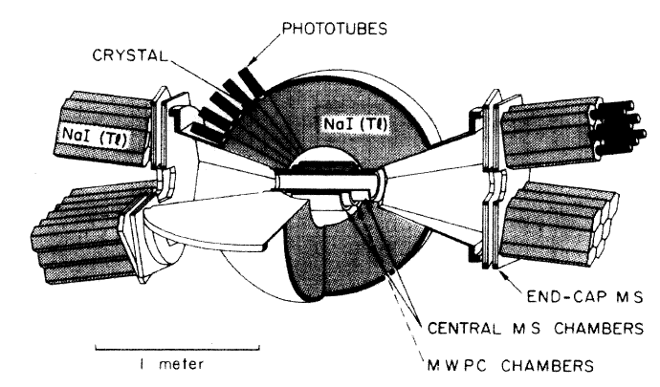
The Crystal Ball Detector

Slide 38
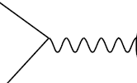
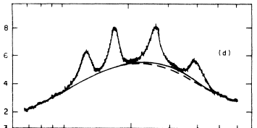
Crystal ball results
anything
ψ’→γ X
e⁺
J^{PC}=1⁻⁻
ψ’
e⁻
“inclusive” γ spectrum
ψ’
E_{γ}
Crystal Ball expt: Phys.Rev.D34:711,1986.
“smoking gun” evidence that
quarks are real spin=1/2 objects
J/ψ

Slide 39
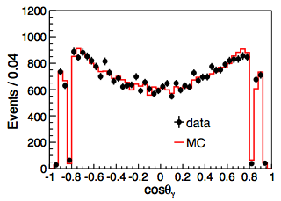
ψ’→γχ_{c0} radiative transition
Expect 1+cos²θ_{γ}
BESIII PRD 84, 092006 (2011)

Slide 40
Discovery of the P-wave triplet states (χ_{c0,1,2}) convinced everyone quarks were real
e⁻
ψ’
E_{γ}
J/ψ
Crystal Ball expt: Phys.Rev.D34:711,1986.

Slide 41
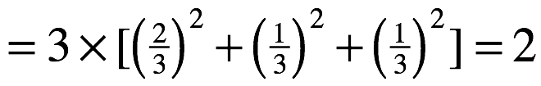
Color explains the discrepancy in R
J^{PC}=1⁻⁻
& color
Each favored quark comes
with 3 different colors

Slide 42
Color explains the discrepancy in R
J^{PC}=1⁻⁻
& color
Each favored quark comes
with 3 different colors
above the charmed particle threshold, add another (⅔)²
to account for the c quark

Slide 43
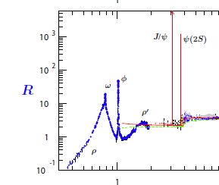
R measurements near charm threshold
~4/3=3Q_{c}
²
~2
~3⅓
2
3
4
E_{cm}

Slide 44
why are the J/ψ and ψ’ so narrow?
2
3
4
E_{cm}

Slide 45

How does the J/ψ (ψ’) decay?
c
α_{s}
g_{ij}
c

Slide 46
How does the J/ψ (ψ’) decay?
c
α_{s}
g_{ij}
c
violates color symmetry

Slide 47
How does the J/ψ (ψ’) decay?
c
c
α_{s}
C=-
α_{s}
C=-
g_{ij}
g_{ij}
c
g_{kl}
α_{s}
C=-
c
violates color symmetry

Slide 48
How does the J/ψ (ψ’) decay?
c
c
α_{s}
C=-
α_{s}
C=-
g_{ij}
g_{ij}
c
g_{kl}
α_{s}
C=-
c
violates color symmetry
violates C parity

Slide 49
How does the J/ψ (ψ’) decay?
c
c
α_{s}
C=-
α_{s}
C=-
g_{ij}
g_{ij}
c
g_{kl}
α_{s}
C=-
c
violates color symmetry
violates C parity
c
α_{s}
g_{ij}
Lowest-order
allowed QCD process:
α_{s}
g_{kl}
α_{s}
g_{mn}
c

Slide 50
How does the J/ψ (ψ’) decay?
c
c
α_{s}
C=-
α_{s}
C=-
g_{ij}
g_{ij}
c
g_{kl}
α_{s}
C=-
c
violates color symmetry
violates C parity
c
α_{s}
Lowest-order
allowed QCD process:
g_{ij}
α_{s}
suppressed by α_{s}³
g_{kl}
α_{s}
g_{mn}
“OZI”* suppression
*Okubo-Zweig-Iizuka
c

Slide 51

How wide are the J/ψ & ψ’?
J/ψ
ψ’
The observed widths of these peaks are due
entirely to experimental resolution, which is
typically a few MeV

Slide 52
Determining the J/ψ (& ψ’) widths
cross section for e⁺e⁻ → J/ψ→X
e⁺
J^{PC}=1⁻⁻
X
Γ_{ee}
Γ_{X}
e⁻

Slide 53
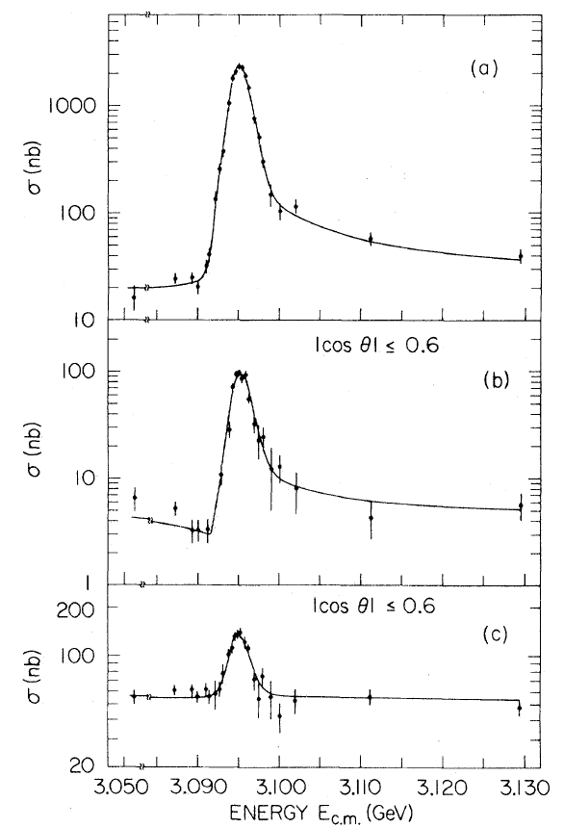
Determining the J/ψ (& ψ’) widths
cross section for e⁺e⁻ → J/ψ→X
Mark-I PRL 34, 1357 (1975)
e⁺
X=hadrons
J^{PC}=1⁻⁻
X
Γ_{ee}
Γ_{X}
e⁻
X=μ⁺μ⁻
X=e⁺e⁻

Slide 54
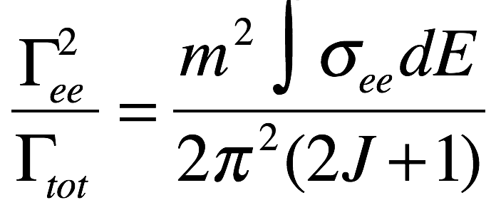
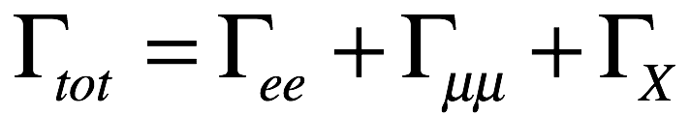
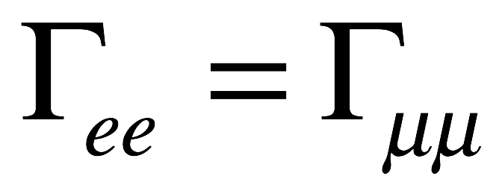
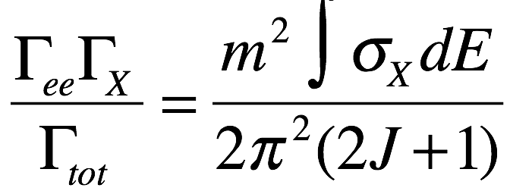
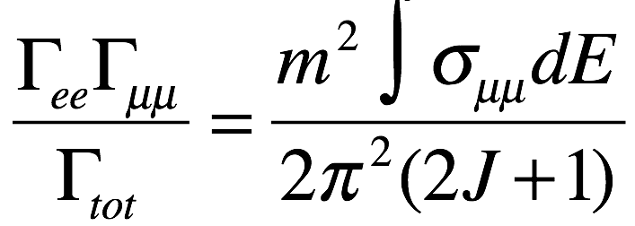
Determining the J/ψ (& ψ’) widths
cross section for e⁺e⁻ → J/ψ→X
Mark-I PRL 34, 1357 (1975)
e⁺
X=hadrons
J^{PC}=1⁻⁻
X
Γ_{ee}
Γ_{X}
e⁻
X=μ⁺μ⁻
X=e⁺e⁻
5 eqns, 4 unknowns: determine Γ_{tot}

Slide 55
Determining the J/ψ (& ψ’) widths
cross section for e⁺e⁻ → J/ψ→X
Mark-I PRL 34, 1357 (1975)
e⁺
X=hadrons
J^{PC}=1⁻⁻
X
Γ_{ee}
Γ_{X}
e⁻
X=μ⁺μ⁻
X=e⁺e⁻
2009 values
 | J/ψ | ψ’
Γ_{tot} | 93±2 keV | 309±9 keV
Γ_{ee} | 5.55±0.14 keV | 5.1±0.5 keV
5 eqns, 4 unknowns: determine Γ_{tot}

Slide 56
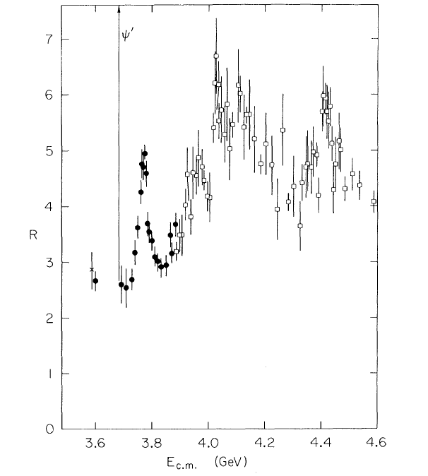
e⁺e⁻→ hadrons at higher E_{cm}: a 3rd peak: the ψ” (ψ(3770))
Γ_{tot} ~150x bigger
ψ’
2009 values
 | J/ψ | ψ’ | ψ”
Γ_{tot} | 93 keV | 209 keV | 27.3+1.0 MeV
Γ_{ee} | 5.55 keV | 5.1 keV | 0.26+0.02 keV
ψ”
Γ_{ee} ~20x smaller
ψ”
LGW PRL 39, 526 (1977)

Slide 57
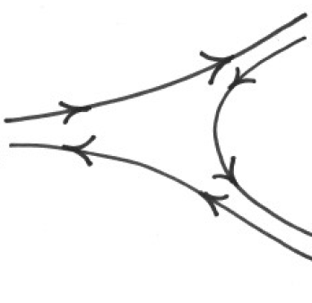
Why is Γ_{tot} (ψ”) much bigger?
“charmed” mesons
New decay channel is availableψ”→DD
c
D
←D⁰ or D⁺
q
ψ”
c
q (=u or d)
c
no “OZI” suppression
q
D
2m_{D}
“open charm”
threshold
c
←D⁰ or D⁻
(M_{ψ”}=3775 MeV )
2m_{D+}=3739 MeV
2m_{D0} =3729 MeV
“fall apart”
decay modes
(M_{ψ’}=3686 MeV )

Slide 58
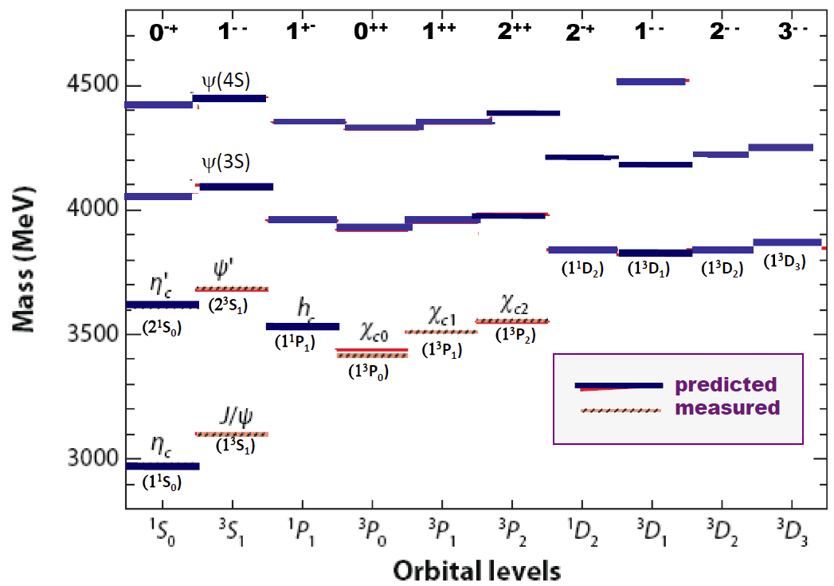
does ψ” fit in the cc spectrum?
_
must be J^{PC} = 1⁻ ⁻
ψ(1D)
3770 MeV
2m_{D}

Slide 59
does ψ” fit in the cc spectrum?
_
must be J^{PC} = 1⁻ ⁻
here?
ψ(1D)
3770 MeV
2m_{D}

Slide 60
does ψ” fit in the cc spectrum?
_
must be J^{PC} = 1⁻ ⁻
here?
or here?
ψ(1D)
3770 MeV
2m_{D}

Slide 61
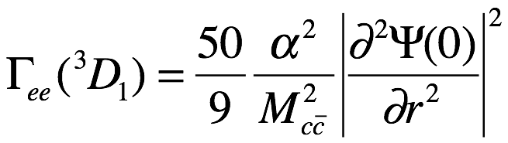
Γ_{ee} (ψ”) considerations
e⁺
c
α
c
e⁻
S-wave
D-wave

Slide 62
Γ_{ee} (ψ”) considerations
e⁺
c
α
c
e⁻
S-wave
D-wave
Γ_{ee} = too small for the ψ(3S)
& too big for the ψ(1D)
all in keV
 | J/ψ | ψ’ | ψ”(S-wave) | ψ”(D-wave)
Γ_{ee}(Theory) | 12.13 | 5.03 | 3.5 | 0.056
Γ_{ee}(expt) | 5.55±0.14 | 5.1±0.5 | 0.26±0.02 | 0.26±0.02

Slide 63
ψ’ and ψ” = 2³S₁ – 1³D₁ mixtures
ψ(1D)
“preferred”
value
mixing
This mixing was predicted by Eichten et al, PRL 34, 369 (1975)
-- before the ψ” was discovered --

Slide 64
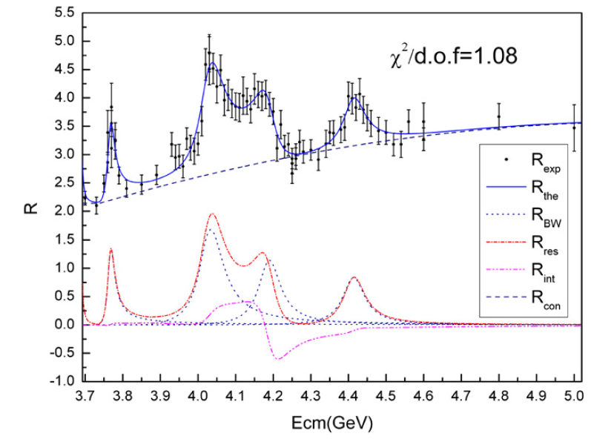
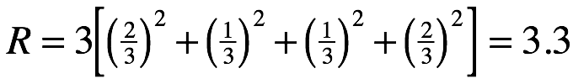
J^{PC} = 1⁻ ⁻ states produce peaks in R_{had}
e⁺
ψ(nS)
e⁻
ψ(4040)
ψ(4160)
ψ(4415)
ψ”
These are wide
because decays
to charmed mesons
are allowed
BES II PL B660, 315 (2008)

Slide 65
Finding other charmonium mesons
ψ”
Look for the η_{c}
via ψ’→γ η_{c}
or J/ψ→γη_{c}
~700MeV
~100MeV

Slide 66
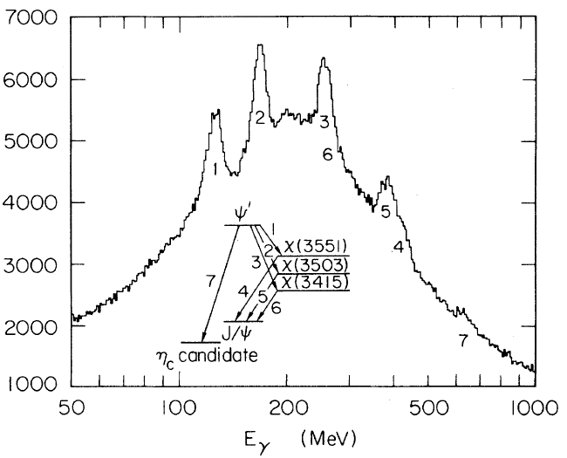
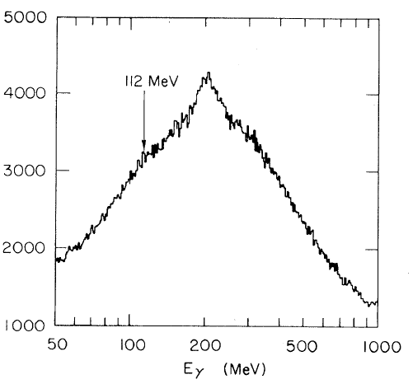
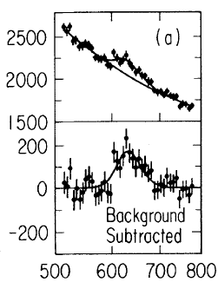
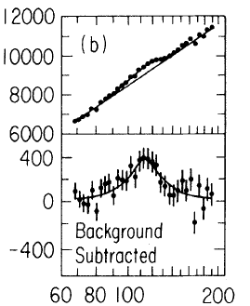
Xtal-ball: J/ψ(ψ’)→γη_{c}, η_{c}→ inclusive
ψ’→ γ + anything
J/ψ→ γ + anything
???
M_{ηc}=2978±9 MeV
Γ<20 MeV
Xtal-Ball PRL 45, 1150 (1980)

Slide 67
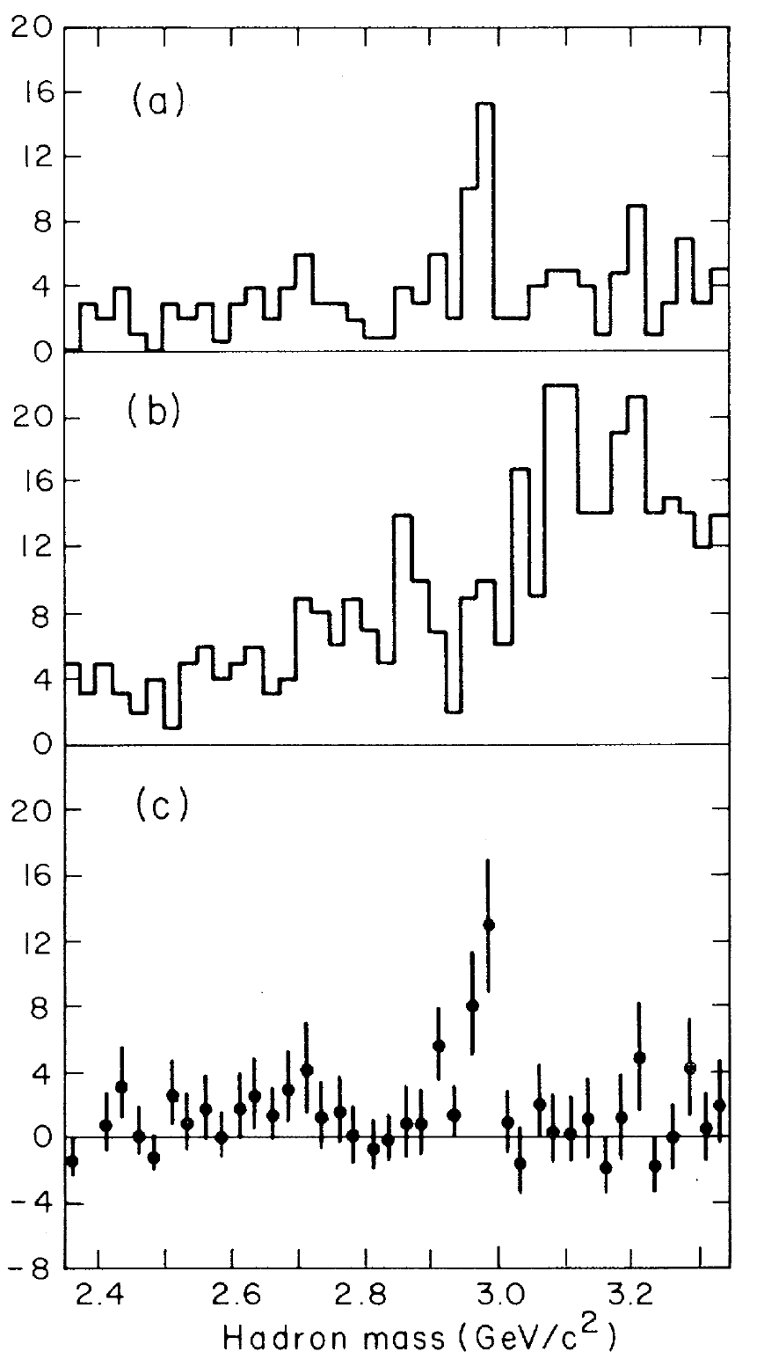

Mark II ψ’→γη_{c} : η_{c}→exclusive
good γ’s
poor γ’s
bkg subtracted
M_{ηc}=2980±8 MeV
Γ<40 MeV
Mark II PRL 45, 1146 (1980)

Slide 68


The η_{c} in 2010 (30 years later)
M & Γ not well measured!

Slide 69

BESIII experiment at IHEP(Beijing)

Slide 70

BESIII: η_{c} parameters from ψ’→γη_{c}
e⁺
ψ’
e⁻
1.843GeV
1.843GeV
γ
hadrons

Slide 71

ψ’→γη_{c} : η_{c}→K_{s}Kπ
BESIII experiment
rapid fall-off
slow rise
high continuum
low continuum

Slide 72


Breit Wigner resonance + constant background
phase structure of A_{BW}
BW resonance
continuum
continuum
φ=0
φ=90⁰
φ=180⁰
constructive
interference
destructive
interference

Slide 73

η_{c}
coherent bkg take as a real constant
destructive
interference
constructive
interference

Slide 74

Interference in η_{c}→hadrons
η_{c}→KsKπ
η_{c}→K⁺K⁻π⁰
η_{c}→π⁺π⁻η
η_{c}→KsK3π
η_{c}→2K2ππ⁰
η_{c}→6π
similar pattern in all η_{c}→ hadron decay modes

Slide 75
Interference in η_{c}→hadrons
η_{c}→KsKπ
η_{c}→K⁺K⁻π⁰
η_{c}→π⁺π⁻η
Interference effects are important
-- cannot be ignored --
η_{c}→KsK3π
η_{c}→2K2ππ⁰
η_{c}→6π
similar pattern in all η_{c}→ hadron decay modes

Slide 76


Mass and width of η_{c}
Mass = 2984.3±0.6±0.6 MeV/c²
Width = 32.0±1.2±1.0 MeV
BESIII PRL108, 222002 (2012)

Slide 77
Search for the η_{c}’
ψ”

Slide 78


ψ’→ γ η_{c}’ in the Crystal Ball?
???
100 MeV
1000 MeV
M_{ηc}=3592±5 MeV
Γ<8 MeV
Xtal-Ball PRL 48, 70 (1982)

Slide 79
ψ’→ γ η_{c}’ in the Crystal Ball?
???
never confirmed
100 MeV
1000 MeV
M_{ηc}=3592±5 MeV
Γ<8 MeV
Xtal-Ball PRL 48, 70 (1982)

Slide 80


M=3592 MeV η_{c}’ not seen elsewhere
_
pp→η_{c}’→γγ (@ Fermilab)
γγ→η_{c}’→hadron (@ LEP)
E835 PRD 64, 052003 (2001)
DELPHI PL B441, 479 (1998)

Slide 81

The Belle experiment at KEK
e⁺
e⁻
~10GeV

Slide 82

Event in the Belle Detector

Slide 83


Belle in 2002 (20 yrs after η_{c} was found)
c
c
_
→η_{c} (η_{c}’ ??) →K_{S}K⁺π⁻
B meson
M_{ηc’}=3654±10 MeV
Γ<55 MeV
η_{c}
s
q
_
η_{c}’
→K
M(K_{S}K⁺π⁻)
Belle PRL 89, 102001 (2002)

Slide 84
Belle in 2002 (20 yrs later)
c
c
_
→η_{c} (η_{c}’ ??) →K_{S}K⁺π⁻
B meson
M_{ηc’}=3654±10 MeV
Γ<55 MeV
η_{c}
s
q
_
η_{c}’
→K
M(K_{S}K⁺π⁻)
“invariant mass”
Belle PRL 89, 102001 (2002)

Slide 85


Confirmed by other measurements
Belle: γγ→ 3(π⁺π⁻)
γγ→ K⁺K⁻2(π⁺π⁻)
γγ → K_{S}K⁺π⁺π⁻π⁻
χ_{c2}
χ_{c0}
χ_{c0}
Belle: 2010
χ_{c0}
η_{c}’
η_{c}’
χ_{c2}
η_{c}’
χ_{c2}
M(3(π⁺π⁻))
M(K⁺K⁻2(π⁺π⁻))
Μ(K_{S}K⁺π⁺π⁻π⁻)
Belle: e⁺e⁻→ J/ψ + X
η_{c}’
PDG 2009
3592 MeV
M(X)
Belle PRL 98, 082001 (2007)

Slide 86
Search for the (J^{PC}=1⁺⁻) h_{c}
ψ”

Slide 87
h_{c} : the singlet partner of the χ_{cJ} triplet
ψ’ = 2³S₁
η_{c}= 2¹S₀
_{c}
χ_{c2} = 1³P₂
χ_{c1} = 1³P₁
c
c
c
h_{c} = 1¹P₁
c
c
χ_{c0} = 1³P₀
J/ψ = 1³S₁
η_{c} = 1¹S₀

Slide 88

Why was the h_{c} so hard to find?
J^{PC}(ψ’):= 1⁻ ⁻
J^{PC} (h_{c}) = 1⁺⁻
➔ ψ’ → γh_{c} not allowed
ψ’ →π⁰ h_{c} allowed but Ispin-suppressed
expected branching fraction ≈ 10⁻³
ψ’
h_{c}
preferred h_{c} decay mode is h_{c}→γη_{c}
expected branching fraction ≈ 0.4
η_{c}
Expected mass = “center-of-gravity” of M(χ_{c0,1,2})
=[M(χ_{c0}) + 3 M(χ_{c1}) +5 M(χ_{c2})]/9 = 3.525 MeV

Slide 89

CLEO detector at Cornell Univ

Slide 90



1st h_{c} signal: CLEO 2005 (exclusive)
Exclusive analysis:
clean h_{c} → γ η_{c} signal
about 20 events

Slide 91


semi-inclusive h_{c} reconstruction
undetected
π⁰
γ
η_{c}
h_{c}
ψ’
detected
γ
γ
detected
(or “tagged”)
Measures: Bf(ψ’→π⁰ h_{c})xBf(h_{c}→γη_{c})
4-momentum conservation
In the cm:

Slide 92


h_{c}: CLEO 2005 (semi-inclusive)
undetected
Inclusive analysis:
detect the π⁰ → γγ & the γ from h_{c}→γη_{c}
h_{c} → γ η_{c} signal
Measures: Bf(ψ’→π⁰ h_{c})xBf(h_{c}→γη_{c})
Mass recoiling from the π⁰
CLEO PRL 95,102003 (2005)

Slide 93
BESIII experiment at IHEP(Beijing)

Slide 94



fully inclusive h_{c} reconstruction
undetected
π⁰
γ
η_{c}
h_{c}
ψ’
detected
γ
recoiling
or “missing”
γ
Measures: Bf(ψ’→π⁰ h_{c})
4-momentum conservation
In the cm:

Slide 95



h_{c}: BES III 2010 (fully inclusive)
Semi-inclusive: ψ’ →π⁰ h_{c}
→γ η_{c}
Fully inclusive: ψ’ →π⁰h_{c}
→γ ηη_{c}
Detect: π⁰ & γ
Detect: π⁰ only
Measures: Bf(ψ’→π⁰ h_{c})xBf(h_{c}→γη_{c})
Measures: Bf(ψ’→π⁰ h_{c})
BES III PRL 104,132002 (2010)

Slide 96
h_{c}: BES III results
results: Bf(ψ’→π⁰ h_{c}) = (8.4 ± 1.3)x10⁻⁴
Bf(h_{c}→γ η_{c}) = (54.3 ± 6.7)%
M(h_{c}) = 3525.4 ± 0.22 MeV
Γ(h_{c}) = 0.73±0.53 (< 1.44) MeV
agree with theory
YP Kuang PRD 65 094024
M_{cog}(χ_{c0,1,2})=3525.3 MeV
BES III PRL 104,132002 (2010)

Slide 97



χ_{c2} discovered by Belle
‘
_
γγ →χ_{c2}→DD
‘
_
M(DD)
“two-photon”
collisions
|cosθ|
results: M(χ_{c2}) = 3929 ± 5 MeV
Γ(χ_{c2}) = 29 ± 10 MeV
‘
‘

Slide 98
Charmonium spectrum today
Masses in pretty good agreement with theoretical expectations
-- biggest discrepancies ~ 50 MeV --
ψ(4415)
ψ(4150)
ψ(4040)
χ’
χ’
_{c2}
_{c0}
ψ_{c2}
ψ”
2m_{D0}

Slide 99
Inter-charmonium transitions

Slide 100



γ Transitions
M1 transitions (Γ(keV))
J/ψ →γ η_{c} 2.4 1.6 ± 0.4
ψ’ →γ η_{c} 4.6 1.1 ± 0.2
Th. Expt
ππ,η,π⁰
γ
e⁻
E1 transitions
Th. Expt
24 27 ± 4
29 27 ± 3
26 27 ± 3
313 426 ± 51
239 291 ± 48
114 110 + 19

Slide 101

Hadronic transitions
ψ’ → J/ψ +hadrons
Γ_{exp}(keV)
ψ‘→π⁺π⁻ J/ψ 88 ± 7
ψ’ →η J/ψ 9 ± 1
ψ’→ π⁰J/ψ 0.4±0.1
ππ, η, π⁰
ππ,η,π⁰
γ
ψ’
J/ψ
Ispin violation:
Γ(ψ’→π⁰J/ψ)
Γ(ψ’→ππJ/ψ)
~1/200

Slide 102
Predictions & measurements for the ψ”
Γ_{exp}(keV)
th. Expt
ψ”→π⁺π⁻ J/ψ ~80 55 ± 15
ψ” →γχ_{c1} 77 70 ± 17
ψ”→ γχ_{c0} 213 172 ±30
γ
γ
ππ,η,π⁰
γ
e⁻

Slide 103


Bottomonium:
history repeats itself
3 narrow states near 10 GeV
σ(e⁺e⁻ → hadrons)
E_{cm} (GeV)
Plus broad states at
higher masses

Slide 104
Same potential works
b
b
r
V(r)
linear “confining”
long distance
component
slope~1GeV/fm
~0.1 fm
r
1/r “coulombic”
short distance
component
2 parameters:
slope & intercept

Slide 105


charmonium-bottomonium differences
Ground-state
r/a₀
 | cc | bb
m_{Q} | ~1.5 GeV | ~4.5 GeV
<R_{rms}> | ~0.15 fm | ~0.05 fm
_
_

Slide 106
Bottomonium probes deeper (stronger) region of the potential
V(r)
slope~1GeV/fm
~0.1 fm
charmonium
r
r, (not r/a₀)
bottomonium
Bottomonium is more tightly bound than charmonium

Slide 107


Bottomonium spectrum
2M_{B} = 10.56 GeV
More states below
“open bottom” threshold

Slide 108
“Fall apart” decays to “B” mesons
B⁰ or B⁺
b
B
q
ϒ(4S)
b
q (=u or d)
b
no “OZI” suppression
q
B
b
2m_{B}
“open bottom”
threshold
B⁰ or B⁻
(M_{ϒ’(4S)}=10.58 GeV )
2m_{B}=10.56 GeV
(M_{ϒ’(3S)}=10.36 GeV )

Slide 109
Bottomonium spectrum 2011
established
recently
discovered
still not
discovered
2M_{B} = 10.56 MeV
h_{b}(3P)
χ_{b}(3P)
Most of the states below
“open bottom” threshold
have been identified

Slide 110
Summary (lecture 3)
The quarkonium spectra are the strongest evidence that hadrons are
composed of spin=1/2 constituent particles
All of the charmonium states below the M=2m_{D} “open charm”
threshold have been found
-most of the bottomonium states below M=2m_{B} have been identified
Above the M=2m_{D} threshold, most of the 1⁻ ⁻ states, but only three
of the others (the χ_{c0}’ , χ_{c2}’ & ψ_{c2}) have been discovered.
The masses of the assigned states match theory predictions
-variations are less than ~50 MeV
Transitions between quarkonium states are in reasonably good
agreement with theoretical expectations

Slide 111
General comments
The charmed and bottom “quarkonium systems” are relatively simple and reasonably well understood.
  The “hydrogen atoms” of QCD.
Let’s try to use them to search for new and unpredicted phenomena.
    If we find a meson that contains a cc (bb) pair
    but doesn’t fit into one of the remaining unassigned
    states, we have a candidate for an exotic hadron,
    the subject of the next lecture
_
_

