Slide 1
On EicC (Electron-Ion Collider at China) March 30 – April 1, 2018 Nu Xu Institute of Modern Physics

Slide 2
Outline
Background Information
Schematic Design of EicC
Science Cases for EicC-I
Summary

Slide 3
High Intensity Heavy-ion Accelerator Facility
HIAF
Booster Ring:
Circumference: 569 m
Rigidity: 34 Tm
Aaccumulation
Cooling & acceleration
Spectrometer Ring:
Circumference: 270.5 m
Rigidity: 15 Tm
Electron cooler
Stochastic cooler
Deacceleration
HFRS
SRing
Phase I
iLinac
Superconducting Ion Linac:
Length: 180 m
Energy: 17 MeV/u (U³⁴⁺)
CW and pulse modes
BRing
Two-plane painting injection scheme
Fast ramping rate operation
Notes:
Accelerate[ækˈsɛləˌret], Circumference [sərˈkʌmfərəns] , equipped[ɪk'wɪpt]
The injector is a superconducting ion Linac with a length of 180 m, and it can be operated with CW or mode. The booster ring is used for beam accumulation and acceleration with a maximum magnetic rigidity of 34 Tm. Two-plane painting injection scheme is adopted to store huge ion number in the ring. Due to space charge and dynamic vacuum effects, ions stored is launched to high energy very quickly using the fast ramping rate operation.

Slide 4
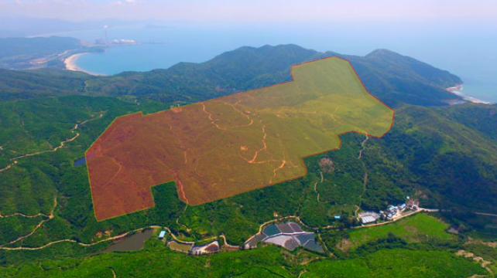
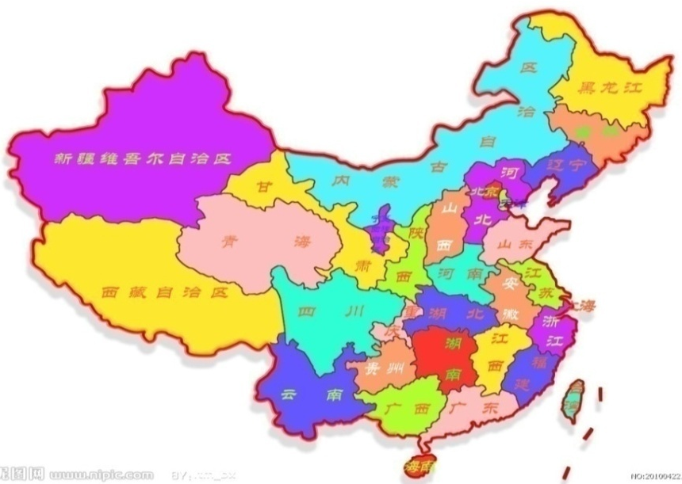
HIAF and Its Location
Location
HIAF

Slide 5
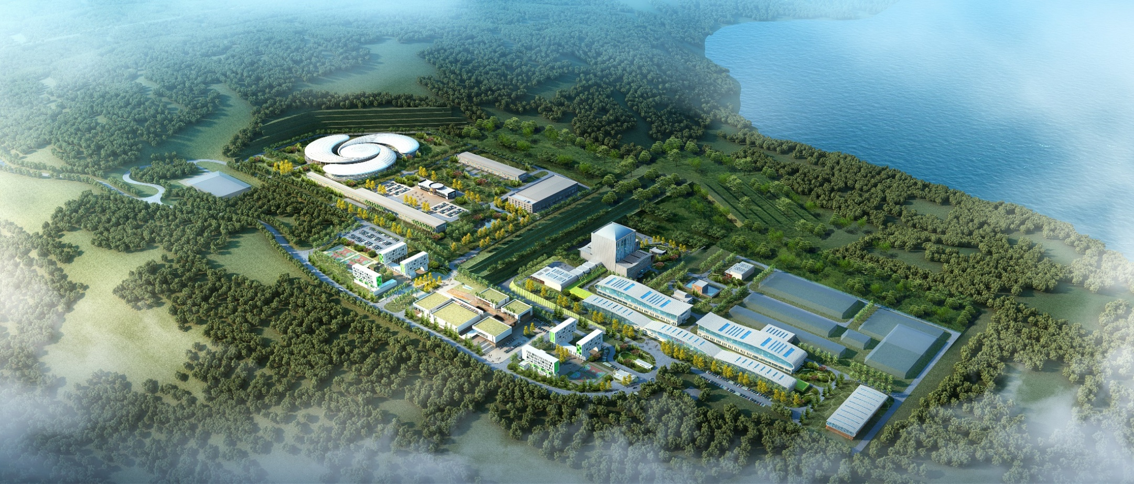
Location
Location
HIAF
CiADS
Huizhou city and Guangdong province will cover the expenses for buying land, preparing land, building roads, building electricity and water supply stations, …
Notes:
Uncivilized ʌnˈsɪvəˌlaɪzd.
geological survey was already done, and it proved that this area is suitable for construction of Accelerator-based research facility and nuclear reactor.

Slide 6
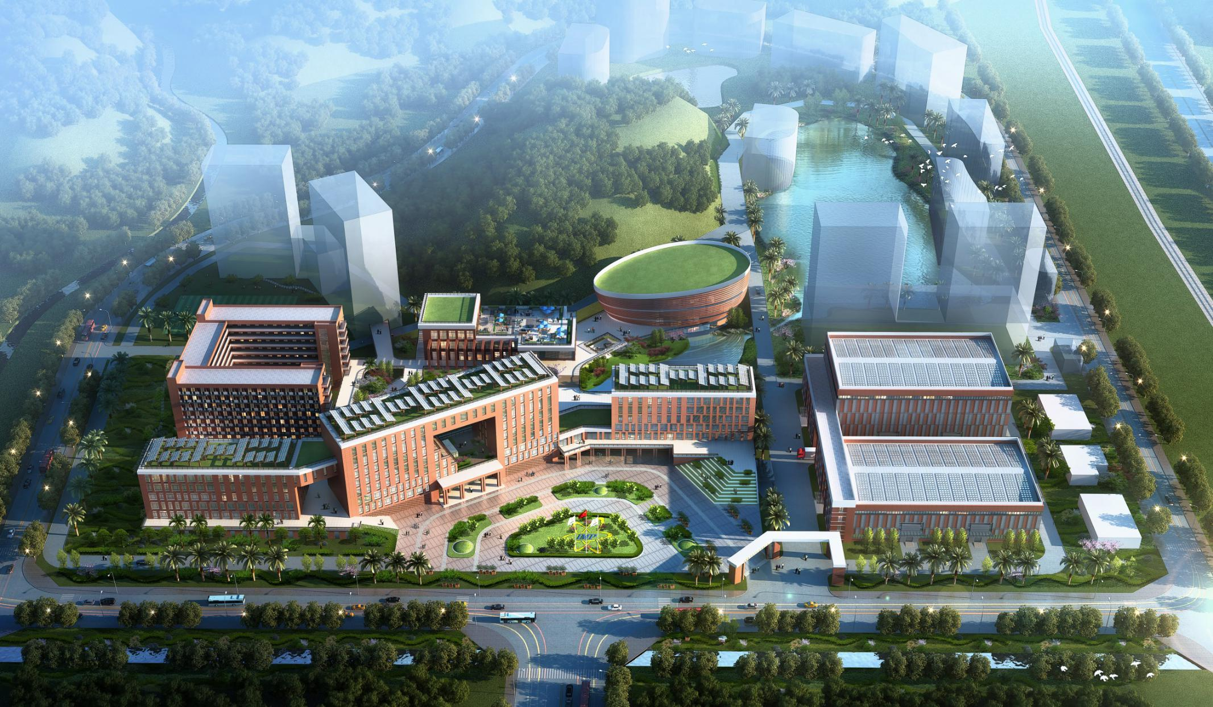
Location
Location
New Branch of IMP
About 5 km to downtown of Huizhou City.
Construction will start soon.

Slide 7
HIAF Timetable
Time Schedule
20~ | 09 | 10 | 11 | 12 | 13 | 14 | 15 | 16 | 17 | 18 | 19 | 20 | 21 | 22 | 23 | 24
Critical Points
Design
Construction and Installation
Commissioning
Plan
Approval
Construction
Commissioning
Operation
Key technology R&D
Preliminary design
Conceptual design
Approval
Detailed design & prototype
Civil construction
Fabrication
Installation
Sub-system commissioning
Facility commissioning
Operation

Slide 8
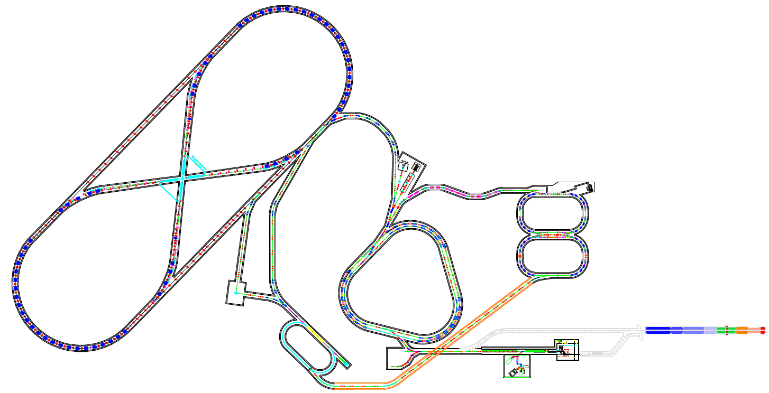
EicC Conceptual Design
L: ~1 x10³⁵cm⁻²/s
p/e, polarized
EicC-I: 2028-2035
HERing
5-10 GeV
C: 1.5-2.0 km
L: ~1 x10³³cm⁻²/s
p/e, polarized
EicC-II
EicC-I
BRing2
SRing
HPRing
60-100 GeV
C: 1.5-2.0 km
3-5GeV/A
C: 600 m
BRing1
MRing
eRing
e: 3-5 GeV
1-3 GeV/A
C: 600 m
HIAF-II
1-2.5 MW primary proton beam from CiADS-linac
iLinac
25-200 MeV/A
ISOL Target
Collider Ring (2 km):
Up: Polarized electron, 10 GeV
Down: Polarized proton, 60-100GeV
HIAF-I
Electron injector:
SRF Linac-ring, 3.5-10GeV
July 27: Machine discussion

Slide 9
Designed Energy and Luminosity
EicC-I: will be constructed at √s ~ 15GeV region
Focus on nuclear physics problems
B-quark hadron production

Slide 10
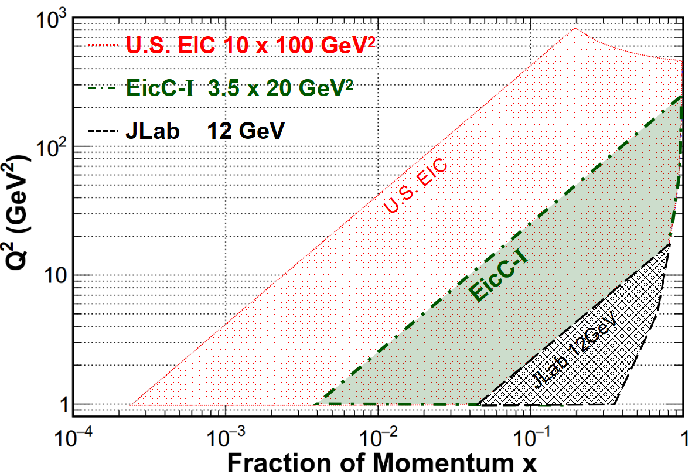
Machine Kinematics
EicC-I: 4x10⁻² < x < ~ 1 region
Valance- and sea-quark
Gluon wavelength ≥ 1fm

Slide 11
EicC Concept Detector
EMCal
VTX
ToF
μ-ID
Forward Tracking
Forward Tracking
e
ion
μ-ID
COIL
TPC
Much more R&D efforts on forward detectors are needed

Slide 12
EicC Timetable
 | 18 | 19 | 20 | 21 | 22 | 23 | 24 | 25 | 26 | 27 | 28 | 29 | 30 | 31 | 32 | 33 | 34 | 35
 | 十三五 |  |  | 十四五 |  |  |  |  | 十五五 |  |  |  |  | 十六五
 | HIAF
EicC-I |  |  |  | R&D
 |  |  |  |  |  |  |  |  | √s ~ 15GeV, 1x10³³/sec cm²
 |  | R&D and construction
 |  | In operation

Slide 13
EicC-I Working Groups
WGs | People | Topics
Accelerator Group (AWG) | M. Bai, L.J. Mao, G.D. Shen, Y.C. Yang, H.Y. Zhang, H.W. Zhao, … | 1) Conceptual design (≥10³³/s cm²) 2) Cooling 3) IR design
Detector Group (DWG) | J.P. Chen, X.R. Chen, H.Y. Gao, F. Liu, A. Deshpande, N. Xu, Z.H. Ye, L. Zhang, Z.W. Zhao | Conceptual design Observables
Physics Group (PWG) | Z.T. Liang, B.Q. Ma, J.P. Ma, Q. Wang, J.J. Xie, B.W. Xiao, F. Yuan, J. Zhou, Q. Zhao, B.S. Zou | Science cases Observables
Local Contact Monthly working group meeting (video meeting) General meeting every three-month (video meetings + annual IMP meeting)
Goals: first draft of EicC-I Whitepaper by the end of 2019

Slide 14
EIC: next frontier for strong interaction
Nucleon Structure:
- spin of nucleon
- mass of nucleon
- role of gluons
- confinement
- exotic states
- …
CERN: LHeC
USA: eRHIC, JLEIC
China: EicC

Slide 15
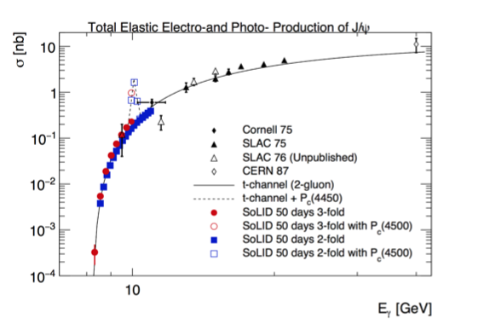
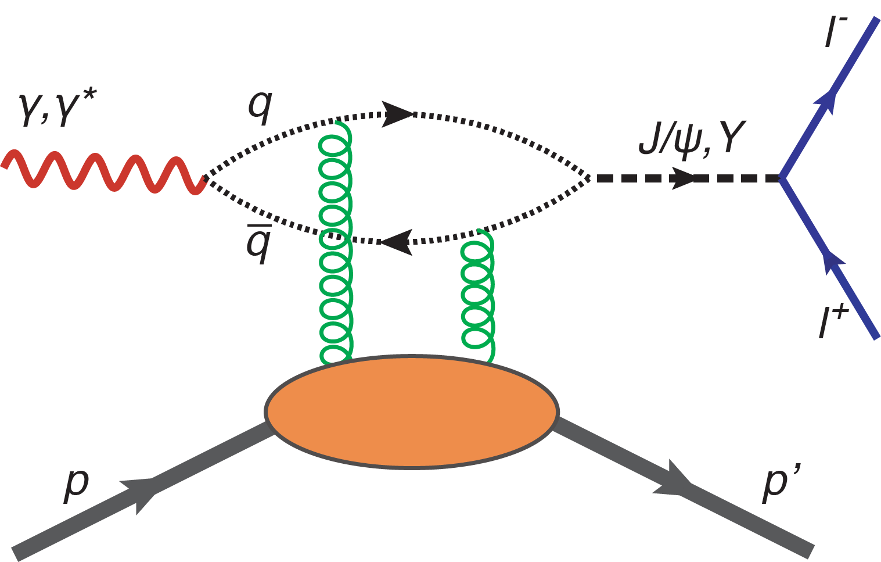
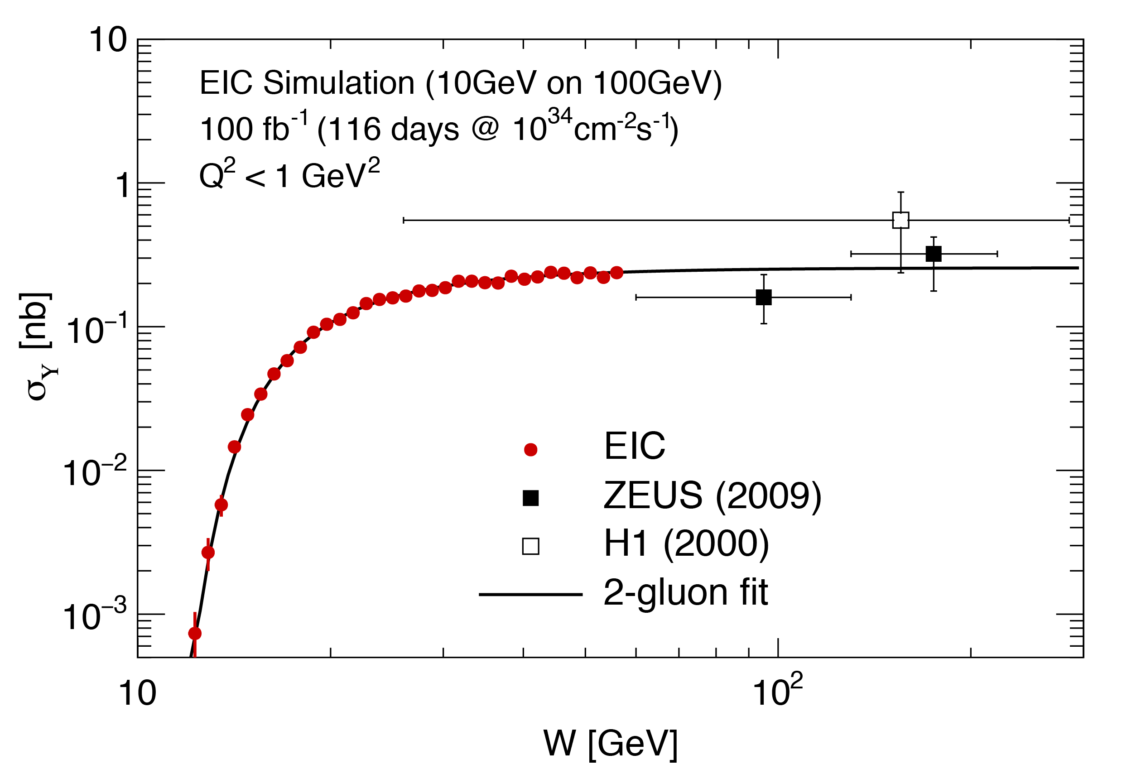
(1) Charm @ SoLID and Beauty @ EicC
Total elastic Electro and photo-Production of J/psi
SoLID with J/psi
Heavy quark – dominated by two gluons
Proton Mass:
Total elastic Electro and photo-Production of Upsilon
EicC with Upsilon
Covariant Decomposition of the Energy Momentum Tensor (EMT)
QCD trace anomaly
Light quark mass
Trace of EMT proportional to Quarkonium
-proton scattering amplitude to be
measured at JLab with J/psi at SoLID or Upsilon at EicC
From JP Chen

Slide 16
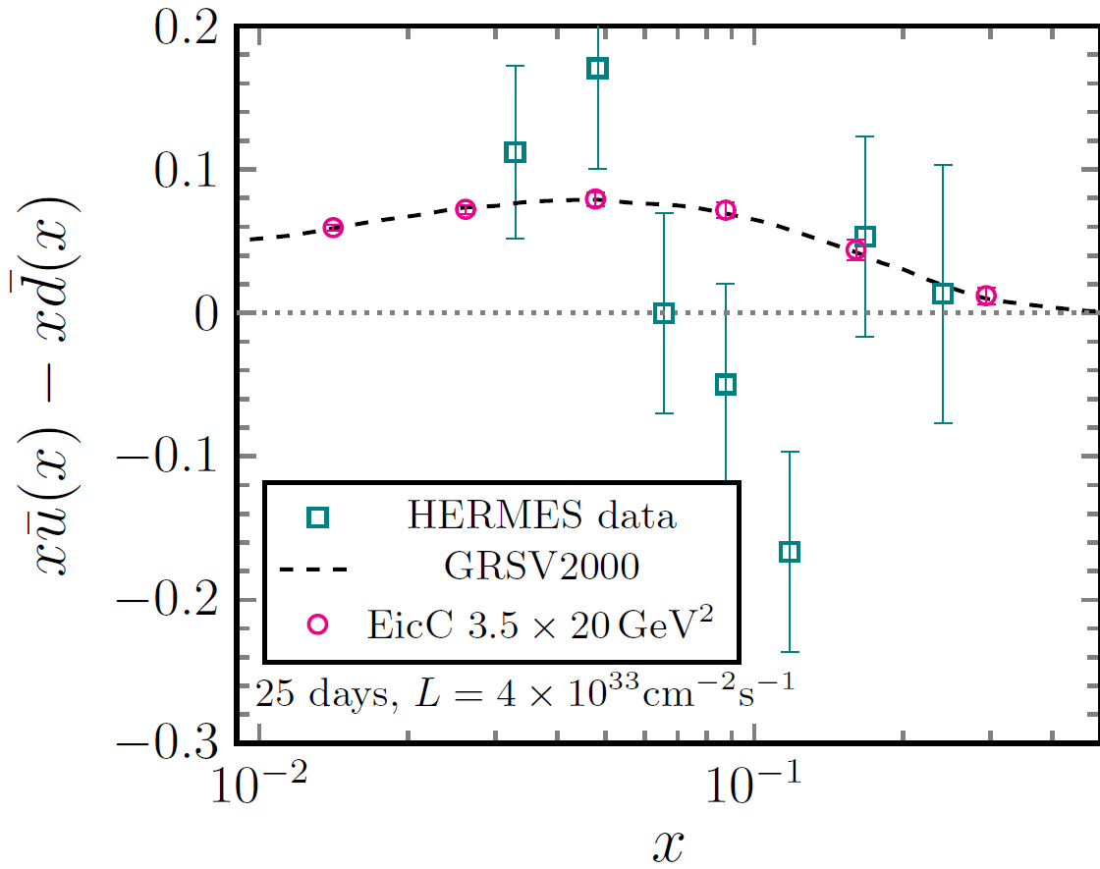
(2) Sea-quark Distributions
From Bowen Xiao
4 weeks running at EicC-I

Slide 17
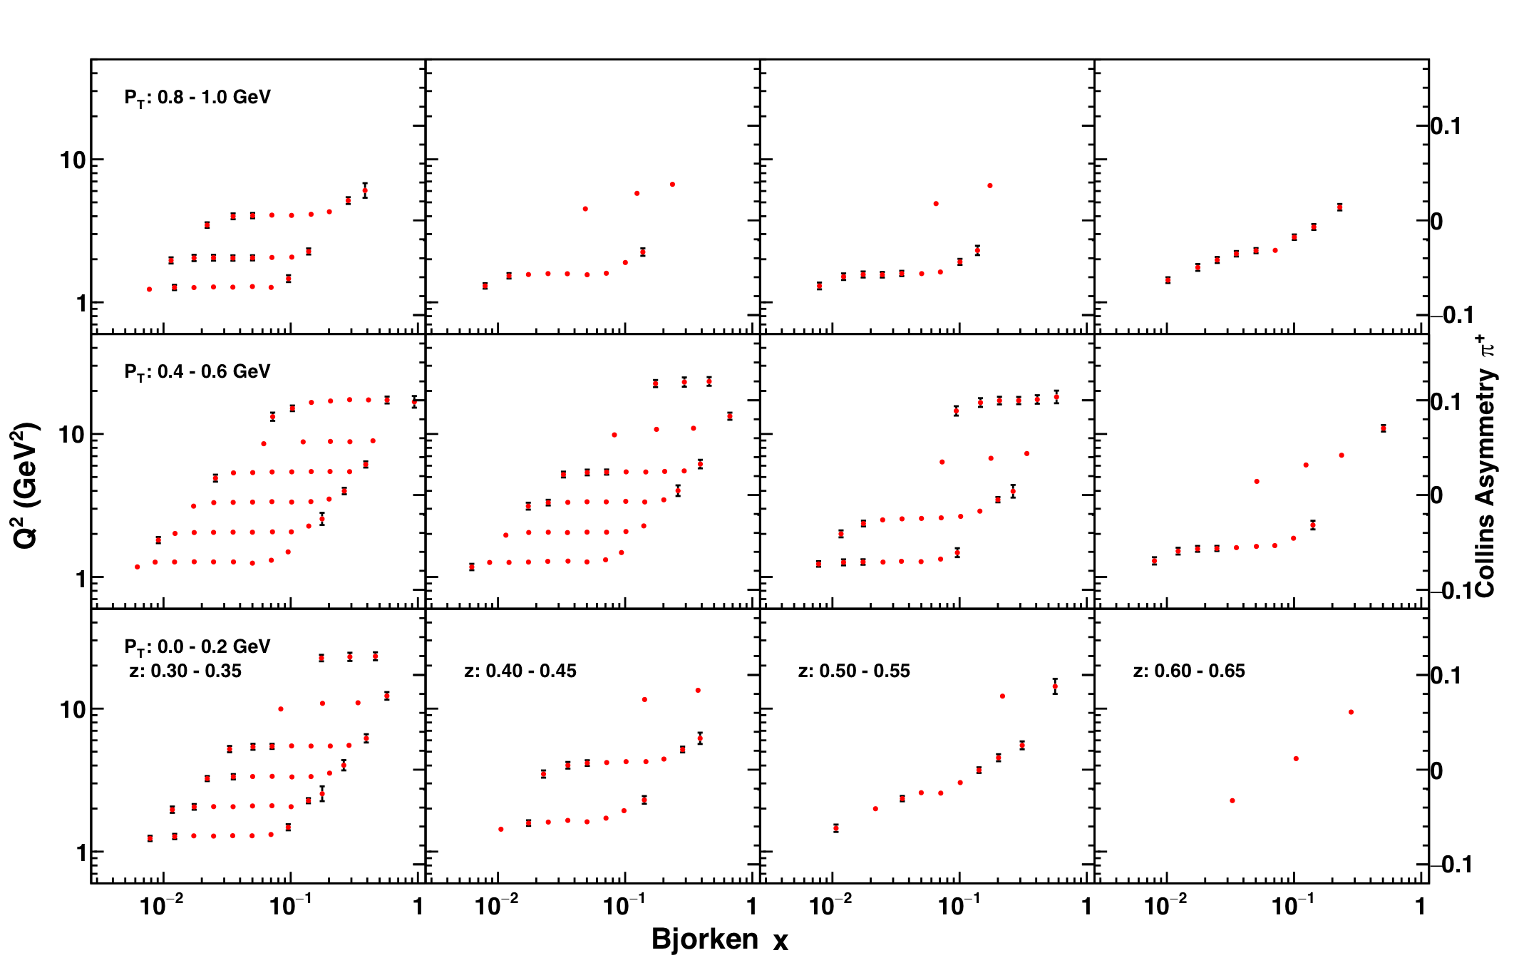
(3) TMD Collins asymmetry uncertainly for Pions
EicC-I: Precision measurement TMD at sea-quark region
More see Z. Yang on July 27

Slide 18
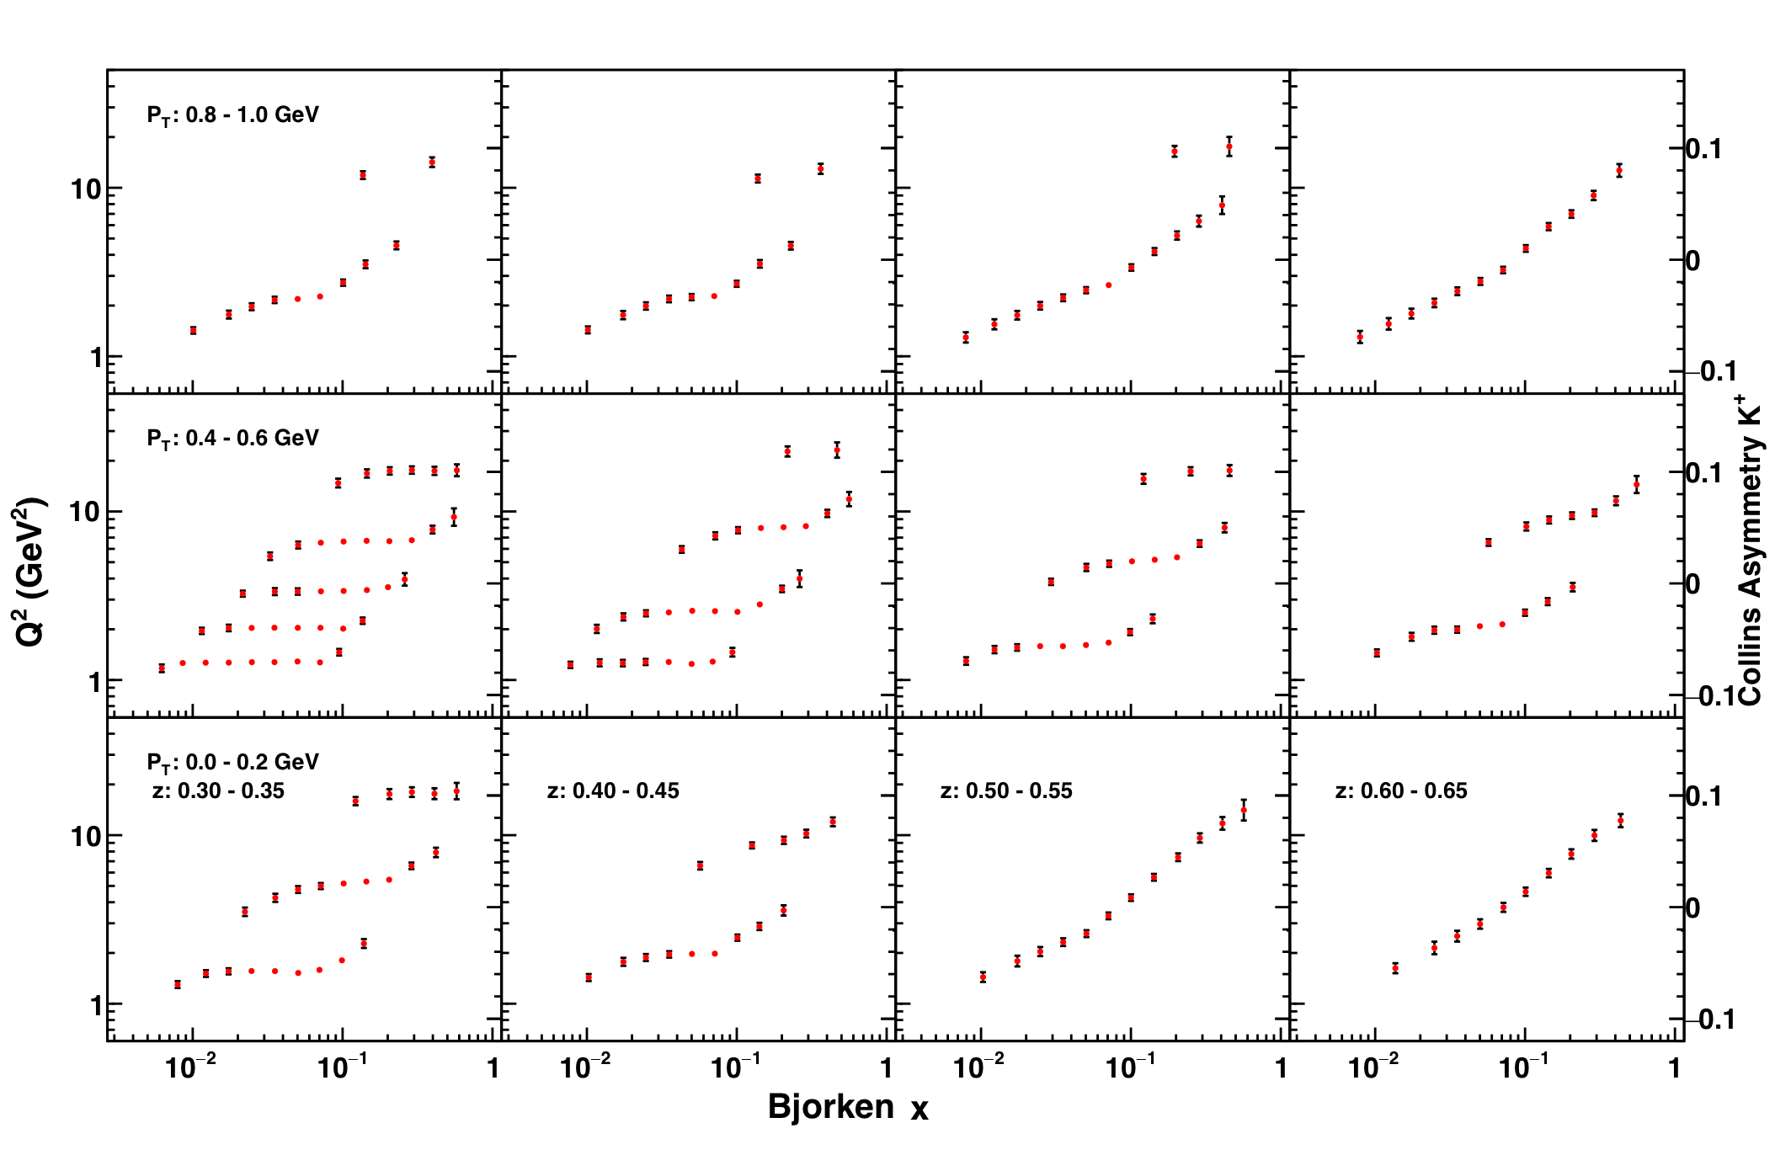
(3) TMD Collins asymmetry uncertainly for Kaons
Kaon is one of key measurements at EicC-I
More see Z. Yang on July 27

Slide 19
EicC-I Discussions in July 27 Afternoon
Jiancheng Yang “EicC Accelerator Conceptual Design”
Feng-Kun Guo “Exotic Bottom Hadron at EicC”
Yuxiang Zhao “Electro-weak physics at EicC”
Qiang Fu “DVCS at EicC”
Zhi Yang “TMD at EicC”

Slide 20
Summary
EicC-I focuses on valence- and sea-quark region (x ~ few x 10⁻²), addresses nuclear physics problem, complements to the world EIC physics programs
End of 2019: EicC-I Whitepaper draft
Worldwide efforts, theoretical and experimental, are needed
You are ALL invited to join the scientific endeavor: EicC-I

Slide 21
The 3rd EicC Discussion Meeting
Date: November 8-9(Thursday-Friday), 2018
Location: Institute of Modern Physics, CAS
Lanzhou, China
Topics to be covered:
Science cases for EicC
Detector and physics simulations
Machine design and simulations
Contact: Xurong Chen: xchen@impcas.ac.cn
Nu Xu: nxu@impcas.ac.cn
Meeting secretary: Ms. Yali Zhao
Phone: +86 181 3999 7361
eMail: zhaoyali@impcas.ac.cn

Slide 22
Thank you!

