Slide 1
GDML Problem and 3D View in Besvis
Long Peixun
2018.1.4

Slide 2
Outline
GDML Problem
3D Views in Besvis
3D Display Solution

Slide 3
GDML Problem
Besvis cannot load GDML file successfully.
The reason has been found by Huang Shuhui, SYSU.
Besvis uses library BesGDML to load GDML file. However, BesGDML is not updated together with Besvis.
More specifically, the order of points in TtwistedtubsSubscriber is wrong.
To fix this bug, we need to modify library BesGDML.

Slide 4
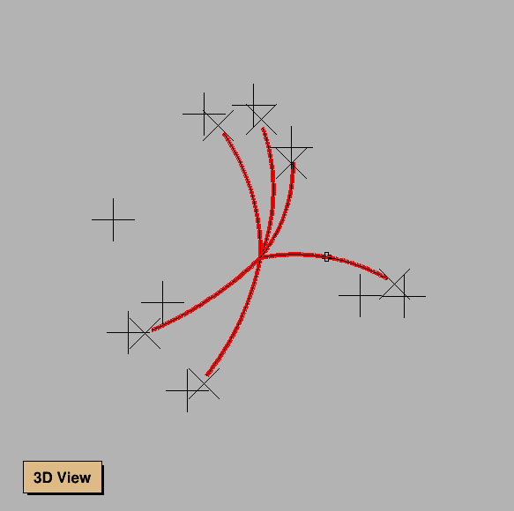
3D Views in Besvis
Actually, Besvis used to have 3 kinds of 3D view: Pad, X3D, OpenGL.
But now:
OpenGL View has been commented out.
X3D View has bug and cannot work.
3D View in Besvis only contains reconstruction tracks.
No detectors and hits.

Slide 5
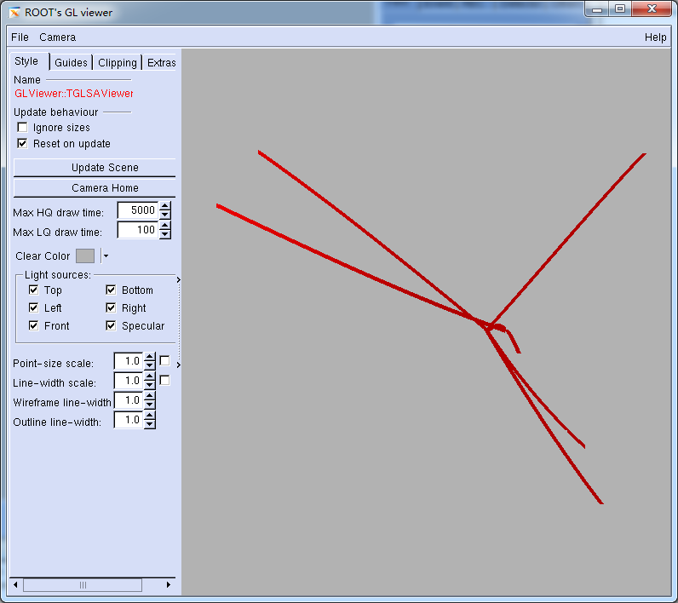
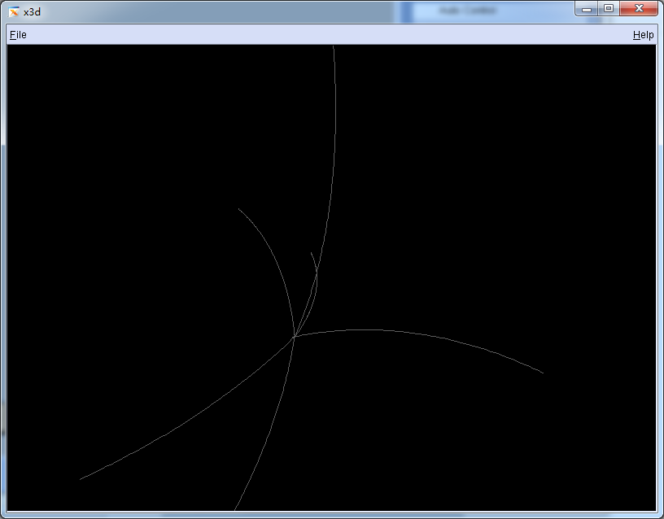
3D Views in Besvis
I have fixed OpenGL View and X3D View functions.

Slide 6
3D Display Solution
Solution 1: Add detectors in existing 3D View
Solution 2: Add a new view to display 3D detectors
I tend to adopt solution 1.
XY+ZR View | XY View | ZR View | 3D View | All View

Slide 7
Detector Panel

