Slide 1
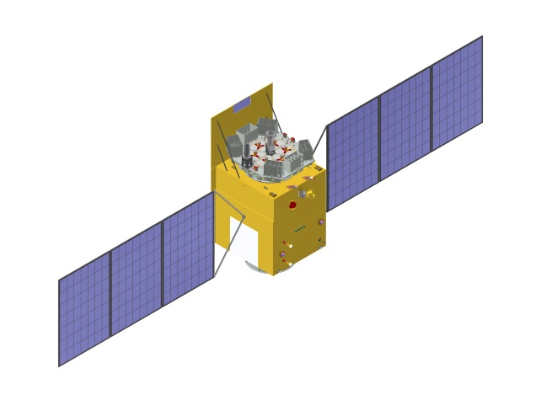
Insight-HXMT Observations of the new Black Hole Candidate MAXI J1535-571: TIMING ANALYSIS
HUANG Yue (IHEP)
on behalf of the Insight-HXMT team
2018-06-18
The 3rd PANDA Symposium 2018-06 Chengdu

Slide 2
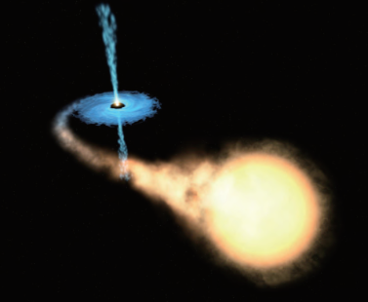
OUTLINE
Introduction
Insight-HXMT observations
Results
Summary

Slide 3
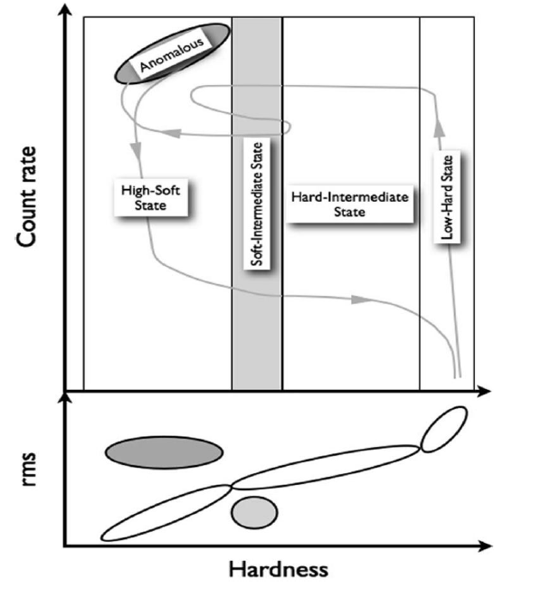
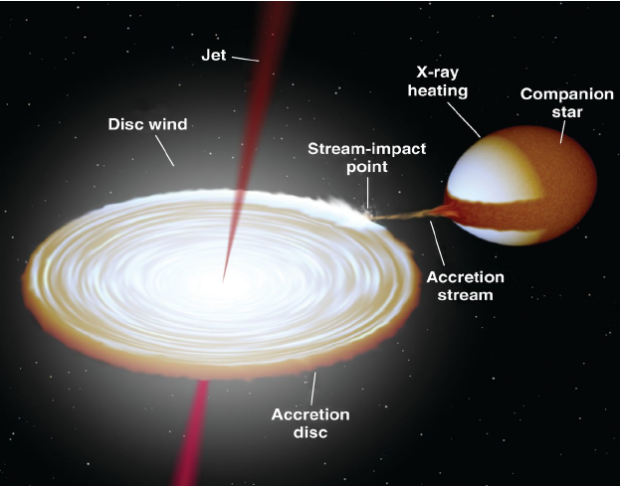
Black Hole Binaries
The fundamental diagrams
HID
HRD
Belloni 2010

Slide 4
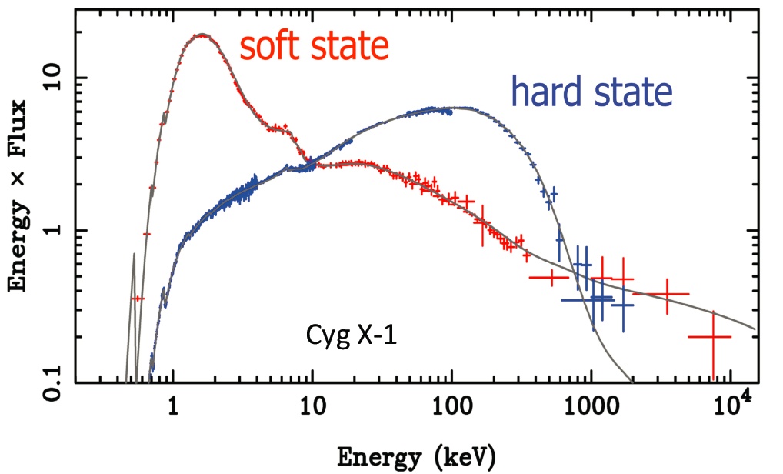
Hard and Soft State

Slide 5
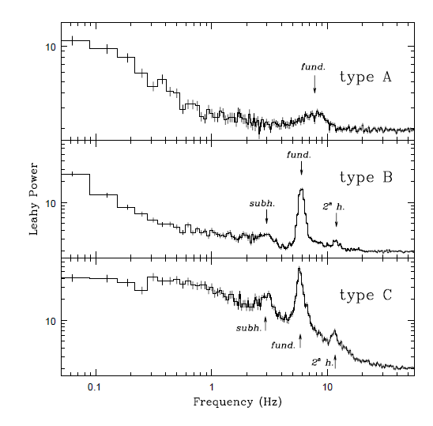
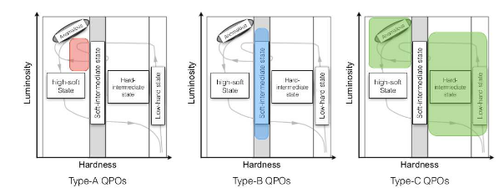
Fast time variability
Low Frequency QPOs
(mHz - ~10 Hz)
Casella et al. 2004
Motta 2016

Slide 6
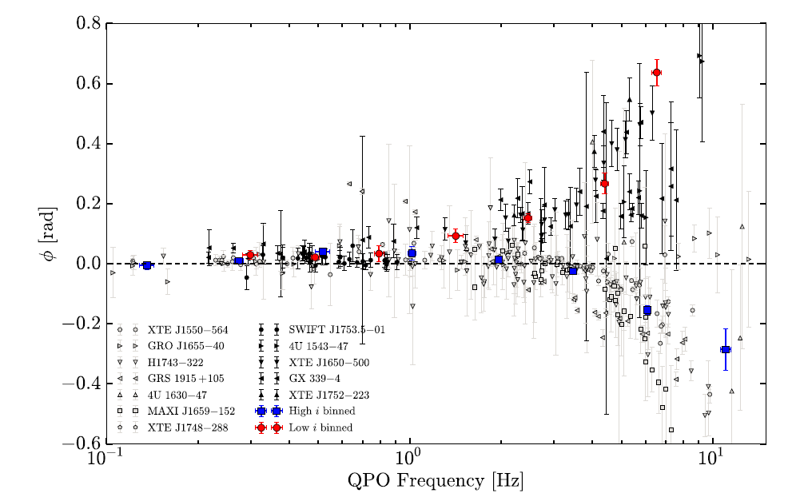
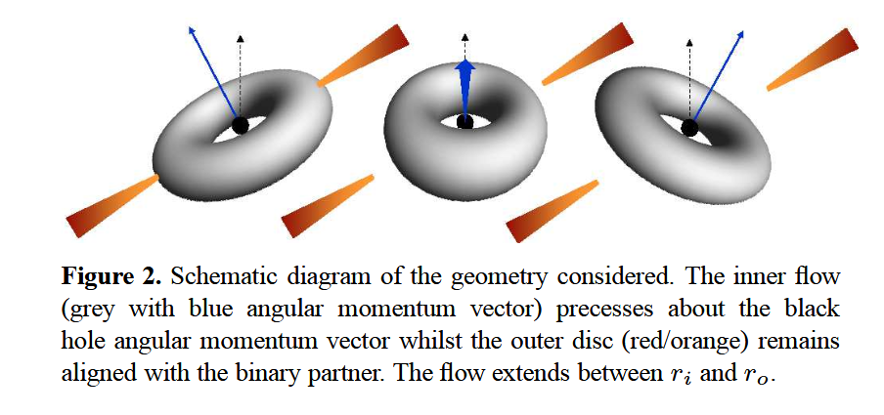
Models For LFQPOs
Instabilities: (e.g. accretion rate fluctuations)
Geometrical effects
Inclination dependence of
type-C QPO phase lags
Lense-Thirring precession
Ingram et al. 2009
J. Van der Eijnden et al. 2017

Slide 7
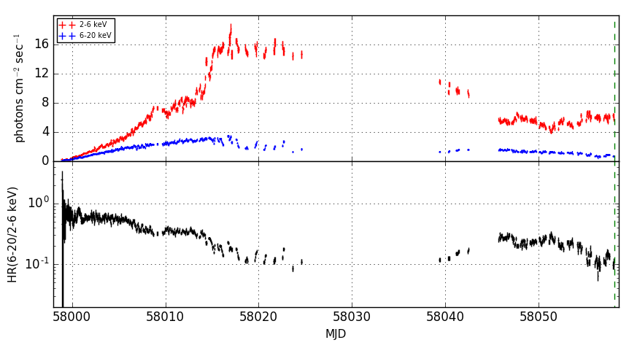
MAXI J1535-571
Detected by MAXI and Swift on 2017 September 02 (ATel #10699 & 10700)
(R.A., Dec) = (233.83, -57.23)
BHB Candidate
MAXI: >L_{Edd} of NS (ATel #10708)
ATCA: radio (ATel #10711)
~5 Crab
http://134.160.243.88/nakahira/1535monitor/

Slide 8
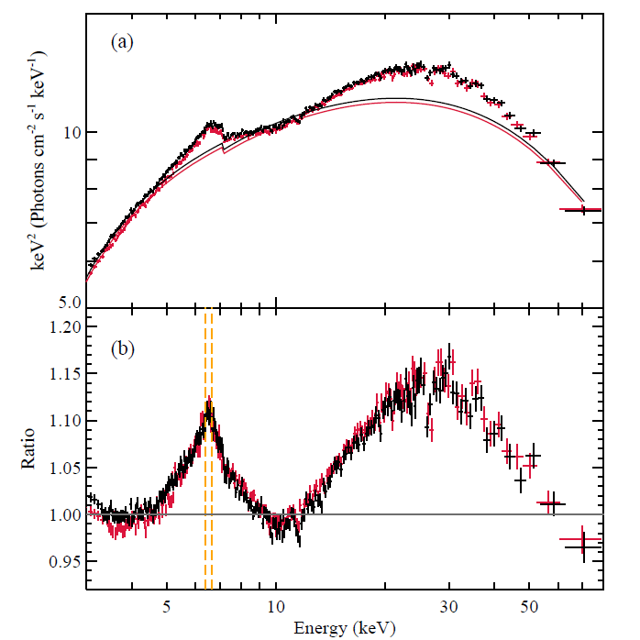
MAXI J1535-571
Swift/XRT: LFQPOs 1.87 Hz & 3.87 Hz (ATel #10734)
NICER: (ATel #10768)
tbabs*(diskbb+relxill)
a=${0.88}_{−0.2}^{+0.1}$, $i={27}_{−5}^{+1}°$
LFQPOs: 1.9--2.8 Hz
NuSTAR:(Xu et al. 2018)
Fe Kα line and a Compton
hump
$a>0.84，i=57°/75°$
NuSTAR
Xu et al. 2018

Slide 9
Insight-HXMT observations
 | Start Time | Exposure (ks)
1 | 2017/09/06 07:37:21 | 100
2 | 2017/09/14 04:56:05 | 8
3 | 2017/09/15 04:48:01 | 8
4 | 2017/09/16 06:15:31 | 8
5 | 2017/09/17 06:07:39 | 8
6 | 2017/09/18 02:48:56 | 8
7 | 2017/09/19 23:22:47 | 8
8 | 2017/09/21 02:26:27 | 150
4-20/2-4 keV

Slide 10
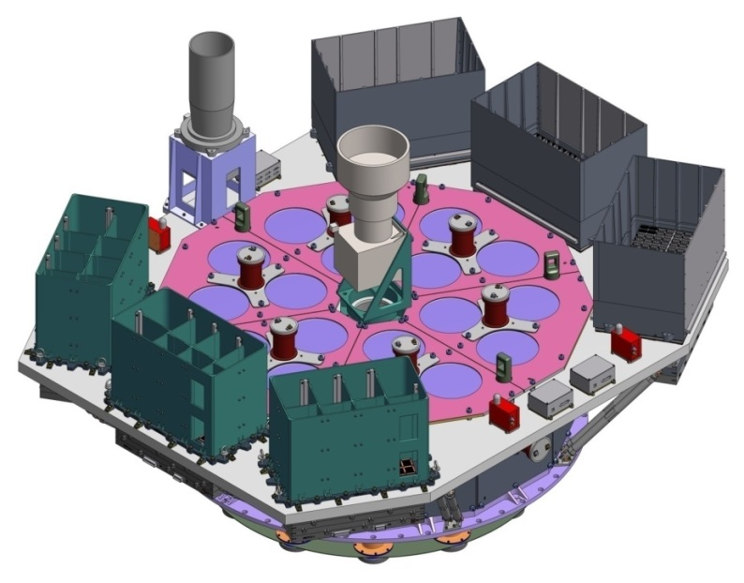
Insight-HXMT
Instrument | HE | ME | LE
Detector type | NaI/CsI | Si-PIN | SCD
Energy range (keV) | 20-250 | 5-30 | 1-15
Detection area (cm²) | 5000 | 952 | 384
Time resolution | 25 μs | 200μs | 1ms
Broad energy band (1-250 keV)
microsecond time resolution
Large effective Area
No pileup

Slide 11
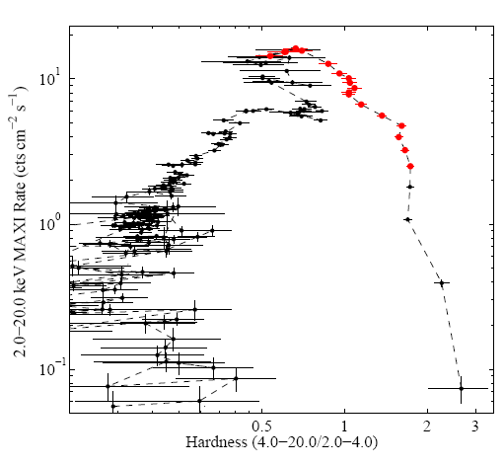
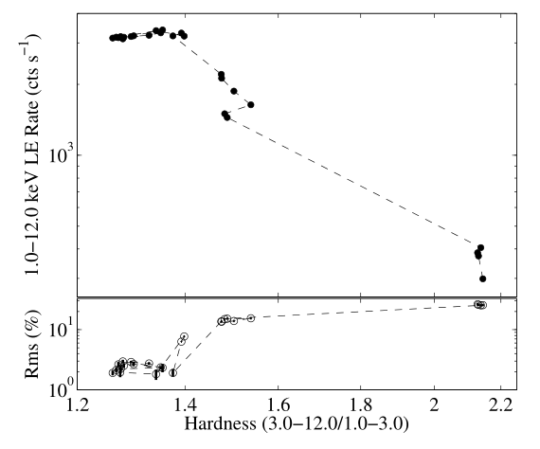
The Outburst Evolution
HID
MAXI
HID
HRD

Slide 12
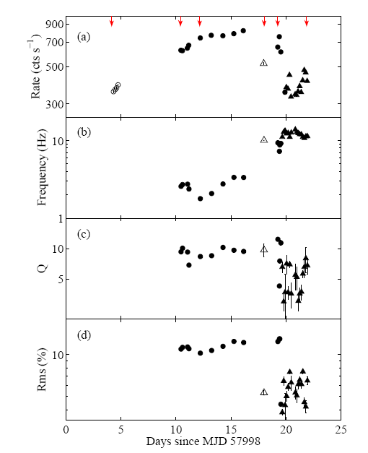
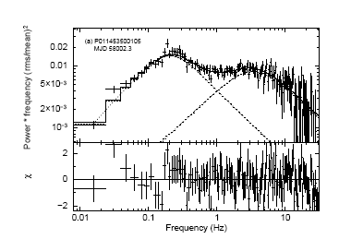
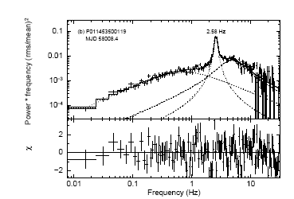
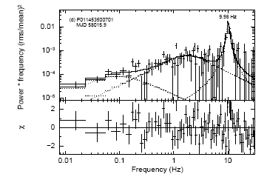
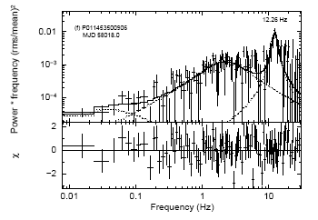
LFQPOs Evolution with Time
6-38 keV
open circles: no QPOs
filled circles: type-C QPOs
open triangles: type-B QPOs
filled triangles: type-A QPOs
LHS→HIMS→SIMS

Slide 13
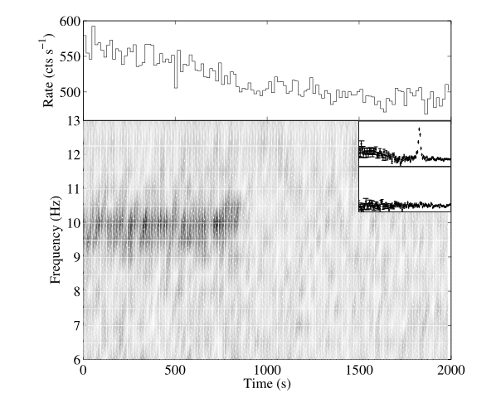
Rapid transition
6-38 keV
Dynamical PDS
state transition ?

Slide 14
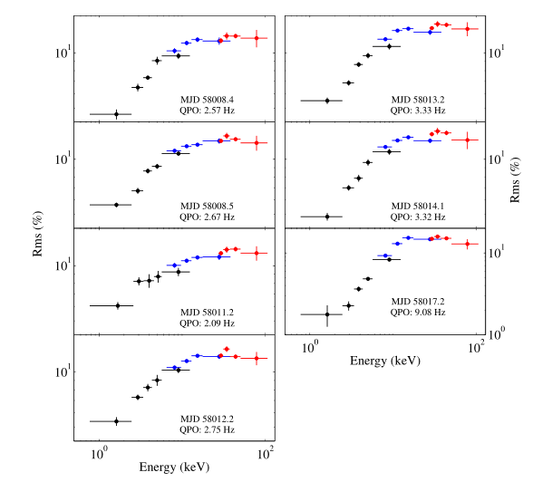
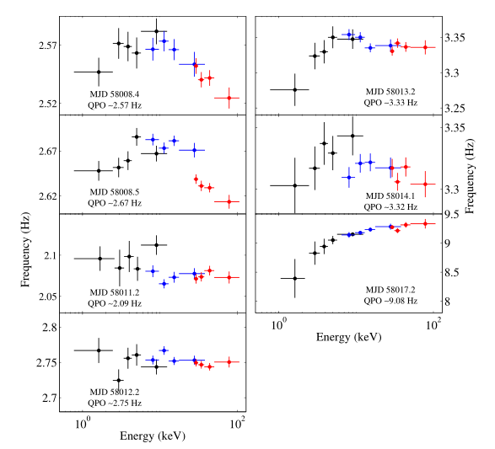
Energy Dependence of Type-C QPOs
RMS vs Energy
Frequency vs Energy
~ 100 keV

Slide 15
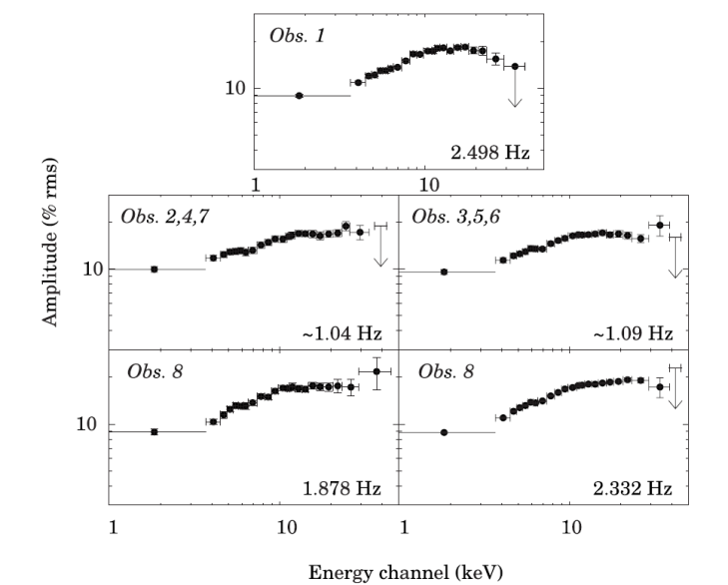
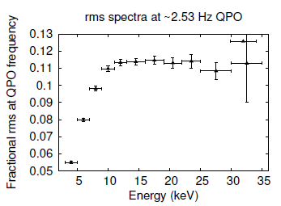
Energy Dependence of Type-C QPOs
GRS 1915+105
RXTE/PCA
AstroSat/LAXPC
YADAV et al. 2016
Rodriguez et al. 2004
~30 keV

Slide 16
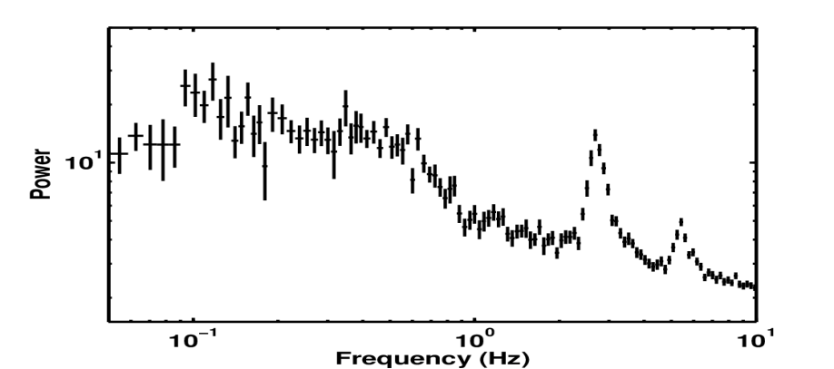
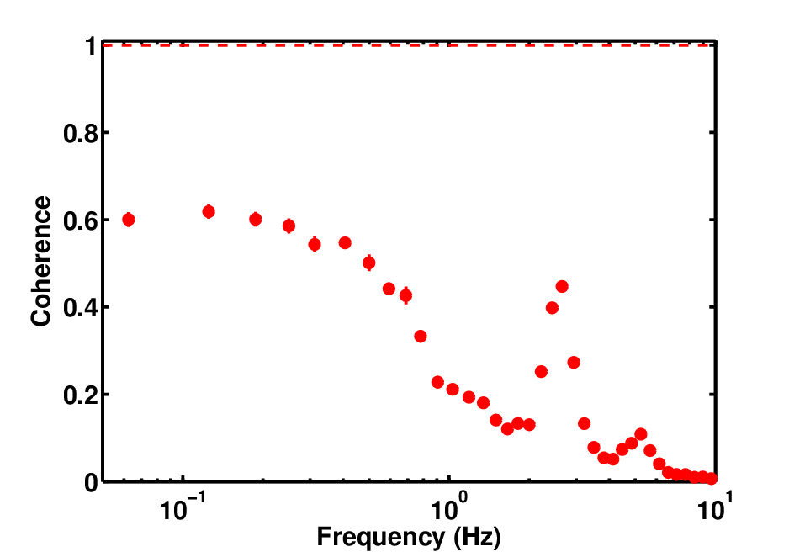
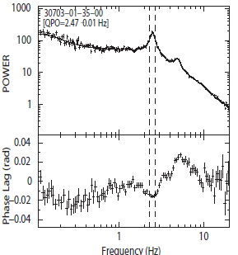
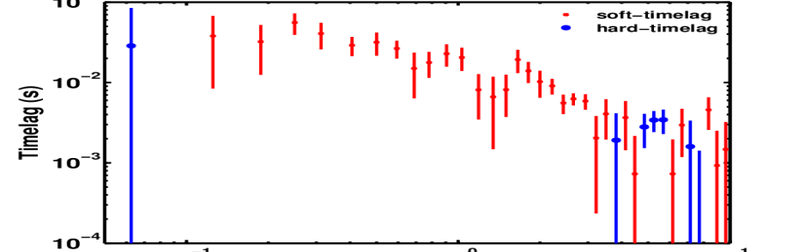
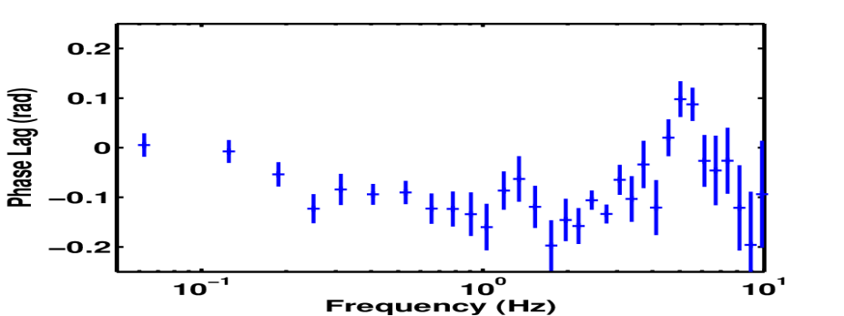
TIME LAG
Fundamental QPO: soft lag
Harmonic: hard lag
PDS: 1-7 keV
RXTE/PCA GRS 1915+105
Coherence
1-3 keV/3-7 keV
Time Lag
Phase Lag
Zhang. et al. 2017

Slide 17
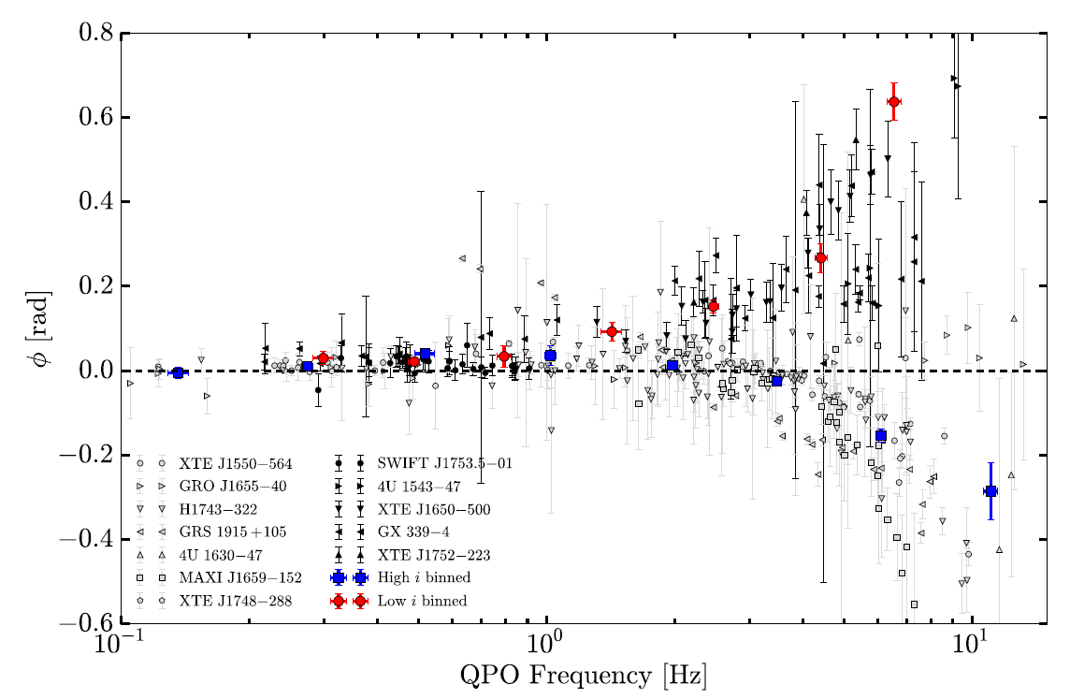
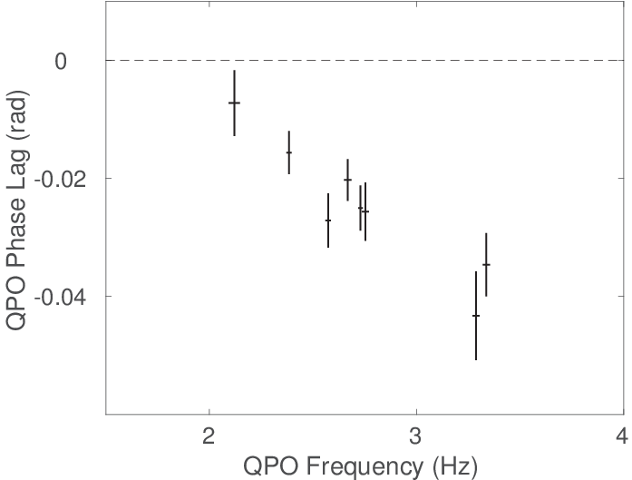
Time lag & Inclination
MAXI J1535-571
15 Galactic black hole binaries
Eijnden et al. 2017
NuSTAR: 57$°$ or 75$°$
NICER: 27$°$

Slide 18
Summary
The source exhibits state transitions from LHS to HIMS, and then SIMS.
We presented an energy dependence of the QPO fractional rms and frequency up to 100 keV, which was unexplored by previous satellites. While the energy dependence rms is similar to other black hole binaries observed by RXTE, Insight-HXMT reveals that the frequency-energy relation changes dramatically.
By assuming a geometric origin of type-C QPO, MAXI J1535-571 is consistent with being a high inclination source.

