Slide 1
CGEM Preliminary Display
Long Peixun
2018.1.25

Slide 2
Outline
CGEM’s rough structure
My work of preliminary display
Question and discussion

Slide 3
CGEM’s rough structure
According to CGEM Conceptual Design Report and Cgem.gdml
CGEM has 3 layers.
Each layer contains anode, cathode and 3 foils, forming 4 gaps.
Anode, cathode and foils consist of several sublayers with different kind of materials.

Slide 4
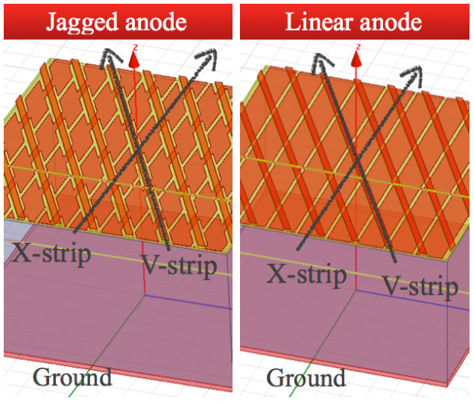
Cgem.gdml
However, current Cgem.gdml is not a full version.
It does not contain V-strips and X-strips in anodes.
It does not contain holes in foils.

Slide 5
My work
Loading CGEM geometry from Cgem.gdml
Drawing CGEM’s XY and ZR view in canvas
CGEM control option
Loading and saving ROOT geometry

Slide 6
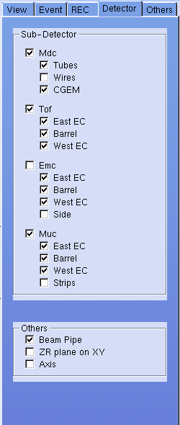
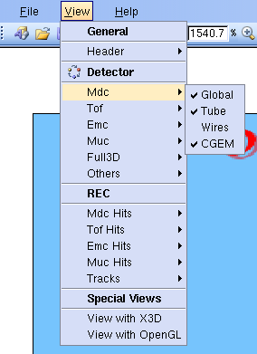
Add CGEM control

Slide 7
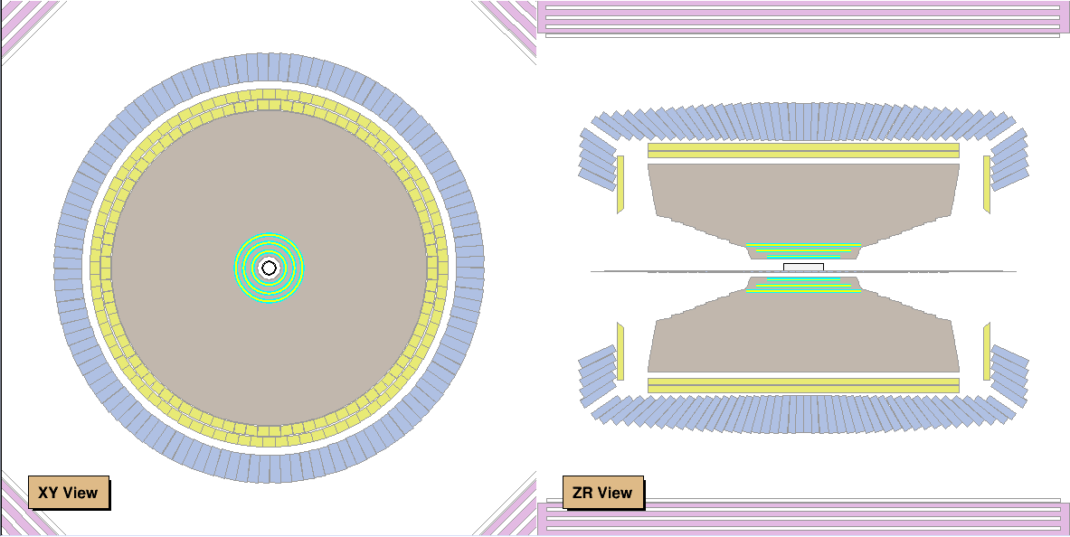
CGEM preliminary display

Slide 8
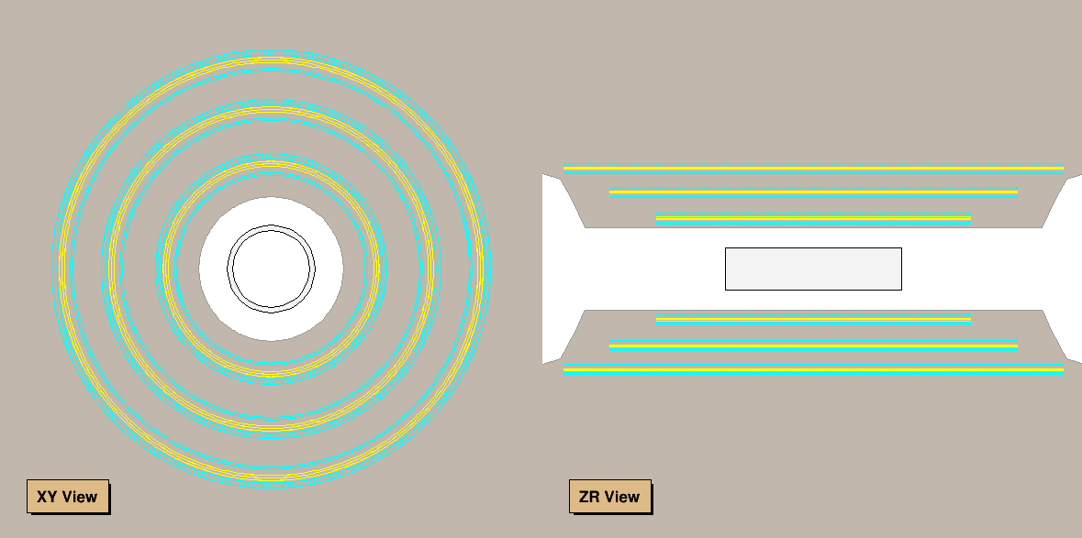
CGEM preliminary display

Slide 9
Question and Discussion
Will Cgem.gdml be merged into Mdc.gdml finally?
  Mdc.gdml + Cgem.gdml or Mdc_cgem.gdml
  Mrpc has been merged into Tof – Tof_mrpc.gdml
How to display X-strips and V-strips?

