Slide 1
Exploring High-energy emission properties of blazars through the GeV spectrum and variability
Xiongfei Geng(耿雄飞)
Tutor：Prof. Dai Benzhong
(戴本忠 教授)
The school of Physics and Astronomy
Yunnan University
（云南大学物理与天文学院）

Slide 2
Outline
Part-Ⅰ: Active galaxies and blazars:
quick summary from the discovery of quasars to the the challenge of radiation production mechanisms in blazar jets
Part-Ⅱ: Observation of BL Lac S5 0716+714 and CTA 102
Part-Ⅲ: Summary and perspectives

Slide 3
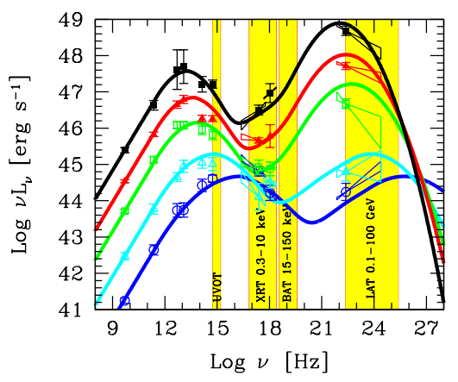
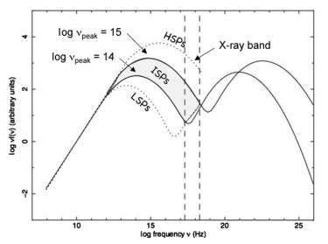
Part-Ⅰ: Active galaxies and quasars
FSRQs versus BL Lacs
Blazars are be identified by the position of the synchrotron peak (Low, Intermediate or High) and classified into two classes:
★ Flat Spectrum Radio Quasars (FSRQs) ● Strong emission lines ● Almost all FSRQs are LSP blazars ● Leptonic process of gamma ray emission mainly though external Compton ● Higher luminosity ● Softer spectral index
G.Ghisellini. 2015 JHEAp 7 163G
★ BL Lacs ● Emission lines weak or non existent ● Leptonic process of gamma-ray emission mainly Synchrotron self-Compton ● Lower luminosity ● Harder spectral index
A. A. Abdo et al. 2010 ApJ 716 30

Slide 4
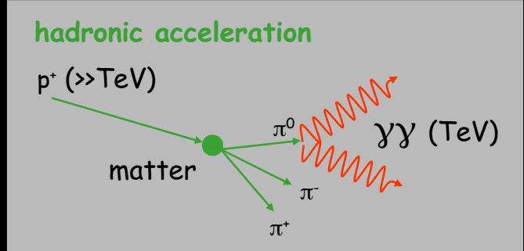
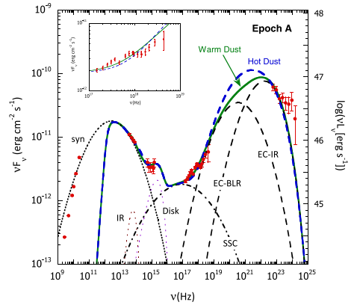
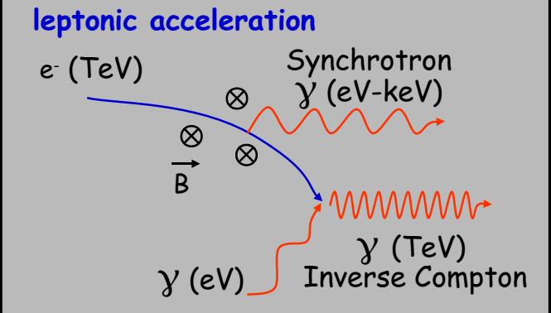
Part-Ⅰ: Active galaxies and quasars
Leptonic and hadronic model
(MJD 54,682−54,729; 2008 August 4–2008 September 19)
C. D. Dermer et al. 2014 ApJ 782 82
3C 279
Need more data in: - soft X-ray domain (Chandra, XMM, XRT) - hard X-rays/soft gamma rays (BAT, INTEGRAL, NuSTAR) - new generation instruments (ASTROSAT,LHAASO) - well located cosmic rays and neutrinos

Slide 5
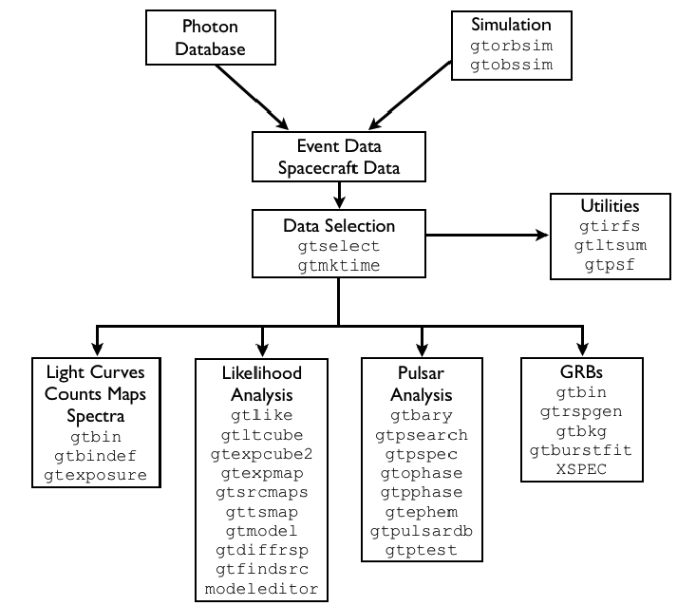
Part-Ⅰ: Active galaxies and quasars
Exploring Fermi-LAT data
Unbinned likelihood analysis performed using gtlike/pyLikelihood Science Tool v10r0p5 ● P8R2_SOURCE_V6 response function (PASS 8);
● diffuse models: gll_iem_v06 / iso_source_v06
● Region of Interest = 10 deg (radius) and Source Region = ROI + 10 deg
● zmax = 90 deg
● Upper limits on SEDs if less than ~3 photons or Test Statistics < 9

Slide 6
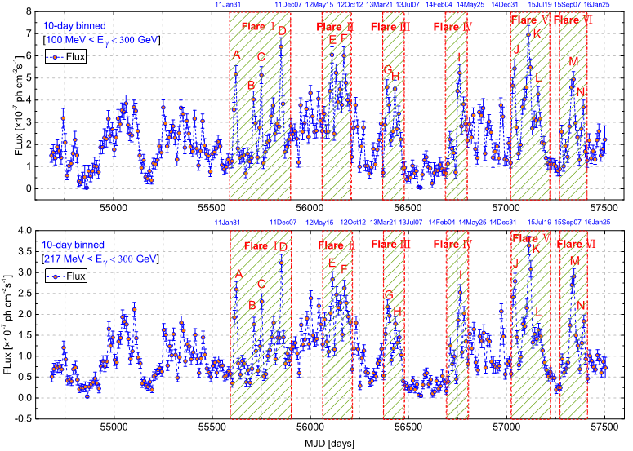
Part-Ⅱ: Observation of BL Lac S5 0716+714 and CTA 102
Variability study S5 0716+714
Obtained optimal energy（优化） E = 217 MeV over the ∼ 8 years by adaptive binning method (Lott et al. 2012)(自适应方法)

Slide 7
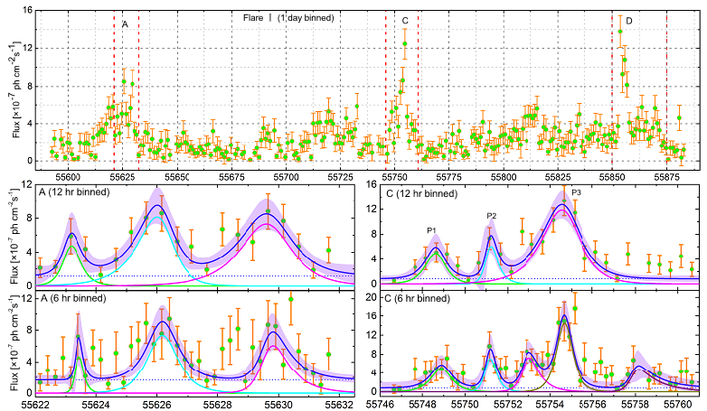
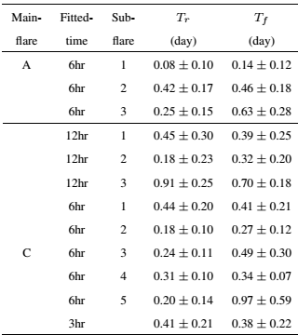
Part-Ⅱ: Observation of BL Lac S5 0716+714 and CTA 102
Individual peaks fitted by:
The symmetry of the flare:
Profile fitting
1.Some flares show essentially equal rise and decay timescales , which implies that they have a symmetric temporal profile.
2.The possible reason is the superposition and blending of several episodes of short duration.

Slide 8
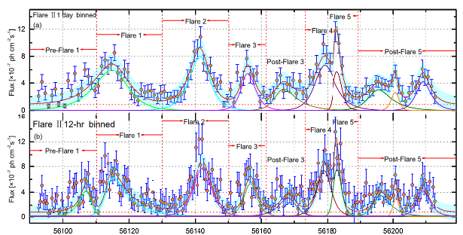
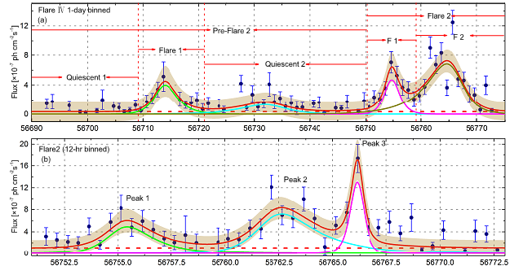
Part-Ⅱ: Observation of BL Lac S5 0716+714 and CTA 102
3. Some flares show essentially unequal rise and decay timescales , which implies that they don’t have a symmetric temporal profile.
4.The possible reason is fast injection of accelerated particles.

Slide 9
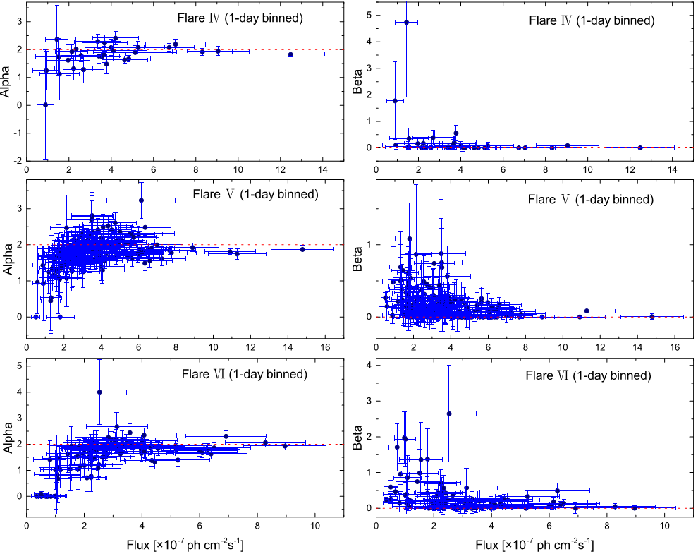
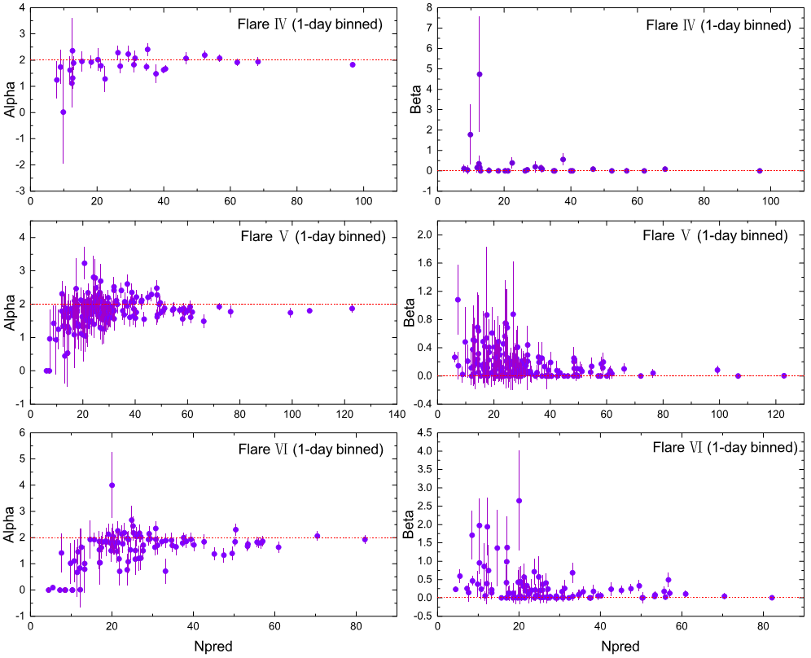
Part-Ⅱ: Observation of BL Lac S5 0716+714 and CTA 102
The spectral evolution of S5 0716+714
(1) α is relatively small with the high flux, suggesting a harder-when-brighter behavior and the energy of emission from high-energy emission less absorbed by lower energy optical and UV photons.(a softer-when-brighter-behaior )
(2) The distribution of β becomes much flatter at high flux. the origin of spectral curvature is still an ambiguous.

Slide 10
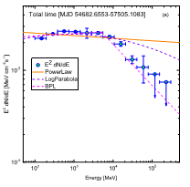
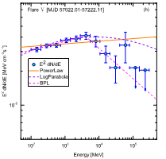
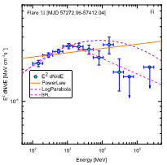
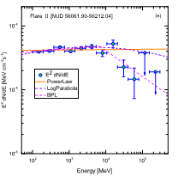
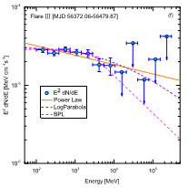
Part-Ⅱ: Observation of BL Lac S5 0716+714 and CTA 102
3.93 GeV(>4σ)
1.11GeV(5.75σ)
5.08 GeV
>7σ
Radiative cooling? Two component model（ Compton-scattered disk and BLR radiations? ）， Absorption via pair production?
Upper-limit
Requiring LHAASO data
6.90 GeV(4σ)
1.11GeV(4.8σ)
Giving a better explanation

Slide 11
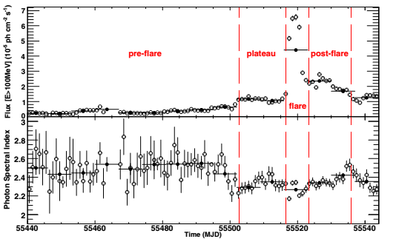
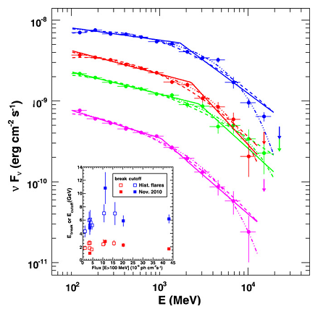
Abdo 2011
3C 454.3
Abdo 2011
A break around the observed GeV photon energy is due to a transition from the dominant IC scatting (in the Thomson region) of the emission from the accretion disk to IC scatting (in the KN region) of the disk emission re-processed in the BLR

Slide 12
Part-Ⅱ: Observation of BL Lac S5 0716+714 and CTA 102
Jet doppler factor
Size of the emission region
0.05 pc
Possibility within BLR
In the BLR
In the MT
This is compatible with the previously estimated value of Γ jet from Jorstad et al (2005) and Sikora et al (2008).
gamma-ray emission region: within or beyond the (BLR)

Slide 13
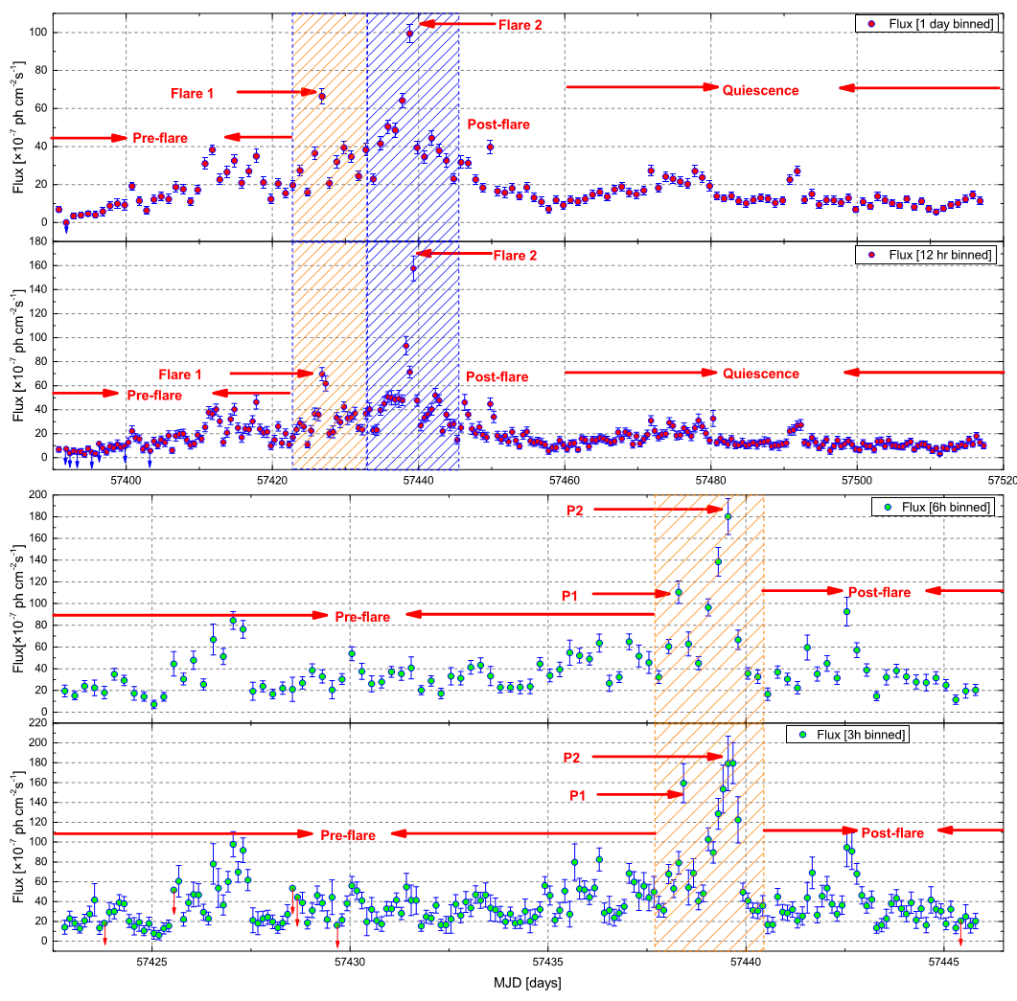
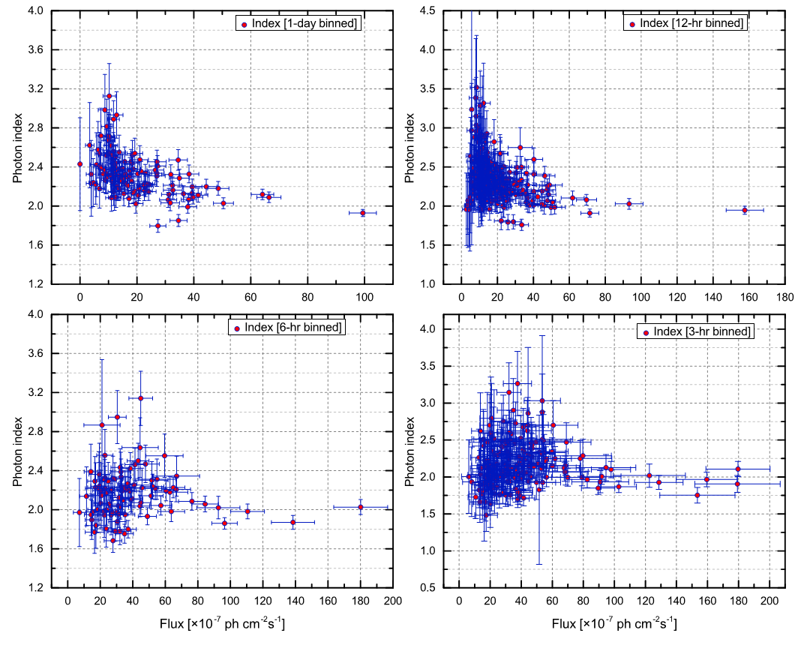
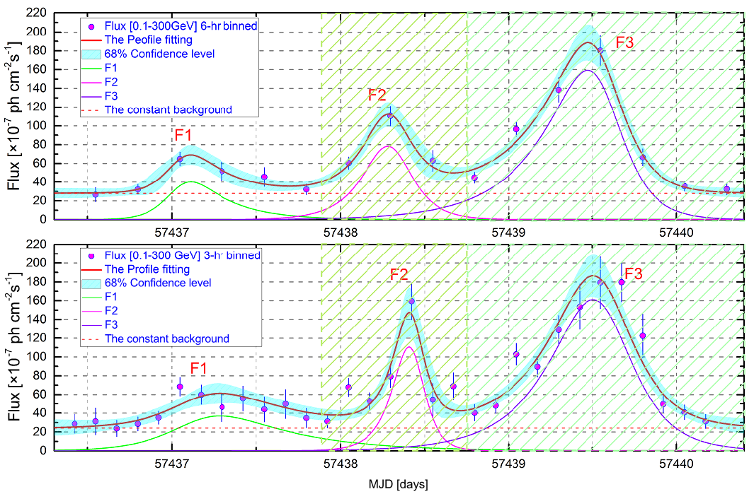
Part-Ⅱ: Observation of BL Lac S5 0716+714 and CTA 102
Variability study CTA 102
a symmetric temporal profile.

Slide 14
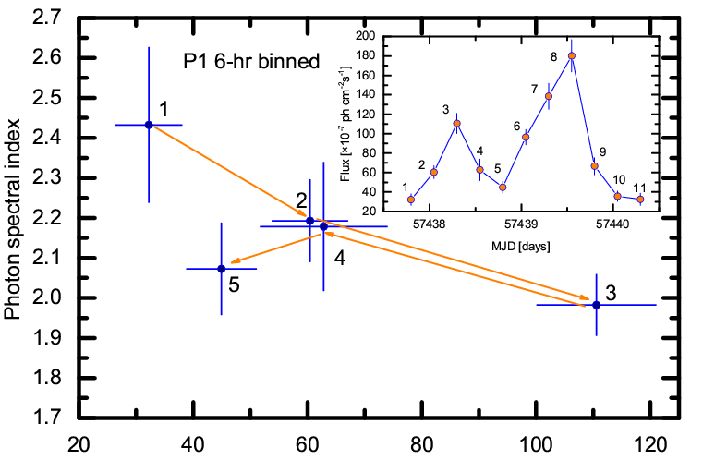
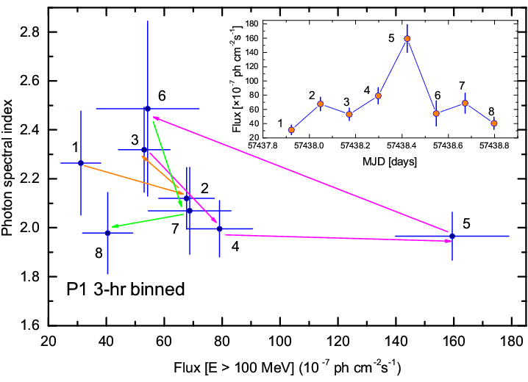
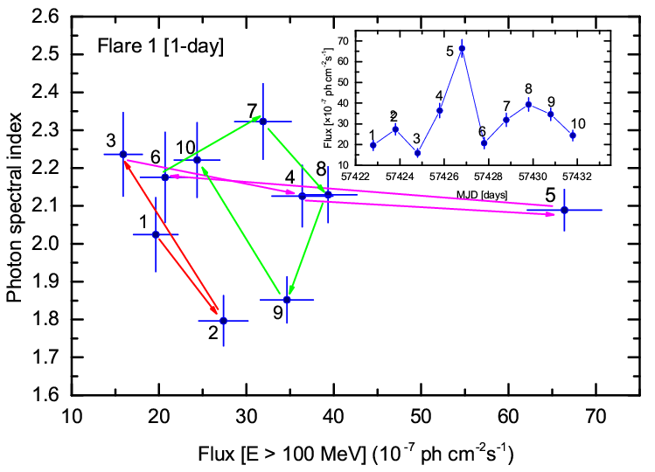
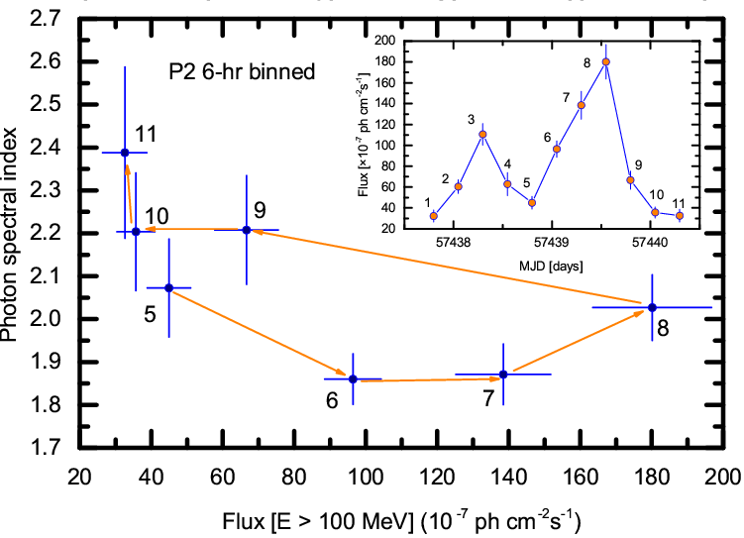
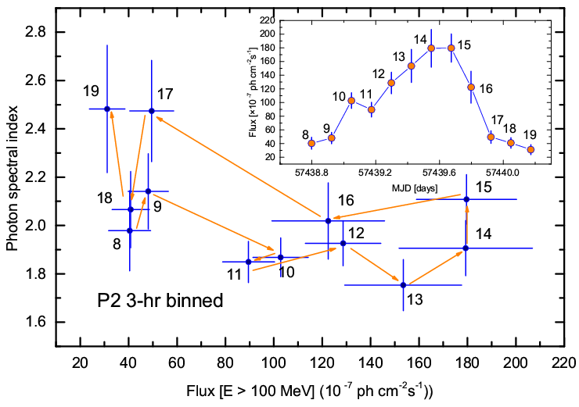
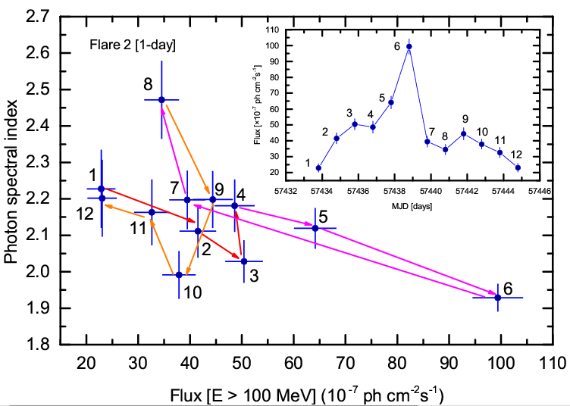
A clockwise loop (1-2-3-4-5)
A counter-clockwise loop (3-4-5-6)
A counter-clockwise loop (3-4-5-6)
A clockwise loop (6-7-8-9-10)
A counter-clockwise loop
(5-6-7-8-9-10)
A counter-clockwise loop
(8-9-10-11----16-17-18-19)
Implying the spectral slope is controlled by the acceleration processes at strong shocks during the flares, but a clockwise loops are expected to occur as a consequence of cooling of the radiating particles.
A clockwise loop (4-5-6-7-8)

Slide 15
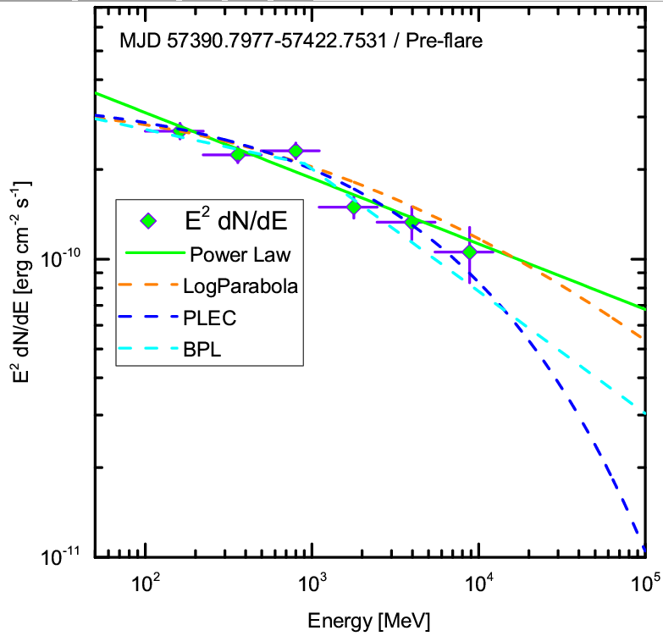
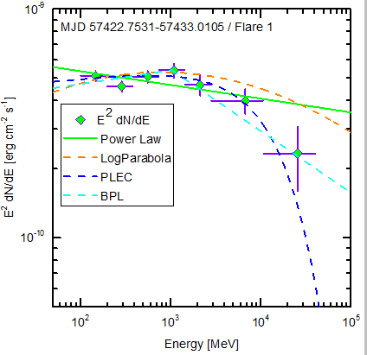
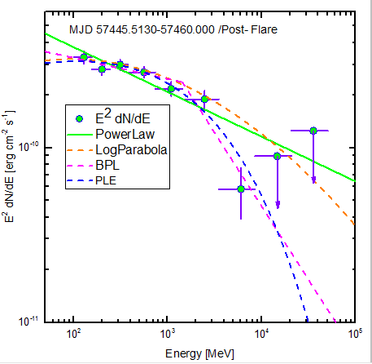
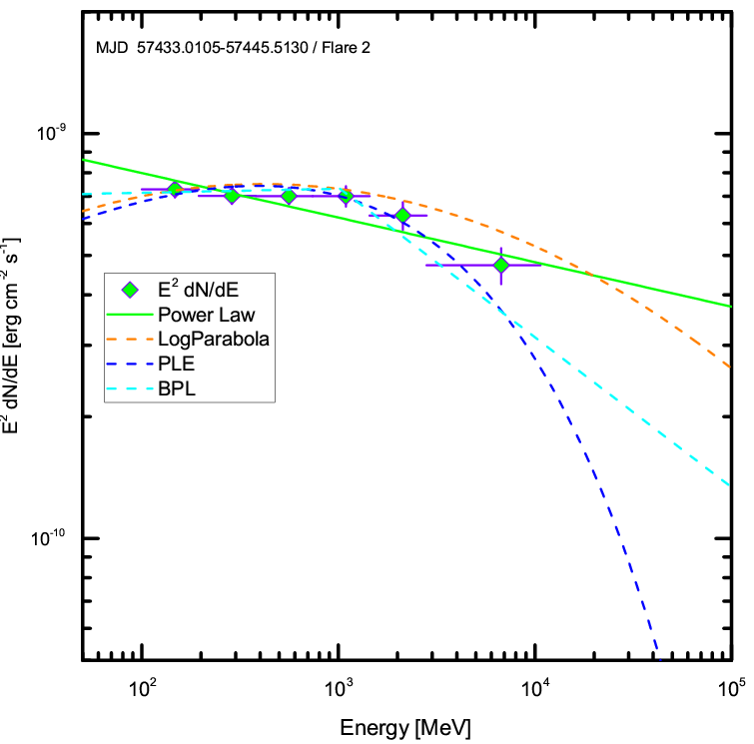
Part-Ⅱ: Observation of BL Lac S5 0716+714 and CTA 102
SED study CTA 102
Upper-limit
Need LHAASO data
Giving a better explanation by modifying models

Slide 16
Part-Ⅲ: Summary and perspectives
Summary and perspectives
●Gamma-ray monitoring of blazars and other AGNs offer a great potential for astrophysical modelling.
● Results on S5 0716+714:
▲Constraints on the size in location of the gamma-ray emitting region by considering fast variability. Within BLR or MT region.
▲Spectrals have GeV break energy, its origin is an open quedtion.
▲ The flares show a symmetric temporal profile or a symmetric temporal profile, implying that the location of gamma-ray may be different.
● Results on CTA 102:
▲Spectrals also have GeV break energy.
▲The flares are likely derived from the acceleration processes at strong shocks
● Perspectives
▲ By SED modeling from multiband data and other blazars to exploring High-energy emission properties .

Slide 17
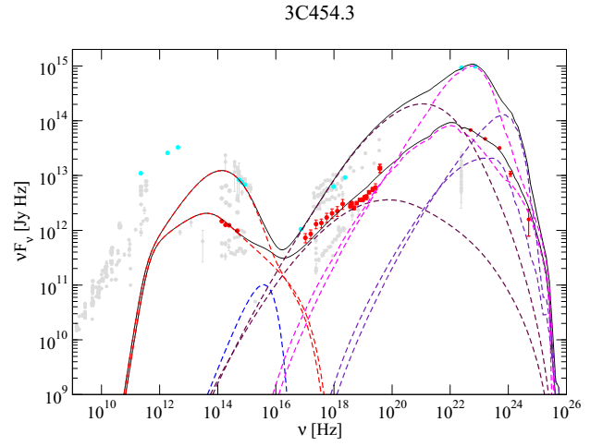
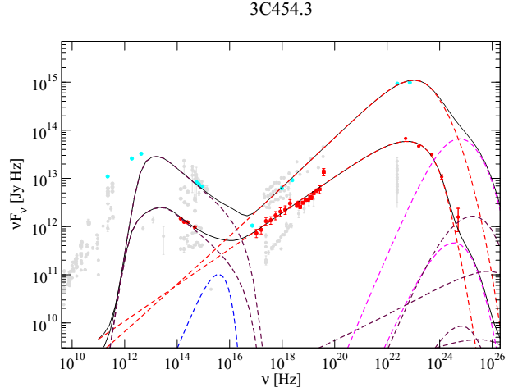
Part-Ⅲ: Summary and perspectives
Summary and perspectives
The Fokker-Planck equations of each particle species, i = e±, p, π±, µ±, is then written(Bottcher 2016):
Leptonic model
Hadronic model

Slide 18
谢 谢!

