Slide 1
LIS spectra of Galactic cosmic rays and solar modulation
报告人：朱成瑞
指导老师：袁强, 韦大明

Slide 2
Outline
Introduction
Our work
Conclusion

Slide 3
Introduction

Slide 4
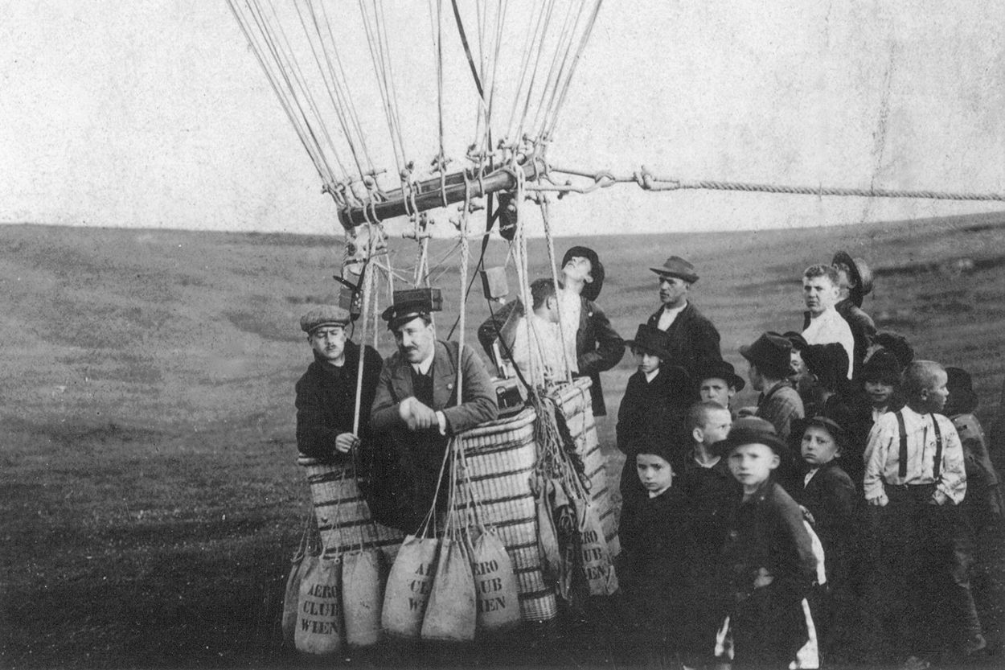
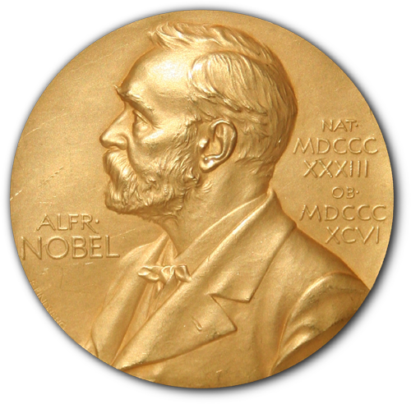
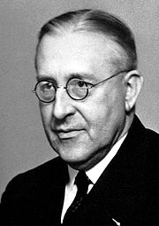
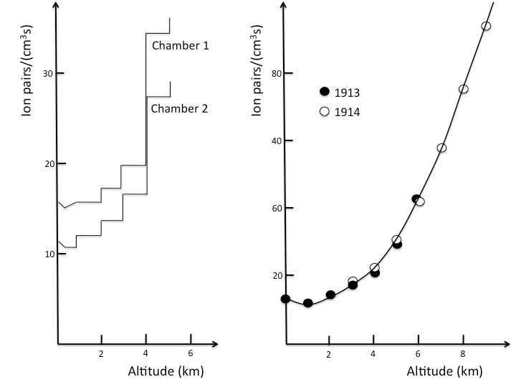
discovered in 1912 by Victor Hess

Slide 5
The importance of cosmic rays
cosmic rays’ sources
the property of interstellar
the property of dark matter

Slide 6
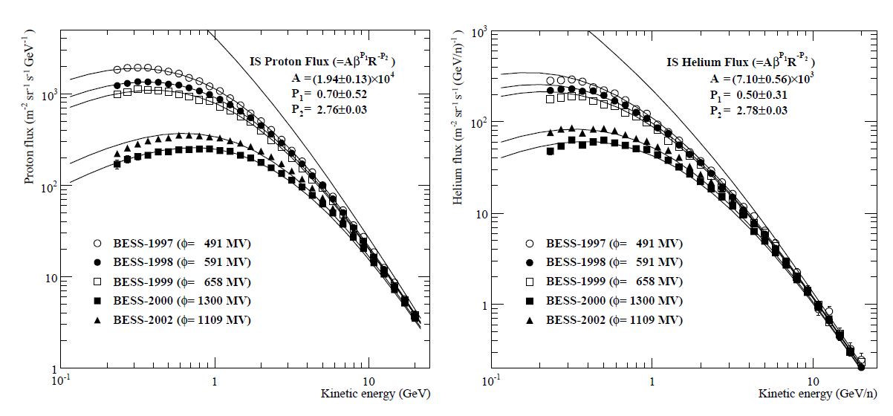
Solar modulation
Shikaze et al. 2007

Slide 7
Solar activity

Slide 8
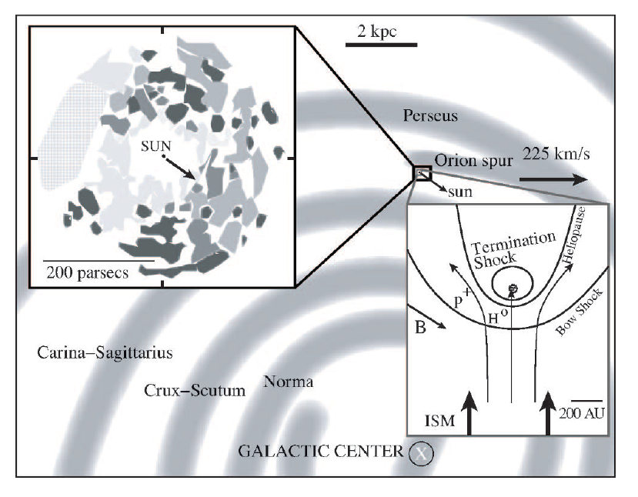
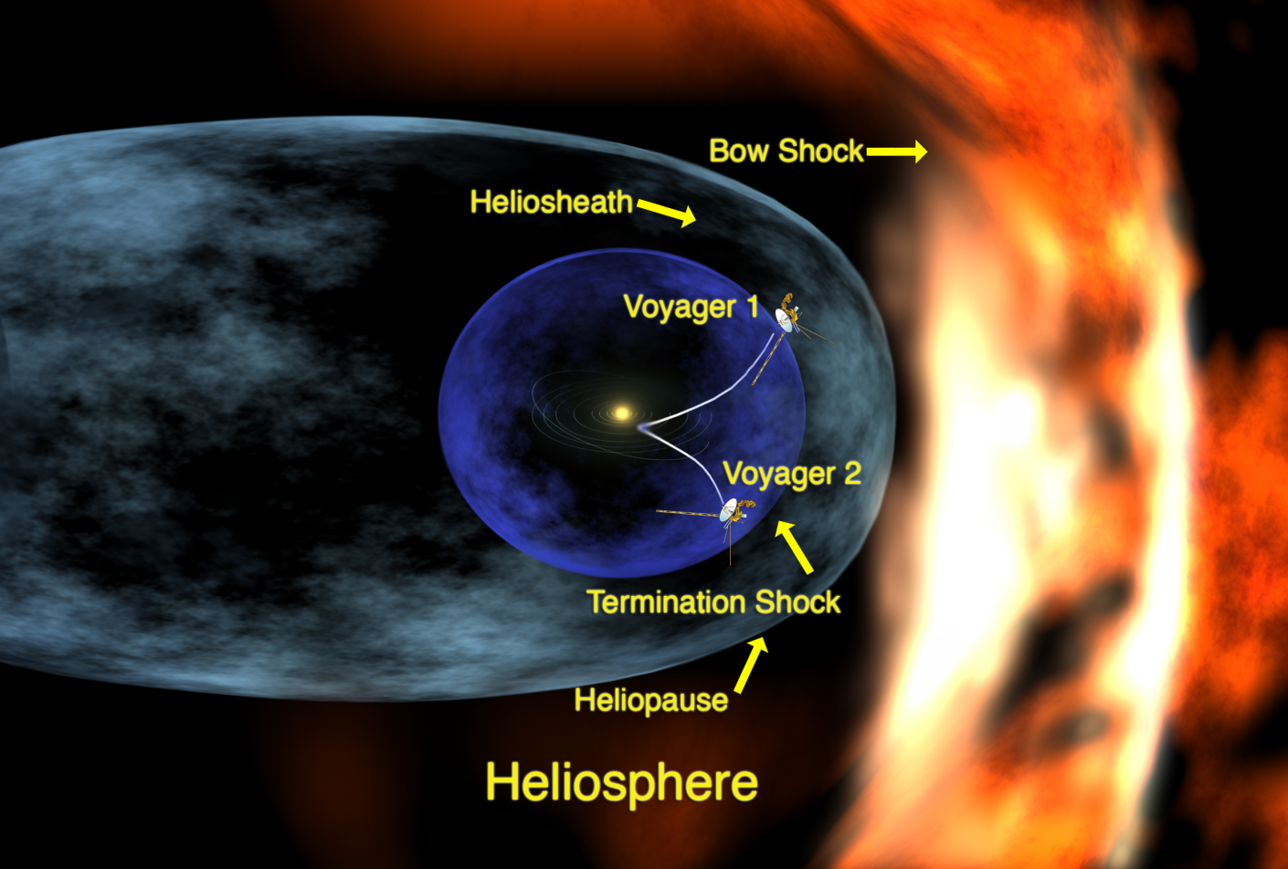
Heliosphere
a region influenced by solar wind
Size :100-150AU
Influence by :
Solar wind
heliospheric magnetic field (HMF)
structure of heliosphere
termination shock (TS)
heliopause (HP)
bow shock (BS)
Voyager 1 arrive heliopause on 2012

Slide 9
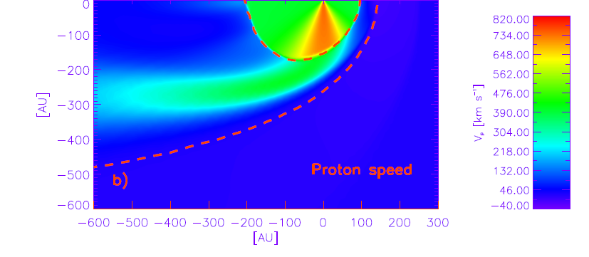
Solar wind
A stream of charged particles from the sun with speed aroud 400 Km/s
Mainly composed of electrons and protons
Carries the sun magnetic field to the interplanetary space
Marius et al. 2013

Slide 10
Global magnetic field geometry
The main attribute of the HMF is that it follows a 22-year cycle with a reversal about every 11 years at the time of extreme solar activity
There exist magnetically neutral layer
(heliospheric current sheet)
Marius et al. 2013

Slide 11
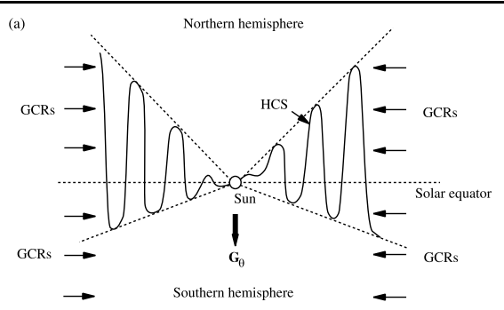
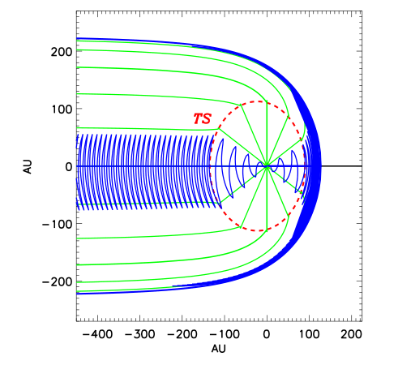
heliospheric current sheet (HCS)
Δ tilt angle α
Δ divides the solar magnetic field into hemispheres of opposite polarity
Marius et al. 2013

Slide 12
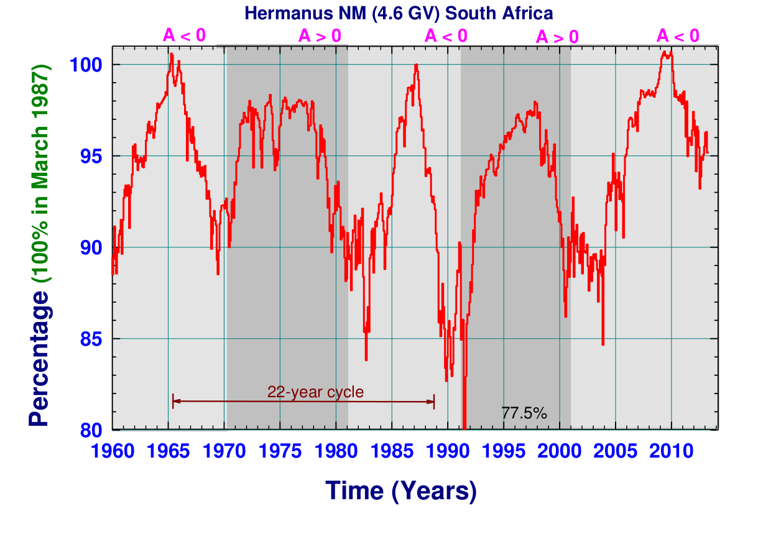
solar cycles
Marius et al. 2013

Slide 13
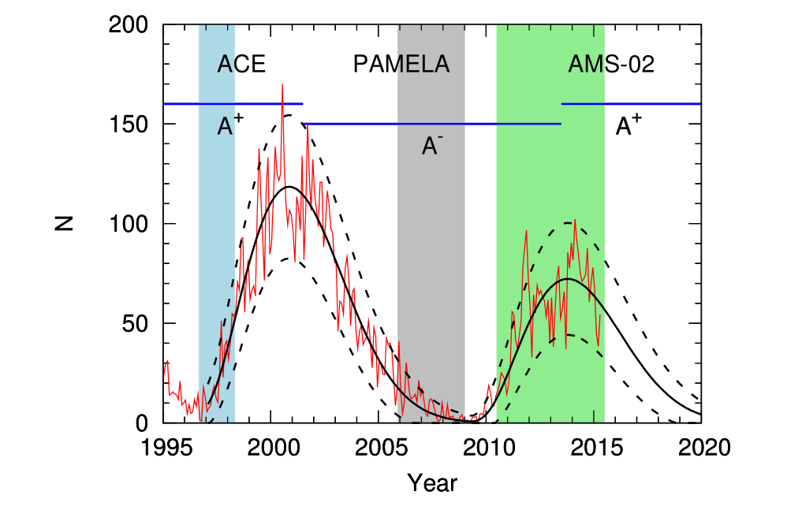
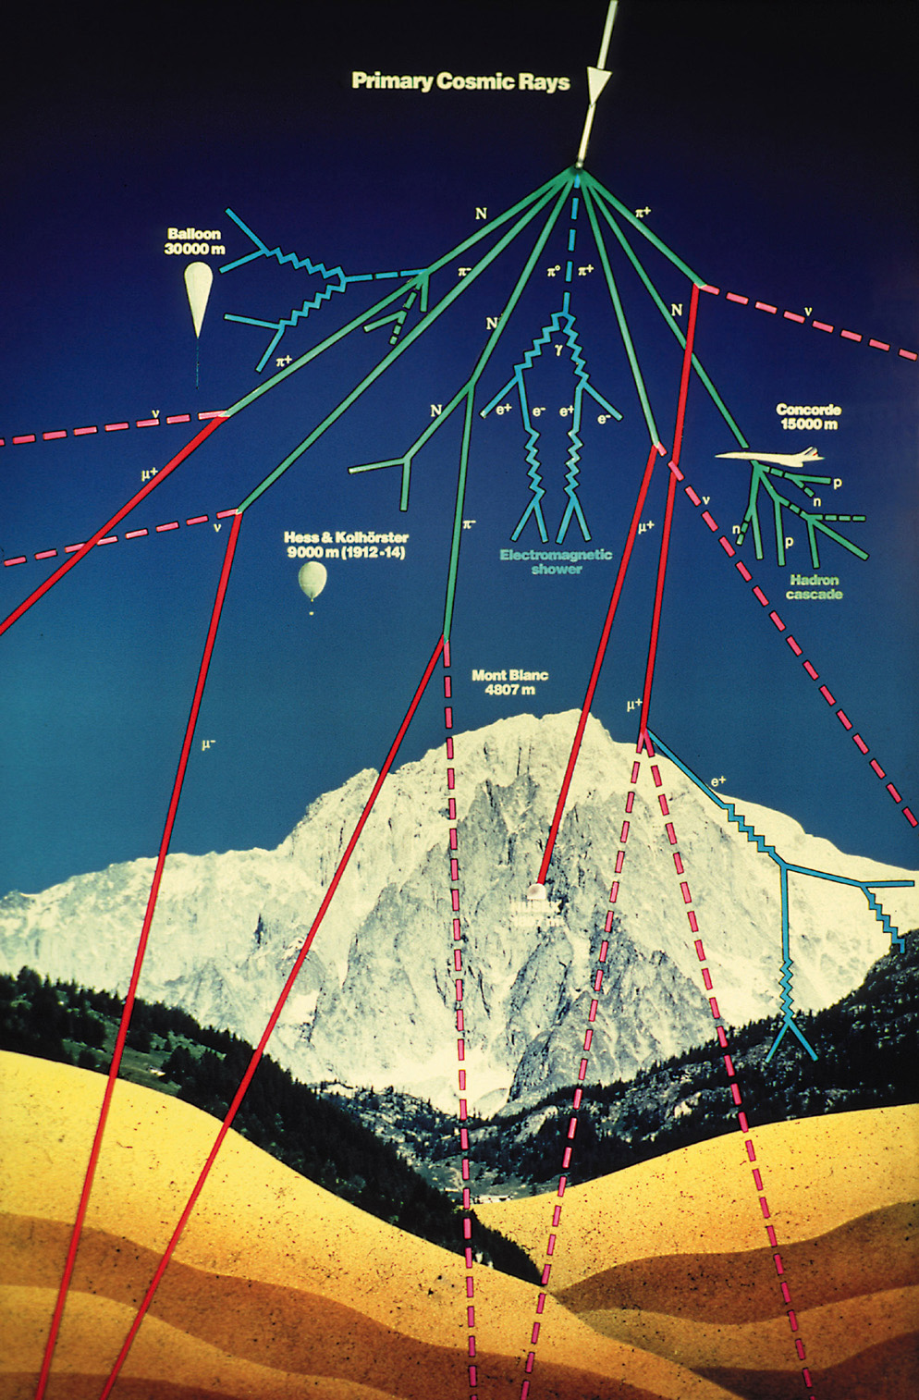
Solar activity indicators
Yuan et al. 2017
Sunspots
the number of sun dark spots (cooler
Than surrounding photosphere) monitors
the solar activity
11 year periodicity
Neutron monitors
primary cosmic rays (protons) interact with
the atmosphere and produce secondary neutrons
Cosmic Rays

Slide 14
Cosmic rays modulation

Slide 15
The flux of travelling galactic cosmic rays experience a modulation process when pass in the heliosphere
the local interstellar spectrum (LIS) is modulated to the spectrum we observe on top-of-atmosphere (TOA)
Interaction processes in heliosphere :
convection in the solar wind
diffusion in the heliospheric magnetic field inhomogeneities
drift motion in non-uniform magnetic field
adiabatic cooling
transport equation(TPE derived by Parker 1965)

Slide 16
TPE
b、wind plasma convection
c、particle drift
d、particle diffusion
e、rigidity change
f(r,p,t) distribution function of Galactic CRs (part/(m ³ GV³)
P=pc/(Ze) rigidity (GV)

Slide 19
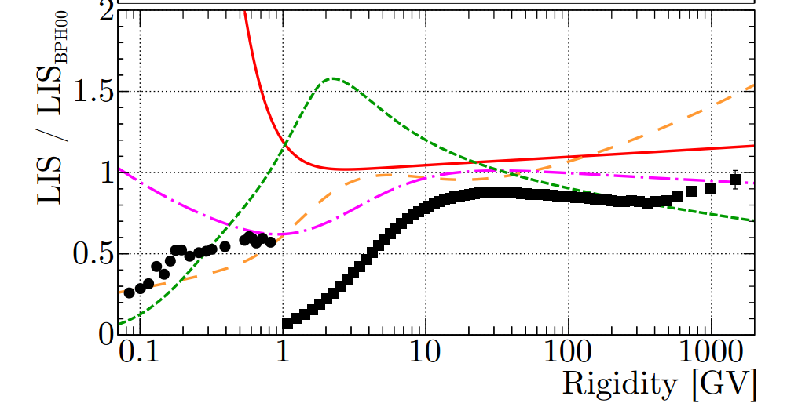
Non-parametric IS flux: splines
LIS fluxes are a source of uncertainty
Corti et al. 2016

Slide 20
Fits of the IS fluxes in the literature are mostly based on simple power laws or broken power laws in total energy or rigidity,
The spline function gives an excellent fit of the data (Ghelfi et al. 2016)
We use both LIS and TOA data to limit LIS and modulation potential
We study solar modulation with He, LI, Be, B, C and O data

Slide 21
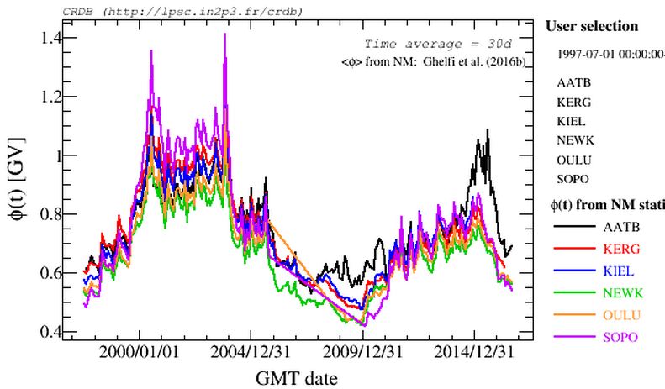
Phi series——Neutron monitors
https://lpsc.in2p3.fr/cosmic-rays-db/

Slide 22
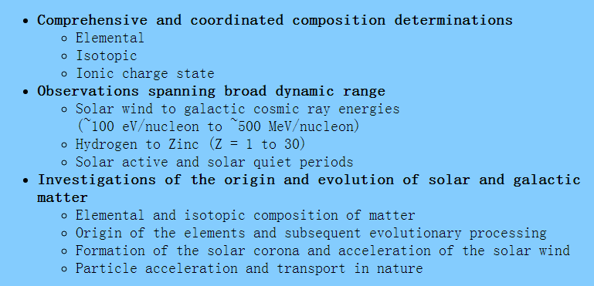
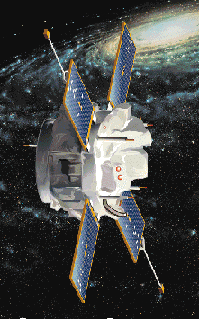
ACE
ACE launched in 1997 from the Kennedy Space Center in Florida.
http://www.srl.caltech.edu/ACE/ASC/index.html

Slide 23
Our work

Slide 24
Data: Voyager 1, AMS-02, ACE
He, B, C and O
Li and Be

Slide 25
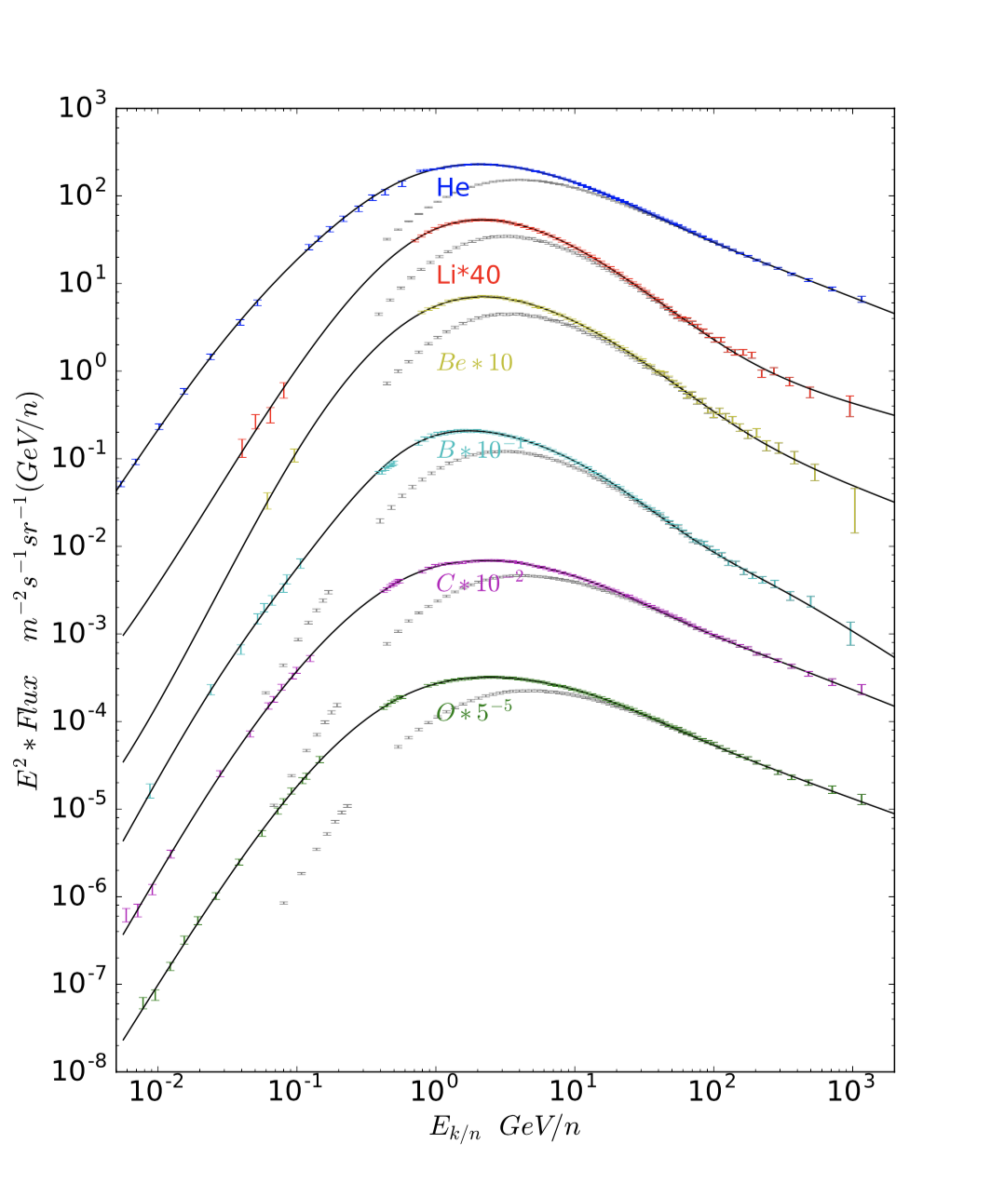
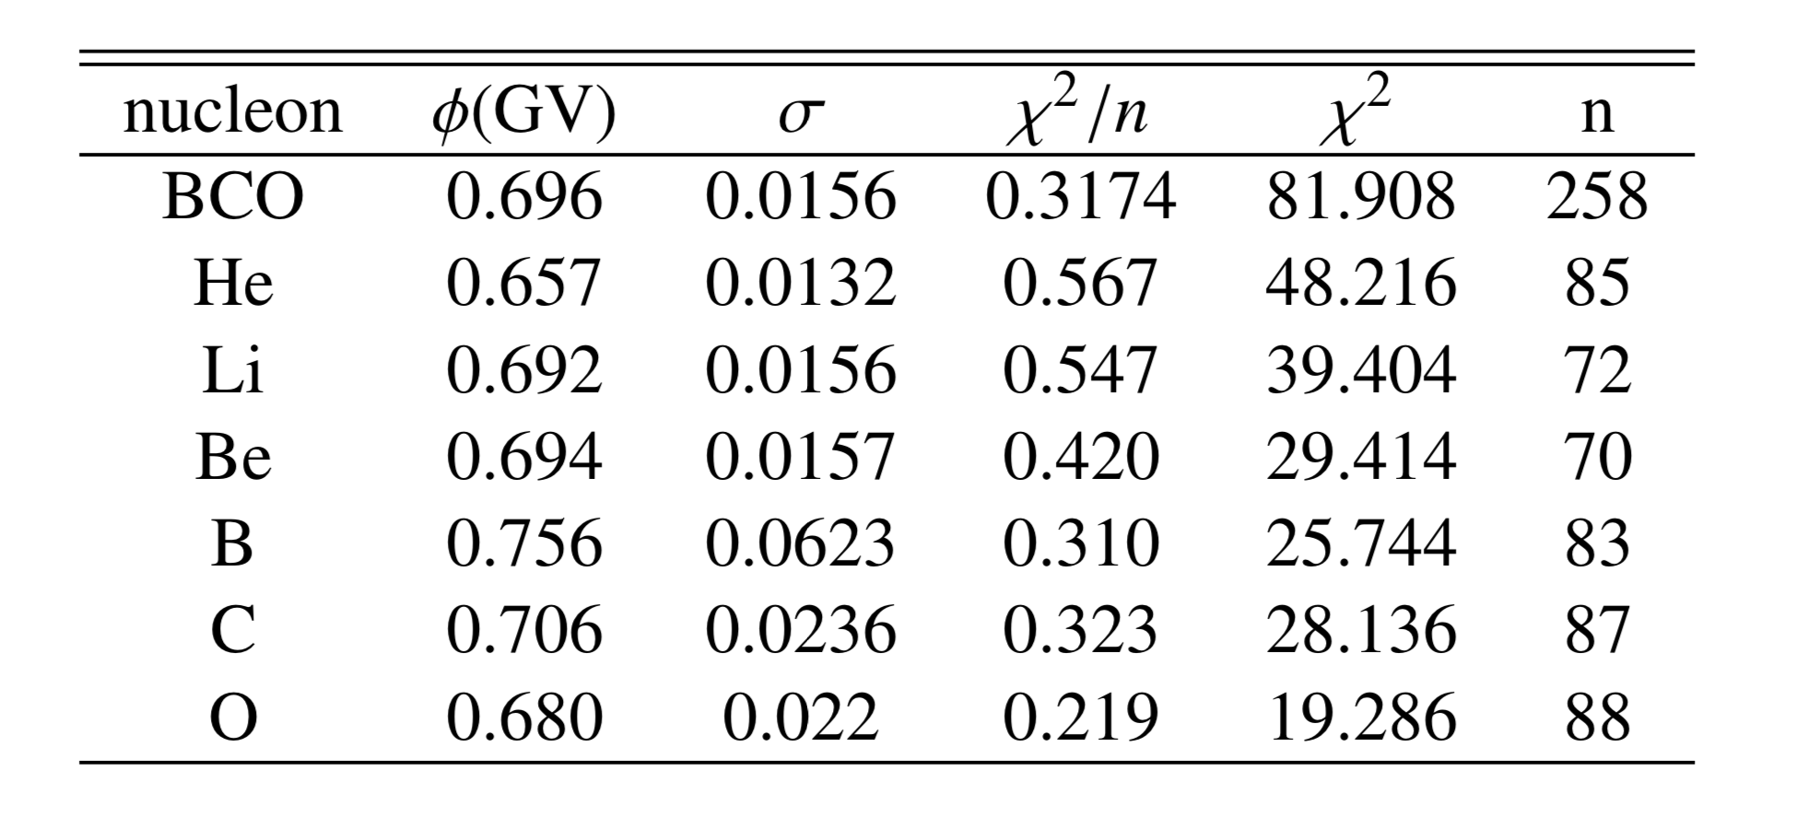

Slide 26
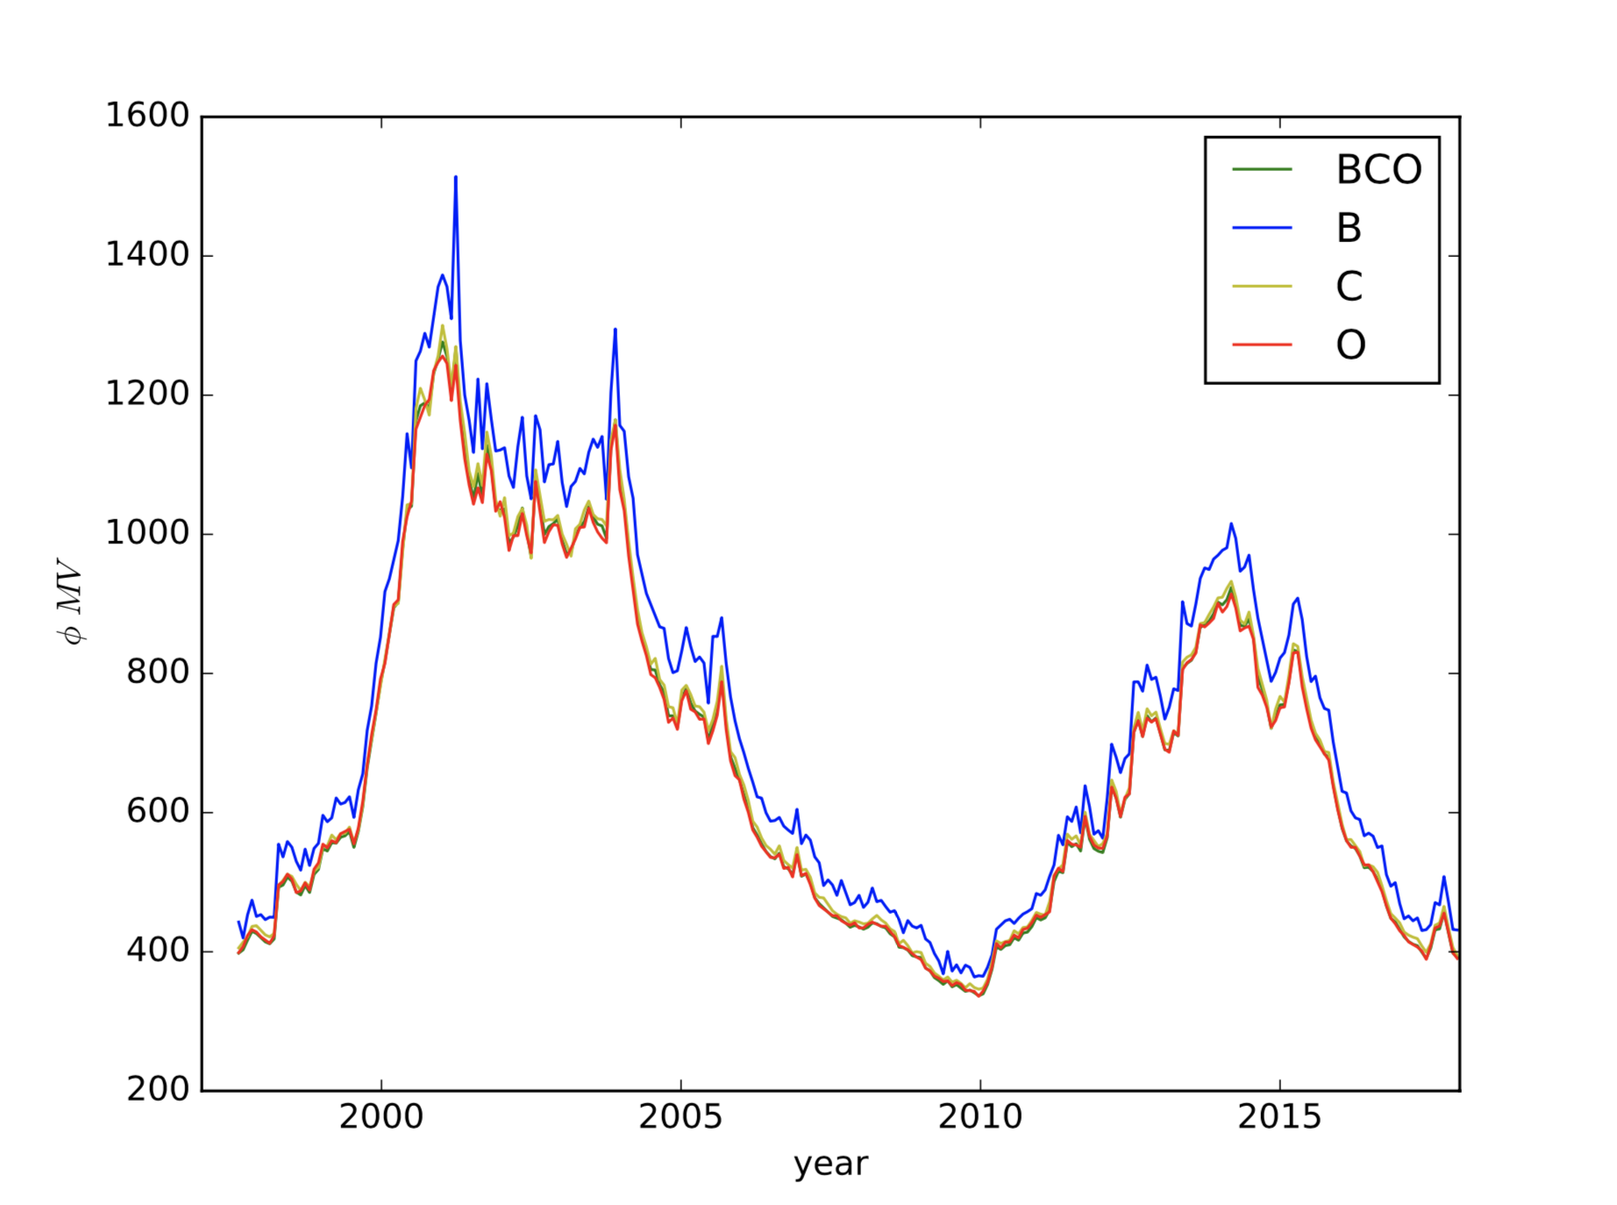

Slide 27
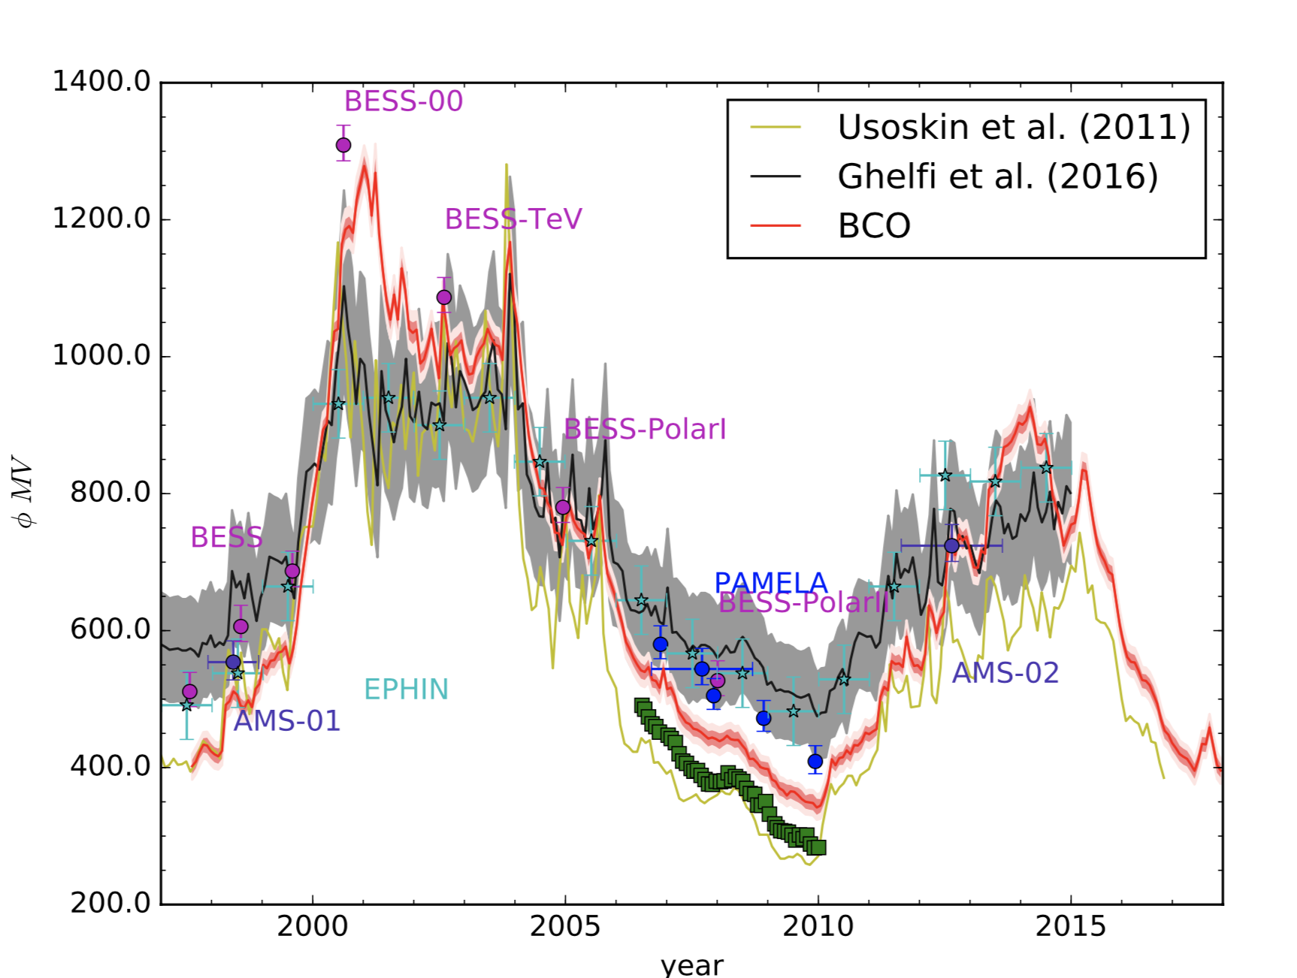

Slide 28
Conclusion
We use data of Voyager 1, AMS-02 and ACE give a more precise modulation potential evolution with time
We provide precise LIS data of He, Li, Be, B, C and O data, and we provide the modulation potential for heavy element

Slide 29
thx

