Slide 1
$ww fusion, H→bb$ and $ZH, H→bb$ separation
2018/1/29
Hao Liang

Slide 2
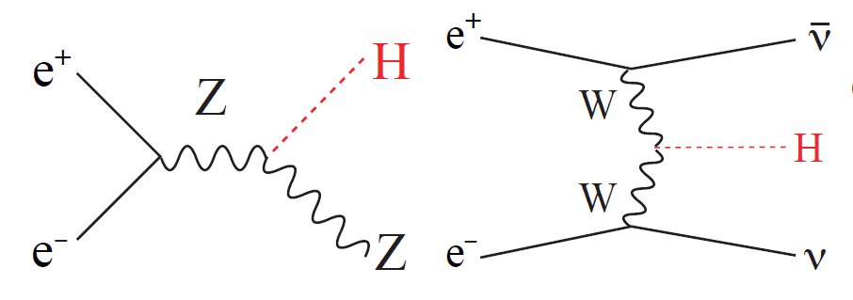
$ww fusion, H→bb$ and $ZH, H→bb$ separation
Separate WW fusion From ZH, via recoil mass of Higgs

Slide 3
Recall the procedure of the kinematic fit methods
Kinematic fit methods
Minimize
With the constraint
Simple kinematic fit
Scale each components of four momentum of each jet with factor $κ$
Such that

Slide 4
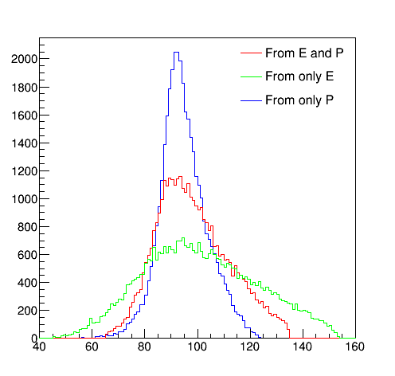
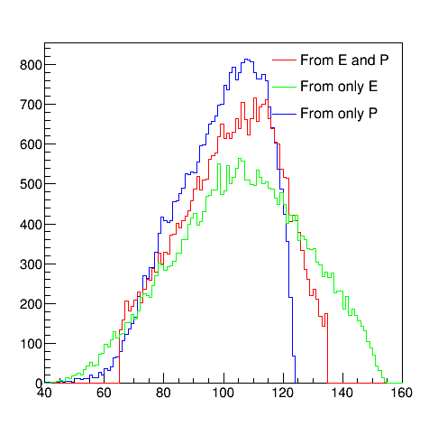

Maybe more simplier
From E and P $M_{recoil}^{2}={(\sqrt{s}−E)}^{2}−p^{2}$
From E $M_{recoil}^{2}=s−2\sqrt{s}E−m_{H}^{2}$
From P $M_{recoil}^{2}=s−2\sqrt{s}\sqrt{p^{2}+m_{H}^{2}}−m_{H}^{2}$

Slide 5
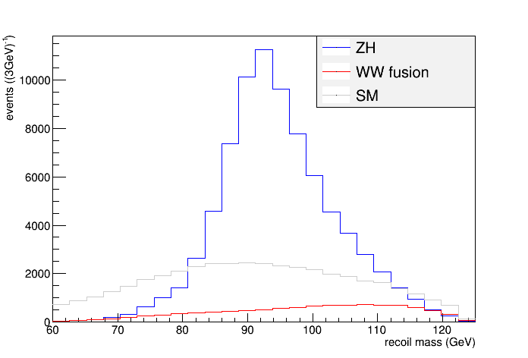
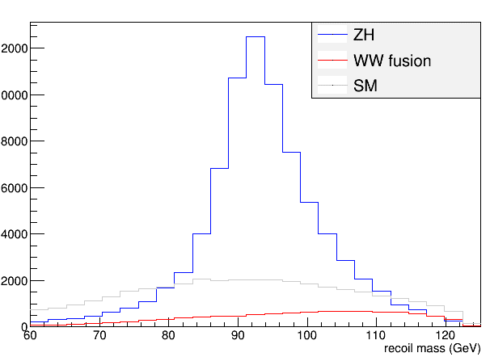
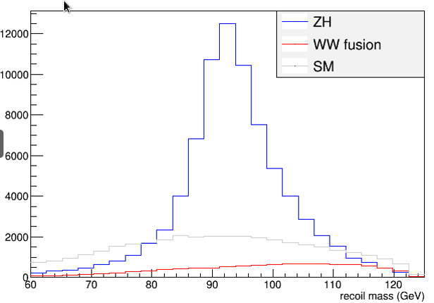
The recoil mass
The approach (from P)
Kinematic fit
Simple Kinematic fit

