Slide 1



First sPHENIX Workshop in China
April 22-23, 2018, Peking University
Jet Physics with sPHENIX at RHIC
Xin-Nian Wang
CCNU/LBNL
In collaboration with S. Cao, W. Chen, Y. He, T. Luo, LG Pang
Notes:
What are the compelling questions that motivate such an experimental program?
Is there a well-defined theoretical framework for studying the QGP and resolving its internal structure over a range of length scales using jet tomography?
Do we have the experimental and theoretical tools to address the compelling physics questions? If not, what else do we need?
What additional theoretical developments will need to happen, and which experimental studies will be needed to provide decisive answers to these questions?
What resources will this require?
Why do we need to invest into improving our jet capabilities at RHIC when jets are produced much more abundantly at the LHC?

Slide 2
Novel properties of sQGP
The most perfect fluid ( η/s ~ (1 - 2)/4π )
The most opaque fluid to jets ( qhat/T³ =4 - 8)
The most vortical fluid (ω/T ~ 0.001)

Slide 3
Relativistic hydrodynamics
  a low-momentum effective theory
  Inputs from first principle QCD (e.g. lattice QCD)
  EoS p=p(ε), transport coefficients η(T), ζ(T)
  Initial condition: parton prod. & thermalization time
Notes:
T^{\mu\nu}=(\epsilon + P)u^\mu u^\nu - P g^{\mu\nu} +\Delta T^{\mu\nu}
\Delta T^{\mu\nu}= \pi^{\mu\nu}(\eta)-\Pi(\zeta)(g^{\mu\nu}-u^\mu u^\nu)
\partial_\mu T^{\mu\nu}=j^\nu

Slide 4
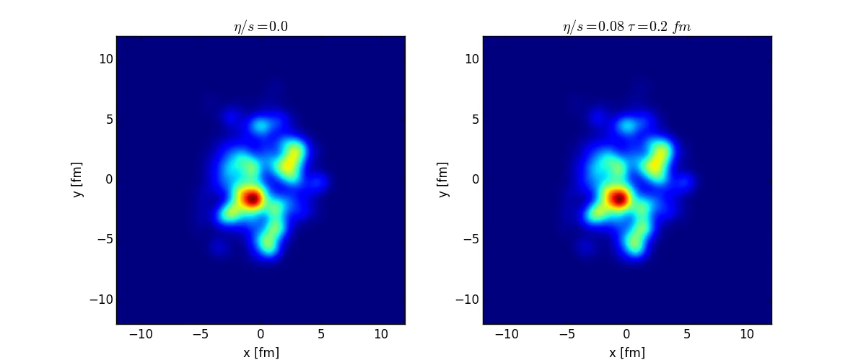
Sounds of QGP
Propagation of primordial sound waves in a rapidly expanding fireball
Sensitivity to viscosity
Longgang Pang（2016）
What happens if the fluid is sparkled with jets and mini-jets?

Slide 5
Jet quenching in heavy-ion collisions
Parton energy loss leads to
jet suppression
Jet 1
q
q
Energy deposition leads to
medium excitation
Jet 2
A-A collision
Notes:
Jet quenching originally was proposed as a signal of the the formation and high density matter in heavy-ion collisions.

Slide 6
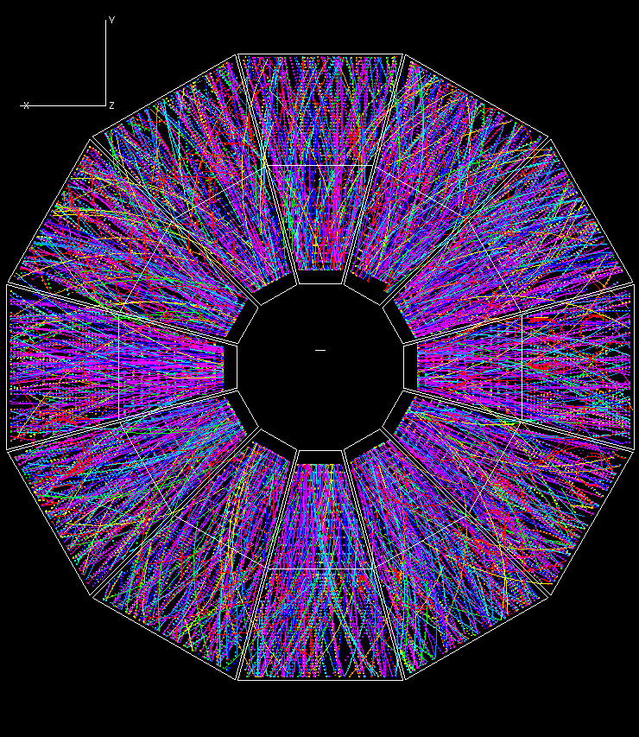
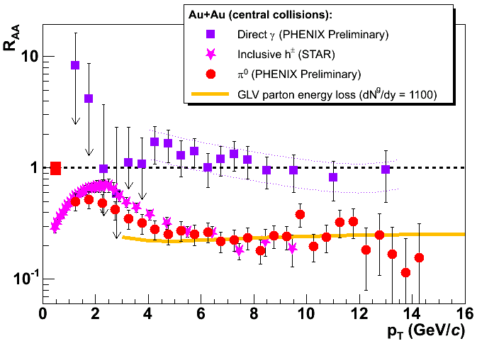
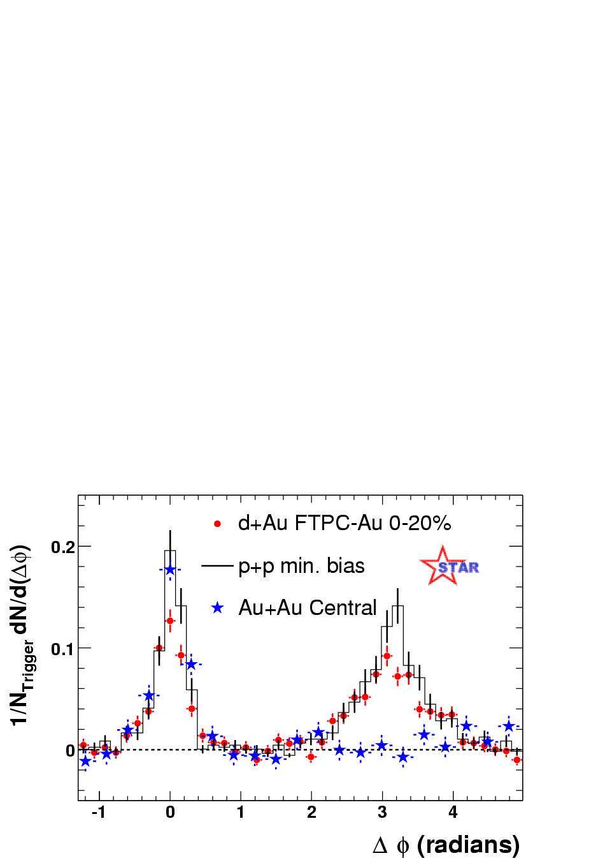
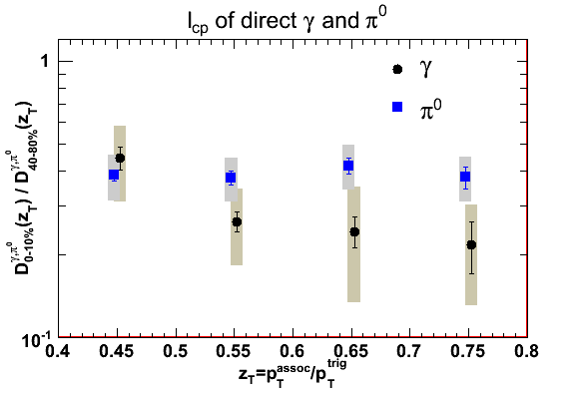
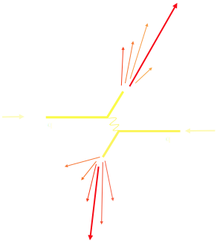
Jet Quenching phenomena at RHIC
Pedestal&flow subtracted
STAR Preliminary
Notes:
RHIC experiments marked a milestone for jet quenching, from a theoretical concept to a reality.

Slide 7
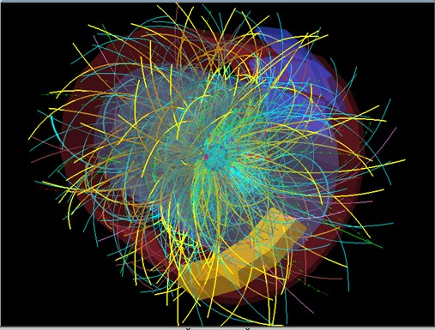
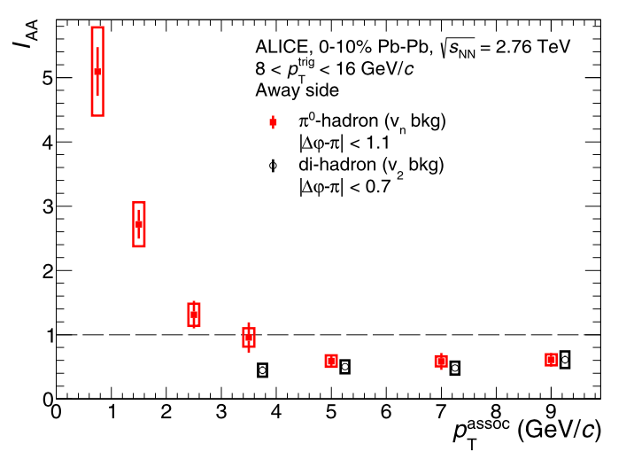
Jet Quenching phenomena at LHC
Pedestal&flow subtracted
Notes:
RHIC experiments marked a milestone for jet quenching, from a theoretical concept to a reality.

Slide 8
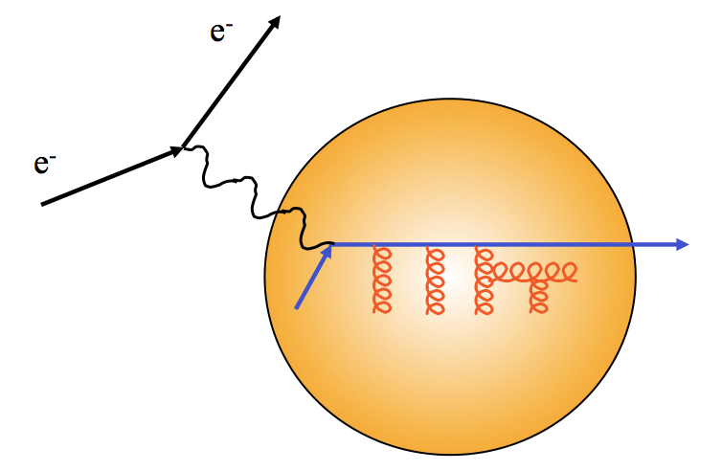
Hard probes of medium properties
TMD gluon distribution or
Jet transport coefficient q
Yuanyuan Zhang, et al 2018
Notes:
\frac{dN}{d\ell_T^2dz}=2\pi\frac{C_2C_A}{d_A}P(z)\int dy \rho(y)\int \frac{d^2q_T}{(2\pi)^2}\phi(x_D,q_T) \\
\times\frac{2 \vec q_T \cdot \vec \ell_T}{q_T^2\ell_T^2(\vec \ell_T - \vec q_T)^2}\left[1-\cos[(x_L+\frac{x_D}{1-z})p^+y^-]\right]
x_L=\frac{\ell_T^2}{2p^+q^-z(1-z)}
x_D=\frac{q_T^2-2\vec q_T\cdot \vec \ell_T}{2p^+q^-z}

Slide 9
Jet transport coefficient
JET Collaboration: Phys.Rev. C90 (2014) 1, 014909

Slide 10
Tomography with full jets
Jet profile and jet yield sensitive to jet-medium interaction
Less sensitive to non-perturbative hadronization
Jet-induced medium excitation becomes relevant

Slide 11

Linear Boltzmann Transport
Induced radiation
Li, Liu, Ma, XNW and Zhu, PRL 106 （2010） 012301
XNW and Zhu, PRL 111 (2013) 062301
Notes:
f_i(p_i)=\frac{1}{e^{p_i\cdot u/T}\pm 1} (i=2,4)
f_i(p)=(2\pi)^3\delta^3(\vec p_i-\vec p_0)\delta^3(\vec x-\vec x_0-t\vec v_i) [i=1,3]
\frac{dN_g}{dzd^2k_\perp dt}=\frac{2\alpha_s N_c}{\pi k_\perp^4} P(z)
(\hat p\cdot u) \hat q \sin^2(\frac{t-t_0}{2\tau_f})

Slide 12
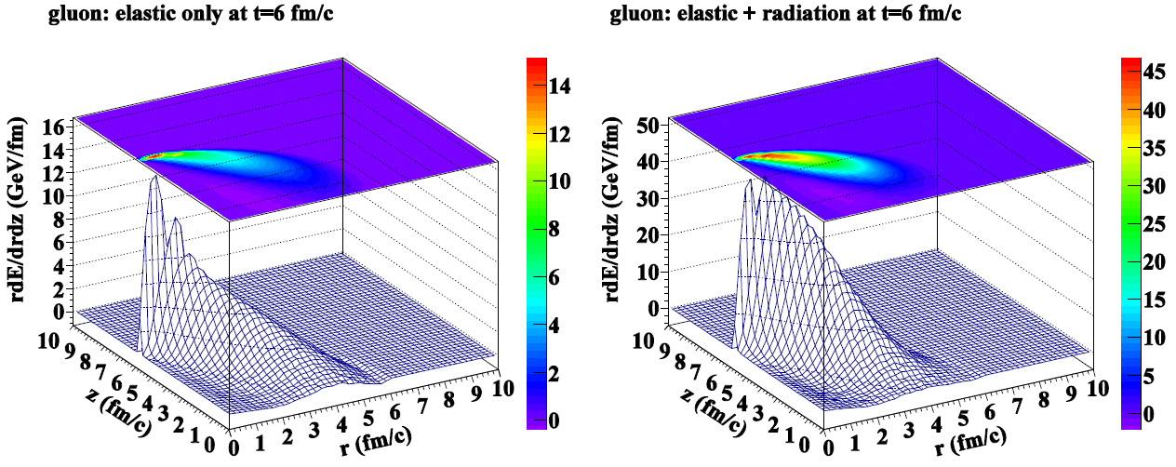
Linear Boltzmann Transport (LBT)
pQCD elastic and radiative processes (high-twist)
Transport of medium recoil partons
3+1D hydro bulk evolution
Li, Liu, Ma, XNW & Zhu, PRL 106 (2011)012301
XNW & Zhu, PRL 111 (2013), 062301
He, Luo, XNW & Zhu, PRC91 (2015) 054908;

Slide 13
Beyond LBT: CoLBT-hydro
(Coupled Linear Boltzmann Transport hydro)
LBT for energetic partons (jet shower and recoil)
Hydrodynamic model for bulk and soft partons: CLVisc
CLVisc: (3+1)D viscous hydrodynamics parallelized on GPU
using OpenCL
Hadronization in LBT: TAMU parton recombination model
Notes:
\partial_\mu T^{\mu\nu}(x) = j^\nu (x)
\delta f(p,x) \ll f(p,x)
j^\nu(x) = \sum_i p^\nu_i \delta^{(4)}(x-x_i) \theta(p^0_{cut}-p\cdot u)
j^\nu(x) = \sum_a\int \frac{d^3p}{(2\pi)^3}\frac{p^\nu}{p^0}f_a(p)\theta(p\cdot u - p^0_{cut})
p\cdot \partial f(p) =- C(p) \;\;\; p\cdot u > p_{cut}^0

Slide 14

γ-jet propagation within CoLBT-hydro
Notes:
\partial_\mu T^{\mu\nu}(x) = j^\nu (x)
\delta f(p,x) \ll f(p,x)
j^\nu(x) = \sum_i p^\nu_i \delta^{(4)}(x-x_i) \theta(p^0_{cut}-p\cdot u)
j^\nu(x) = \sum_a\int \frac{d^3p}{(2\pi)^3}\frac{p^\nu}{p^0}f_a(p)\theta(p\cdot u - p^0_{cut})
p\cdot \partial f(p) =- C(p) \;\;\; p\cdot u > p_{cut}^0

Slide 15
Light and heavy quark hadron suppression
AuAu@200 GeV
PbPb@5020 GeV
PbPb@2760 GeV
Cao, Luo, Qin & XNW, PRC94 (2016) 014909

Slide 16
Effect of recoil partons and diffusion wake on jet energy loss
Recoil partons within the jet
cone reduce the net jet energy loss
Diffusion wake (backreaction)
reduces the thermal
background, if taken into
account, increase the net jet
Energy loss with given cone-size
Depend on jet cone-size R
Sensitive to radial flow
preliminary

Slide 17
Single jet suppression at LHC
LBT: preliminary
preliminary
preliminary
Weak pT dependence: initial jet spectra and pT dependence of energy loss ΔE
Week energy dependence: increase of jet energy loss and the slope of initial spectra

Slide 18
Energy dependence of jet spectra

Slide 19
Energy dependence of jet spectra

Slide 20
Jet suppression at RHIC

Slide 21
Jet energy loss and γ-jet asymmetry
Notes:
v_2^{jet}=\frac{\langle v_2^{soft} \cos(2[\phi^{jet}-\Psi_2])\rangle}{\sqrt{\langle(v_2^{soft})^2\rangle}}

Slide 22
Gamma-jet profile
Pb+Pb @ 2.76 TeV
p+p @ 2.76 TeV

Slide 23
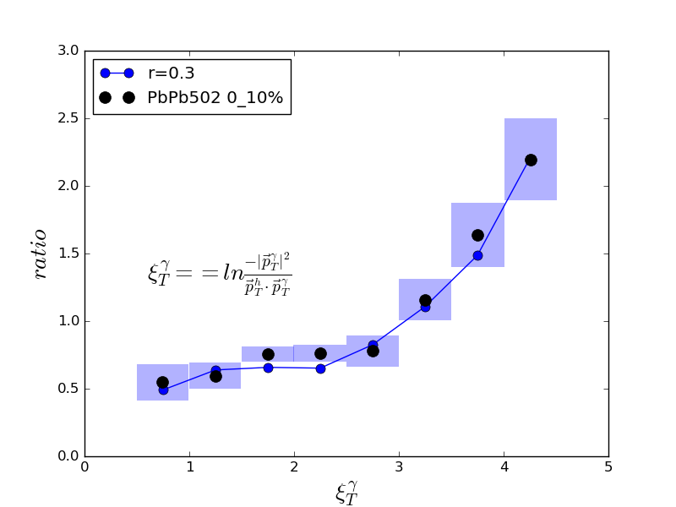
gamma-jet fragmentation function
Preliminary
CoLBT-hydro
CMS
R=0.3

Slide 24
Enhancement of soft hadrons
PLB777(2018)86
Onset of soft hadron
enhancement is at
fixed pt ~ 1.6 GeV

Slide 25
Azimuthal distribution of soft hadrons from jet-induced medium excitation
PLB777(2018)86

Slide 26
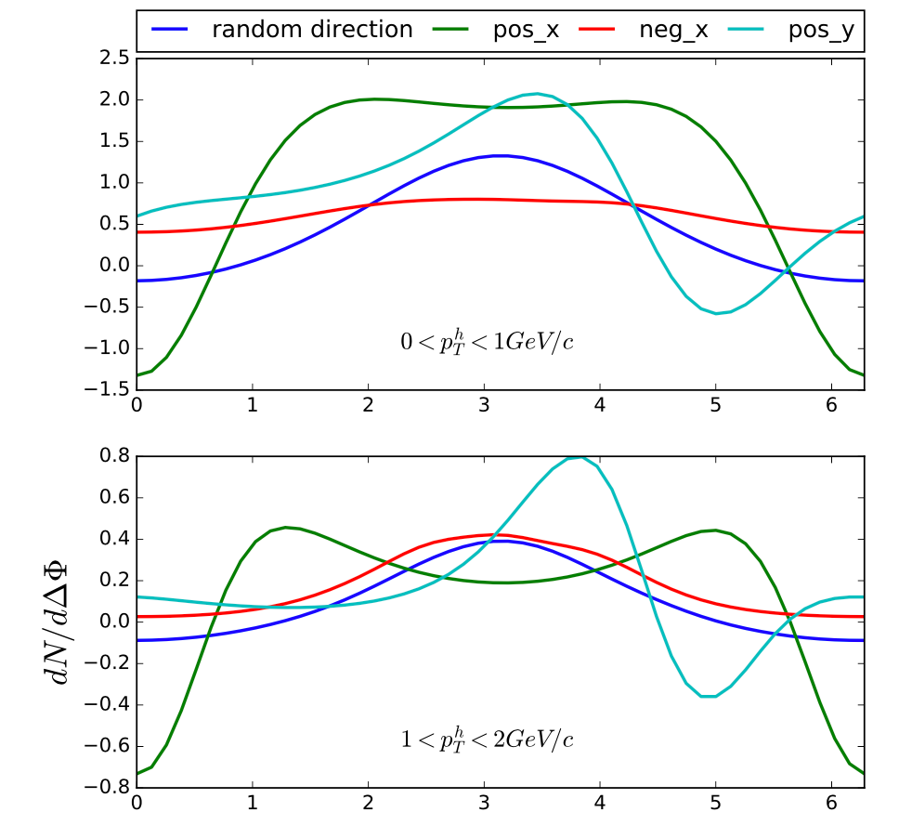
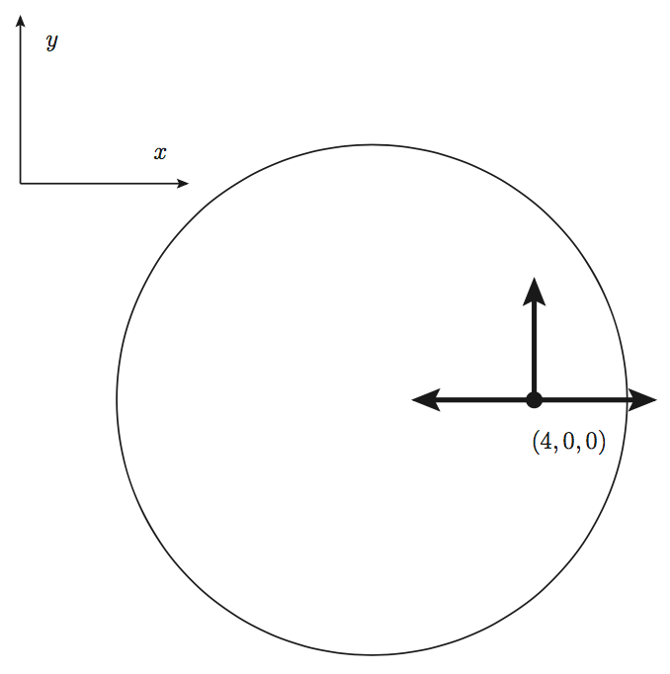
Wide angle distribution of soft hadrons
ΔΦ

Slide 27
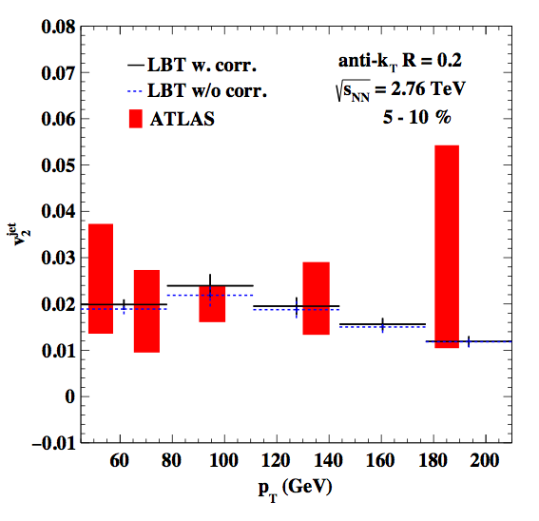
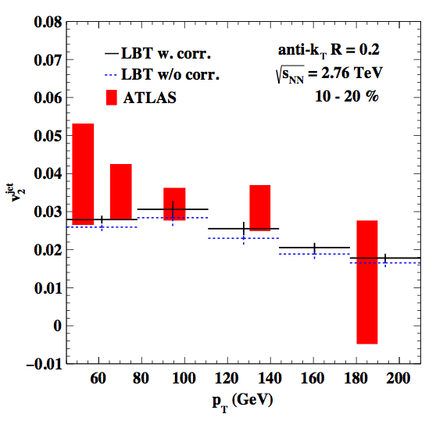
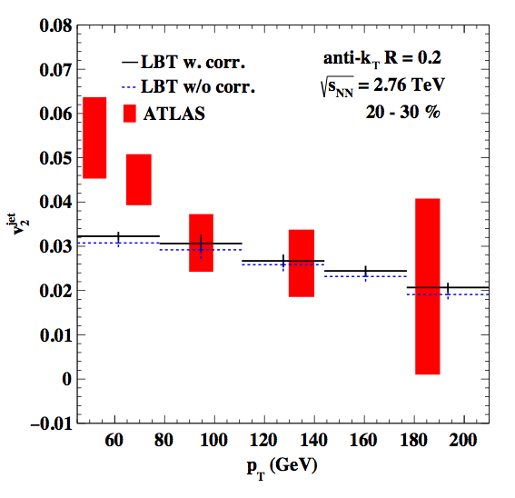
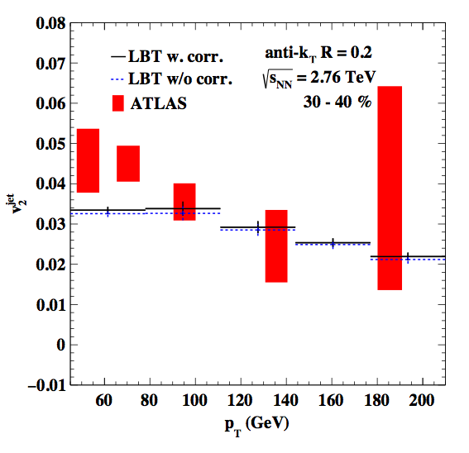
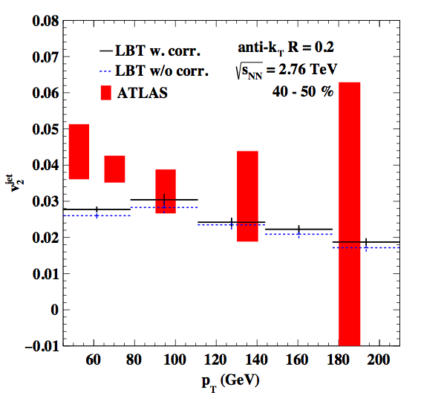
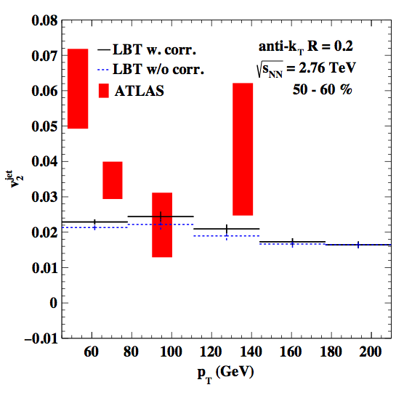
Azimuthal anisotropy of jet suppression
preliminary
Effect of bulk v₂ fluctuation is small

Slide 28
Summary
Hadron probes enter into the stage of precision study at RHIC
Effect of Jet-induced medium excitation in jet quenching
Study of jet profile and hadron distribution within jet
Jet quenching more sensitive to jet energy loss at RHIC, opportunities for sPHENIX

