Slide 1
Tungsten Powder Studies at Fudan
Huanzhong Huang
Subikash Choudhury
Weihu Ma
Yu Hu
Yang Shen
2018-04-22 @ PKU
The 1st sPHENIX Workshop in China
Notes:
Good afternoon every one. I’m yang from IMP in Fudan University. We just start the work on EMCal, so I’ll introduce some basic testing work on W powder briefly.

Slide 2
Outline
PIXE test results for some samples
The tap density testing of different samples
Epoxy glued powder test
Next plan
Notes:
My talk includes 4 parts

Slide 3
Outline
PIXE test results for some samples
The tap density testing of different samples
Epoxy glued powder test
Next plan
Notes:
The First part is PIXE test results for some samples

Slide 4
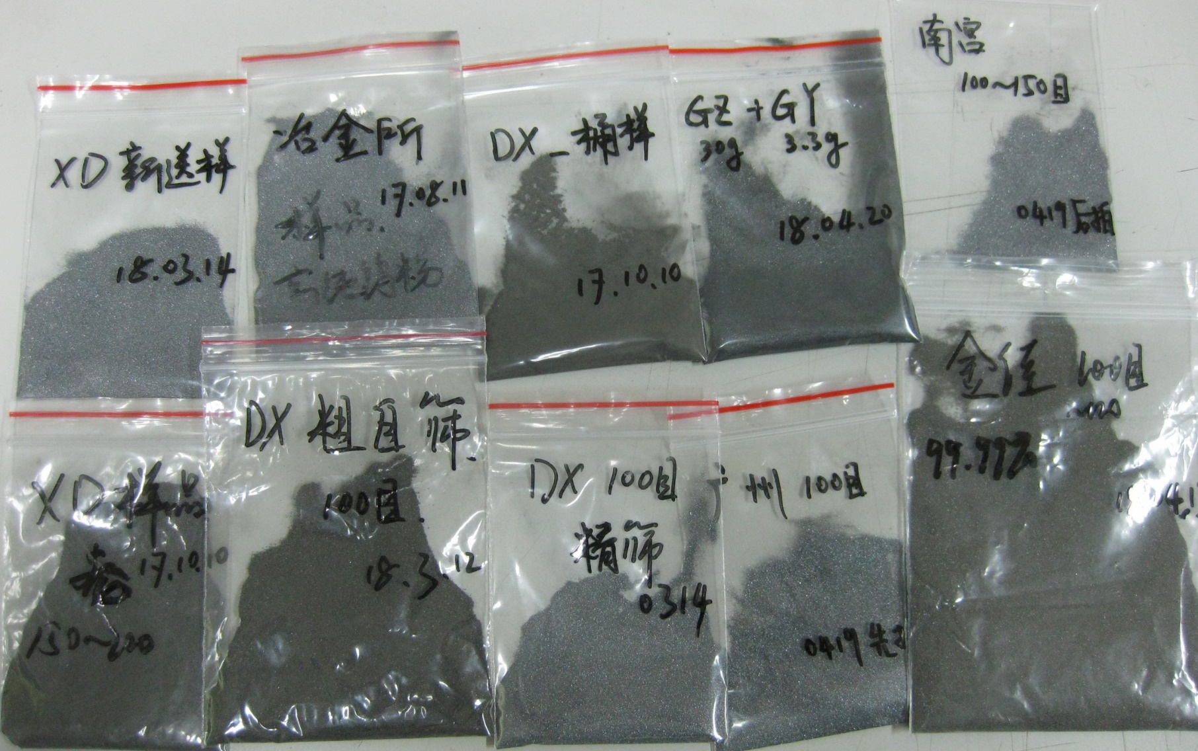
Samples from different Co.
Light——Rough
Dark——Fine
Notes:
This picture shows part of powder sample we bought. The request is same,100 mesh, but the powder we got seems quite different. The finer the powder, the darker the color. The particle is more rough, it’ll more bright. Some samples are much more finer than we need. So, All the company claim the purity is around 99.9% even 99.99%. We have to do some test to prove.

Slide 5
PIXE test for powder samples
Using a tablet press to make samples
Sample1
99.99%
Sample2
99.9%
UCLA
99.3%
Notes:
We use a tablet press to make three samples. Two is made of powder we bought and the third is from UCLA.

Slide 6
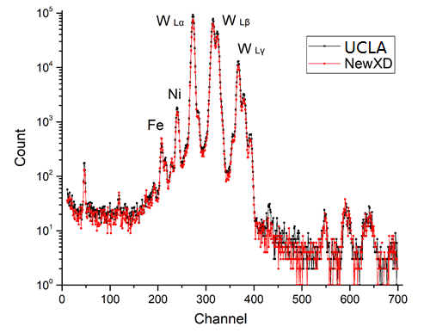
PIXE test for two samples
Notes:
That’s the figure we get. In general, the powder we bought is almost the same as the powder from UCLA

Slide 7
PIXE test for two samples
 | Atomic Percentage |  |  | Mass Fraction
Element | UCLA | Sample1 | Sample2 | UCLA | Sample1 | Sample2
V | 0.000% | 0.032% | 0.024% | 0.000% | 0.009% | 0.007%
Cr | 0.034% | 0.045% | 0.145% | 0.010% | 0.013% | 0.041%
Mn | 0.068% | 0.078% | 0.063% | 0.020% | 0.023% | 0.019%
Fe | 0.324% | 0.500% | 0.526% | 0.098% | 0.152% | 0.160%
Co | 0.027% | 0.028% | 0.021% | 0.009% | 0.009% | 0.007%
Ni | 0.037% | 1.019% | 0.087% | 0.012% | 0.325% | 0.028%
Cu | 0.020% | 0.103% | 0.030% | 0.007% | 0.036% | 0.010%
Zn | 0.041% | 0.048% | 0.028% | 0.015% | 0.017% | 0.010%
Ga | 0.011% | 0.000% | 0.000% | 0.004% | 0.000% | 0.000%
Ge | 0.015% | 0.038% | 0.005% | 0.006% | 0.015% | 0.002%
As | 0.031% | 0.013% | 0.022% | 0.013% | 0.005% | 0.009%
Se | 0.000% | 0.000% | 0.003% | 0.000% | 0.000% | 0.001%
Br | 0.036% | 0.000% | 0.000% | 0.016% | 0.000% | 0.000%
Kr | 0.000% | 0.005% | 0.000% | 0.000% | 0.002% | 0.000%
Rb | 0.000% | 0.000% | 0.004% | 0.000% | 0.000% | 0.002%
Sr | 0.003% | 0.000% | 0.000% | 0.001% | 0.000% | 0.000%
Y | 0.000% | 0.000% | 0.001% | 0.000% | 0.000% | 0.000%
Zr | 0.000% | 0.000% | 0.000% | 0.000% | 0.000% | 0.000%
W | 100.000% | 100.000% | 100.000% | 100.000% | 100.000% | 100.000%
Hg | 0.013% | 0.000% | 0.000% | 0.014% | 0.000% | 0.000%
99.99%
99.9%
Normalized by W
Notes:
But if we fit the data carefully, we’ll find in the sample we bought, cobalt is OK, and the iron, nickel is a little bit more. The purer one they claim has even more impurity. That means we should carefully test the powder before assembling the detector, no matter what the company claimed.

Slide 8
Outline
PIXE test results for some samples
The tap density testing of different samples
Epoxy glued powder test
Next plan
Notes:
Next is tap density test

Slide 9
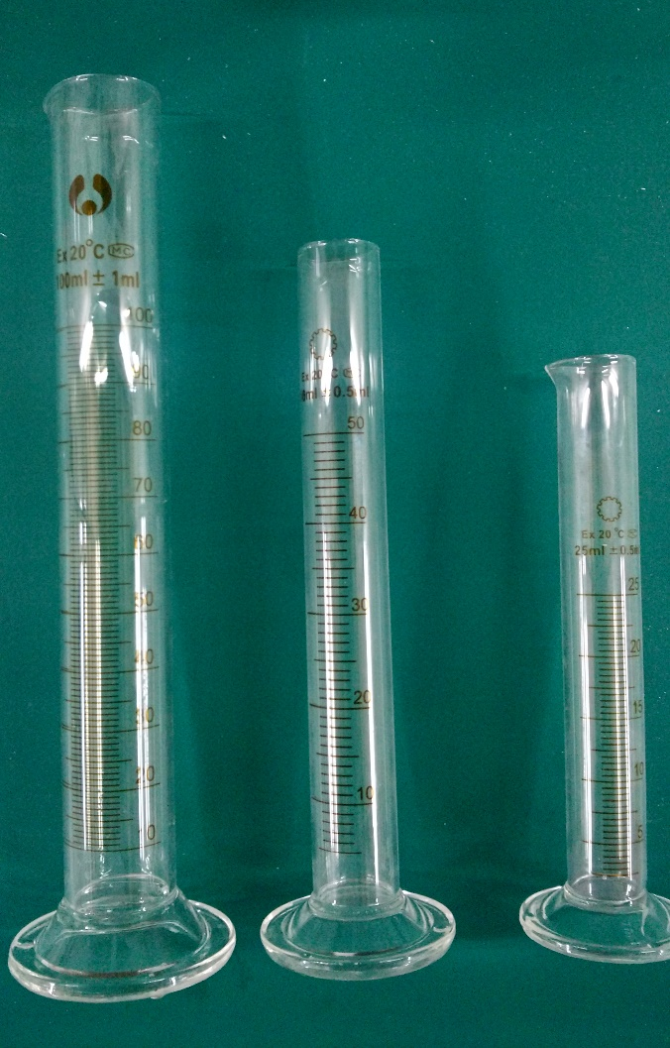
Tap density measuring
Size | Max. scale | Min. scale | Weight
Big | 100 ml | 1 ml | 138.0 g
Medium | 50 ml | 1 ml | 73.0 g
Small | 25 ml | 0.5 ml | 52.2 g
Notes:
We put a cylinder on the vibration machine. Turn on the machine and fill the powder slowly. We also try different cylinder size to see if it will affect the result.

Slide 10
Tap density test
 | Sample | Container | Gross weight /g | Net weight /g | Bulk /ml | Time /mins | Tap density /g/cm³
1 | XD | Big | 492.1 | 354.1 | 42 | 12 | 8.43
2 | XD | Big | 492.1 | 354.1 | 40 | 20 | 8.85
3 | XD | Medium | 409.7 | 336.7 | 38 | 20 | 8.86
4 | GZ | Small | 210.9 | 158.7 | 17 | 20 | 9.33
5 | YT | Small | 129.1 | 76.9 | 8.5 | 20 | 9.04
6 | JJ | Small | 160.1 | 107.9 | 11.2 | 20 | 9.63
7 | GY | Small | 106.0 | 53.8 | 15.5 | 20 | 3.47
Notes:
Line 1 and 2 means the longer we tap, the higher density we get. The density will rise quickly just after the turn on the vibration machine and the speed of change will slow down, and the density will reach a limit finally.
Line 2 and 3 means different size of container not affect the result much, but we can get more accurate volume number by using smaller cylinder.
The table below shows the density of different company not much difference except line 7.

Slide 11
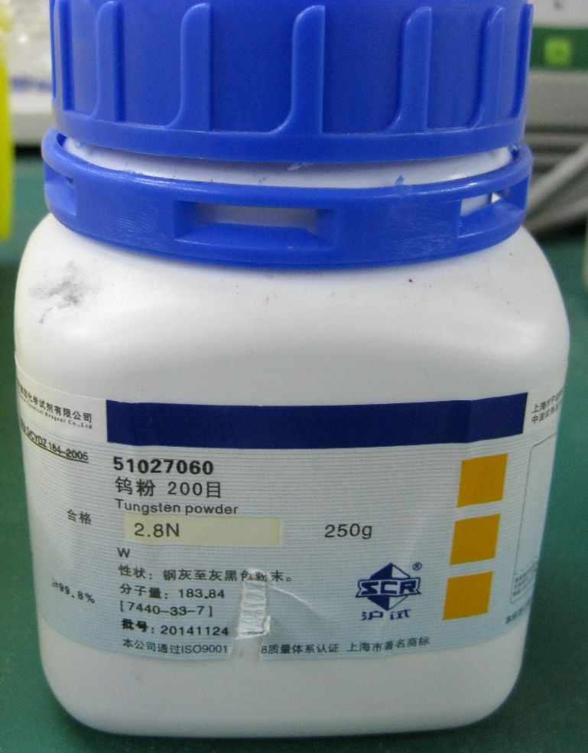
Sample from GY
2 mm
Notes:
The sample from GY is much finer than we want. So we don’t know it’s the particle size cause the problem or they send the wrong sample.

Slide 12
Sample from UCLA
particle size distribution 90% between 40 and 150 microns
Tap density:
~11.25 g/cm³
2 mm
Ref.: Journal of Physics: Conference Series 404 (2012) 012023
Notes:
That’s the picture of sample from UCLA under microscope. According to the reference, the particle size distribution 90% between 40 and 150 microns, and tap density can reach 11.25g/cm³

Slide 13
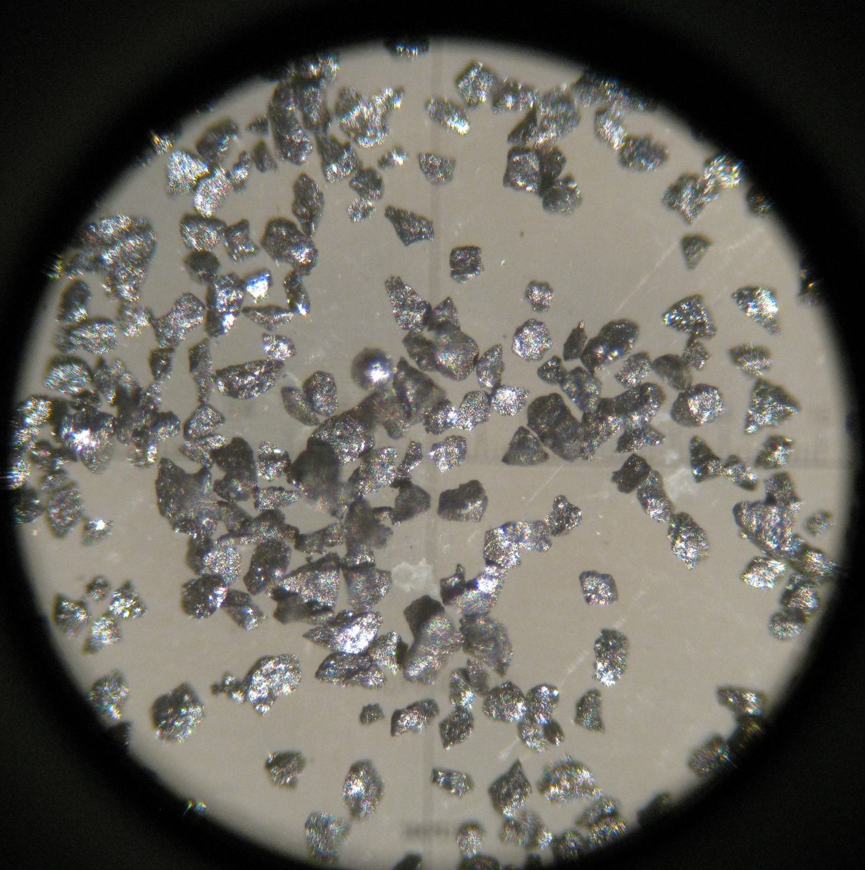
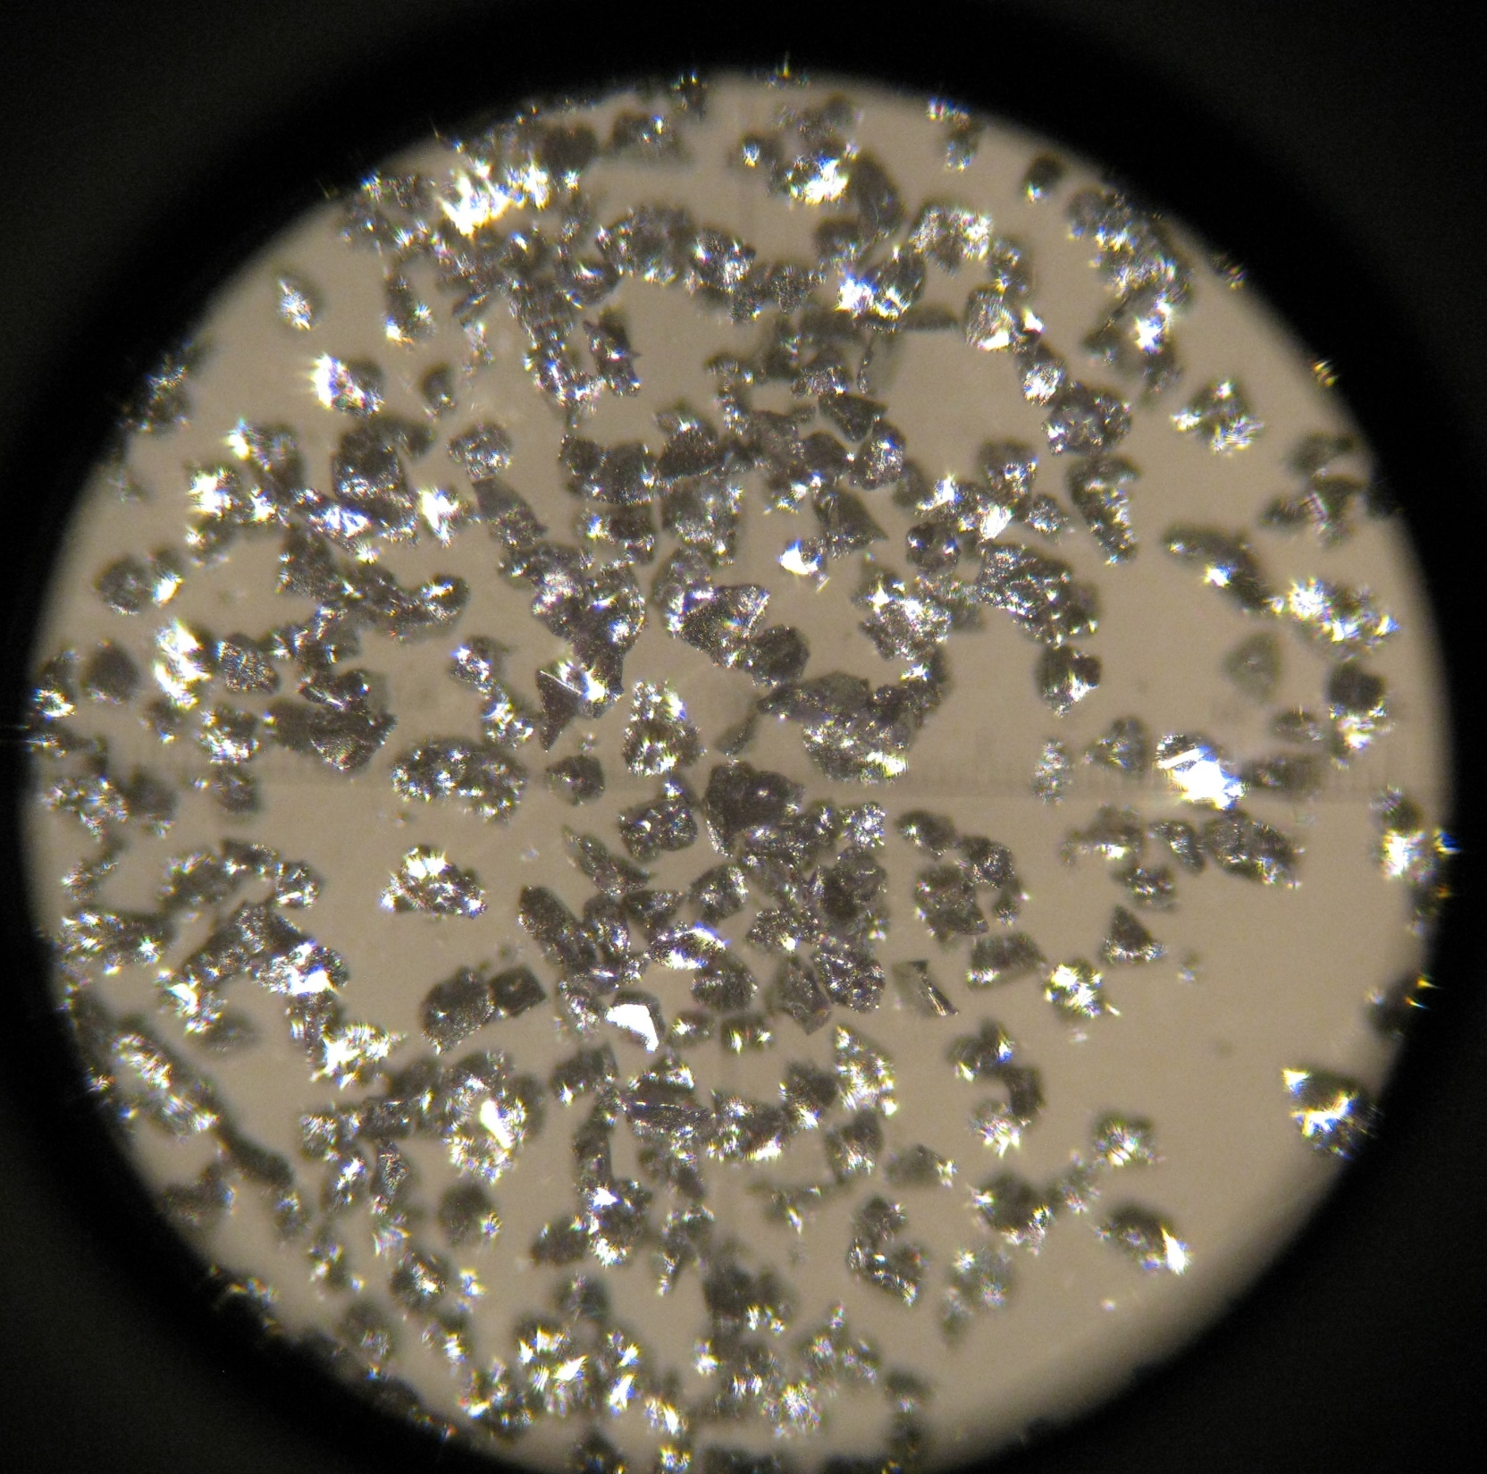
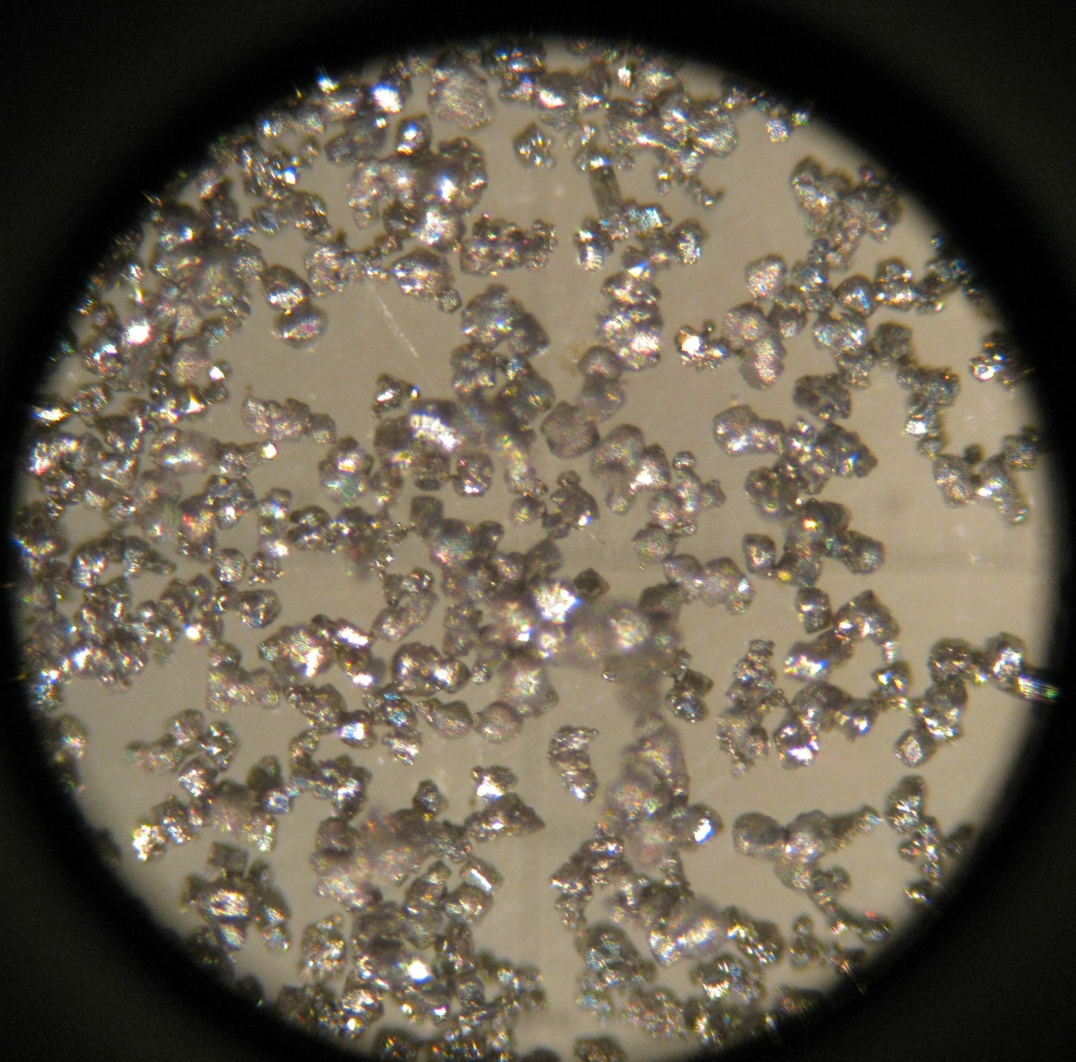
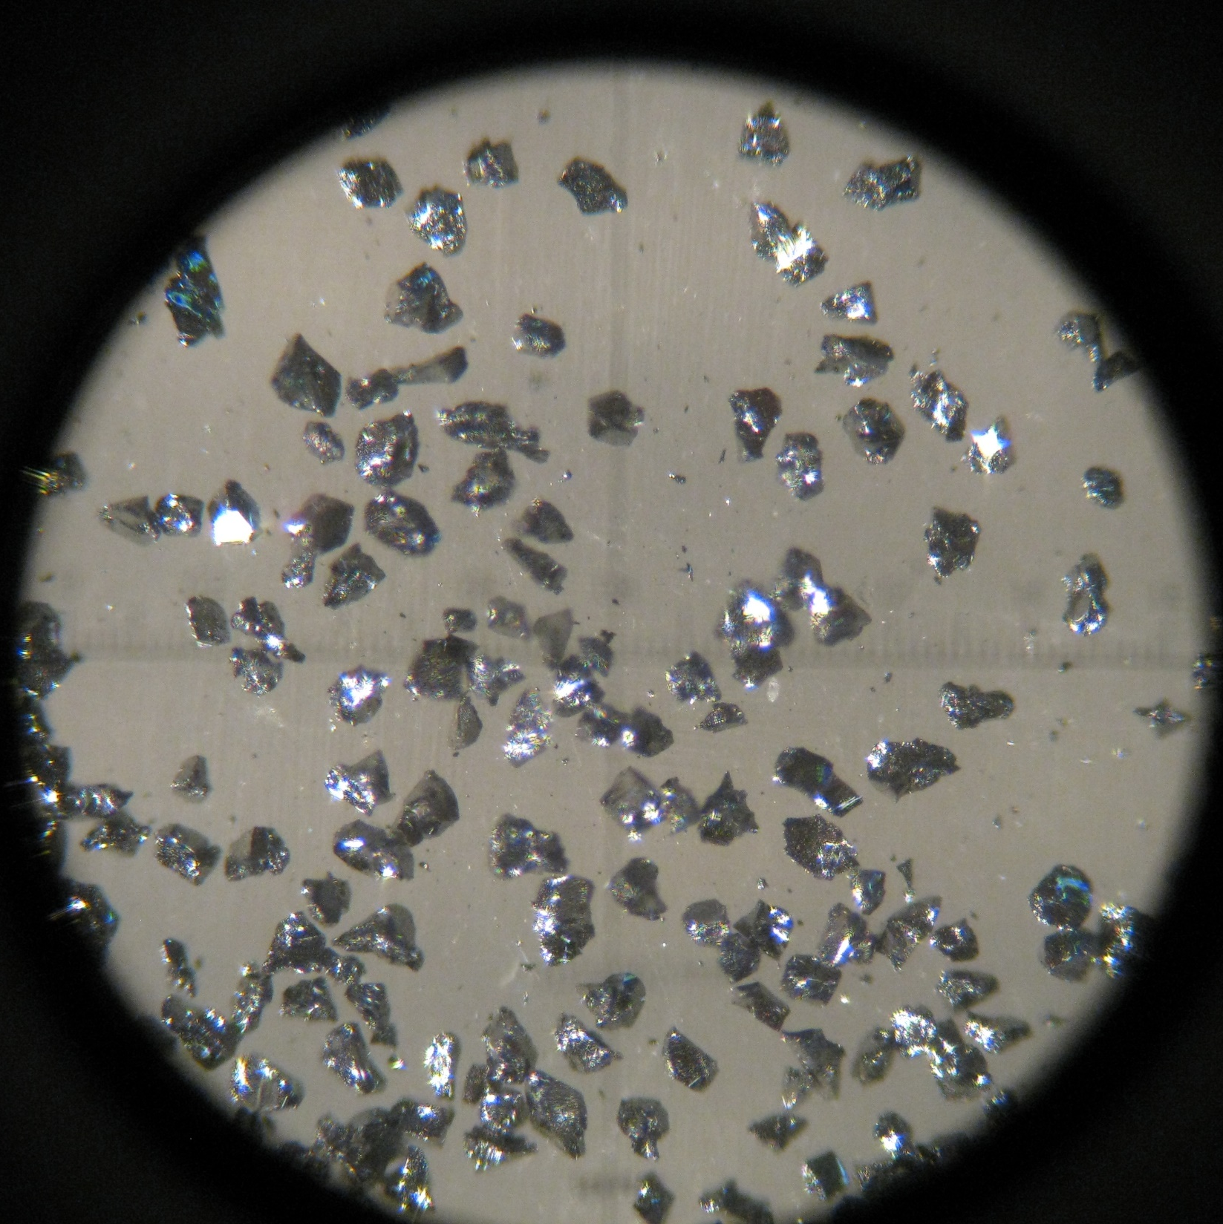
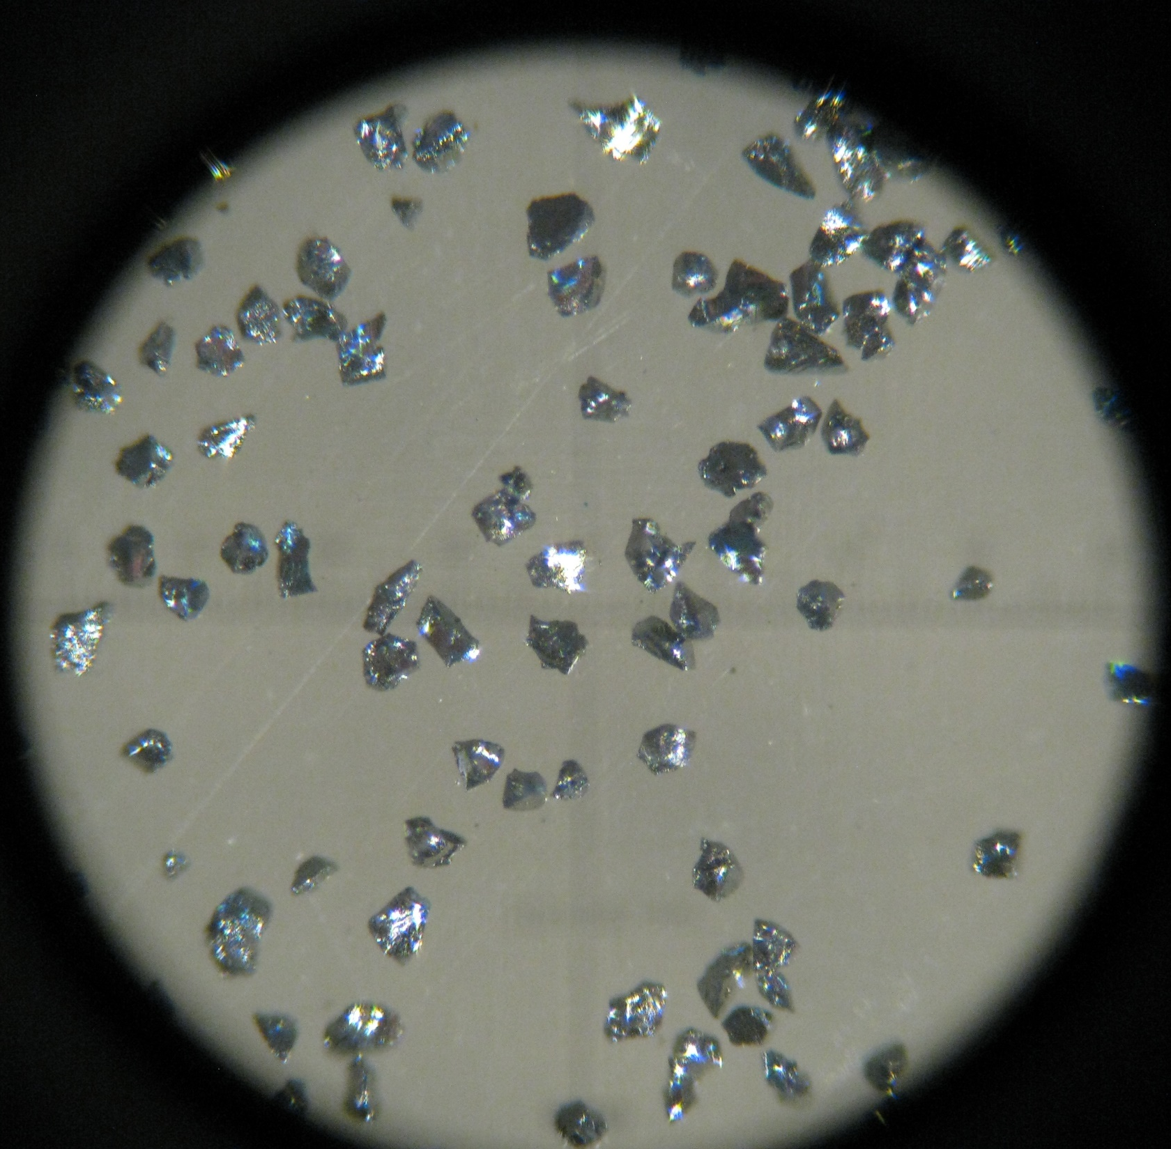
UCLA:11.25
XD1
XD2:8.86
2mm
JJ:9.63
GZ:9.33
YT:9.04
Notes:
From the cooperation of pictures under microscope, we’ll find the particals from UCLA is round or mellow. And it seems that if the size of particles are too uniform the density won’t be very high.

Slide 14
Outline
PIXE test results for some samples
The tap density testing of different samples
Epoxy glued powder test
Next plan
Notes:
The third part is epoxy glued powder test

Slide 15
Epoxy and mold test
Optical grade epoxy
Use a syringe(PP) as mold, sample can take out easily
Notes:
We use a kind of optical grade epoxy. And use a PP syringe as mold for convenient. The result is very good, the sample can take out easily without any tools.

Slide 16
Epoxy glued W powder test
PTFE end cap
PP pipe
Pump if need
Notes:
Than we make two PTFE end cap put on both side of a PP pipe. Fill the powder and tap, then fill the epoxy.

Slide 17
Epoxy glued sand test
100 mesh sand
Notes:
Because the W is expensive. So we use 100 mesh sand instead first to verify the process

Slide 18
Epoxy glued W powder test
Notes:
Finally test the W

Slide 19
Use lathe tunes both ends
Tuning surface is rough
Powder tap density:
8.86 g/cm³
Glued density:
~9.2 g/cm³
Close but not enough
Side surface is very smooth
Notes:
We use lathe tunes both ends of the sample and get the bulk showing in the picture. The density is about 9.2. the particle size is about 100 um, so the tuning surface is rough but the side surface touch the PP pipe is very smooth.

Slide 20
Next plan
Do PIXE test for good tap density samples;
Try different size powder to see if can get higher tap density;
Machine cuboid mold, change mold materials and test glue process;
Machine screens for fiber and assembling test.
Notes:
Next we want to do is test the purity for good tap density samples, and mix different size powder to see if can get higher tap density. Finally the detector will be like a cuboid, so we’ll design cuboid mold and do some glue process test to see if there is some special affect for example some gap at the corner. We also plan to design meshes for fiber and verify the assembling process.

Slide 21
Thank you!
^{2018-04-22 @ PKU}

