Slide 1

simulation
1st sPHENIX workshop in China, School of Physics, Peking University, Beijing, China
(from three view points: simulation team, HF topical group, and DAQ)
Jin Huang (黄进)
Brookhaven National Lab, NY, USA

Slide 2
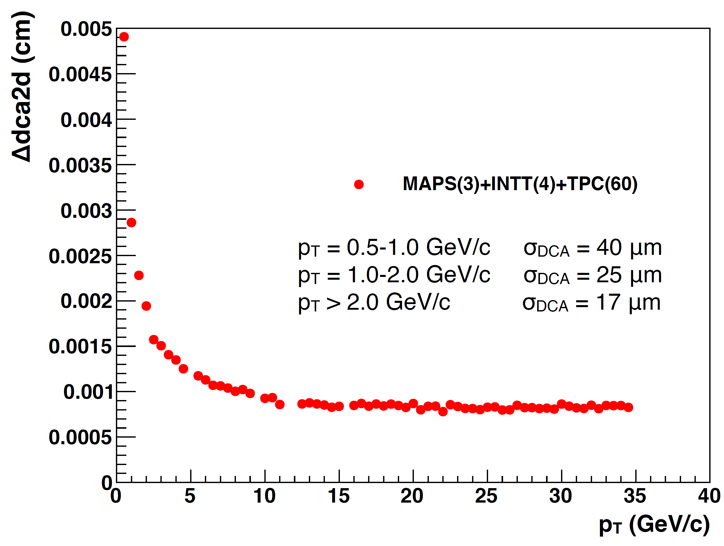
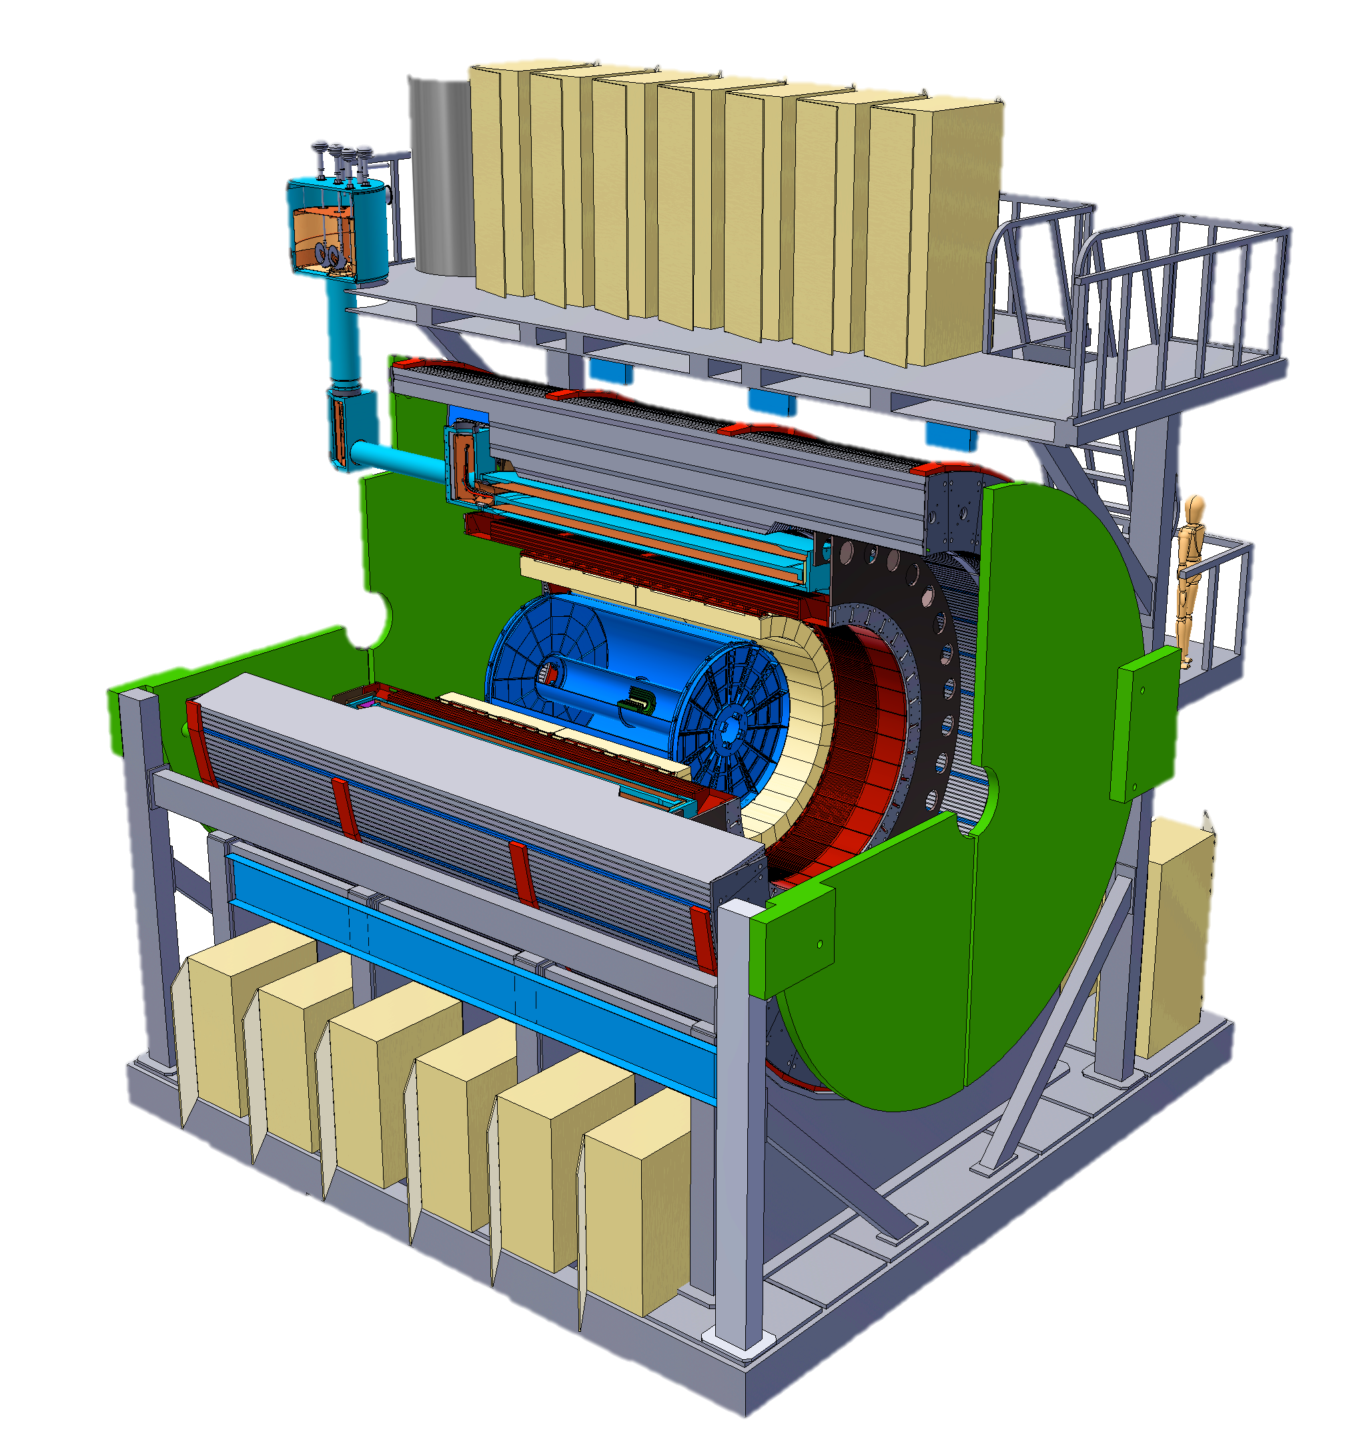
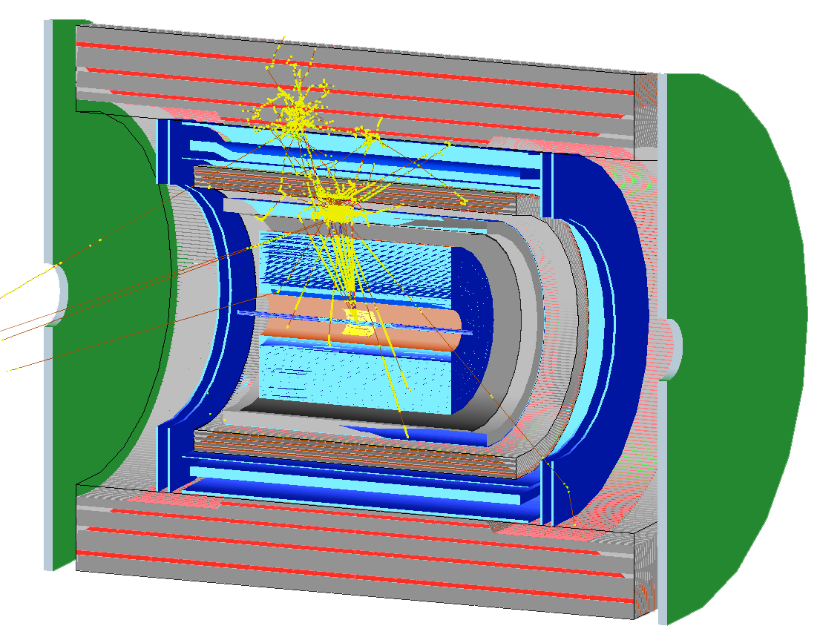
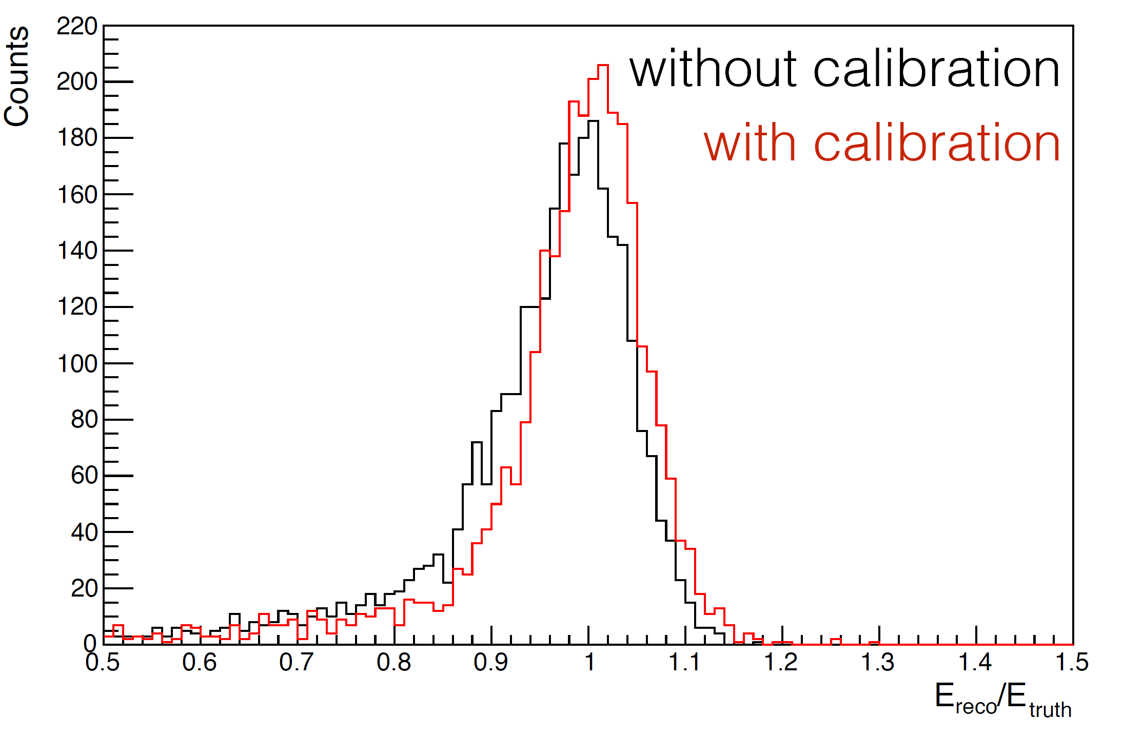
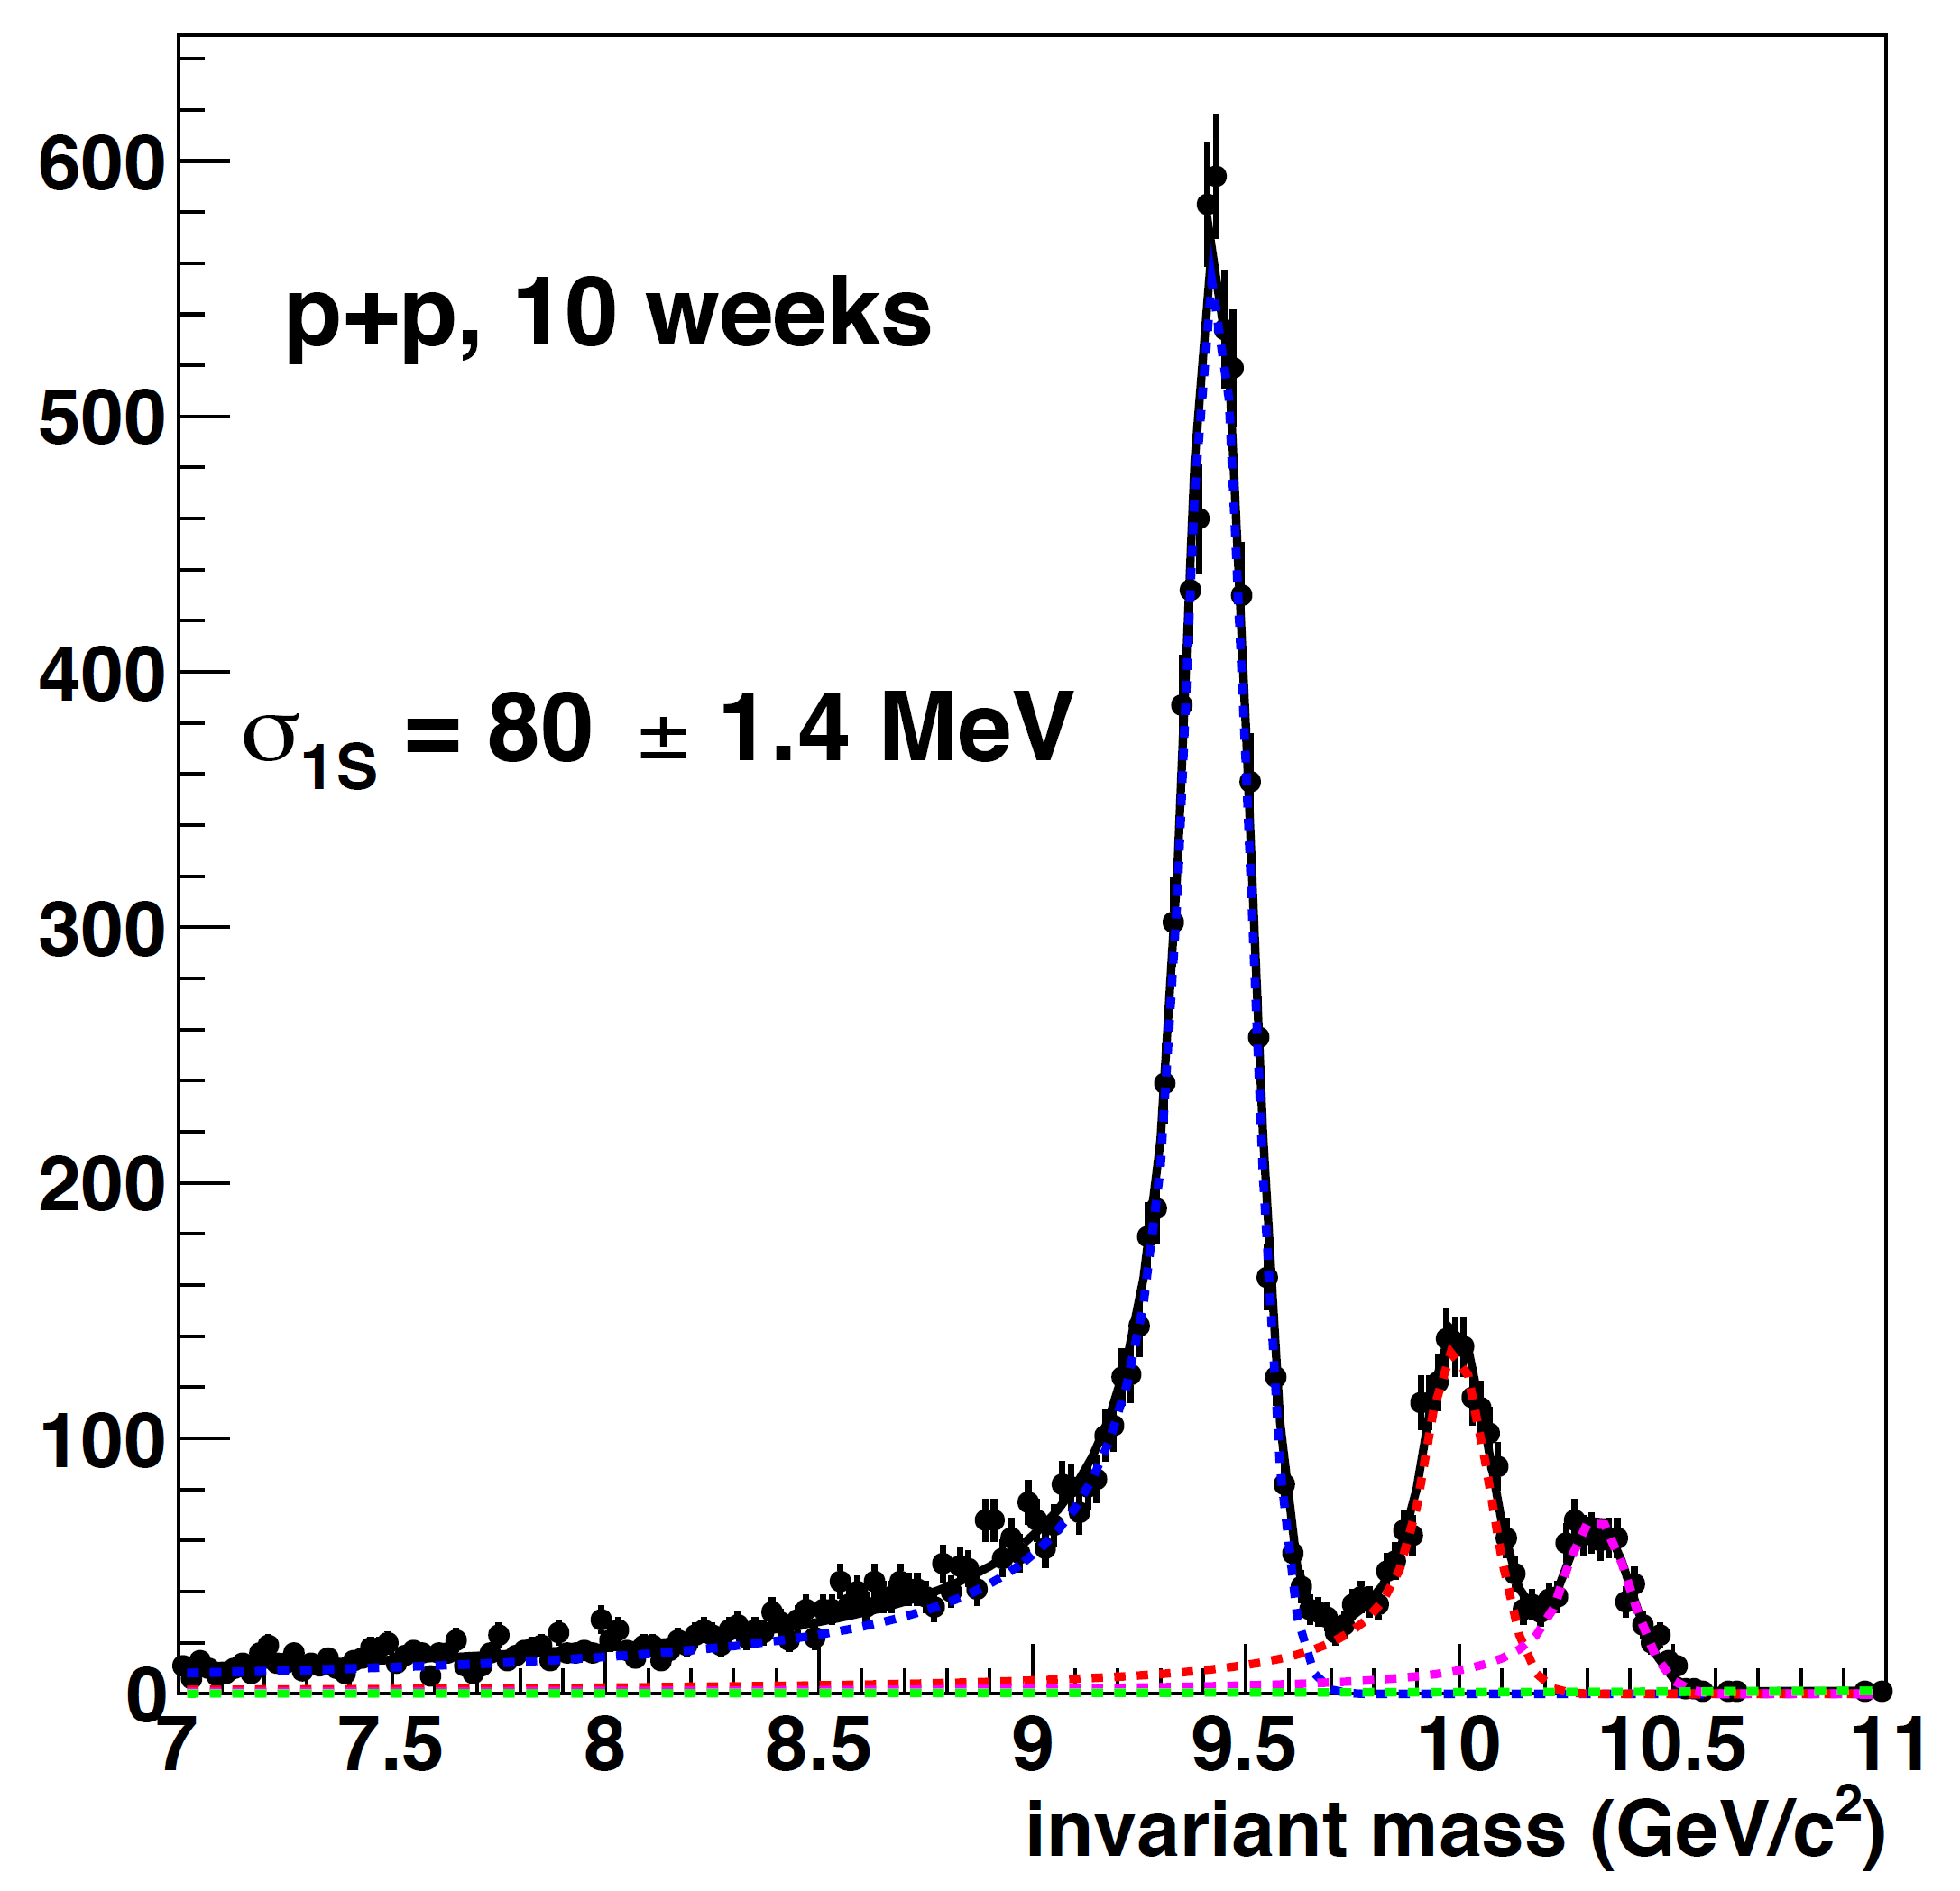
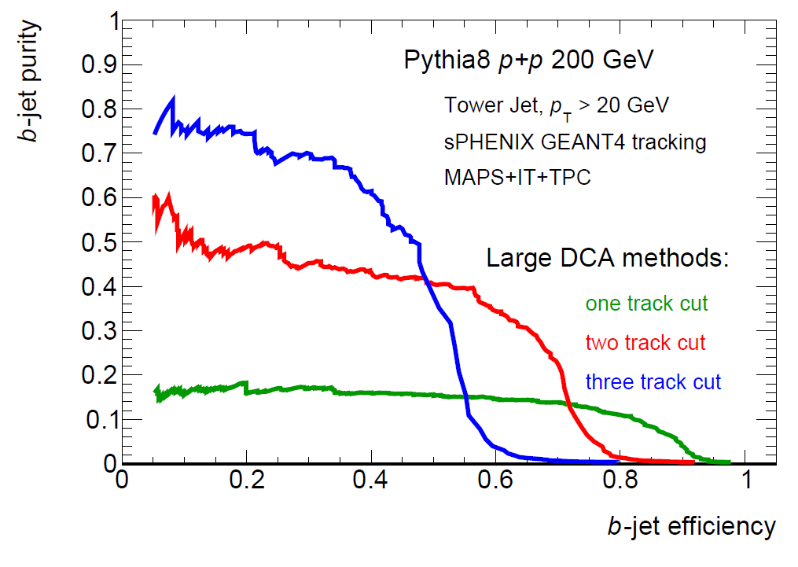

sPHENIX Software
Detector performance
Physics obs. Projection
Detector Design
→ G4 Simulation
→ Digitization
Reconstruction
Real Data
Open source @
https://github.com/sPHENIX-Collaboration/
Core software: 200k line of code
Analysis: 59k line of code

Slide 3
Subsystem simulation and reconstruction

Slide 4
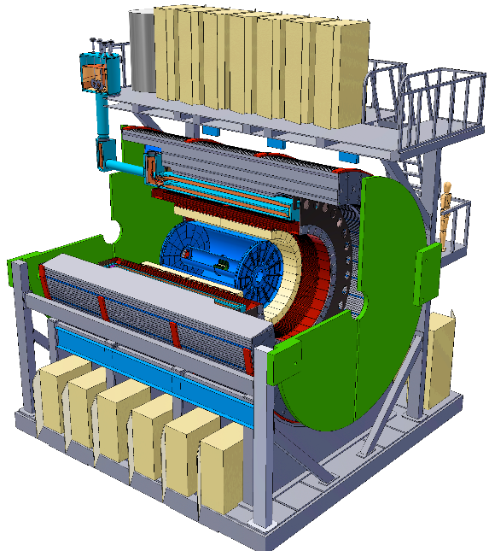
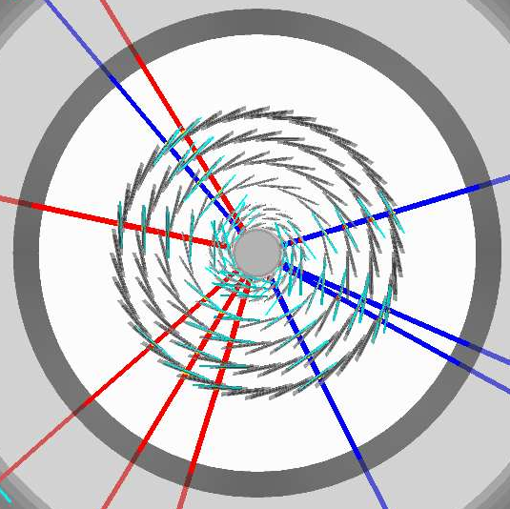
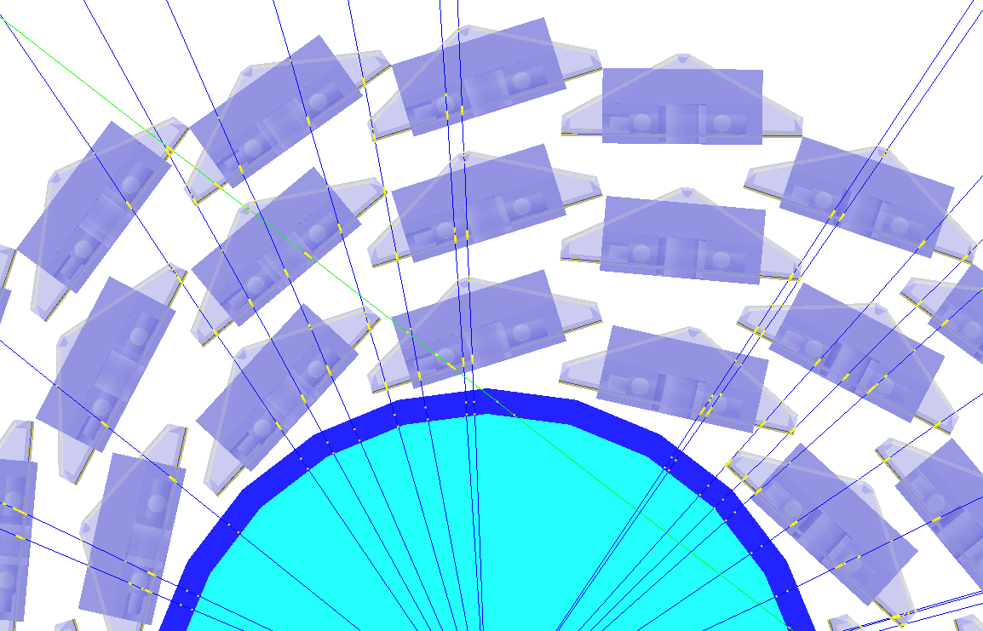
Full detector simulation + reconstruction
Open source @ : https://github.com/sPHENIX-Collaboration/
sPHENIX Geant4 display of p_{T}=30 GeV/c B⁺-hadron
Design to Simulation
Inner tracker (MVTX and INTT) _
_ MVTX Ladders modeled in details

Slide 5
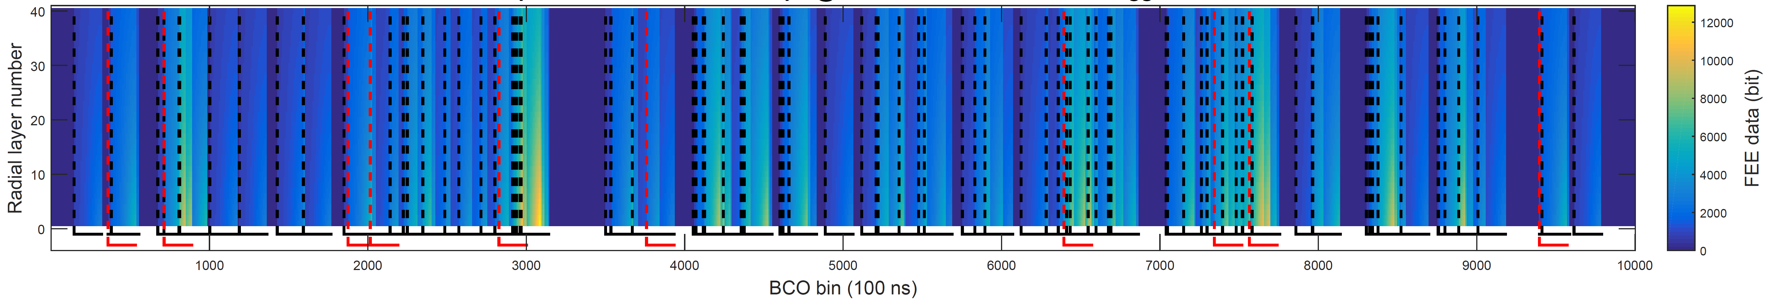
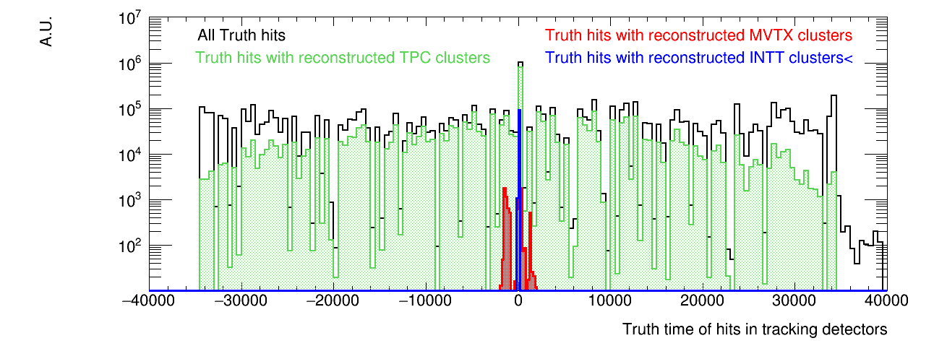
Event generator: event pile up
High rate → Pile up → studied in our software suit
Simulated TPC data stream
Collisions: +/- 35 µs
TPC: +/- 35 µs
MVTX: +/- 2 µs
INTT: [-20 ns, +80 ns]

Slide 6
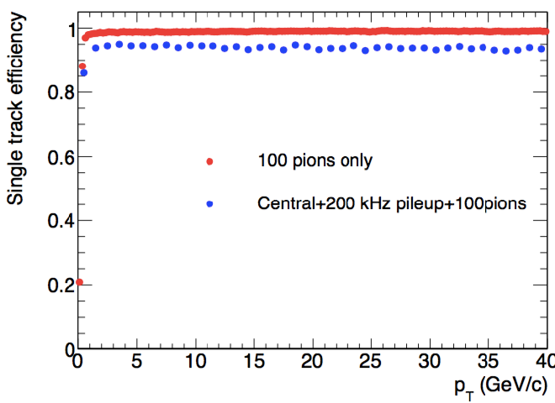
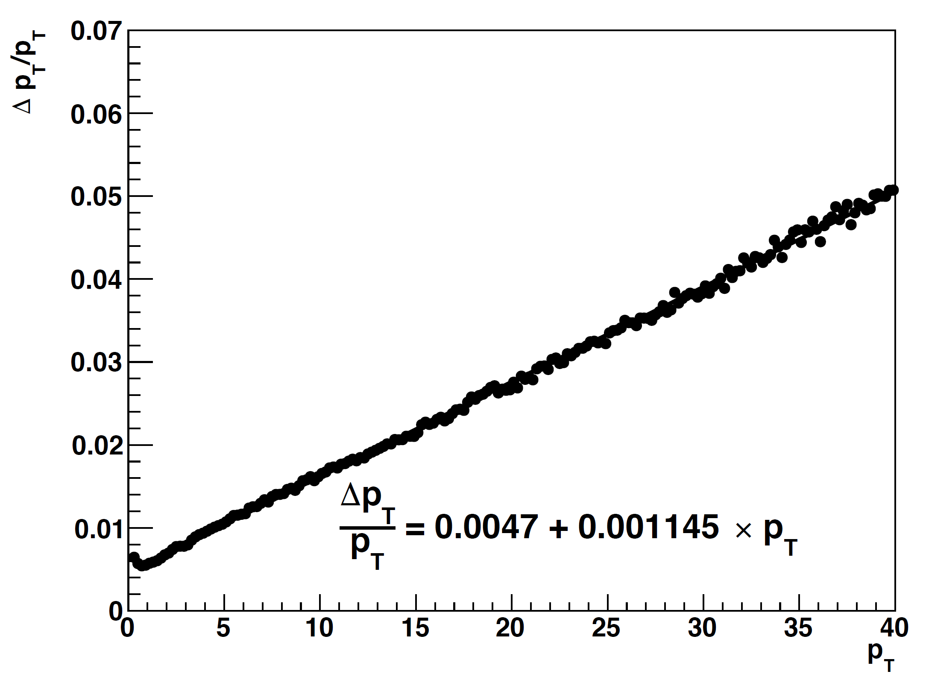
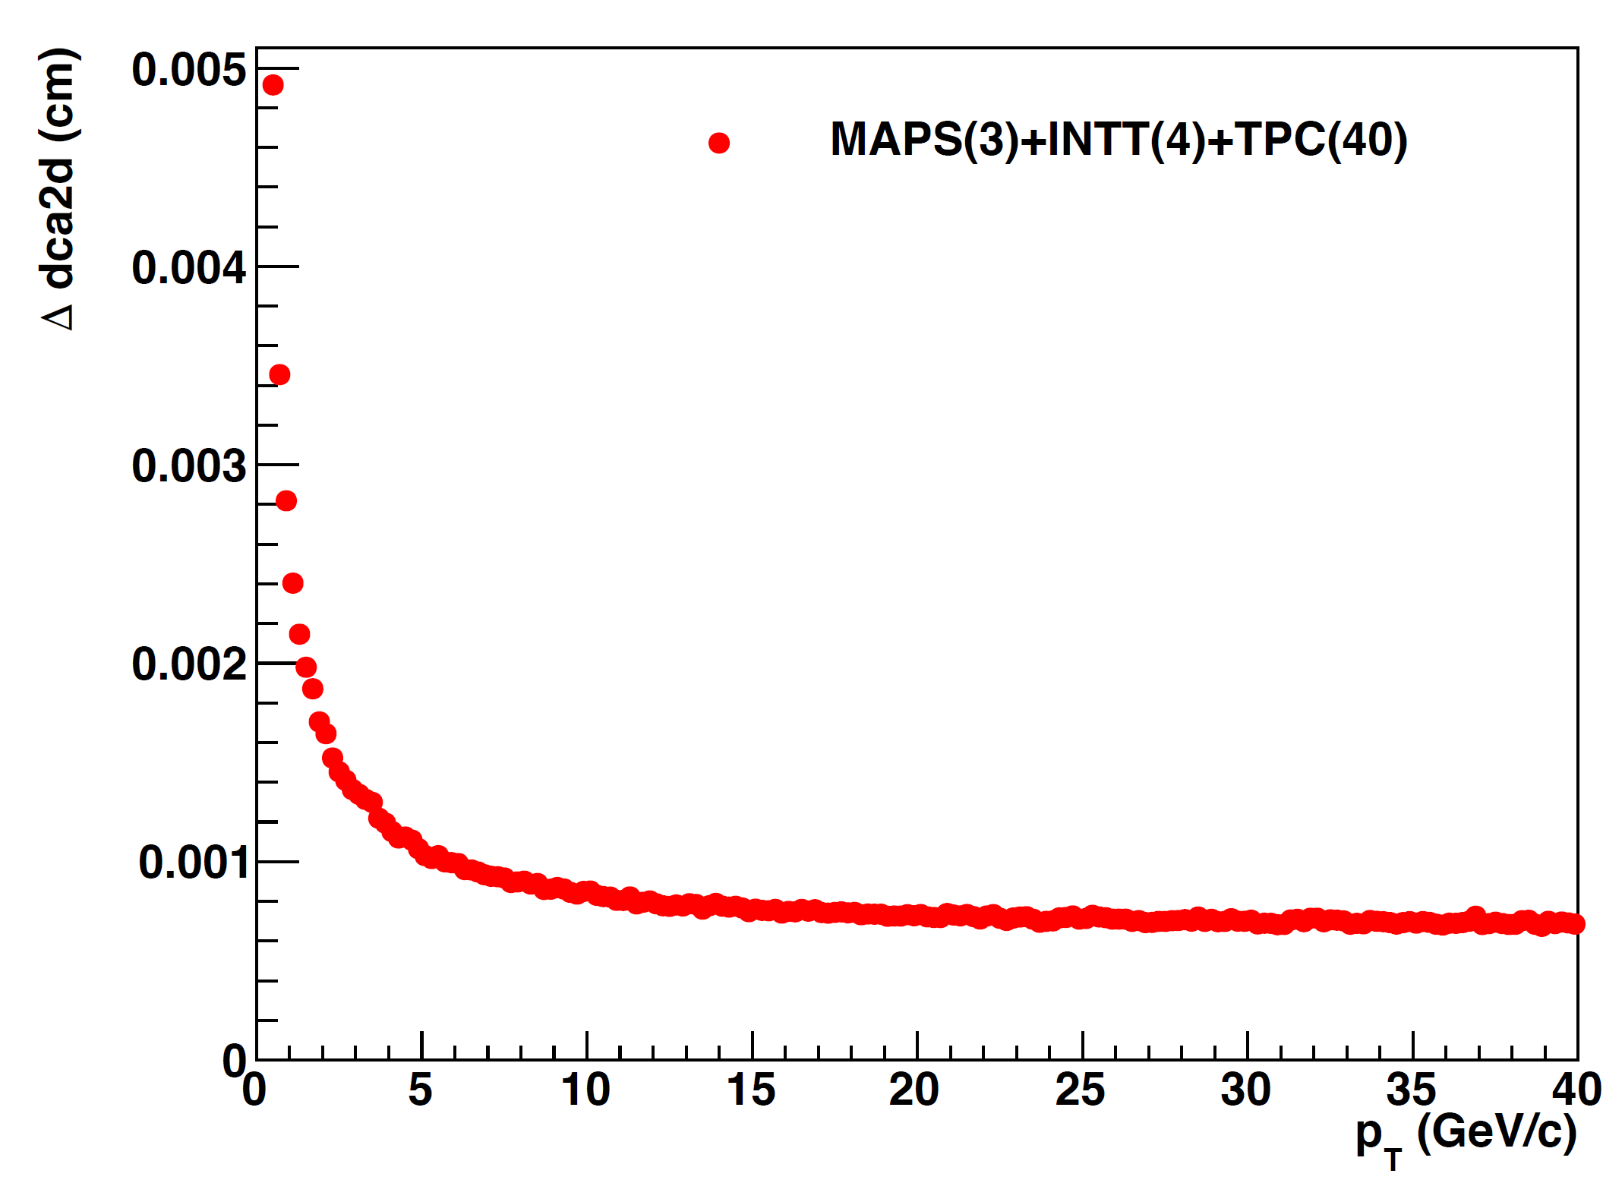
Tracking simulation + reconstruction
Tracker simulation
Track fit
Detailed ladder models
Pattern recognition, ghost rejection
GenFit2-based Kalman filter
RAVE-based multivertex finding and fitting
Final Vertex finding
Hough transform seeding
Event generation
Improving TPC ionization simualtion
Kalman filter propagation
2 iterations
Pile up
Multi event generators
Tracking software improved significantly over the past year from a team of hardworking developers
Full simulation + reco chain
Improving details of detector description and improving tracking speed
Full tracking simulation in 0-4 fm Au+Au collisions
sPHENIX simulation
sPHENIX simulation

Slide 7

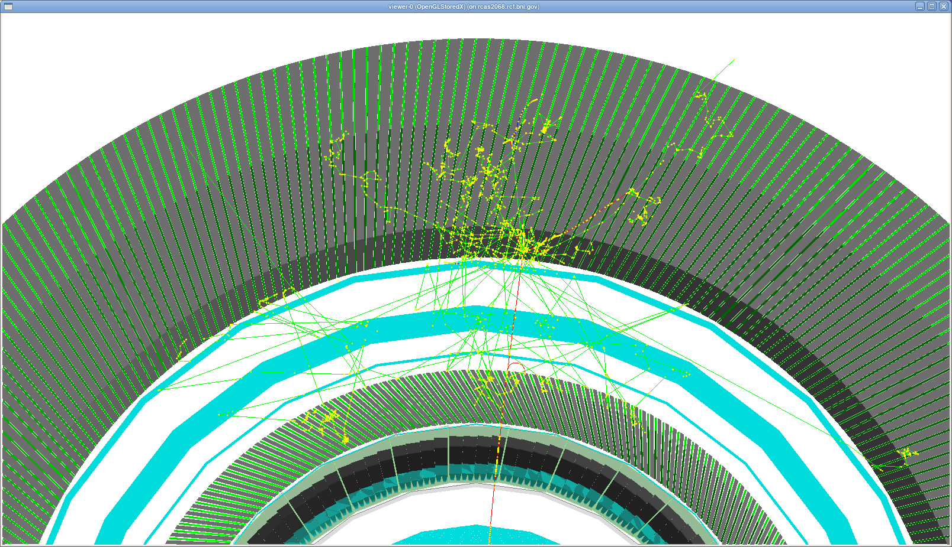
Calorimeters: in Simulation
EM calorimeter (EMCal) : 18 X₀ W-SPACAL
Inner hadron calorimeter (Inner HCal) : .25 λ₀ Al (Scint. Sampling)
sPHENIX coil and cryostat. (Magnet): 1.4 X₀ Coil & Cryostat
Outer hadron calorimeter (Outer HCal) : 4 λ₀ SS-Scint. sampling
Beam view of full calorimeters
Outer HCal
Geant4 Land
Magnet
Inner HCal
EMCal
24-GeV pion shower

Slide 8
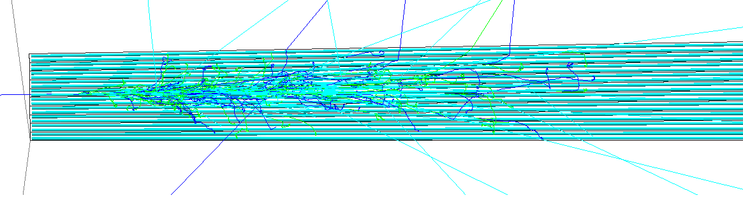
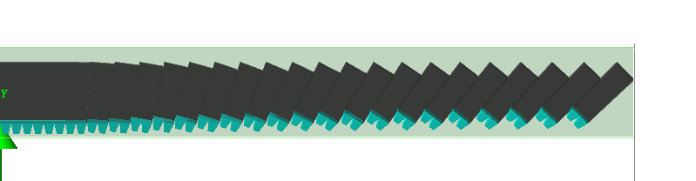
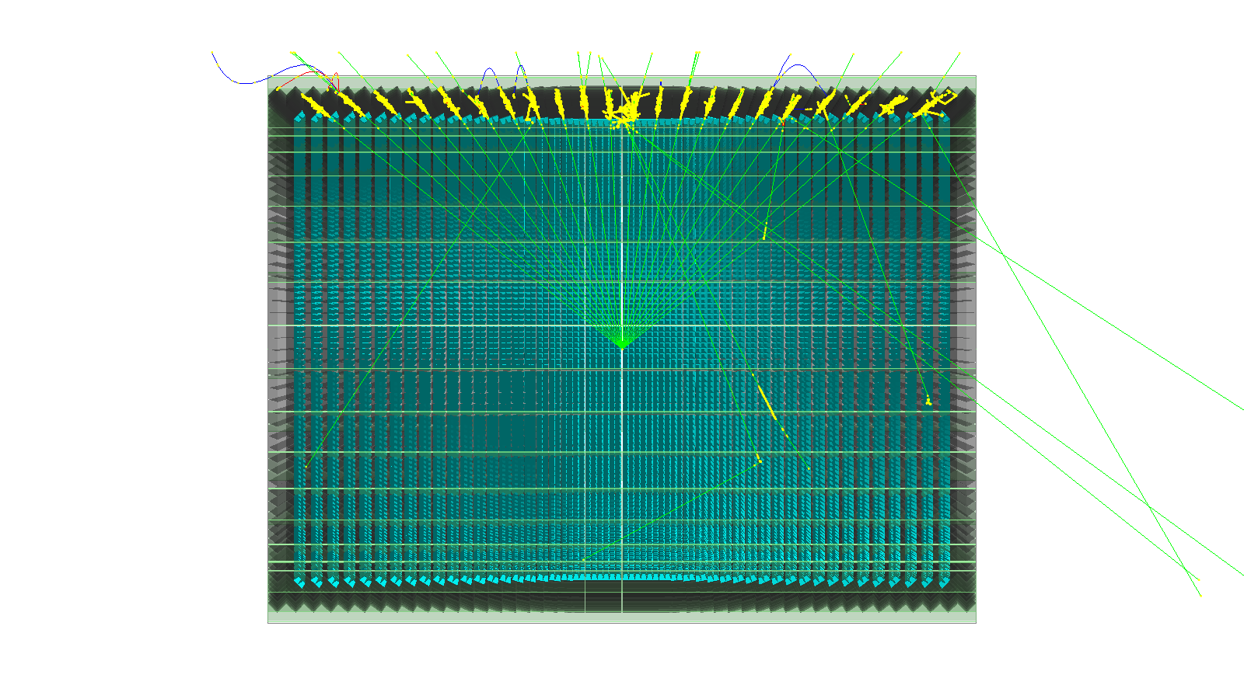
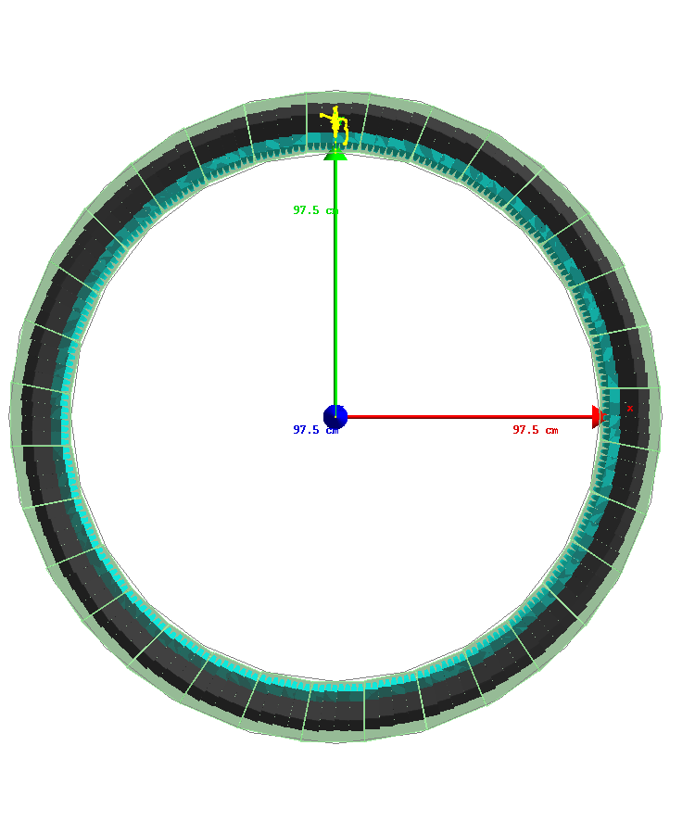
Simulation Setup: EMCal
2 cm
10GeV, e+
SPACAL Tower
w/ fibers displayed
EMCal Half Sector
(fibers simulated but hidden from display)
full EMCal

Slide 9
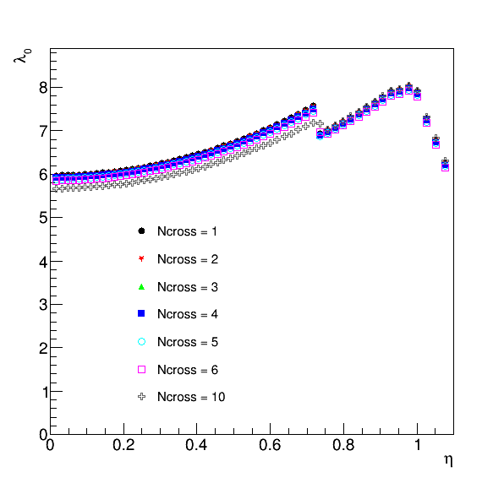
Simulation Setup: HCal
Beam view of full calorimeters
Outer HCal
Magnet
Baseline design
Inner HCal
EMCal
24-GeV pion shower
Calorimeter simulation & analysis chain:
GEANT4 hit → Scintillation light model → Light collection model → Tower readout → Digitization → Calibrated tower energy → Clustering/Track matching/Jet finding

Slide 10
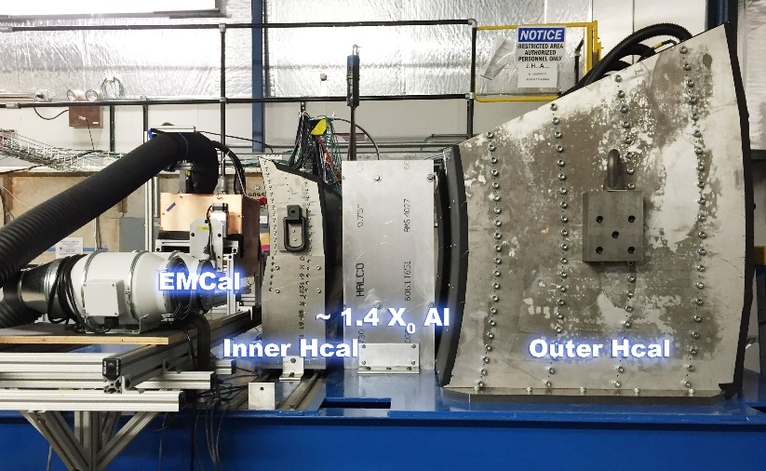
Test Beam Verification [arXiv:1704.01461]
Geant4 World

Slide 11
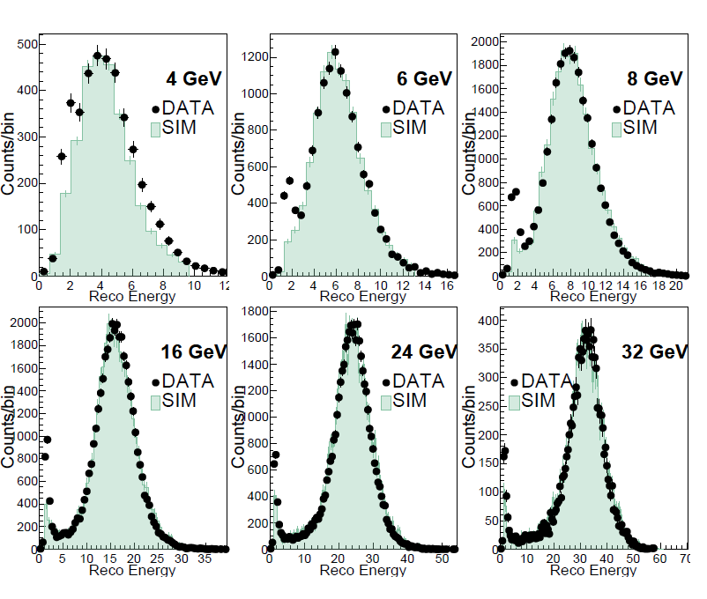
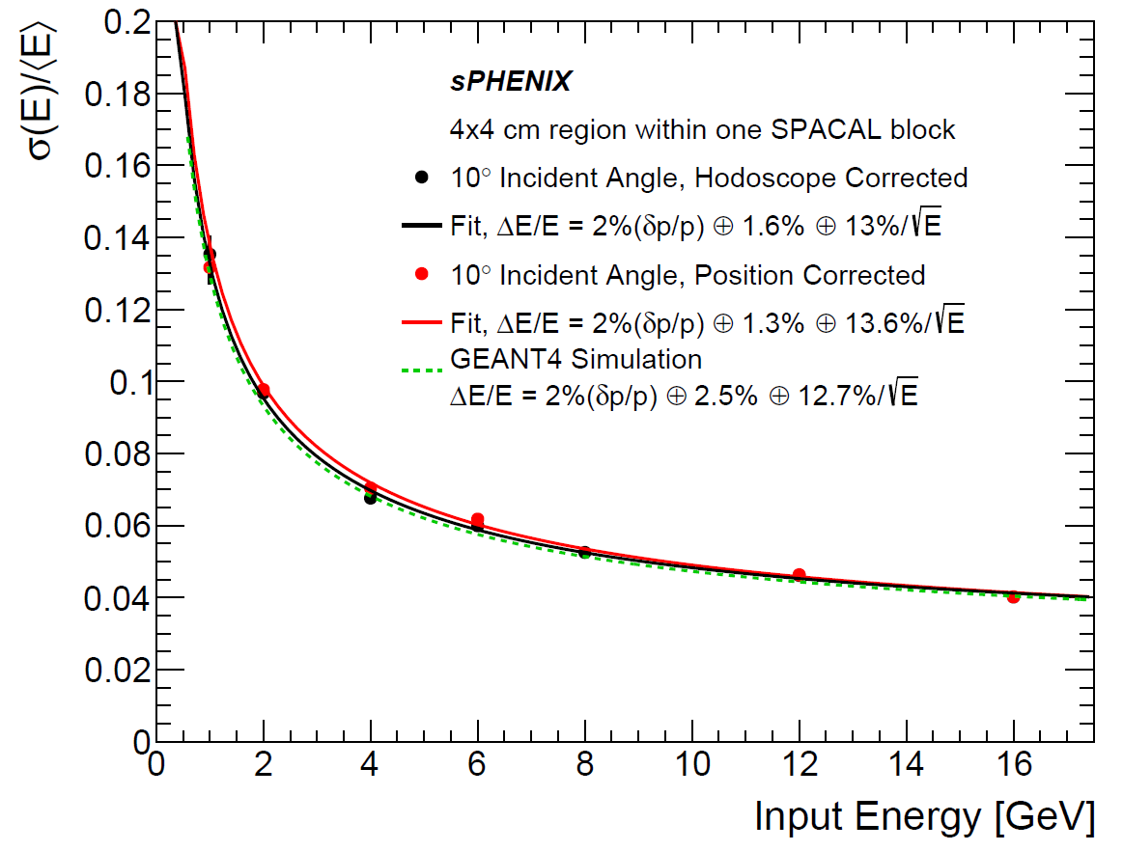
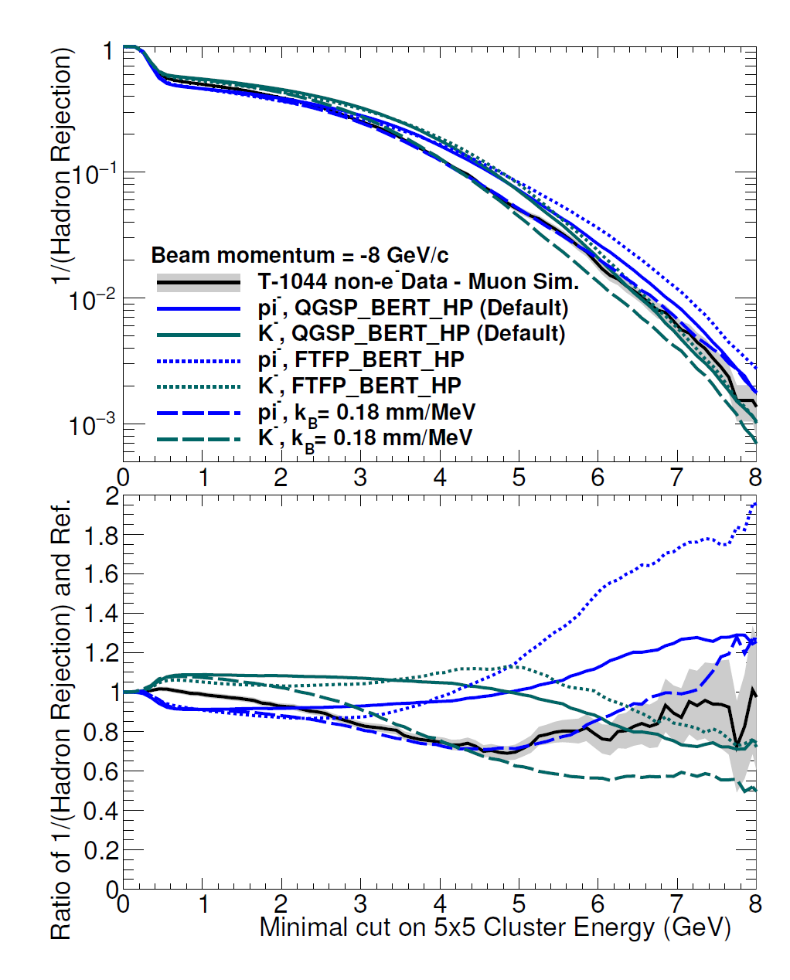
Test Beam Verification [arXiv:1704.01461]
EMCal energy resolution
for EM shower in tower center
EMCal rejection
for pion-
HCal energy response for pion-
New 2017 data
2016 data and submitted to IEEE TNS

Slide 12
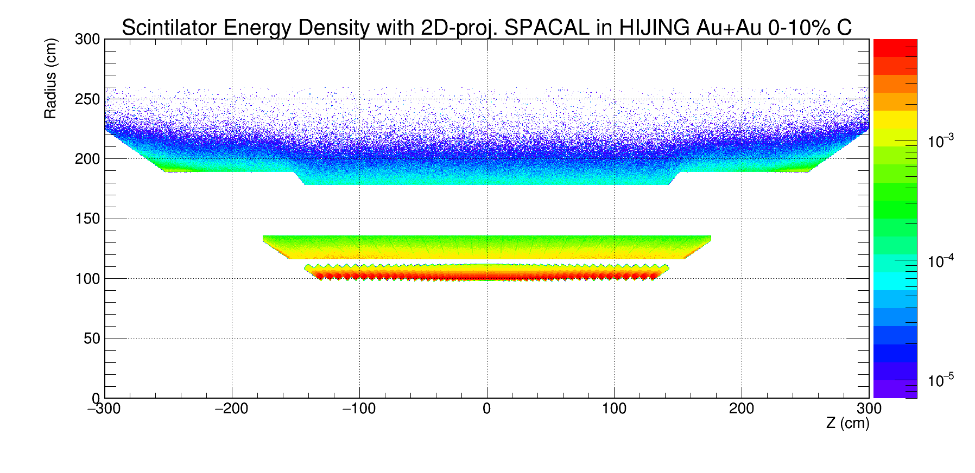
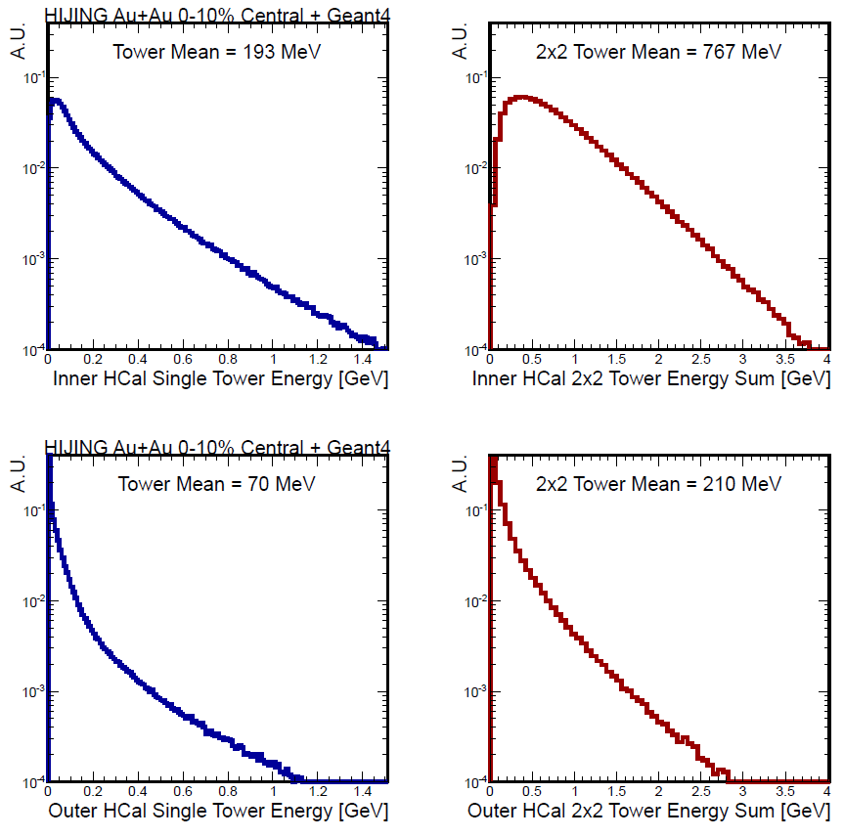
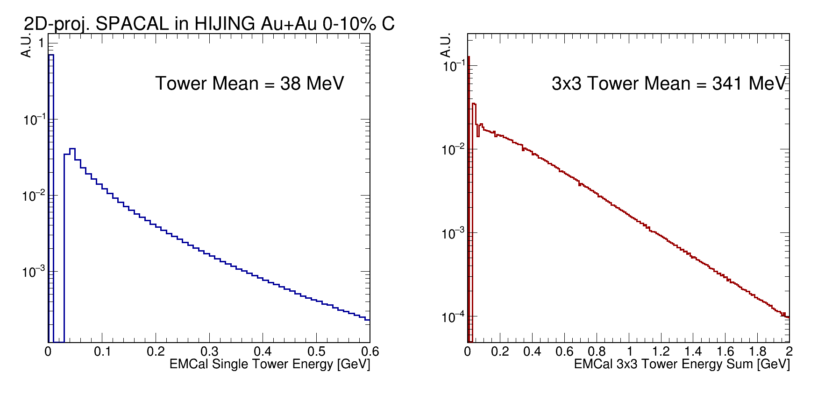
Au+Au background → Compact shower
Inner HCal
EMCal
Outer HCal

Slide 13
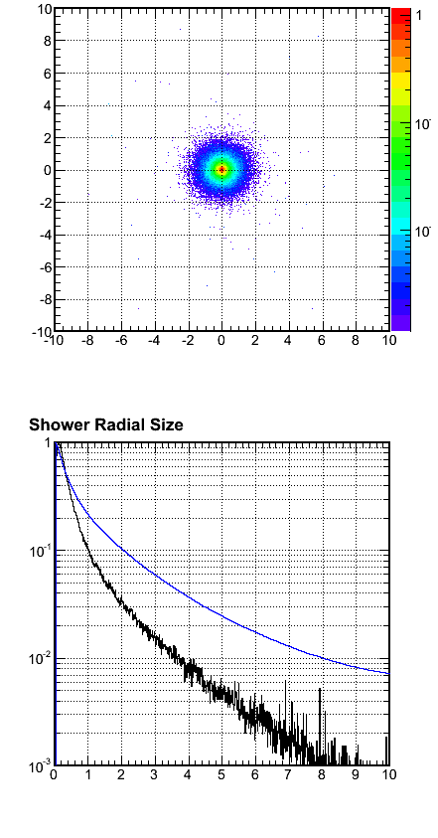
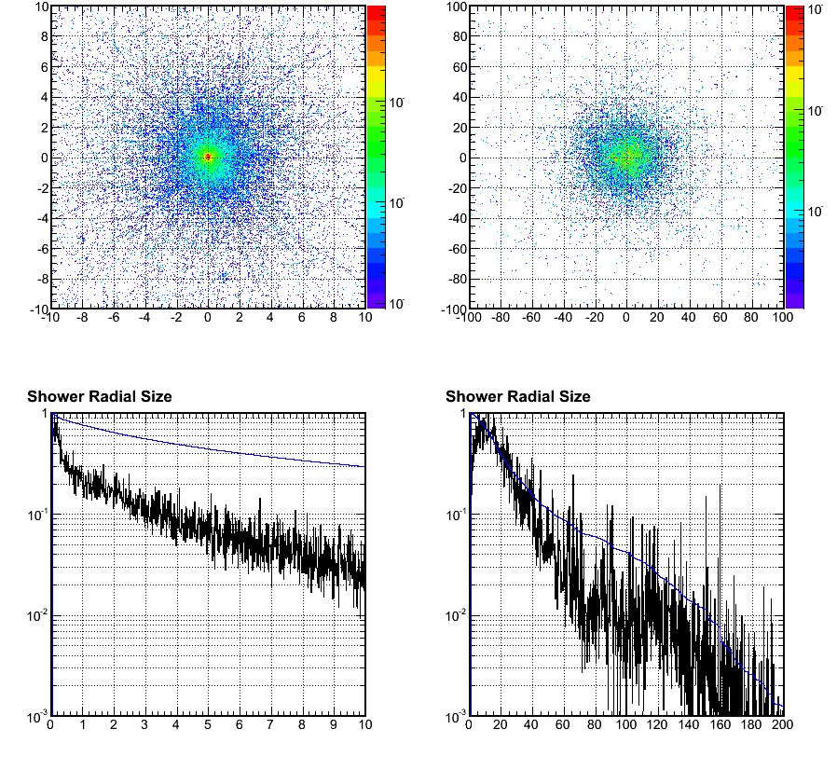
4 GeV Electrons in EMCal
4 GeV Pions in EMCal, that passed E/p electron-ID cut
EMCal
EMCal
Inner HCal
EMCal Y (cm)
EMCal Y (cm)
Inner Hcal Y (cm)
EMCal X (cm)
EMCal X (cm)
Inner HCal X (cm)
― Energy deposition (A.U.)
― Percentage outside radius
A.U./Leakage Ratio
← Moliere radius, 2cm
A.U./Leakage Ratio
A.U./Leakage Ratio
← 3x3 tower
95% containment
← 3x3 tower
50% containment
← ~3x3 tower
60% containment
EMCal radius (cm)
EMCal radius (cm)
Inner HCal radius (cm)

Slide 14
Performance simulations

Slide 15
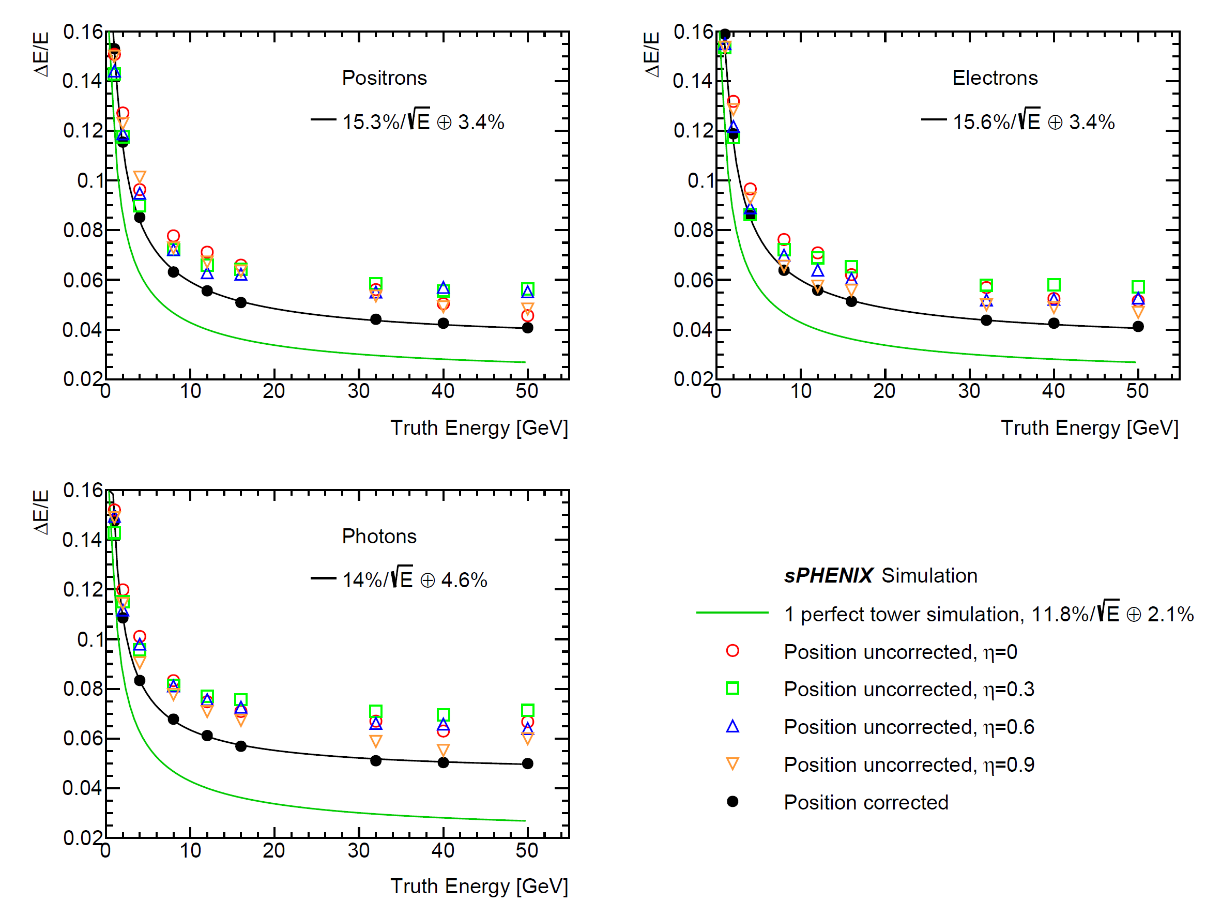
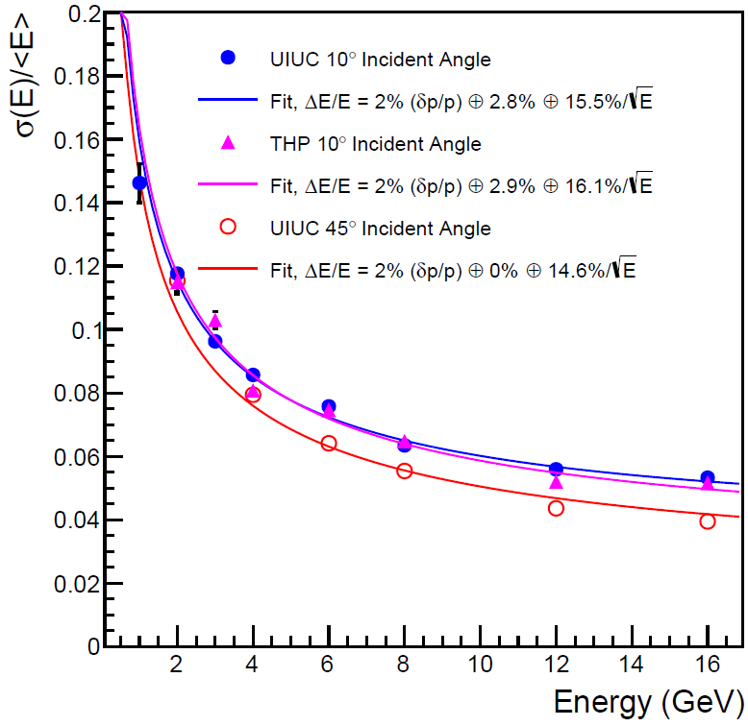
Performance : Single EM Showers
Applied cluster-position-based non-uniformity correction as used in test beam analysis
dE/E ~ 15%/ √(E) + 4% (meets sPHENIX goal)
Beam test [arXiv:1704.01461] Full sPHENIX detector simulation

Slide 16
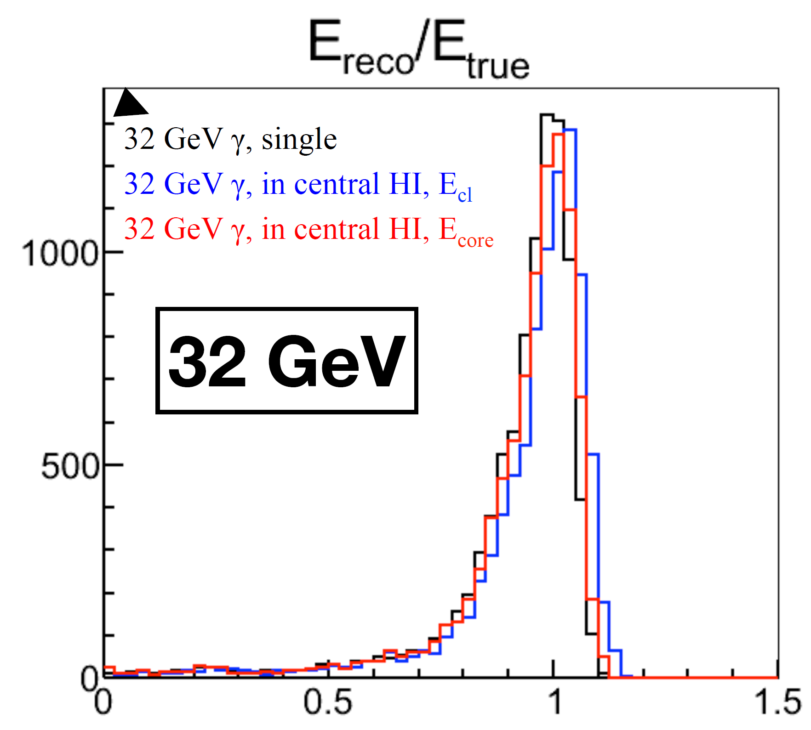
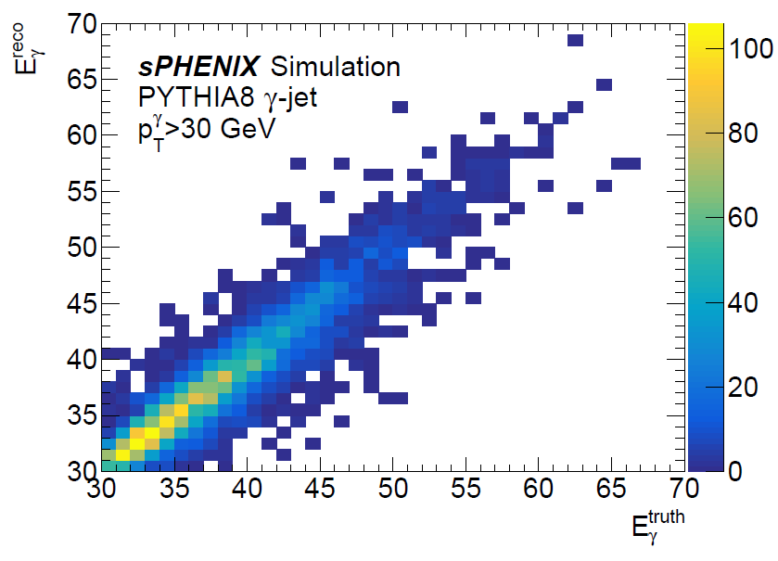
Performance : Photon in Full Event
Good linearity up to photon kinematic limit of sPHENIX
Good photon response shown in full event simulations

Slide 17
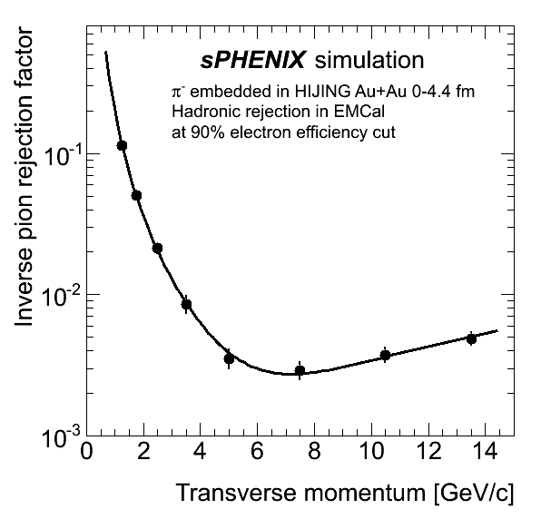
Physics Performance : Electron-ID
Critical driving factor for EMCal design: Upsilon electron ID
Satisfied detector requirement
(>90:1-pion rejection @ p_{T}=4 GeV/c in central Au+Au collisions at 70% efficiency)
Updating Upsilon background and R_{AA} projections
Upsilon R_{AA} projections in sPHENIX proposal
Pion rejection
@ 90% efficiency
(higher than spec.)
Updating ...

Slide 18
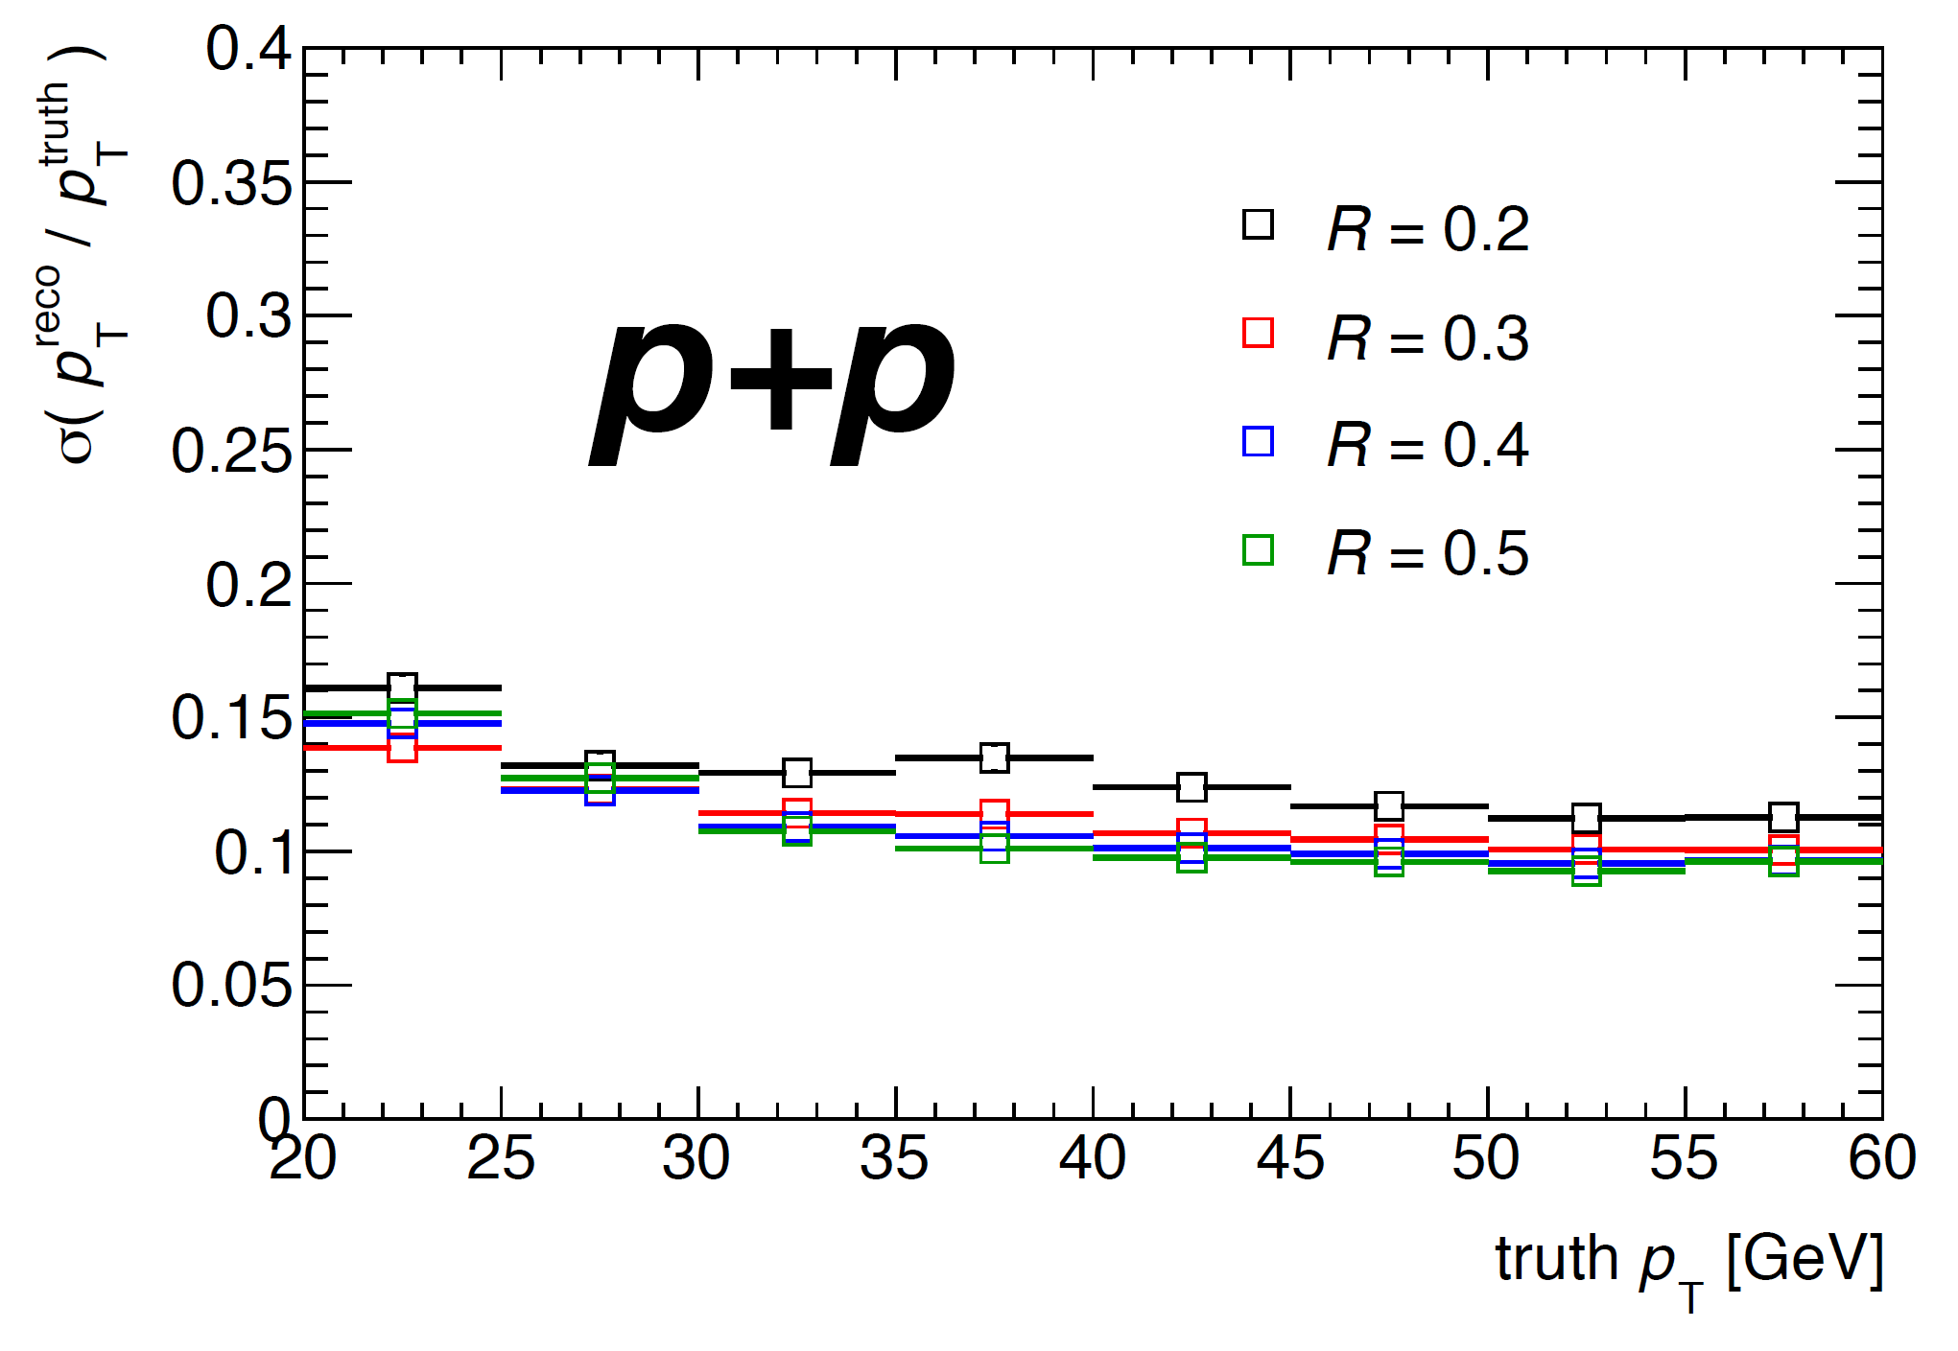
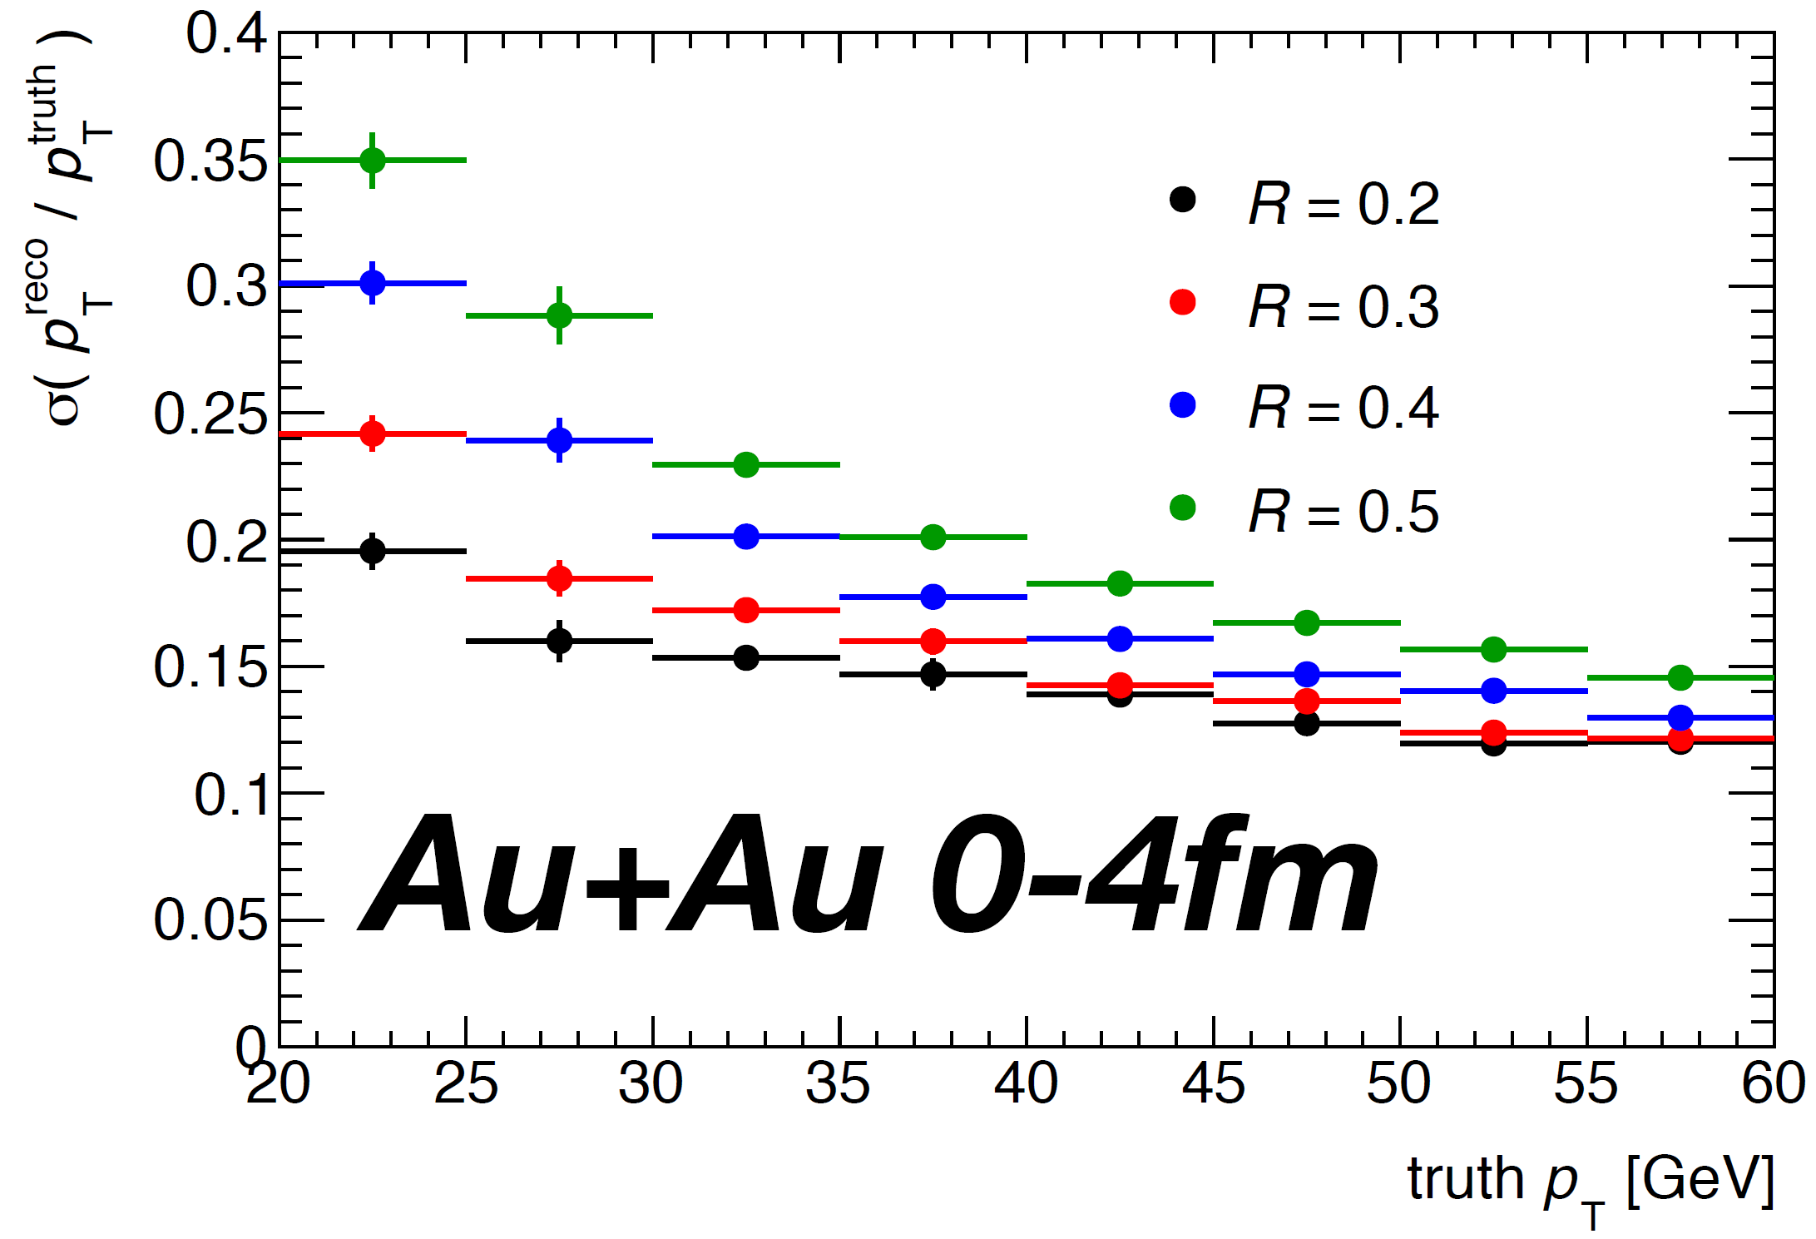
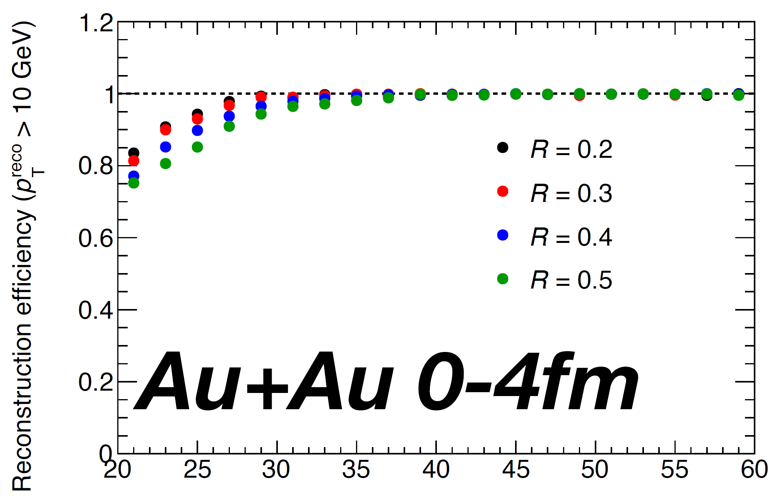
Performance : Jet Finding
Jets in p+p and central Au+Au collisions are also studied in full detector simulations
Jet finding followed by ATLAS style iterative background subtraction [10.1103/PhysRevC.86.024908]
Performance meeting sPHENIX spec.
Further improving underlying event subtraction and fake-jet rejection algorithm based on RHIC and LHC experiences

Slide 19
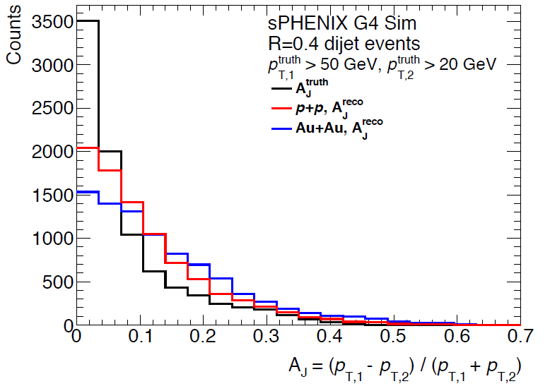
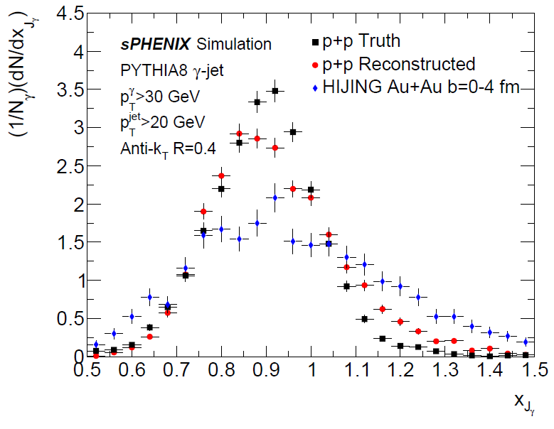
Physics Performance : Jet Observables
Jet-balance/imbalance observables simulated in full detector events:
day-1 measurement, resolution under control
On-going effort in understanding the details of the jet simulations and unfolding studies.
Expanding jet observables studied with the updated design and simulations
Shape of observable well controlled
from truth → measured quantities
Promising for unfolding and sys. control
Di-jet transverse momentum asymmetry
γ-jet transverse momentum balance

Slide 20
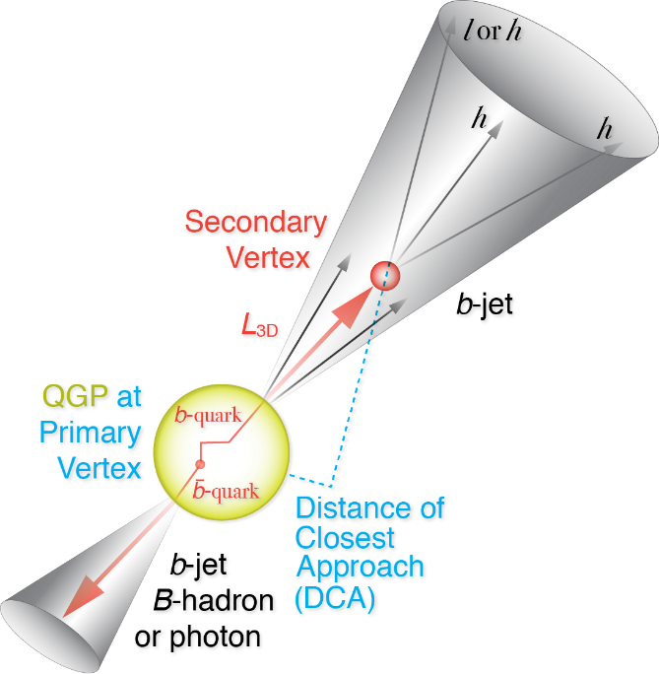
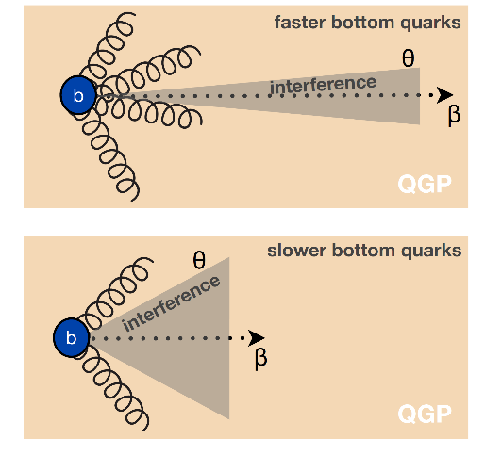
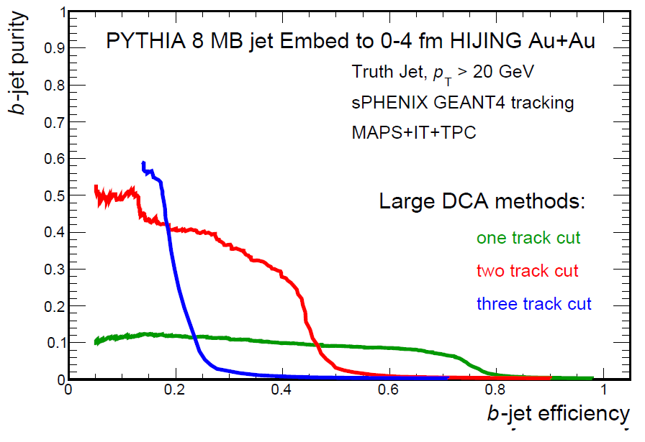
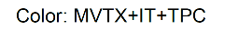
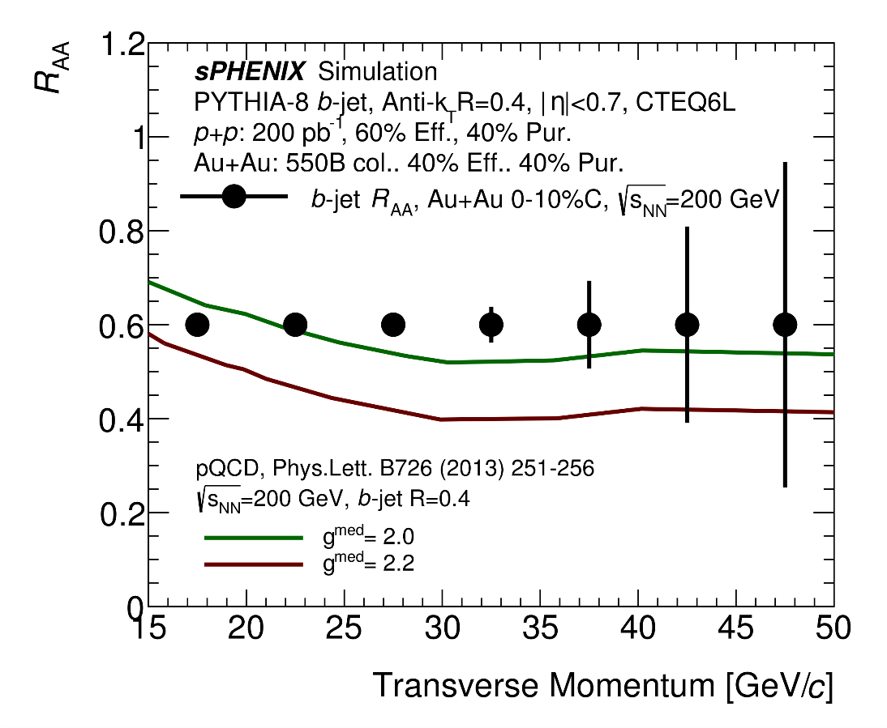
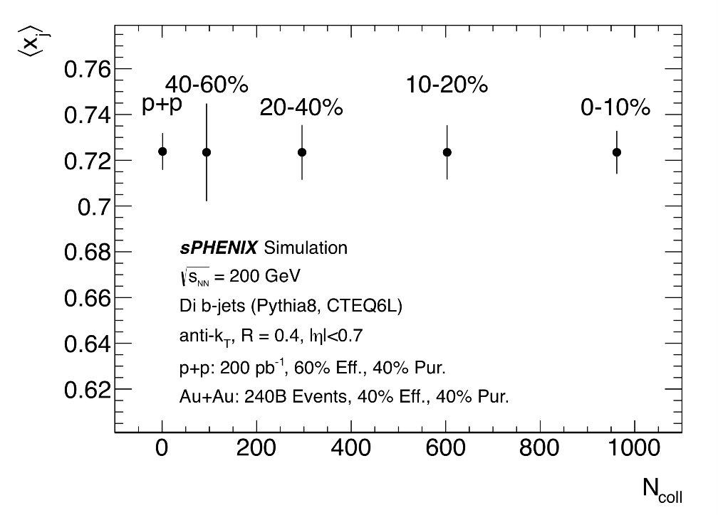
b-quark jet
sPHENIX simulation
CMS work-point, Phys. Rev. Lett. 113, 132301 (2014)
b-jet + light jet: differential sensitivity to radiative VS collisional energy loss.

Slide 21
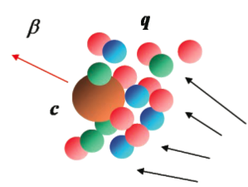

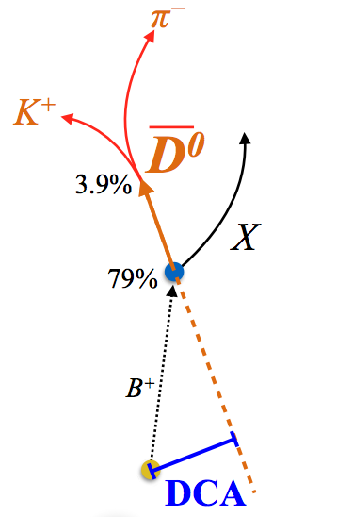
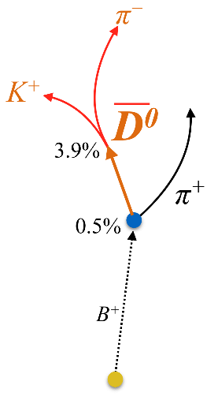
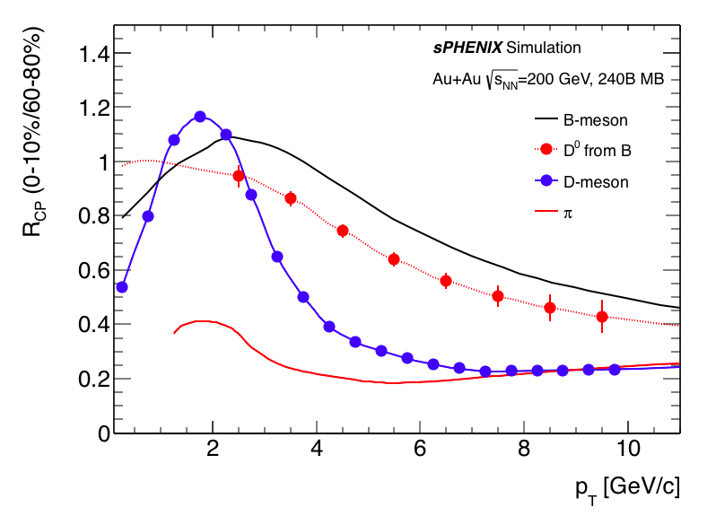
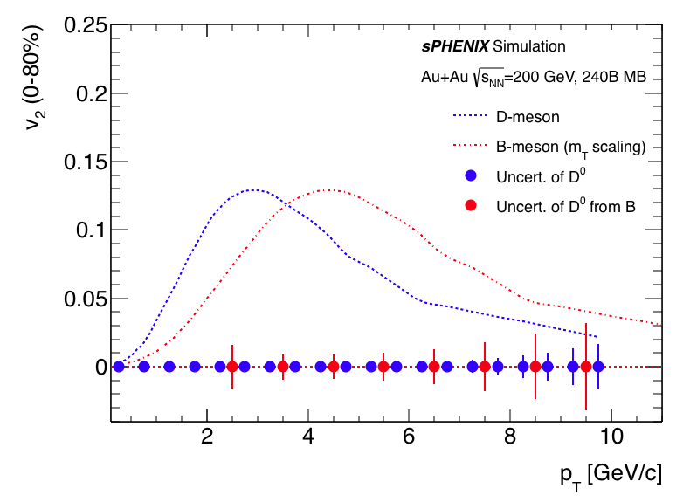
Precision open bottom meson
“Brownian” motion
→ Langevin simu.
b
drag
fluctuations
Diffusion coefficient D_{HQ}
B-meson program: p_{T} 2-10 GeV/c, precisely determine the bottom quark collectivity → clean access to D_{HQ}

Slide 22
Beyond sPHENIX

Slide 23



Evolution of the PHENIX Interaction region
PHENIX experiment
An EIC detector
16y+ operation
Broad spectrum of physics (QGP, Hadron Physics, DM)
170+ physics papers with 24k citations
Last run in this form 2016
Comprehensive central upgrade base on BaBar magnet
Rich jet and HF physics program
→ nature of QGP
Possible forward tracking, and calorimeter → Spin, CNM
Path of PHENIX upgrade leads to a capable EIC detector
Large coverage of tracking, calorimetry and PID
Open for new collaboration/new ideas
arXiv:1501.06197 [nucl-ex]
arXiv:1402.1209 [nucl-ex]
~2000
2017→2022, CD-0 @ 2016
≥2025
Time
RHIC: A+A, spin-polarized p+p, spin-polarized p+A
EIC: e+p, e+A

Slide 24



Evolving upgrade concepts
arXiv:1501.06197
CDR in preparation
To RHIC PAC 2017
arXiv:1402.1209

Slide 25



EIC detector studies
DIS collision @ Q² ≈ 100 (GeV/c)²
Forward tracking resolution
(Haiwang Yu)
EIC LOI being updated this year.
Many opportunity to contribute
and design future of sPHENIX

Slide 26


Full detector EIC simulation in sPHENIX framework:
Promise to stream readout EIC detector with sPHENIX DAQ
See my slide @ EIC stream readout meeting and sPHENIX cold-QCD TG meeting https://indico.bnl.gov/event/4464/contributions/20809/attachments/17998/22285/2018.04.02_EIC_Stream_Readout2.pdf
50 ub cross section
@ L = 10³⁴ cm⁻² s⁻¹
→
~100 Gbps (30 Gbps+ PID + headers) stream readout EIC without triggering
≈ sPHENIX DAQ disk rate

Slide 27
How to get involved

Slide 28
How to get involved
Always good to start with day-1 checklist
Discussion group:
  sPHENIX simulation meeting: https://indico.bnl.gov/categoryDisplay.py?categId=88
  Software and repository email list:
    https://lists.bnl.gov/mailman/listinfo/sphenix-software-l
    https://lists.bnl.gov/mailman/listinfo/sphenix-github-l
Documentation
  Software wiki: https://wiki.bnl.gov/sPHENIX/index.php/Software
  Doxygen software reference: https://www.phenix.bnl.gov/WWW/sPHENIX/doxygen/html/
Resource
  RCAF
    Works with both PHENIX and STAR(in testing) existing RCF account
    10 TB per user base disk associated with sPHENIX group tag: Register with this form .
  sPHENIX code repository: https://github.com/sPHENIX-Collaboration

Slide 29

Framework: Fun4All
Based on PHENIX software framework, a.k.a. Fun4All
  Modular design, C++ based, 1 PB data / week PHENIX data analysis
Built-in Geant4 support Common macro run the simulation and standard analysis chain
Easy access for user modules in analysis : https://wiki.bnl.gov/sPHENIX/index.php/Example_of_using_DST_nodes

Slide 30
Framework: Logistic
Repositories: https://github.com/sPHENIX-Collaboration
  analysis: which contains the analysis modules. Everyone who is a collaborator (request to join here) can update this repository directly.
  coresoftware: which contains the framework, the G4 simulation and the Event library to read raw data.
    Pull request & review required for updates
  macros: which contains macros to run the show.
    Pull request & review required for updates
Nightly build:
  Most recent software build for use on RCF daily (new builds)
  Weekly snapshot of software environment (ana builds)
Further information :
  https://wiki.bnl.gov/sPHENIX/index.php/Software

Slide 31
Summary
sPHENIX has a robust simulation + reconstruction software
  Checked with test beam with detailed detector description
  Used in large studies in multiple campaigns
  Improving fidelity of simulation, optimizing speed of reconstruction
Current simulation show designed detector fit sPHENIX scientific goals
Many opportunity for Chinese collaborator to contribute
  Detector refinement
  Studies of physics opportunities : four topical groups
Join me this afternoon for a tutorial
Always start from here: day-1 checklist

Slide 32
Extra Information

Slide 33






Cold QCD
x₁
arXiv:1602.03922
sPHENIX simulation
p↑ + p → jet (h±) + X
√s = 510 GeV
sPHENIX simulation
p↑ + p → jet (h±) + X, √s = 510 GeV
Charge-track tagged jet asymmetry
→ Access Sivers effect
Charge-track asymmetry in jet
→ Access Transveristy @ large x

Slide 34
Event generator
Standard inputs: HEPMC format
  Fun4AllHepMCInputManager -> HepMCNodeReader
Generators in
  Pythia8 for p+p: PHPythia8
  Pythia6 for p+p/e+p: PHPythia6
  Hijing for p+A, A+A
Additional event generator
  JEWEL/PHSartre/sHepGEN
  Suits of EIC event generators via EIC-Smear package
  Of-course single particle generator for testing
For your study, welcome to contribute your favorite generator or HepMC data sets:
  https://github.com/sPHENIX-Collaboration/coresoftware/tree/master/generators

Slide 35


Slide 36

Inclusive b-jet R_{AA} Performance
MVTX aiming first b-jet nuclear modification factor
@ RHIC, covering ~15-40 GeV/c
  Mass dependence of parton energy loss
  Cleaner access to partonic kinematics
Uniqueness at RHIC (vs. LHC)
  Gluon splitting contribution is much less (~10%)

Slide 37

EMCal: EM-shower energy resolution
Joe Osborn (UMich),
June 13 Sim meeting
Request:
Update with EMCal tower-by-tower calibration
Apply sPHENIX style

Slide 38




EMCal: Hadron rejection
Hadron rejection @ 90% electron eff. for embedded particle in 0-4.4 fm Au+Au collision
Work by Sasha Lebedev (ISU), quoted from Quarkonium-TG wiki, June-2017 Col. meeting
Anti-proton
Rejection
Pion rejection
+
p_{T} [GeV/c]
p_{T} [GeV/c]
Requests in priorities:
Update to sPHENIX plotting style
Produce Upsilon spectrum update with updated background
Use 2017 EMCal design and tracking simulations. Help on running?
Finalizing Upsilon R_AA projection?
More in Sasha’s talk today.

Slide 39



Performance : electron-ID in Au+Au
Updated and more detailed simulation show good safety margin on electron-ID performance on top of the baseline design (as required to reach Upsilon program physics goal)
Reconstructed η and p
Reconstructed η and p
Baseline performance,
design goals
Sum all scintillator energy
1D SPACAL material with hits grouped into 2D SPACAL towers
2D projective SPACAL
Updated studies (Preliminary)
Sum all hadron taking account of hadron ratio
Full digitization (w/ Birk corrections)
Full tracking with silicon opt.
Fully implemented 2D SPACAL (tower/support structure)
1D projective SPACAL
Updated studies (Preliminary)
Sum all hadron taking account of hadron ratio
Full digitization (w/ Birk corrections)
Full tracking with silicon opt.
Ideally towering (no-tower boarder, no enclosure structure)

