Slide 1
Electroweak Physics in CEPC
Zhijun Liang
IHEP,CAS

Slide 2
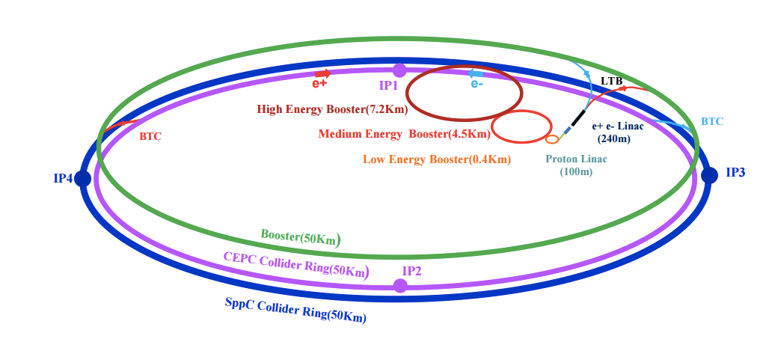
CEPC
Electron-positron circular collider
Higgs Factory（E_{cms}=250GeV , 10⁶ Higgs)
Precision study of Higgs coupling in ZH runs
complementary to ILC
See Manqi and Gang’s talk this morning in Higgs section for more details
Z factory（E_{cms}=91 GeV, 10¹⁰ – 10¹¹ Z Boson）:
Precision Electroweak measurement in Z pole running
Preliminary Conceptual Design Report( Pre-CDR) available :
http://cepc.ihep.ac.cn/preCDR/volume.html
Aiming for Conceptual Design Report (CDR) in next month
TDR study in the longer term future

Slide 3
Current
Current team
W mass : Bo Liu (IHEP) , PeiZhu Lai(NCU)
R_B: Bo Li (Yantai )
Afb: Mengran Li
WW threshold scan：Peixun Shen
CEPC physics and simulation group convener : Manqi and Gang
Welcome the new members
Maarten Boonekamp : W mass , R_b
Fulvio Piccinini : electroweak physics in Z pole

