Slide 1
The detector solenoid Vs Luminosity
Chenghui Yu
for CEPC team
Feb. 7, 2018

Slide 2
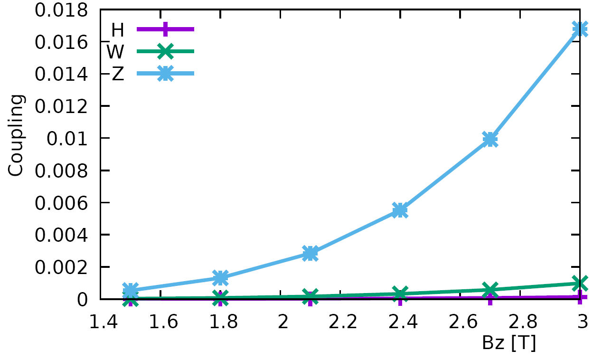
Start from detector solenoid 3.0T
Emittance growth caused by the fringe field of solenoids
Design emitY/emitX expected contribution real contribution
H: 3.6pm/1.21nm (0.3%) 0.36pm 0.14pm (0.01%)
W: 1.6pm/0.54nm (0.3%) 0.16pm 0.47pm (0.09%)
Z: 1.0pm/0.17nm (0.5%) 0.09pm 2.9pm (1.7%)

Slide 3
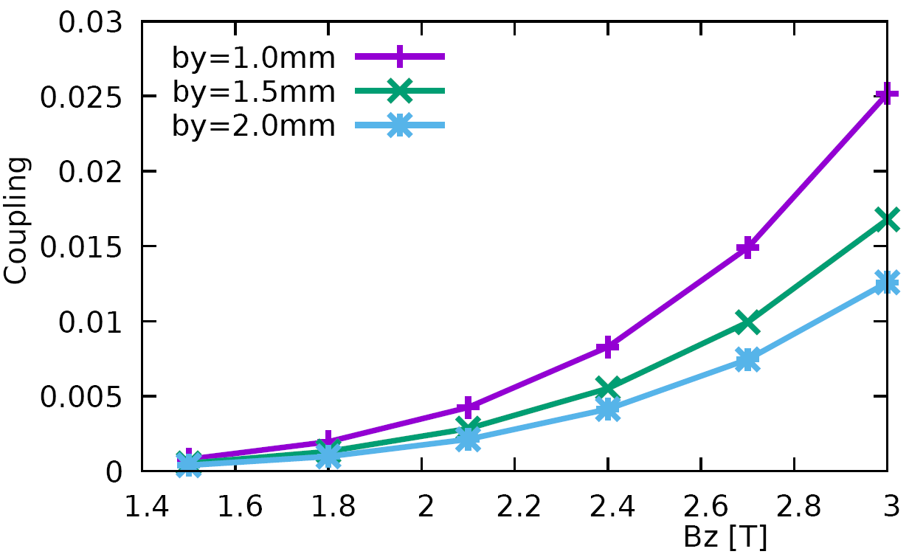
Start from detector solenoid 3.0T
β_{y}* Vs. coupling @ Z
Limitation of the luminosity improvement by reducing the β_{y}*

Slide 4
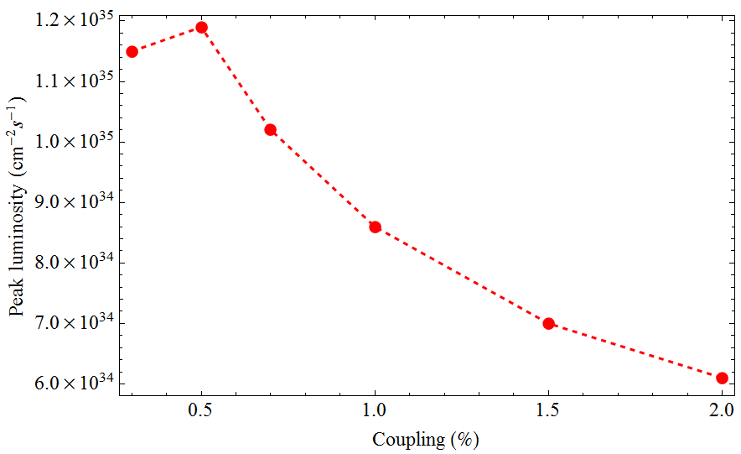
Start from detector solenoid 3.0T
Coupling=1.7% + 0.3~0.5%
Large beam size
&
serious bunch lengthening
Coupling Vs. Luminosity @ Z
For the 2Cell cavity operation, if the coupling lose control L ≈ L₀/2 ~ L₀/4

Slide 5
The parameters of CEPC
 | Higgs | W | Z
Number of IPs | 2
Energy (GeV) | 120 | 80 | 45.5
Circumference (km) | 100
SR loss/turn (GeV) | 1.73 | 0.34 | 0.036
Half crossing angle (mrad) | 16.5
Piwinski angle | 2.58 | 7.74 | 23.8
N_{e}/bunch (10¹⁰) | 15 | 15 | 8.0
Bunch number (bunch spacing) | 242 (0.68us) | 1220 (0.27us) | 12000 (25ns+10%gap)
Beam current (mA) | 17.4 | 87.9 | 461
SR power /beam (MW) | 30 | 30 | 16.5
Bending radius (km) | 10.6
Momentum compaction (10⁻⁵) | 1.11
β_{IP} x/y (m) | 0.36/0.0015 | 0.36/0.0015 | 0.2/0.0015
Emittance x/y (nm) | 1.21/0.0031 | 0.54/0.0016 | 0.17/0.004
Transverse σ_{IP} (um) | 20.9/0.068 | 13.9/0.049 | 5.9/0.078
ξ_{x}/ξ_{y}/IP | 0.031/0.109 | 0.013/0.12 | 0.0041/0.056
V_{RF} (GV) | 2.17 | 0.47 | 0.1
f _{RF} (MHz) (harmonic) | 650 (216816)
Nature bunch length σ_{z} (mm) | 2.72 | 2.98 | 2.42
Bunch length σ_{z} (mm) | 3.26 | 6.53 | 8.5
HOM power/cavity (kw) | 0.54 (2cell) | 0.87(2cell) | 1.94(2cell)
Energy spread (%) | 0.1 | 0.066 | 0.038
Energy acceptance requirement (%) | 1.35
Energy acceptance by RF (%) | 2.06 | 1.47 | 1.7
Photon number due to beamstrahlung | 0.29 | 0.44 | 0.55
Lifetime _simulation (min) | 100
Lifetime (hour) | 0.67 (40 min) | 2 | 4
F (hour glass) | 0.89 | 0.94 | 0.99
L_{max}/IP (10³⁴cm⁻²s⁻¹) | 2.93 | 11.5 | 16.6
3T→2T
0.2/0.001
0.17/0.0015
32

Slide 6
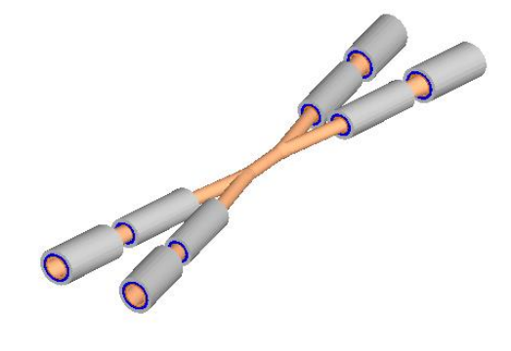
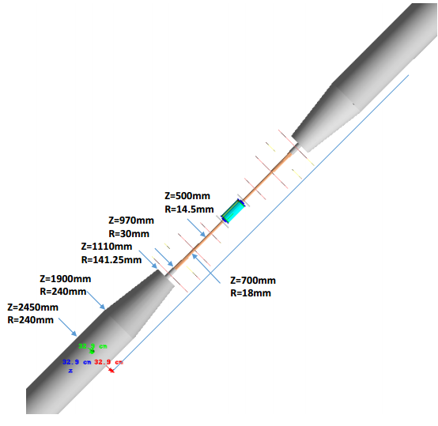
The design of interaction region
The inner diameter of the beryllium pipe is 28mm with the length of ±7cm.
Without tungsten shield.

Slide 7
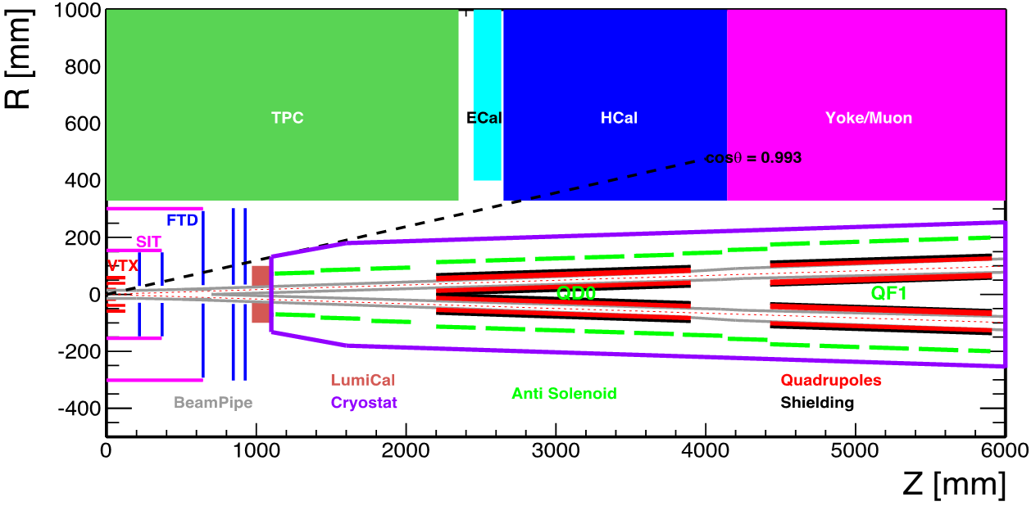
The design of interaction region
3T & 7.6m
Specification of Anti-Solenoid
Anti-solenoid | Before QD0 |  | Within QD0 |  | After QD0
Central field（T） | 7.2 |  | 2.8 |  | 1.8
Magnetic length（m） | 1.1 |  | 2.0 |  | 1.98
Conductor (NbTi-Cu, mm) | 2.5×1.5
Coil layers | 16 | 8 |  | 4/2
Excitation current（kA） | 1.0
Inductance（H） | 1.2
Peak field in coil (T) | 7.7 | 3.0 |  | 1.9
Number of sections | 4 | 11 |  | 7
Solenoid coil inner diameter (mm) | 120
Solenoid coil outer diameter (mm) | 390
Total Lorentz force F_{z} (kN) | -75 | -13 |  | 88
Cryostat diameter (mm) | 500
22 anti-Solenoid sections with different inner coil diameters
∫B_{z}ds within 0~2.12m. Bz < 300Gauss away from 2.12m with local cancellation structure
The skew quadrupole coils are designed to make fine tuning of Bz over the QF&QD region instead of the mechanical rotation.

Slide 8
Summary
Set the detector solenoid at 2T
Higher luminosity & Lower difficulty of SC magnet & More free space nearby IP
Only set the detector solenoid at 2T or < 2T during Z operation
Only higher luminosity @ Z

