Slide 1
CEPC Accelerator R&D plan
Feb.10, 2018

Slide 2
R&D Funding (~285 M RMB)
IHEP fund: 6.83 M RMB
  Accelerator physics
  Research of High Q cavity
  650MH/ 300kW klystron development
  Digital BPM
Most fund 2016 (phase I): 15.48 M RMB
  Accelerator physics
  SRF Technology R&D
  Injector key technology R&D
PAPS fund: 210 M RMB
  SRF infrastructure construction
  SC Cavity R&D
  Cavity & klystron high power test
Beijing fund: 5 M RMB
  EP etc.
Yifang Wang’s Scientist studio fund:
35 M RMB
  650MHz/800kW CW high efficiency klystron
  QD0 power supply
  Survey & alignment
  Control system
  Radiation shielding
  Key tech. of cryogenics
  Permanent diple magnet
  IR quodrupole
  Vacuum
Most fund 2018 (phase II): ~10 M RMB
  Low field dipole magnet
  Copper chamber & chamber
  Electro static separator

Slide 3
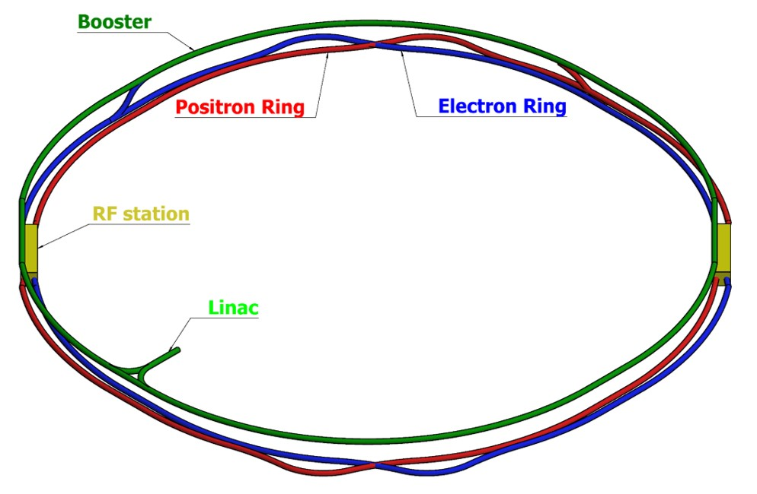
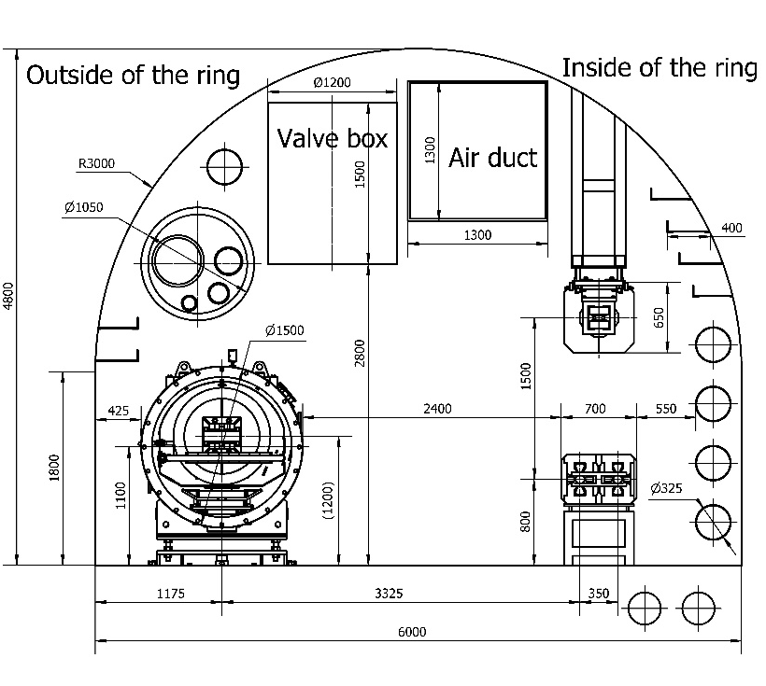
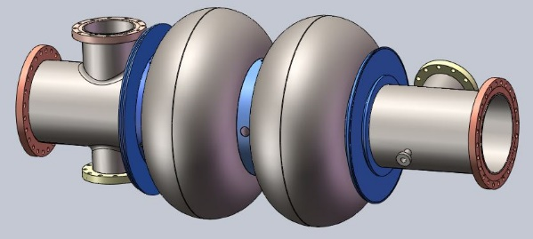
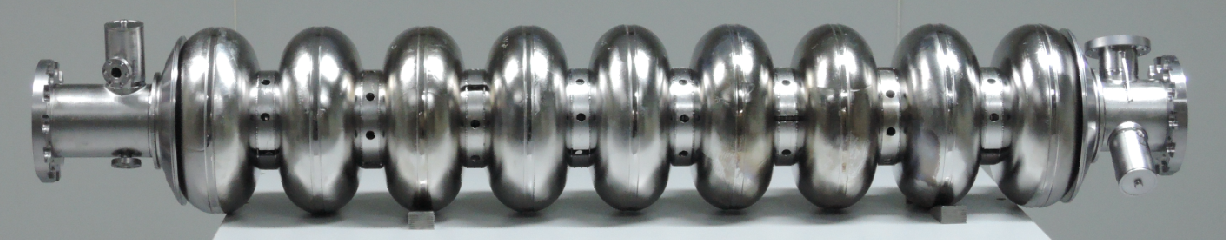
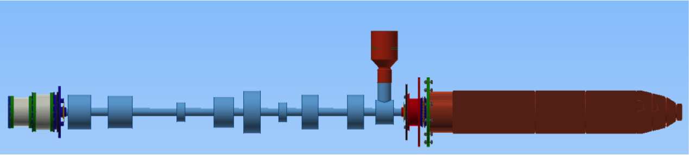
Accelerator design and R&D
  Accelerator physics
  Linac
  SRF
  RF power source
  Cryogenics
  Magnet
  SC magnet
  Power supply & E- seperator
  Vacuum
  Instrumentation
  Control
  Radiation Shielding
  Survey & Alignment
  Mechanics
  Conventional facilities
  Etc.

Slide 4
IHEP fund: 6.83 M RMB
  Accelerator physics
  Research of High Q cavity (1.82 MCNY)
    Study the key technologies to increase Q and gradient of SRF cavity (N-doping, Nb3Sn, et al.)
    650 MHz single-cell cavity: Q0 = 2e10 @ Eacc = 15.5 MV/m for vertical test.
  650MH/ 300kW klystron development （3.71 MCNY）
    Design of high efficiency klystron (efficiency ～ 80%)；
    Beam tester for klystron development；
    High power test for beam tester.
  Digital BPM

Slide 5
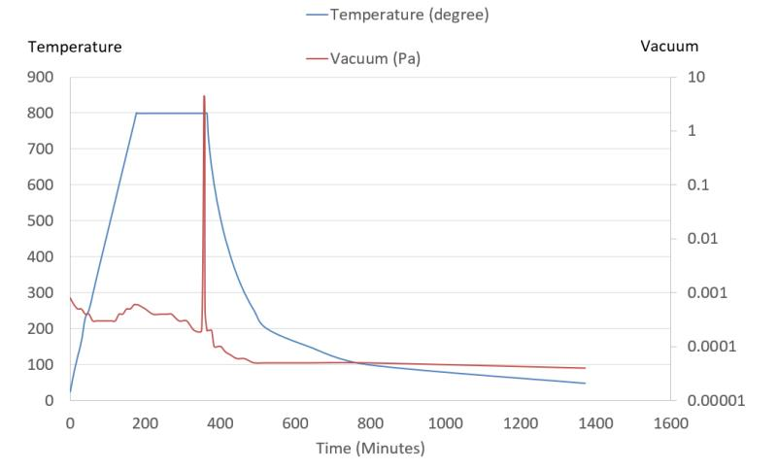
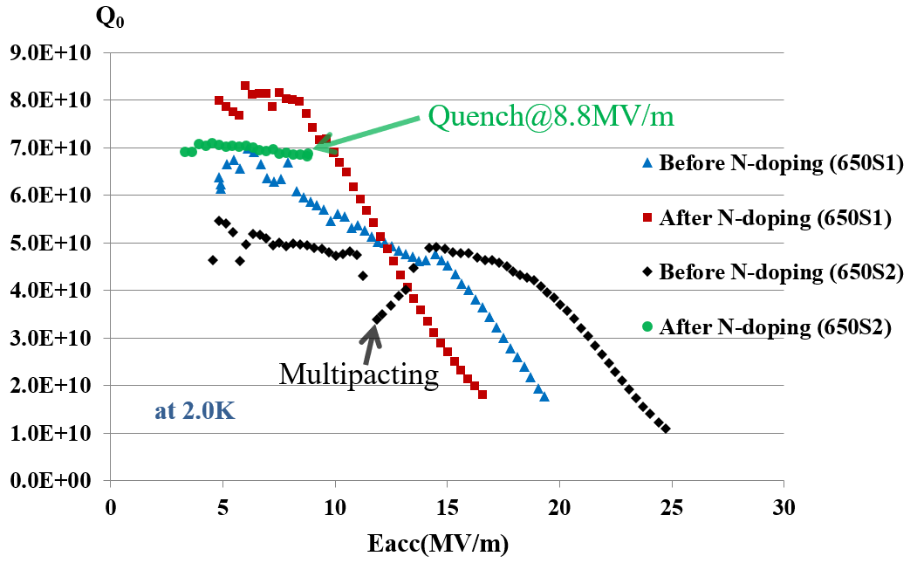
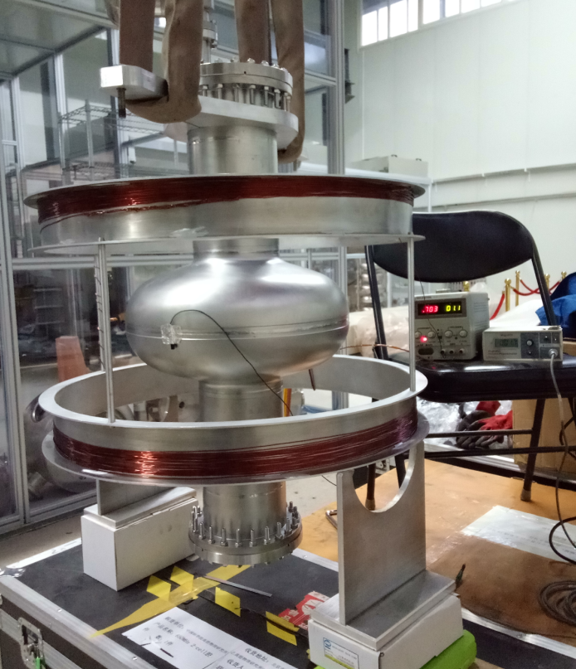
N-doped 650 MHz Single-cell Cavity
After N-doping of two 650 MHz single cell cavities (BCP treated), Q₀ increased obviously at low field for both cavities.
650S1: Q₀=7e10 @ Eacc=10 MV/m. But Q₀ decreased quickly at high field (>10 MV/m).
650S2: Quench at Q₀=6.9e10 @ Eacc=8.8 MV/m.
Flux gate and Helmholtz coil will be added soon for demagnetization.
EP facility will be ready to use in mid 2018.

Slide 6
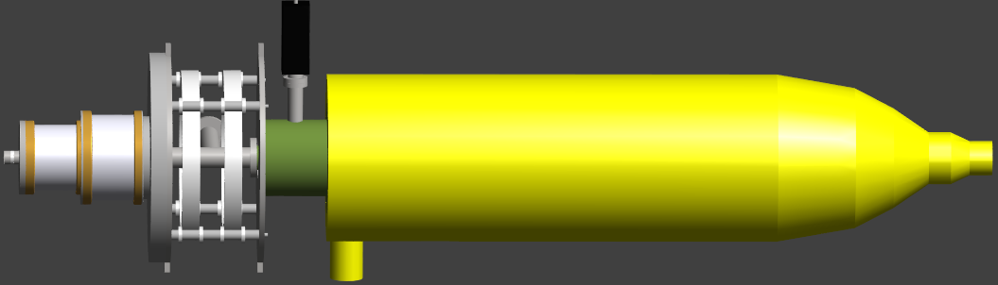
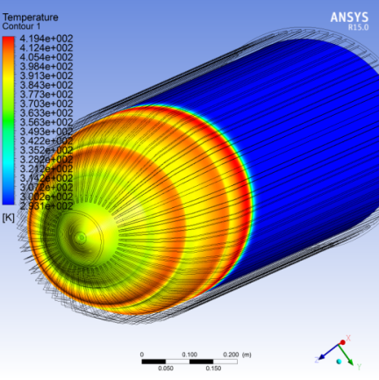
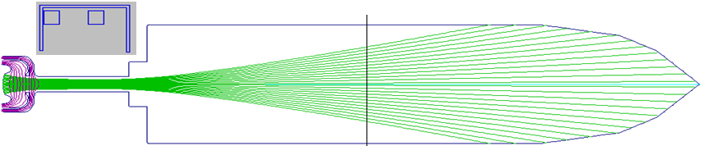
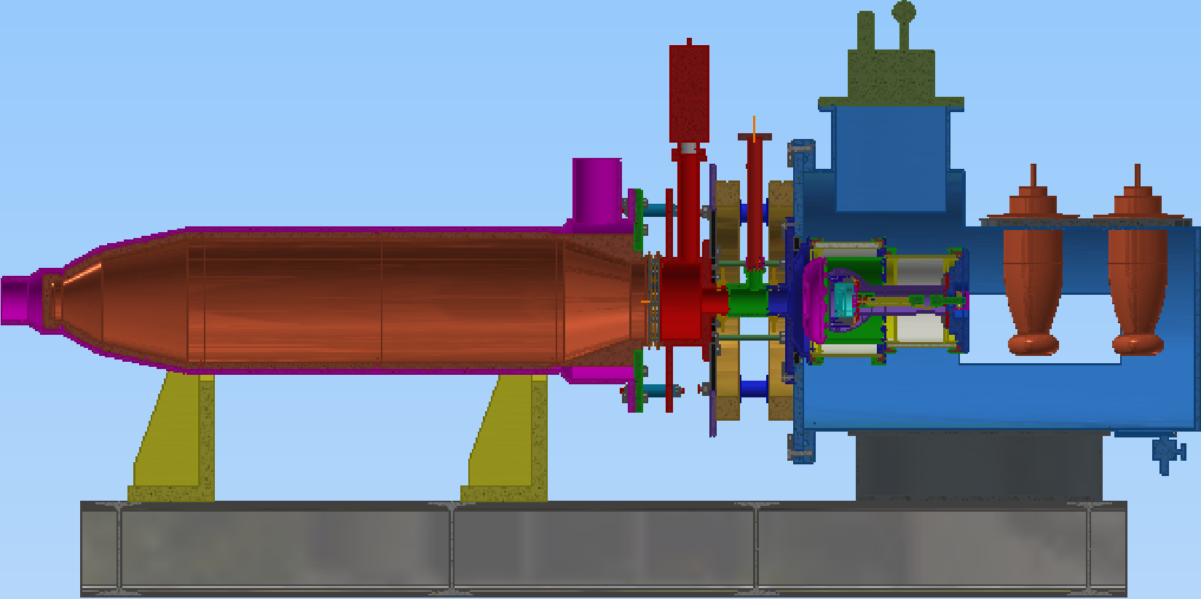
  650MH/ 300kW klystron Beam tester

Slide 7
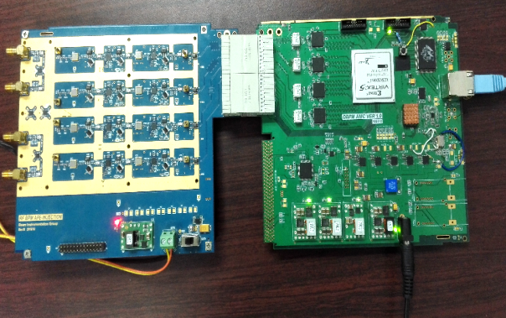
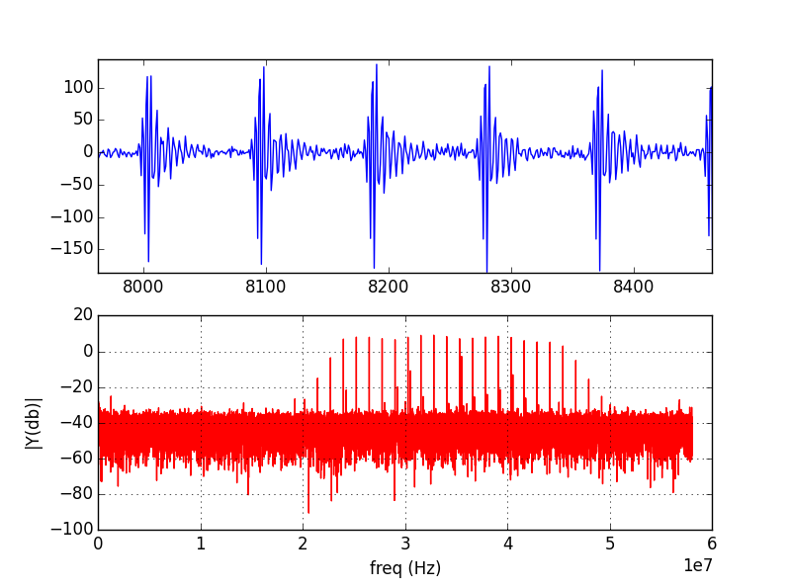
BPM electronics
Adopt MicroTCA.4 standard
Electronics including three parts: RF Frontend board, Digit board, Timing module
The timing trigger can be adjusted to make ADCs peak sampling
在BEPCII上进行了束流测试；逐圈数据分辨率为1.2µm；快轨道数据（3.3s）分辨率为0.4 μm；闭轨数据（1s）分辨率为0.12μm

Slide 8
Most fund 2016 (2016-2020): 15.48 M RMB
  Accelerator physics
  SRF Technology R&D（7.35 MCNY）
    650 MHz 2-cell cavity: Q₀ > 4E10 @ 20 MV/m
    Input coupler: 300 kW CW power
    HOM coupler and absorber: 1 kW and 5 kW
  Injector key technology R&D（4.25MCNY）
    ~ 3nC for single positron bunch
    Emittance of positron less than 0.3mm.mrad ；
    Accelerating gradient more than 30MV/m

Slide 9
CEPC SRF Design Challenges
 | H | W | Z
Collider Ring | 650 MHz 2-cell cavity
Lumi. / IP (10³⁴ cm⁻²s⁻¹) | 2.9 | 7.3 | 4.1
RF voltage (GV) | 2.17 | 0.47 | 0.054
Beam current (mA) | 17.4 x 2 | 87.8 | 160
Cavity number | 336 | 108 x 2 | 24 x 2
SR power (MW) | 30 | 30 | 5.7
2 K cavity wall loss (kW) | 6.6 | 1.9 | 0.1
Booster Ring (extraction) | 1.3 GHz 9-cell cavity
RF voltage (GV) | 1.84 | 0.75 | 0.39
Beam current (mA) | 0.52 | 0.66 | 0.53
Cavity number | 96 | 64 | 32
RF input power (MW) avg. | 0.14 | 0.04 | 0.06
2 K wall loss (kW) avg. | 0.37 | 0.1 | 0.1
Higgs: high energy (voltage), low current
  High gradient for less cavity (also limited by coupler power)
  High Q for less cryogenics (but should be realistic)
  Narrow bandwidth operation (microphonics, multi-cavity feedback, extra power, especially for higher energy)
W & Z: low energy (voltage), high current
  HOM coupled-bunch-instabilities (CBI)
  Fundamental mode CBI
  HOM power per cavity (not a limit for baseline)
  Parasitic loss (significant luminosity loss for high current)

Slide 10
SRF R&D Plan (2017-2022)
Two small Test Cryomodules (650 MHz 2 x 2-cell, 1.3 GHz 2 x 9-cell)
Two full scale Prototype Cryomodules (650 MHz 6 x 2-cell, 1.3 GHz 8 x 9-cell)
Schedule
  2017-2018 (key components, IHEP Campus)
    high Q 650 MHz and 1.3 GHz cavities, N-doping + EP
    650 MHz variable couplers (300 kW)，1.3 GHz variable couplers (10 kW)
    high power HOM coupler and damper, fast-cool-down and low magnetic module, reliable tuner
  2019-2020 (test modules integration, Huairou PAPS)
    Horizontal test 16 MV/m, Q₀ > 2E10
    beam test 1~10 mA
  2021-2022 (prototype modules assembly and test, Huairou PAPS)

Slide 11
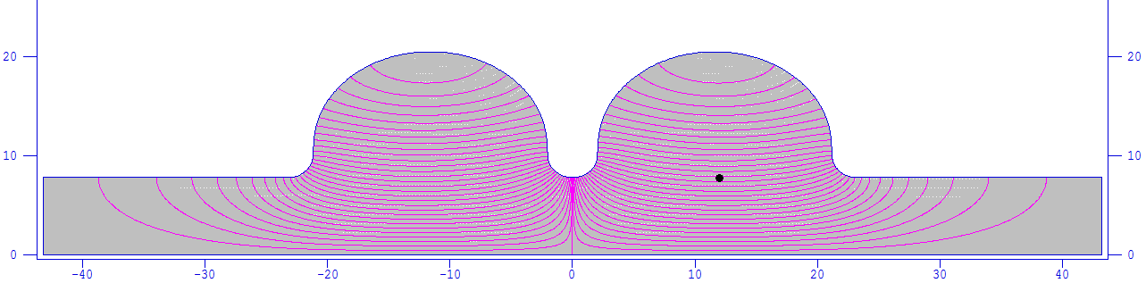
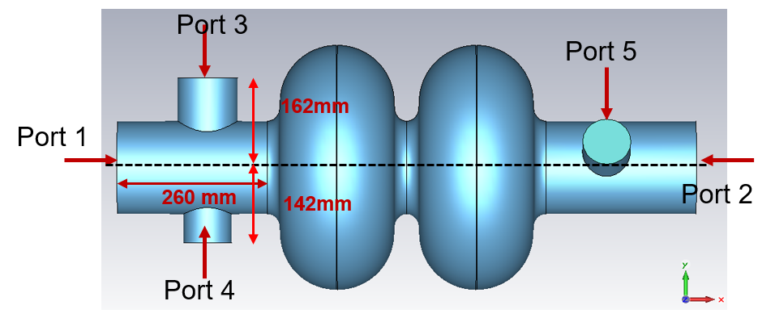
RF Design of 650 MHz 2-cell Cavity
The length of the cavity beam pipes and ports should be long enough to ensure negligible power dissipation on the gaskets and flanges surface, but cannot be too long to go beyond the critical temperature of Nb.
Special gapless gaskets will be considered to avoid the additional dissipation at different joints.
Cooling of cavity ports by extended helium vessel could be considered especially for the power coupler.
Copper plating is necessary for the bellows between cavities. RF shielded bellow might be needed.
Parameter | Unit | Value
Cavity frequency | MHz | 650
Number of cells | - | 2
Cavity effective length | m | 0.46
Cavity iris diameter | mm | 156
Beam tube diameter | mm | 156
Cell-to-cell coupling | - | 3%
R/Q | Ω | 213
Geometry factor | Ω | 284
E_{peak}/E_{acc} | - | 2.4
B_{peak}/E_{acc} | mT/(MV/m) | 4.2
 | P (W) (U = 1J) | Qe
Port 1 | 0.001867 | 2.19E12
Port 2 | 0.001352 | 3.02E12
Port 3 | 0.005441 | 7.51E11
Port 4 | 0.003435 | 1.19E12
Port 5 | 0.003320 | 1.23E12

Slide 12
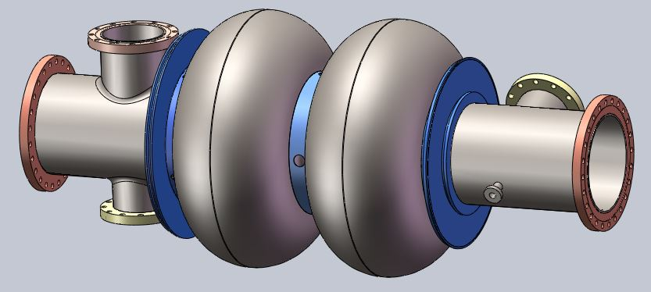
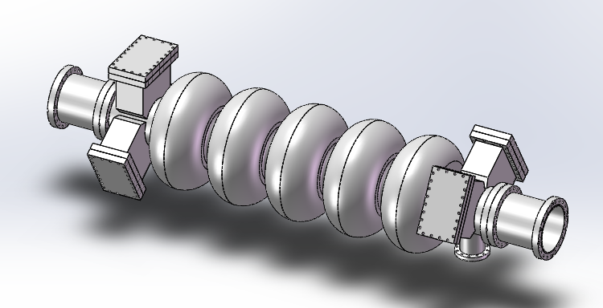
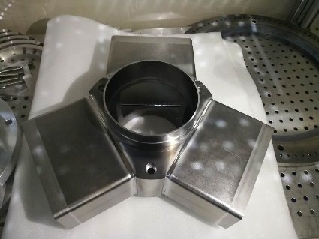
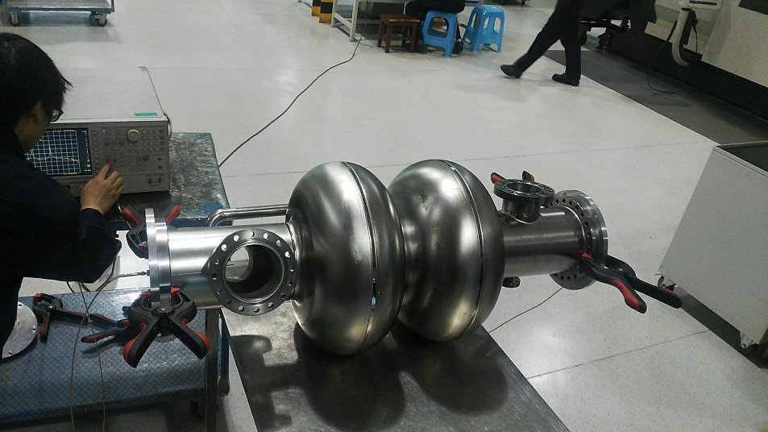
Cavity Fabrication
Three 2-cell cavities with coaxial HOM coupler, one 5-cell cavity with waveguide HOM coupler.
Cavity with more cells (4 or 5-cell)
A must for higher energy operation, and low HOM power (due to low current)
Possible for H with shared cavity if the input coupler power capacity could be increased to 500 ~ 800 kW or use two couplers per cavity for same gradient. If same coupler power, the gradient will be too low and cost more, beam loading effect ... But 1.5 times more HOM power, HOM damping and trapping, cavity pretuning, handling and infrastructure...
Not suitable for high current W and Z

Slide 13
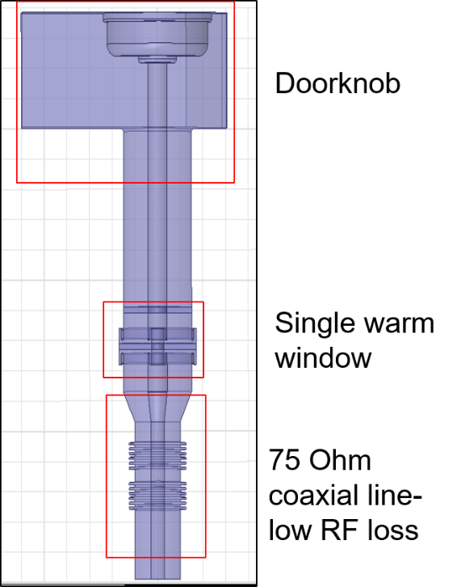
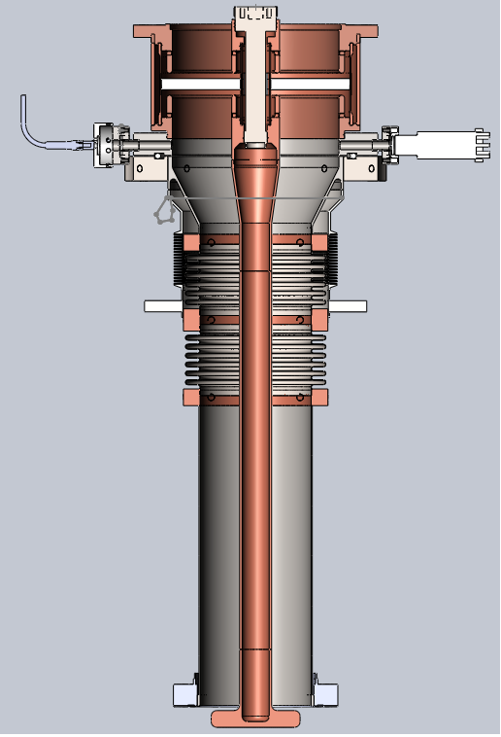
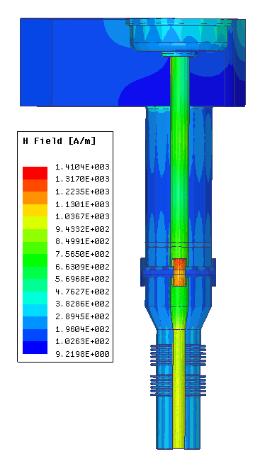
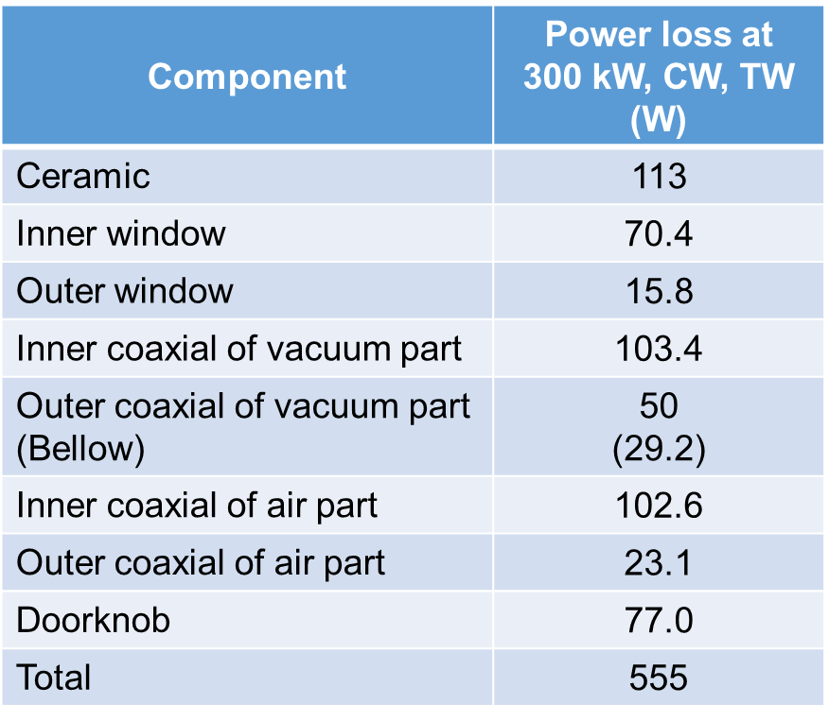
Variable 650 MHz Input Coupler Design
RF design complete, thermal and mechanical design ongoing.
Thermal anchor or helium gas cooling of outer conductor. Water or gas cool of inner conductor.
Start fabrication in end 2017.

Slide 14
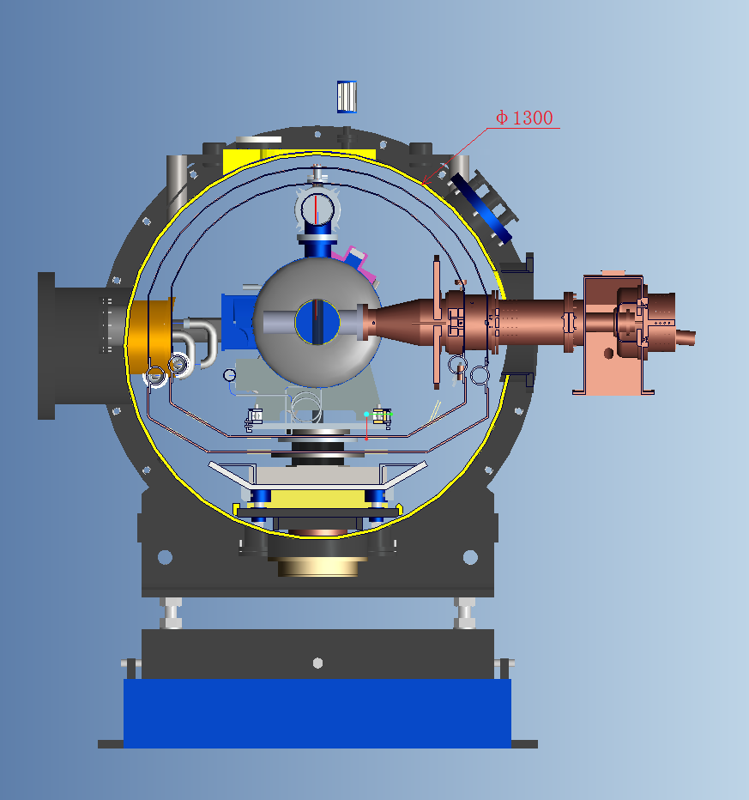
CEPC Input Coupler Challenges
  High power handling capability: CW, 300 kW ( > 400 kW, update).
  Wide-range variable coupler with low heat load to save power.
  Clean assembled with cavity in class 10 clean room
  Balance coupler vacuum part length (cryomodule diameter size) and heat load.
Frequency (GHz) | 0.65
Power (kW) | 300
Coupling (Qext) | Variable: 1E5~2E6
Heat load spec (dynamic 300 kW, TW, CW) | Dynamic: 1 W / 6 W / 10 W @ 2 K / 5 K / 80 K Static: 0.3 W / 3 W / 6 W @ 2 K / 5 K / 80 K

Slide 15
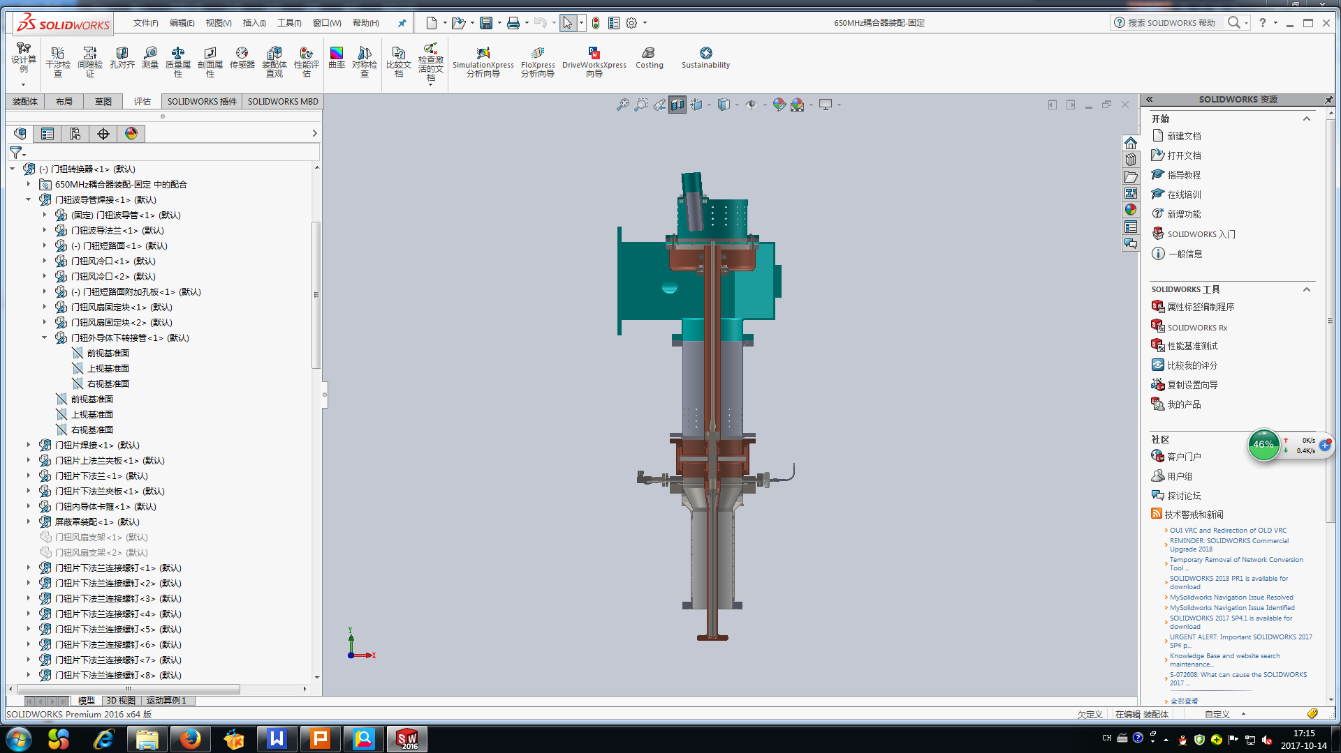
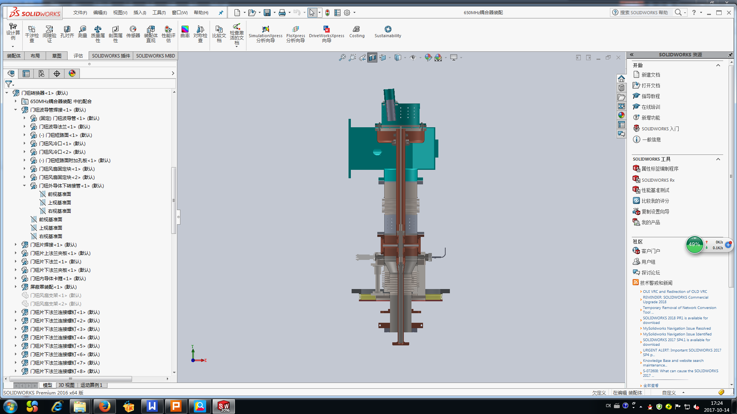
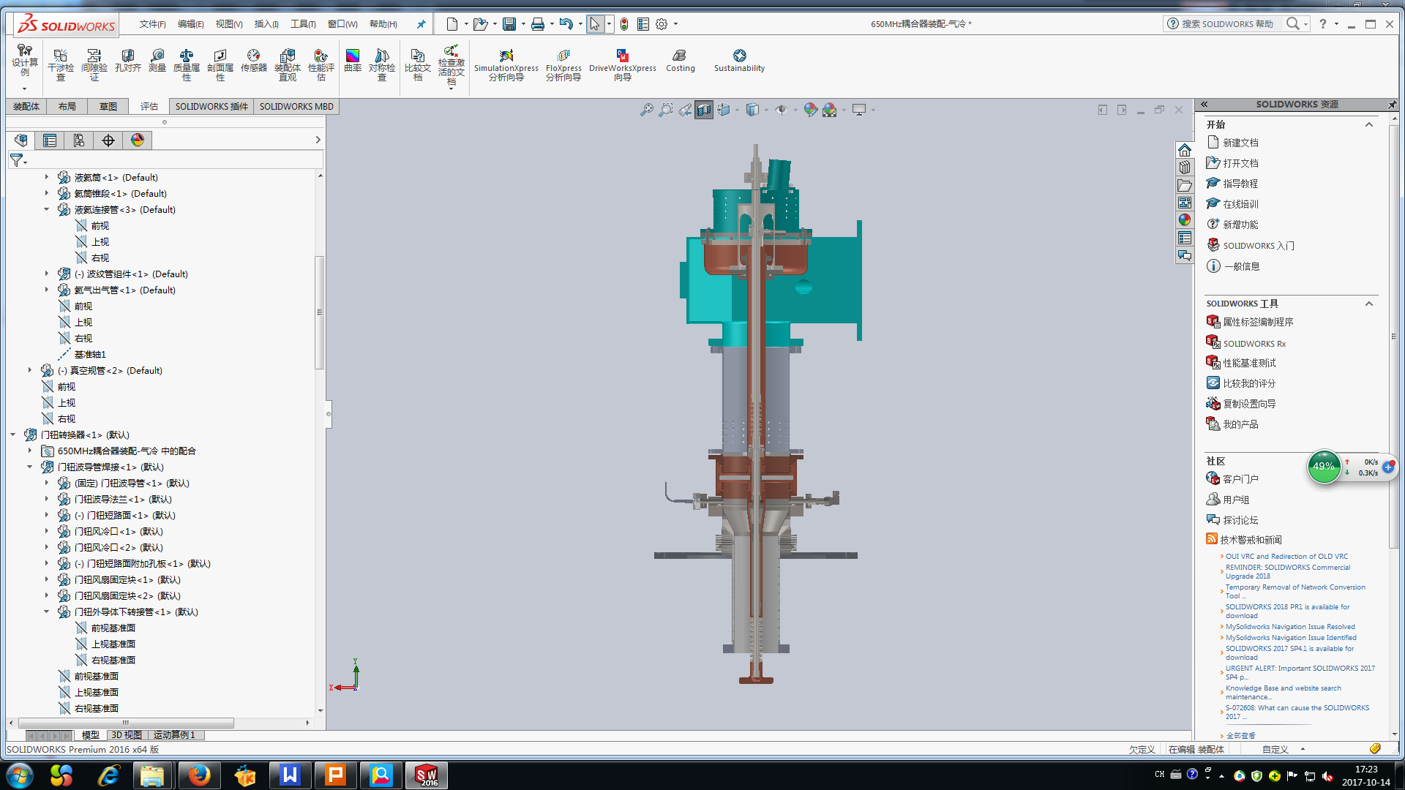
Coupling Adjusting Mechanism
Two bellows on outer or inner conductor.
Method other than changing the penetration depth of the antenna tip : RF short plunger on the doorknob waveguide (standing wave, frequency change, adjusting range …)

Slide 16
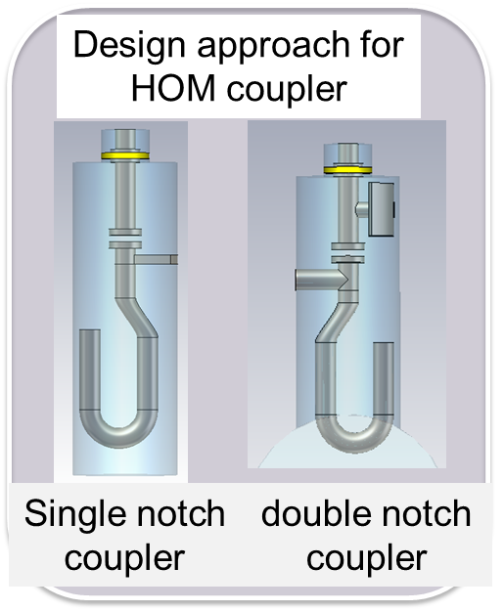
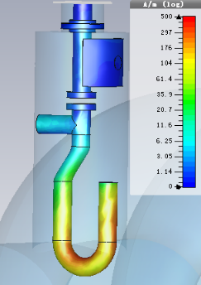
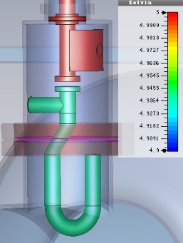
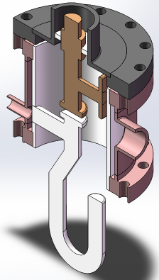
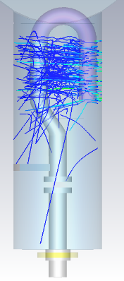
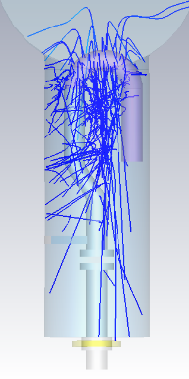
650 MHz Cavity HOM Coupler Design
RF design
Thermal Design
Mechanical designs
Multipacting analysis
Five-pages report from the International Review Committee of the CEPC HOM Coupler Design chaired by Bob Rimmer (JLAB), July 18, 2017.
> 1 kW power

Slide 17
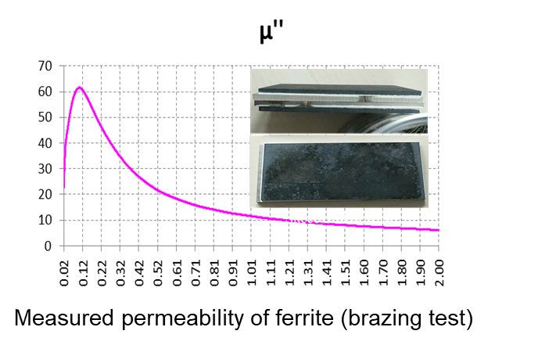
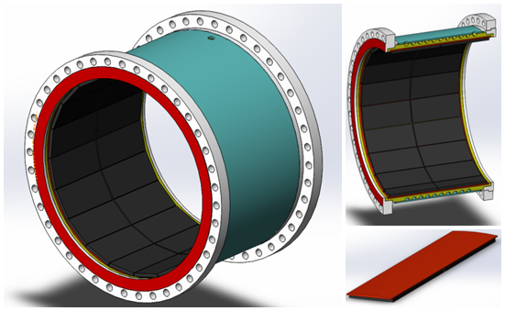
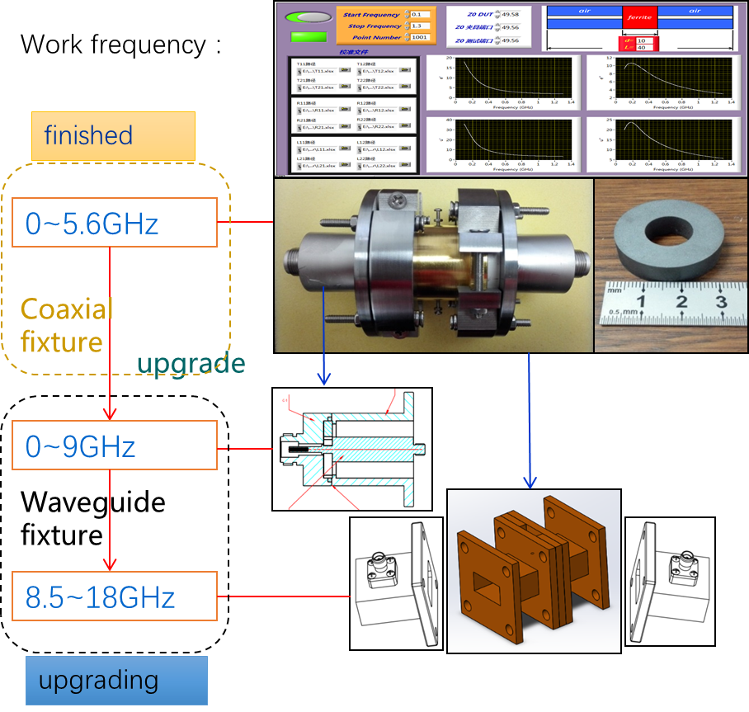
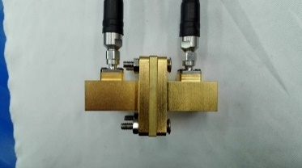
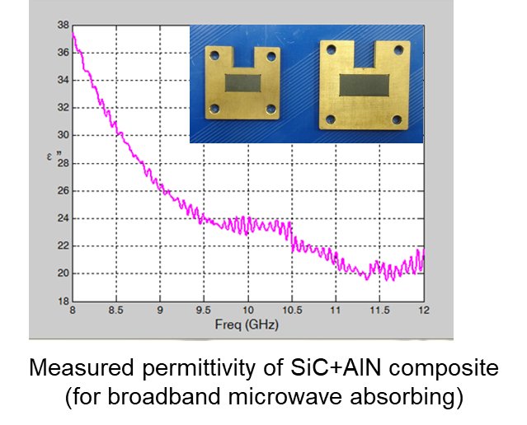
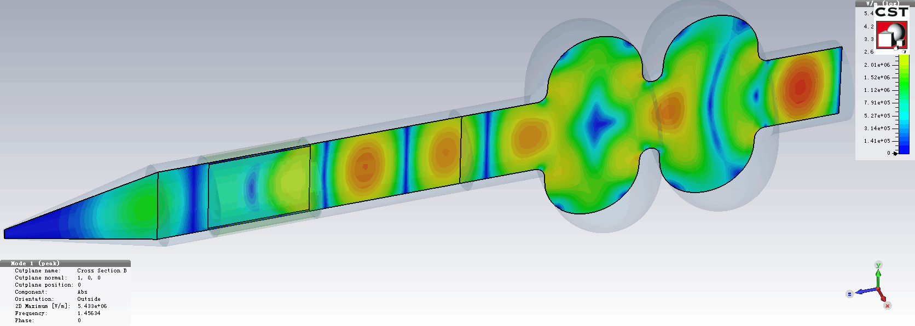
HOM Absorber (Ferrite and SiC)
Brick structure to reduce the fabrication cost
Microwave absorbing material test system

Slide 18
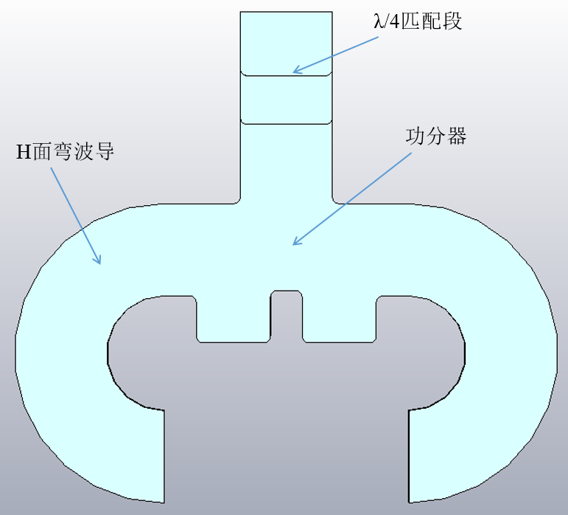
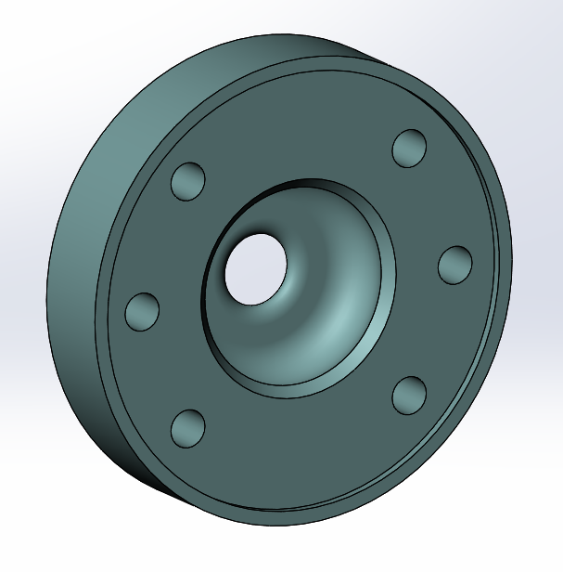
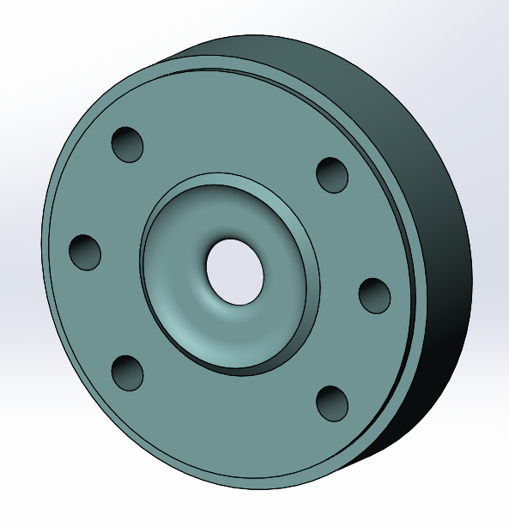
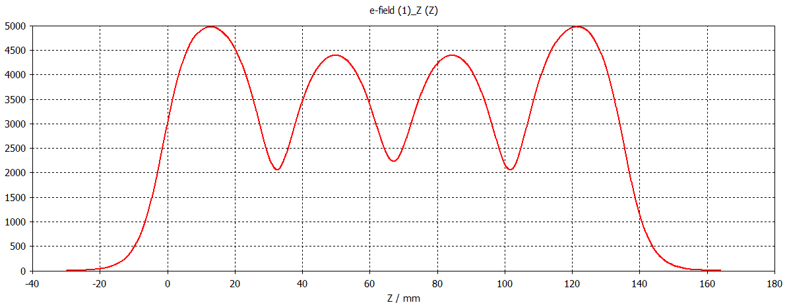
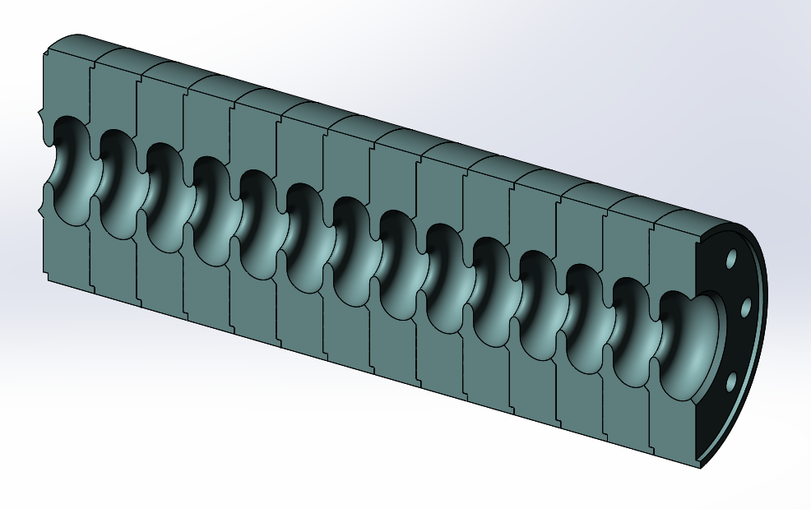
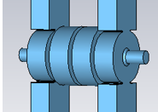
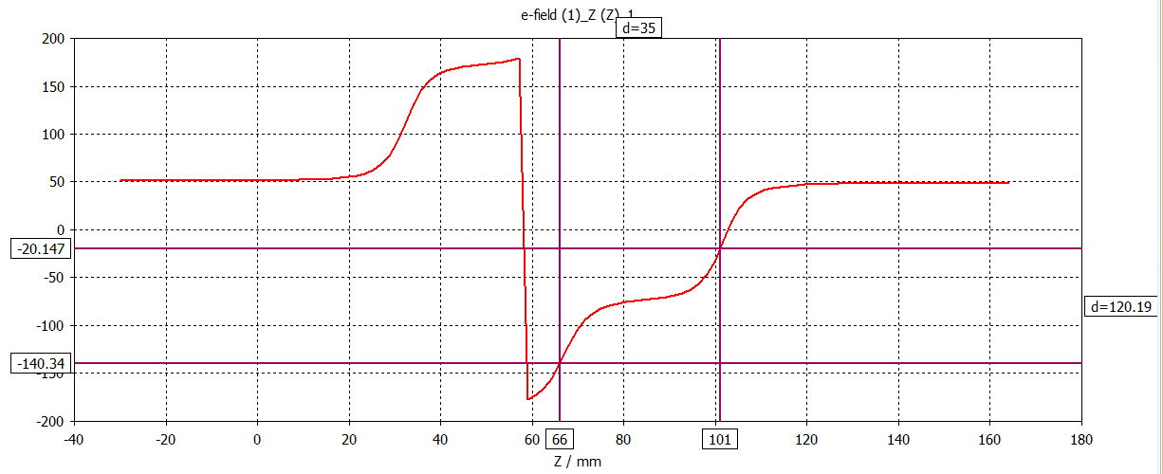
MOST2016: CEPC injector Linac R&D
For the 3 meters long Acc. Structure, accelerating gradient more than 30MV/m@1uS.
connector
39
52
The distribution of the electric field on axis
Design model
Phase advance per cell

Slide 19
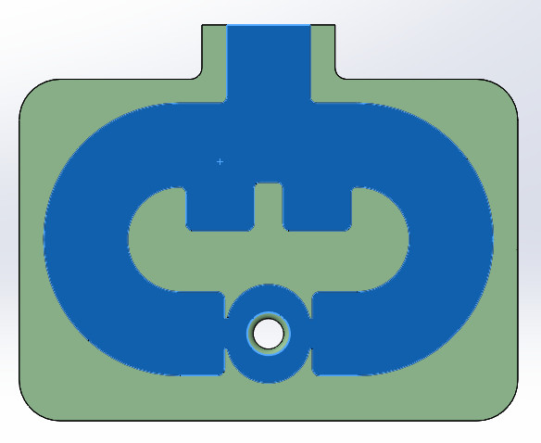
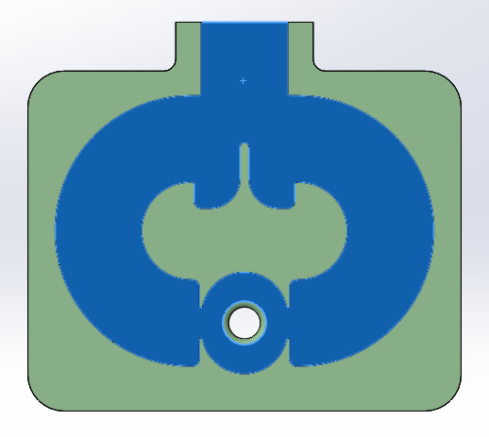
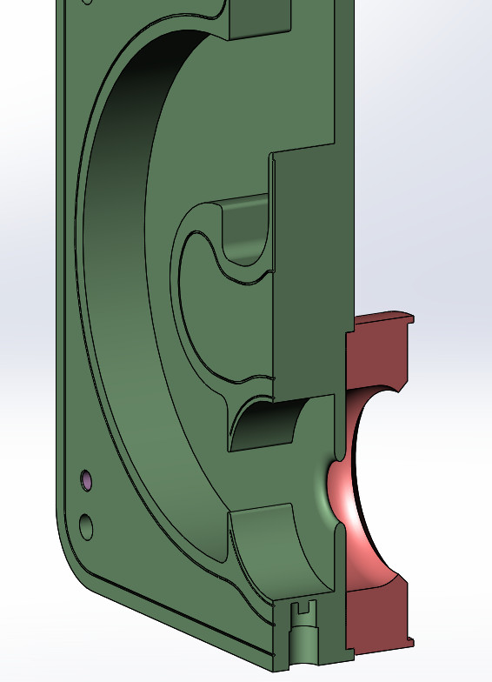
高梯度S 波段加速结构的研制
加速结构的优化设计
重新优化耦合器功分器部分进行
由于耦合器相邻腔体腔型变化，重新计算了耦合器的尺寸
初步设计的耦合器：功分器部分尺寸过大，导致机械尺寸长×宽约为430×340，所占据圆周空间直径约500mm，已经超出工厂最大氢炉焊接空间。
优化后耦合器：减小了功分器跑道部分尺寸，机械设计后尺寸长×宽约360×325，占据圆周空间直径约440mm，工厂最大氢炉可提供焊接。
将耦合器相邻腔体，由半圆弧形腔优化为一段直段加一段圆弧的结构，利于机械加工工艺以及焊接工艺的可靠（周期参数等不变）。

Slide 20


高梯度S 波段加速结构的研制
加速结构的优化设计
确定了加速结构冷却水路的连接方式
完成了加速结构整管的机械设计
单腔结构共计8路水；
8路水采取串联方式，总水为1进1出水路；
输出耦合器
加速管组段
输入耦合器

Slide 21





正电子源关键部件研制
磁号装置的研制
磁号系统将小横向尺寸、大发散角的正电子转换到大横向尺寸、小发散角，实际可采用脉冲电源形成脉冲磁场，磁场从6T->0.5T。
已完成磁号装置的物理设计和机械设计，下一步将进行加工。
磁号装置示意图
磁号装置的Opera仿真

Slide 22


正电子源关键部件研制
磁号装置的研制
磁号的研制将与日本KEK开展合作
访问KEK并确定磁号装置难度最大的一道加工工艺“螺旋线切割” 将由日本KEK的实验工厂承担
磁号装置机械设计图
日本KEK在运行中的磁号装置

Slide 23


正电子源关键部件研制
15kA/15kV固态脉冲电源研制
脉冲电源是正电子源磁号装置的重要组成部分，其脉冲高压输出将在磁号装置内部产生峰值场强达到6Tesla的脉冲磁场，要求脉冲电源输出为15kA/15kV
该固态脉冲电源已于2017年5月底完成招投标工作
2017年7月完成脉冲电源的方案评审，目前正在厂家进行研制集成
固态脉冲电源方案评审会
固态脉冲电源方案设计

Slide 24




1.3 GHz SRF Technology for CEPC Booster
XFEL and LCLS-II type cryomodule, without SCQ. Technology R&D in synergy with Shanghai XFEL (SCLF). No big challenge.
TESLA cavity. Nitrogen-doped bulk niobium and operates at 2 K. Q₀ > 3 × 10¹⁰ at 24 MV/m for the vertical acceptance test. Q₀ > 1×10¹⁰ up to 20 MV/m for long term operation.
XFEL/ILC/LCLS-II or other type variable power coupler. Peak power 30 kW, average 4 kW, Q_{ext} 1E7-5E7, two windows.
XFEL/LCLS-II type end lever tuner. Reliability. Large stiffness. Piezos abundance, radiation, overheating. Access ports for easy maintenance.

Slide 25





SRF Industrialization
CEPC Industry Consortium
TESLA FG 9-cell cavity by HERT (new vendor). Processed and tested at KEK. Two more TESLA cavities in fabrication by HERT (material delivered). High gradient and N-doping / infusion study.

Slide 26

CEPC Industrial Promotion Consortium (CIPC)
为了更好地推进CEPC-SppC，协调与CEPC-SppC相关技术的前期预研，组织联合攻关突破关键技术，培育相关企业的技术发展与产业化准备。
1) Superconducting materials (for cavity and for magnets)
2) Superconducting cavities
3) Cryomodules
4) Cryogenics
5) Klystrons
6) Vacuum technologies
7) Electronics
8) Superconducting cavities
9) Power supplies
10) Civil engineering
11) Precise machinery.....
More than 40 companies joined in first phase of CIPC，
and more will join later....
Established in Nov. 7 , 2017

Slide 27

Beijing Fund：PAPS （210 M RMB）
“Platform of Advanced Photon Source Technology R&D”, to provide infrastructure for construction of future project.
Construction: 2017.5-2020.6
Consist of 7 systems:
    RF system(80L*50W*18H, 30Ton Crane full covered)
    Cryogenic system
    Beam test
    Magnet technology
    X-ray optics
    X-ray detection
    X-ray application

Slide 28



PAPS project---RF Hall bird view

Slide 29

PAPS cryogenic system
The cryogenic system
  2.5kW@4.5K and 300W@2K LHe system
  210m³/h gas recycle and 100m³/h gas purify capability
It would be the largest cryogenic system for SRF cavity tests in China

Slide 30




PAPS Test Stand with Beam
Test 650MHz & 1.3Ghz cavities with beam
Test High Efficiency klystron
Test CW beam10 mA, 50 MeV
DC photo cathode gun
650 MHz test module
1.3 GHz test module

Slide 31



Beijing fund: 5 M RMB
Horizontal EP System for SRF cavities
Tooling variable up to about 2 m length and 1m for diameter, compatible from 1.3GHz to 650MHz and 500MHz cavities.
Flow chart of acid mixing and storage unit
3D design of mechanical setup
Flow chart of circulation unit

Slide 32
申请Most fund 2018 (2018-2022): ~10 M RMB
加速器关键技术的研发和验证 ：
（1）研制增强器交变二极低场磁铁的原型机：最低工作磁场 31Gs，最高磁场 620Gs，均匀性要求5×10⁻⁴ ，重复性 2×10⁻⁴ ；
（2）研制弯转真空盒和 RF 屏蔽波纹管的原型机：真空度好于2×10⁻¹⁰Torr，总漏率小于2×10⁻¹⁰Torr.L/S；RF屏蔽波纹管：指接触力为 125±25 g/Finger；
（3）研制正负电子束静电分离器的原型机，正负电子分离最高能量为 120GeV，最大工作场强2MV/m；
（4）研究设计在 Z 能区极化束对撞，束流极化度大于 50%，寿命大于 60 分钟。

Slide 33
High precision low field dipole magnet
Motivation:
To get low field of 29 Gs with high precision, several subscale prototype dipole magnets will designed, fabricated and tested.
A final high precision low field prototype dipole magnet with expected specifications will be developed.
A high efficiency field measurement system with high precision will be designed and set up.
 | BST-63B
Quantity | 15360
Minimum field (Gs) | 29
Maximum field (Gs) | 492
Gap (mm) | 63
Magnetic Length (mm) | 5000
Good field region (mm) | 55
Field uniformity | 0.1%
Field reproducibility | 0.05%
Challenges:
Total length of the dipoles ~75km how to reduce cost
Field error <29Gs*0.1%=0.029Gs how to design
Field reproducibility<29Gs*0.05%=0.015Gs how to measure
Magnet length ~5000mm how to fabricate

Slide 34

Booster low field dipole magnet R&D
In order to verify the design of the CEPC low field dipole magnet, a subscale prototype dipole magnet was produced.
The core of the magnet is about 1m long. One half is stacked by the steel laminations, another half is stacked by the steel laminations interleaved with the aluminum laminations.
The coils of the magnet have only one turn per pole, which is made by solid aluminum bars without water cooling.

Slide 35
Booster low field dipole magnet R&D
Due to remnant field, the field errors at low field becomes 10 time larger than that at high field.
The measured remnant field in the magnet gap is about 4-6Gs, which is 13%-20% of the low field of 30Gs.

Slide 36





  Copper chamber & RF shielding bellow
The prototypes of both copper and aluminum vacuum chambers will be fabricated and tested. The ultimate pressure of the vacuum chambers is less than 2×10⁻¹⁰Torr；The thermal outgassing rate is less than 5×10⁻¹²Torr•L/s/cm².
The RF shielding bellows will be designed and produced, The design specification of the contact pressure for RF contact fingers is 125±25g/finger.
A set of NEG coating equipment will be built and tested. The copper vacuum chamber will be coated with Ti-Zr-V film. The design specification with pumping speed of 200 L/s⋅m for the coating vacuum chamber will be achieved.

Slide 37



Electrostatic Separator
Main Design Goals
Maximum operating field strength | 2MV/m
Maximum operating voltage | ±110kV
Maximum deflection | 62.5urad
Nominal vacuum pressure | 2×10⁻¹⁰Torr
  A electrostatic separator unit comprise a pair of electrodes, UHV tank, metal-ceramic supports, high voltage feedthrough, High voltage circuit and vacuum system, etc.
  Using Opera software to design the electrostatic field, optimizing the electrodes (shape, material and surface finish) to reduce the impedance and loss factor;
  The HV feedthrough will use modular design for convenient installing and maintenance, the high voltage is designed up to 160 kV;
  Design the absorber and cooling system to extract heats due to the HOM losses on the separator;
  According to the content of residual gas in the electrostatic separator, design the vacuum system to reach the requirements of vacuum pressure of the UHV tank, 2×10⁻¹⁰Torr.
schematic diagram of Electrotatic Separator
Field distribution
Field homogeneity

Slide 38
科学家工作室 Fund: 35 M RMB
财务处：请将课题王贻芳科学家工作室（课题号：Y4291331K2）经费按下表拨至子课题。
课题号 | 子课题负责人 | 子课题名称 | 下拨经费（万元）
 | 裴士伦 | CEPC速调管 | ？？？？
Y4291332K2 | 陈斌 | CEPC高精度直流稳流超导磁铁电源及正负电子束静电分离器 | 90
Y4291333K2 | 王小龙 | CEPC加速器准直用视觉测量仪及机械结构研究 | 40
Y4291334K2 | 李刚 | CEPC控制系统关键技术研究 | 20
Y4291335K2 | 马忠剑 | CEPC强辐射场问题研究 | 20
Y4291336K2 | 李少鹏 | CEPC低温系统关键技术设计研究 | 10
Y4291337K2 | 康文 | CEPC低场高精度二极磁铁 | 85
Y4291338K2 | 陈福三 | CEPC永磁二极磁铁 | 85
Y4291339K2 | 朱应顺 | CEPC对撞区超导四极磁体 | 40
Y429133AK2 | 董海义 | CEPC真空系统 | 20

Slide 39

RF system for the CEPC collider
Parameters for the CEPC collider RF system
CEPC schematic layout
Parameter | Value
Frequency (MHz) | 650
Cell number per cavity | 2
Input power per cavity (kW) | 278
Total cavity number | 336
Total input power (MW) | 93.4
Cavity number per klystron | 2
Klystron number | 168
10GeV→45/120GeV
45/120GeV
45/120GeV
10GeV
800kW saturated klystron output power by taking into account the transmission loss, the power reflection caused by the cavity mismatch and the operation margin for the LLRF system
The higher the klystron efficiency, the lower the collider operation cost
>80% ultimate goal for the 650MHz/800kW klystron (needs more studies and work, long way to go)
RF unit for CEPC collider

Slide 40
650MHz/800kW Klystron R&D
Main parameters | UHFKP8001 | UHFKP8002 | UHFKP8003
Frequency (MHz) | 650 | 650 | 650
Vk (kV) | 81.5 | 81.5 | 110
Ik (A) | 15.1 | 15.1 | 9.1
Perveance (µP) | 0.65 | 0.65 | 0.25
Efficiency (%) | >60 | >70 | >80
Saturated gain (dB) | >40 | >40 | >40
Output power (kW) | 800 | 800 | 800
1dB bandwidth (MHz) | ±0.5 | ±0.5 | ±0.5
Brillouin magnetic field (Gs) | 106.7 | 106.7 | 115.8
Reduced plasma wavelength(m) | 3.47 | 3.47 | 6.46
N cavities | 6 | 7 | 7
Normalized drift tube radius | 0.63 | 0.63 | 0.38
Normalized beam radius | 0.41 | 0.41 | 0.23
Filling factor | 0.65 | 0.65 | 0.6

Slide 41
650MHz/800kW Klystron R&D plan
FY 2016: done
  Finalize the gun and the collector design of the 1st conventional klystron prototype (UHFKP8001, Ultra High Frequency band Klystron Prototype with 800kW output power)
  Initialize the interaction section design of the UHFKP8001
FY 2017: done
  Finalize the interaction section and the coil design of the UHFKP8001
  Preliminary mechanical design of the UHFKP8001
FY 2018: being carried out
  Finalize the mechanical design and the fabrication of the UHFKP8001
  Infrastructure construction for the klystron brazing, baking and testing
  Finalize the interaction section design of the 2nd high efficiency klystron prototype (UHFKP8002)
  Initialize the design of the new gun with a lower perveance
  Initialize the multi-beam high efficiency klystron study
FY 2019
  High power test of the UHFKP8001 (>60% efficiency to be expected)
  Finalize the mechanical design and fabrication of the UHFKP8002
  Finalize the mechanical design of the new gun with a lower perveance
  Finalize the interaction section design of the 3rd high efficiency klystron prototype (UHFKP8003)
FY 2020
  High power test of the UHFKP8002 (>70% efficiency to be expected)
  Finalize the mechanical design and fabrication of the UHFKP8003
FY 2021
  High power test of the UHFKP8003 (>80% efficiency to be expected)
  More klystron prototypes or klystron industrialization

Slide 42



650MHz/800kW Klystron R&D
China consortium HERSC (High Efficiency RF Source R&D Collaboration) established in 2017 for 650MHz/800kW klystron design and fabrication
Preliminary mechanical design achieved (L×W×H: 5.12m×0.87m×1.56m)
Discussion on the manufacturing details being conducted
Preliminary mechanical design for UHFKP8001

Slide 43
其他R&D
  Cryogenics
  Collider Magnet
  SC magnet
  Power supply
  Control
  Radiation Shielding
  Survey & Alignment
  Mechanics
  Conventional facilities
  Etc.

Slide 44
小结
R&D 经费来源：IHEP、MOST、北京市、科学家工作室….；
Cavity、Klystron 等已经有一定规模的经费支持，R&D工作正在稳步进行；
在科学家工作室的小额经费的支持下其他设备的设计研究在进行；
低场二极铁、真空盒及RF屏蔽波纹管、静电分离器、极化等R&D正申请2018年MOST经费；
理想是在能有一个相当规模像KEK ATF+STF那样的CEPC的ATF。

