Slide 1

Lattice design for the CEPC collider ring
Yiwei Wang, Yuanyuan Wei, Yuan Zhang, Dou Wang,
Sha Bai, Xiaohao Cui, Tianjian Bian, Chenghui Yu, Jie Gao
The Institute of High Energy Physics, Beijing
CEPC CDR internal review, 10 Feb. 2018

Slide 2
Outline
Introduction
Lattice design of the collider ring
  Interaction region
  Arc region
  RF region
  Straight section region
Dynamic aperture
Performance with errors
Summary

Slide 3
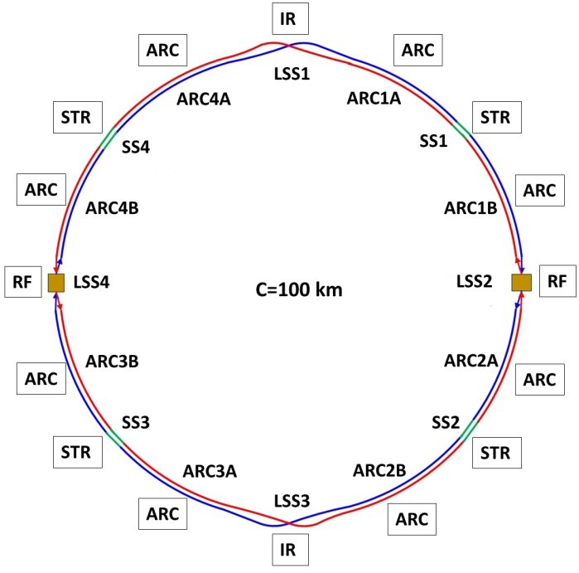
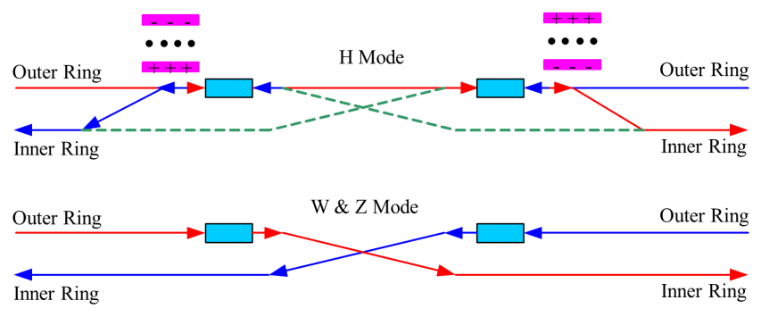
Introduction
The circumference of CEPC collider ring is 100 km.
In the RF region, the RF cavities are shared by two rings for H mode.
Twin-aperture of dipoles and quadrupoles is adopt in the arc region to reduce the their power. The distance between two beams is 0.35m.
Compatible optics for H, W and Z modes
  For the W and Z mode, the optics except RF region is got by scaling down the magnet strength with energy.
  For H mode, all the cavities will be used and bunches will be filled in half ring.
  For W & Z modes, bunches will only pass half number of cavities and can be filled in full ring.
Notes:
2 fold symmetry

Slide 4
Parameters of CEPC collider ring
 | Higgs | W | Z
Number of IPs | 2
Energy (GeV) | 120 | 80 | 45.5
Circumference (km) | 100
SR loss/turn (GeV) | 1.73 | 0.34 | 0.036
Half crossing angle (mrad) | 16.5
Piwinski angle | 2.58 | 7.74 | 23.8
N_{e}/bunch (10¹⁰) | 15 | 15 | 8.0
Bunch number (bunch spacing) | 242 (0.68us) | 1220 (0.27us) | 12000 (25ns+10%gap)
Beam current (mA) | 17.4 | 87.9 | 461
SR power /beam (MW) | 30 | 30 | 16.5
Bending radius (km) | 10.6
Momentum compaction (10⁻⁵) | 1.11
β_{IP} x/y (m) | 0.36/0.0015 | 0.36/0.0015 | 0.2/0.001
Emittance x/y (nm) | 1.21/0.0031 | 0.54/0.0016 | 0.17/0.0016
Transverse σ_{IP} (um) | 20.9/0.068 | 13.9/0.049 | 5.9/0.04
ξ_{x}/ξ_{y}/IP | 0.031/0.109 | 0.013/0.12 | 0.0041/0.072
V_{RF} (GV) | 2.17 | 0.47 | 0.1
f _{RF} (MHz) (harmonic) | 650 (216816)
Nature bunch length σ_{z} (mm) | 2.72 | 2.98 | 2.42
Bunch length σ_{z} (mm) | 3.26 | 6.53 | 8.5
HOM power/cavity (kw) | 0.54 (2cell) | 0.87(2cell) | 1.94(2cell)
Energy spread (%) | 0.1 | 0.066 | 0.038
Energy acceptance requirement (%) | 1.35
Energy acceptance by RF (%) | 2.06 | 1.47 | 1.7
Photon number due to beamstrahlung | 0.29 | 0.44 | 0.55
Lifetime _simulation (min) | 100
Lifetime (hour) | 0.67 (40 min) | 2 | 4
F (hour glass) | 0.89 | 0.94 | 0.99
L_{max}/IP (10³⁴cm⁻²s⁻¹) | 2.93 | 11.5 | 32.1
D. Wang

Slide 5
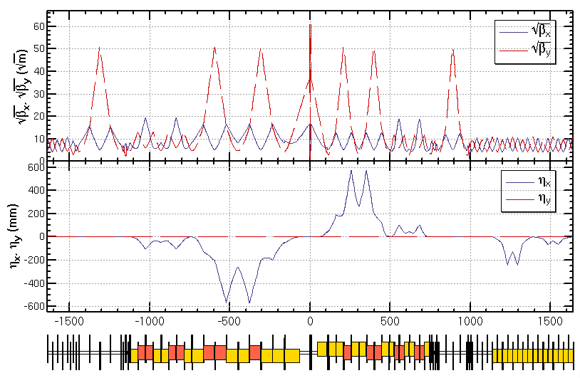
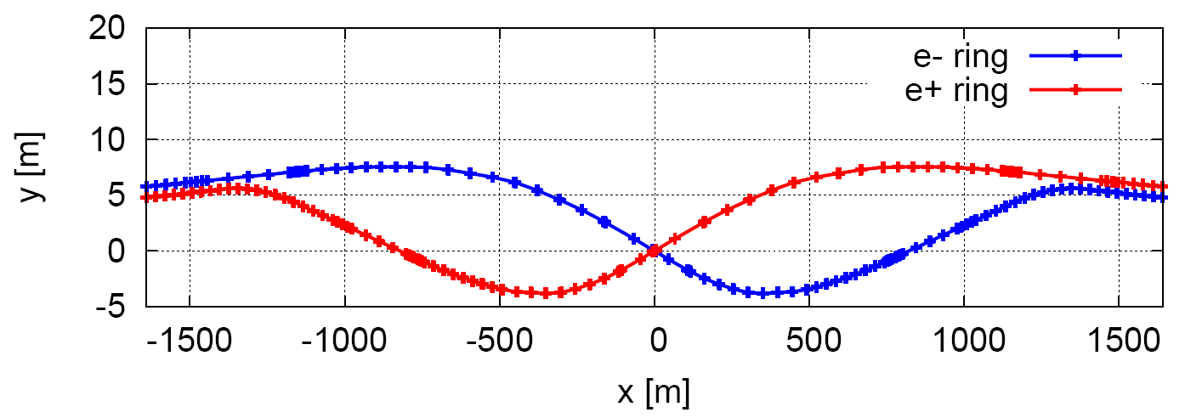
Linear optics of Interaction region
Provide local chromaticity correction of both plane
L*=2.2m, θc=33mrad, GQD0=136T/m, GQF1=111T/m
IP upstream of IR: Ec < 120 keV within 400m, last bend Ec = 45 keV
IP downstream of IR: Ec < 300 keV within 250m, last bend Ec = 97 keV
The vertical emittance due to fringe file of solenoid εy/εx is 0.01%.
Relaxed optics for injection can be re-matched easily as the modular design.
CW
CCX
CCY
FT
Δμ=(6π, 6.5π)
L*= 2.2m
βx*= 0.36mm
βy*= 1.5mm
GQD0≅-136T/m
GQF1≅111T/m
LQD0=2.0m
LQF1=1.48m
max deviation between two beamlines 9.7m
asymmetric IR layout*
*ref: K. Oide, ICHEP16.

Slide 6
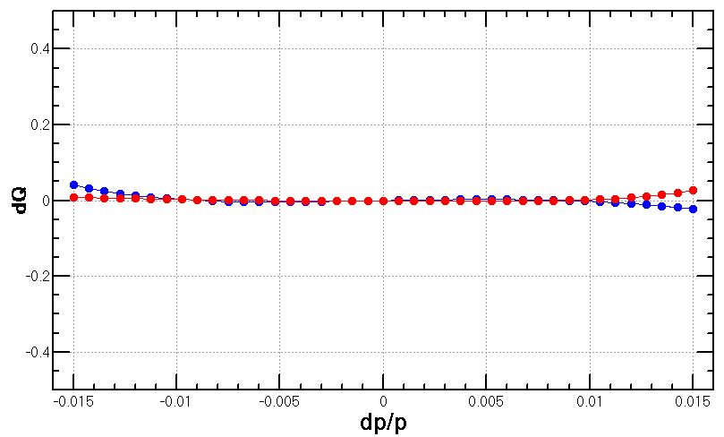
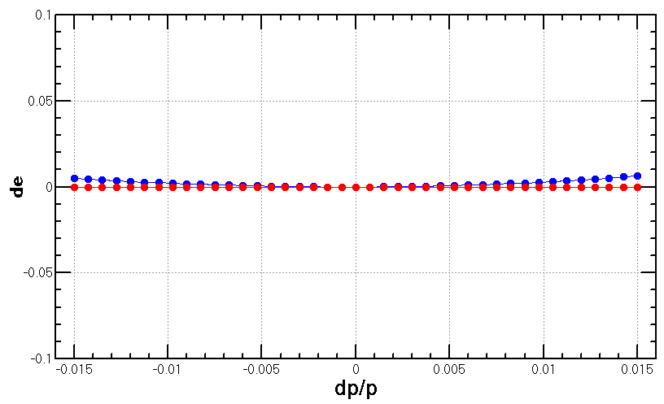
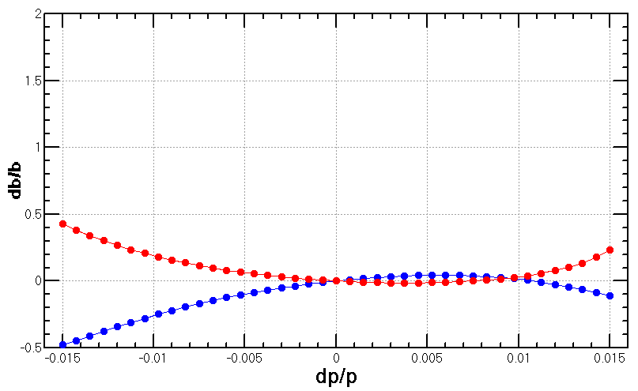
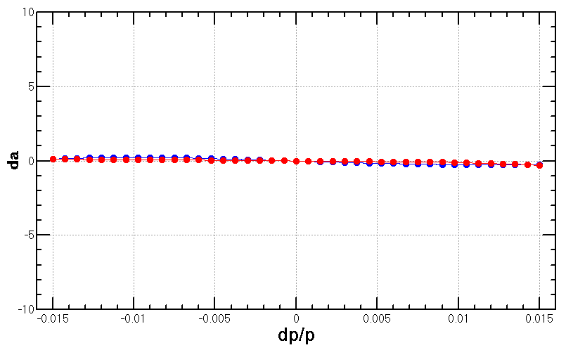
Nonlinearity correction of Interaction region
  Local chromaticity correction with sextupoles pairs separated by –I transportation
  up to 3rd order chromaticity corrected with main sextupoles, phase tuning and additional sextupole pair 2,3)
  higher order chromaticities can be corrected with higher order multipoles 3)
Ref: 2) Brinkmann 3) Y. Cai

Slide 7
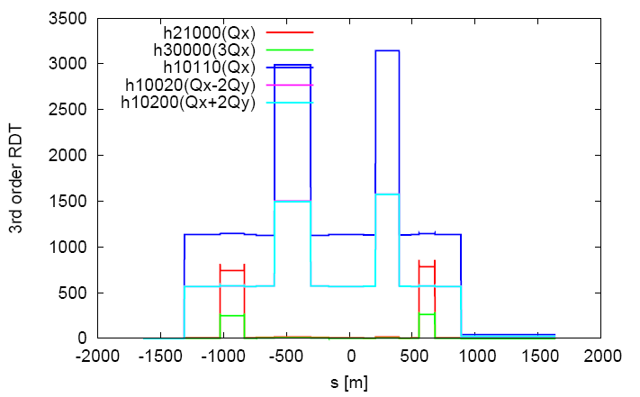
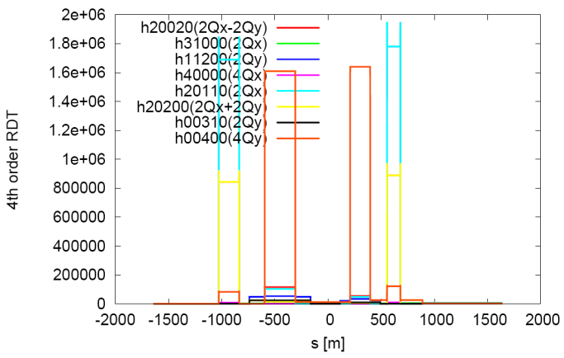
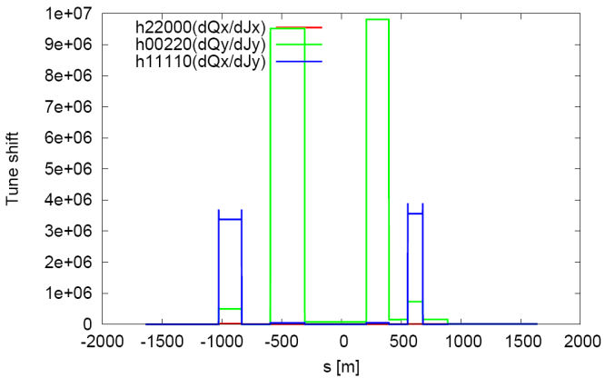
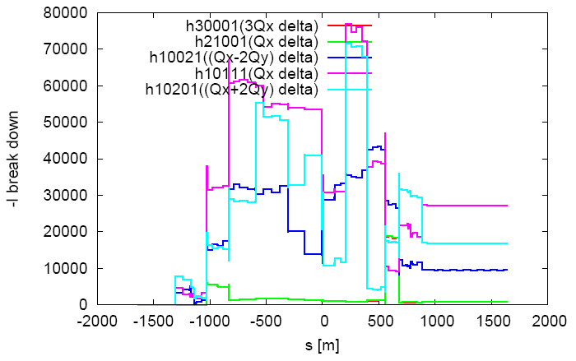
Nonlinearity correction of Interaction region
  Local chromaticity correction with sextupoles pairs separated by –I transportation
  all 3rd and 4th RDT due to sextupoles almost cancelled 1)
  tune shift dQ(Jx, Jy) due to finite length of main sextupoles corrected with additional weak sextupoles 3,4)
  Break down of -I due to energy deviation corrected with ARC sextupoles
    could be further optimized with odd dispersion scheme 5),
    Brinkmann sextupoles 2) or pair of decapoles 3)
Ref:
1) K. Brown
2) Brinkmann
3) Y. Cai
4) Anton
5) K. Oide
6) J. Bengttson’s

Slide 8
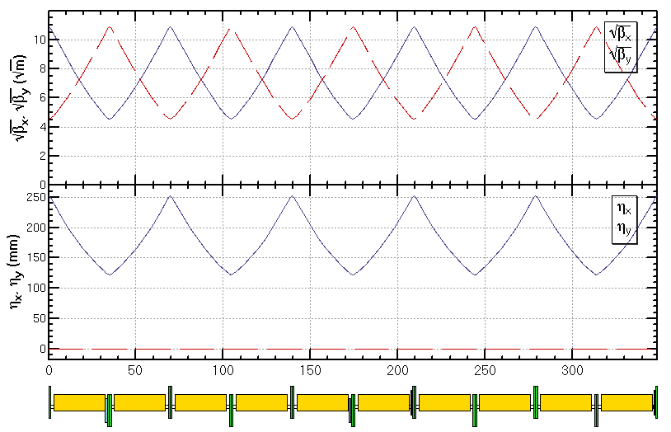
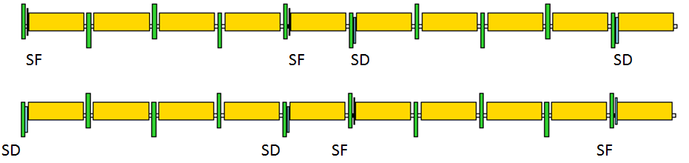
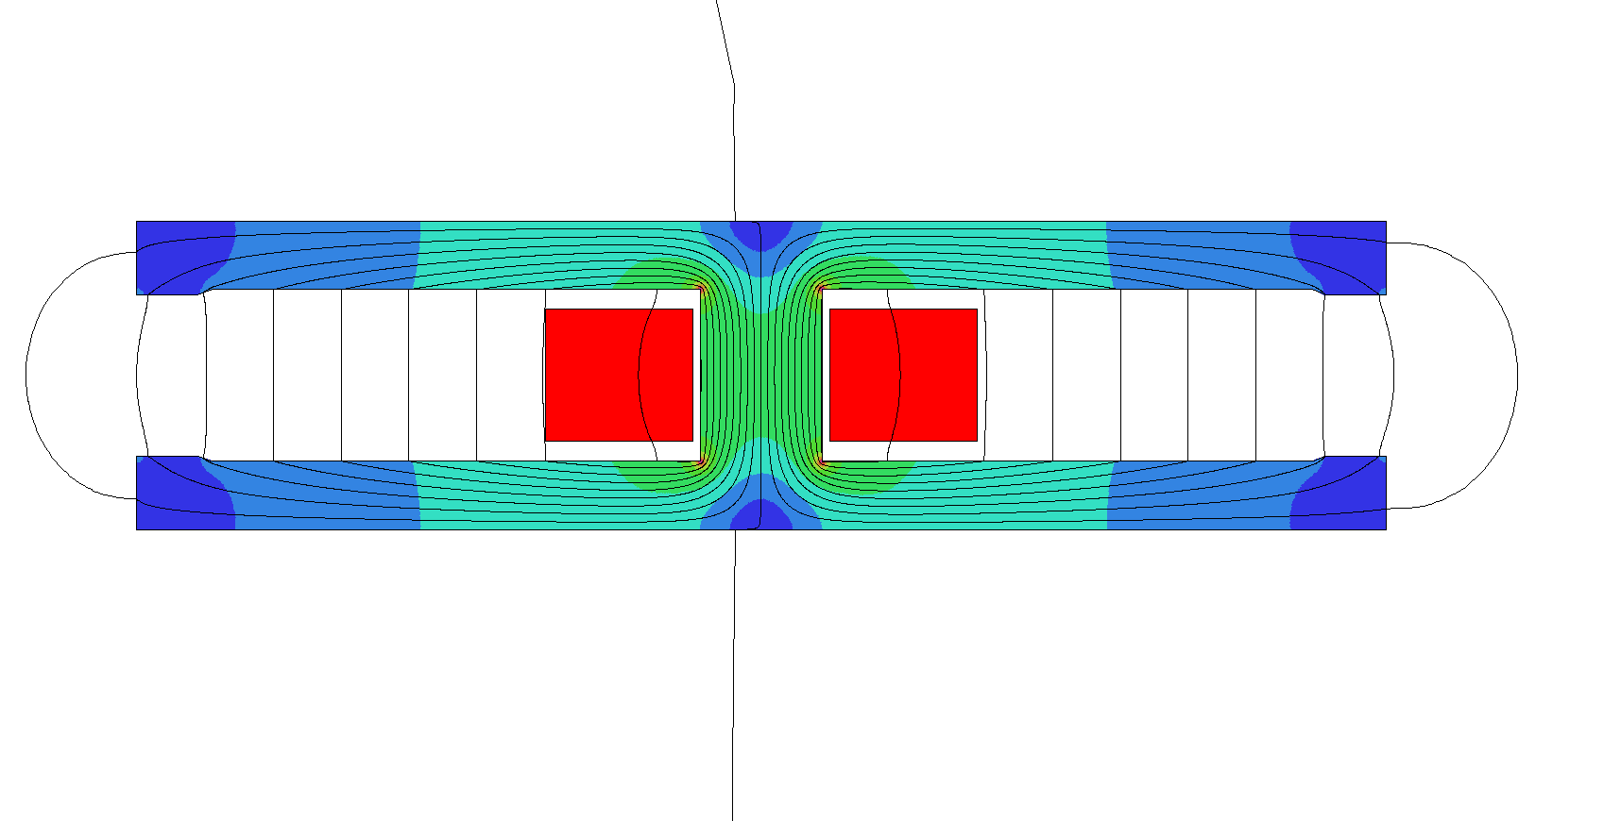
Linear optics design of ARC region
  FODO cell, 90°/90°, non-interleaved sextupole scheme, period =5cells
-I
-I
SD
SD
SF
SF
Twin-aperture of dipoles and quadrupoles* is adopt in the arc region to reduce the their power. The distance between two beams is 0.35m.
*Ref: A. Milanese,
PRAB 19, 112401 (2016)
magnets designed by F. Chen, M. Yang, X. Sun et al.

Slide 9
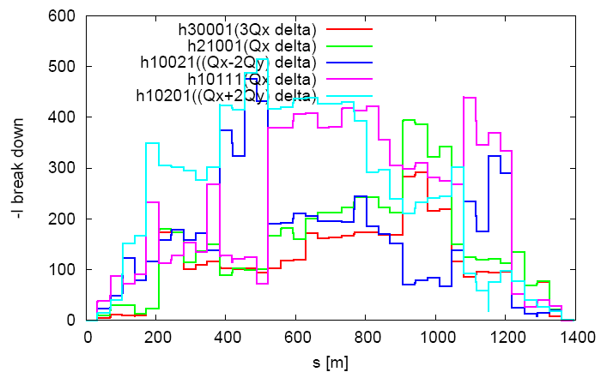
Nonlinearity correction of ARC region
  FODO cell, 90°/90°, non-interleaved sextupole scheme, period =5 cells
  tune shift dQ(Jx, Jy) is very small
    DA on momentum: large
  Chromaticity dQ(δ) need to be corrected with many families
    DA off momentum: with many families to correct dQ(δ)
  With 2 families of sextupoles in each 4 periods i.e. 20 cells
    all 3rd and 4th resonance driving terms (RDT) due to sextupoles cancelled, except small 4Qx, 2Qx+2Qy, 4Qy, 2Qx-2Qy
    break down of -I due to energy deviation cancelled
    thus cells numbers equal to 20*N in each ARC region

Slide 10
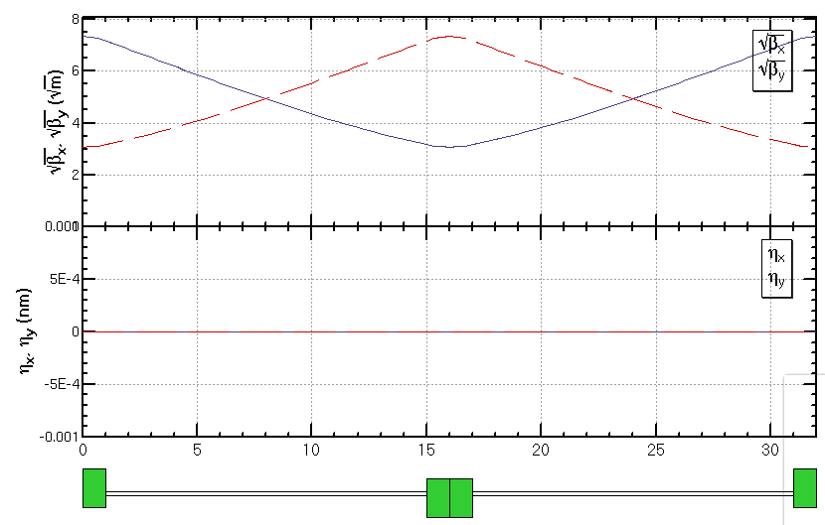
FODO cell for cryo-module
Get a smallest average beta function to reduce the multi-bunch instability caused by RF cavities (compatible for Z mode)
  90/90 degree phase advance
  as short as possible distance between quadrupoles, but should be larger than a module length (12m)
  Filling factor of module is 75 %.
336 / 6 / 2RF stations / 2 sections / 2= 7 cells in each section
90/90 deg
Half cell: 13.7m+2.3m
βmax: 53.8 m
βmin: 9.5 m
cryo-module
quadrupole

Slide 11
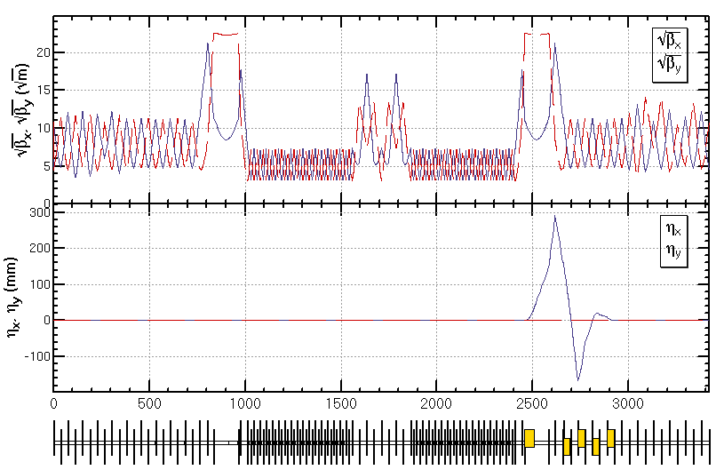
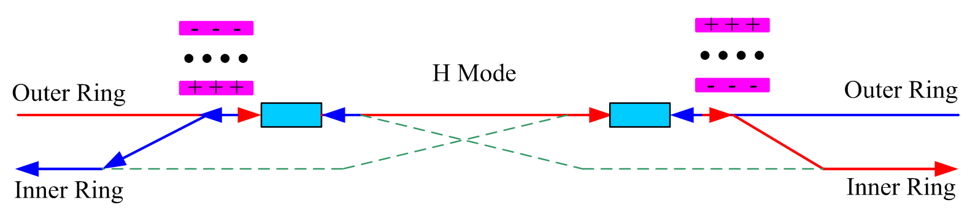
Optics design of RF region
Common RF cavities for e- and e+ ring (Higgs)
An electrostatic separator combined with a dipole magnet to avoid bending of incoming beam (ref: K. Oide, ICHEP16)
RF region divided into two sections for bypassing half numbers of cavities in Z mode
Phase tuning
Phase tuning
common RF cavities
combined magnet
Esep=1.8 MV/m
Lsep=50m
Ldrift=75m
Δx=10 cm at entrance of quad

Slide 12
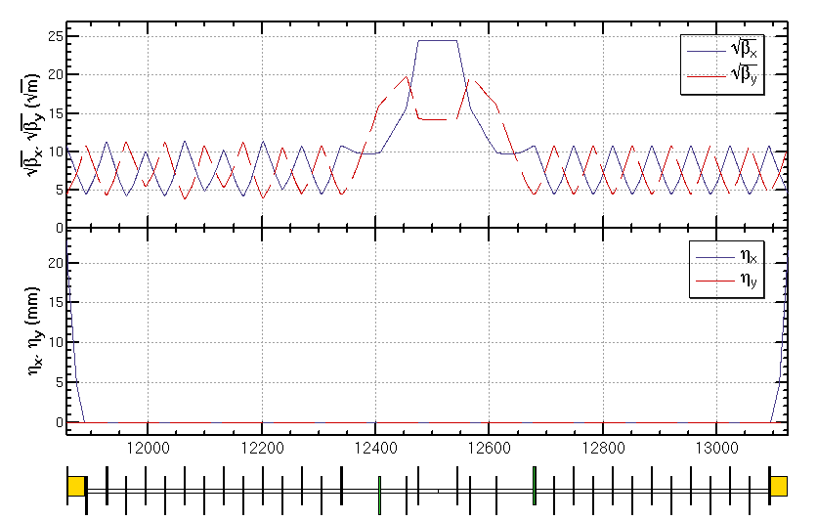
Optics design of Straight section region
The function of the straight section is phase advance tuning and injection.
  Independent magnets for two rings
  0.3m of longitudinal distance between two quadrupoles of two rings allows a larger size of quadrupoles
Bx=600 m at injection point
Injection section 66.7 m
Phase tuning
Injection
Phase tuning

Slide 13
Injection
conventional off axis injection
4 kicker for local bump in the collider
X’
Bumped
Stored beam
Septum
2mm
Injected beam
X
For Higgs:
ε_x = 1.21 nm.rad; ε_inject = 3.58 nm.rad
σx = 0.85 mm, σ_inject = 0.94 mm
Septum = 2 mm
Acceptance > 13 σ
Bump Height
by Xiaohao Cui
Acceptance >4σ_{xc} + 6σ_{xi} + S

Slide 14
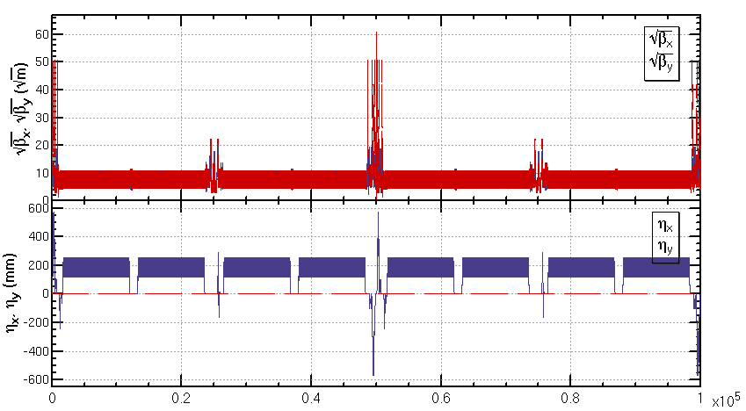
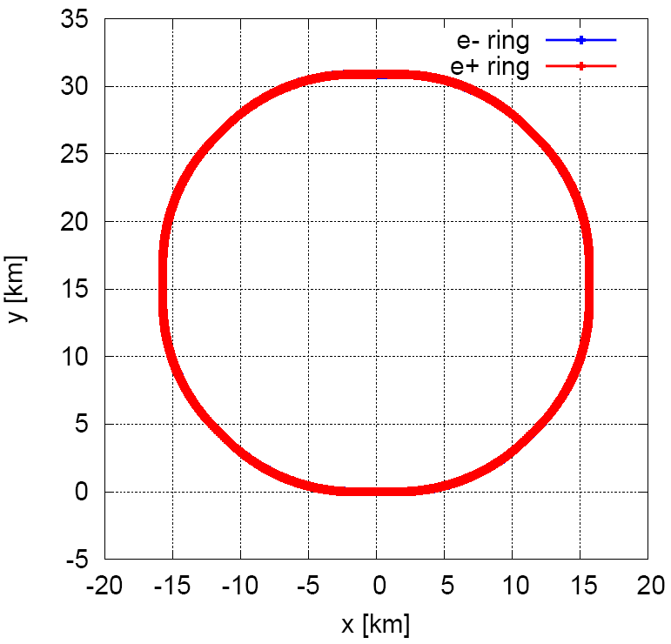
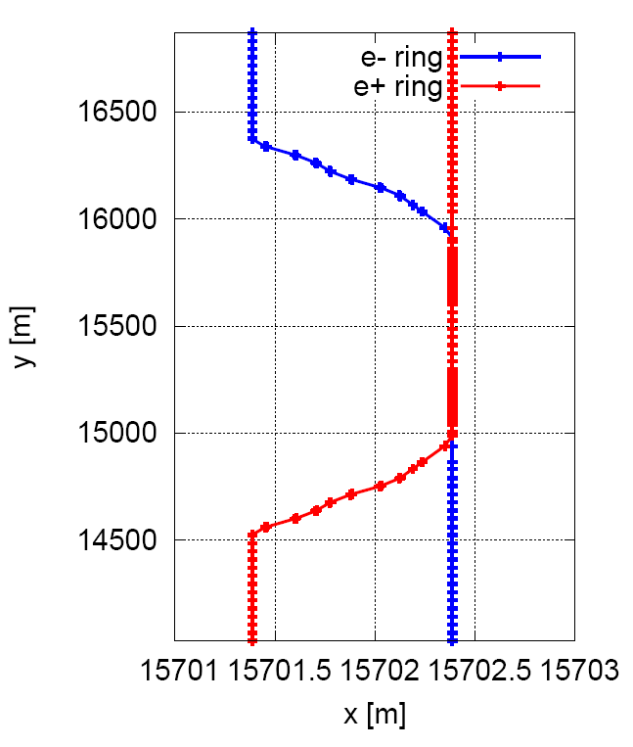
Linear optics of the collider ring
  An optics fulfilling requirements of the parameters list, geometry, photon background and key hardware.
tune= 363.10 / 365.22 (near integer with two IPs)
natural chromaticity= -493 / -1544

Slide 15
Parameter of collider ring lattice
Parameter | Symbol, unit | Higgs | W | Z
Beam energy | E, GeV | 120 | 80 | 45.5
Circumference | C, km | 100
Beam current | I₀, mA | 17.4 | 87.9 | 461.0
Bunch number | n_{b} | 242 | 1220 | 12000
Bunch Population | N_{e} | 15×10¹⁰ | 15×10¹⁰ | 8.0×10¹⁰
Natural bunch length | σ_{l0}, mm | 2.7 | 3.0 | 2.4
Emittance (horz./vert.) | ε_{x}/ε_{y}, nm | 1.21/0.0031 | 0.54/0.0016 | 0.17/0.004
RF frequency | f_{rf}, MHz | 650 (216816)
RF voltage | V_{rf}, GV | 2.17 | 0.47 | 0.1
Natural energy spread | σ_{e0} | 1E-3 | 6.6E−4 | 3.8E−4
Momentum compaction | α_{p} | 1.11E−5
Betatron tune | ν_{x}/ν_{y} | 363.10/365.22
Synchrotron tune | ν_{s} | 0.065 | 0.039 | 0.028
Synchrotron damping time | x/y/z, ms | 46/46/23 | 157/157/78 | 843/843/436
Natural Chromaticity (dQ/dδ) | x/y | -493 / -1544 | -493 / -1544 | -520/-3067
*Na Wang, this meeting

Slide 16
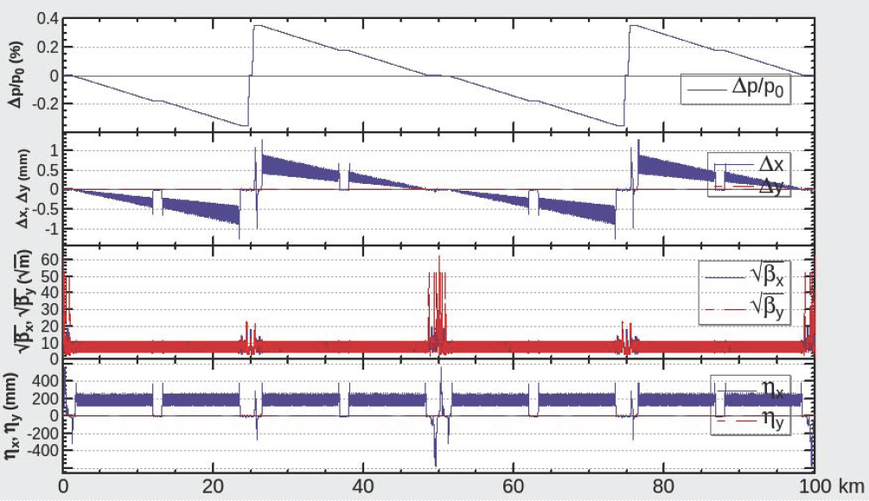
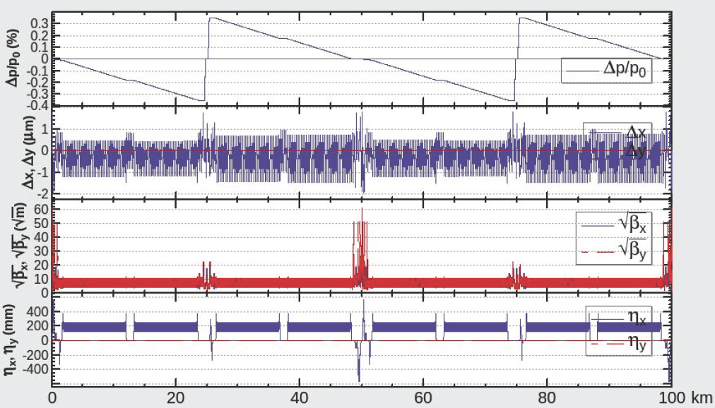
Energy sawtooth effects and correction
With only two RF stations, the energy sawtooth is around ±0.35%
The closed orbit distortion in CEPC collider ring is around 1mm and becomes 1um after tapering the magnet strength with beam energy.

Slide 17
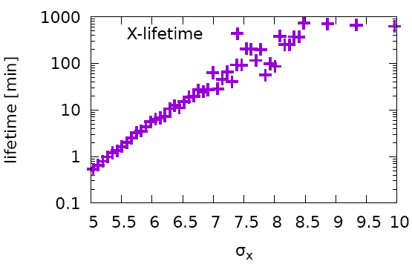
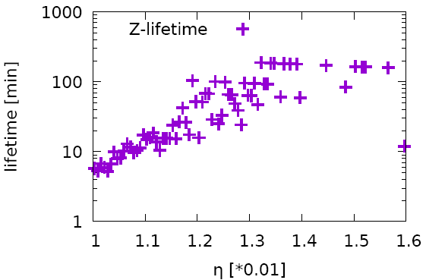
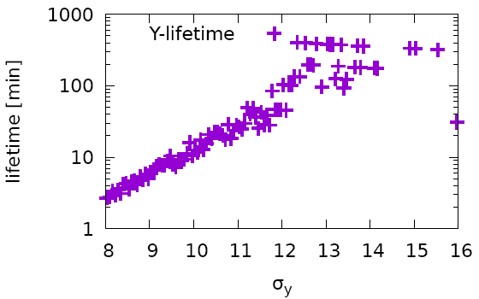
Requirement of the dynamic aperture
Goal: 13 σx ×12 σy × 1.35%
  Requirement from injection*: 13 σx
  Requirement from beam beam (life time 100 min)#: 7.5 σx, 12σy, 1.35 %
Simulation of Lattice + Beamstrahlung + SR Fluctuation
x-100min: 7.5 σx
y-100min: 12 σy
z-100min: 1.35%
*X. Cui, # Yuan Zhang

Slide 18
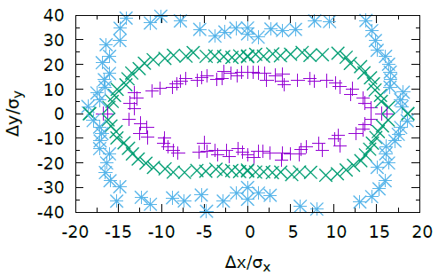
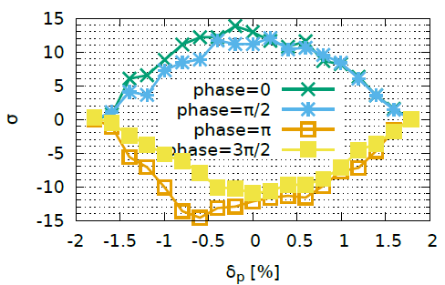
Dynamic aperture optimization
Start point of the optimization
  Nonlinearity optimized term by term with 10 families of sextupoles in the IR and 4 families of sextupoles in the ARC.
Optimize dynamic aperture directly with MODE (Y. Zhang, IHEP)
  With 10 families of sextupoles in the IR, 32 families of sextupoles in ARC and 8 phase advances
Tracking in SAD w/ damping, fluctuation(100 samples), energy sawtooth and tapering 200 turns, 4 initial phases
initial phase=0
4 initial phases
Achieved (without errors)@ Higgs : 16 σx ×15 σy × 1.6%
by Y. Zhang et. al.

Slide 19
Performance with errors
by Yuanyuan Wei
LOCO based on AT is used to correct distortion of closed orbit, beta, dispersion and coupling
About 1500 BPMs, horizontal and vertical correctors are respectively placed in the collider ring (4 per one betatron wave; IR is perfect ). About 200 Skew-quads (1/5 sextupoles) are used in the coupling correction.
  1. correct COD w/o sextupoles
  2. correct optics w/ sextupoles
  3. correct coupling
Component | Δx (mm) | Δy (mm) | Δθ_{z} (mrad)
Dipole | 0.05 | 0.05 | 0.1
Quadrupole | 0.03 | 0.03 | 0.1
Sextupole | 0.03 | 0.03 | 0.1
Component | Field error
Dipole | 0.01%
Quadrupole | 0.02%

Slide 20
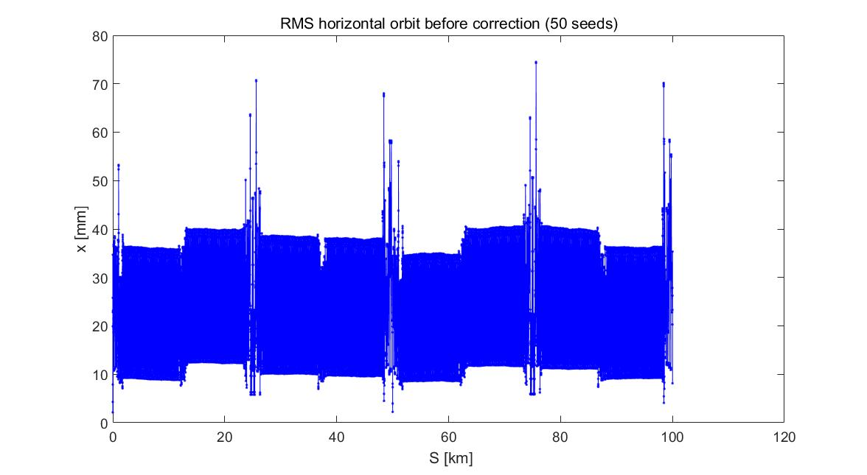
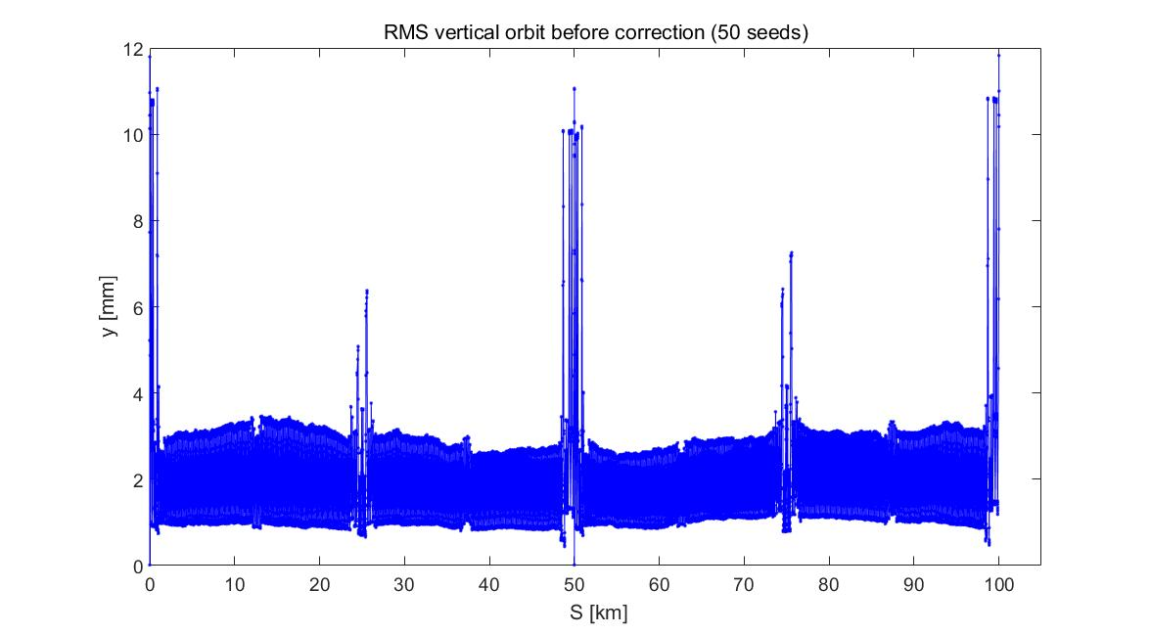
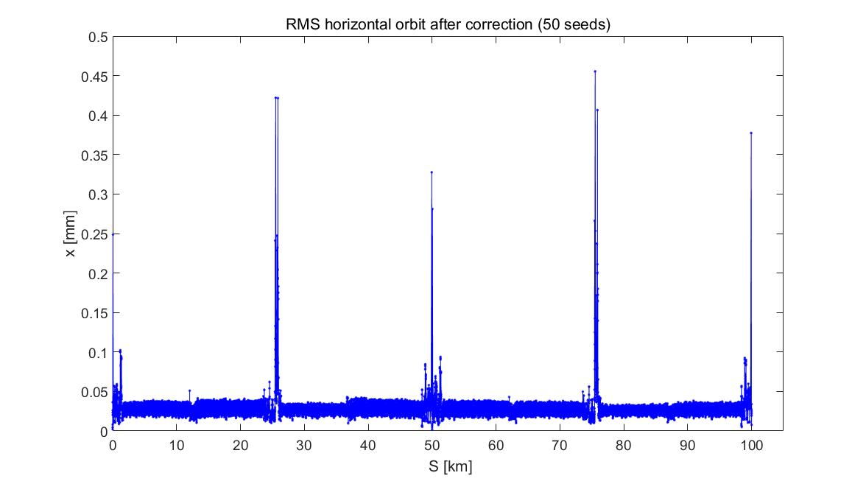
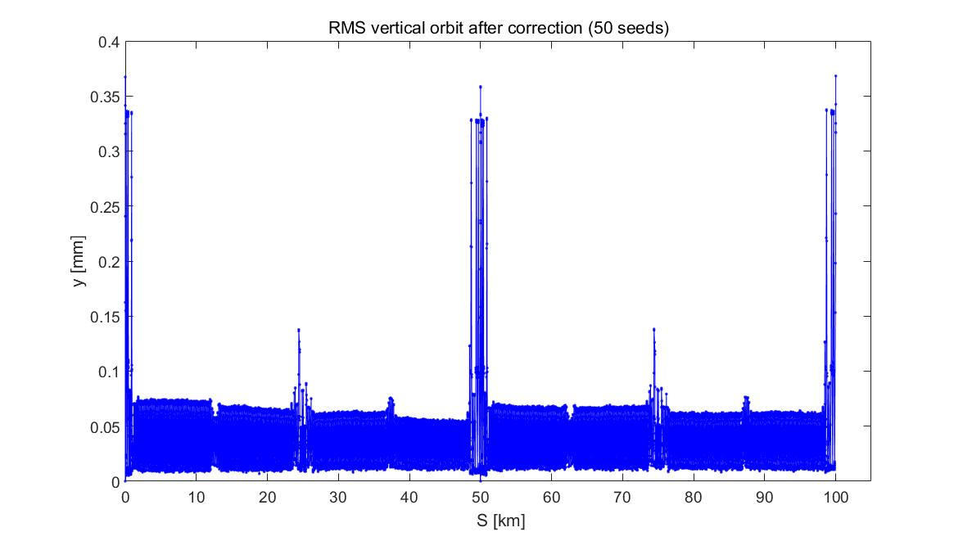
50 samples
  1. correct COD w/o sextupoles
Closed orbit distortion
before
after
Need more corrector in the long drifts
σ_{COD} ≈ 40/3 mm (x/y) before orbit correction except for IR region
σ_{COD} ≈ 40/75 um (x/y) after orbit correction except for IR region

Slide 21
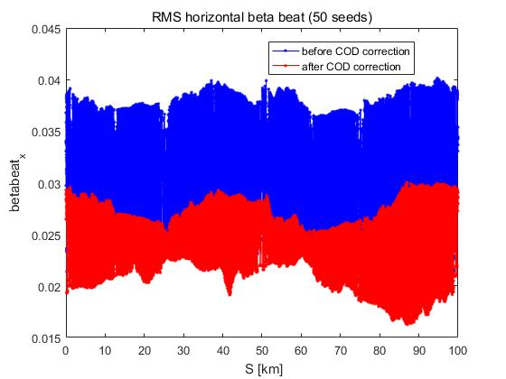
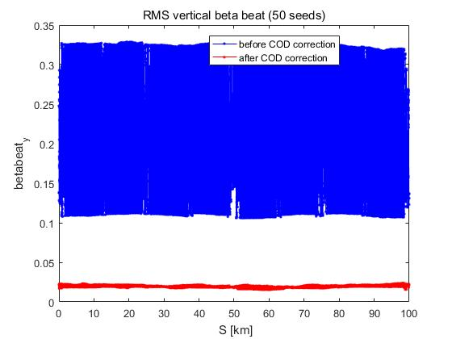
  1. correct COD w/o sextupoles
Beta functions distortion
50 samples
X direction
y direction
(β_{_err}/β)_{max} = 4% / 3.3% (x/y) before COD correction
(β_{_err}/β)_{max} = 3% / 2% (x/y) after COD correction
The vertical beta beat is larger than horizontal beta beat due to the fringe field effect of dipoles and quadrupoles.

Slide 22
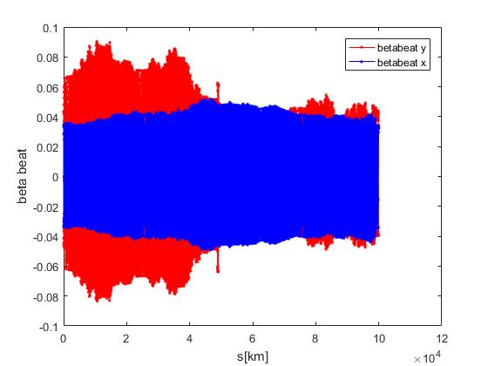
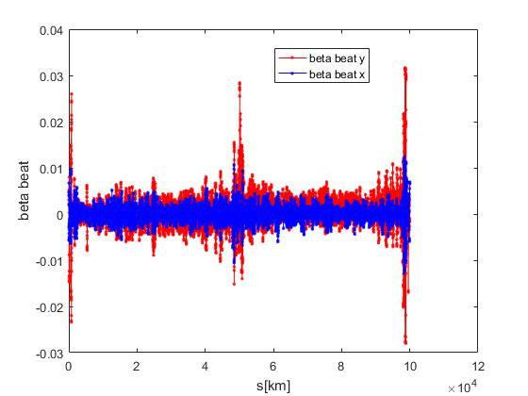
2. correct optics w/ sextupoles
one sample
1/5 quadrupole ( around 600 out of 3000 quadrupoles) strengths are changed to restore beta functions
before
after
(β_{_err}/β)_{max} = 4% / 8% (x/y) before COD correction
(β_{_err}/β)_{max} = 1% / 1% (x/y) after COD correction except for IR region

Slide 23
3. correct the coupling
one sample
Quadrupoles rotation and feed-down effects in the quadrupoles will generates betatron coupling and cause vertical dispersion.
Skew-Quads are installed in the sextupoles. Totally about 200 Skew-quads (1/5 sextupoles) are used in the coupling correction.
Before correction
emity/emitx=0.4%
After correction
emity/emitx=0.08%

Slide 24
Summary
  Linear optics of the CEPC collider ring designed fulfilling requirements of the parameters list, geometry, photon background and key hardware.
Nonlinearity correction made to give a good start point of dynamic aperture optimization.
Further optimization of dynamic aperture is made with MODE and downhill simplex method.
Study of errors and correction made and the study of effects on dynamic aperture is under going.
  Translate corrected lattice from AT to SAD

Slide 25
Thank you!

